Slide 1


Slide 2


Slide 3
Unit-2-
Careers
L-9 Reading

Slide 4


Analyze information in a job website format
Discuss other ways to find a job
Match the information with jobs
Match the skill with its type
Find what a person needs to do in the text
Decide whether a sentence is true or false

Slide 5

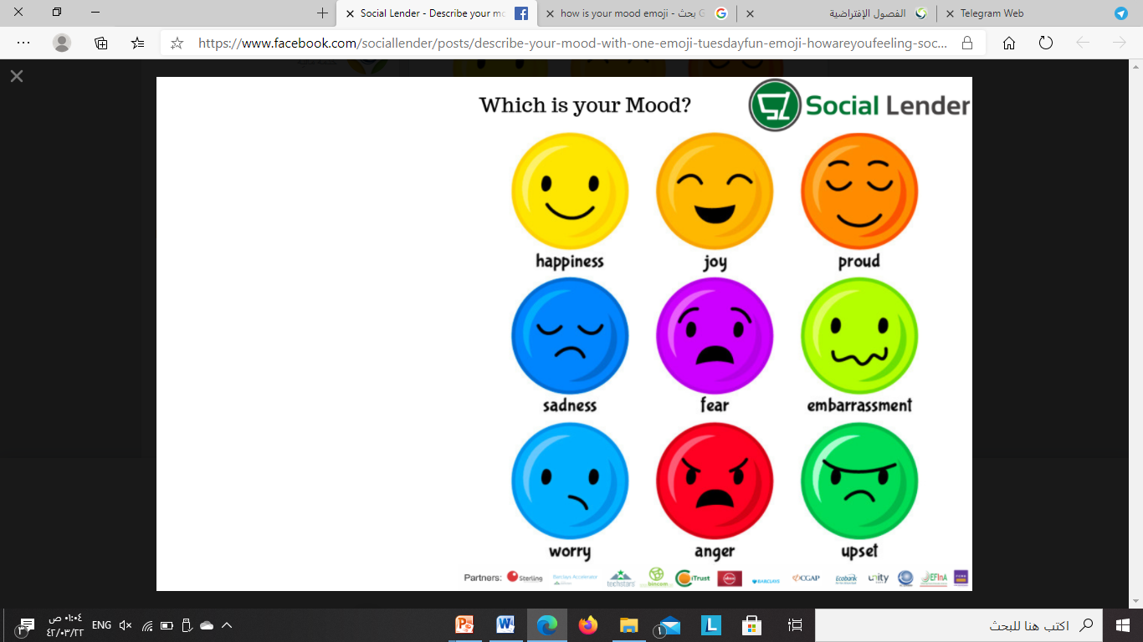

Slide 6

Warm Up
What should a person do when he wants to
apply for a job?

Slide 7

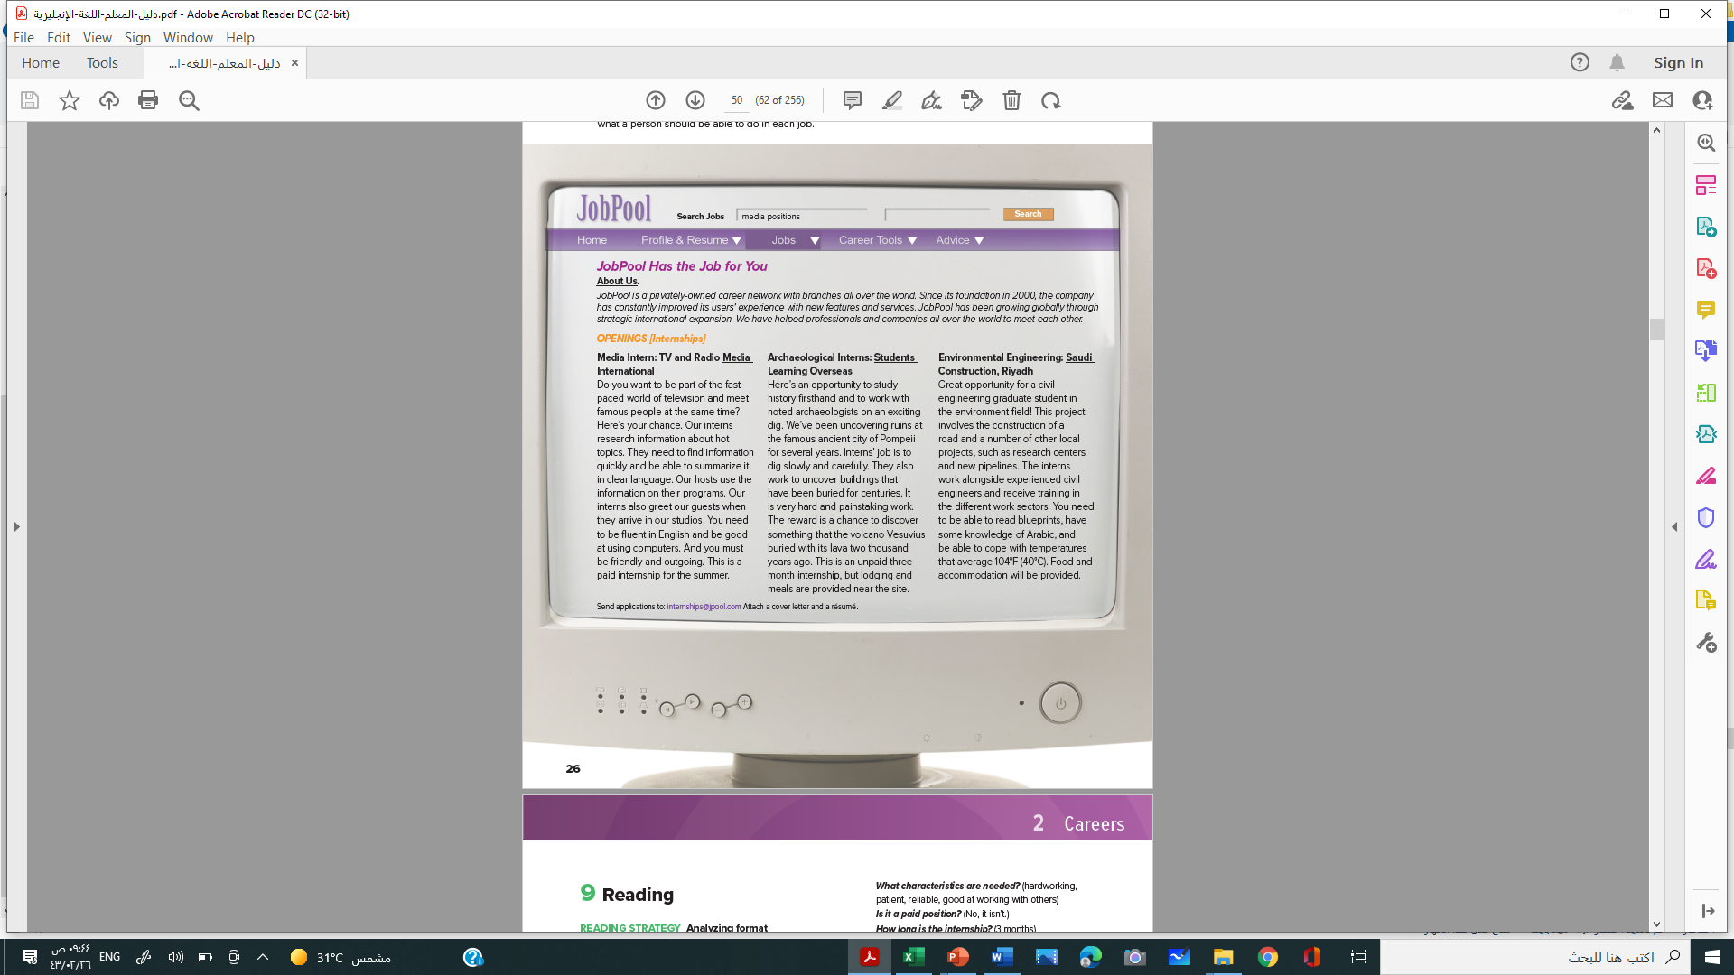
Skimming
Pre-Reading
What’s this ?
What is the title?
How many paragraphs?
What’s the title of each paragraph?
Website

Slide 8



Slide 9
1- What a person should be able to do ?

Slide 10
1- What a person should be able to do ?

Slide 11
1- What a person should be able to do ?

Slide 12
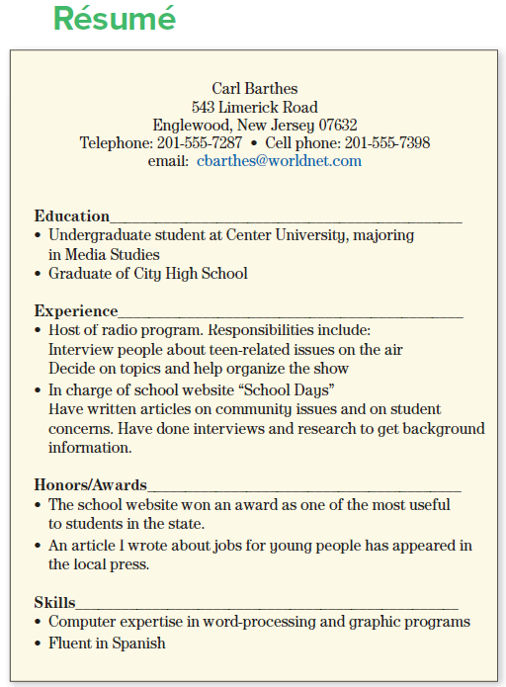



Scanning
Opening-Internships
The training time
Résumé
Fast-Paced
Adj- moving or developing very quickly.
blueprints
Cope with
The ability to handle something successfully.

Slide 13
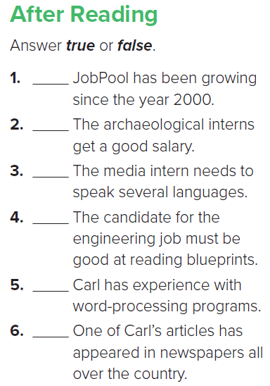

Slide 14
T
F
F
T
T
F

Slide 15





Mention some examples of Internship/Job Websites:

Slide 16

Discussion
A- Organize students into groups to answer and have a discussion about questions 1 and 2.
a After the group discussion, hold a class discussion for question
3. As students share their ideas, list them on the board.

Slide 17
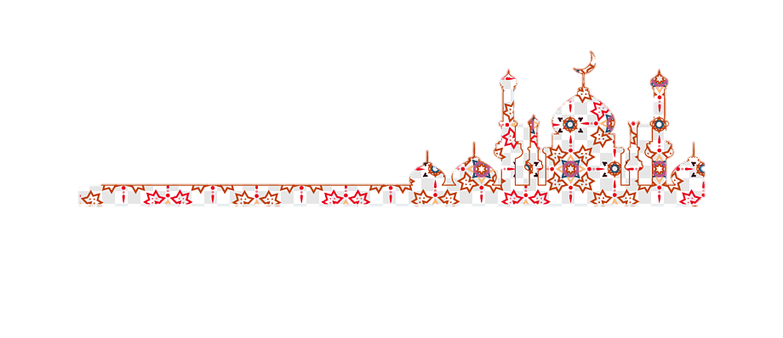
قَال: سمِعْتُ رَسُول اللَّهِ ﷺ، يقولُ: منْ سَلَكَ طَريقًا يَبْتَغِي فِيهِ علْمًا سهَّل اللَّه لَه طَريقًا إِلَى الجنةِ، وَإنَّ الملائِكَةَ لَتَضَعُ أجْنِحَتَهَا لِطالب الْعِلْمِ رِضًا بِما يَصْنَعُ، وَإنَّ الْعالِم لَيَسْتَغْفِرُ لَهُ منْ في السَّمَواتِ ومنْ فِي الأرْضِ حتَّى الحِيتانُ في الماءِ، وفَضْلُ الْعَالِم عَلَى الْعابِدِ كَفَضْلِ الْقَمر عَلى سَائِرِ الْكَوَاكِبِ، وإنَّ الْعُلَماءَ وَرَثَةُ الأنْبِياءِ وإنَّ الأنْبِياءَ لَمْ يُورِّثُوا دِينَارًا وَلا دِرْهَمًا وإنَّما ورَّثُوا الْعِلْمَ، فَمنْ أَخَذَهُ أَخَذَ بِحظٍّ وَافِرٍ
رواهُ أَبُو داود والترمذيُّ.

Slide 18


