Slide 1

Mega goal 1

Slide 2
Unit 1

Slide 3
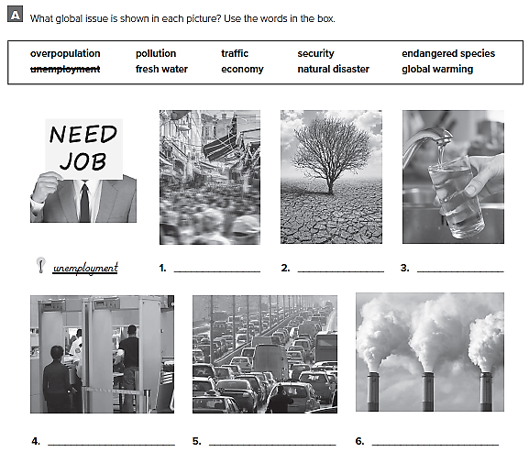
Overpopulations global warming fresh water
Security traffic pollution

Slide 4
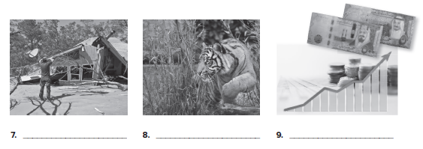
natural disaster endangered species economy

Slide 5
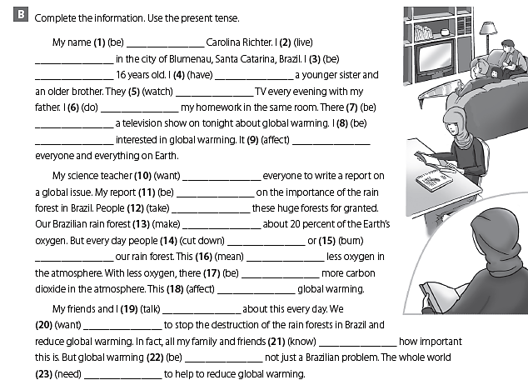
is
live
am
have
watch
do
is
am
affects
wants
is
take
makes
cut down
burn
means
is
affects
talk
want
know
is
needs

Slide 6
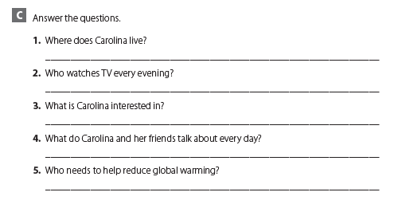
She lives in Blumenau, Santa Catarina, Brazil.
Carolina’s sister, brother, and father watch TV every evening.
She is interested in global warming.
They talk about the rain forests and global warming.
The whole world needs to help reduce global warming.

Slide 7
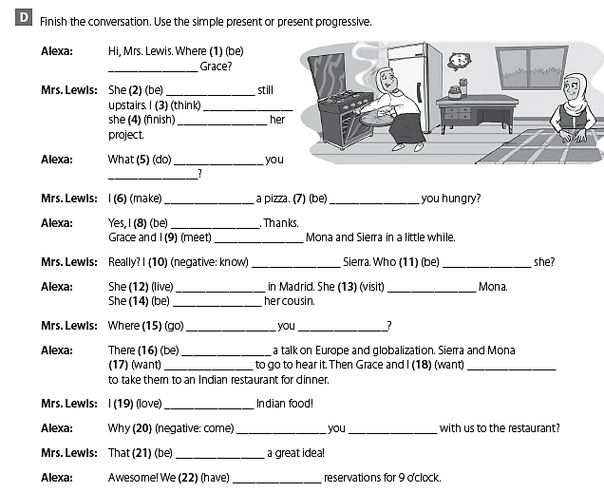
is
is
think
is finishing
are
doing
am making
Are
am
are meeting
don’t know
is

Slide 8
lives
is visiting
is
are
going
is
want
want
love
don’t
come
is
have

Slide 9
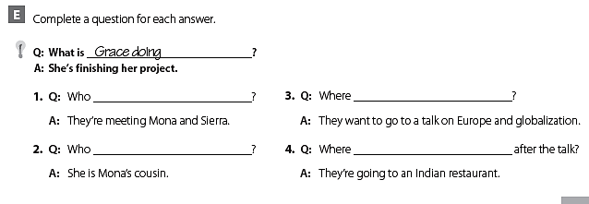
are they meeting
do they want to go
is Sierra
are they going

Slide 10
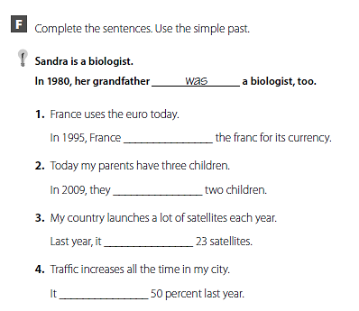
used
had
launched
increased

Slide 11
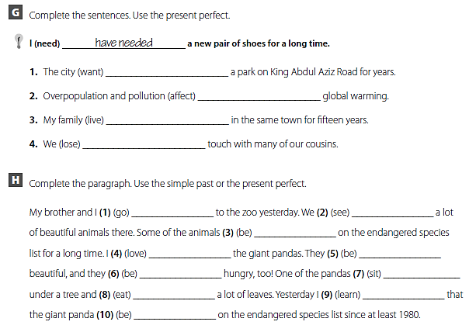
has wanted
have affected
has lived
have lost
went
saw
have been
loved
were
were
sat
ate
learned
has been

Slide 12
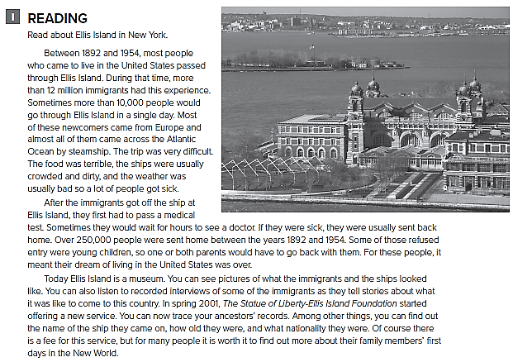

Slide 13
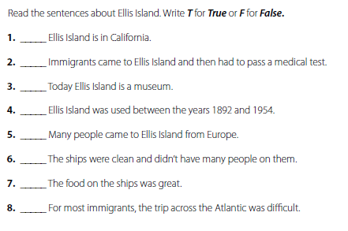
F
T
T
T
T
F
F
T

Slide 14
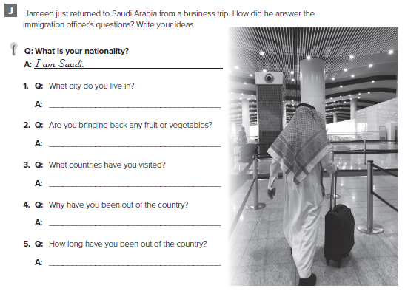
الإجابات من الممكن أن تختلف .
I live in Jeddah
No , I’m not
Spain and France
I have been on business
20 days

Slide 15
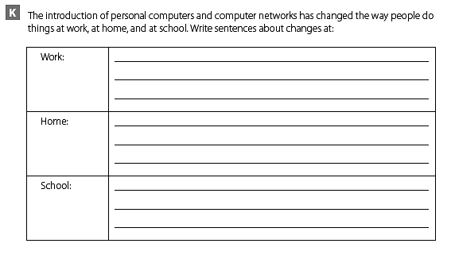
الإجابات من الممكن أن تختلف .
People can access their files
They can have video meetings
People can have access to the internet
They can watch online television Channels
Students can have interactive lessons
They can take tests

Slide 16
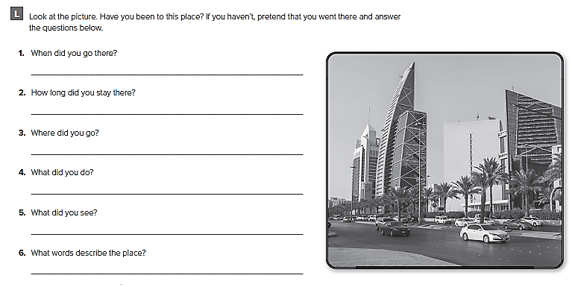
الإجابات من الممكن أن تختلف .
I went about a month ago
I stayed for about 2 weeks
I visited some malls
I went shopping
I saw some interesting stores
Fascinating , interesting , luxurious

Slide 17
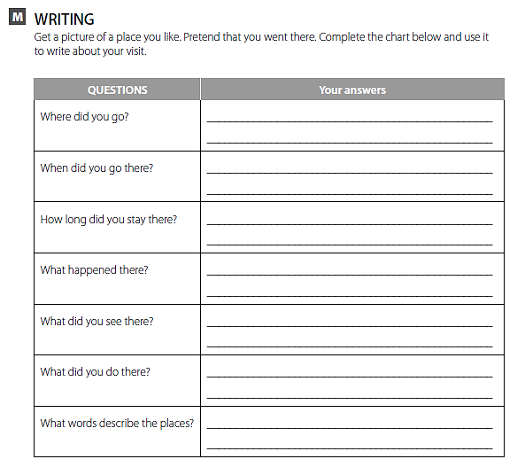
تحدث عن مكان قمت بزيارته
ثم أكمل الجدول

Slide 18
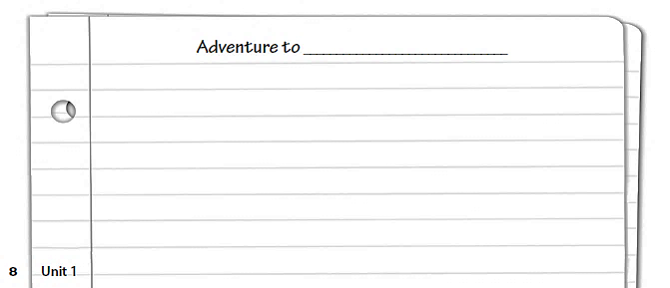
قم بالكتابة عن هذا المكان

Slide 19
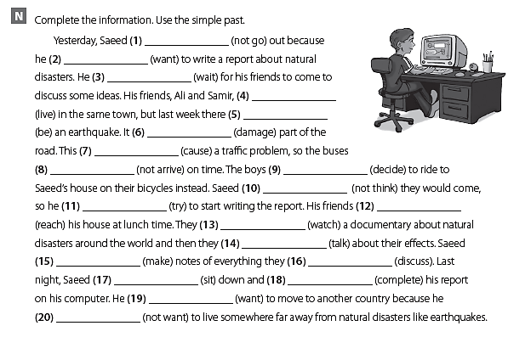
didn’t go
wanted
waited
lived
was
damaged
caused
didn’t arrive
decided
didn’t think
tried
reached
watched
talked
made
discussed
sat
completed
wanted
didn’t want

Slide 20
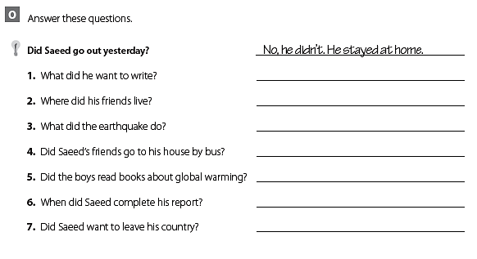
He wanted to write a report
They lived in the same town.
It damaged the road
No. They went by bicycle.
No. They watched a documentary.
He completed it last night.
Yes, he did.

Slide 21
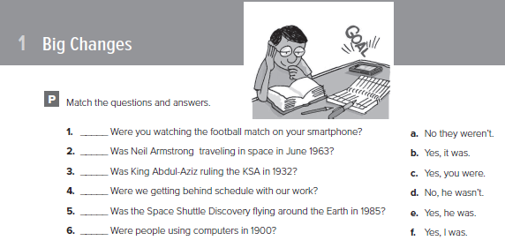
f
d
e
c
b
a

Slide 22
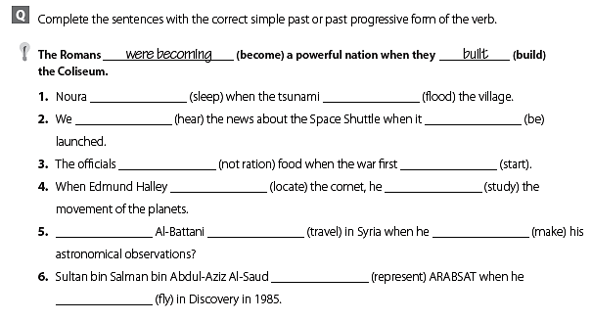
was sleeping flooded
heard was
weren’t rationing started
located was studying
was traveling made
was representing
flew

Slide 23
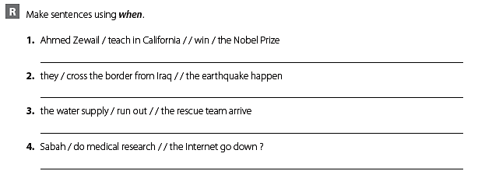
Ahmed Zewail was teaching in California when he won the Nobel Prize.
They were crossing the border from Iraq when the earthquake happened
The water supply was running out when the rescue team arrived
Was Sabah doing medical research when the Internet went down?

Slide 24
Unit 2

Slide 25
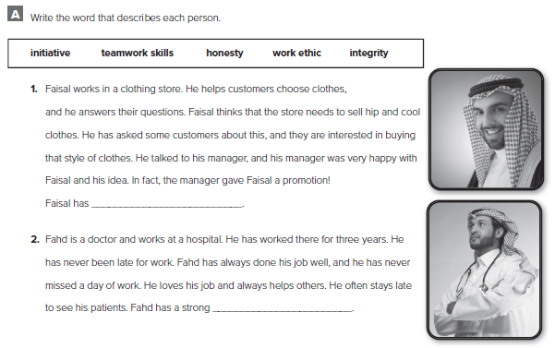
initiative
work ethic

Slide 26
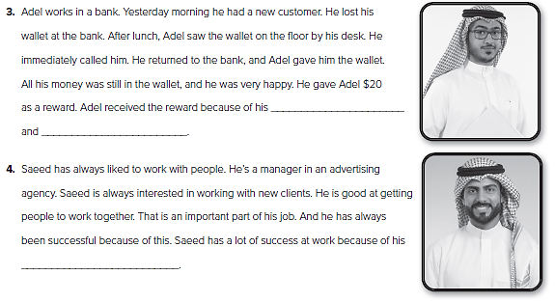
honesty
integrity
teamwork skills

Slide 27
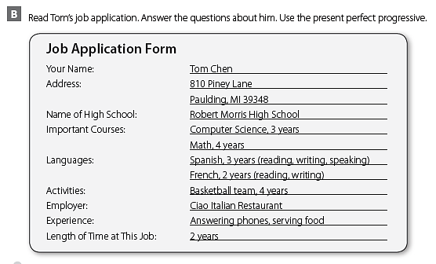

Slide 28
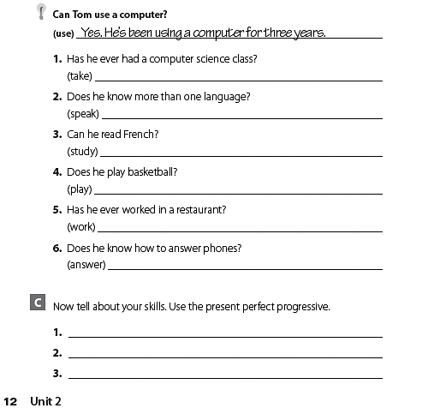
Yes. He has been taking computer science for three years.
Yes. He has been speaking Spanish for three years.
Yes. He has been studying French for two years.
Yes. He has been playing basketball for four years.
Yes. He has been working in a restaurant for two years.
Yes. He has been answering phones for two years.
I have been studying English for four years.
I have been working at a bookstore for one year.
I have been playing football for ten years.

Slide 29
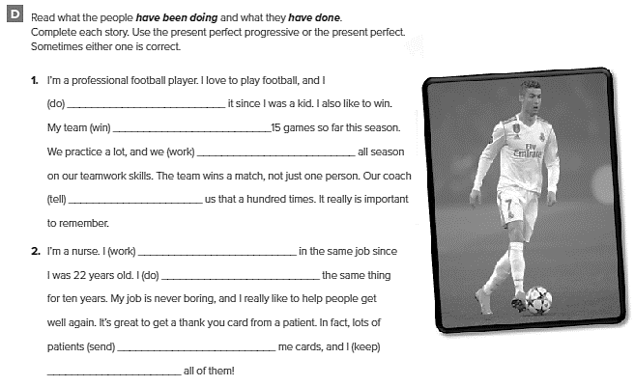
have been doing
has won
have been working
has told
have been working
have been doing
have sent
have kept

Slide 30
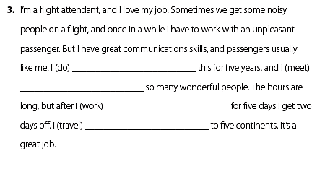
have been doing
have met
have been working
have traveled

Slide 31
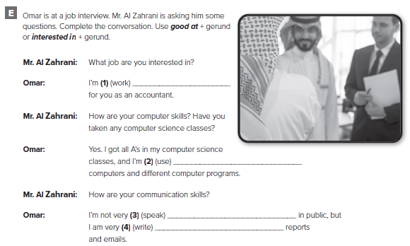
interested in working
good at using
good at speaking
good at writing

Slide 32
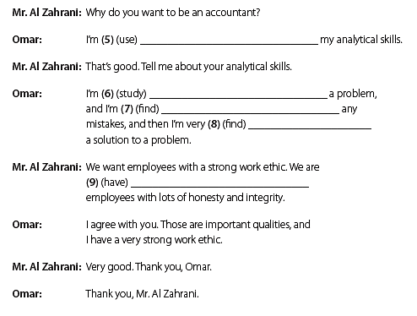
interested in using
good at studying
good at finding
good at finding
interested in having

Slide 33
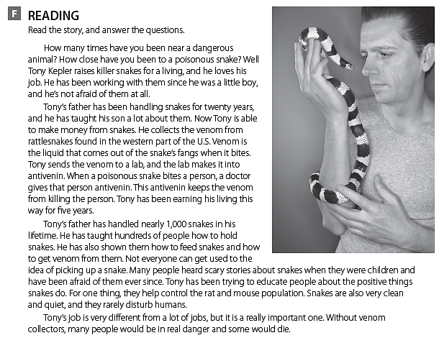

Slide 34
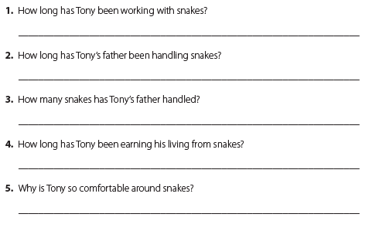
He has been working with snakes since he was a little boy.
Tony’s father has been handling snakes for twenty years.
He’s handled nearly 1,000 snakes.
He’s been earning his living from snakes for five years.
because he has been working with them since he was a little boy.

Slide 35
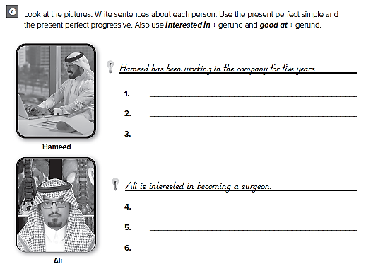
الإجابات من الممكن أن تختلف .
He has been a sales manager for the last two years.
He is interested in signing new contracts.
Ali has been studying for the last ten years.
He has been doing his internship in Dubai.

Slide 36
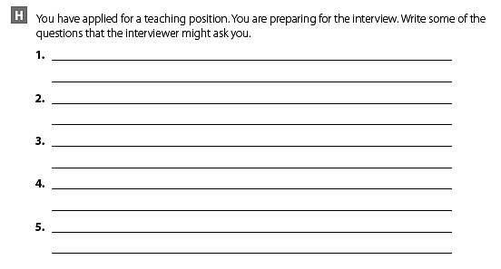
الإجابات من الممكن أن تختلف .
How did you find out about the job?
Why are you applying for it?
What are some of your strengths?

Slide 37
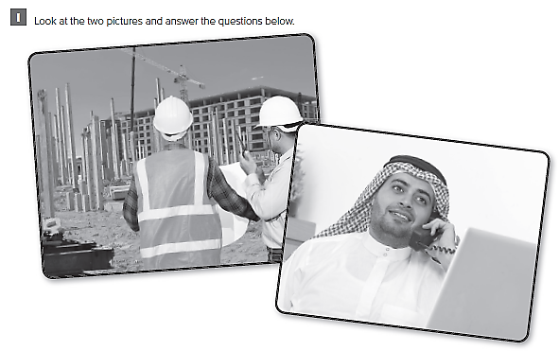

Slide 38
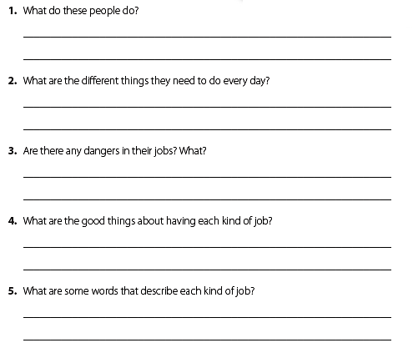
الإجابات من الممكن أن تختلف .
The man on the left is an architect
The man on the right is a researcher
The architect needs to check the blueprints
The researcher needs to search on the web

Slide 39
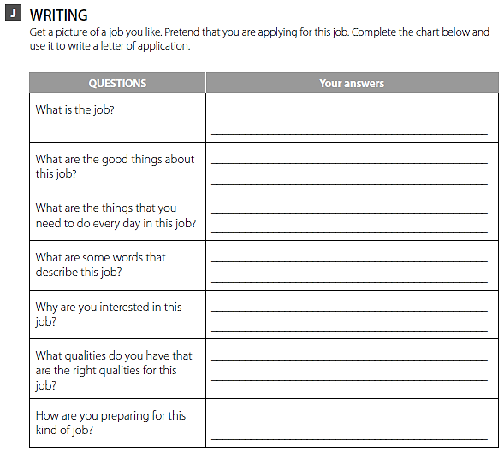
تصور بأنك تقوم بالتقدم لوظيفة ما ثم أكمل الجدول

Slide 40
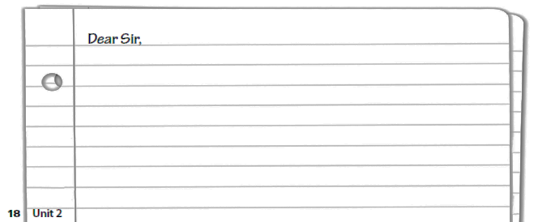
قم بكتابة خطاب طلب التقدم على وظيفة ما

Slide 41
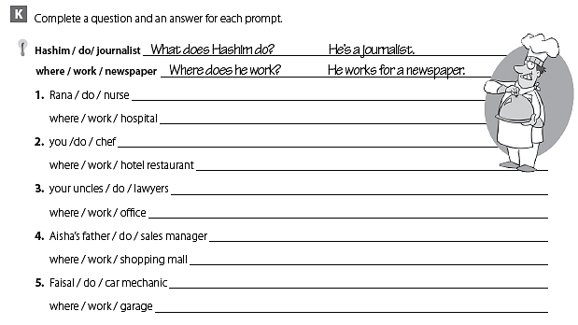
What does Rana do? She’s a nurse
Where does she work? She works in a hospital.
What do you do? I’m a chef
Where do you work? I work in a hotel restaurant.
What do your uncles do? They are lawyers
Where do they work? They work in an office.
What does Aisha’s father do? He’s a sales manager
Where does he work? He works at the shopping mall
What does Faisal do? He’s a car mechanic
Where does he work? He works in a garage.

Slide 42
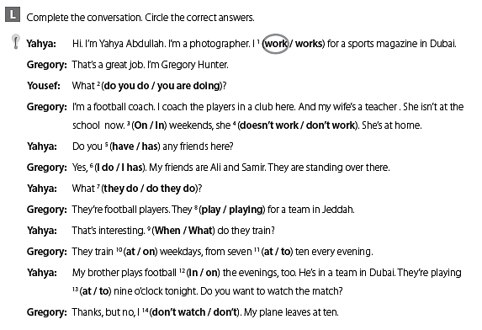

Slide 43
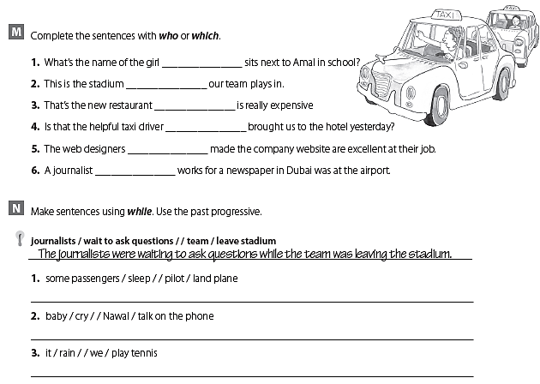
who
which
which
who
who
who
Some passengers were sleeping while the pilot was landing the plane
The baby was crying while Nawal was talking on the phone
It was raining while we were playing tennis

Slide 44
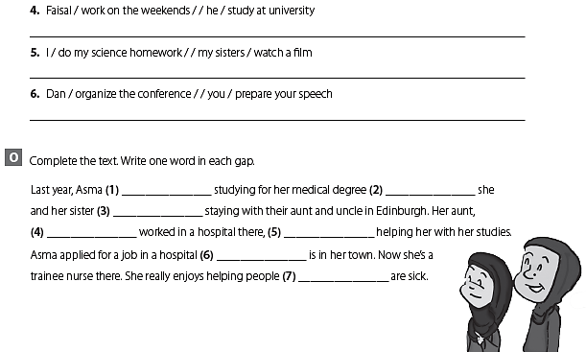
Faisal was working on the weekends while he was studying at university
I was doing my science homework while my sisters were watching a film.
Dan was organizing the conference while you were preparing your speech
was
while
were
who
was
which/that
who/that

Slide 45
Unit 3

Slide 46
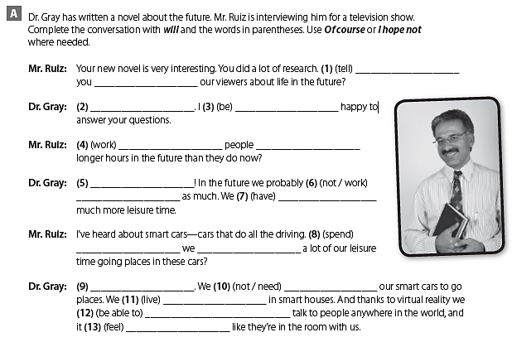
Will
tell
Of course
will be
Will
work
I hope not
will not work
will have
Will
spend
will not need
I hope not
will live
will be able to
will feel

Slide 47
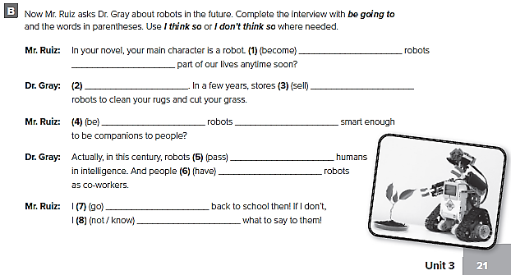
Are
going to become
I think so
are going to sell
Are
going to be
are going to pass
are going to have
am going to go
am not going to know

Slide 48
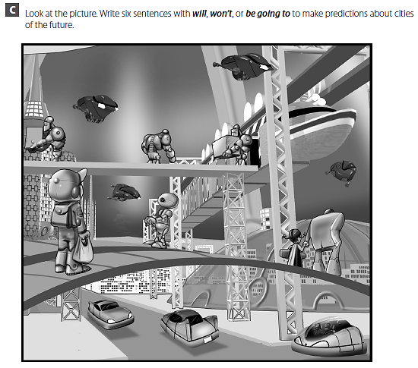

Slide 49
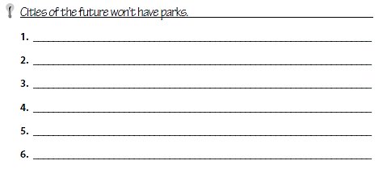
الإجابات من الممكن أن تختلف .
Cars won’t have wheels.
Cars are going to fly.
Robots will carry things.
Cities in the future won’t have trees.
There will be steel sidewalks.
Cities won’t have bus stops.

Slide 50
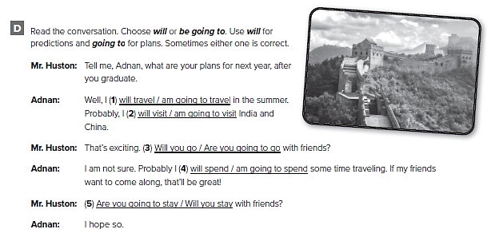
كلا الاجابتين صحيحة

Slide 51
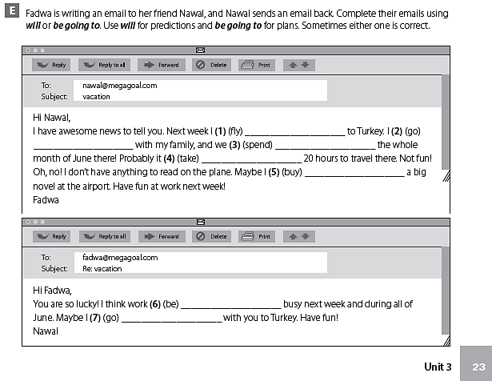
am going to fly
am going to go
are going to spend
will take
will buy
is going to be
will go

Slide 52
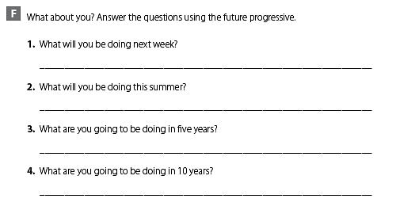
الإجابات من الممكن أن تختلف .
I will be writing a report for class next week
I will be visiting some relatives in Australia this summer.
I am going to be studying in college in five years
I am going to be working as a biologist in 10 years

Slide 53
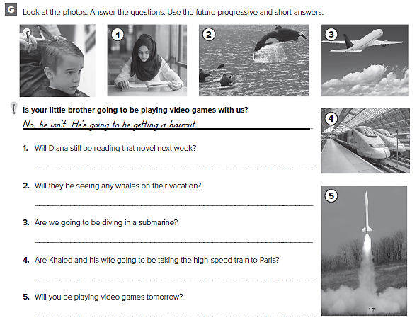
Yes , she will
Yes , they will
No, we aren’t. We’re going to be flying in a plane
Yes , they are
No, I won’t. I’ll be launching my rocket tomorrow

Slide 54
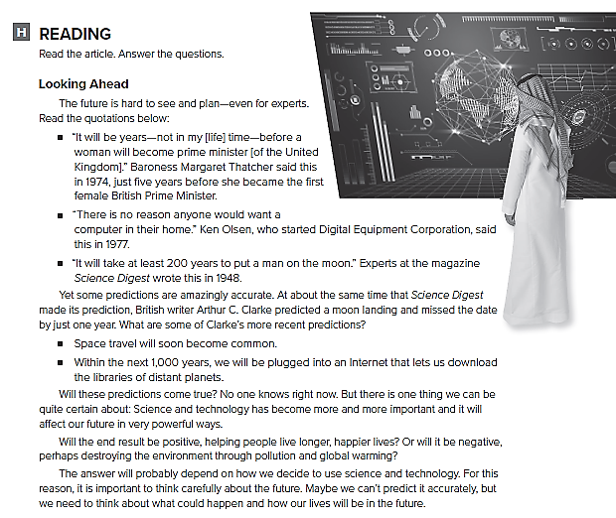

Slide 55
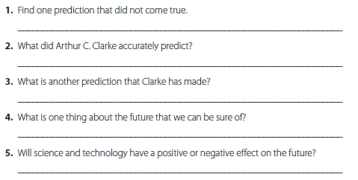
الإجابات من الممكن أن تختلف .
There is no reason anyone would want a computer in their home
He accurately predicted the moon landing
He predicted that space travel would soon become common
Science and technology will affect the future in very powerful ways
It will depend on how we decide to use it.

Slide 56

الإجابات من الممكن أن تختلف .
He will move to a large house.
He will be travelling all over the world.

Slide 57

I am going to visit my aunt and uncle. We are going to drive to their house which is about 50 km from the center of town. Maybe we will spend the night there and return on Saturday morning.
I am going to study and do my homework. Then I’m going to meet my friends at the mall. We’ll go shopping and then have a burger at restaurant. Then maybe we’ll go to a friend’s house to watch a DVD.

Slide 58


Slide 59

الإجابات من الممكن أن تختلف .
Both the buildings show towers. In photo A, the tower is a modern skyscraper. In photo B, the tower is part of a castle.
In photo A, the tower is probably made from glass and metal. In photo B, the tower was made from brick.
The architects will probably make the modern skyscrapers ‘greener’ by installing wind turbines and solar panels on the roof.

Slide 60

تحدث عن مدينتك أو احدى المدن داخل المملكة وما هي التطورات التي قد تحدث مستقبلا بها

Slide 61

قم بكتابة قطعة عن المستقبل الذي تصورته لهذه المدينة

Slide 62


Slide 63

f
c
a
d
e
b

Slide 64

كل طالب يجيب عن نفسه

Slide 65

do they ?
No , they don’t
won’t it ?
Yes , it will
does it ?
No , it doesn’t
are they ?
No , they are not
isn’t it ?
Yes , it is
will we ?
No , we won’t
is she ?
No , she isn’t
aren’t you ?
Yes , I am

Slide 66
Expansion 1 – 3

Slide 67

global warming
Traffic
motivation
steel
natural disaster
microscope
qualification
rockets
satellites

Slide 68

global warming
Poverty
Disease
Flexibility
Adaptability
Integrity
Honesty
Rocket
Satellite
Submarine
Microscope

Slide 69

are
living
am living
are
taking
am taking
Are
working
am not working
am looking
is looking
am going

Slide 70

have
been working
have been working
have met
haven’t made
have
been saving
have been saving
Have tried
have been
have been going
have done
haven’t spent

Slide 71

will do
will do
will publish
am going to give
Will buy
are going to get
will be
is going to take

Slide 72

my brother will be attending
Will you be attending
I am going to be working
Are you going to be living
will be saving
you are not going to be working

Slide 73

الإجابات من الممكن أن تختلف
She’ll take her math exam’s next week
This summer she is going to travel to
He is going to play basketball next week
He is going to start training for the season

Slide 74

الإجابات من الممكن أن تختلف
Buy a house he saved money move into the house
Do an MA he got a scholarship study in another country
Teach at she applied for she got the job
university a job

Slide 75


Slide 76

الإجابات من الممكن أن تختلف
A civil engineer reads blueprints.
A pharmacist distributes pharmaceuticals to customers
Creative , good at math , good at design
Organized , polite , careful , tidy
He needed to study structural engineering.
He needed to study pharmacology.

Slide 77

قم بالكتابة عن المهنة التي تحلم بها

Slide 78

قم بالكتابة عن المهنة التي تحلم بها

Slide 79
Unit 4

Slide 80

compact
options
customize
classic
smooth

Slide 81

were made
were bought
were produced
were sold
were told
is spent
are shown
is not launched
have been asked
Have
been affected
will be spent
will be asked

Slide 82

The Longest Marriage
The Tallest Man
The Most Expensive Movie
The Most Valuable Slice
of Cake

Slide 83


Slide 84

more expensive
cheaper
more comfortable
more special
healthier
more refreshing
smaller
larger

Slide 85

not as warm as
not as expensive as
as healthy as
as hot as

Slide 86

smell
tastes
sound
look

Slide 87


Slide 88

They use stories and pictures
They try to show people that they can meet their needs
Three of the needs are friendship, success, and escape
Companies are advertising during children’s TV shows

Slide 89

was invented
were also invented
was invented
patented
was made
was sold
was processed
used
was made
were soaked
are equipped
were updated
was installed
were trained

Slide 90

smart phone
biscuits
a car
a car dealer
a soft drink
watches
vacation
a printer

Slide 91


Slide 92

الإجابات من الممكن أن تختلف
reliability, precision, quality, style
smooth, elegant, prestigious, traditional
at home , at work
at school , at work
Professional , casual
Knowledge , respectful

Slide 93

قم بتصميم إعلان حول مشروب غازي جديد

Slide 94

قم بكتابة الإعلان

Slide 95

What are these ? They’re sculptures.
What is this ? It’s an airplane.
What is this ? It’s an electric car.
What are these ? They’re smartphones.
What is this ? It’s a magazine.

Slide 96

كل طالب يجيب عن نفسه

Slide 97

yours
mine
your
my
hers
her
your
ours

Slide 98


Slide 99
Unit 5

Slide 100

d
a
e
f
b
g
c
h

Slide 101

equipment
avoid
injured
obey
helmet

Slide 102

myself
ourselves
itself
themselves
himself
herself
ourselves
yourself
yourselves
myself
yourself
himself

Slide 103

myself
himself
yourself
themselves
himself
ourselves

Slide 104

g
f
e
h
b
c
d
a

Slide 105

so
because
because
so
so
because
because
so

Slide 106

c
a
e
f
b
d

Slide 107

من الممكن أن تختلف الإجابات
Neither have I.
I haven’t eaten anything all day, so I can eat a lot at the restaurant tonight.
So did I.
I went to bed late last night because I watched a movie on TV.
So did I.
I visited my uncle last weekend because I wanted to give him a present
Neither do I.
I very seldom cut myself because I’m careful.
So do I.
I always brush my teeth, so I don’t have to go to the dentist.

Slide 108

حدد أدوات الأمن والسلامة الموجودة في منزلك

Slide 109

F
T
T
F
T

Slide 110

أكمل الجدول عن حادث شاهدته

Slide 111

من الممكن أن تختلف الإجابات
I think he probably hurt himself
He probably suffocated

Slide 112


Slide 113

من الممكن أن تختلف الإجابات
He is fastening the baby in the child seat
The baby might get hurt.
It should be placed on the back seat of the car
They should ensure the child locks are activated

Slide 114

اكتب قصة عن حادث شاهدته

Slide 115

اكتب قصة عن حادث شاهدته

Slide 116

must pay attention to the road
mustn’t fall asleep at the wheel
must ask the driving instructor for advice
mustn’t sit in the front seat
must fasten her seat belt
mustn’t tailgate
mustn’t run across the street
should wear
The baby shouldn’t sit
should stop
shouldn’t ride
shouldn’t talk
should

Slide 117

well
badly
late
patiently
luckily
fast
carefully
clearly
safely
hard
easily

Slide 118

across from
next to
between

Slide 119

It’s across from the bank hotel.
It’s between the subway station and the pharmacy
It’s between the pharmacy and the bookstore.
It’s across from the bank
far from
near
straight
Take
across from
between

Slide 120
Unit 6

Slide 121

fitness
avoid

Slide 122

lose control
hungry
turn down
pressure

Slide 123

should
could
might

Slide 124

shouldn’t
should
ought to

Slide 125

ought to
might

Slide 126

أكمل النصائح باستعمال عباراتك الخاصة

Slide 127

أكمل النصائح باستعمال عباراتك الخاصة

Slide 128

give up
turn down
put off
take up
throw away
put up with
get along
give up
threw away
put off
turned down
gets along with
take up

Slide 129

put it off
put up with it
throw it away
throw it away
throw them away
put up with you

Slide 130


Slide 131

Eppie Lederer
Pauline Phillips
Jeanne Phillips
Margo Howard Eppie Lederer’s

Slide 132

من الممكن أن تختلف الإجابات
Hello,
Please don’t worry. Email your friend and ask him/her to scan the pages you need and send them to you.
Hi,
Why don’t you tell me what you are having difficulty with. And I will call you as soon as I check on it

Slide 133

Hello,
No need to be desperate. You left it on the shelf with the science books when Sabah turned up

Slide 134


Slide 135

Father
Son
University
Course
Decision
Consider
Think
Change
Make
Choice
Careful
The best
Suitable
Fast
Large
من الممكن أن تختلف الإجابات
You’d better think carefully about what you want to do.
Why don’t you decide according to your skills, background and preferences?

Slide 136

قم بتصور مشكلة لدى صديقك
ثم قم بكتابة بعض النصائح له

Slide 137

قم بكتابة بعض النصائح لصديقك

Slide 138

much
little
few
lot
much
much
lot
much
little
often

Slide 139

lot
many
much
often
lot
many
often
lot
often
much
few
little

Slide 140

Take cough syrup
Drink some tea
Use a skin cream
Take painkillers
Stay in bed
Relax
excited, fine/OK, glad, great, happy, relaxed, strong, wonderful
afraid, angry, bad, bored, nervous, sad, sick, sleepy, terrible, tired

Slide 141

كل طالب/ة يجيب عن نفسه

Slide 142
Expansion 4 – 6

Slide 143

Cures have been discovered, for many diseases
Many more cures will probably be found
Soccer is played by most young people in Brazil
I was surprised by his letter
The package will be mailed this afternoon
All the windows have been washed

Slide 144

coolest
smaller
more compact
lighter
more unbelievable
amazing
more unbelievable
better

Slide 145

because
so
because
so
because
because
so
because

Slide 146

Abdullah burned himself on the hot stove while cooking eggs this morning
Saeed and Fahad slipped on the ice, but luckily they didn’t hurt themselves
Hameed taught himself Spanish last year
Noura saw herself in a lot of the photos that Jennifer took at the park

Slide 147

f
b
h
a
c
g
d
e

Slide 148

The bike is as old-fashioned as the car.
The car is not as old-fashioned as the bike
My cell phone is as big as my friend’s cell phone.
My cell phone is not as big as my friend’s cell phone
The latest Star Trek movie is as interesting as the other ones
The latest Star Trek movie is not as interesting as the other ones

Slide 149

roses
a piece of chicken
a native speaker
a new car

Slide 150

think it’s best if you don’t use your phone while you are driving.
Why don’t you tell the caller that you cannot speak now
Don’t you feel it’s safer to keep your eyes on the road?
Try not to resolve issues while driving .
من الممكن أن تختلف الاجابات

Slide 151

كل طالب يجيب عن نفسه

Slide 152


Slide 153

It makes me feel anxious, and guilty for not studying enough
feel like that because it reminds me of exams
I close my eyes and breathe deeply and steadily
من الممكن أن تختلف الاجابات

Slide 154

تحدث عن الأمور التي تثير قلقك وكيف تتعامل معها

Slide 155

قم بالكتابة عن الأمور التي تثير قلقك وكيف تتعامل معها

Slide 156

Prepared by
Teacher :
Badr Sayid Al-Shehri

