Slide 1

School Supplies

Slide 2
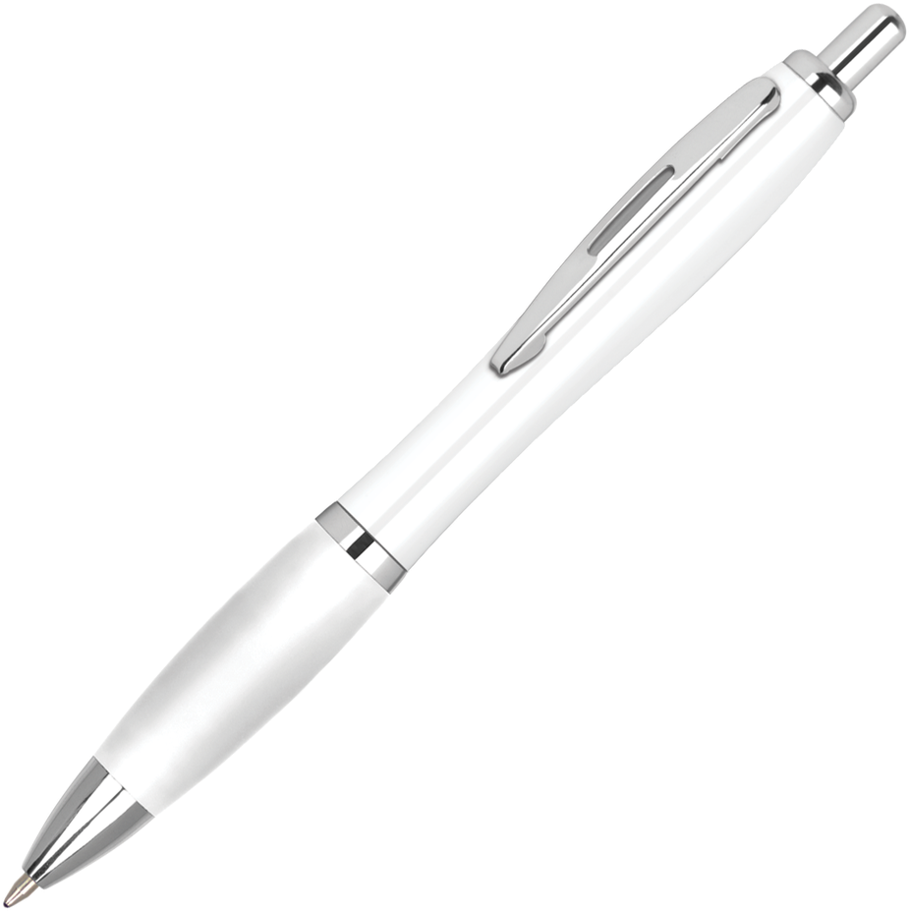

pen

Slide 3
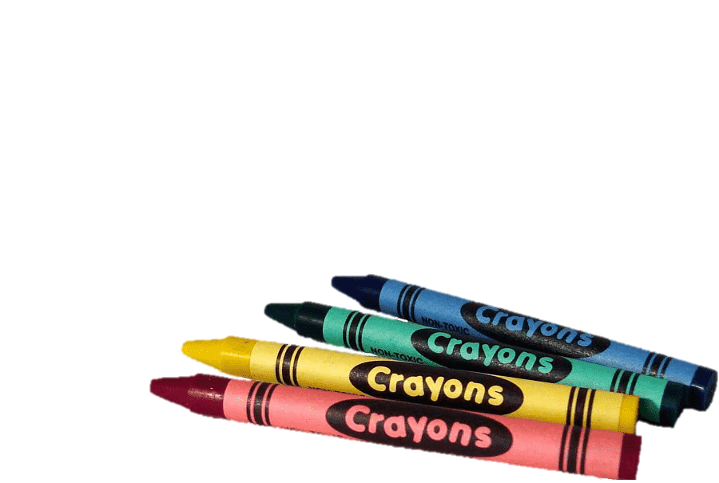
Crayons

Slide 4

books

Slide 5

paints

Slide 6

pencil

Slide 7

Note book

Slide 8
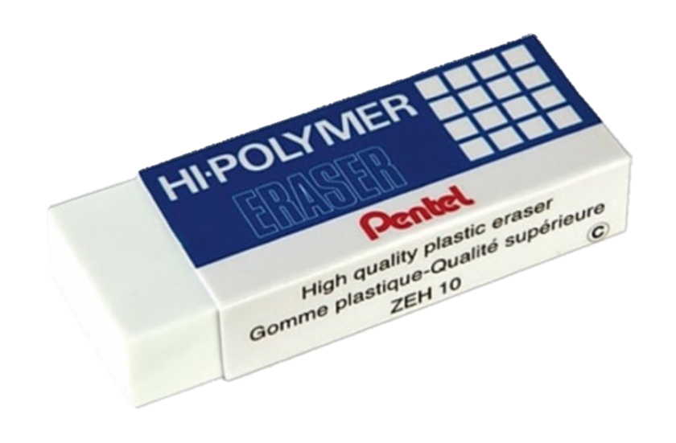
eraser

Slide 9
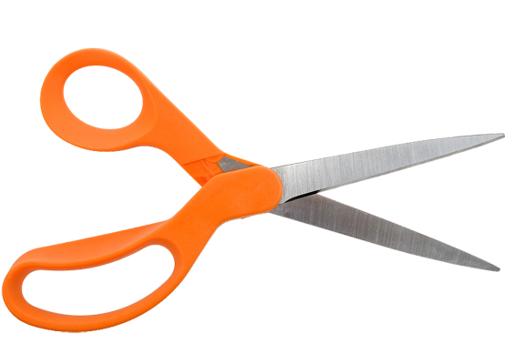
scissor

Slide 10
Let’s answer
Page 9

Slide 11
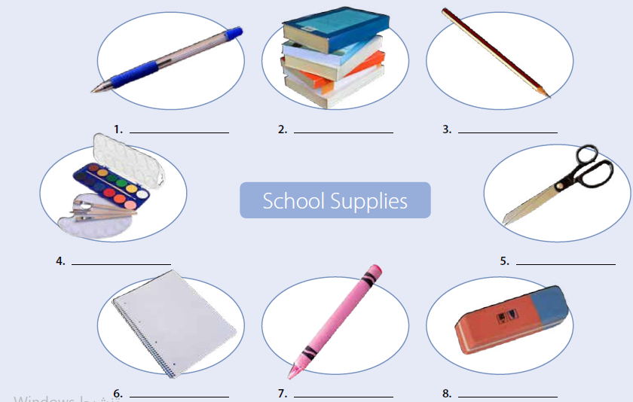
pen
books
pencil
paints
scissors
notebook
crayon
eraser

Slide 12
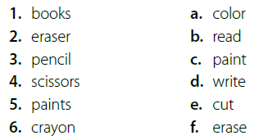







What do you use each school supply for?
with crayon
books
with paints
with pencil
with scissors
with eraser

Slide 13

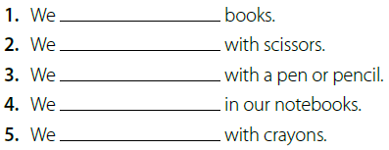
read
cut
write
write
color

