Slide 1



Revision for Super Goal 3 (Unit 1,2 and 3)
The Kingdom of Saudi Arabia
Ministry of Education
Afif Governates
Tariq Bin Ziyad Intermediate School
Mr. Yasir Alotaibi

Slide 2
Grammar
Relative Pronouns
Conjunctions
Simple Present Tense
Imperatives
Present Progressive
Prepositions of Place
&
Giving Directions
Simple Present of the Verb Be
Information Questions
Polite Request
End

Slide 3
Simple Present of the Verb Be
4
Verb to Be S + Be + Comp.
Examples | Complement | Be | Subject
Make a sentence: S + Be + Comp. I am a student. I am not a student. He is a doctor. He is not a doctor. You are teachers. You are not teachers. Make a question: Be + S + Comp? Am I a student? Yes, you are. Is he a doctor? No, he is not. Are you teachers? Yes, we are. Are you a teacher? No, I am not. | a teacher | am | I | Speaker
 | Khalid | is | He | Third Singular
 | Fatima |  | She
 | a cat |  | It
 | a student students | are | You | Listener
 | hard worker |  | We | Plural
 | good |  | They

Slide 4
Information Questions
4
Information Questions Wh + Be + S + Comp?
How to Make a Question | Examples | Asking About | Wh-Questions
He is from Jeddah. Where is he from? ----------------------------------- The National Day is in September. When is the National Day? | How are you? | Manner or Method | How
 | What is your name? | Information or things | What
 | When is the National Day? | Time | When
 | Where are you from? | Place | Where
 | Who is your Math teacher? | Person | Who
 | Why are you here? | Reason or Cause | Why

Slide 5
Polite Requests
8
For a sentence: (Would like)
I want to have a coffee.
I would like to have a coffee.
I want to make reservation.
I would like to make a reservation.
For a question: (Can/ Could/ May)
Spell your last name.
Could you spell your last name?
Pass me the salt.
Can you pass me the salt, please?

Slide 6
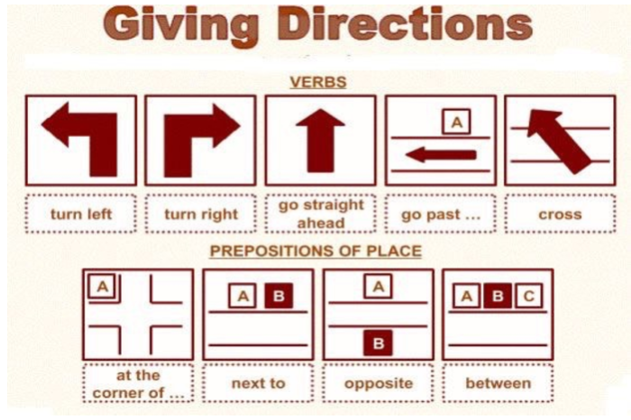
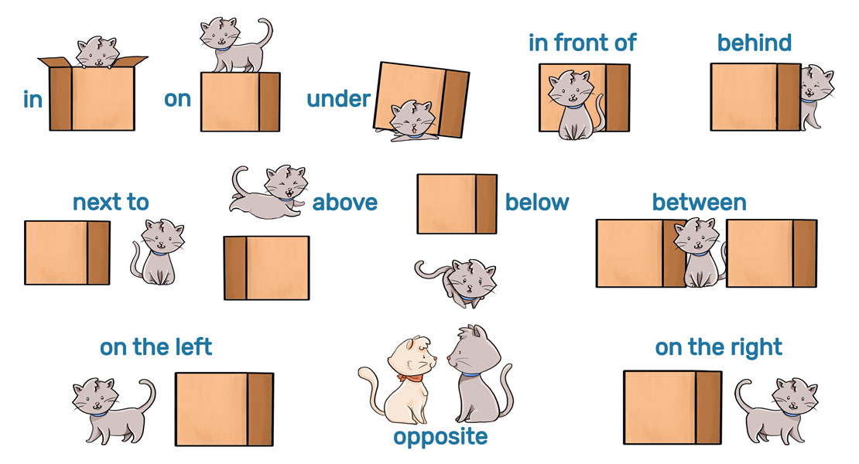
Prepositions of Place & Giving Directions
9
17
On the corner
Across from

Slide 7
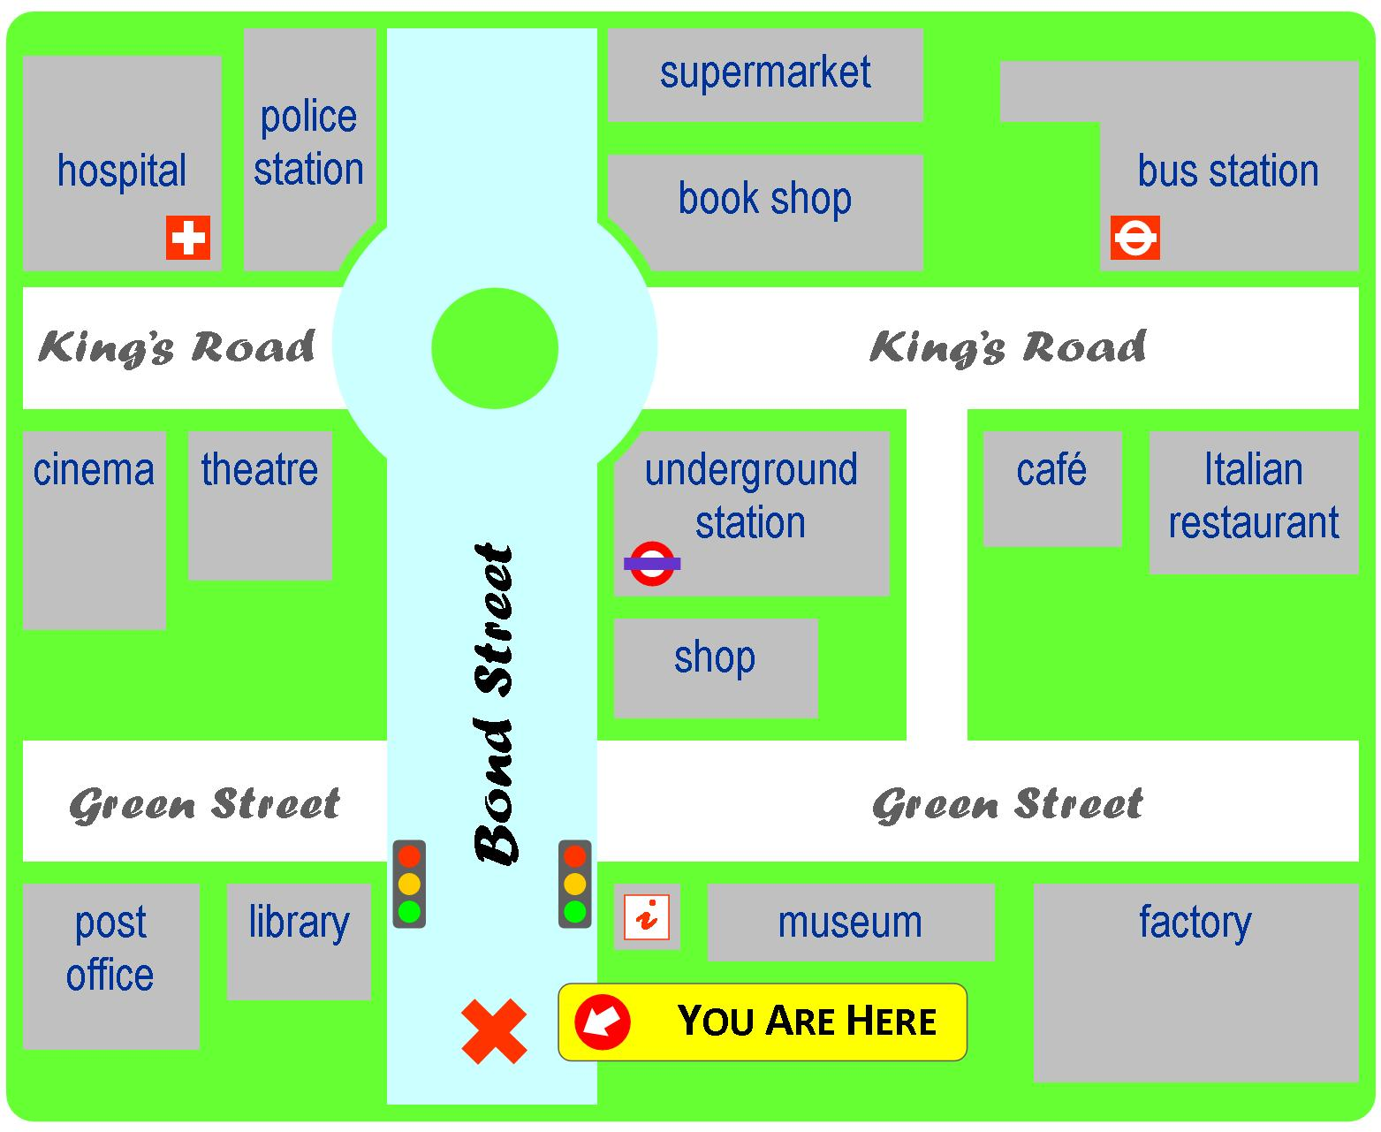
Prepositions of Place & Giving Directions
9
17

Slide 8
Present Progressive Tense
12
Present Progressive Tense S + Be + V₁-ing + Comp.
Examples | Complement | V₁-ing | Be | Subject
Make a sentence: S + Be + V₁-ing + Comp. I am (not) studying English. He is (not) swimming in the pool. You are (not) lying down for rest. Make a question: Be + S + V₁-ing + Comp? Am I studying English? Yes, you are. Is he swimming in the pool? No, he is not. Are you Lying down for rest? Yes, we are. Are you Lying down for rest? No, I am not. | English | teaching | am | I
 | a book | reading | is | He
 | Fatima | calling |  | She
 | on the floor | rolling |  | It
 | for the exam | preparing | are | You
 | on Madrasati | studying |  | We
 | others | helping |  | They

Slide 9
Imperatives
17
Imperatives
To tell someone how to do something
Don’t have a subject
Use the base verb
V₁ + Comp.
Affirmative:
Close the door.
Open your book, please.
Negative:
Don’t close the door.
Don’t open your book, please.

Slide 10
Simple Present Tense
20
Simple Present Tense S + V₁ + Comp.
Examples | Complement | V₁ | Subject
Make a sentence: S + V₁ + Comp. I study English. I do not study English. He plays basketball. He does not play basketball. You wash dishes. You do not wash dishes. Make a question: H.V. + S + V₁ + Comp? Do I study English? Yes, you do. Does he play basketball? No, he does not. Do you wash dishes? Yes, we do. Do you wash dishes? No, I do not. | classes on Madrasati | attend | I
 |  |  | You
 |  |  | We
 |  |  | They
 | classes on Madrasati | attends | He
 |  |  | She
 | the pet show |  | It

Slide 11
Conjunctions
24
To connect two different sentences:
And: to connect words and ideas which are similar
I am hungry and I am thirsty.
But: to connect contrasting ideas
I am hungry but I am not thirsty.
Because: to give a reason for something
I am hungry because I did not eat dinner.

Slide 12
Relative Pronouns
25
To add information about a noun in the main clause:
Who / That: to add information about people
The man who is in the corner is my classmate.
The man that is in the corner is my classmate.
Which / That: to add information about things and animals
The language which you are studying is global.
The language that you are studying is global.

Slide 13

Any Question
Thank you

