Slide 1

U 2 Writing
Nora Khalid

Slide 2

How was your last weekend?
It was long.

Slide 3
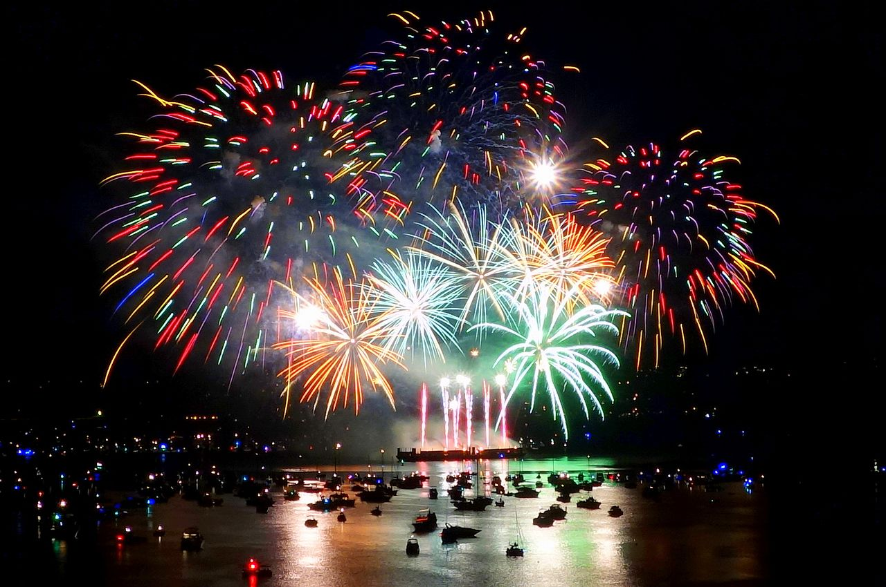
Why it was long?
It was long because we celebrated the Saudi national day

Slide 4
My weekend was long because we celebrated the Saudi National Day

Slide 5

Reason
Examples

Slide 6

Reason
Examples
for instance
Such as
for example
because
especially
like

Slide 7

Main
idea
Linking word
detail

Slide 8
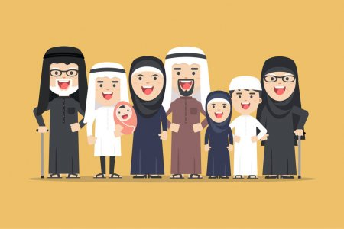
because
I love my family ………….. they take care of me.
My mother loves me so much, ………………… she can’t sleep at night when I’m sick.
for example

Slide 9

The Internet is an endless source of entertainment, ……………….. you can download videos or play a wide variety of online.
for example

Slide 10
The Internet can help us plan a vacation……………….. we can book tickets and make hotel reservations online
For instance

Slide 11
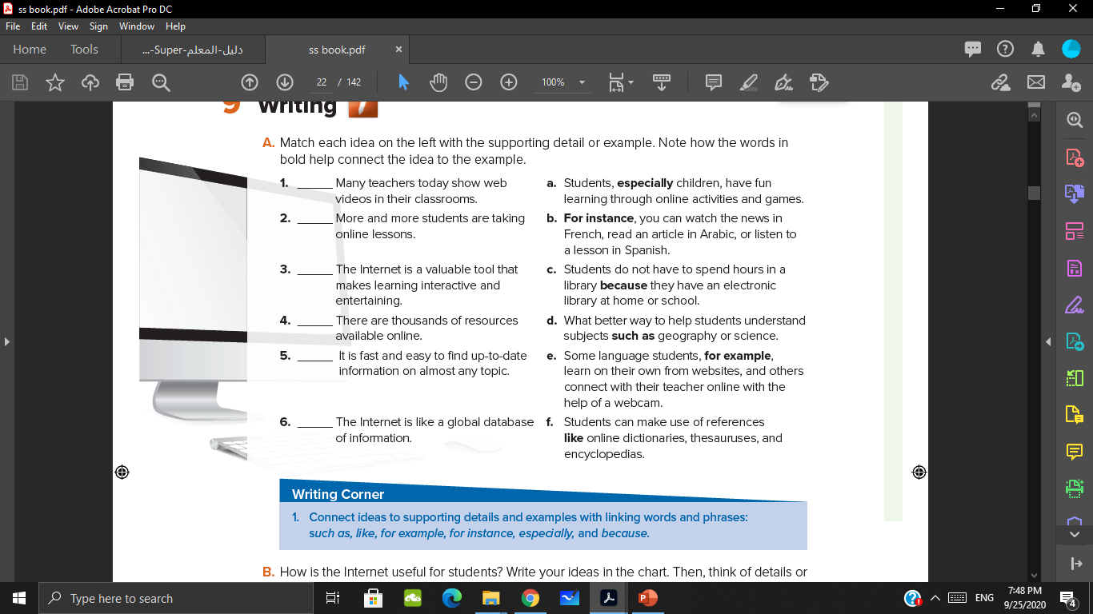
d
e
a
f
c
b

Slide 12
Main
idea
Linking word
detail

Slide 13

1
Ideas
how can you use the Internet to learn?
2
details

Slide 14
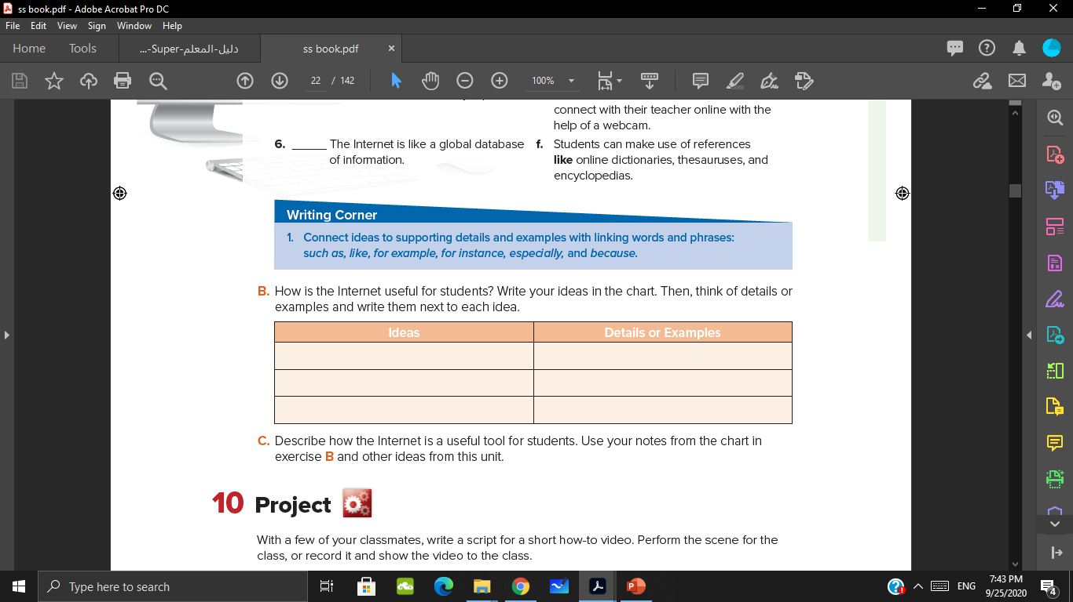
Individual task

Slide 15

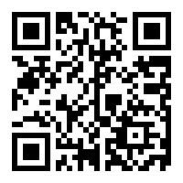
https://www.liveworksheets.com/1-iq1258205gg

Slide 16
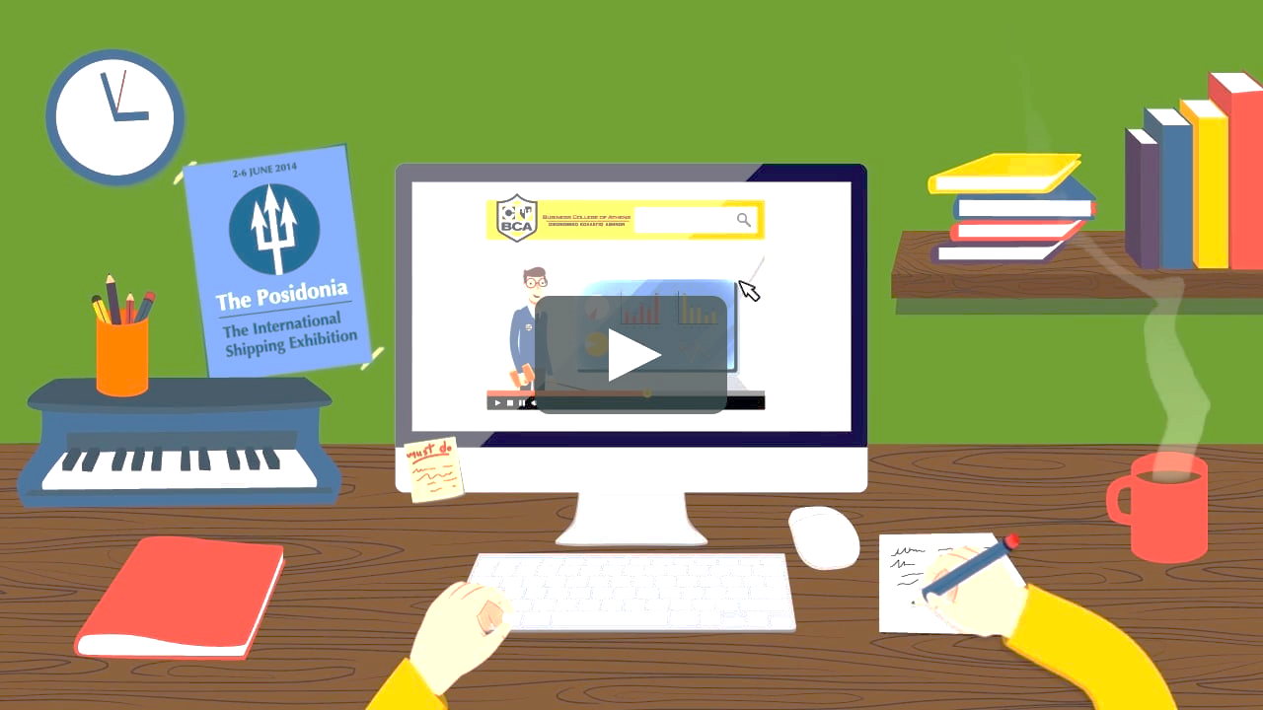
https://wordwall.net/resource/4607831
إثراء
لعبة من تصميم الأستاذة دلال الجعيد

