Slide 1
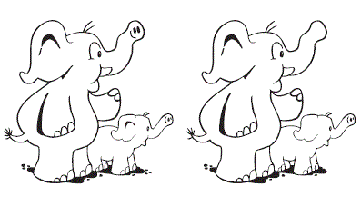

Can you spot all the differences between the two pictures?

Slide 2
Unit:1
Good morning

Slide 3

Role play
A -HI. My name is…….
-What’s your ………….?
B- My name is…..
A-How are you?
-I’m …………..

Slide 4
☺Grammar
☺pronunciation
☺listening
Page: 4+5

Slide 5
Objectives:
1
2
3
4
Use singular possessive adjectives correctly.
Use verbs be correctly.
Practice intonation in questions.
Answer some questions after listening.

Slide 6
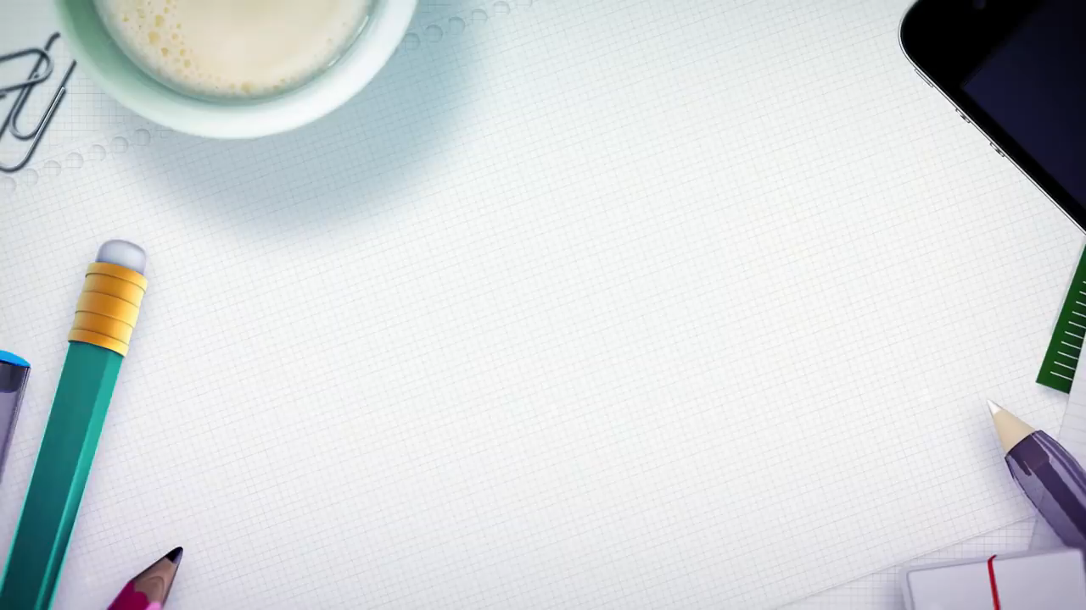

Slide 7
Verbs To Be
am
is
are

Slide 8
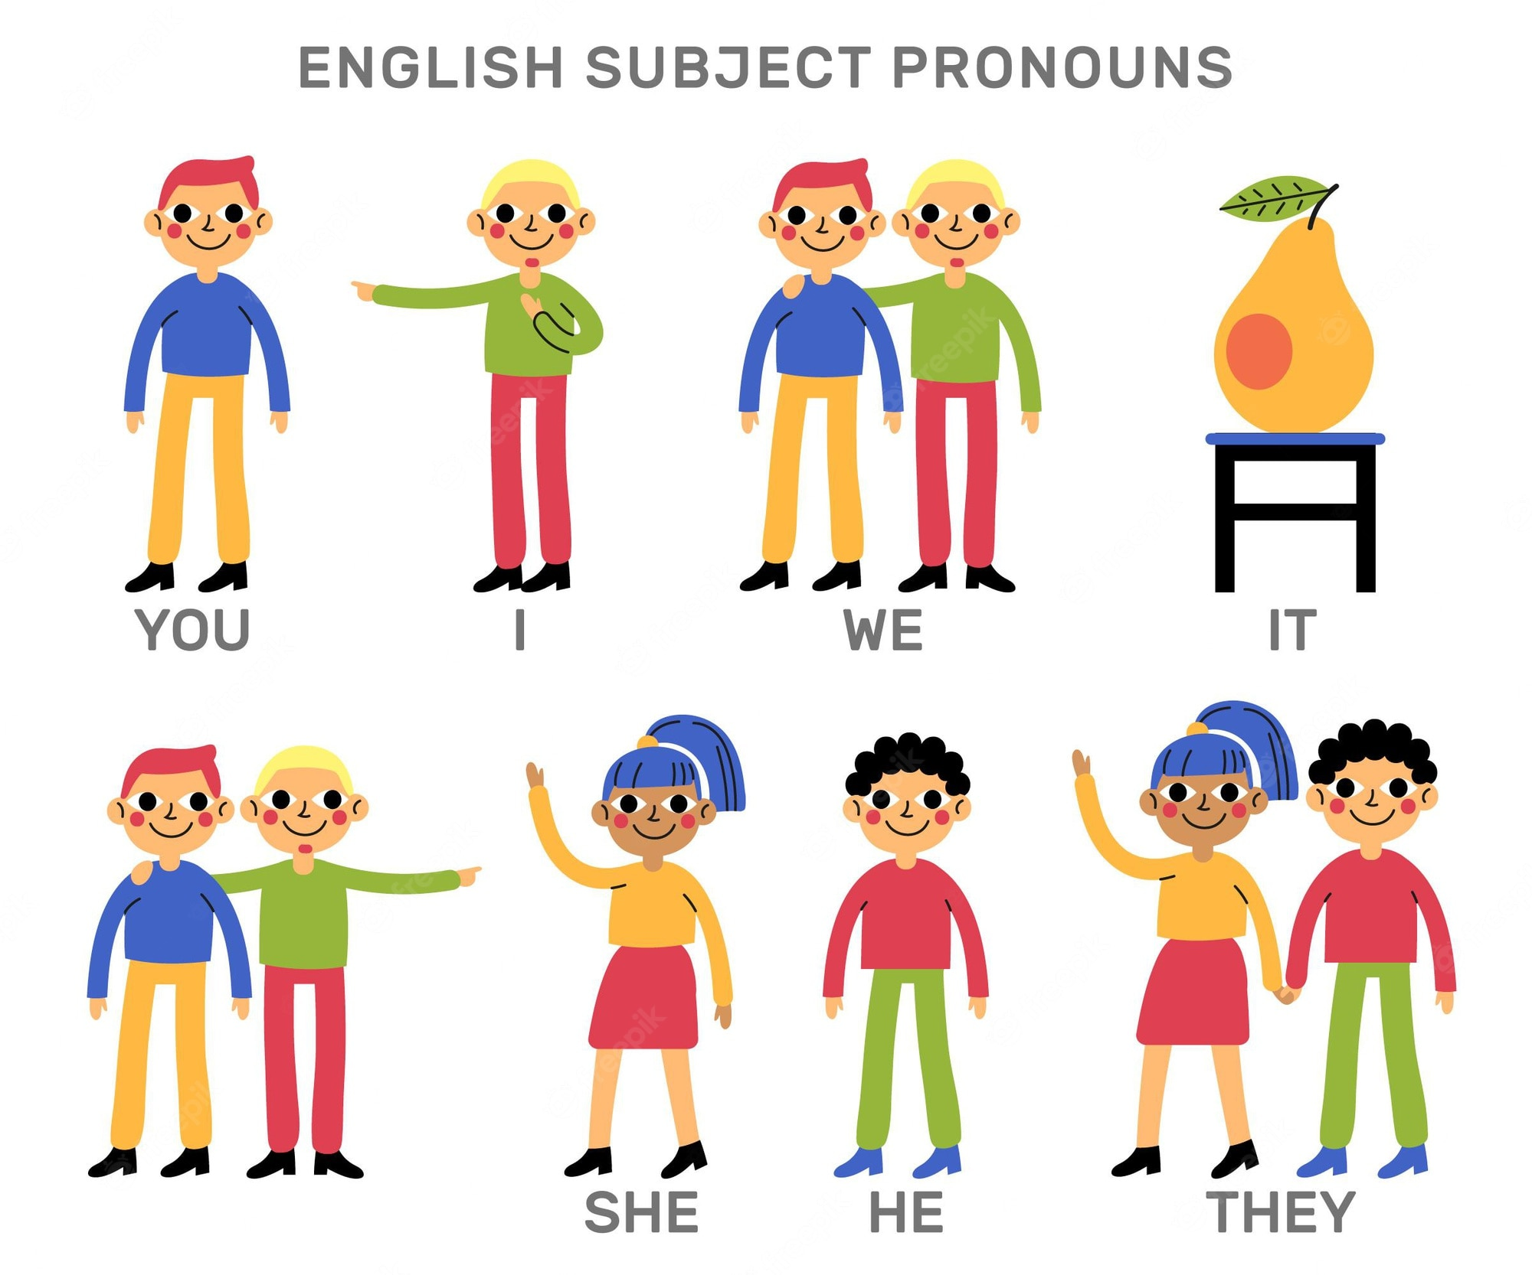

Slide 9
Pronouns
Verb To Be
I
He
She
IT
They
We
You
am
is
are
happy.

Slide 10

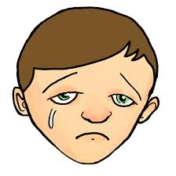


affirmative
I am happy.
He is sad.
They are friends
She is Asma.
Notes:
Give student 5 Minute for answers

Slide 11
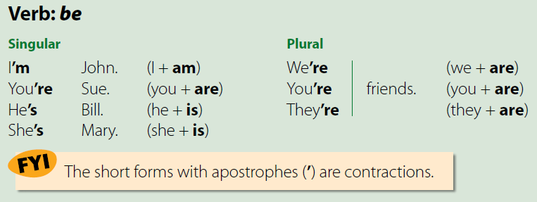

Slide 12
Let’s practice

Slide 13
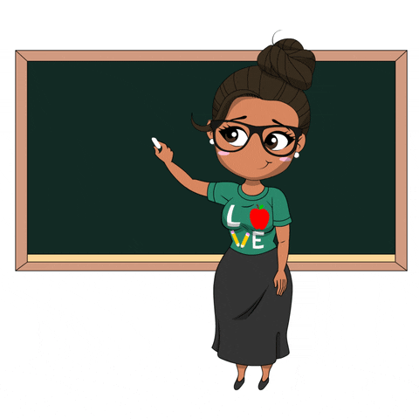
I _____________ your teacher
GREAT
is
am
are

Slide 14

She___ my best friend.
GREAT
is
am
are

Slide 15
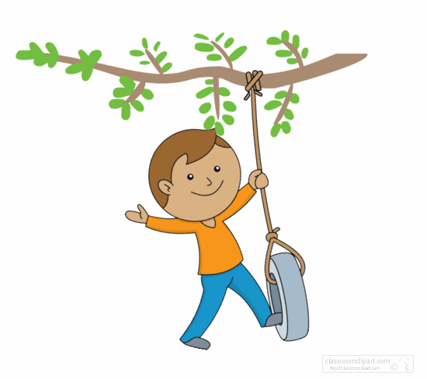
He _____ my brother.
GREAT
am
are
is

Slide 16
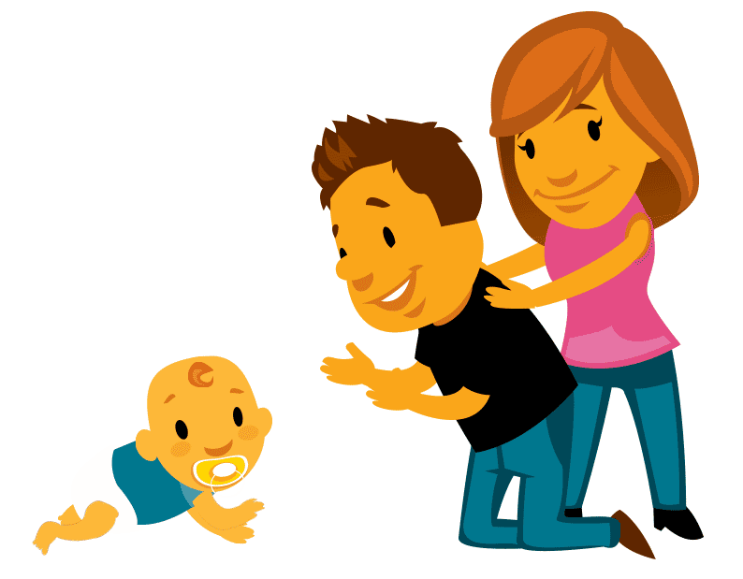
They ____ my parents.
GREAT
be
are
is

Slide 17

She_____ happy.
GREAT
are
am
is

Slide 18

Mona _____ cold.
GREAT
am
is
you

Slide 19

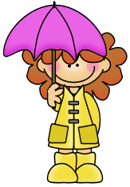
It ____ winter.
GREAT
is
are
we

Slide 20

Write a sentence using verbs be:

Slide 21
Possessive Adjectives: my, your, his, her
What is your name ?
My name is Mona.
What is his name ?
His name is Ahmad.
What is her name ?
Her name is Asma.

Slide 22
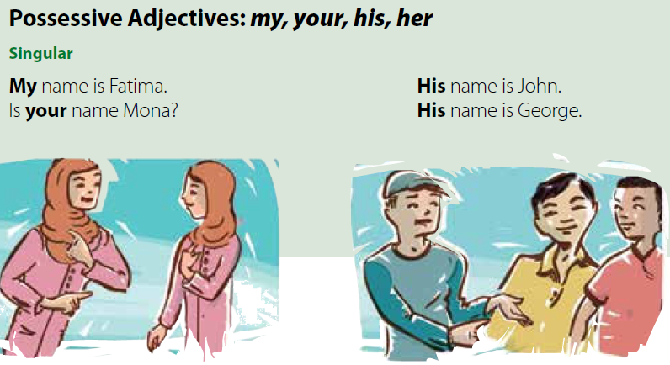

Slide 23
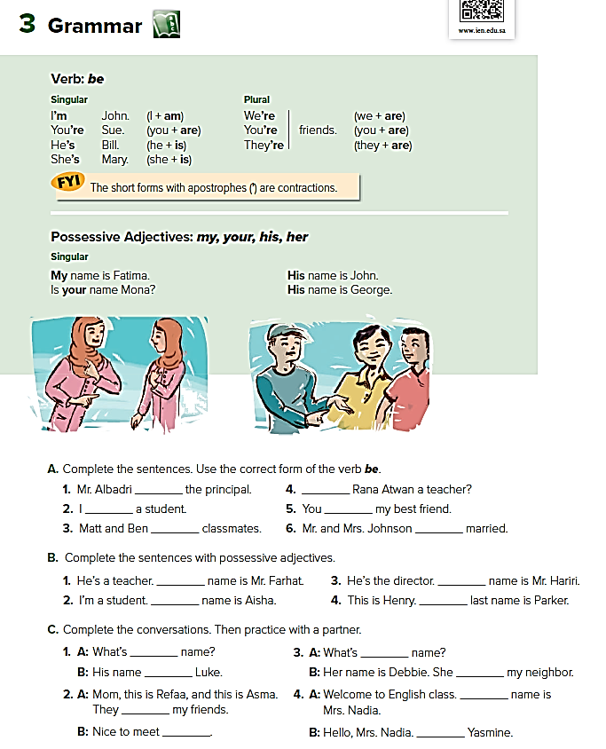
is
’m/am
are
Is
’re/are
are
His
His
His
My
his
’s /is
her
’s/is
My
I’m/I am
’re/are
you

Slide 24

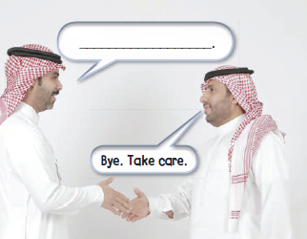
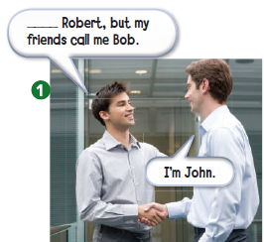
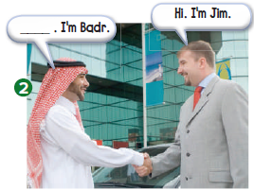
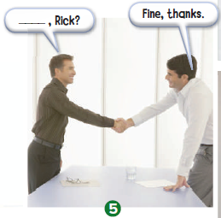
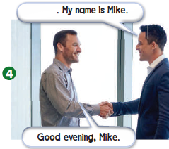
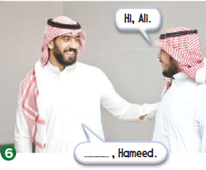
My name is
Nice to meet you
See you later
How are you
Good evening
Good morning

Slide 25





Slide 26




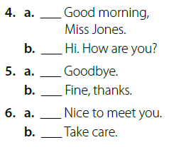
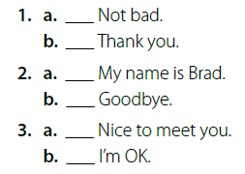

Slide 27

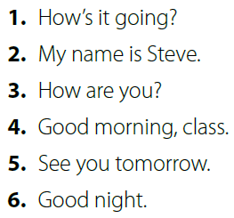

Slide 28
Good bye

Slide 29
Homework:
Page: 188
B + C
Page: 189
D + E

