Slide 1

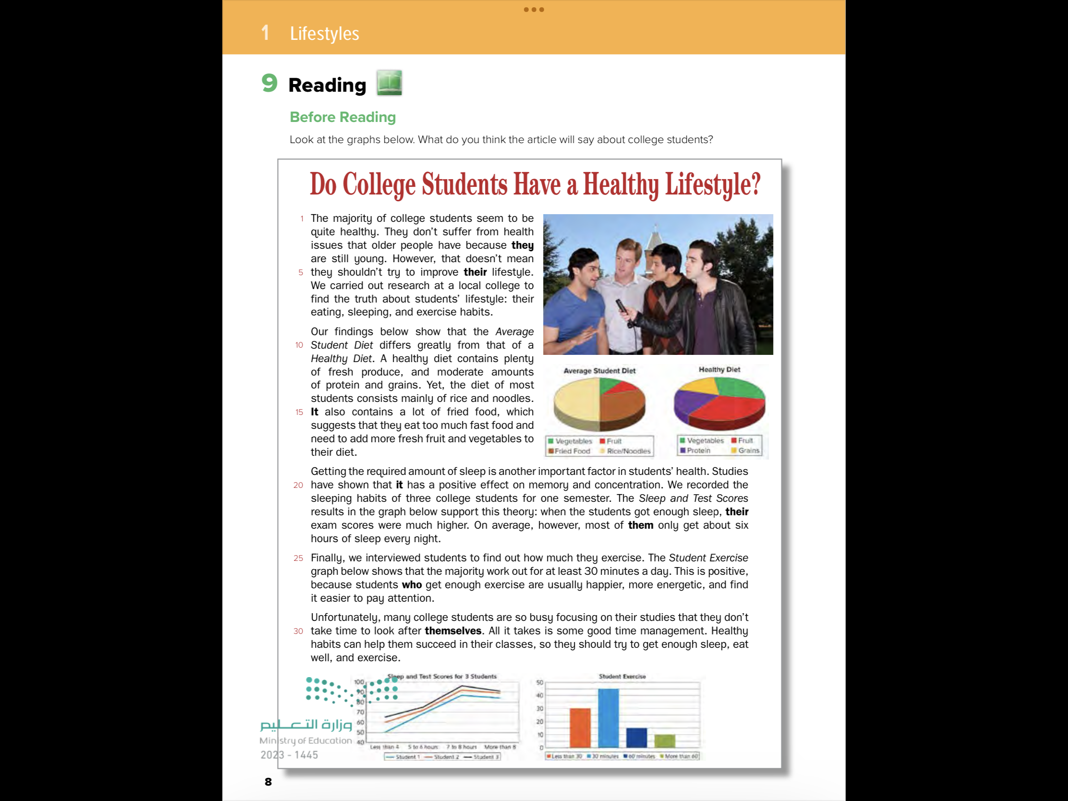
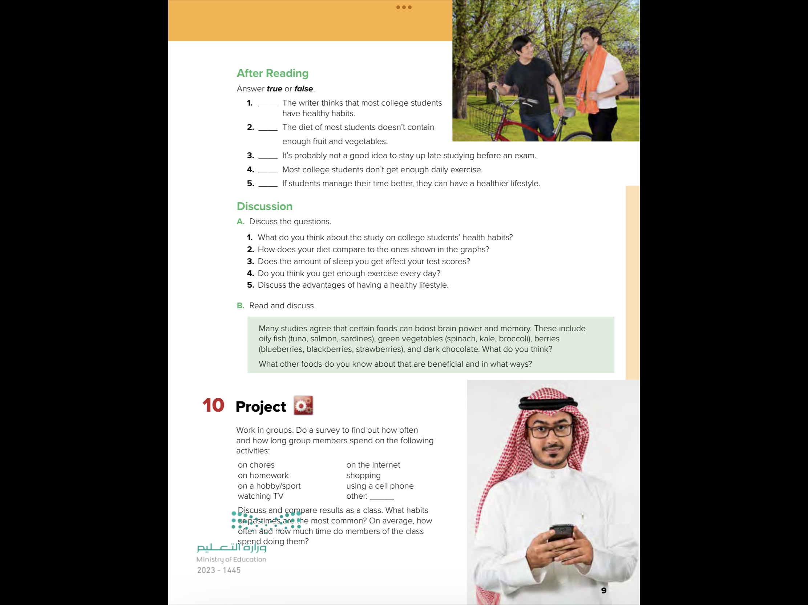

Slide 2

Objectives
1
Identify the new words
2
Read the text correctly
3
Answer the question in the book

Slide 3
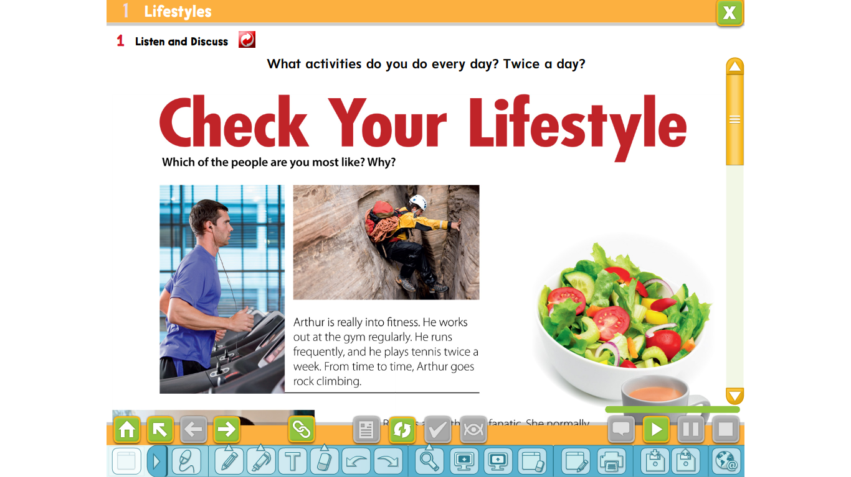
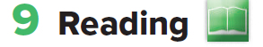





Slide 4
Who are the people and what are they doing?
They are college students. One young man is interviewing the others.
What are the young men doing?
exercising

Slide 5
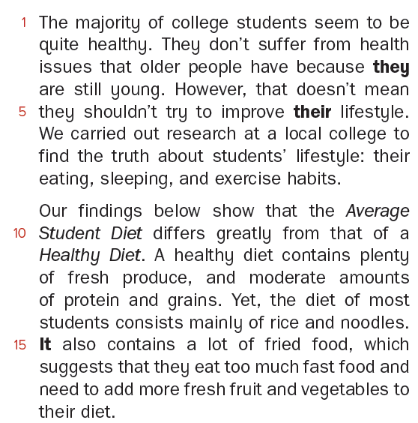
































Slide 6
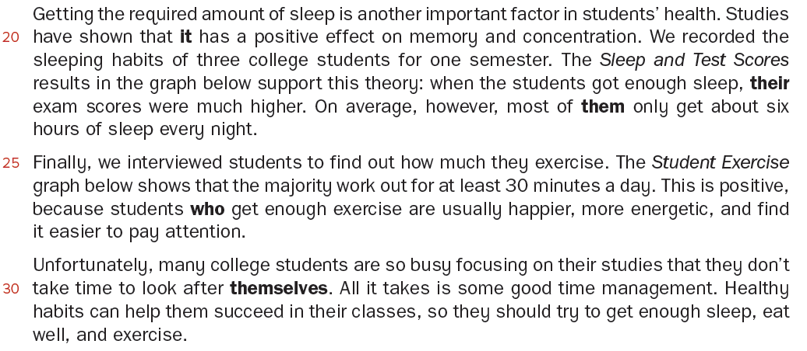









Slide 7

Where was the research carried out?
At a local College.
What three aspects of students’ lifestyle did the research focus on?
Their eating, sleeping and exercise habits.

Slide 8




What does a Healthy Diet contain?
lots of fresh fruit and vegetables and moderate amounts of protein and grains.
What does the Average Student Diet consist of?
mostly rice, noodles, and fried food, with a small amount of fruit and vegetables.
What is missing from the Average Student Diet?
fresh fruit and vegetables

Slide 9



Why is getting the required amount of sleep important?
It has a positive effect on memory and concentration.
What does the graph about Sleep and Test Scores compare?
How the number of hours of sleep affected the test scores of three students.
How many hours of sleep do most students get on average?
only 6 hours.

Slide 10
According to the graph about Student Exercise,
what percentage of students worked out for 30 minutes or more per day?
70 percent
What are the benefits of getting enough exercise for students?
They feel happier, more energetic, and find it easier to pay attention.

Slide 12
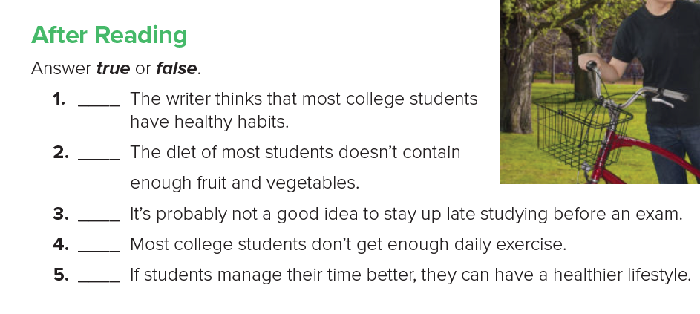
F
T
T
F
T

Slide 13

قال صلى الله عليه وسلم:
"نعمتان مغبون فيهما كثير من الناس: الصحة والفراغ"

Slide 14
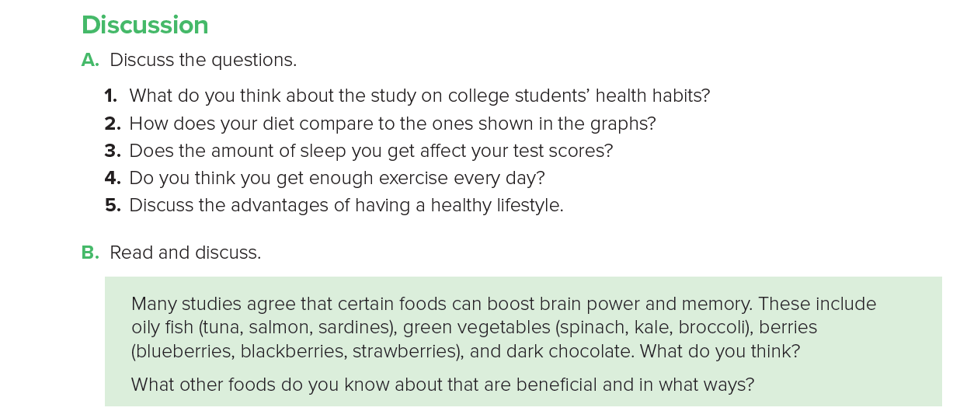

Slide 15
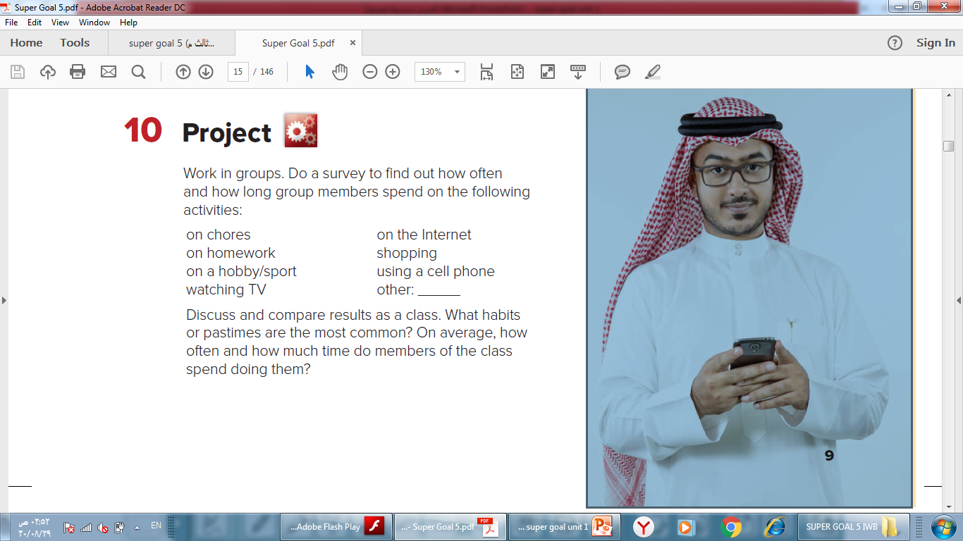


Slide 16
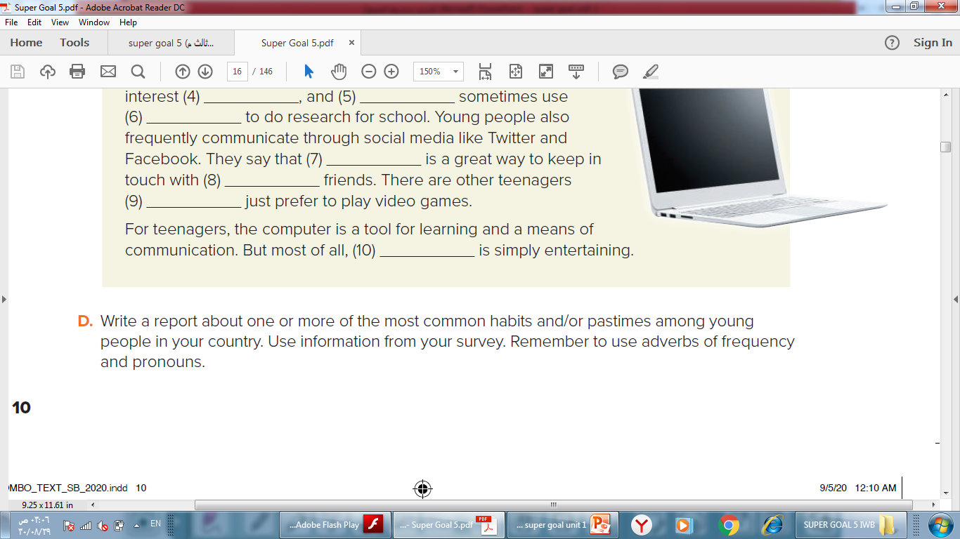

Slide 17
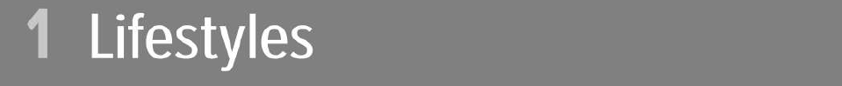
Workbook
171

Slide 18
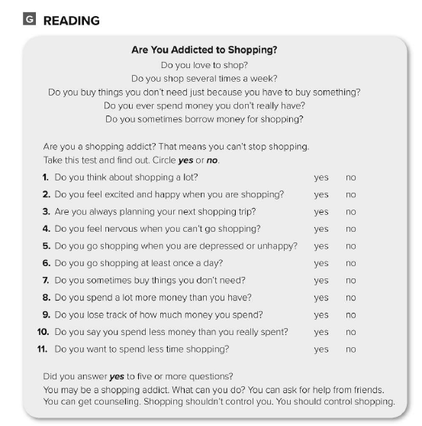

Slide 19
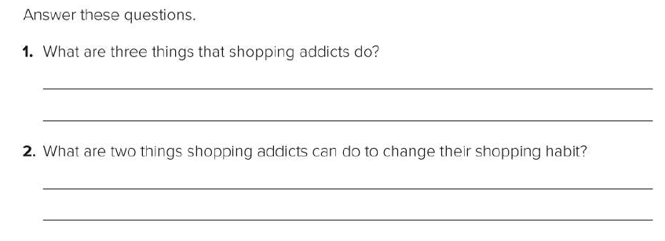
They go shopping when they’re depressed. They spend more money than they have. They feel nervous when they can’t go shopping.
They can ask friends for help. They can get counseling.

Slide 20
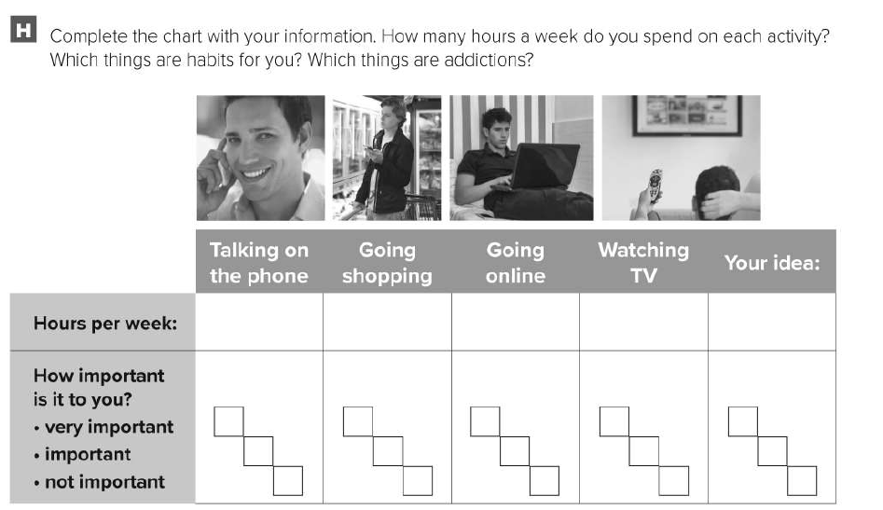

Slide 21
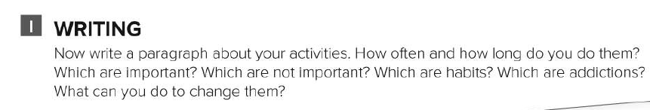
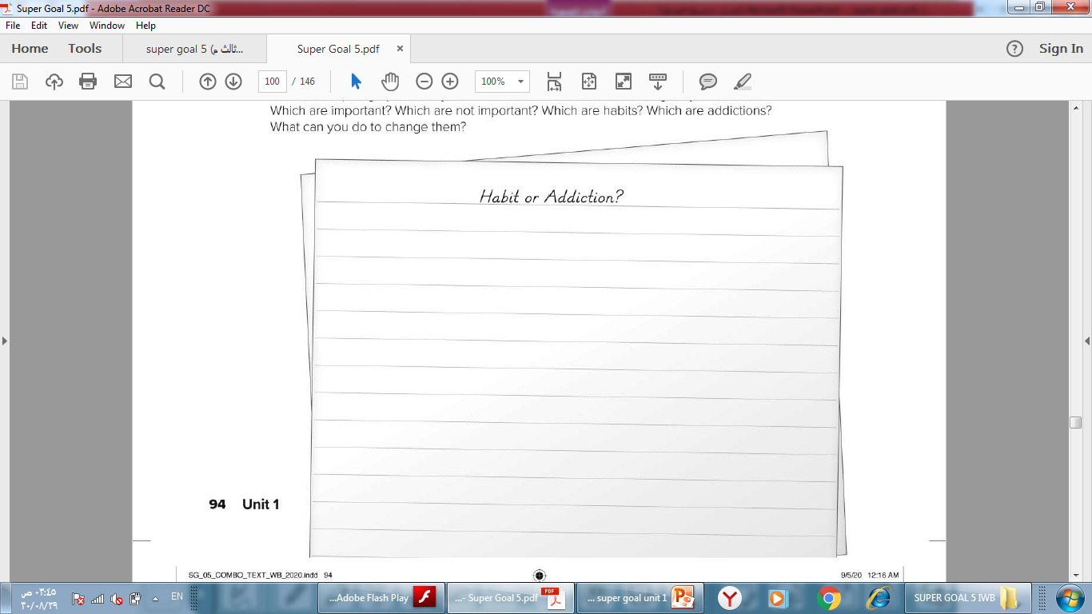

Slide 22
Habit or Addiction?
I do a lot of things during the week. Some are habits and some are addictions. Going shopping and watching TV are not important. I think they are just habits. Talking on the phone and going to the gym are important. They’re not really addictions. I think they are habits too. But going online is very important, and I know this is an addiction! I can probably study more instead of going online. I definitely need to study more!

