Slide 1


Unit 1
Lifestyle
Writing

Slide 2

بسم الله الرحمن الرحيم
Day:
Date:

Slide 3
Learning Objectives
discuss the topic based on Ss' information
write about teenagers' most common habits in KSA
Use the suitable pronoun in a sentence
Use pronouns and possessive adjectives to link ideas in sentences

Slide 4
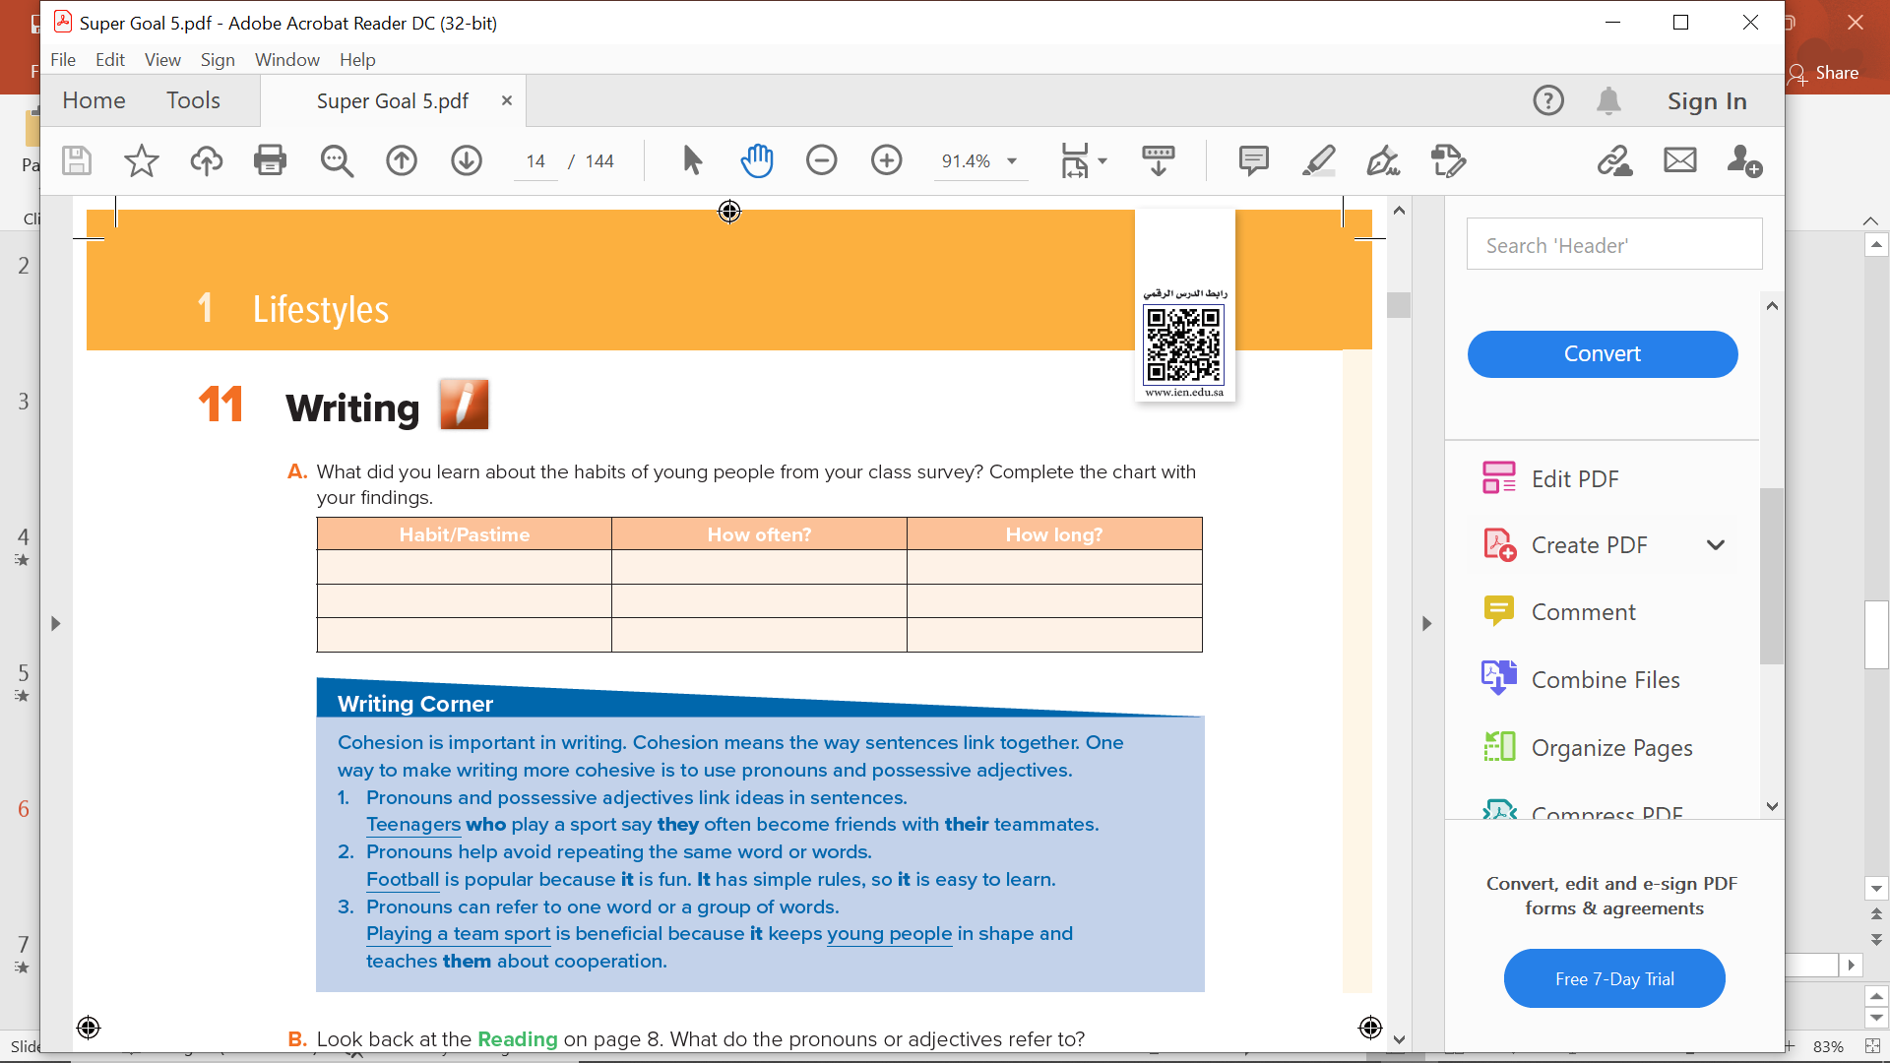
Page 10

Slide 6
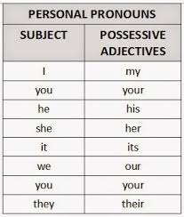

Slide 7
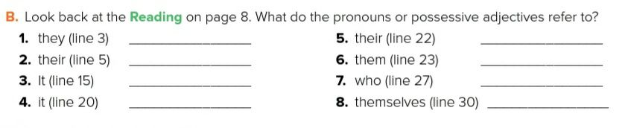
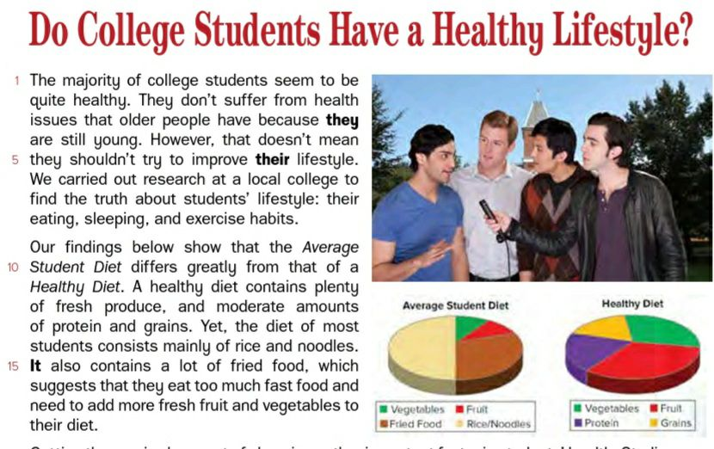
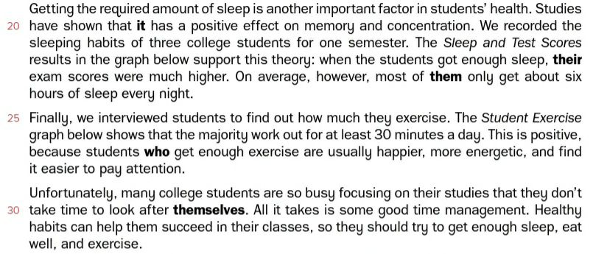
College students
The three college students
College students
College students
the diet of most students
College students
Getting the required amount of sleep
College students

Slide 8
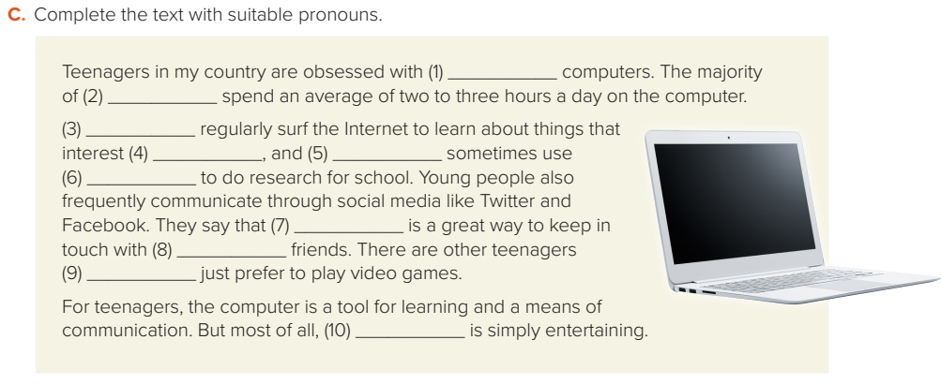
their
them
They
them
they
it
it/this
their
who
it

Slide 9


One of the most common habits among teens in my country is using cell phones. Cell phones are part of today's culture. Teenagers spend an average of an hour a day talking on their cell phones. They use their cell phones to communicate with each other, to surf the Internet and to study.

Slide 10

Homework
1
Workbook Page 172

Slide 11
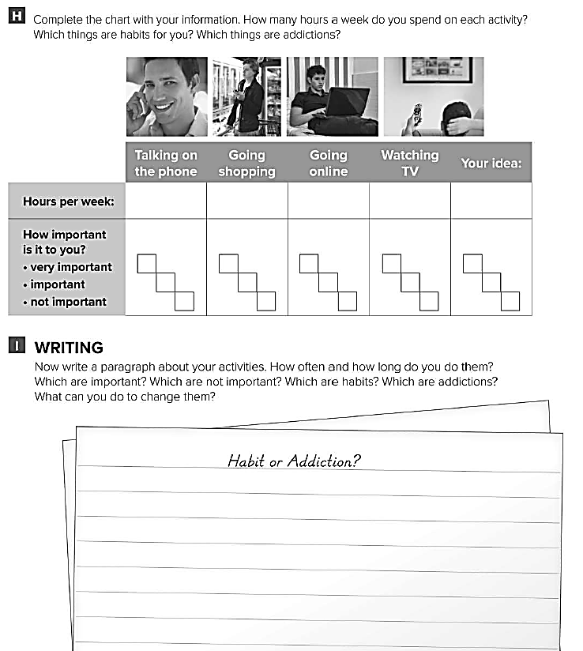

Slide 12

Done

