Slide 1


12: form , meaning and function
Super goal 5
Unit : 1
Tr: Kholoud AlGhamdi

Slide 2

1 - Both and neither
( tow people or things)
How many girls in this picture ?
What are they doing ?
Both of them read a book.
Both of the girls are happy.
Two

Slide 3
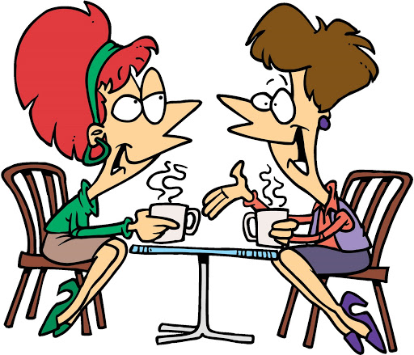
Both of them drink tea .. both of them are women..
Both of them talk fast.
Both of + them + v/be (plural)
يعامل معاملة الجمع

Slide 4
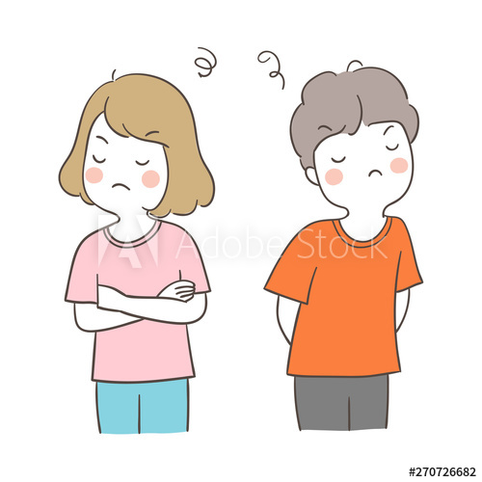
Are they look happy ?
Are they talking together?
Neither of them is happy.
Neither of them talks to each other

Slide 5


.
Neither of them studies hard.
Neither of them is awake .
Not one
Neither of + them + v-s /be(singular)
معاملة المفرد

Slide 6
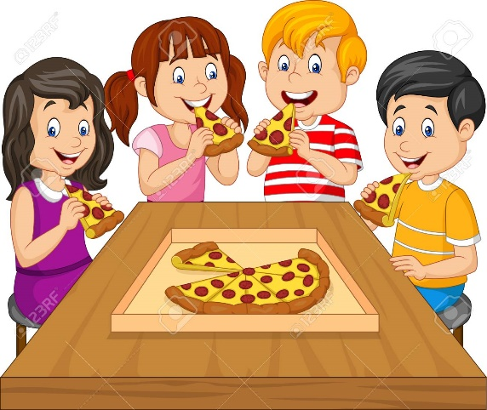
2- All and None
( three or more )
How many kids are there ?
What are they doing?
All of them eat Pizza
All of them are hungry.

Slide 7
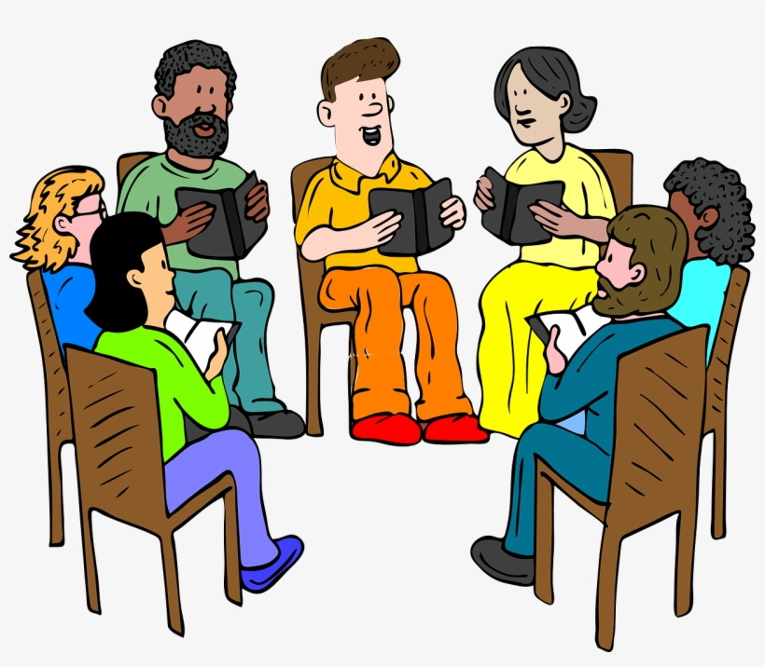
.
All of them read books.
All of them are busy .
معاملة الجمع
all of + them + v /be (plural)

Slide 8
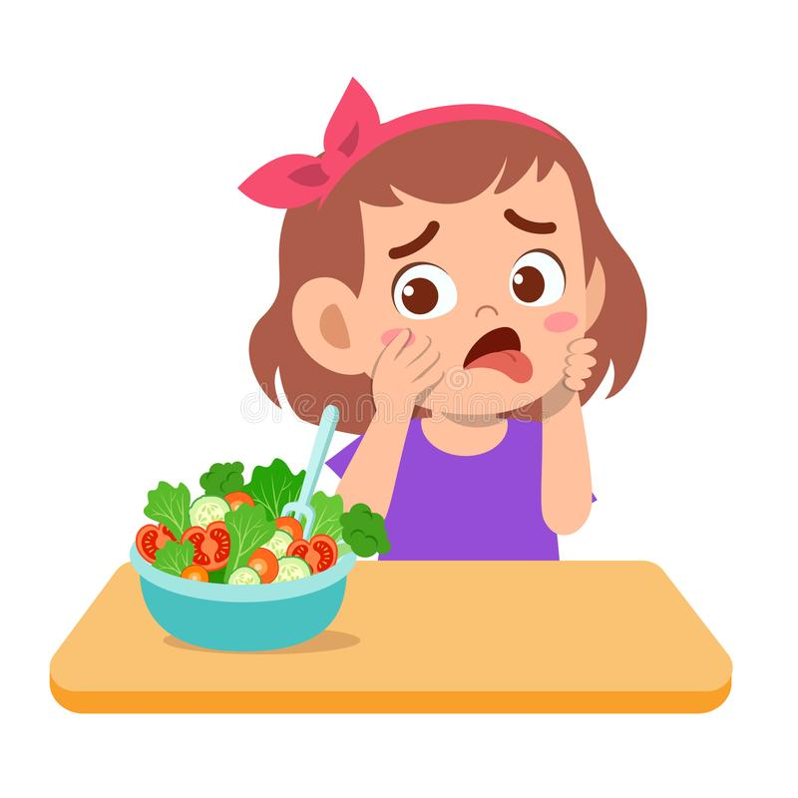
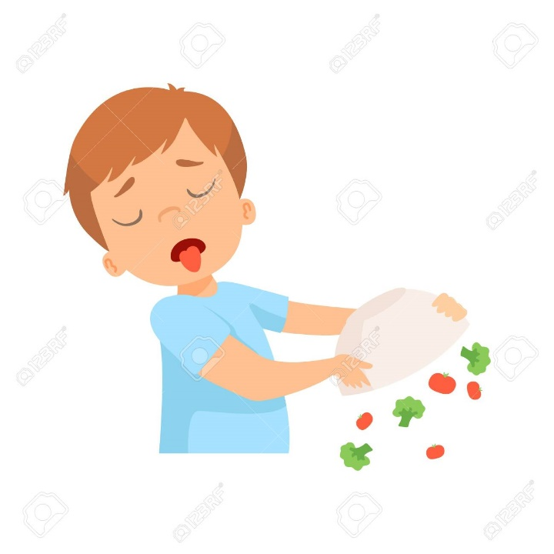
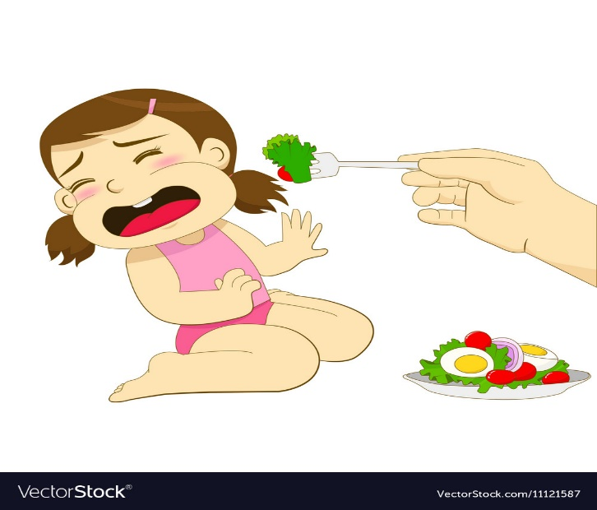
..
None of them like salad.
None of them are healthy .
معاملة الجمع
None of + them + v /be(plural)

Slide 9
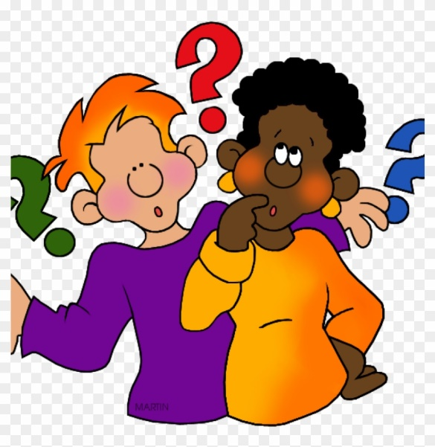
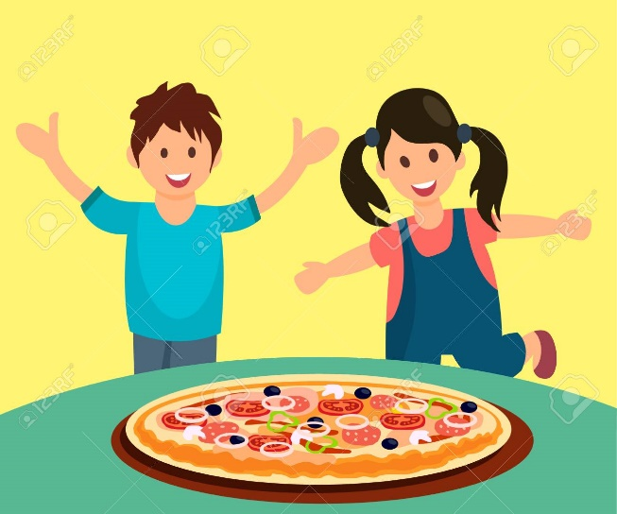
Let’s make sentences!!!
Use Neither/understand .
……………………………………………………………………………..
Use Both / eat:
…………………………………………………………………………………

Slide 10
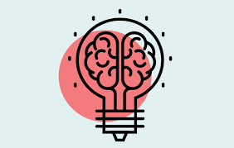
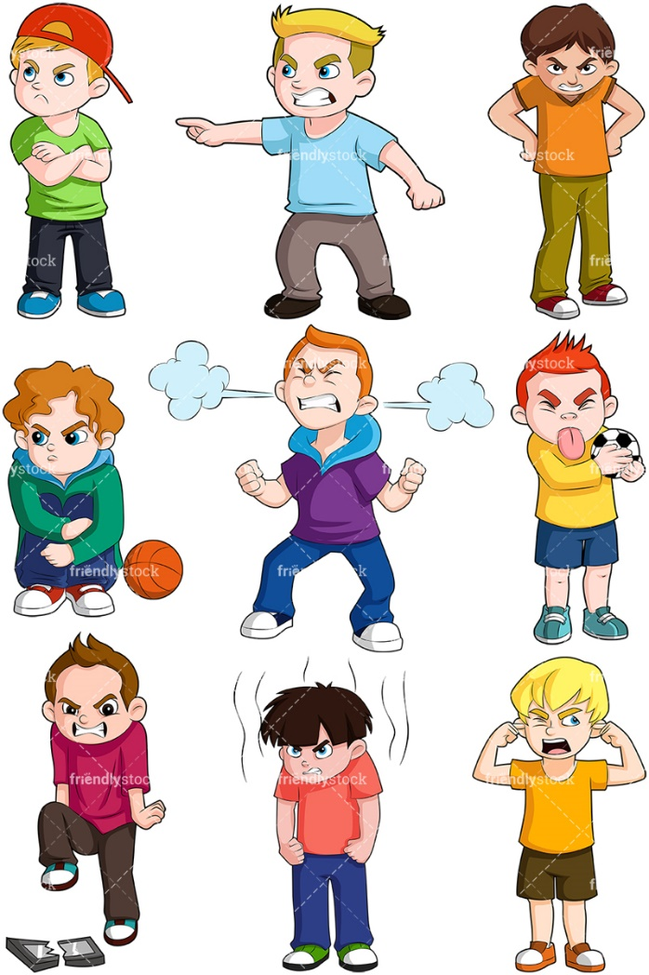
Use all / be angry
……………………………………………
Use none/ play
……………………………………………………………………………..

Slide 11
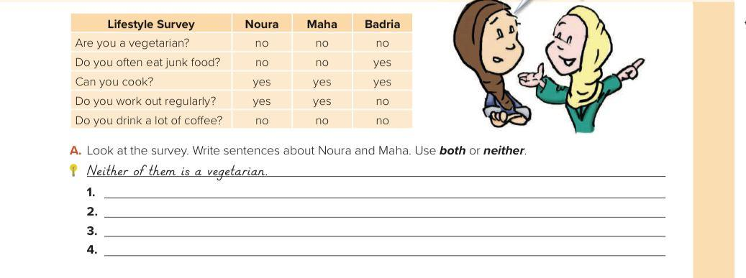
Open your book .. p 11
2 yes both
2 no neither
Neither of them is vegetarian

Slide 12

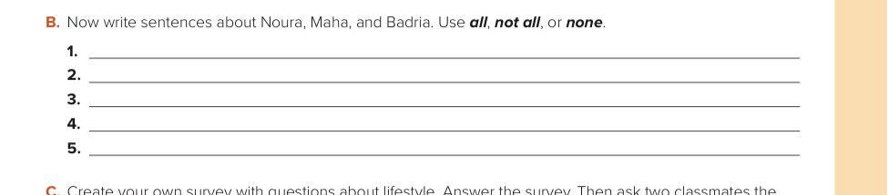
3 yes all
3 no none
None of them are vegetarian

Slide 13
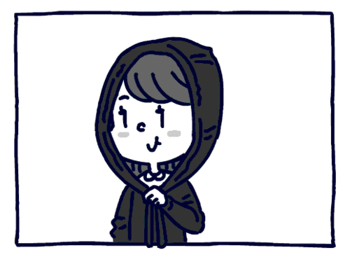
Have a nice day…
Tr : Kholoud AlGhamdi

