Slide 1
Lifestyles
Reading & Project

Slide 2
Lifestyles
Objectives:
Answer some comprehension questions
Find out the meaning of some words

Slide 3


Slide 4
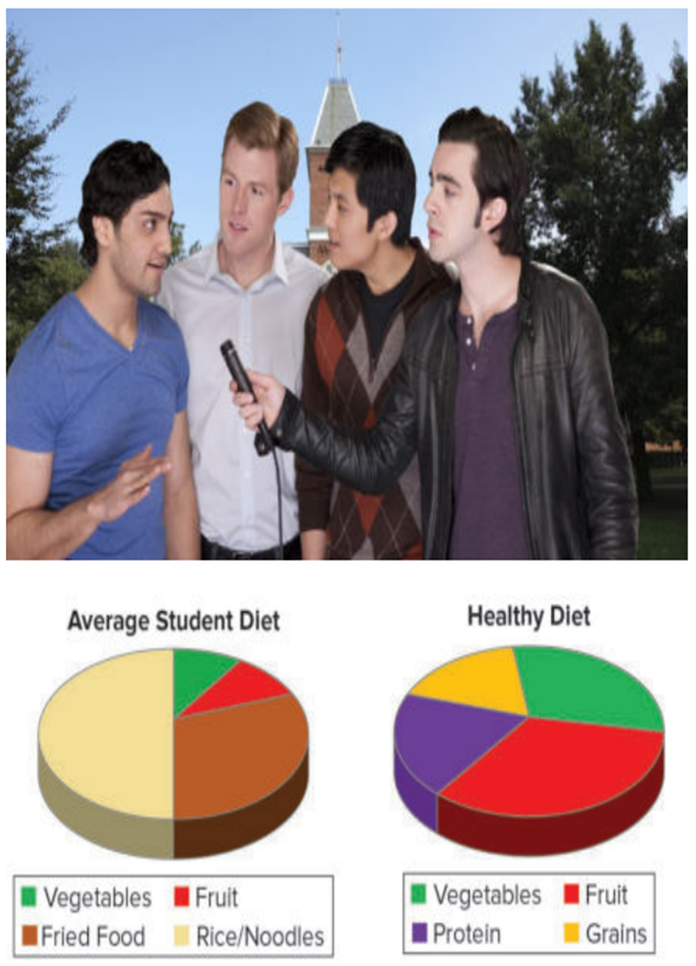
Who are the people and what are they doing?
What do you think the interview is about?
What is the graph about?
What do you think the article will say about college students?

Slide 5
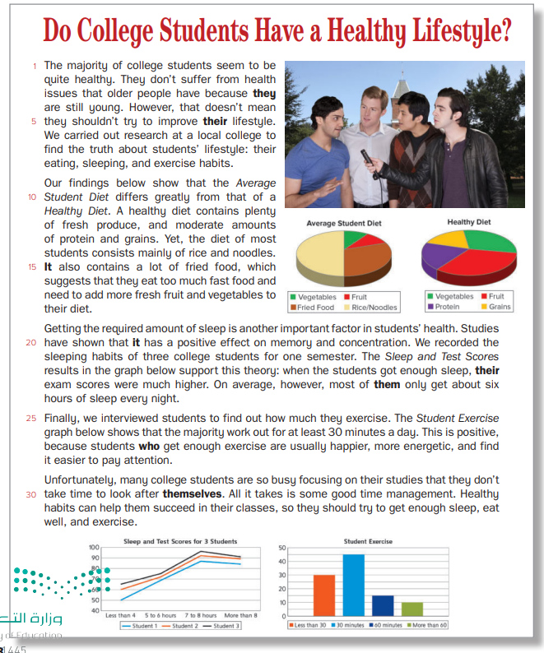
P. B. P. 8

Slide 6
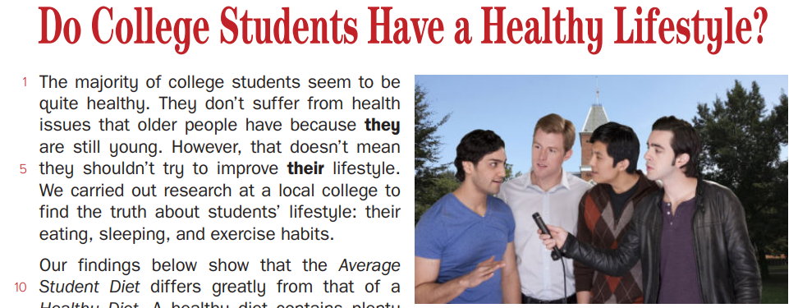

* Where was the research carried out?
at a local college
* What three aspects of students’ lifestyle did the research focus on?
their eating, sleeping and exercise habits

Slide 7
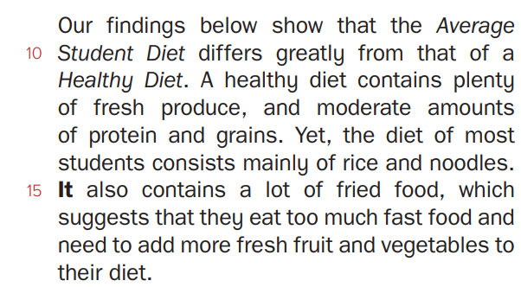
What does a healthy diet contain?
lots of fresh fruit and vegetables and moderate amounts of protein and
grains.
What does the Average student diet consist of?
mostly rice, noodles, and fried food, with a small amount of fruit and vegetables
What is missing from the Average Student Diet?
fresh fruit and vegetables

Slide 8
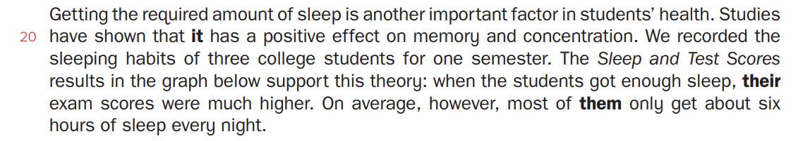
Put [ T ] or [ F ]:
Getting the required amount of sleep has a positive effect on memory and concentration.
The graph about Sleep and Test Scores Compare how the number of hours of sleep affected the test scores of 4 students.
Most students get on average of 9 hours of sleep.
T
F
F

Slide 9

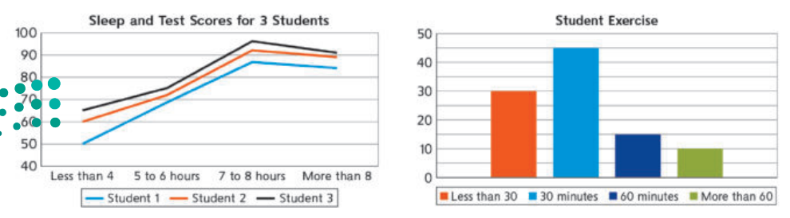
Match the questions with the answers
1. According to the graph about Student Exercise, what percentage of students worked out for 30 minutes or more per day?
-They feel happier, more energetic, and find it easier to pay attention.
3
2. How many exercised for less than 30 minutes per day?
1
-70 percent
3. What are the benefits of getting enough exercise for students?
2
-30 percent

Slide 10
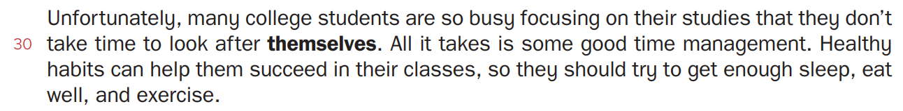
Complete the following:
Many college students are so focused on their studies that they don’t look after their ……………… .
Healthy habits can help students succeed in their …………………… .
health
classes

Slide 11

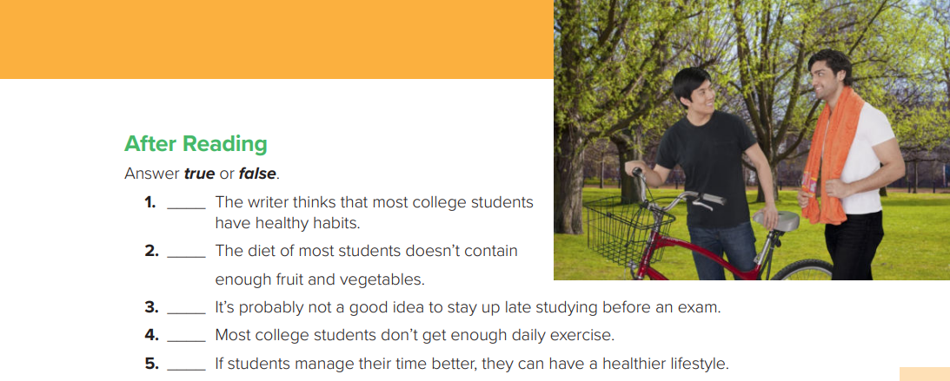


P. B. p 9
F
T
T
F
T

Slide 12
Match the following correctly:
A
B
1. contain
2. percentage
3. concentration
4. popular
5. majority
3
a- focus
b- division / part
c- most
d- have / include
2
4
1
Now, use them in sentences

Slide 13
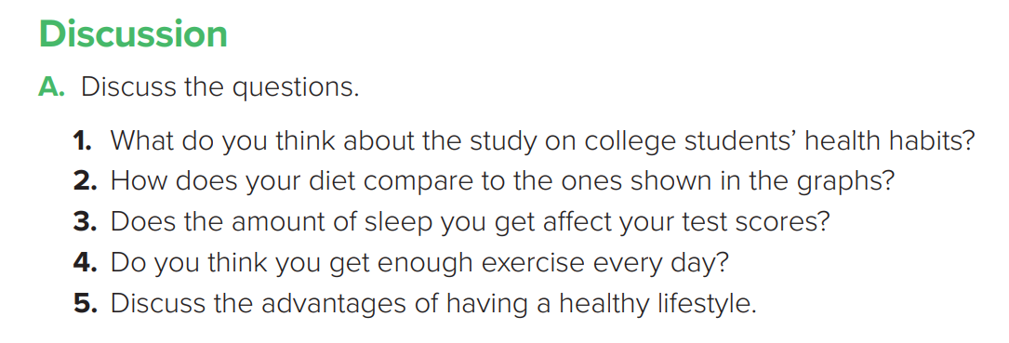
P. B. P. 9

Slide 14
B. Read and discuss
Many studies agree that certain foods can boost brain power and memory. These include oily fish (tuna, salmon, sardines), green vegetables (spinach, kale, broccoli), berries (blueberries, blackberries, strawberries), and dark chocolate.
What do you think?
What other foods do you know about that are beneficial and in what ways?
P. B. P. 9

Slide 15

P. B. P. 9

Slide 16


