Slide 1


Super goal 3
Unit 1
Lesson 6 form , meaning & function
اعداد المعلم / يحيى المنقري متوسطة المأمون بالهفوف

Slide 2

Learning Objectives
*By the end of this lesson, Ss will be able to:
1- Practice describing a location.
2- Ask for directions

Slide 3
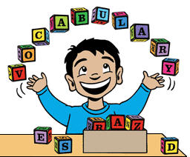

Slide 4








On
Between
Next to
Across
Near
Far

Slide 5
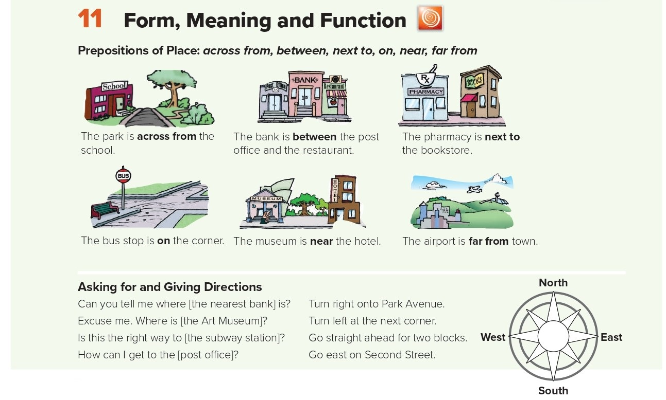

Slide 6
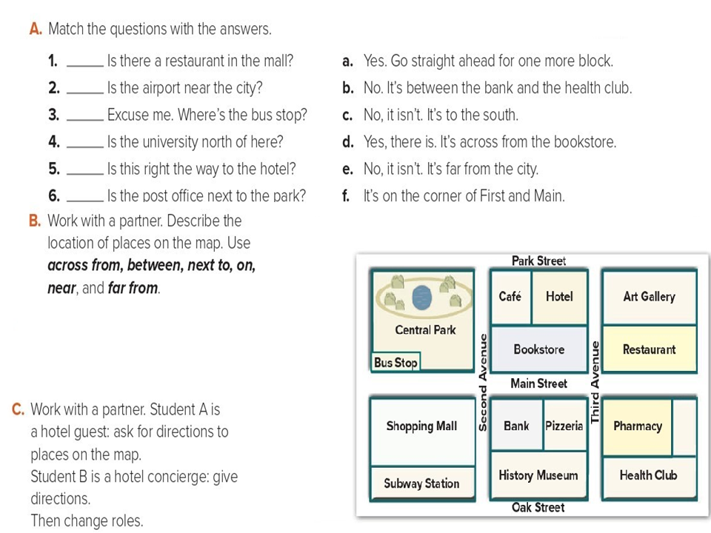
d
e
f
c
a
b
B - Answers will vary. Sample answers:
1-The café is next to the hotel.
2-The pizzeria is between the bank and the pharmacy.
3-The bus stop is across from the shopping mall.
4-The restaurant is near the hotel.
C- answers

Slide 7
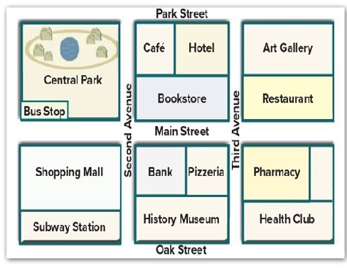
C- Answers will vary. Sample answers:
A: Can you tell me where the subway station is?
B: Go west on Park Street. Turn left onto Second Avenue. Go straight for two blocks. It’s next to the shopping mall.
A: Excuse me. Where is the History Museum?
B: Go straight on Third Avenue. Then turn right onto Oak Street.

Slide 8
Choose the correct answer :
1-
2-
Between
in
Under
on
3-
4-
Across
Over
Behind
Next to

Slide 9


Slide 10


Back

Slide 11


Back

