Slide 1


Super goal 3
Unit 1
Lesson 4 reading
اعداد المعلم / يحيى المنقري متوسطة المأمون بالهفوف

Slide 2

Learning Objectives
*By the end of this lesson, Ss will be able to:
1- Find the meaning of new words through the text.
2- Match the main ideas in the text with its paragraph.
3-Answer questions about the text.

Slide 3
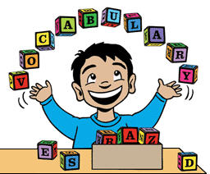

Slide 4
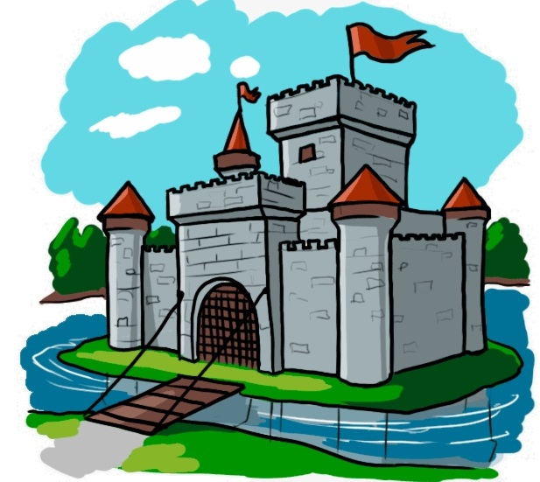
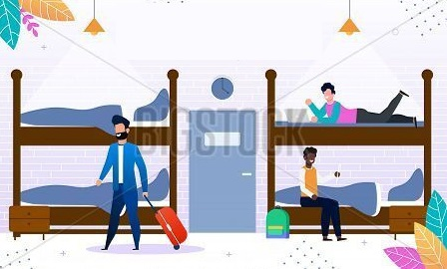
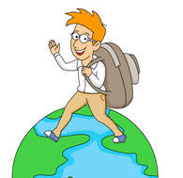


Backpacker
Youth hostels
Castle

Slide 5
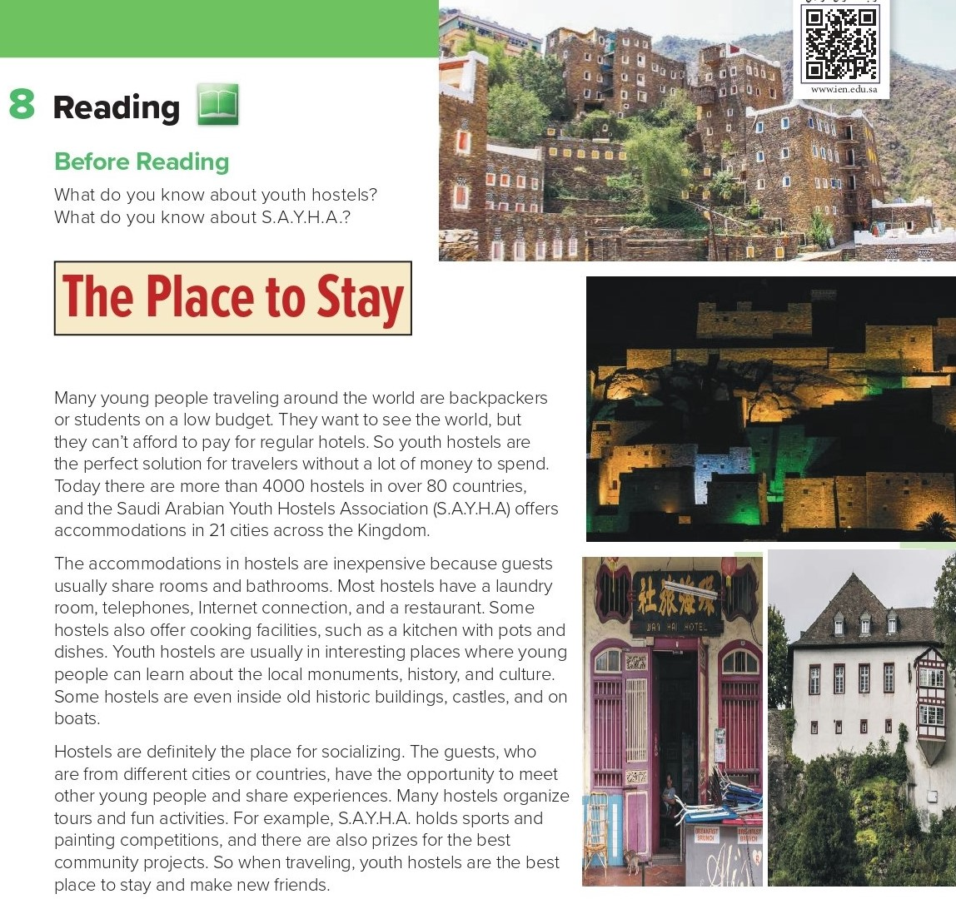

Slide 6
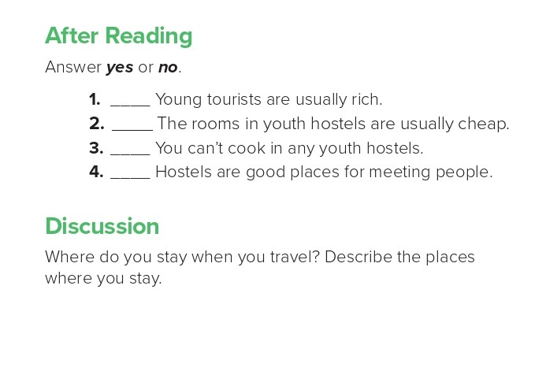
no
yes
no
yes
I go to Rome with my family. Rome is fantastic. We go by plane and stay in a nice hotel. We do lots of exciting things in Rome. We got for long walks. The parks in Rome are huge. At night, we usually eat in amazing restaurants. The food is delicious! Rome is a beautiful place to visit.

Slide 7

Choose the correct answer :
1-
Many young people travelling on low budget
TRUE
FALSE
2-
You can’t cook in any youth hostels.
TRUE
FALSE
3-
4-
Castle
Hotel
Palace
Youth hostel

Slide 8


Slide 9


Back

Slide 10


Back

