Slide 1

Unit : 1
Lifestyles
Language in context

Slide 2
Objectives
1
Interview partner about internet
2
Write correct sentences about someone’s routine

Slide 3
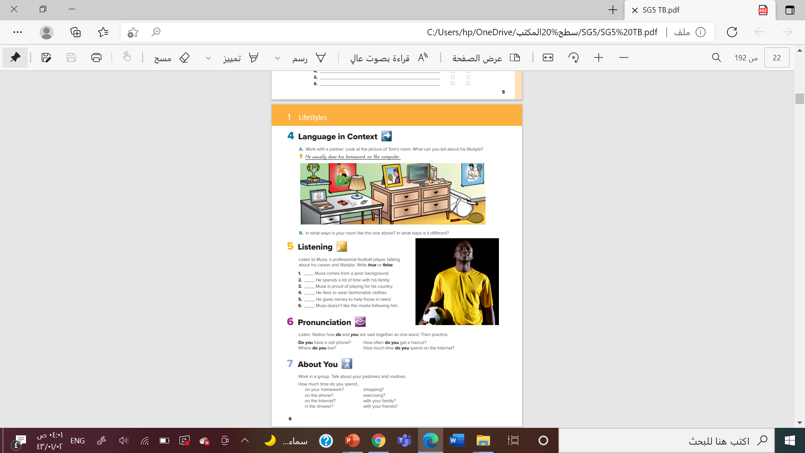

@ page 6

Slide 4
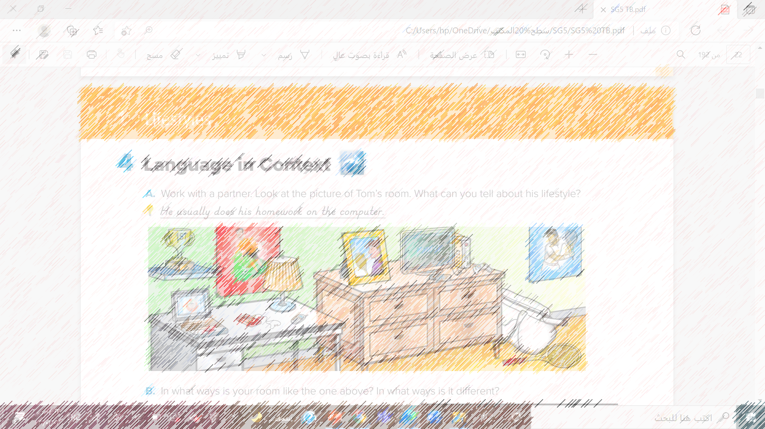
Do you think it’s a girl’s or boy’s room?
Why?
? How old do you think the person is?
Why ?
What can you say about the person’s lifestyle?

Slide 5
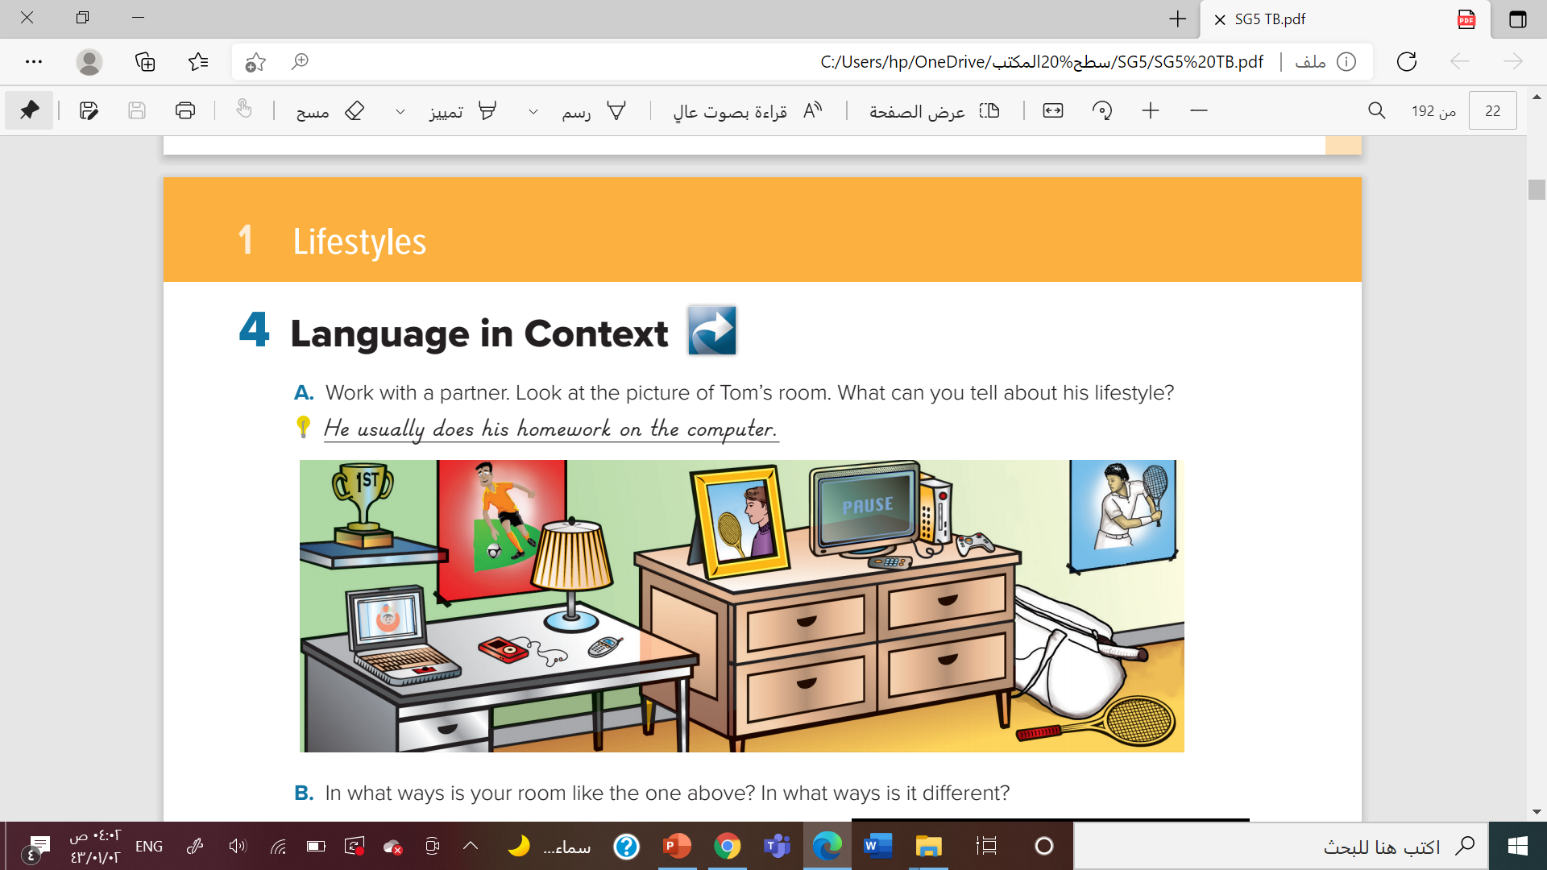
He likes football.
He plays computer games
He plays tennis
He sends text messages.
He has a trophy
He likes tennis a lot
I haven’t posters on the wall.
My room is neat

Slide 6
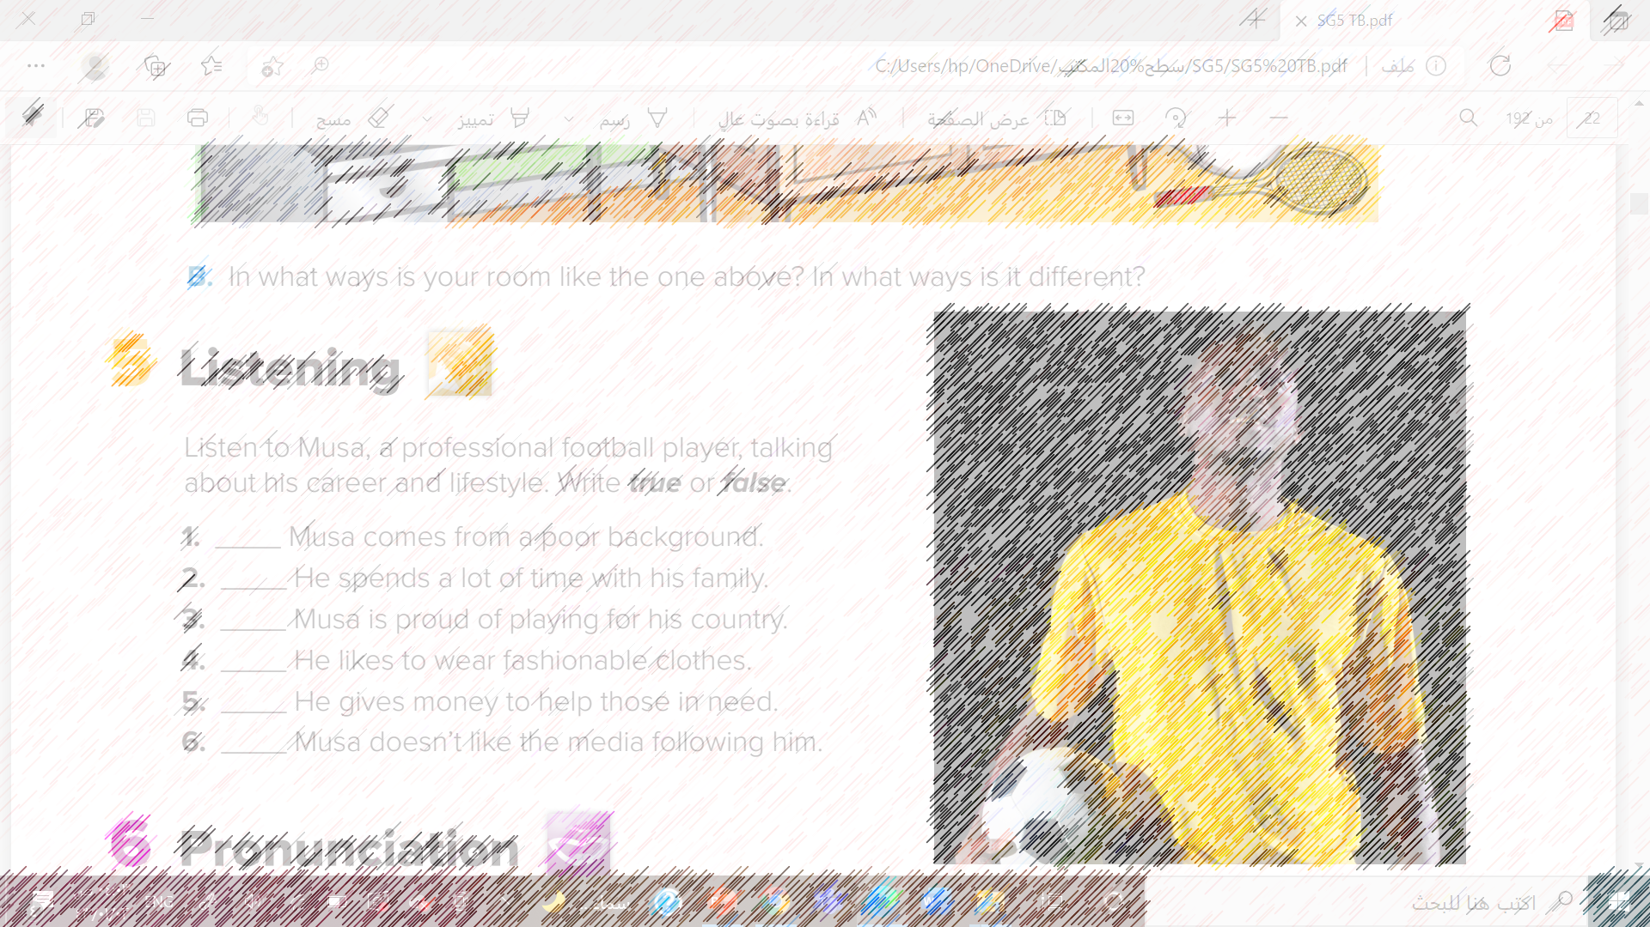


Who is the man?
Where is he from?
What is his everyday life like?
What do you think his lifestyle is like?

Slide 7
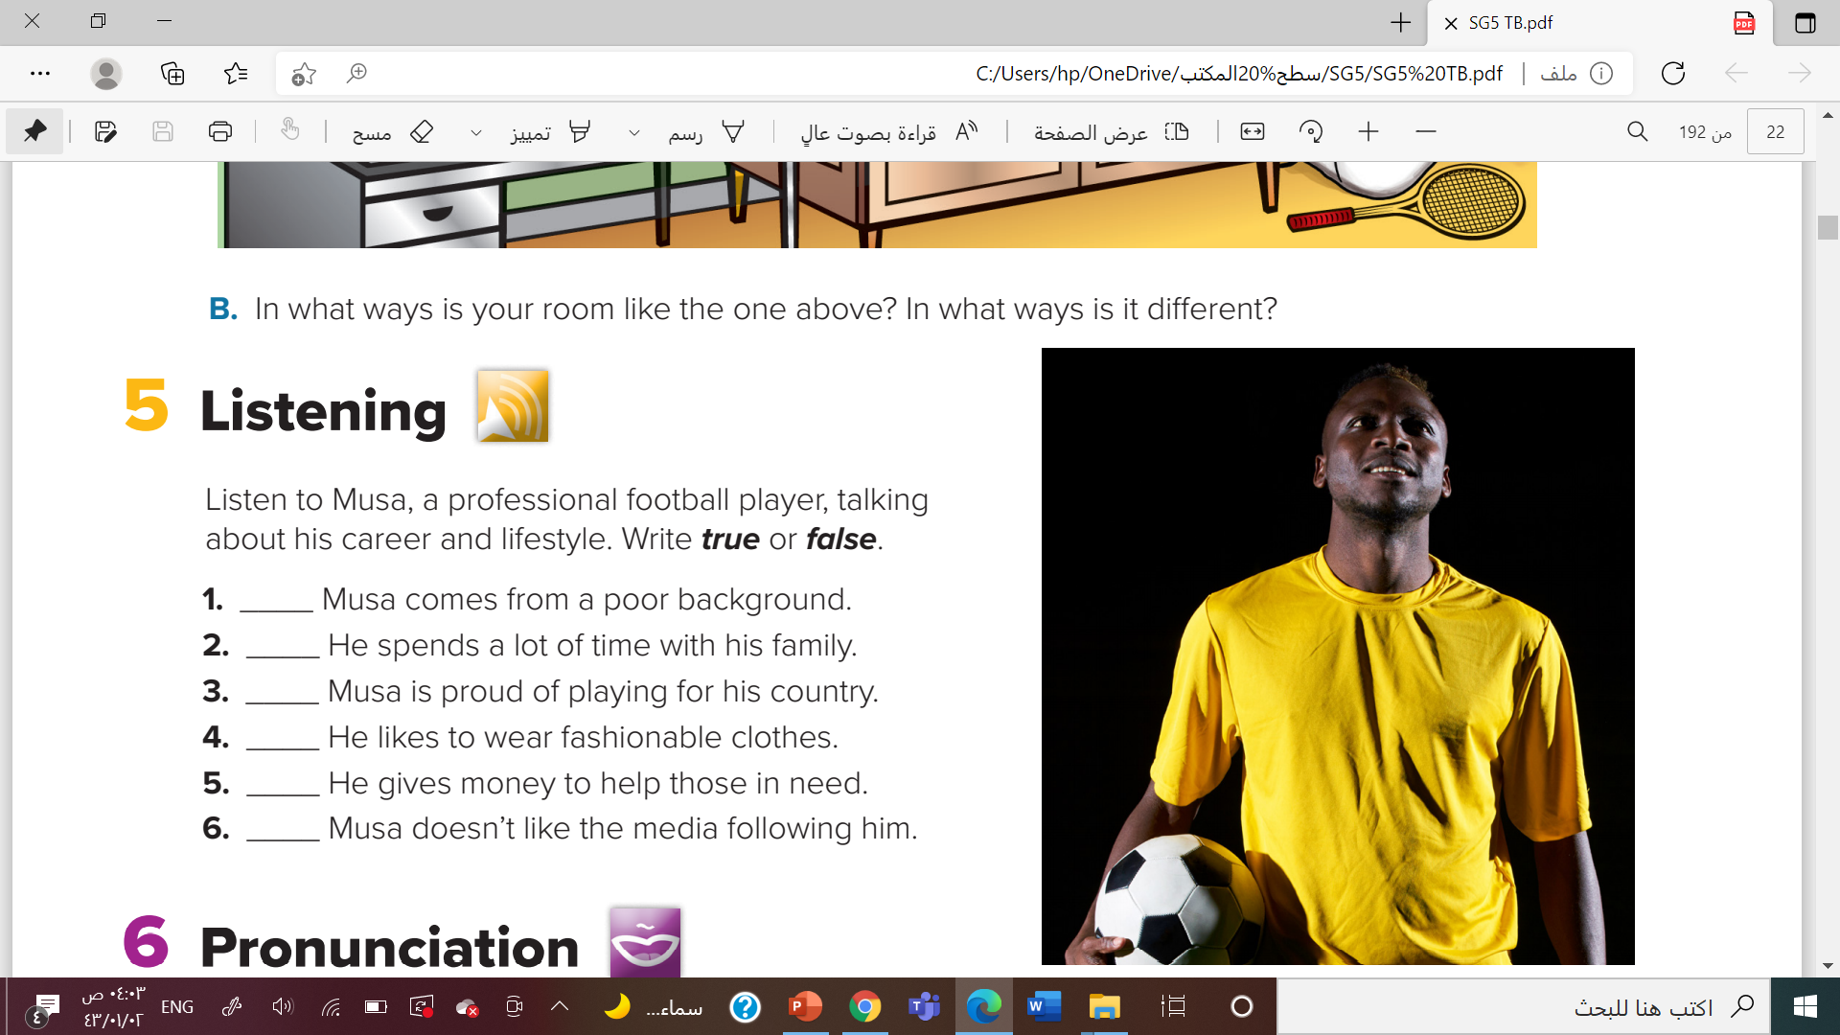

false

Slide 8
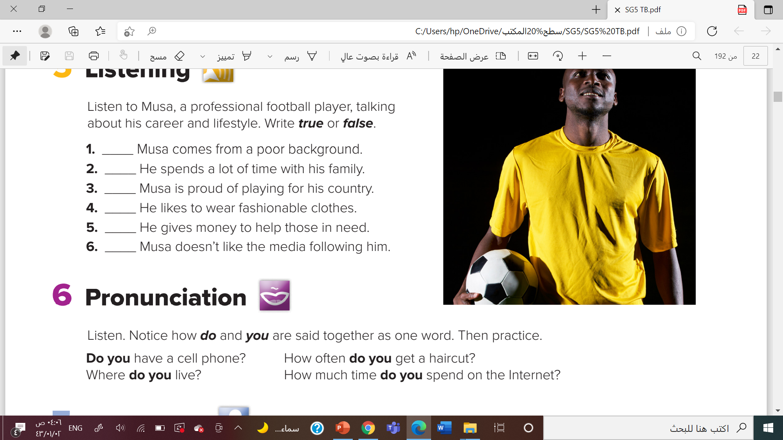

Slide 9
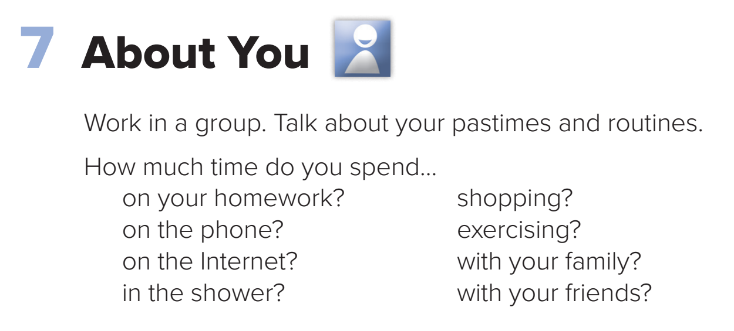


Slide 10




Slide 11


