Slide 1

Unit : 1
Lifestyles
Conversation
By: ET Asma Almjlad

Slide 2
Objectives
1
Read the conversation correctly
2
Answer the questions in their books

Slide 3


Slide 4
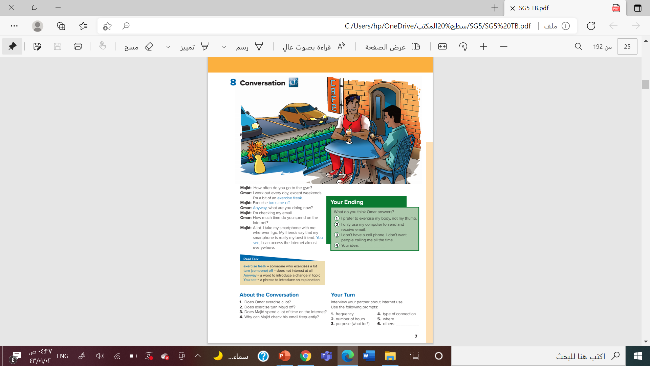

@ page 7

Slide 5
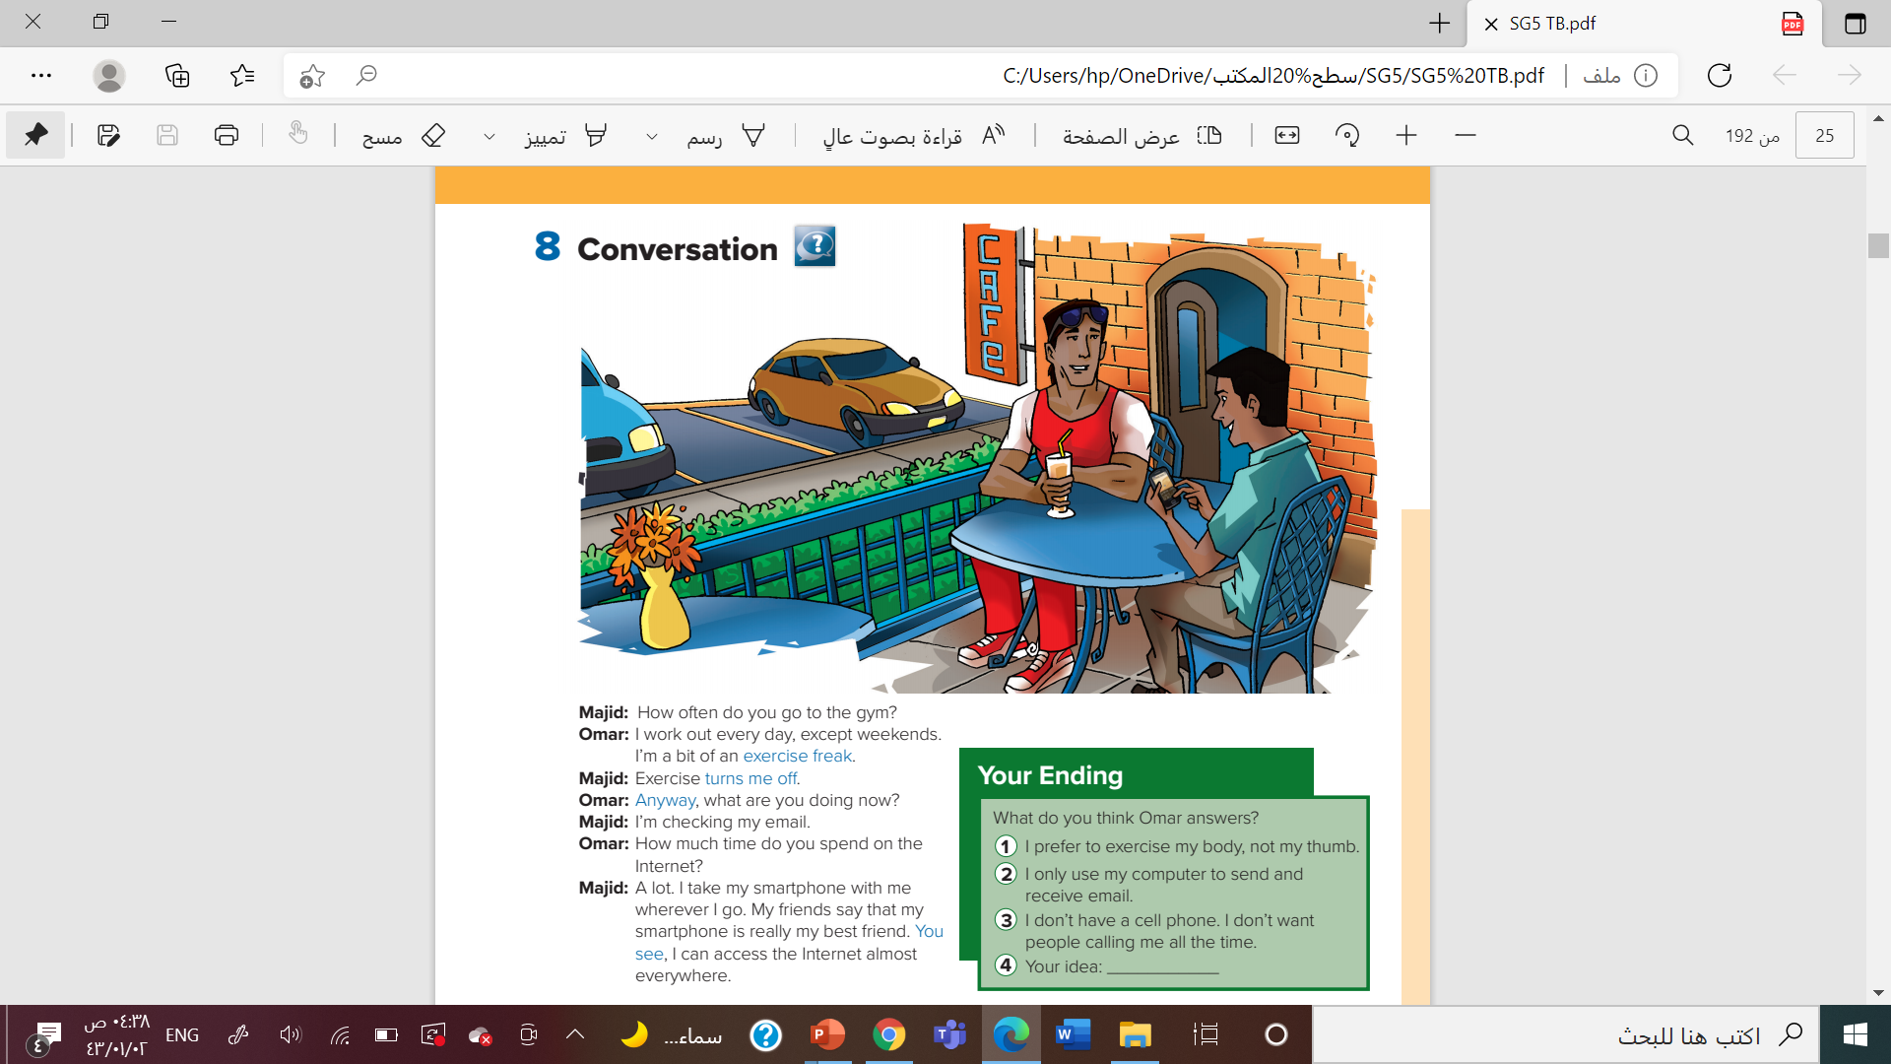



listen

Slide 6
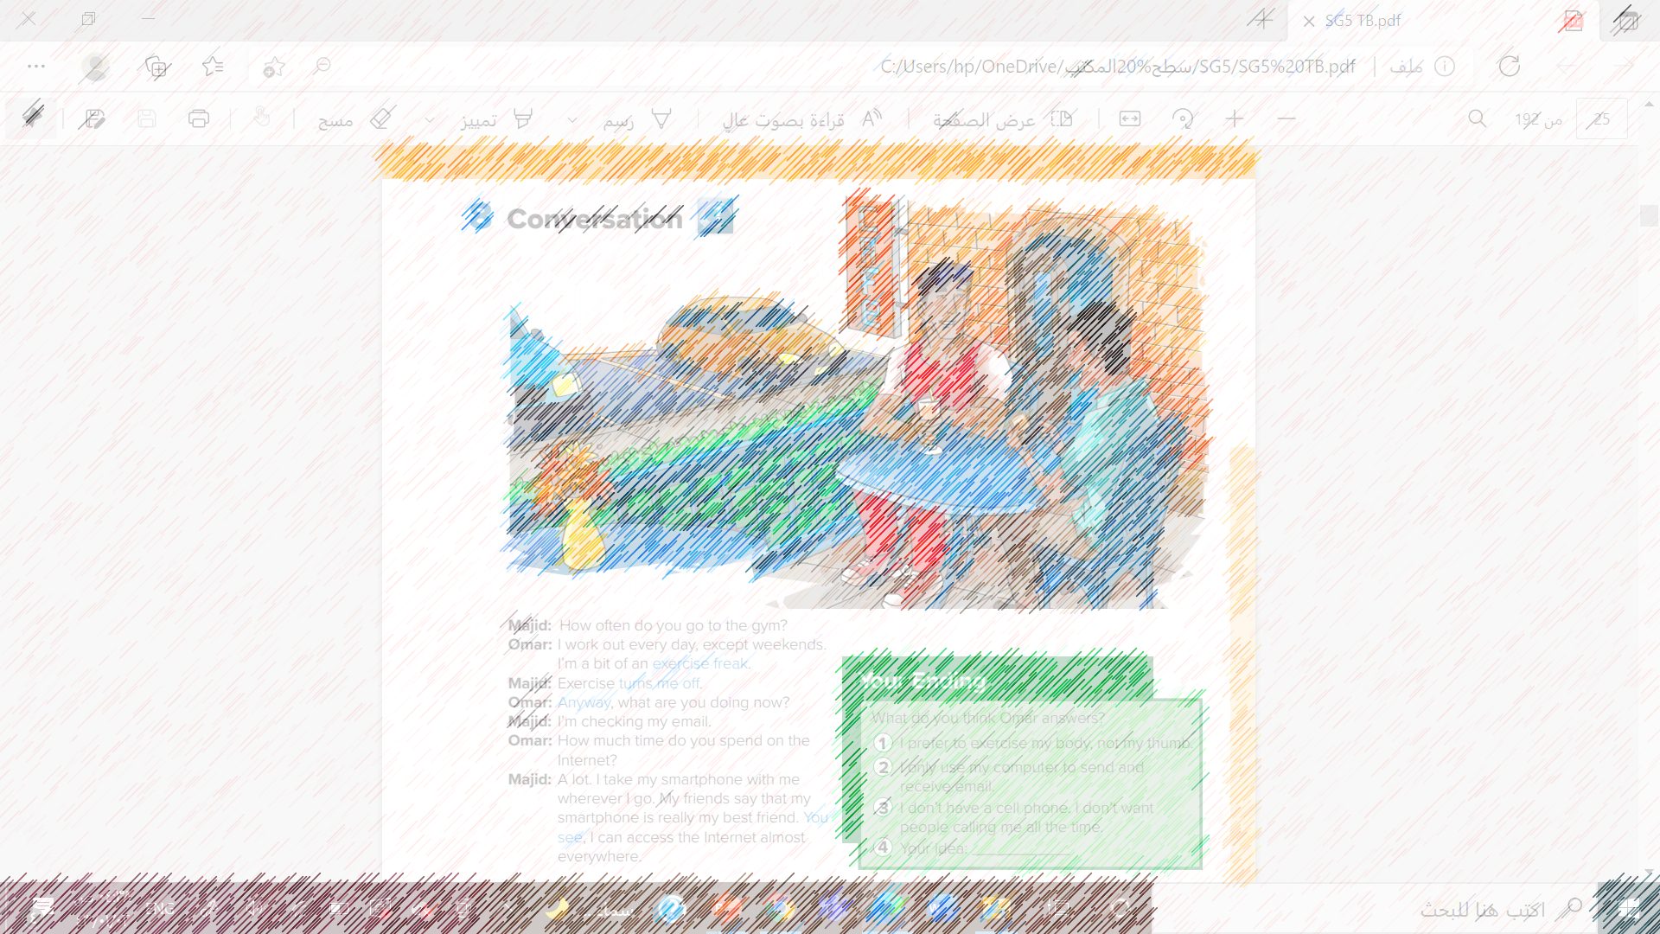
How many characters in this conversation?
Who are they?
What is the young man on the left wearing?
What does that tell you about his lifestyle?
What is the other young man doing?

Slide 7
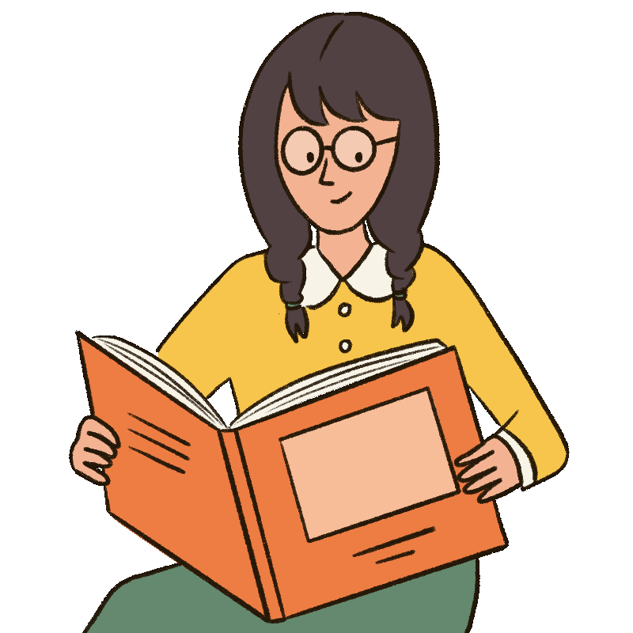
read

Slide 8
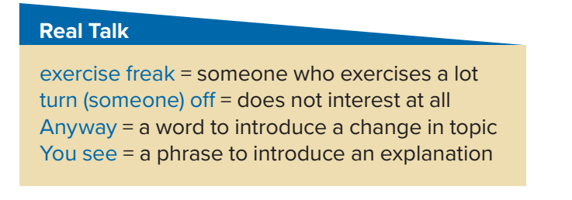
Who is an exercise freak?
What is an exercise freak?
What turns Majid off?
Does he like it or not?
Who says Anyway?
What do they talk about afterwards?
Who says You see?
What does Majid explain after he says this?

Slide 9
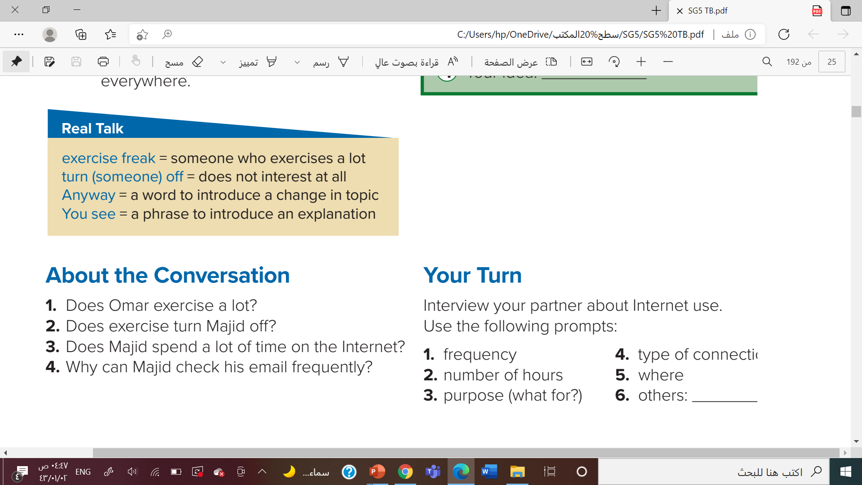
1. Yes, he does. He works out every day except weekends.
2. Yes, it does.
3. Yes, he does
4. He has a smartphone, and he can access the Internet almost everywhere.

Slide 10
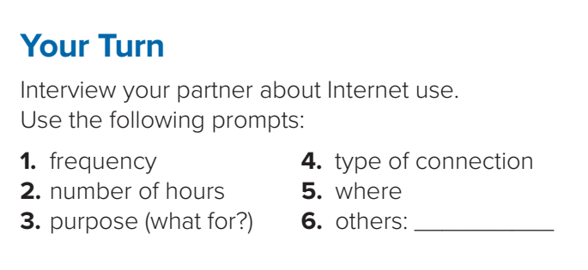
How important is the Internet in your life?

Slide 11

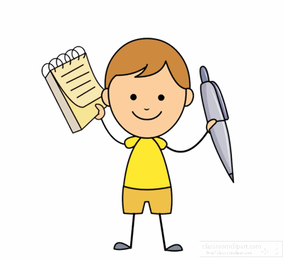


Slide 12


