Slide 1

Unit : 1
Lifestyles
Grammar
By: Nora Khalid

Slide 2
Objectives
1
Write correct present simple questions and answer
2
Use adverb of frequency correctly
3
Compare the present simple sentences

Slide 3
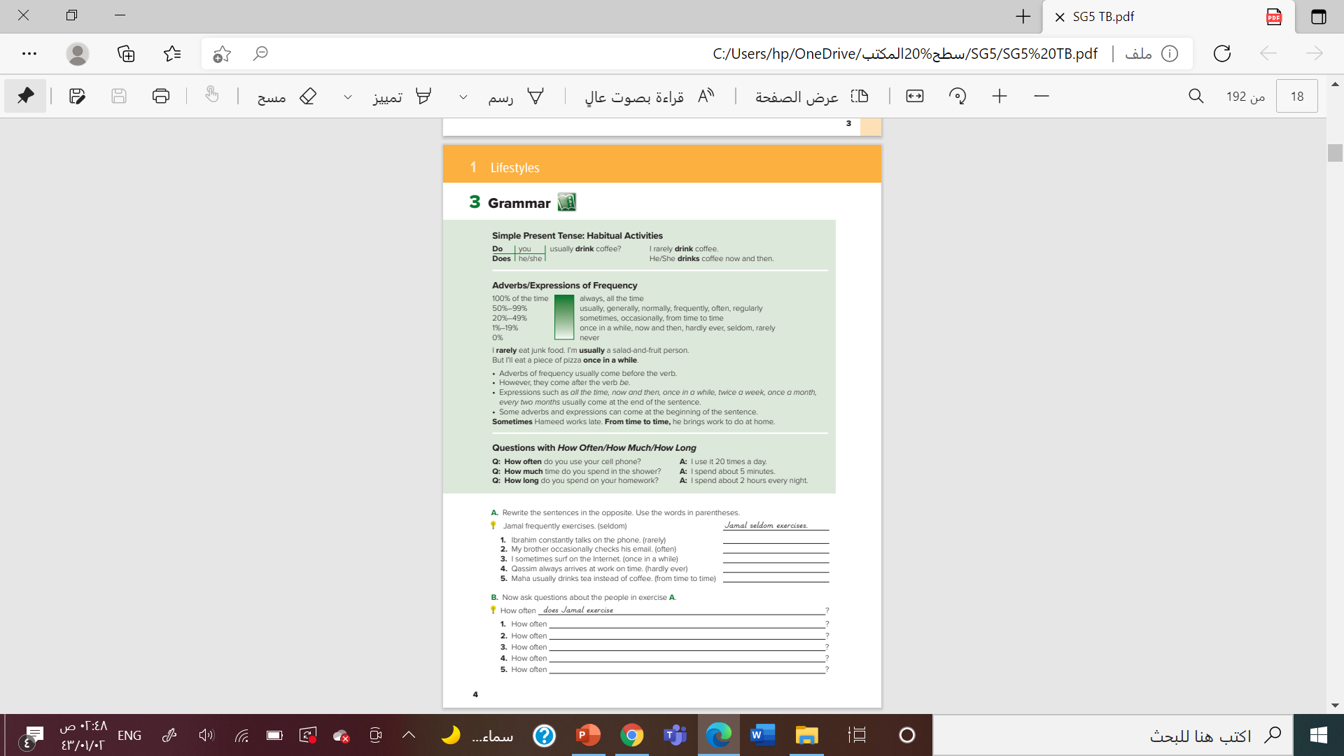
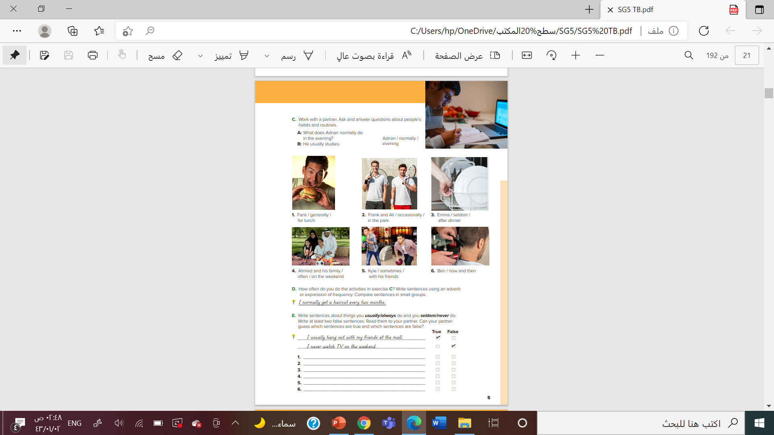

Slide 4
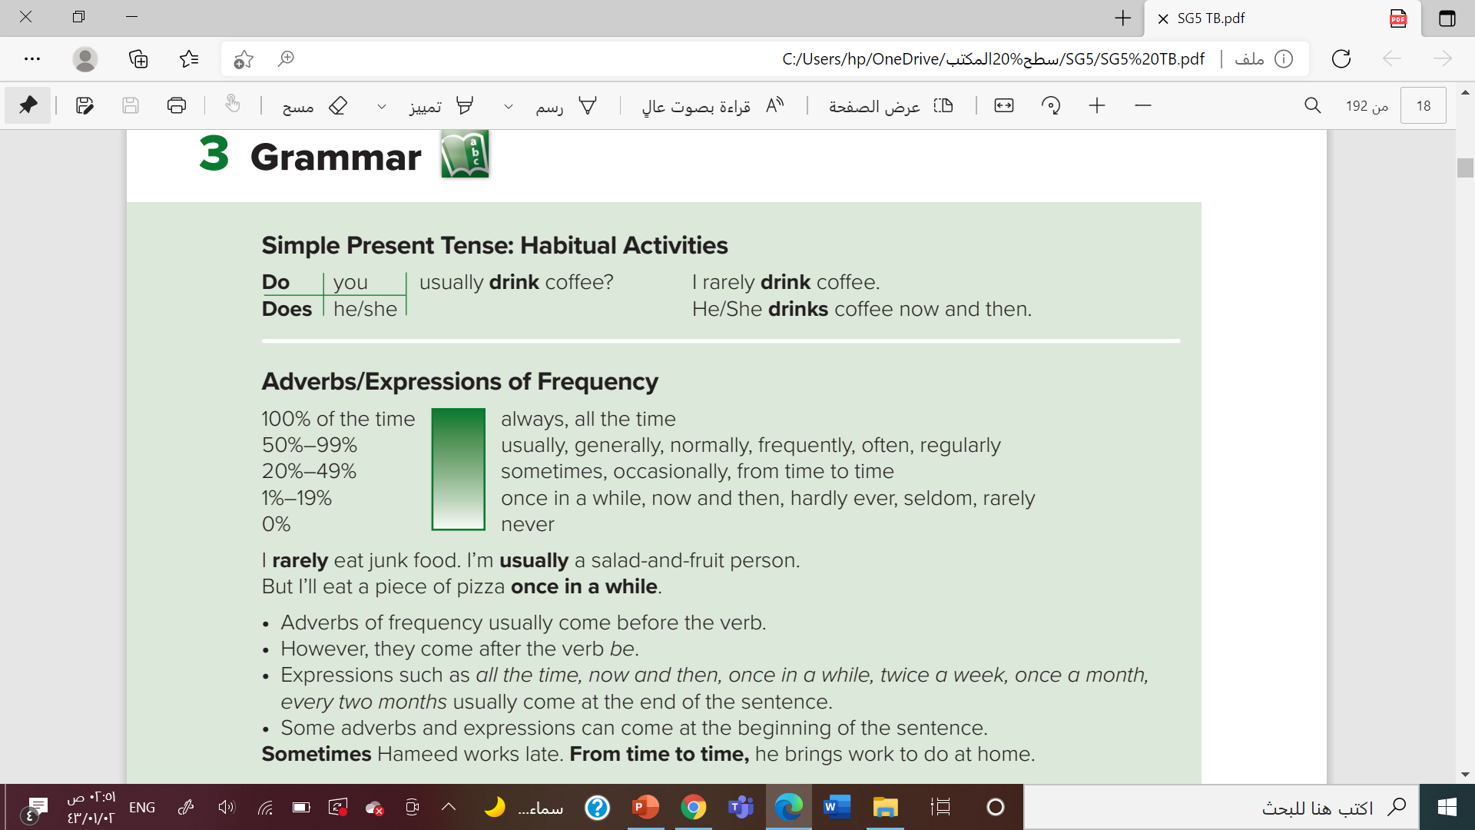
She ( don’t – doesn't - isn’t ) play tennis

Slide 5
Omar (play- played – plays ) football twice a week
I usually (work – works –working )in bank
She rarely ( read – reads – reading ) books
She ( don’t – doesn't - isn’t ) play tennis

Slide 6


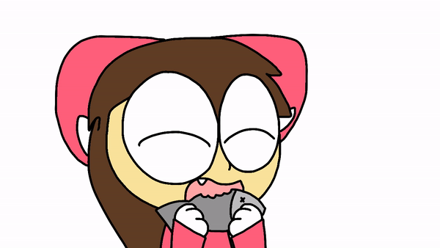
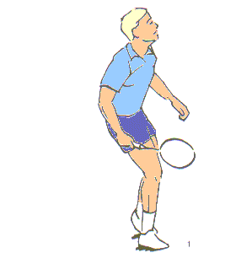
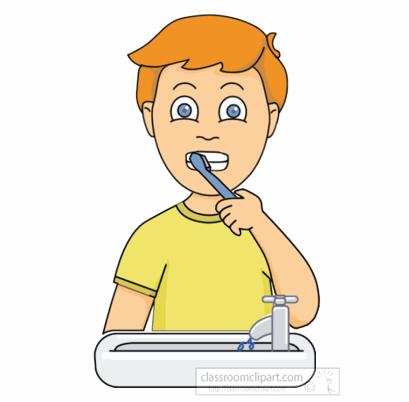
Do you usually drink coffee ?
Do you usually eat fish ?
Do you usually play tennis ?
Do you usually brush your teeth ?

Slide 7
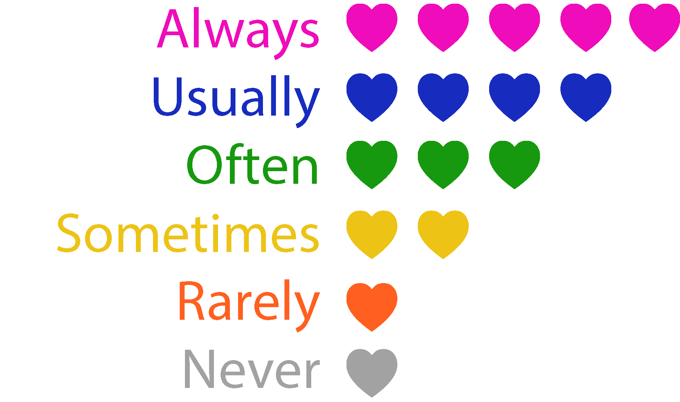

Slide 8
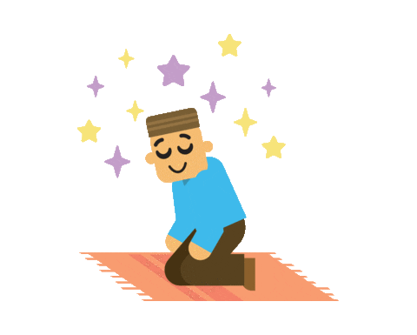
I always pray
I usually read the Holy Quran
I often help my Mom
I sometimes play football
I never disobey my parents

Slide 10

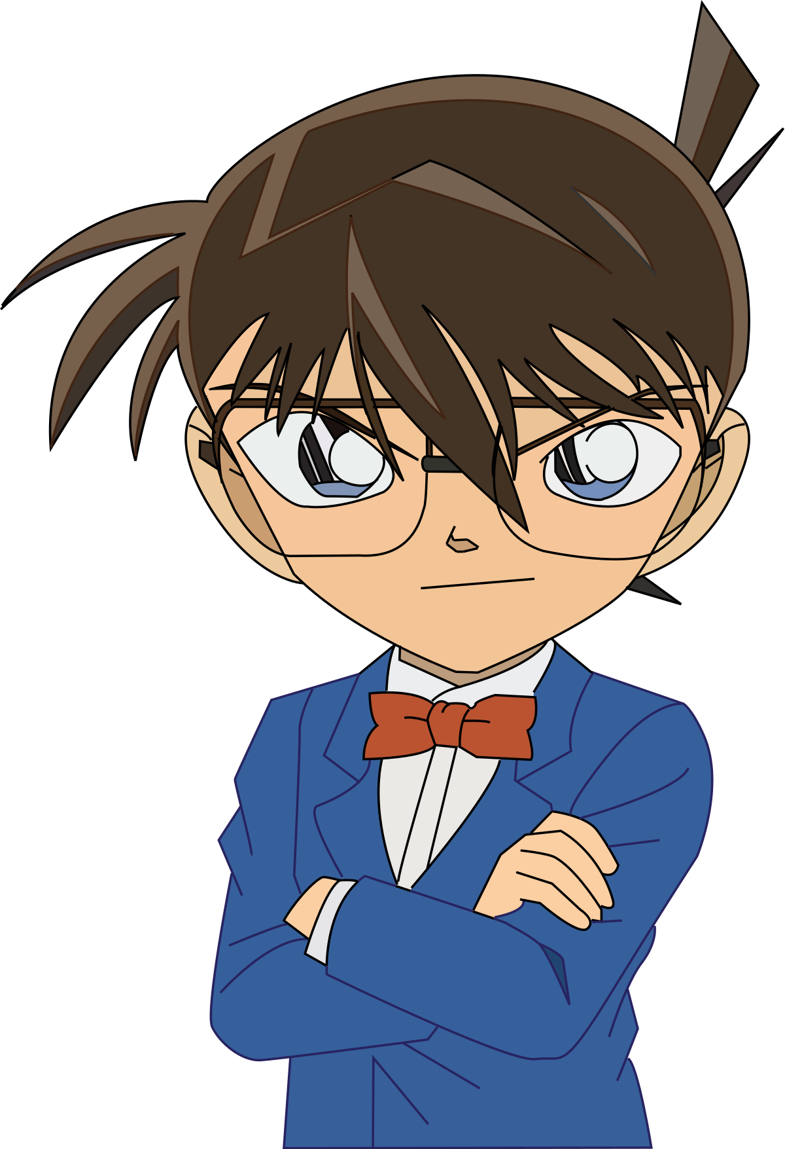
Find the fib
Sara eat never junk food

Slide 11
Find the fib
Always Omar check his email

Slide 12
Find the fib
They from time to time arrive at work on time

Slide 13
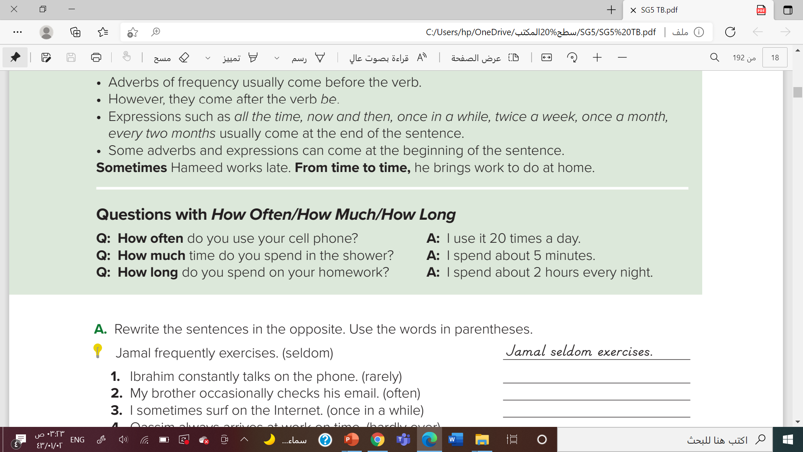

Slide 14
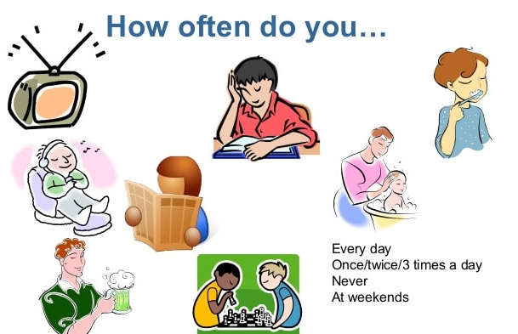

Slide 15
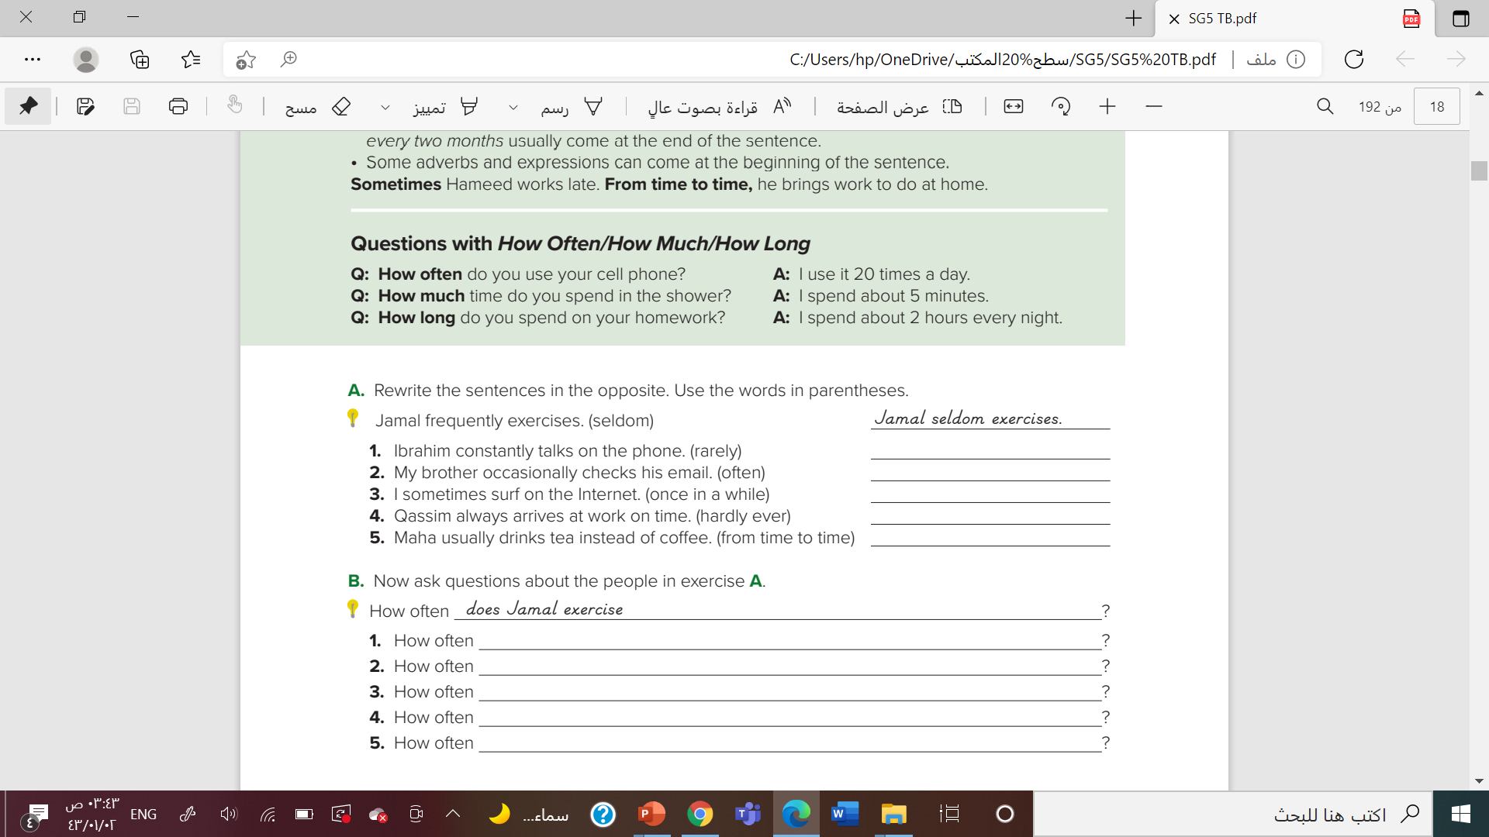
Ibrahim rarely talks on the phone.
My brother often checks his email.
I surf on the Internet once in a while.
Qassim hardly ever arrives at work on time.
Maha drinks tea instead of coffee from time to time.

Slide 16
does Ibrahim talk on the phone?
does your brother check his email?
do you surf on the Internet?
does Qassim arrive at work on time?
does Maha drink tea instead of coffee?

Slide 17
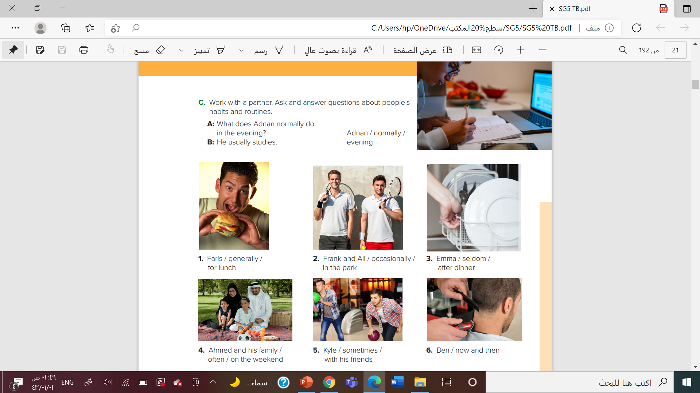

Slide 18
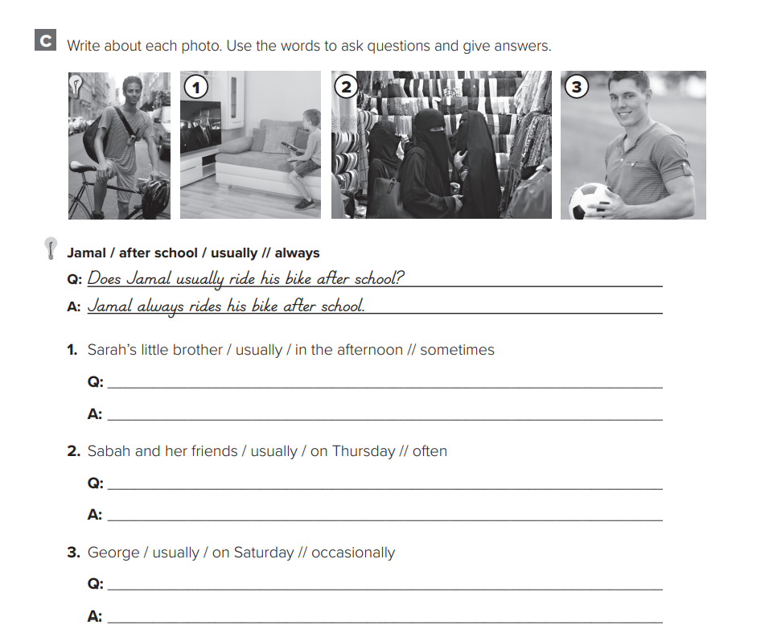

Slide 19
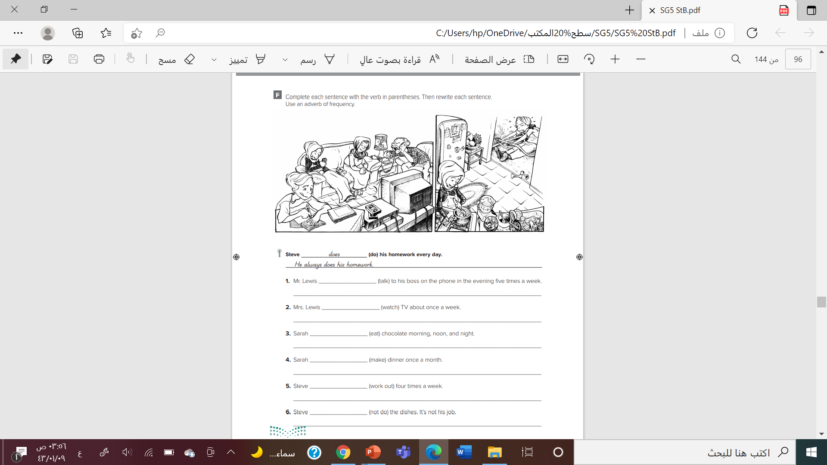

Slide 20

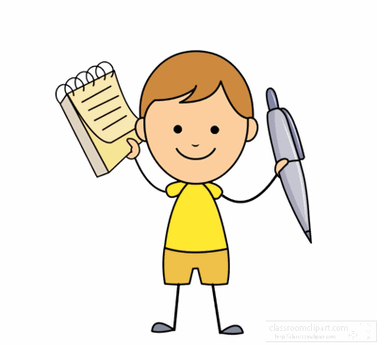


Slide 21


