Slide 1

Unit : 1
Lifestyles
Listen and discuss
By: Nora Khalid

Slide 2
Objectives
1
Recognize adverbs of frequency
2
Assemble someone’s routine
3
Practice asking someone about their routine

Slide 3
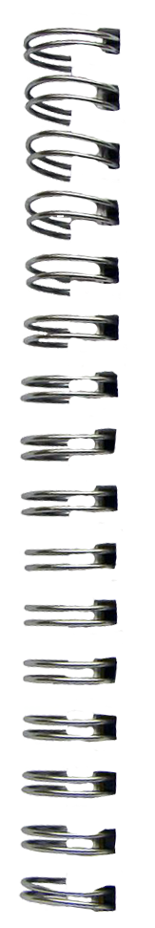


New Words

Slide 4
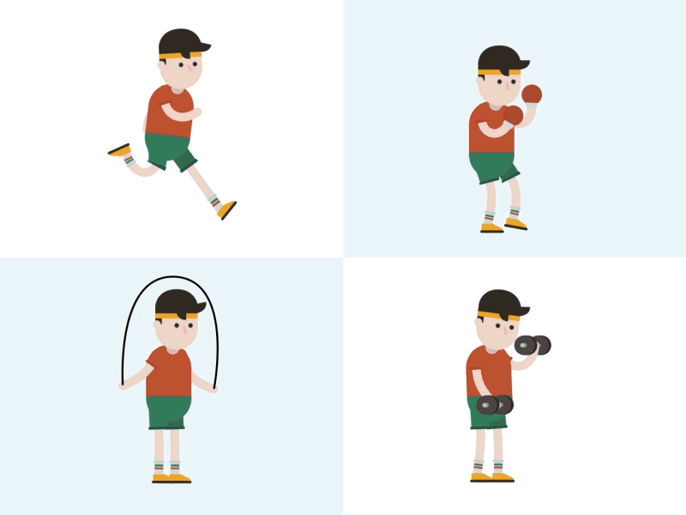

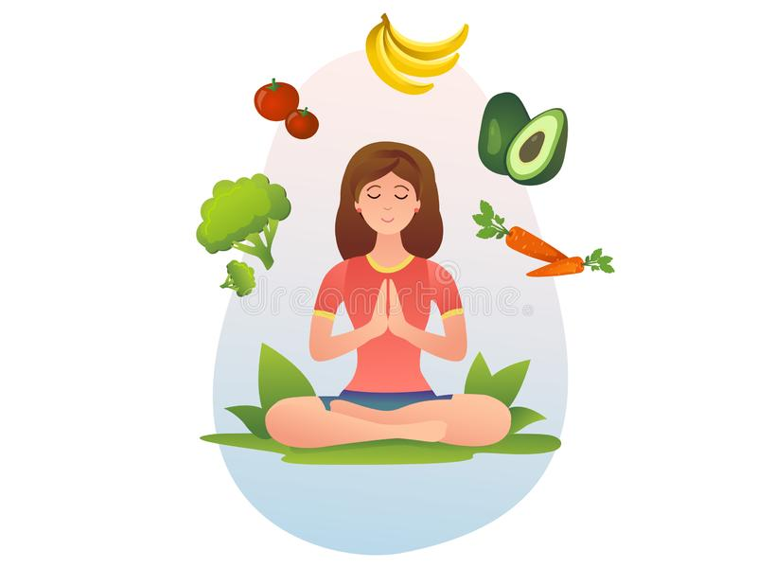
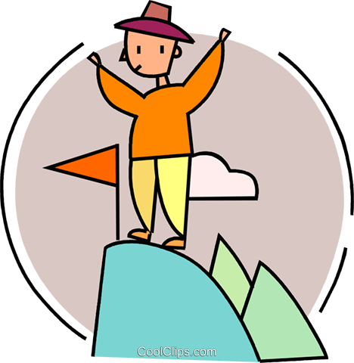
herbal tea
fitness
challenge
vegetarian

Slide 5
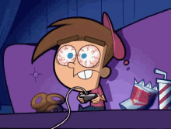
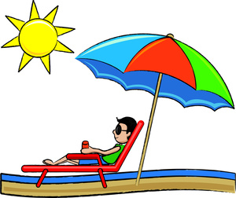
vacation
Addict

Slide 6
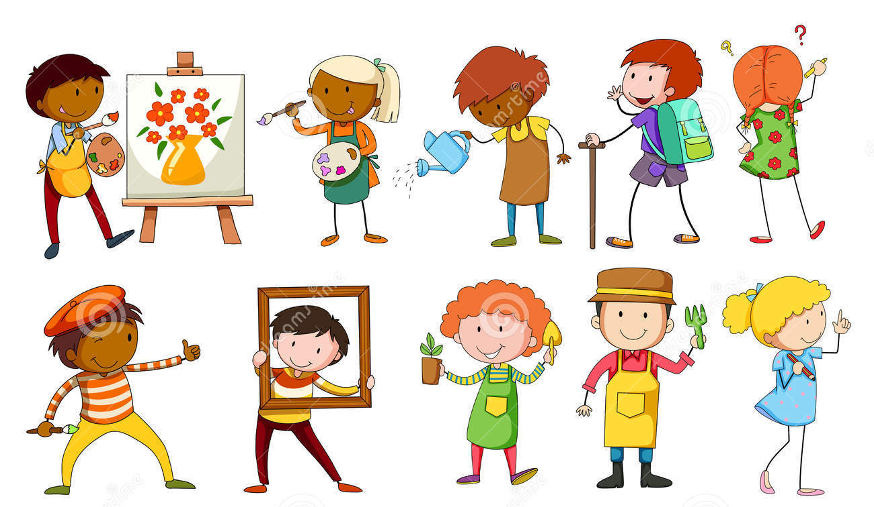
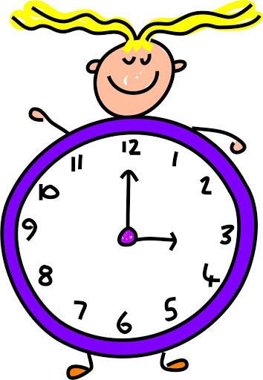
What do you do in your free-time?
What activities do you do every day?

Slide 7

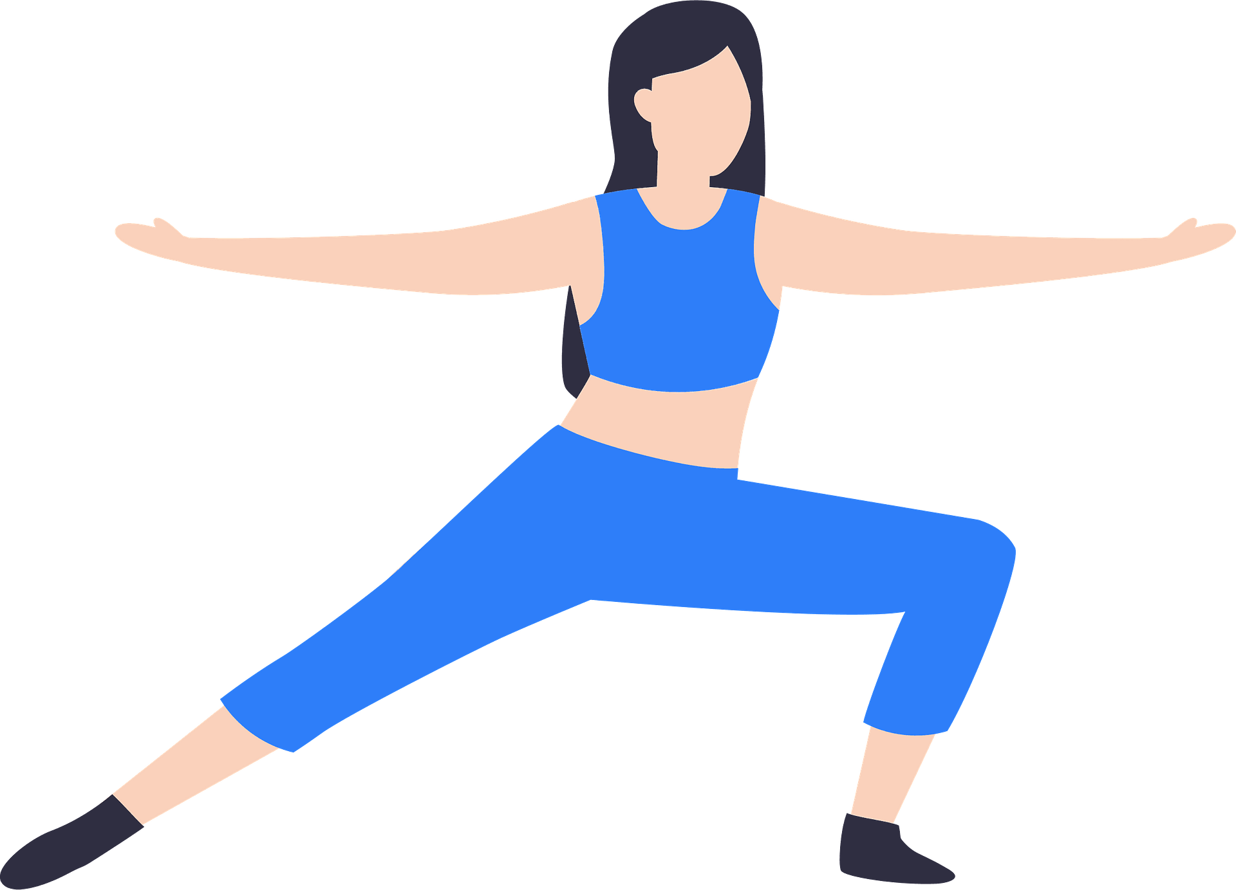
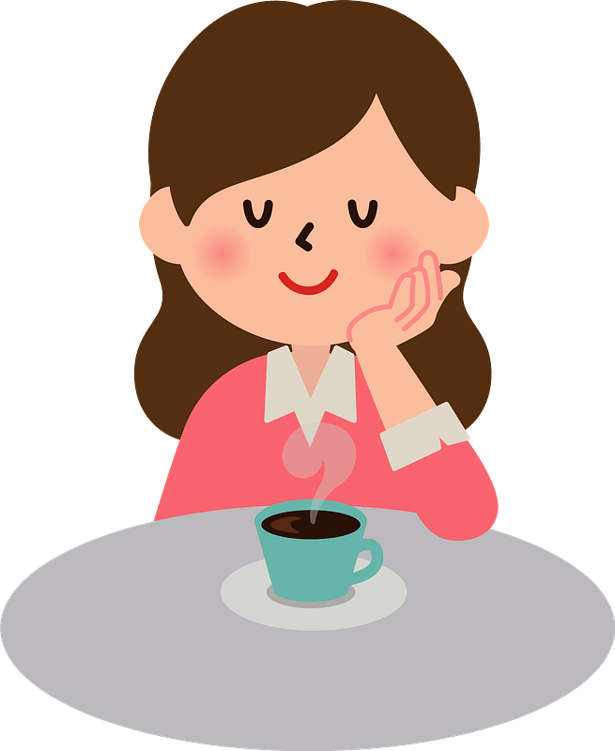

I teach English twenty hours a week
I exercise everyday .
I drink coffee twice a day
I sometimes read books

Slide 8
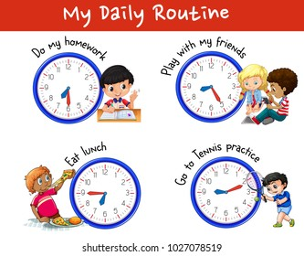

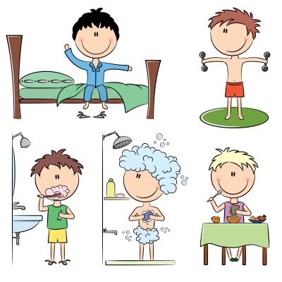

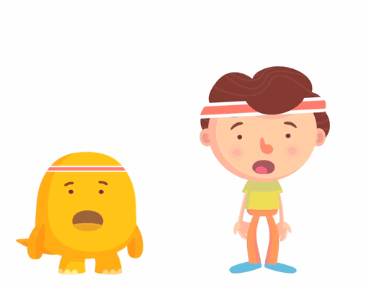
What about you?
Do you exercise?
How many hours a week do you exercise?

Slide 9

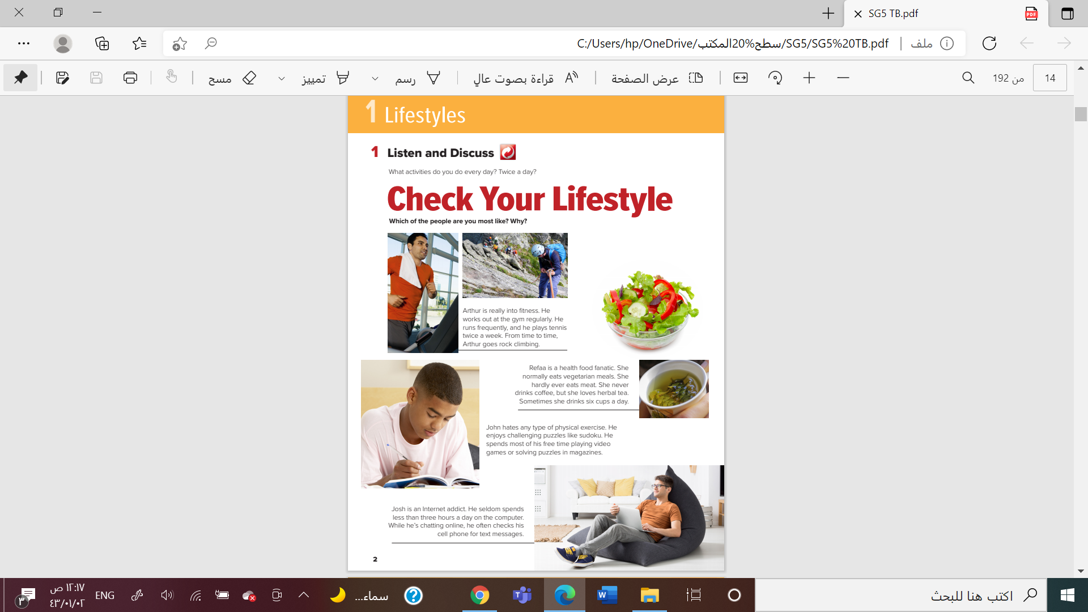
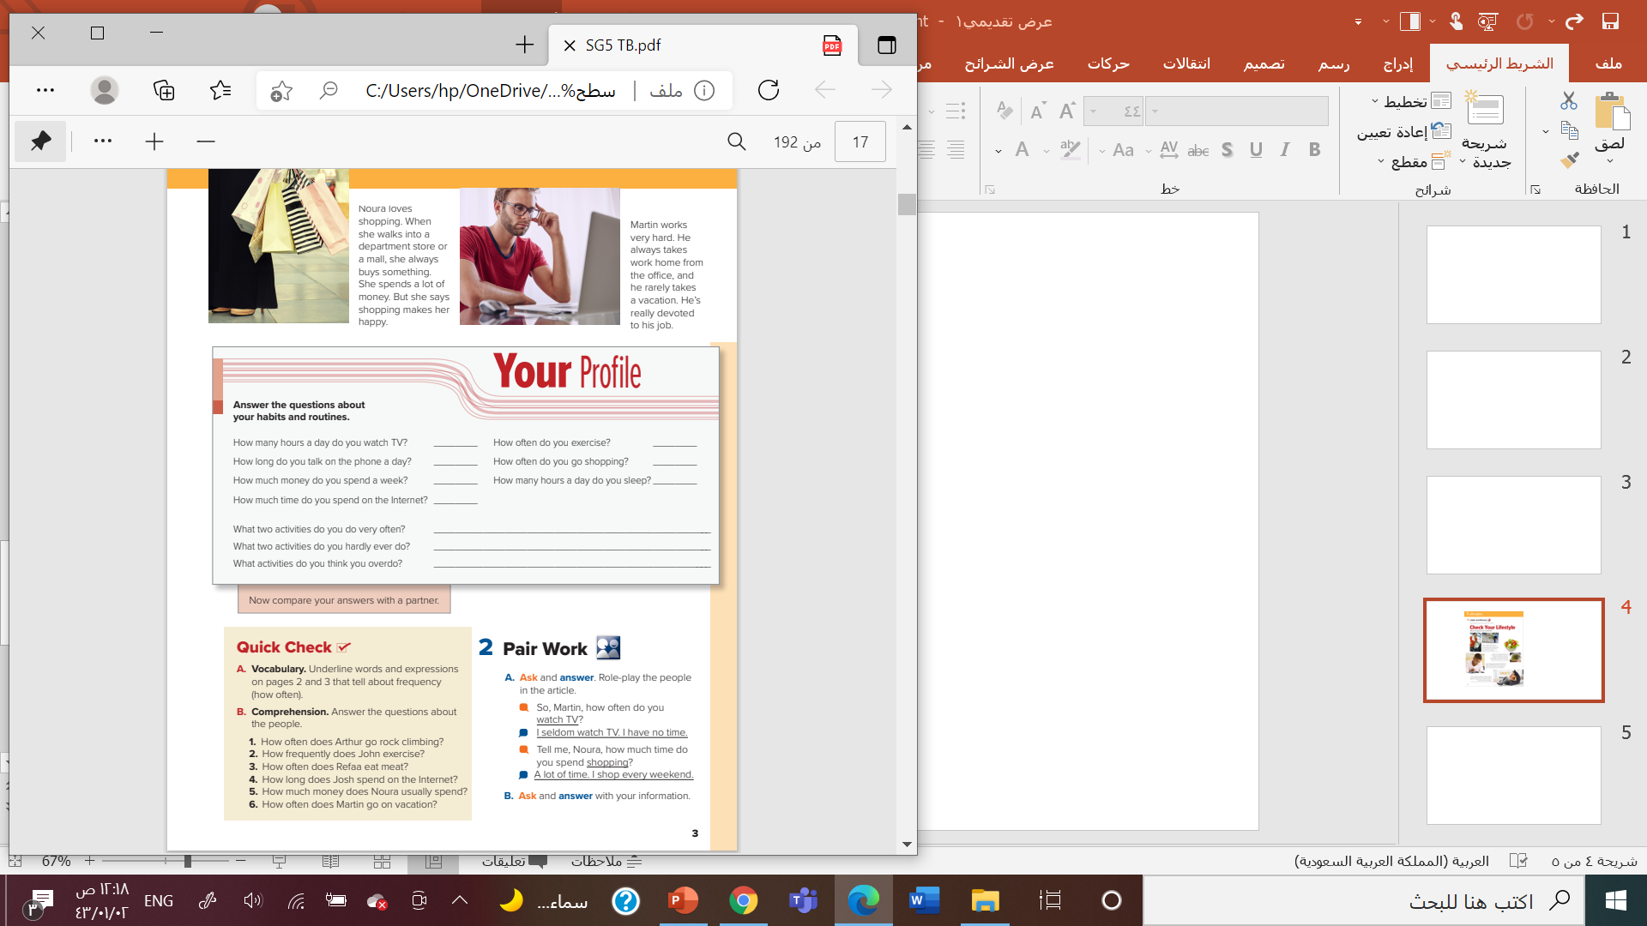
How many people are they ?
What are they doing ?

Slide 10
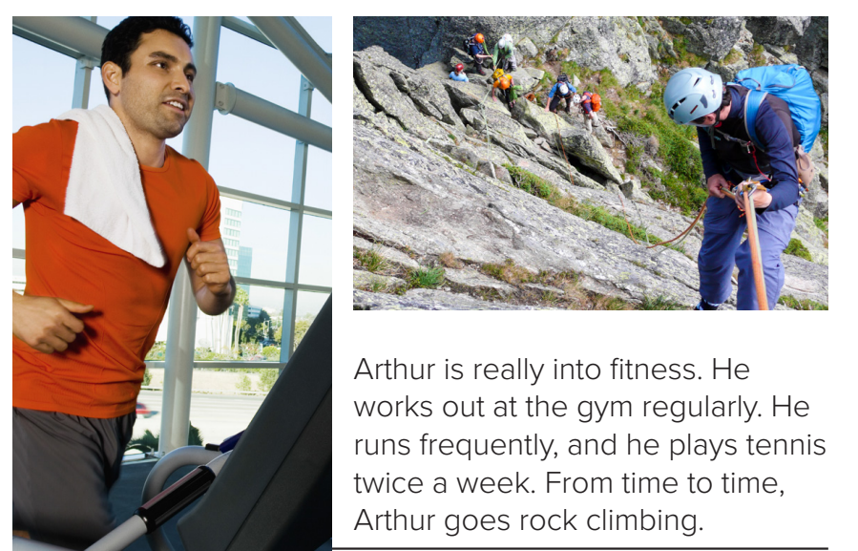

Where is the man in the first picture?
What is he doing?
What is he doing in the next picture?

Slide 11
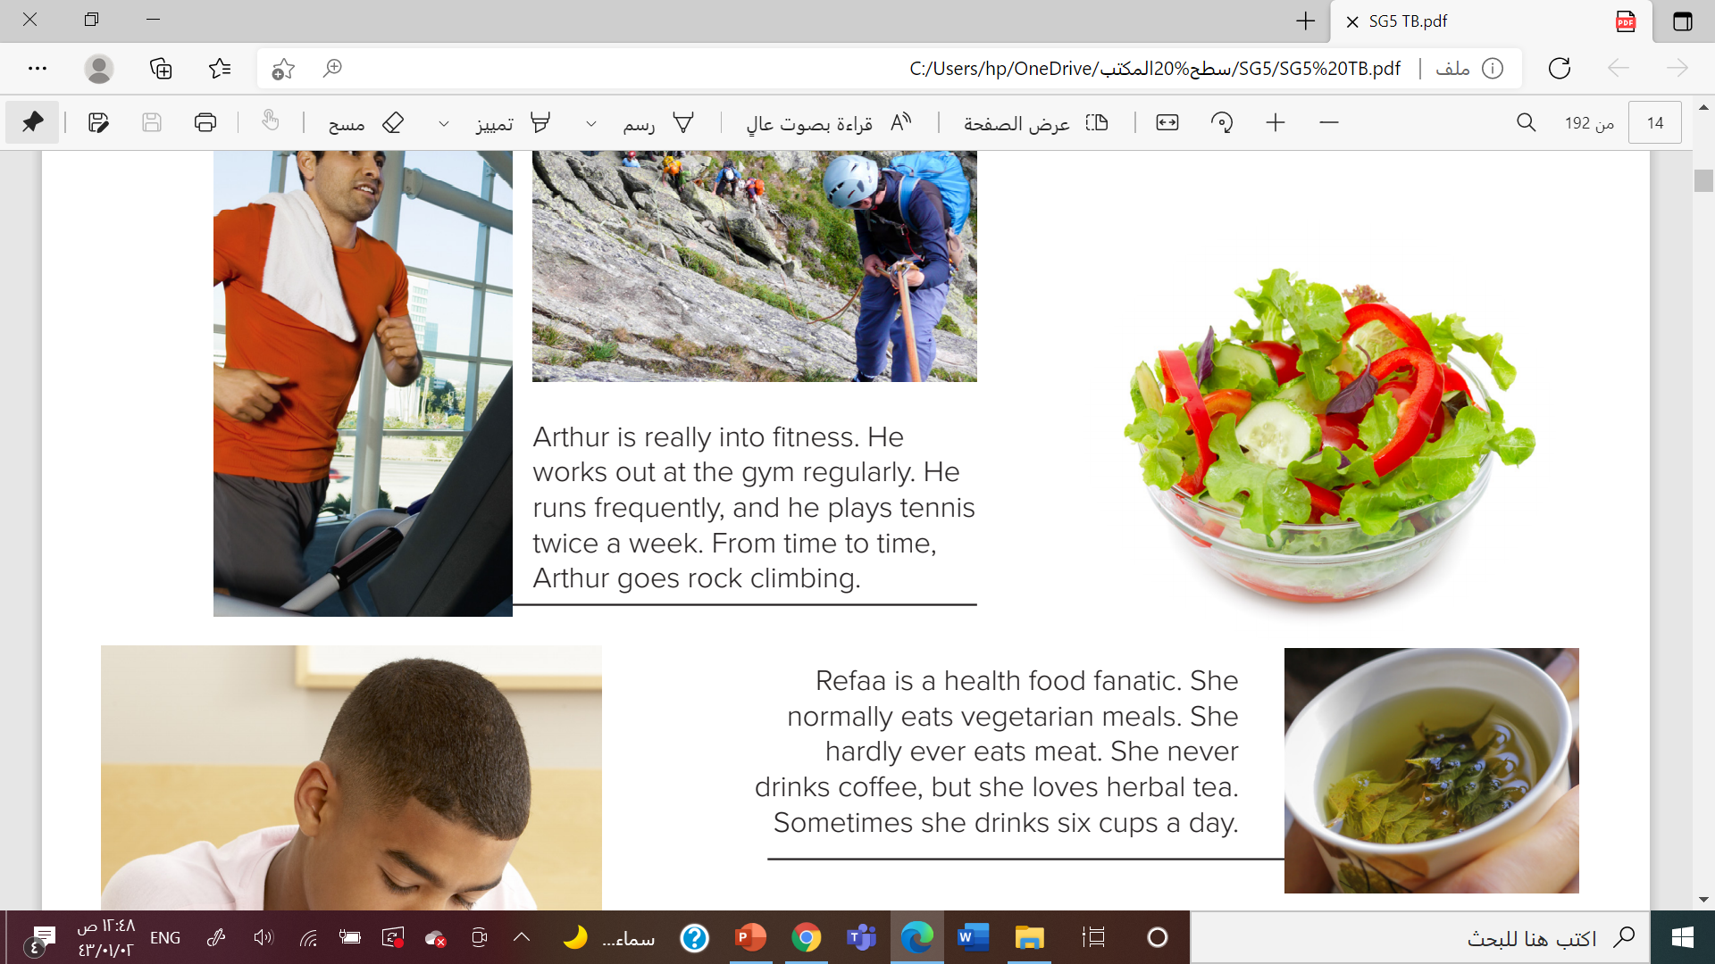
What is in the third picture?
What is the next picture?
Are these healthy food?

Slide 12
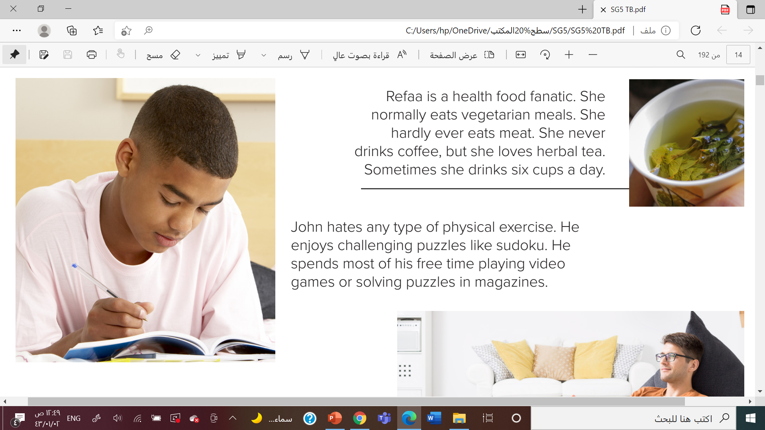
Is the teen on the couch exercising?
What’s he doing?
Does John like video games ?

Slide 13
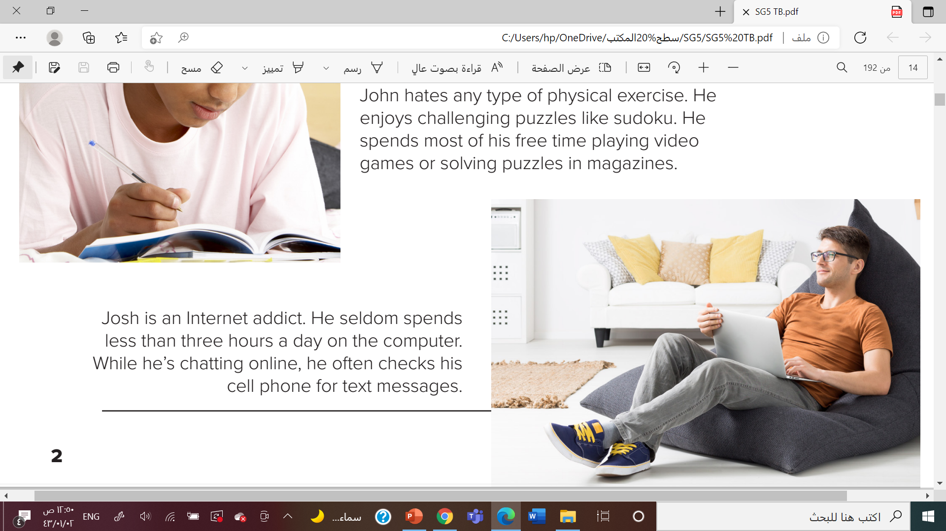
What is the teen doing?
How much time every day do you think he spends on the computer?

Slide 14
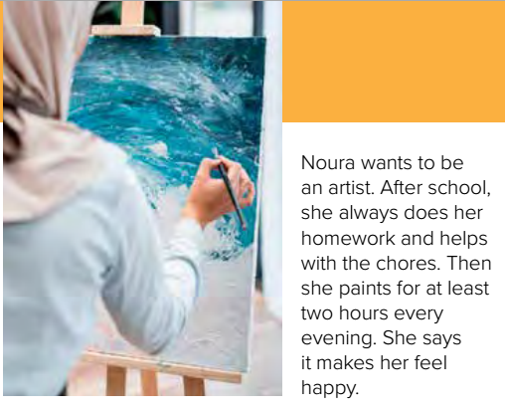
What is Noura doing ?
How often do you think she paints pictures?

Slide 15
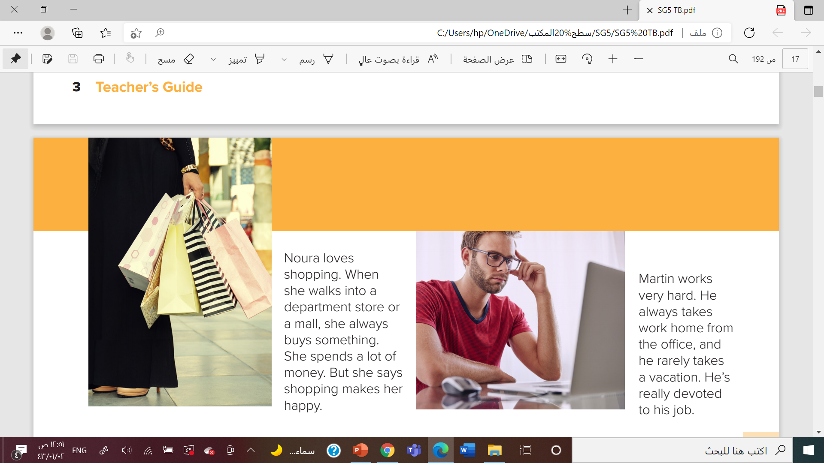
Where is the man in the last picture?
How much time do you think he spends at the office every day?

Slide 16

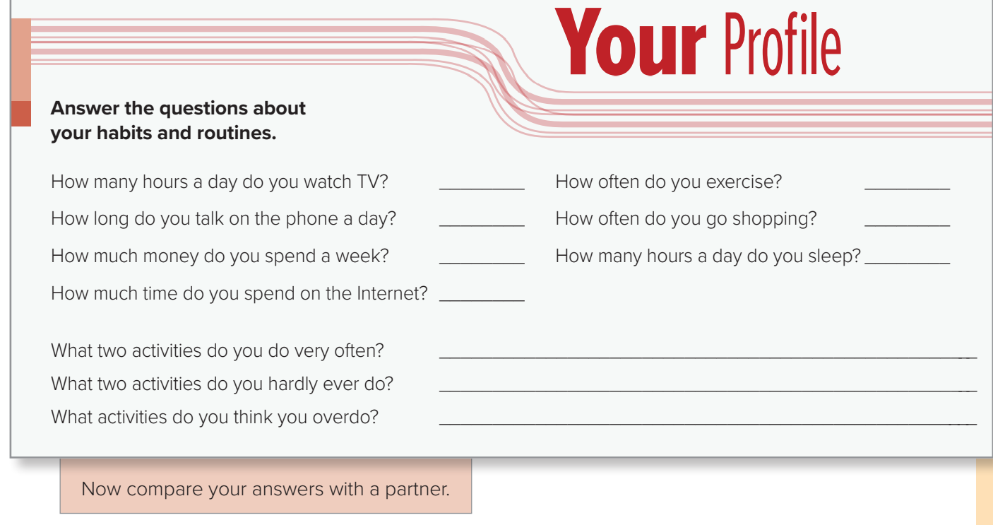

Slide 17


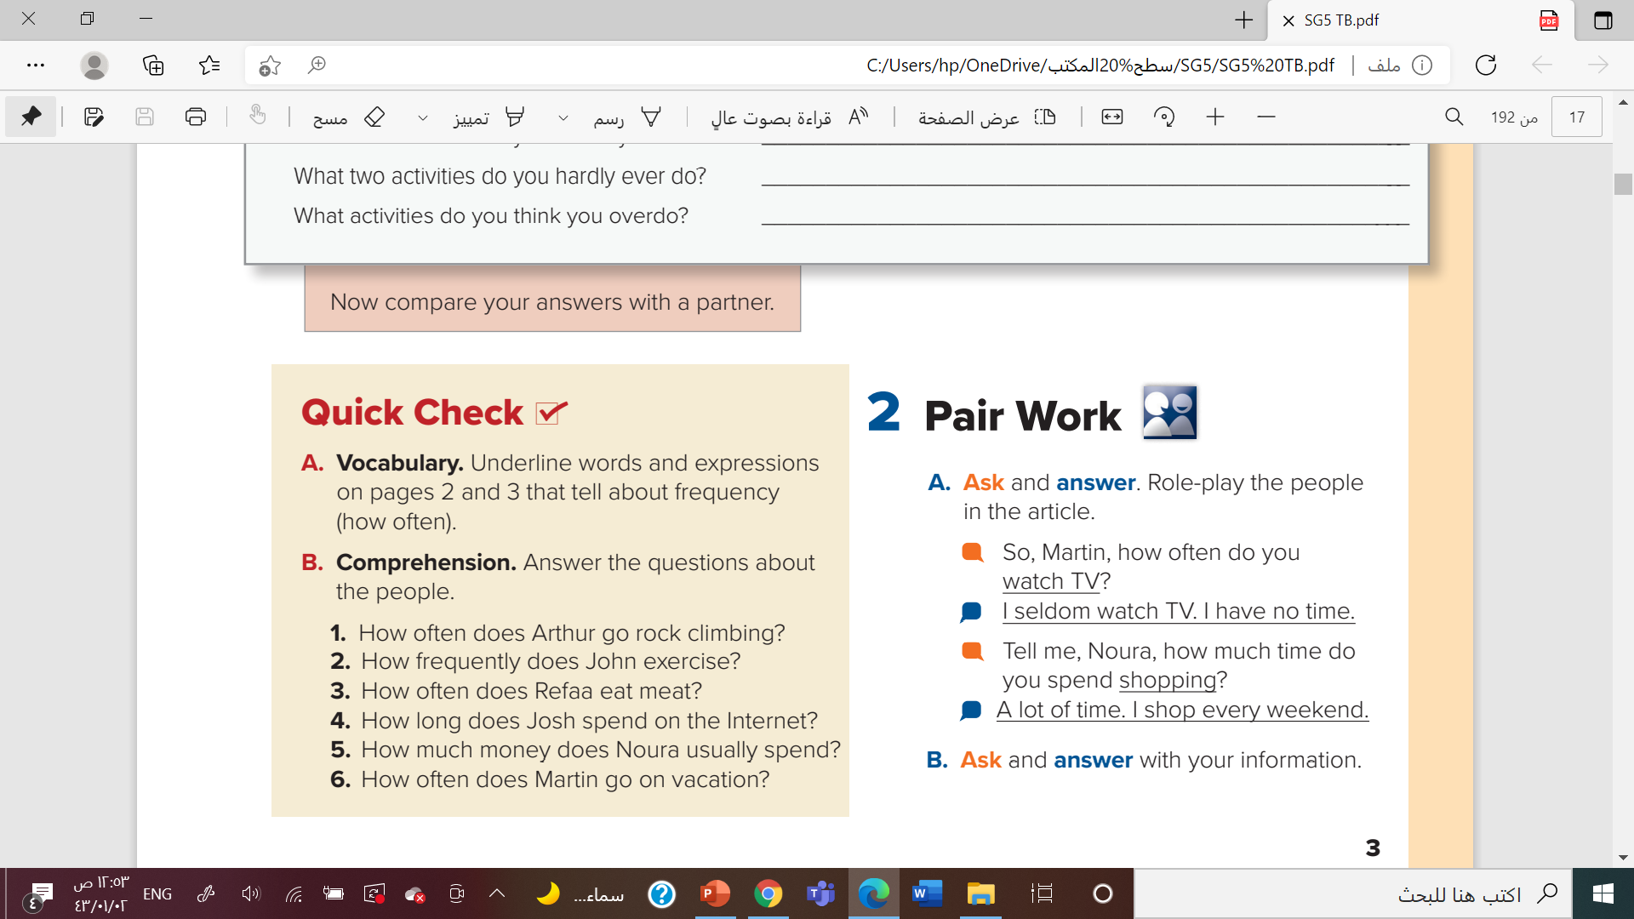

Slide 18
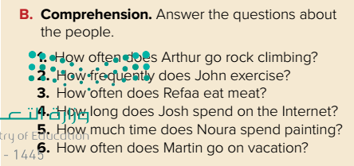
1. Arthur goes rock climbing from time to time
2. John never exercises.
3. Refaa hardly ever eats meat.
4. Josh seldom spends less than three hours a day on the computer
5. Noura spends at least two hours a day painting.
6. Martin rarely takes a vacation.

Slide 19
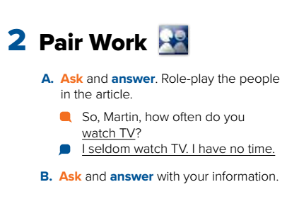

Slide 20
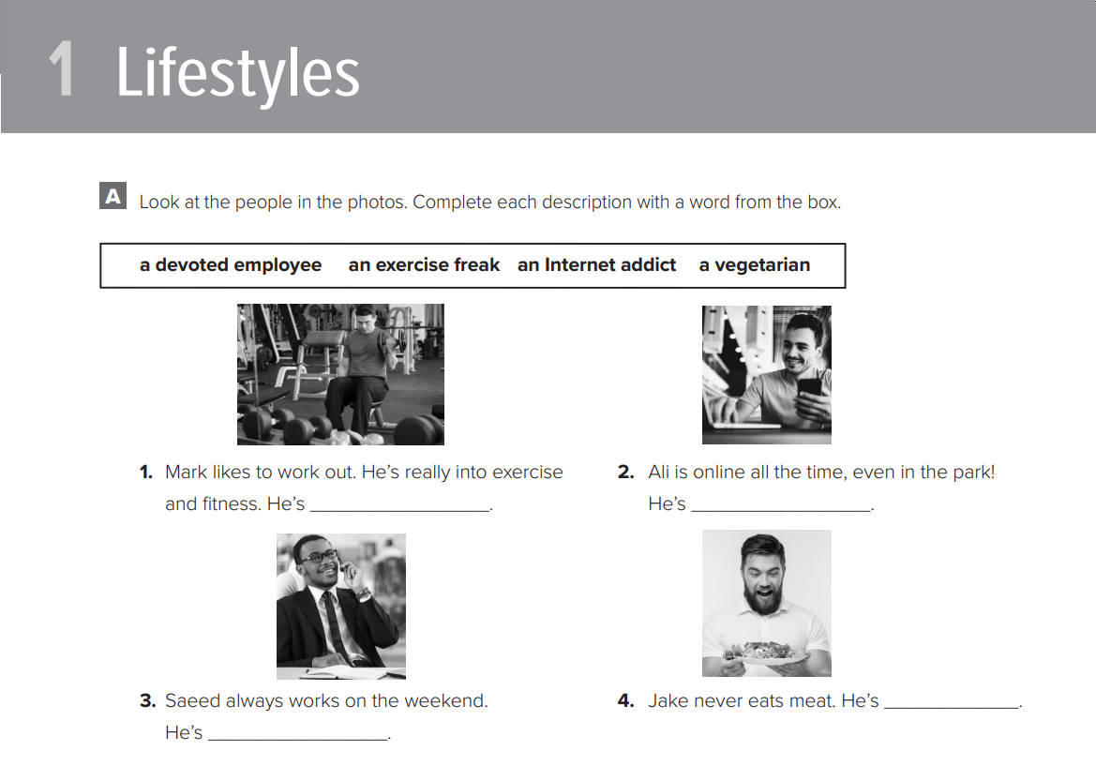
\
@ page 89

Slide 21
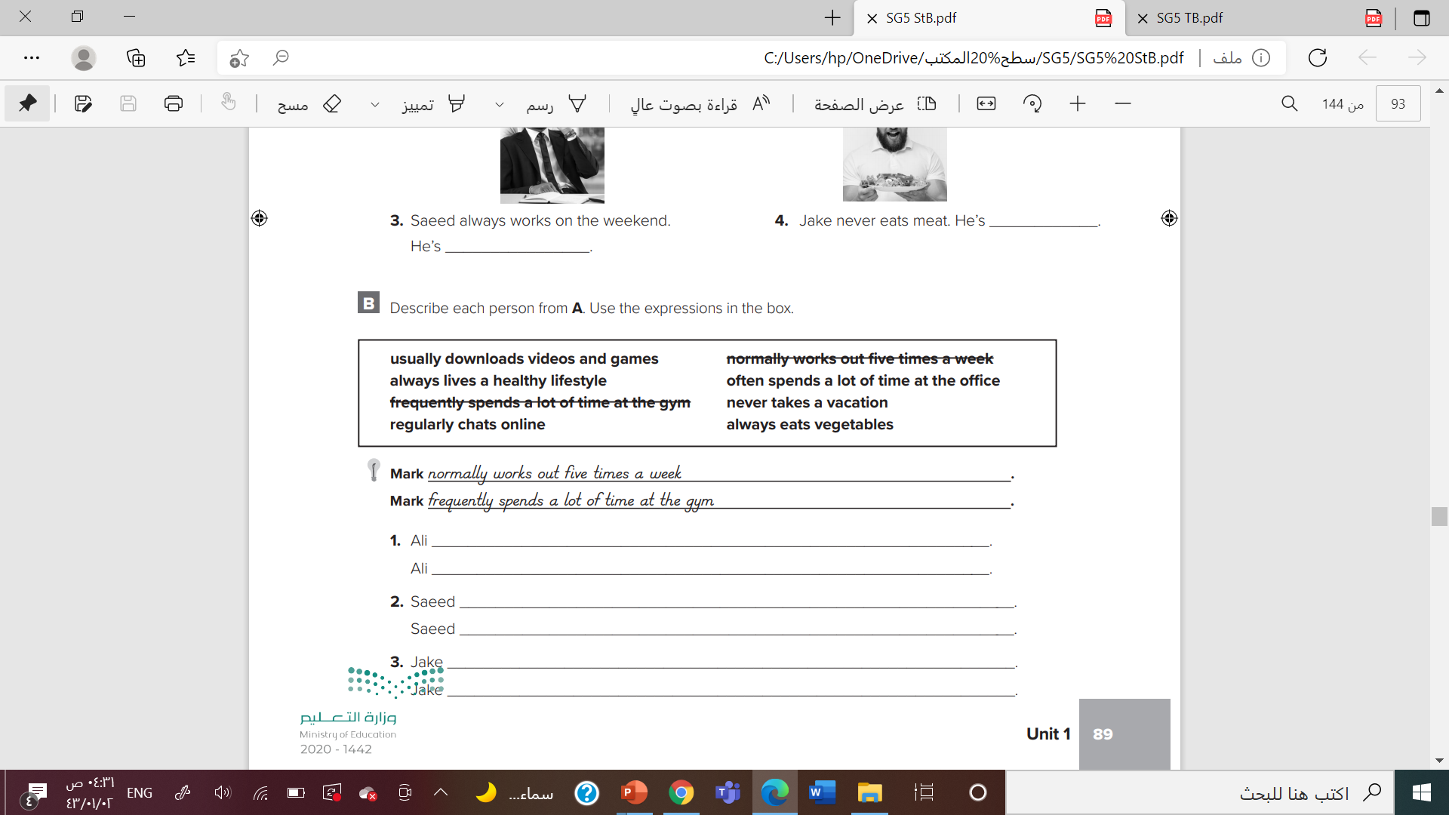
\

Slide 22




Slide 23


