Slide 1
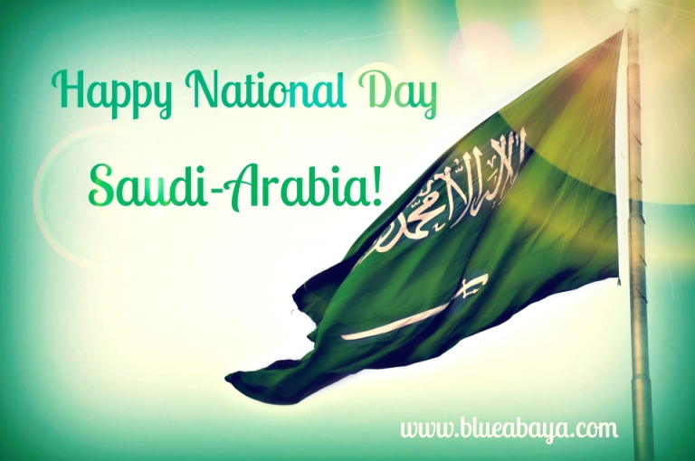
This Photo by Unknown Author is licensed under CC BY-NC-ND

Slide 2
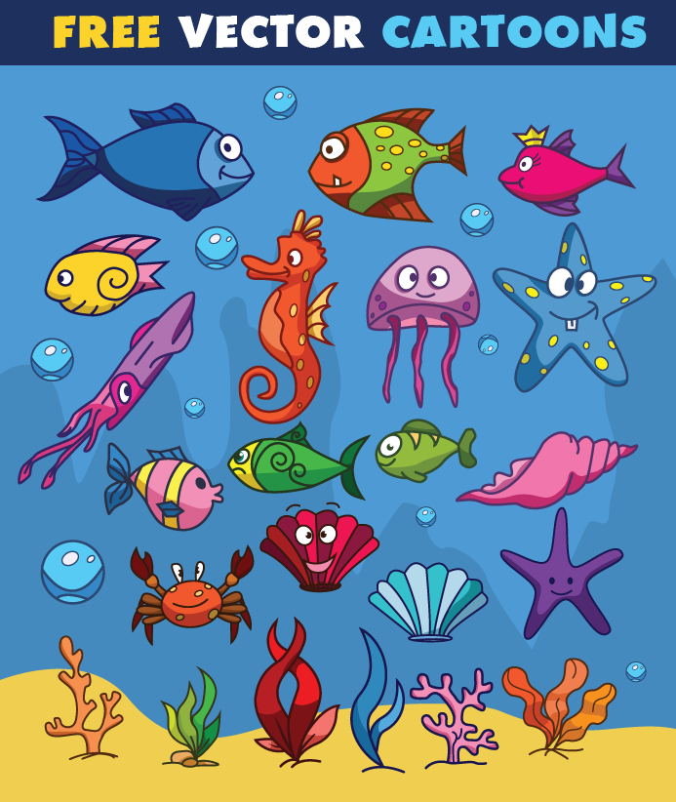
Sea animals
.

Slide 3
I think
انا اعتقد او انا اظن

Slide 4
Amal / cute
I think ……………………………………. is …………………………………. .

Slide 5
I think Amal is cute.

Slide 6
I don’t think
انا لا اعتقد

Slide 7
Ali / sad
I don’t think ……………………………………. is …………………………………. .

Slide 8
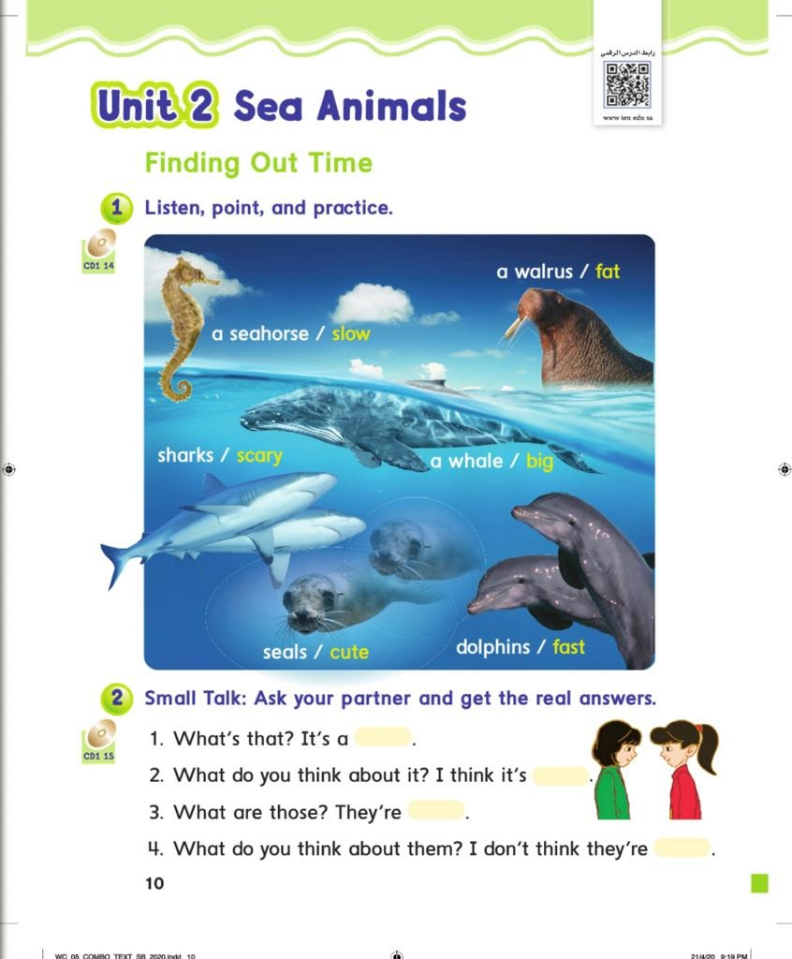

Slide 9
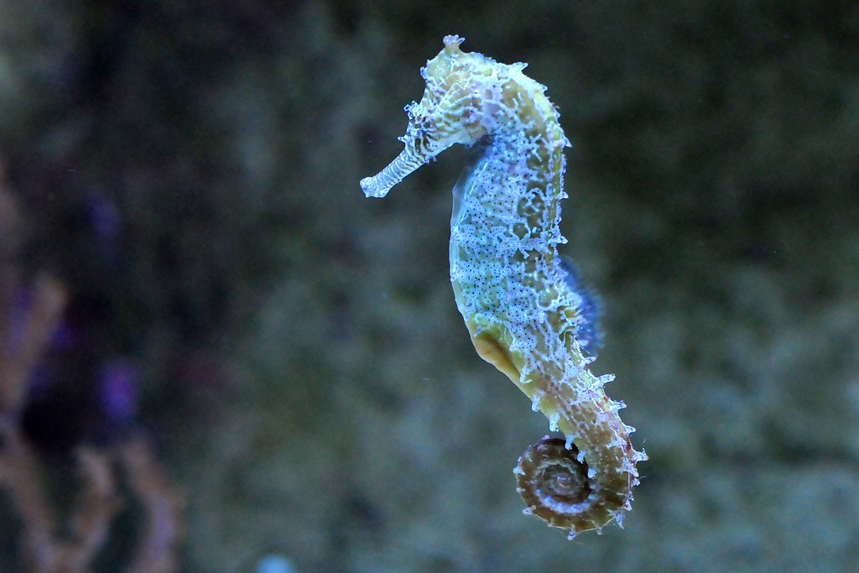
Seahorse/ slow
I think seahorse is slow.
This Photo by Unknown Author is licensed under CC BY-SA-NC

Slide 10
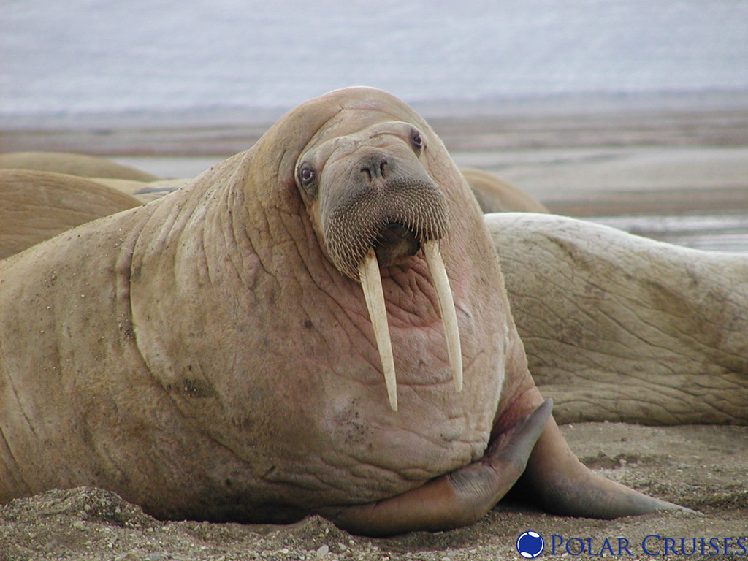
Walrus / fat
I think walrus is fat.
This Photo by Unknown Author is licensed under CC BY

Slide 11
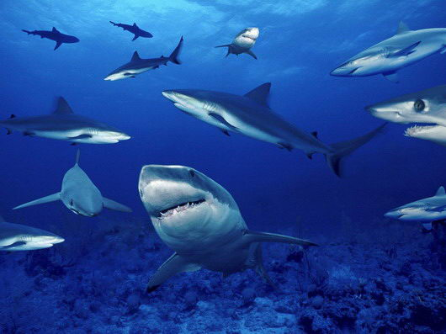
Sharks/scary
I think sharks are scary.
This Photo by Unknown Author is licensed under CC BY-SA

Slide 12
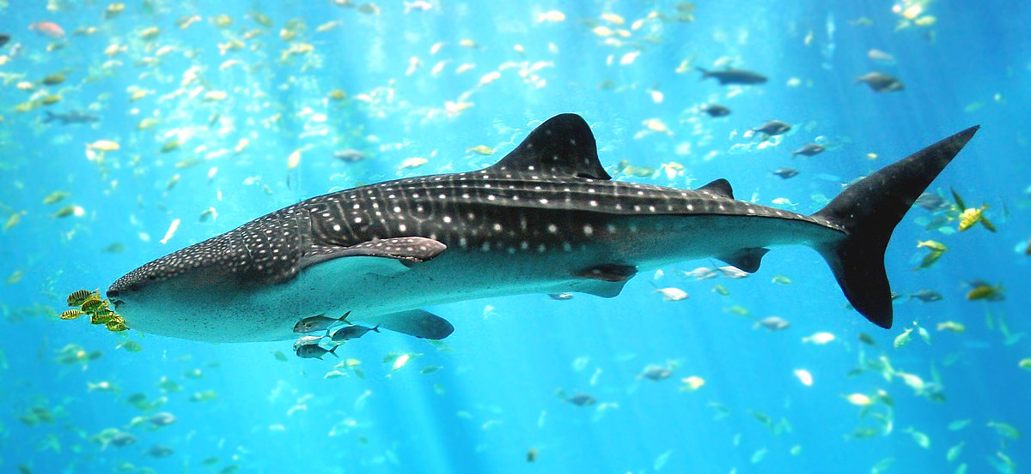
Whale
I think whale is big.
This Photo by Unknown Author is licensed under CC BY-SA

Slide 13
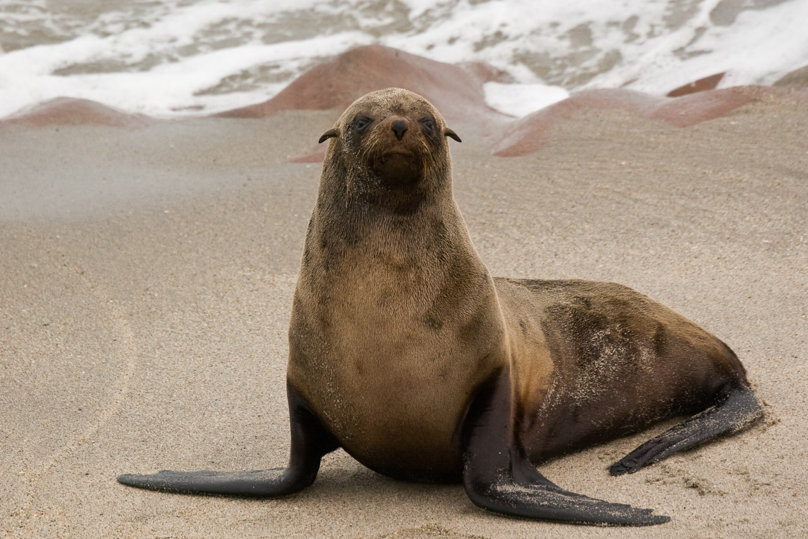
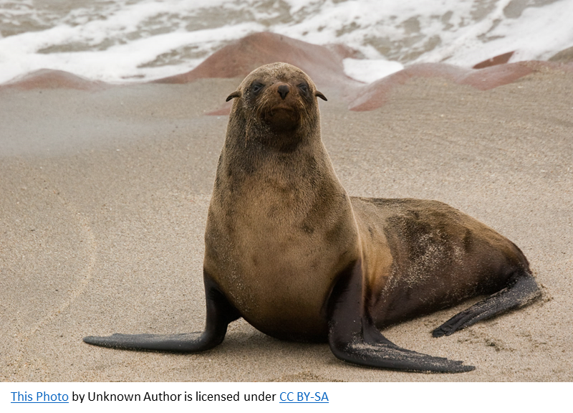
Seals/ cute
I think seals are cute.
This Photo by Unknown Author is licensed under CC BY-SA

Slide 14
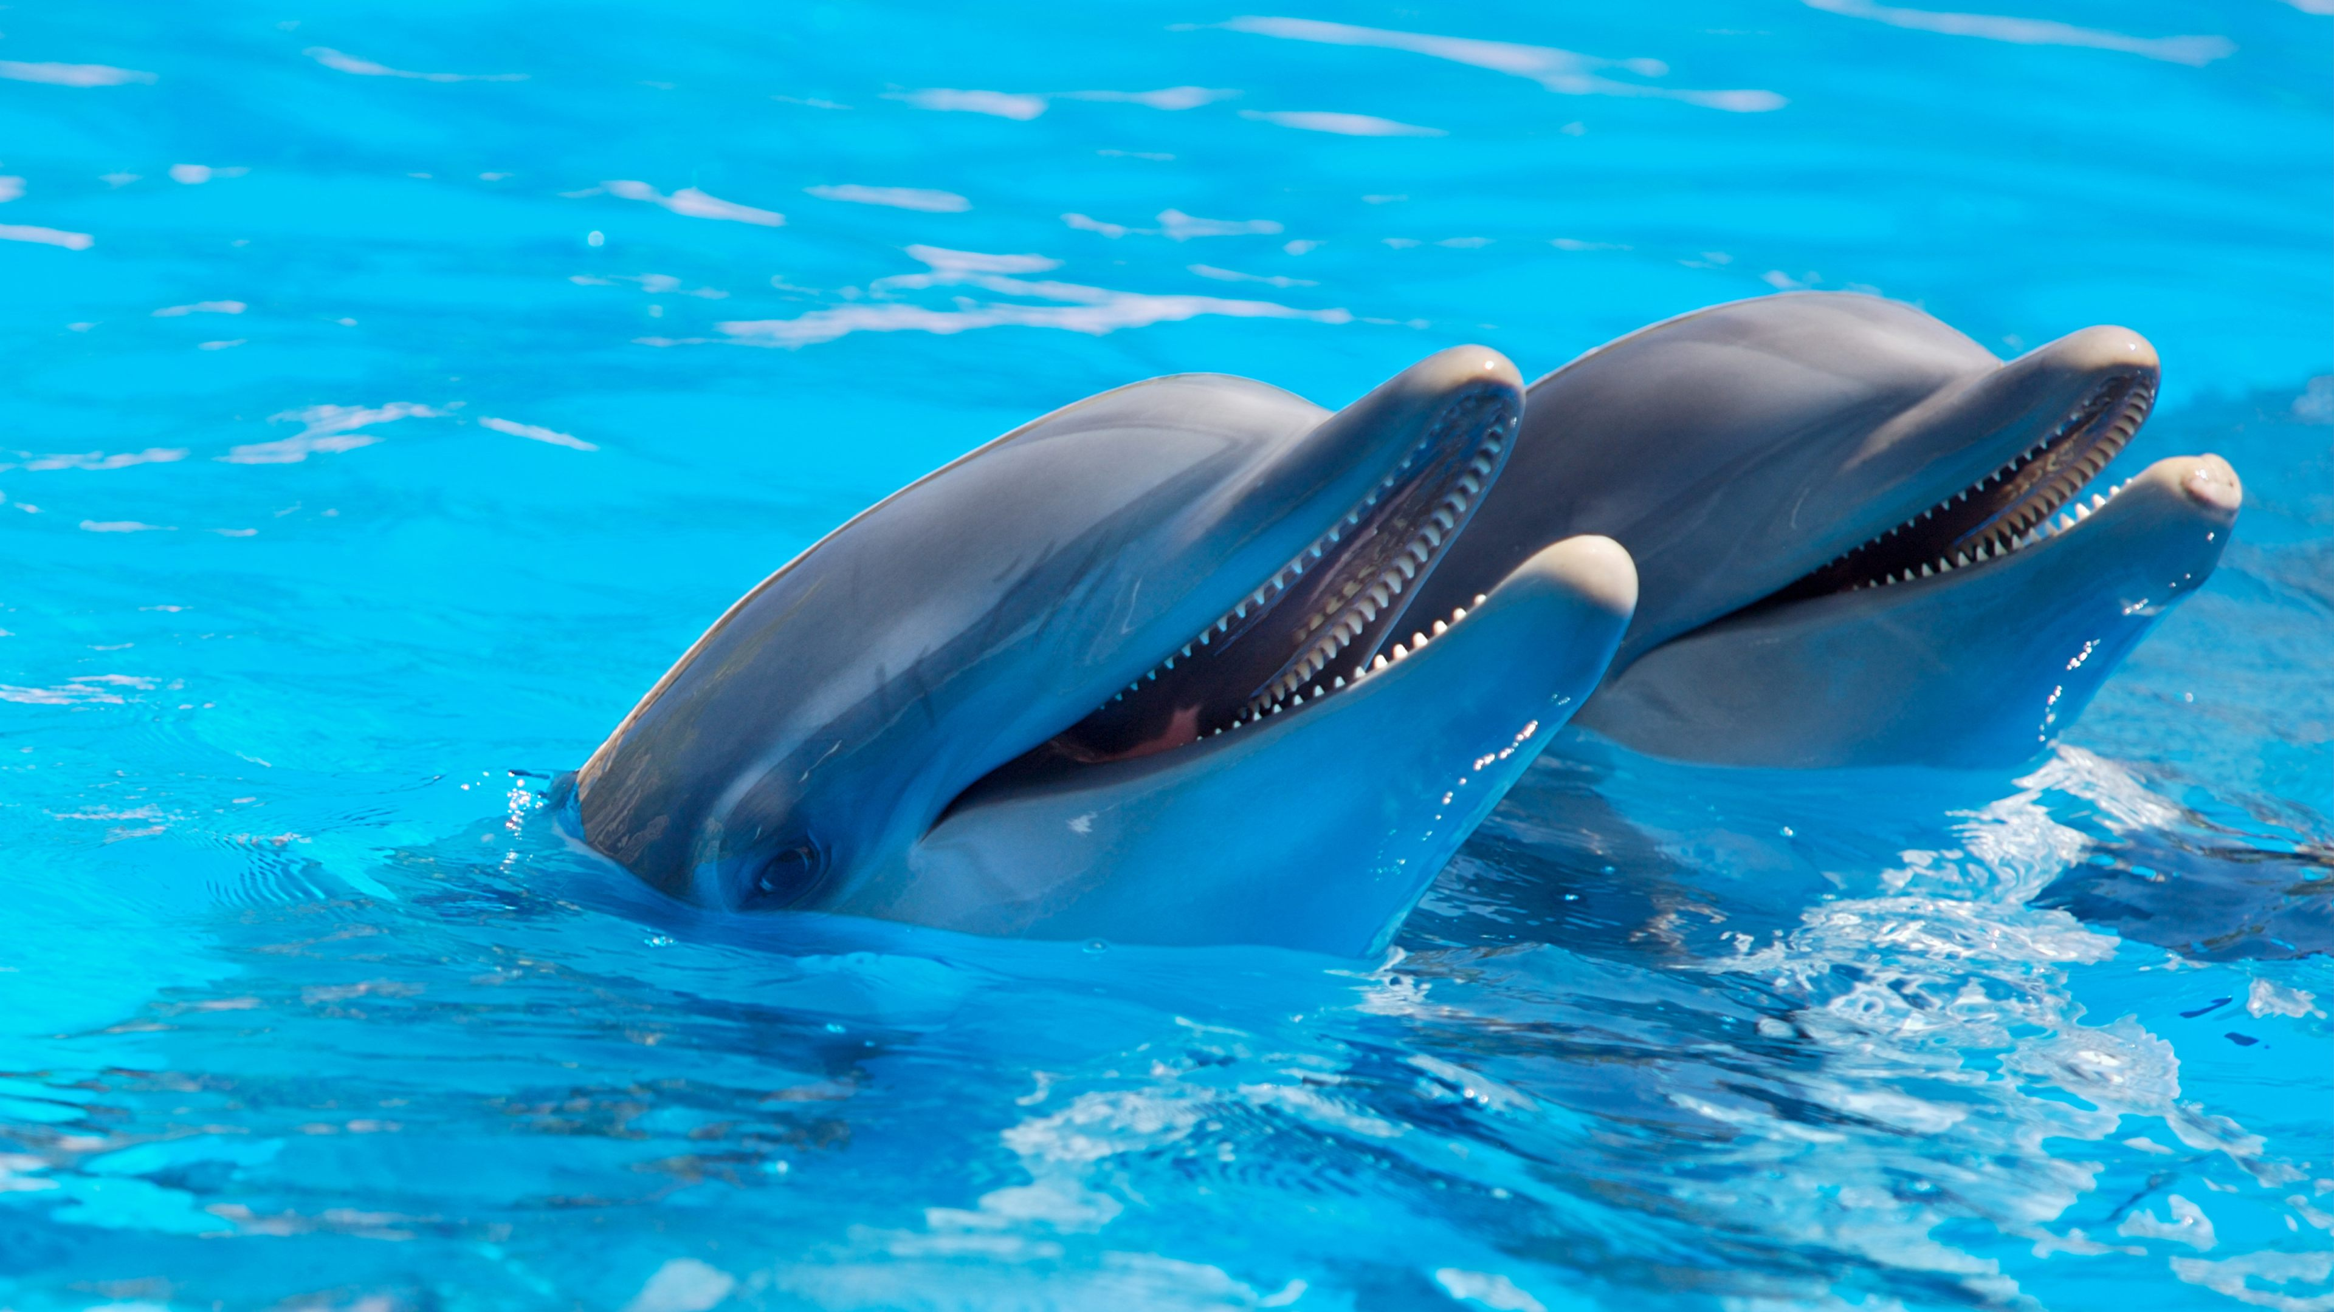
Dolphins / fast
I think dolphins are fast.

Slide 15
homework
p.79+80

