Slide 1

Unit 1
Two Is Better Than One Listen & Discuss
Mega Goal 5
Done by: Entisar Al-Obaidallah
HOME
BACKGROUNDS
AVATAR KIT
PLANNERS
HOMEWORK

Slide 2
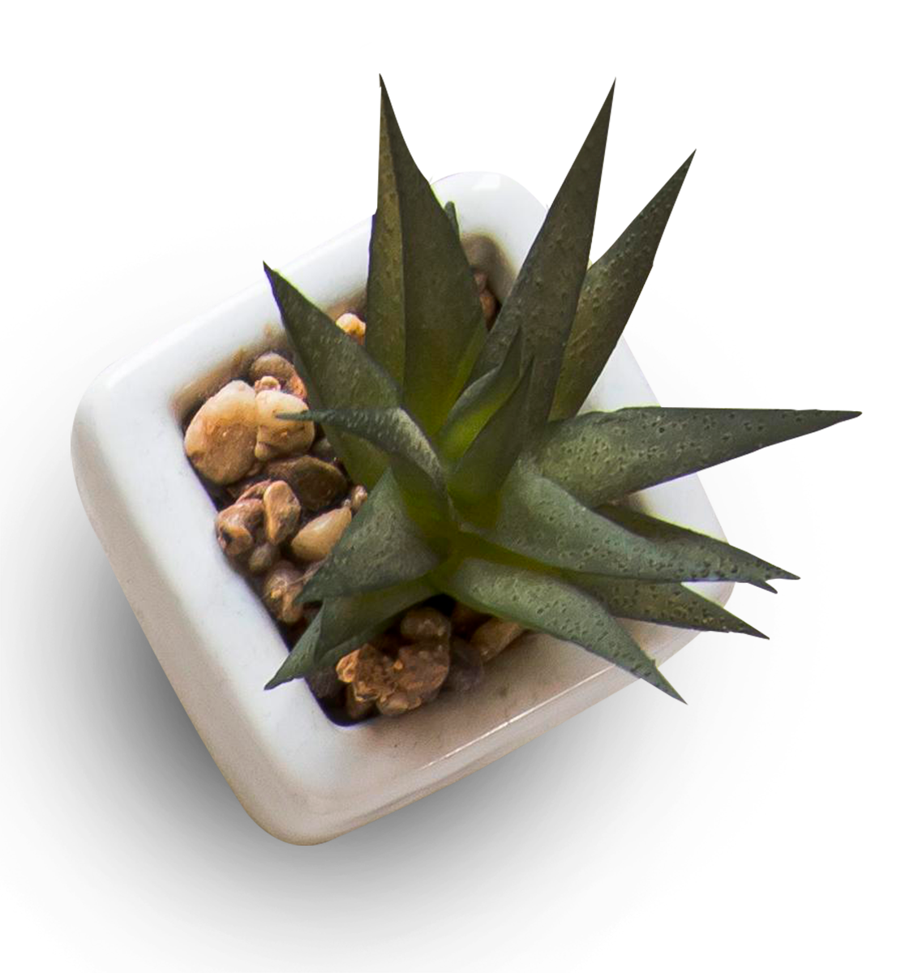
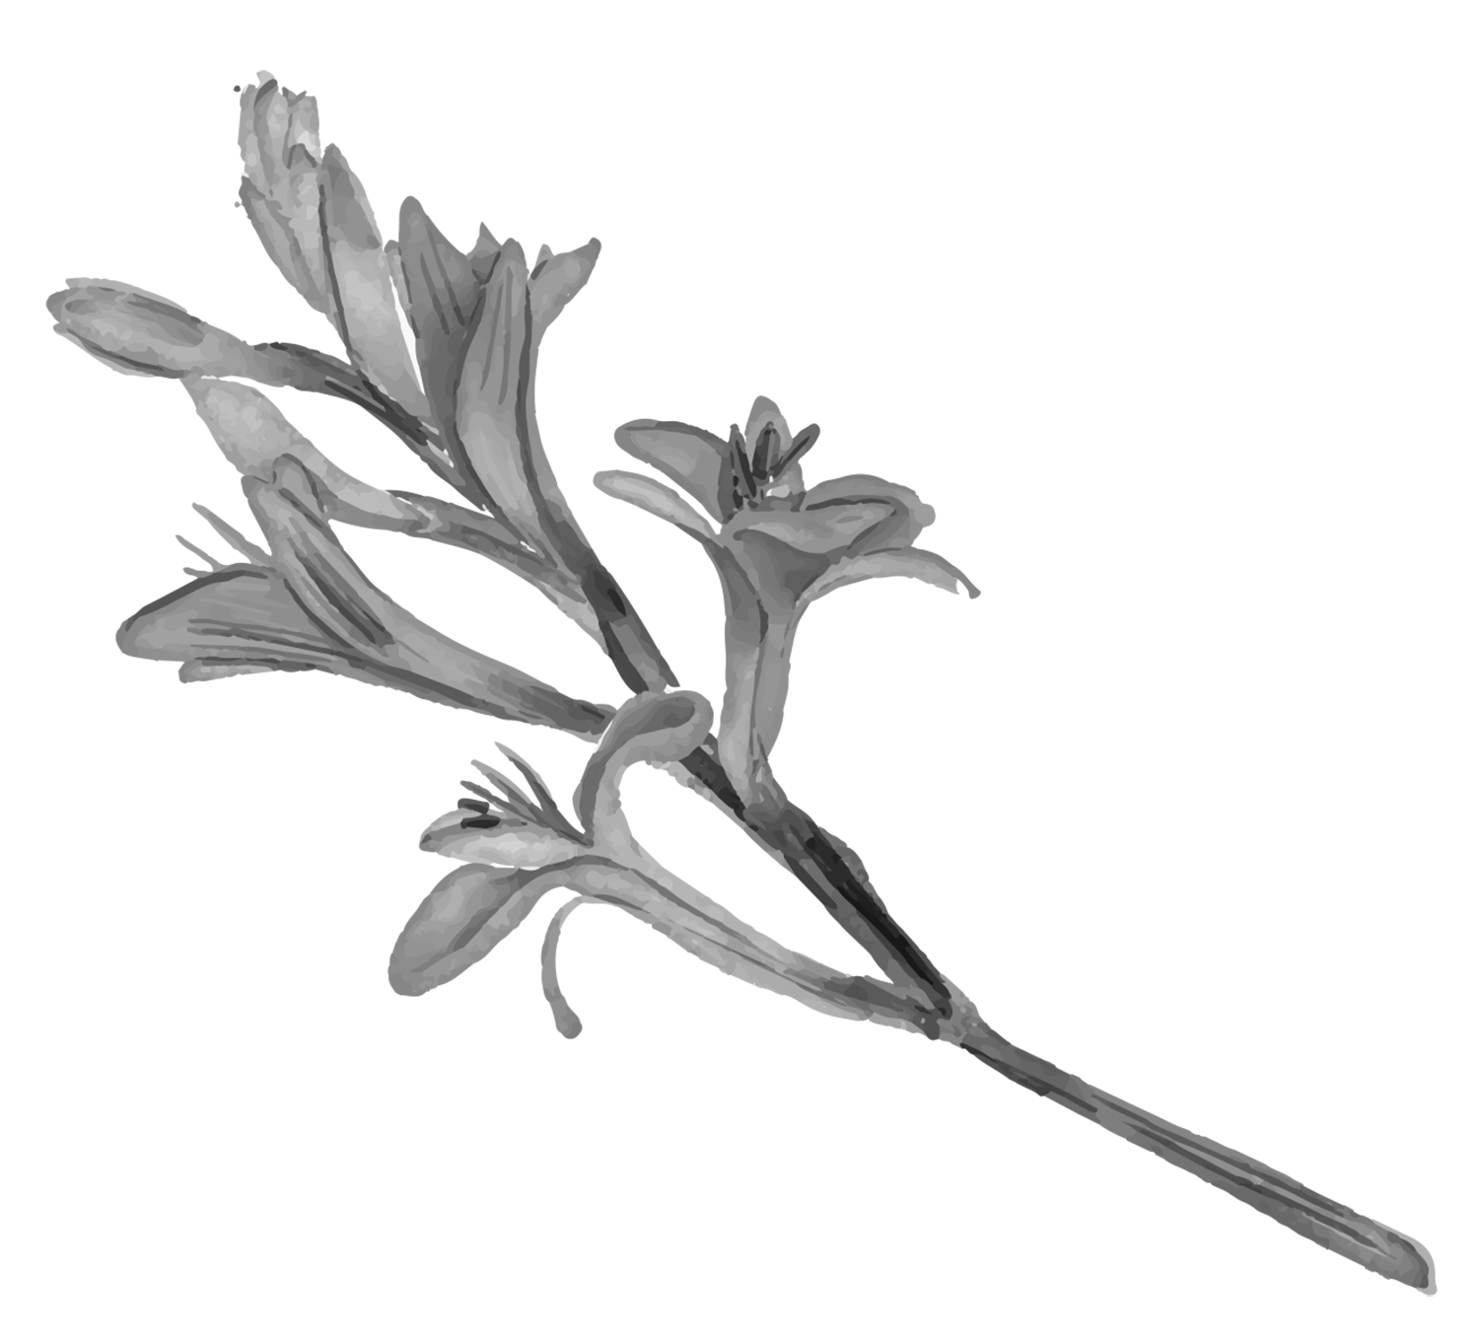

Goals of Lesson
01
Name
02
Listen
03
Answer
04
Match
05
Mention
Some famous couples in history
for specific information
Some questions about the text
The words with the correct meaning
an Islamic couple who made a difference.
HOME
BACKGROUNDS
AVATAR KIT
PLANNERS
HOMEWORK

Slide 3

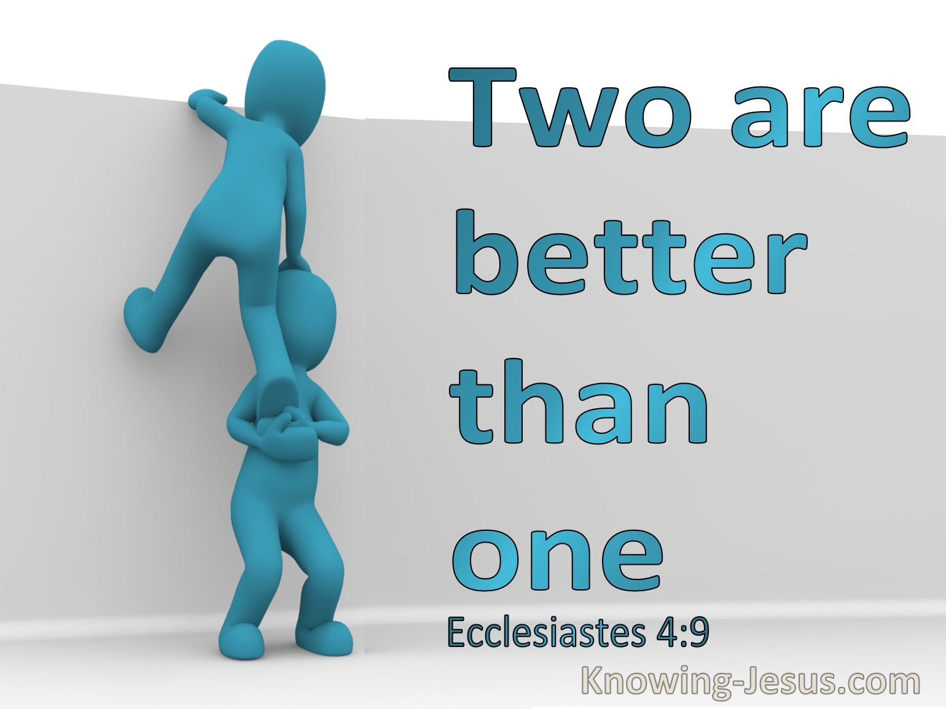

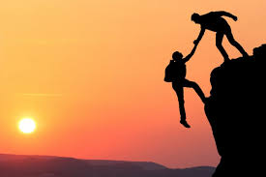
Warm up
What all these pictures have in common ?
They all contain two persons help each other .

Slide 4
Warm up
According to the pictures, can you fill in space to get the title of our unit?
Two
The title of our unit is: ………………is better than one .

Slide 5

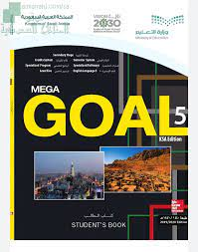
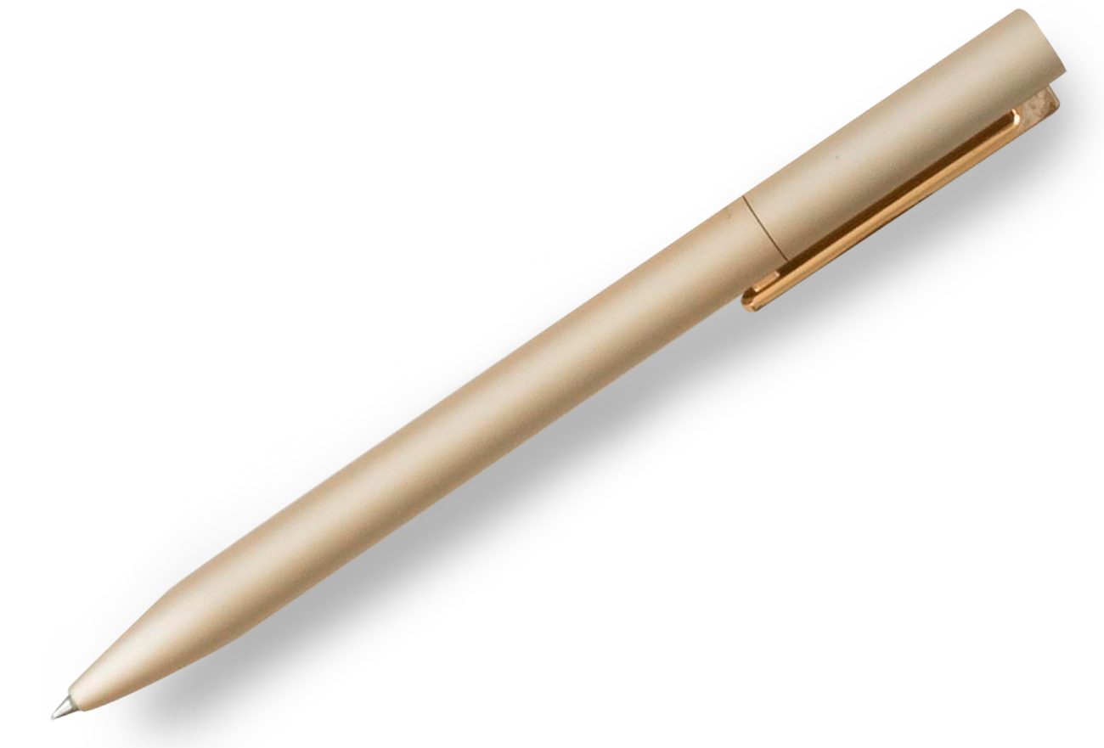
Open Book
pages ( 6 & 7)

Slide 6
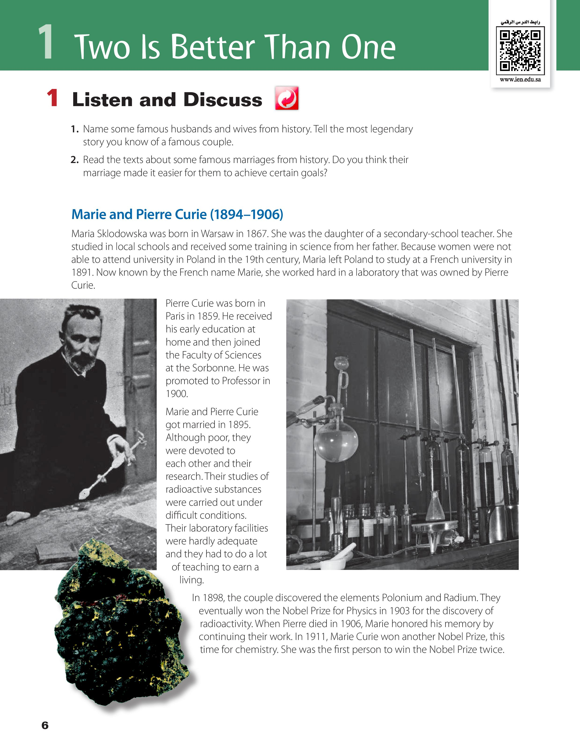
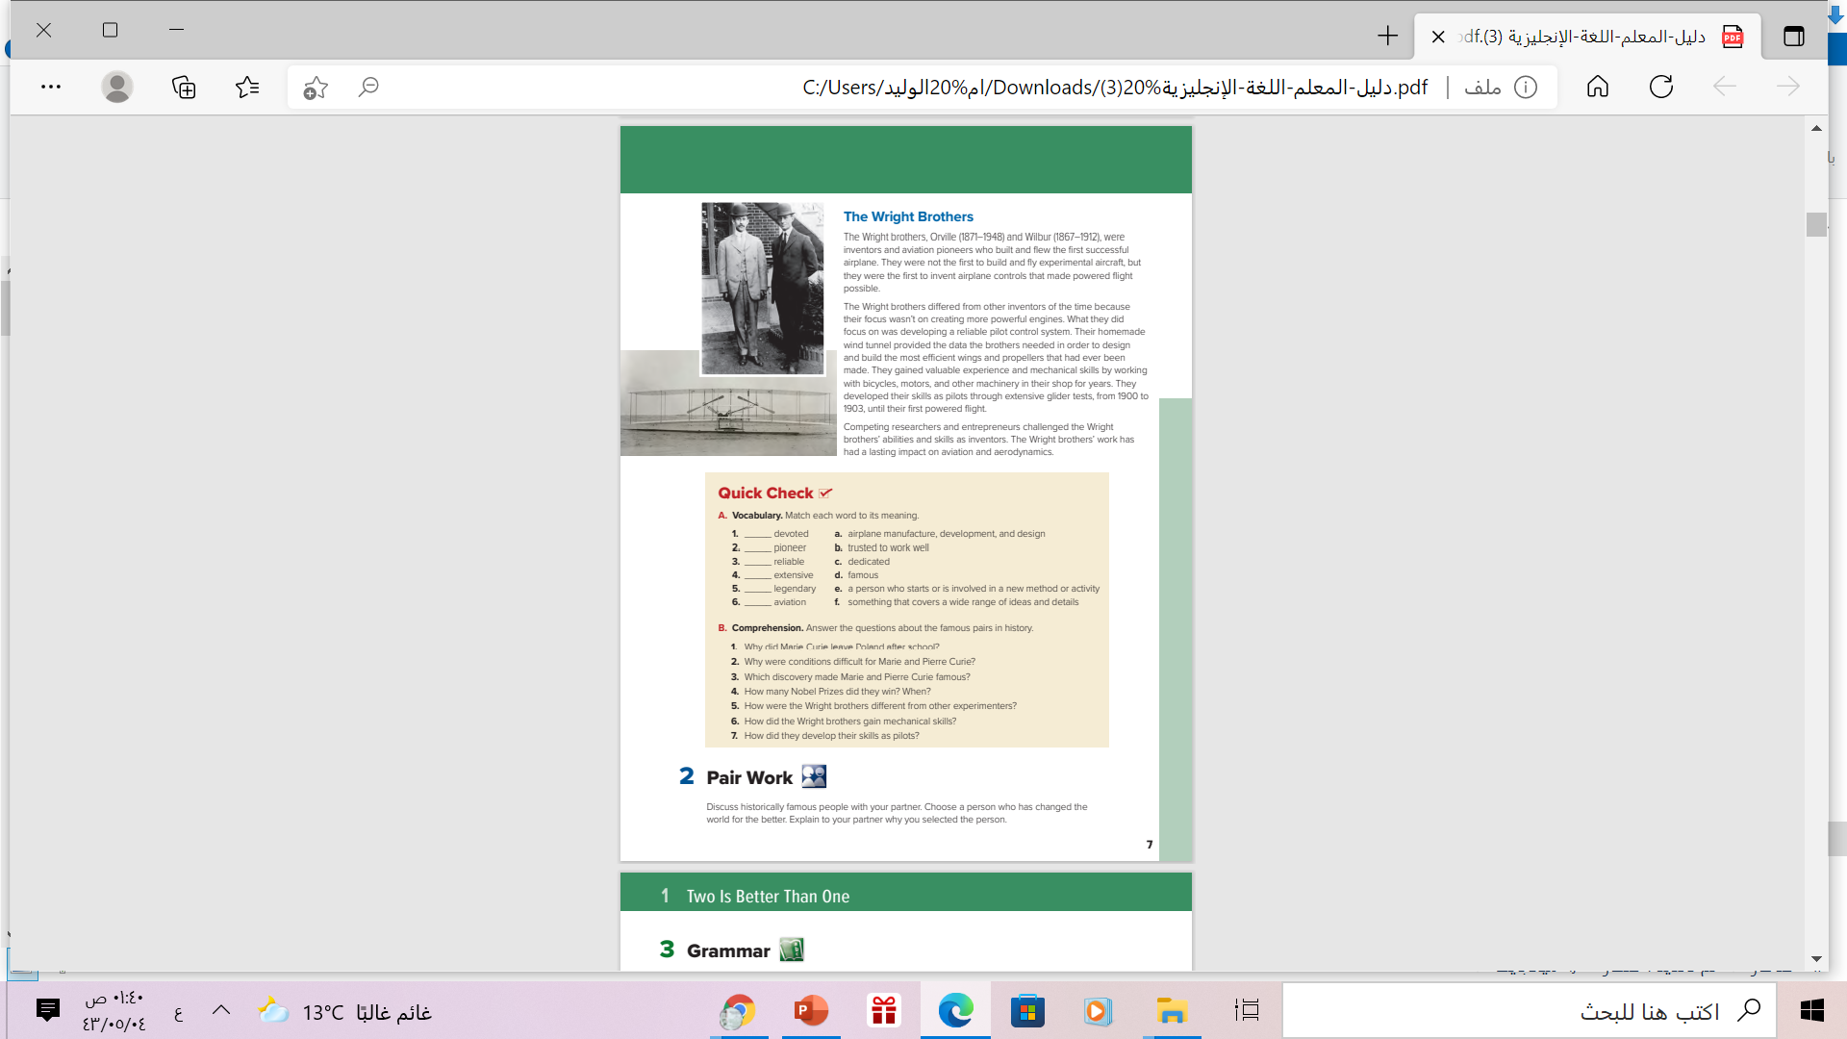
HOME
BACKGROUNDS
AVATAR KIT
PLANNERS
HOMEWORK

Slide 7
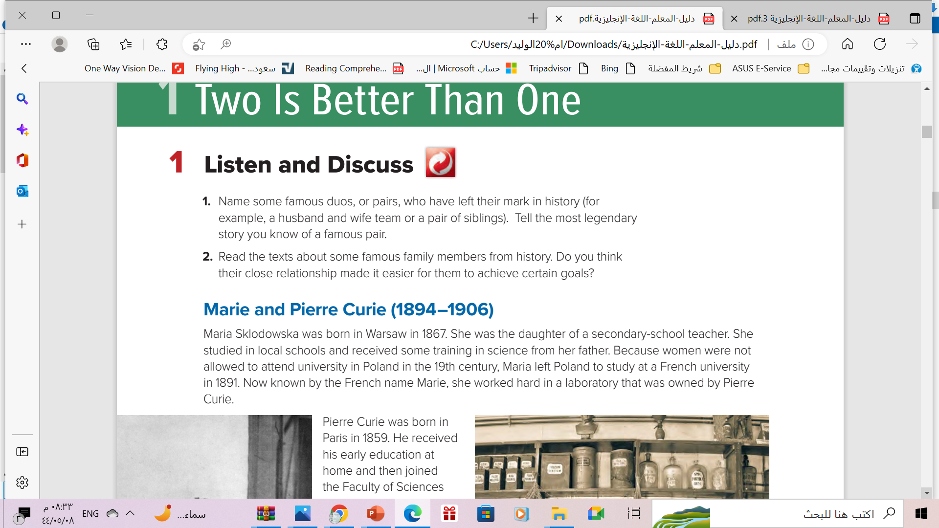
Listen & Discuss
HOME
BACKGROUNDS
AVATAR KIT
PLANNERS
HOMEWORK

Slide 8
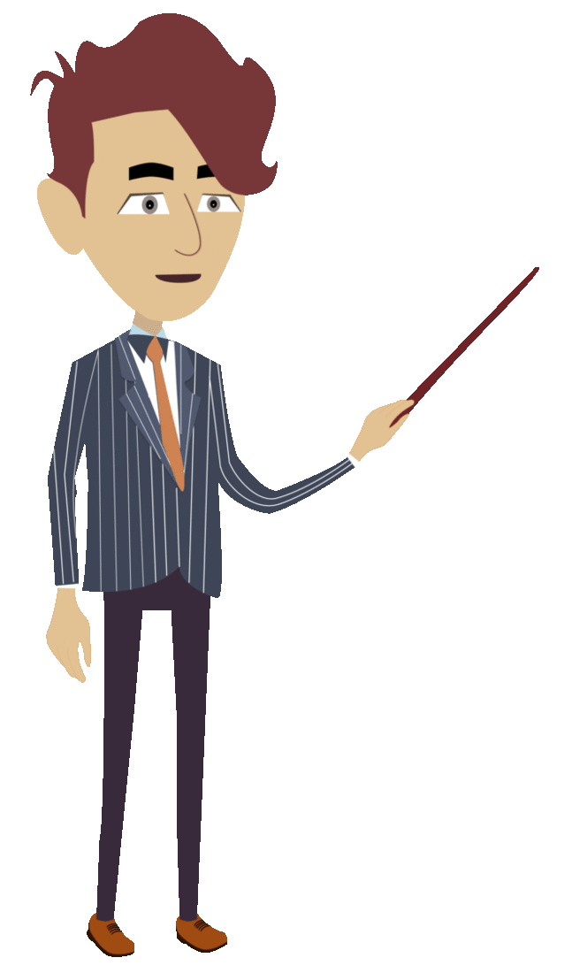

6-7
Listen & Discuss
Books open
What famous marriages are discussed on these pages?
Anita and Giuseppe Garibaldi
HOME
BACKGROUNDS
AVATAR KIT
PLANNERS
HOMEWORK

Slide 9
6-7
Listen & Discuss
Books open
What famous
siblings are discussed?
Orville and Wilbur Wright
HOME
BACKGROUNDS
AVATAR KIT
PLANNERS
HOMEWORK

Slide 10
6-7
Listen & Discuss
Books open
Do you think their close
relationship made it easier for them to achieve
certain goals?
Yes , it is
HOME
BACKGROUNDS
AVATAR KIT
PLANNERS
HOMEWORK

Slide 11



Listen & Read as long you listen

Slide 12

Where did Marie and Pierre meet?
in a laboratory in France
What did they discover together?
the elements
polonium and radium

Slide 13
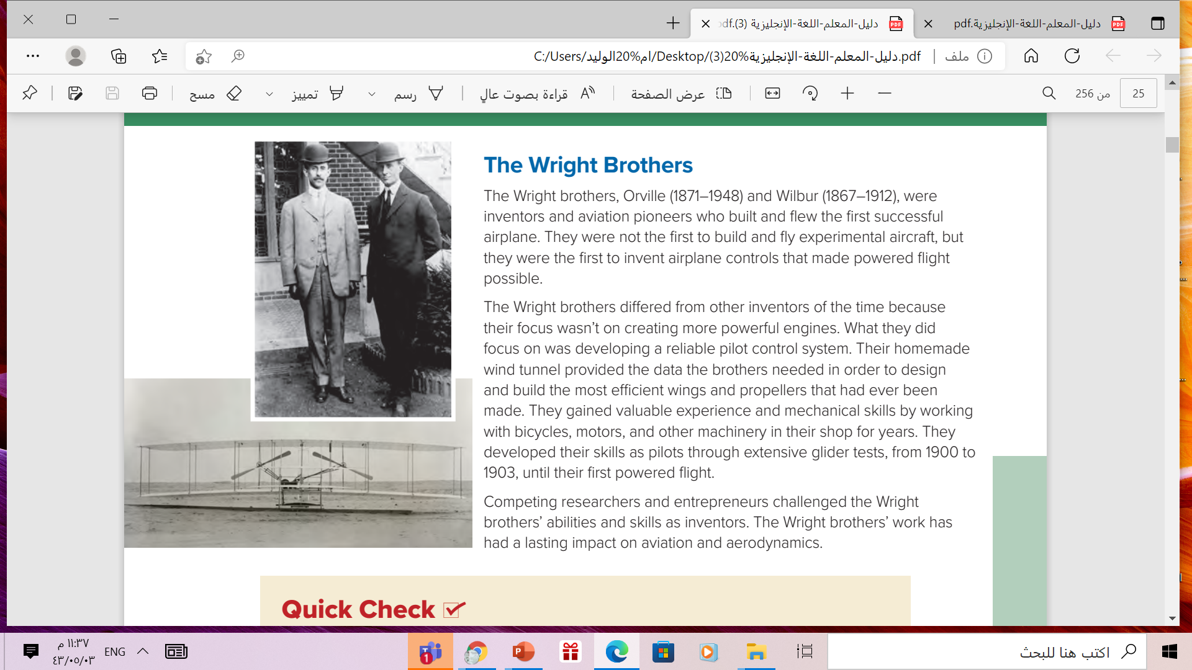
Who were the Wright brothers?
inventors and aviation pioneers
Why were they famous?
They built and flew the first
successful airplane
What did their homemade wind tunnel help them do?
design and build the most efficient wings and propellers that had ever been made

Slide 14
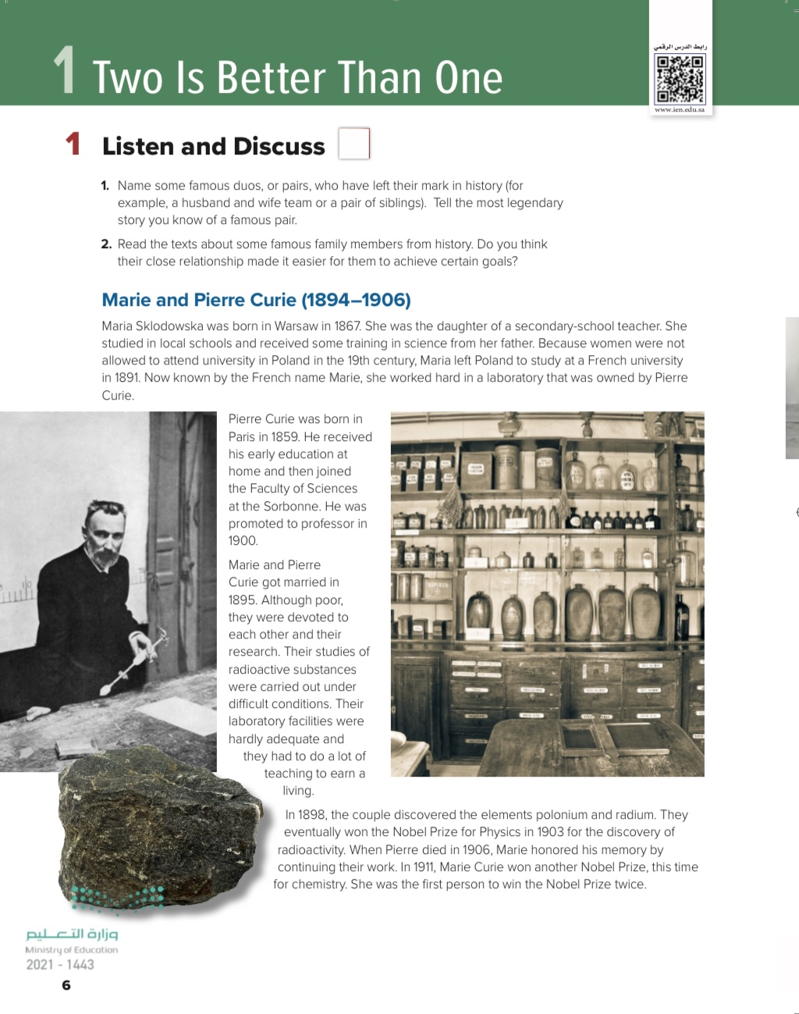
What do these dates refer to?
the dates of each couple’s marriage

Slide 15
What do these dates refer to?
their years of birth and death
HOME
PLANNERS
HOMEWORK

Slide 16
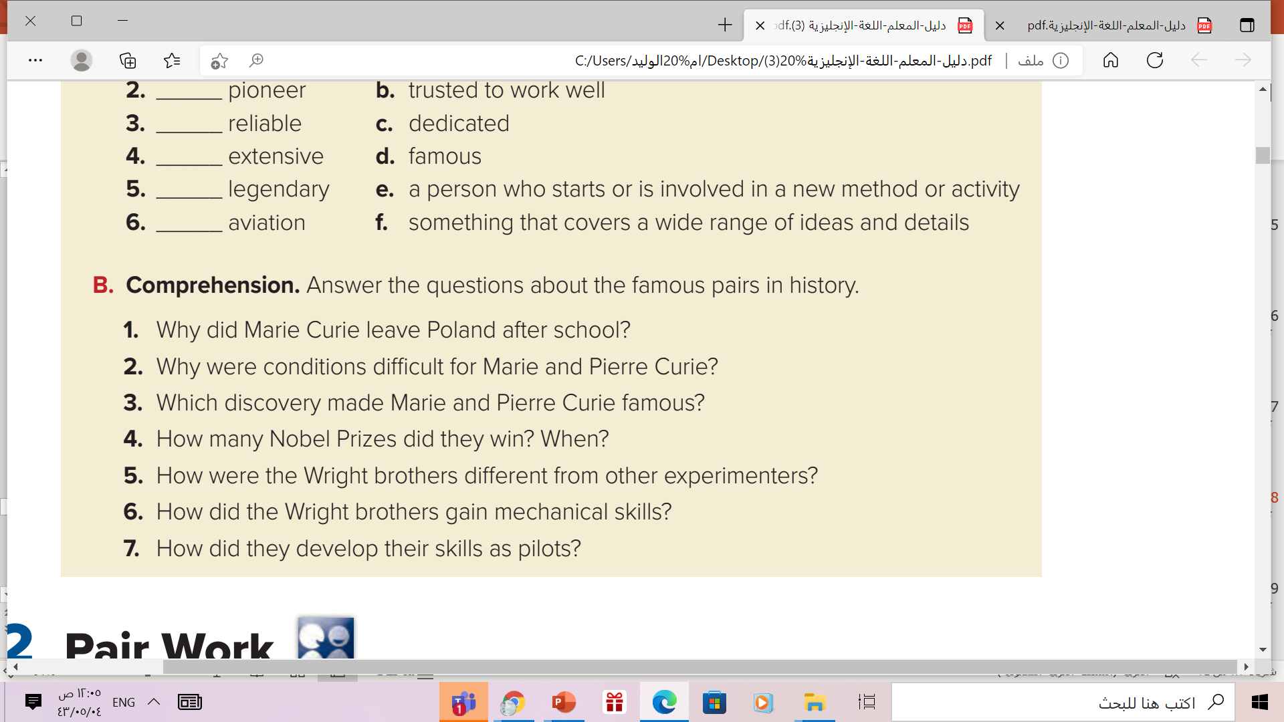
1.Because women were not able to attend university in Poland.
2. They had to work long hours in order to earn a living and their laboratory did not have a lot of facilities.
3. The discovery of radioactivity made them famous.
4. They received a Nobel Prize for Physics in 1903 and Marie Curie won another Nobel Prize in chemistry in 1911.
5. They focused on developing a reliable pilot control system, rather than more powerful engines.
6. They gained mechanical skills by working with bicycles, motors, and other machinery in their shop.
7.They developed their skills as pilots by testing gliders

Slide 17
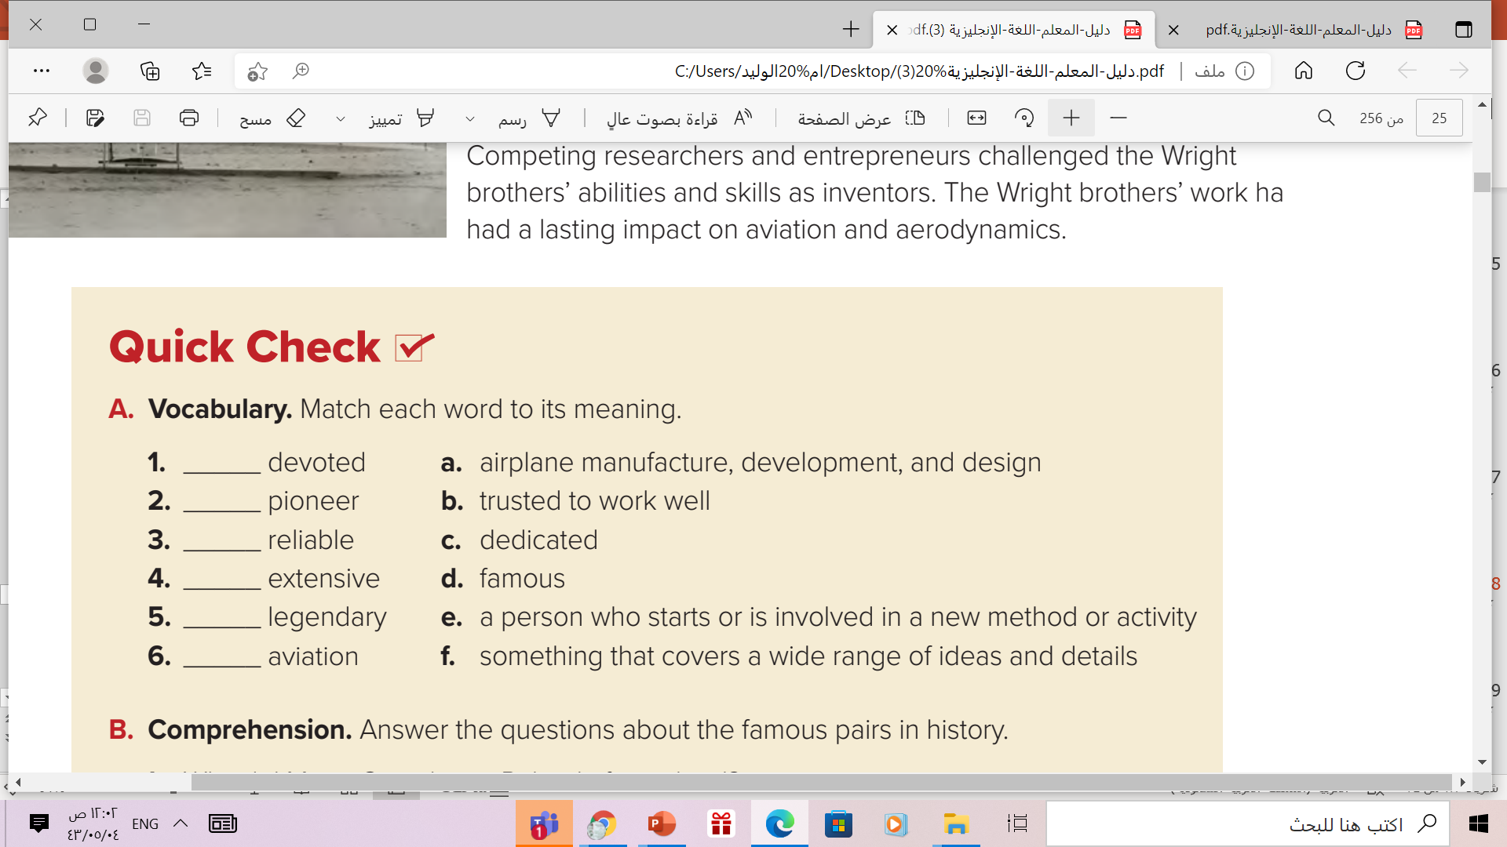
c
e
b
f
d
a

Slide 18
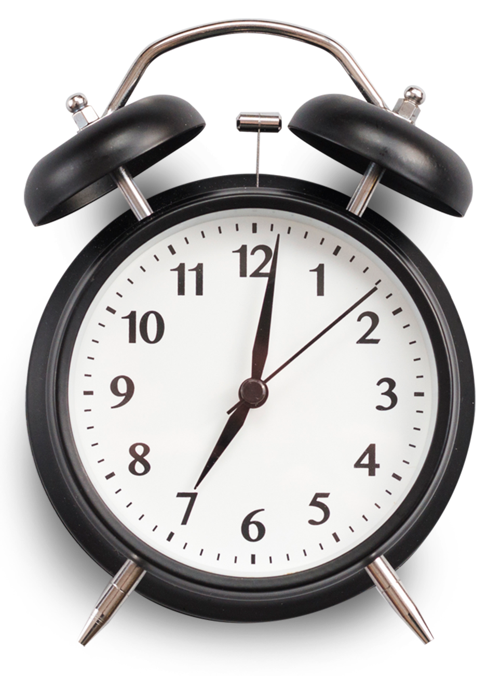

1 MIN
Mention an Islamic couple who made a difference.
HOME
BACKGROUNDS
PLANNERS
HOMEWORK

Slide 19
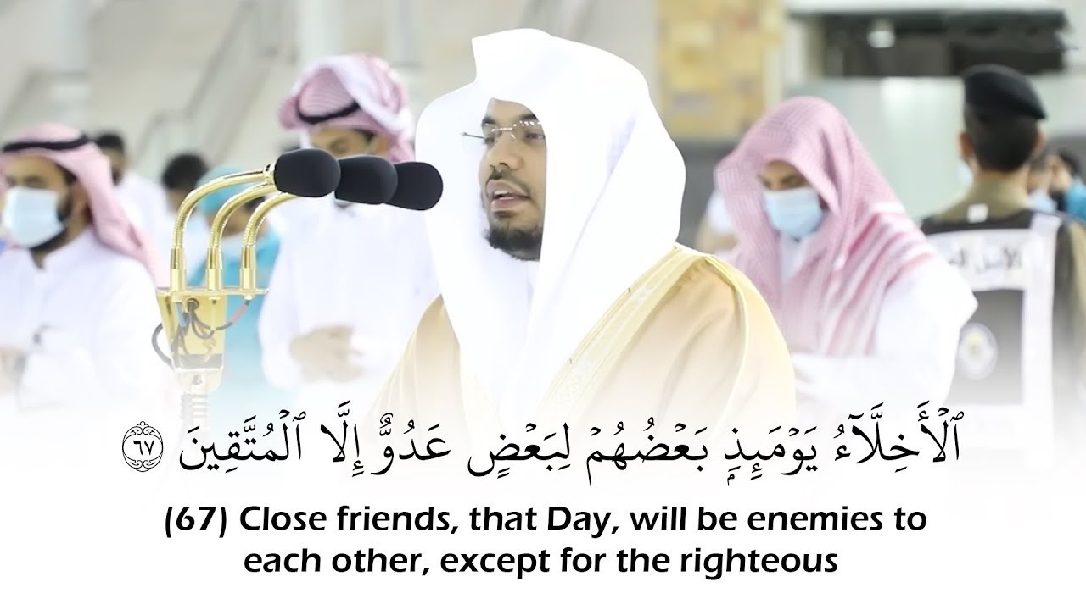
Remember
HOME
BACKGROUNDS
AVATAR KIT
PLANNERS
HOMEWORK

Slide 20
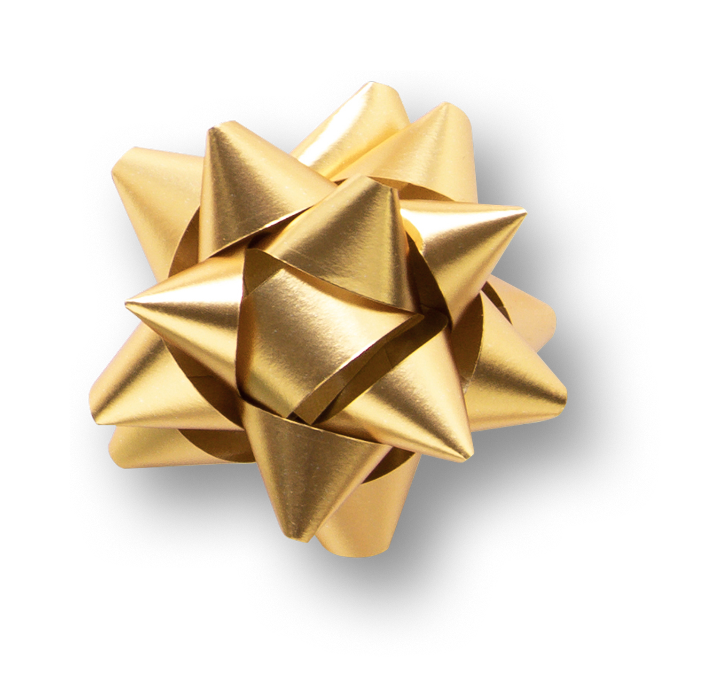
Homework
Workbook page ( 6) , exercise (a)
HOME
AVATAR KIT
PLANNERS
HOMEWORK

Slide 21


Thanks!

