Slide 1


Welcome to class
T.

Slide 2

1
Unit 1

Slide 3
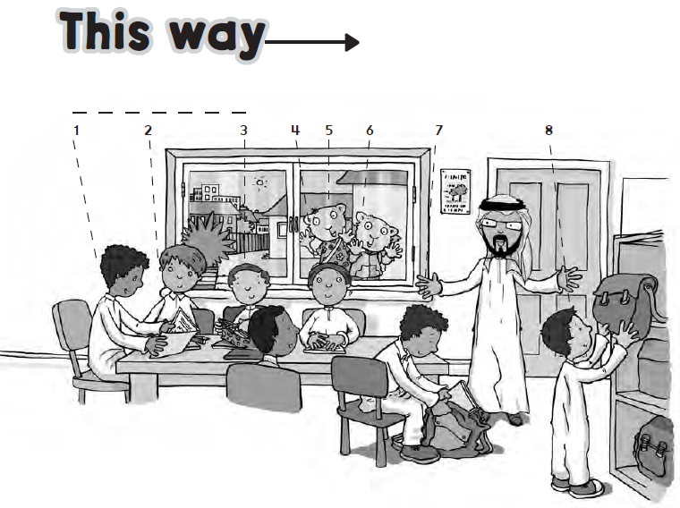

Slide 4
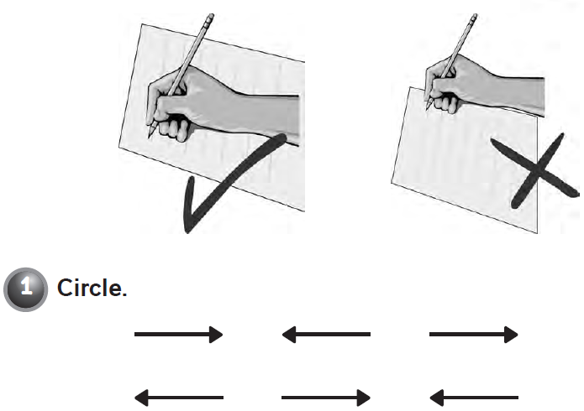

Slide 5
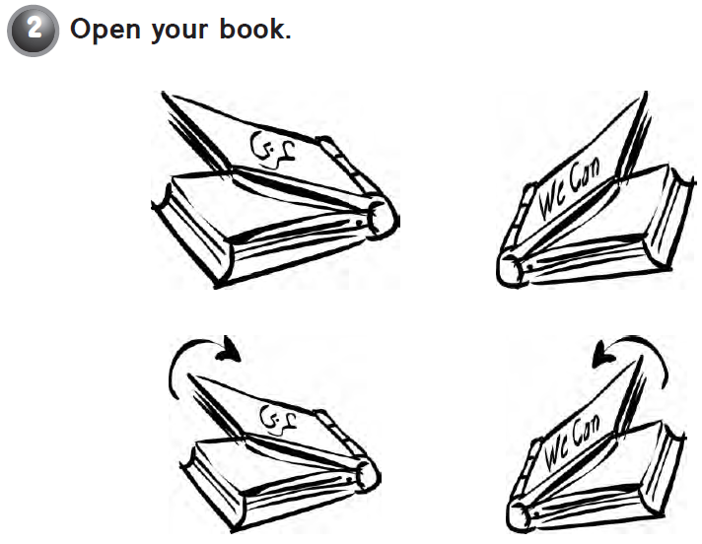

Slide 6



Slide 7





workbook
Pages 45 , 46

Slide 8

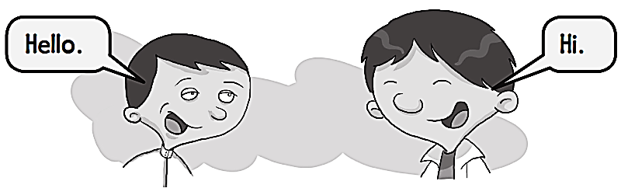
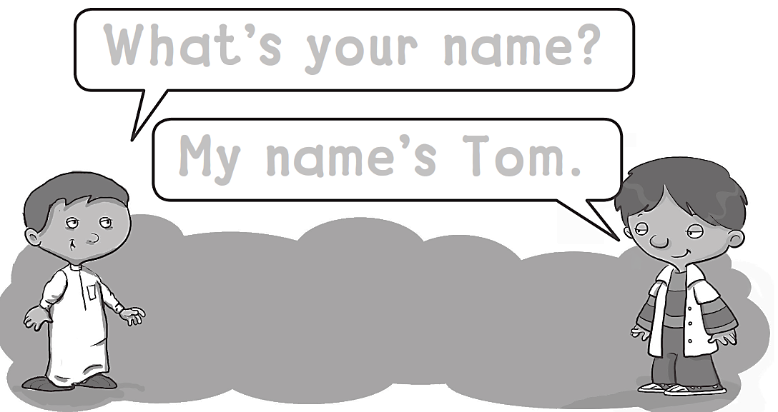
What΄s your name?
My name΄s tom.

Slide 9

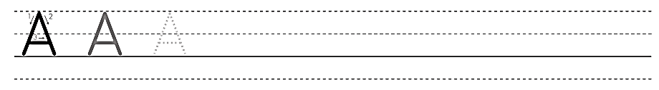
A A A A A A A A

Slide 10

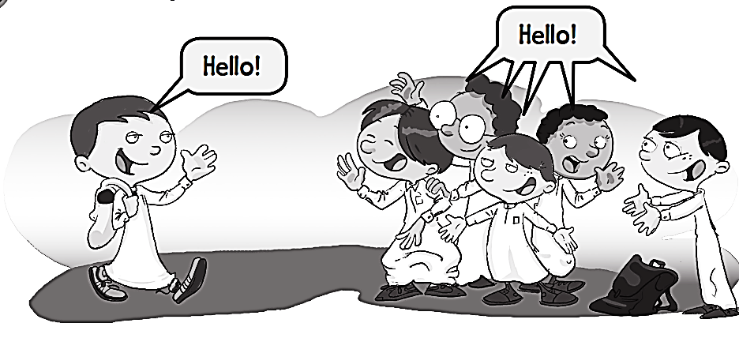
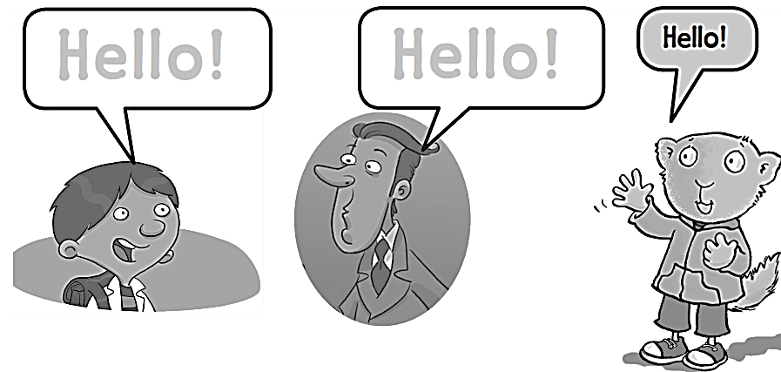
Hello !
Hello !

Slide 11

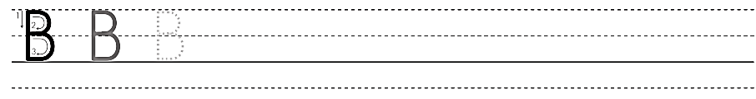
B B B B B B B B B

Slide 12
workbook
Pages 47 , 48

Slide 13


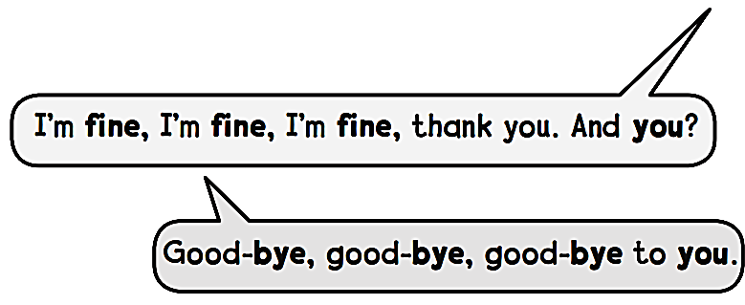
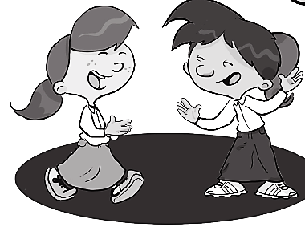
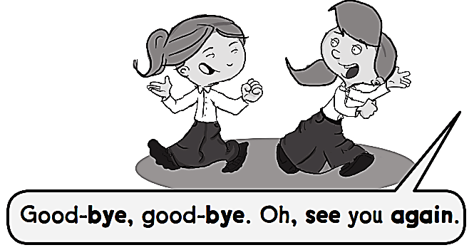
Hello, hello, hello.
How are you ?

Slide 14

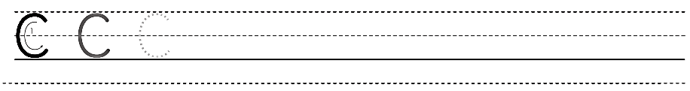
C C C C C C C C

Slide 15

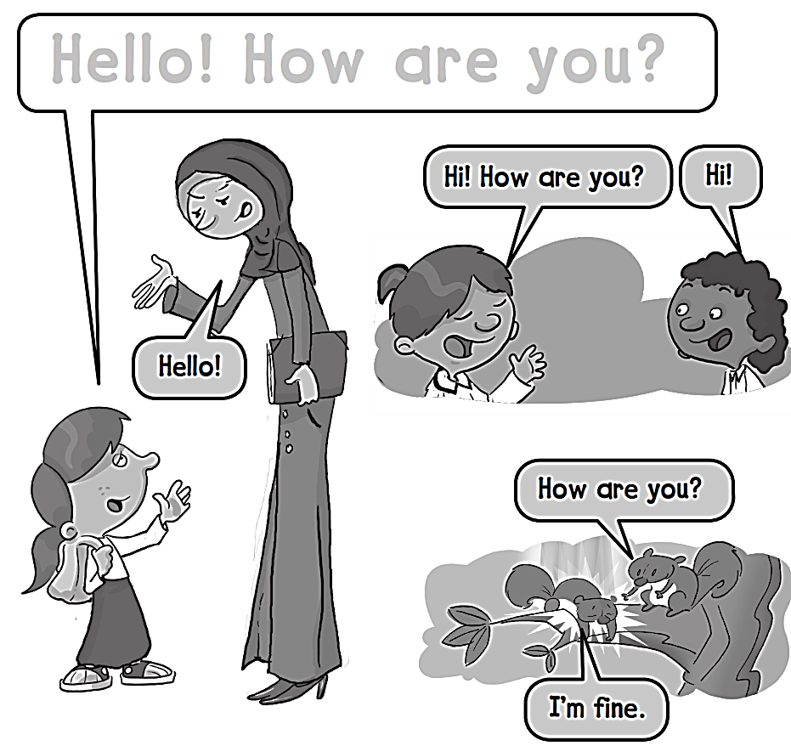
Hello ! How are you ?

Slide 16

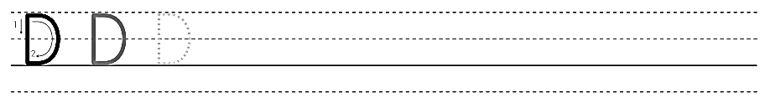
D D D D D D D D

Slide 17
workbook
Pages 49 , 50

Slide 18

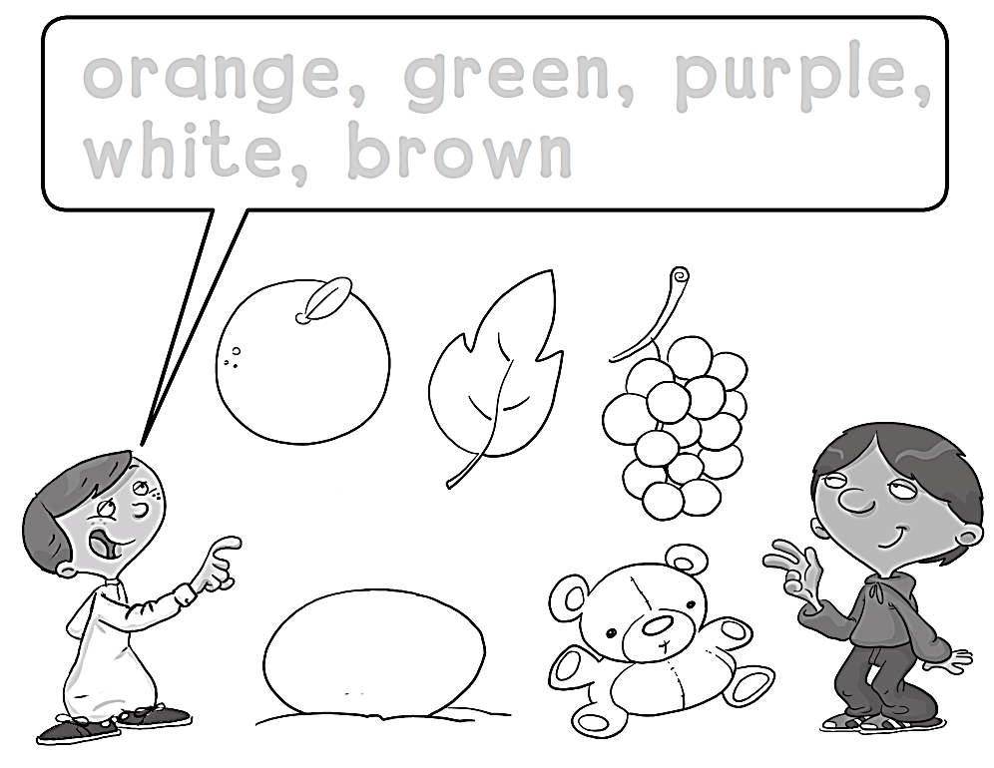
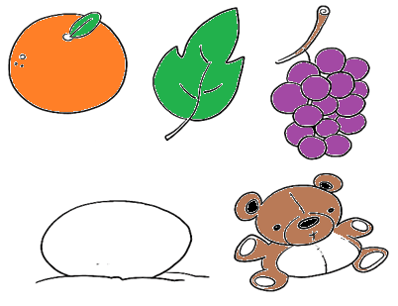
Orange , green , purple ,
white , brown

Slide 19

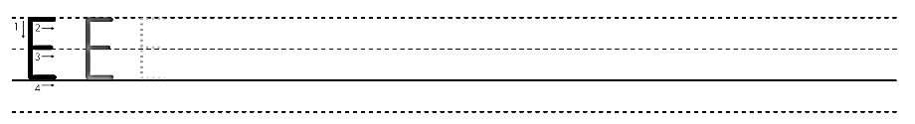
E E E E E E E E E E

Slide 20
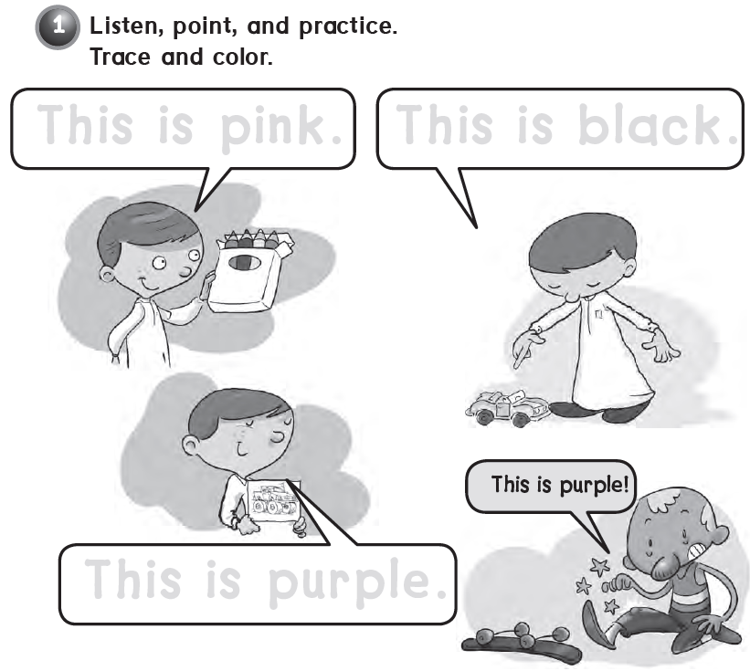
This is pink .
This is black.
This is purple.

Slide 21

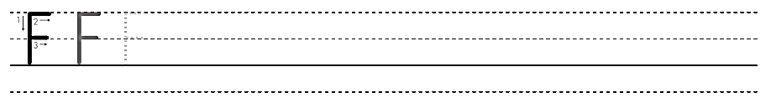
F F F F F F F F F F F

Slide 22
workbook
Pages 51 , 52

Slide 23

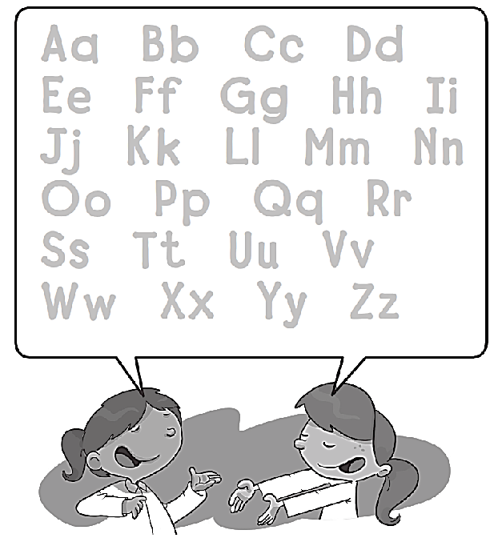
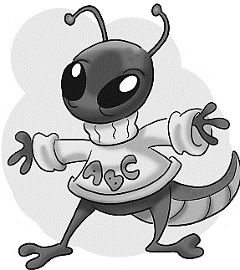
Aa Bb Cc Dd
Ee Ff Gg Hh Ii
Jj Kk Ll Mm Nn
Oo Pp Qq Rr
Ss Tt Uu Vv
Ww Xx Yy Zz

Slide 24

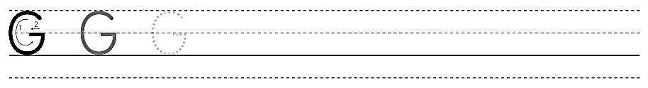
G G G G G G G G

Slide 25
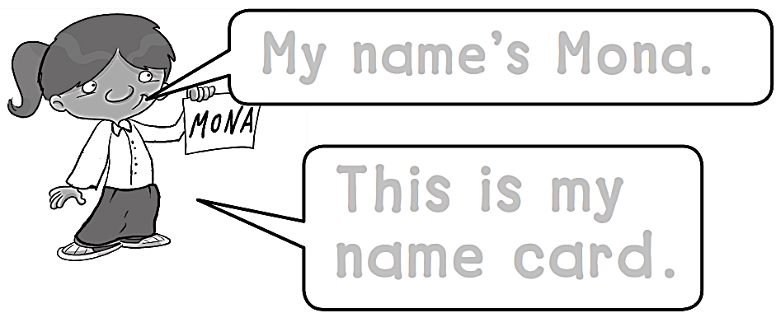
My name’s Mona.
This is my
Name card .

Slide 26

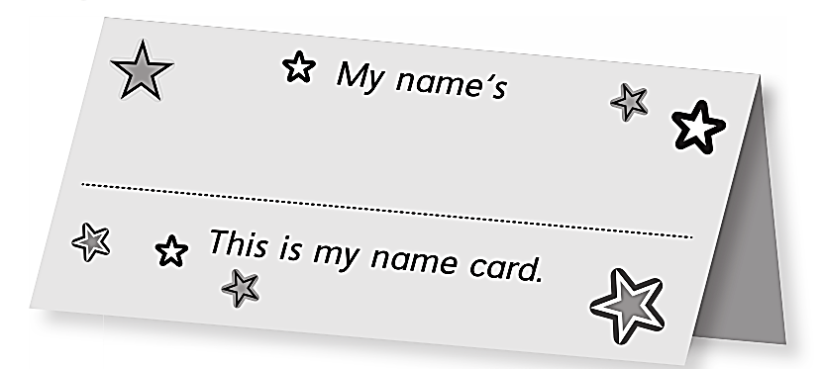
Write your Name here.

Slide 27

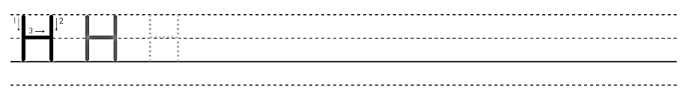
H H H H H H H H

Slide 28


