Slide 1



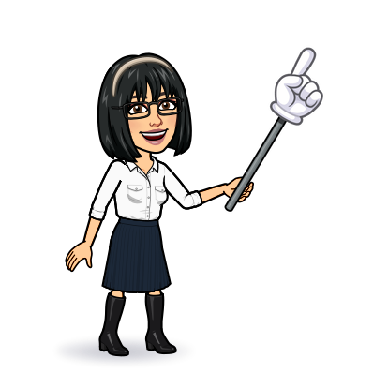


11 Form , meaning & function
Today:
Date:
- -
Page 9
By: Dalal Al-Juaid

Slide 2


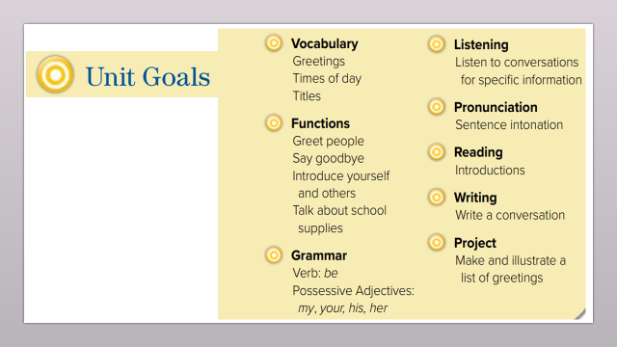
Identify school supplies correctly.
Match the school supplies with the correct verb
Warm up
conversation
New words
Write the correct verb
match
summative

Slide 3
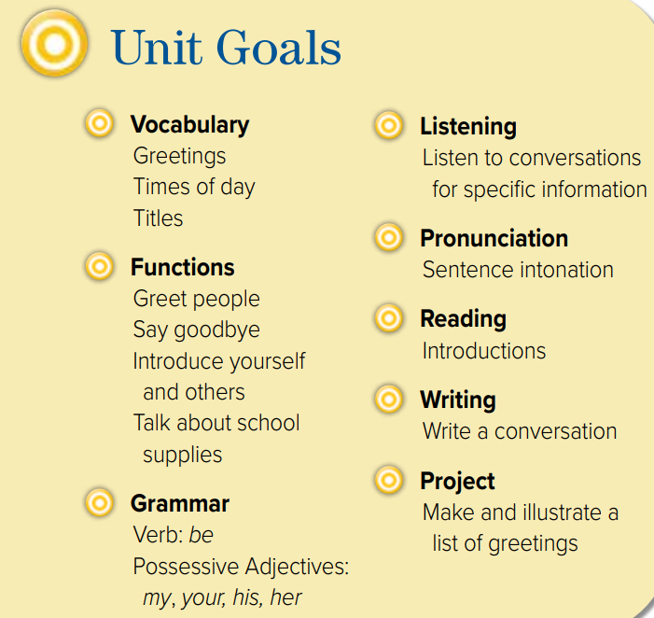

Slide 4

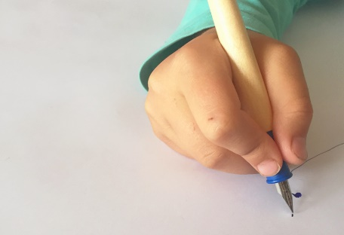


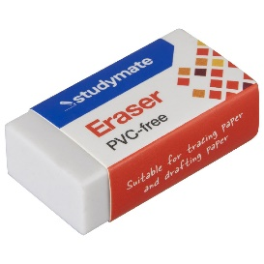
Talk about the picture:
read
write
We read books.
We write with a pen.
Warm up
The preposition with is used when the item is used a tool.
School things
New words
eraser
match
We erase with an eraser.
summative

Slide 5

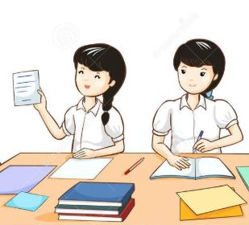


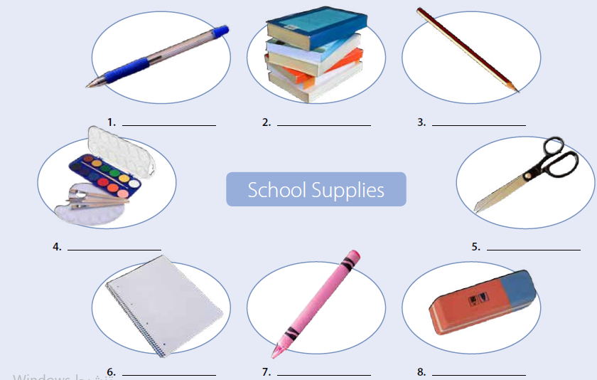
Page 9
read
Think pair share
pen
books
pencil
Warm up
scissors
School things
paints
New words
match
notebook
crayon
eraser
summative

Slide 6
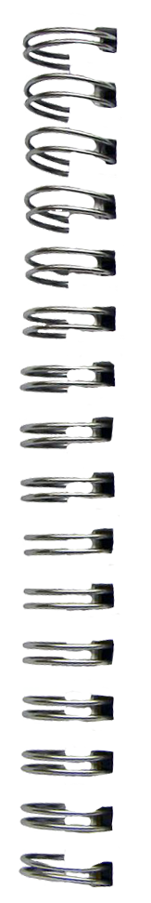
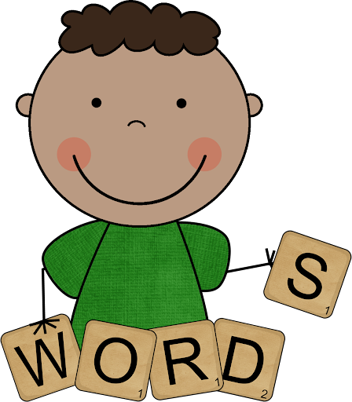

pen
New Words
pencil
book
notebook
eraser
scissors
paints
crayon

Slide 7
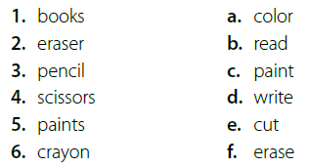







What do you use each school supply for?
with crayon
pair work
books
with paints
with pencil
with scissors
Warm up
with eraser
School things
New words
write
We write with a pen.
match
summative

Slide 8


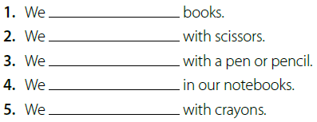

read
cut
write
write
color
Warm up
School things
New words
Make a question
match
summative

Slide 9





Write a sentence in your notebook
Warm up
School things
New words
match
summative

