Slide 1



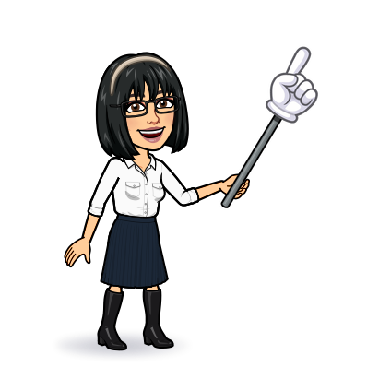


8 Reading
Today:
Date:
- -
Page 7
By: Dalal Al-Juaid

Slide 2


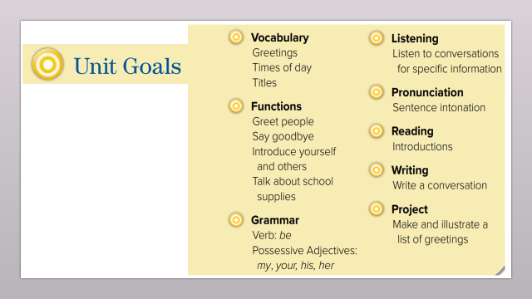
Complete the dialogue.
answer some questions from a reading text.
Warm up
conversation
New words
Find out the meaning of the new words.
complete
summative

Slide 3
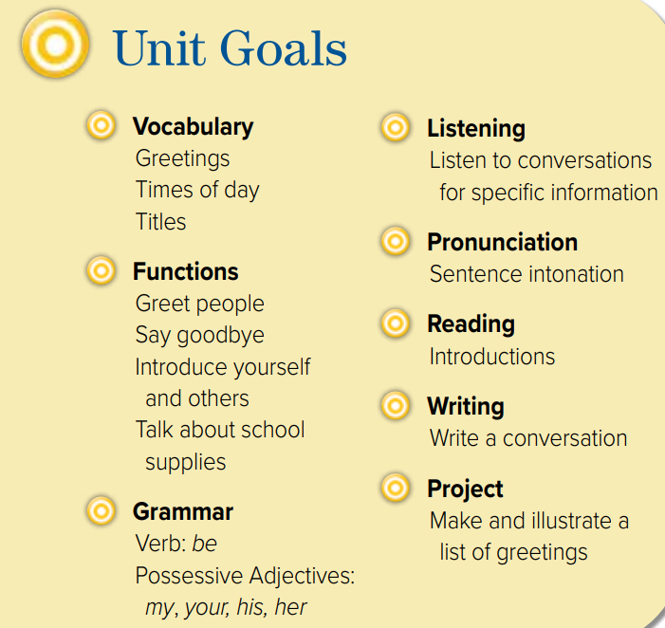

Slide 4

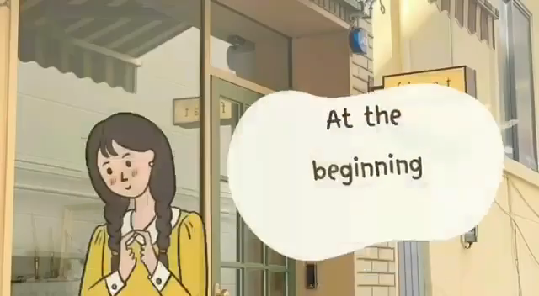

Warm up
conversation
New words
complete
summative

Slide 5


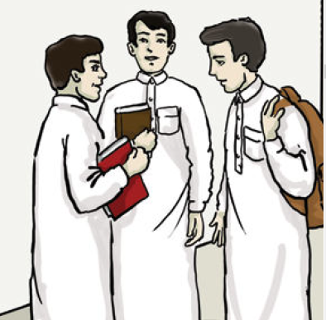

Look at picture
Page 7
Hello
Welcome to ….
My name is ….
Nice to meet you.
Warm up
conversation
New words
complete
summative

Slide 6




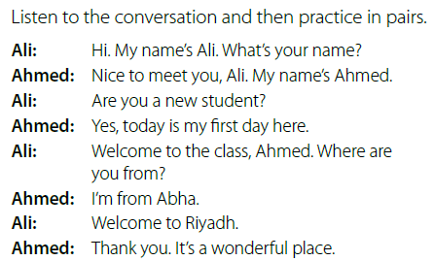

Page 7
Listen and read along.
Are Ali and Ahmed friends?
Warm up
conversation
New words
Find expressions people
use during introductions
complete
summative

Slide 7
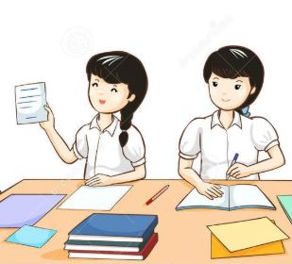


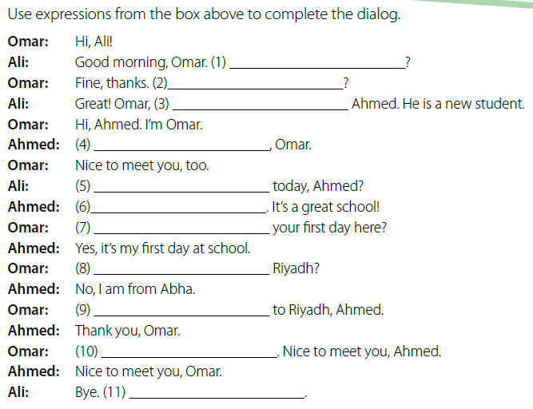
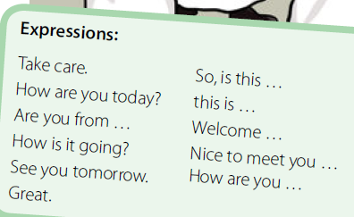
Think pair share
How are you today?
How is it going?
this is
Nice to meet you
How are you
Great
So, is this
Warm up
Are you from
conversation
New words
Welcome
See you tomorrow
complete
Take care
summative

Slide 8




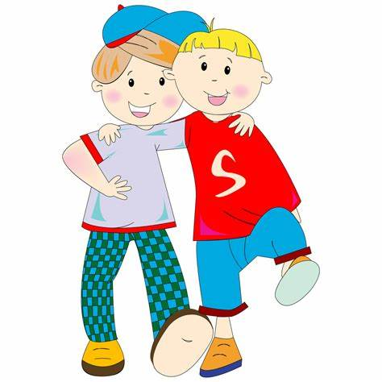


school
New Words
student
friend
classmate
meet (v)
See someone
new #
#
old

Slide 9

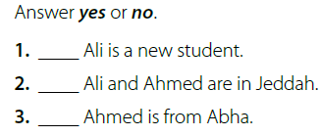

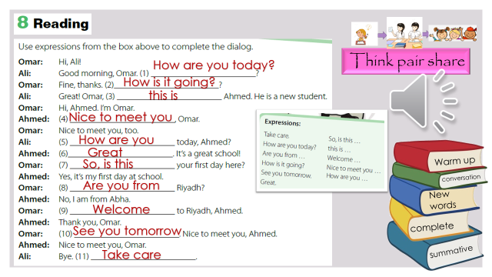
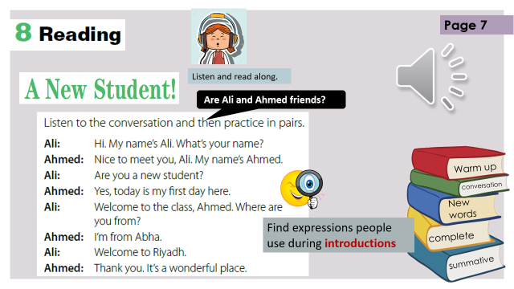
pair work
no
no
yes
Warm up
conversation
New words
Make new (wh) questions
Where are they ?
complete
What’s the name of the new student?
summative

Slide 10





page 190 Ex (F)
for practice with new words
Warm up
conversation
New words
complete
summative

Slide 11

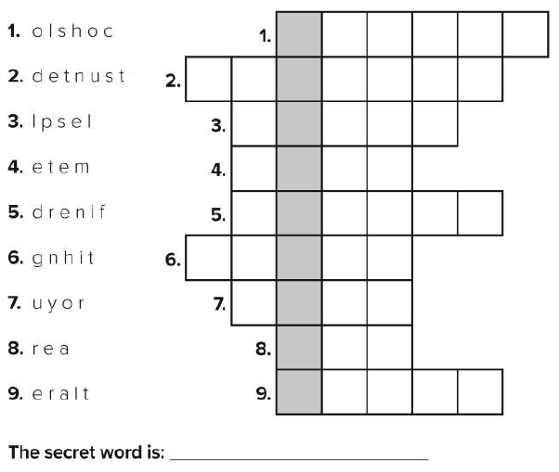
p.190
s
c
h
o
o
l
s
t
u
d
e
n
t
s
p
e
l
l
m
e
e
t
f
r
i
e
n
d
n
i
g
h
t
Warm up
y
o
u
r
conversation
a
r
e
New words
l
a
t
e
r
complete
Super Goal
summative

