Slide 1






1 Listen & discuss
2 pair work
Today:
Date:
- -1444
Page 2-3
By: Dalal Al-Juaid

Slide 2


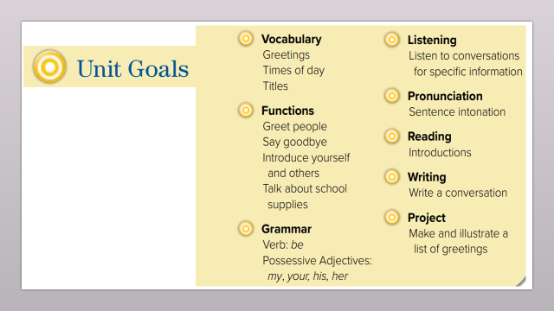
Apply greetings in a simple conversation.
Introduce a friend to others.
Warm up
1-Listen
New words
Quick check
2-Pair work

Slide 3
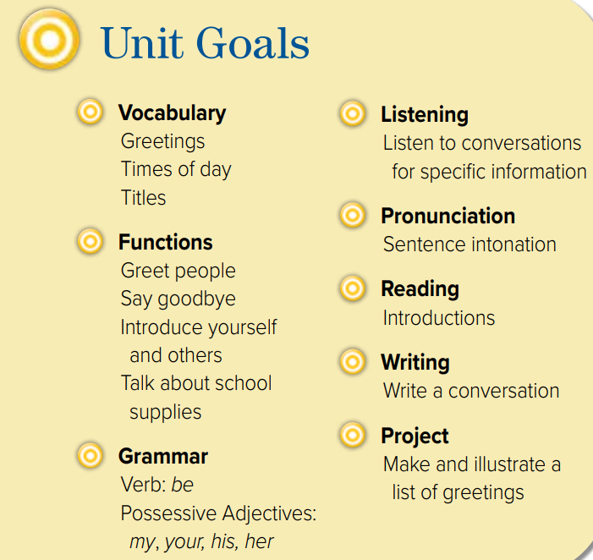

Slide 4




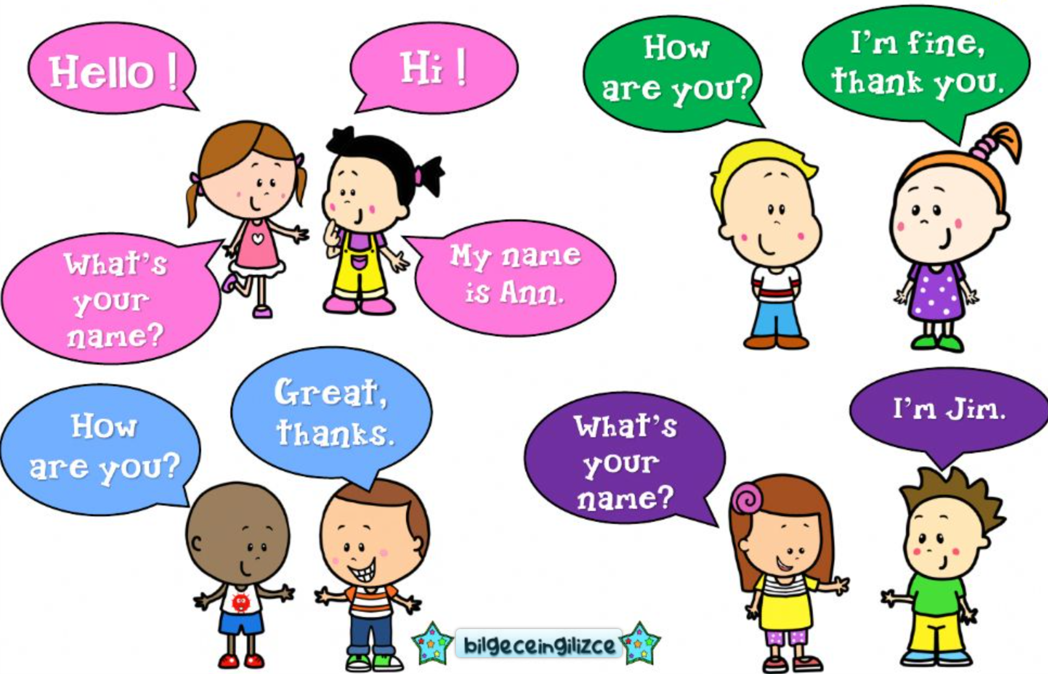
Warm up
1-Listen
New words
Quick check
2-Pair work

Slide 5
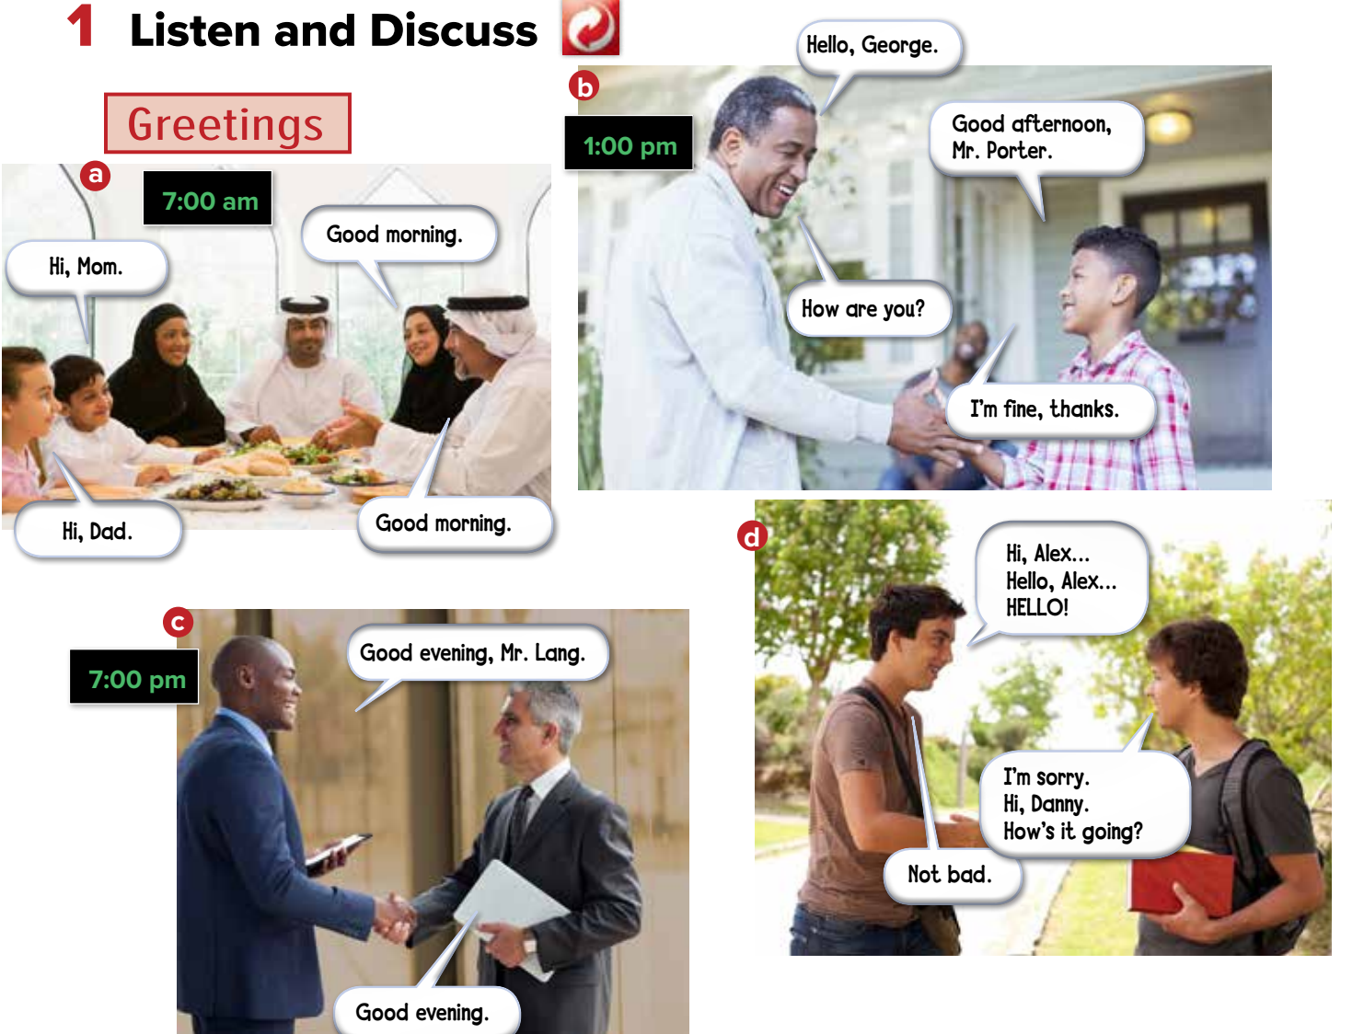


Page 2
Warm up
1-Listen
New words
Quick check
2-Pair work

Slide 6
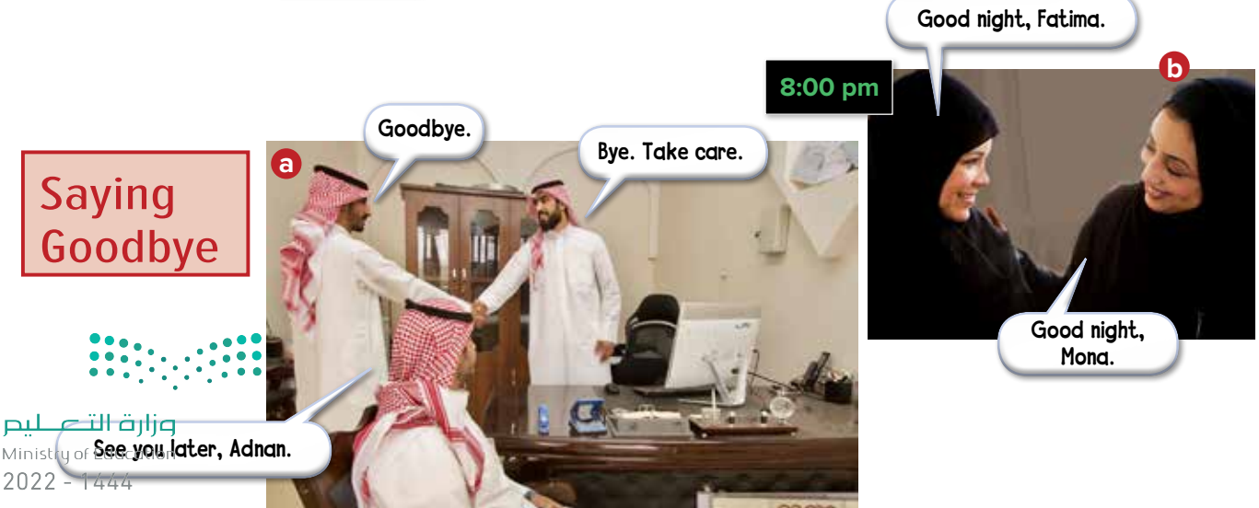
Page 2
Warm up
1-Listen
New words
Quick check
2-Pair work

Slide 7
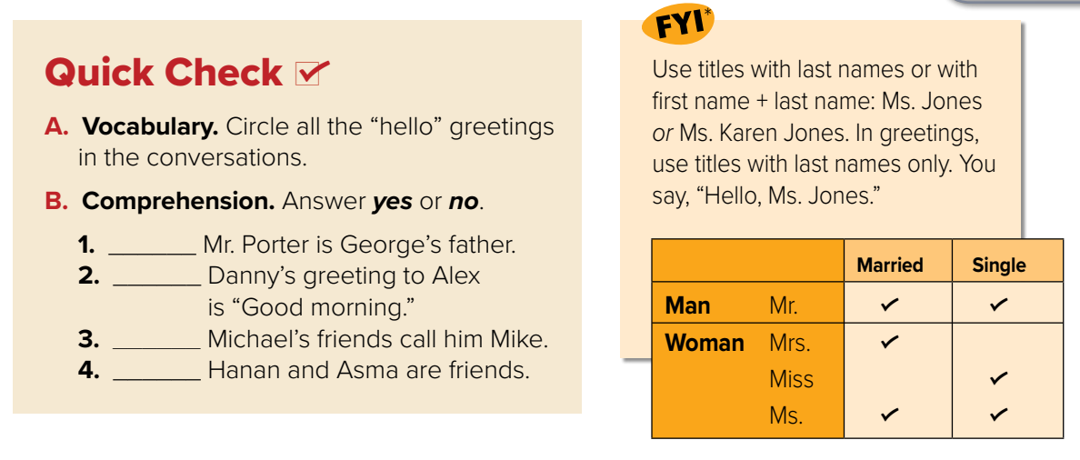
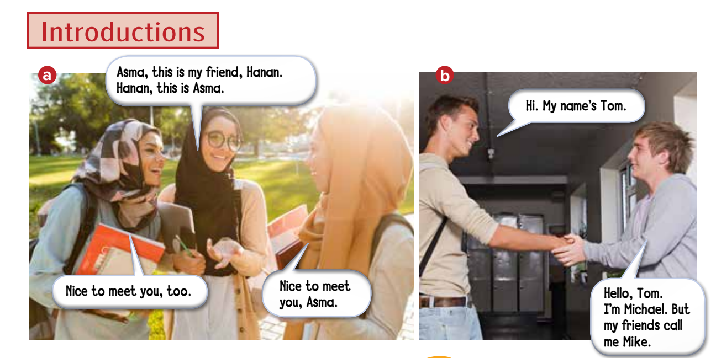
Warm up
1-Listen
New words
Quick check
2-Pair work

Slide 8

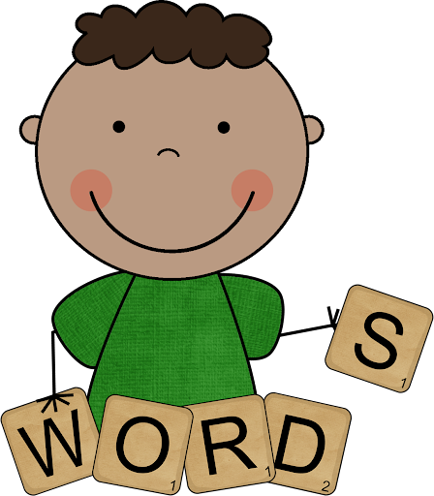

New Words
Greetings:
Hello
Hi
Good morning
Good afternoon
Good evening
Goodbye
Farewells:
Good night

Slide 9
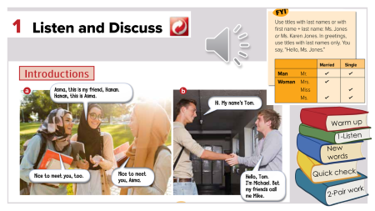
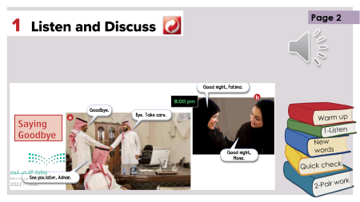
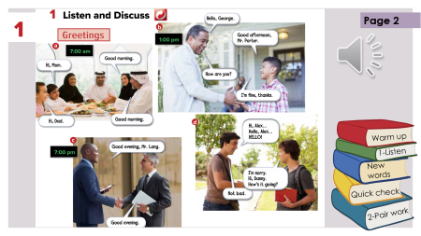
Page 3
no
no
Warm up
1-Listen
yes
New words
no
Quick check
2-Pair work

Slide 10

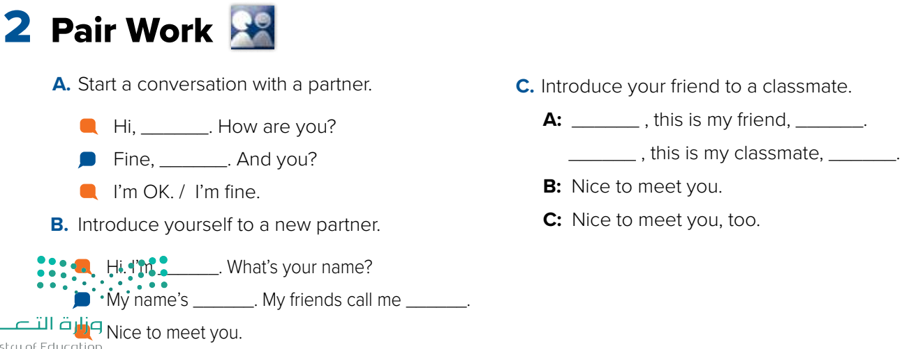


Warm up
1-Listen
New words
Quick check
2-Pair work

Slide 11





page 187 Ex (A)
for practice with new words
Warm up
1-Listen
New words
Quick check
2-Pair work

Slide 12


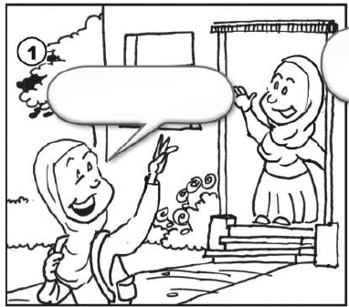
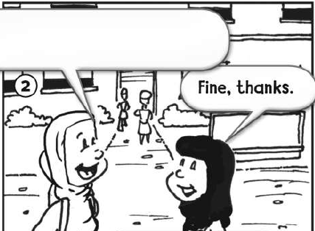
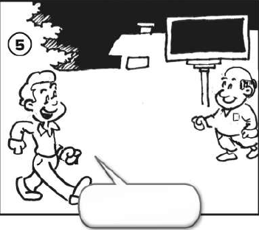
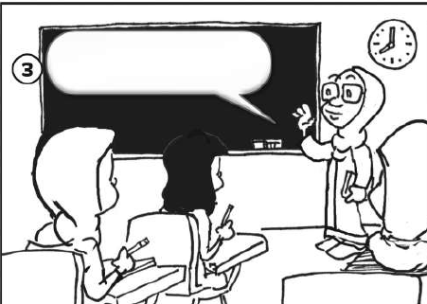
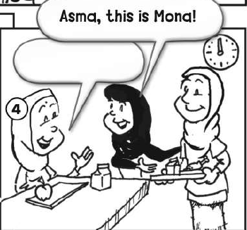
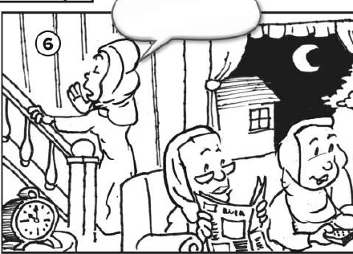
p.187
Hi. How are you?
Goodbye.
Good evening.
Good morning.
Warm up
Nice to meet you.
Good night.
1-Listen
New words
Quick check
2-Pair work

