Slide 1






7 Conversation
Today:
Date:
- -1444
Page 6
By: Dalal Al-Juaid

Slide 2


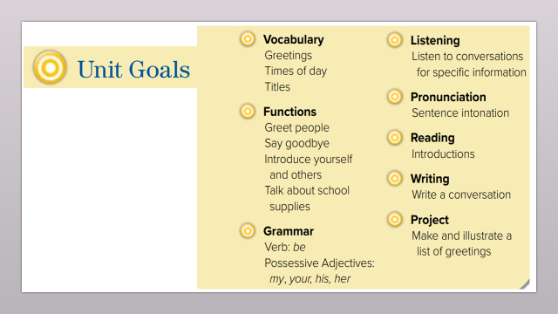
practice a welcoming conversation.
answer questions about a conversation.
Warm up
conversation
New words
Make a new conversation.
Answer Qs.
summative

Slide 3
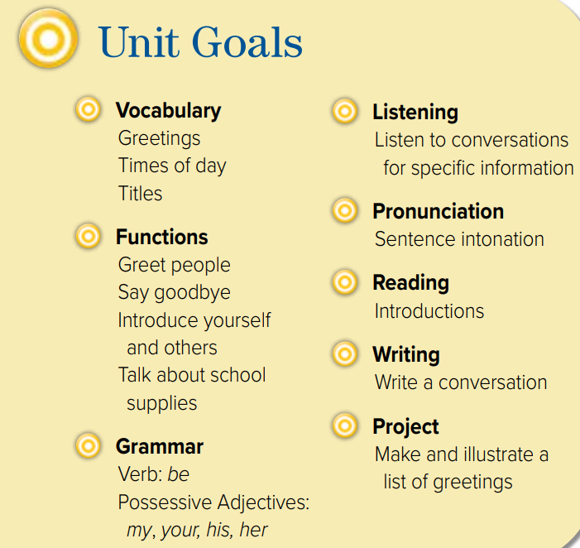

Slide 4




Warm up
conversation
New words
Imagine that Rasha is new in your class,
what will you say to her?
name –you from - nice to meet
Answer Qs.
summative

Slide 5


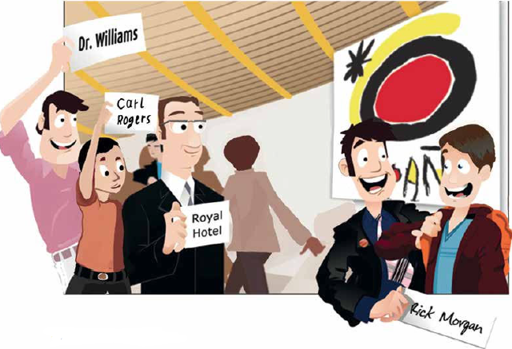
Look at picture
Page 6
Where are the people in the picture?
Where are the signs for?
They’re at the airport.
They’re waiting for people to arrive.
Warm up
conversation
New words
Where are the signs for?
☺the signs with the names of people that they are waiting for.
Answer Qs.
summative

Slide 6



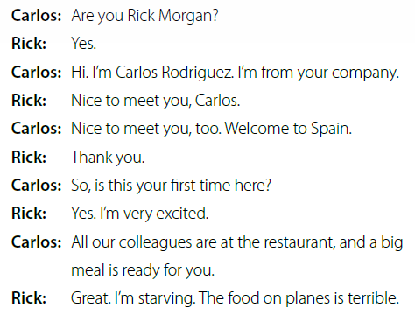

Listen and read along.
Warm up
conversation
New words
Answer Qs.
summative

Slide 7






welcome
New Words
be pleased about something.
starving
very hungry.
terrible
very bad.
Small #
#
big

Slide 8





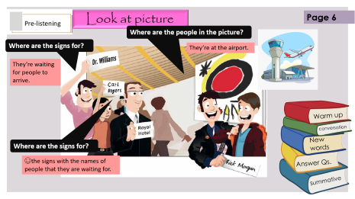
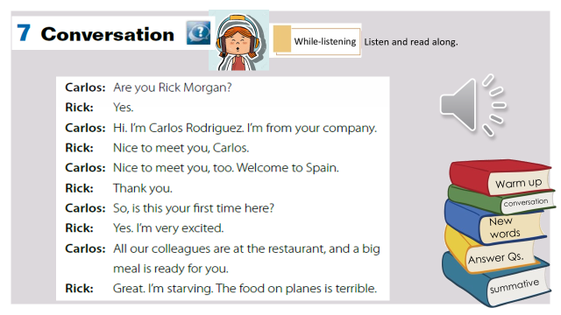


Think pair share
Find Carlos and Rick in the picture.
What country is Rick visiting?
Warm up
Spain.
conversation
Did he come here before?
New words
No
Answer Qs.
How was the food on the plane?
Terrible.
summative

Slide 9



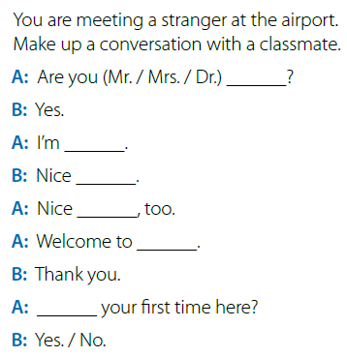
Write down and complete conversation
Rana
Lura Fadi.
to meet you Lura.
Warm up
to meet you, too
conversation
Jeddah
New words
Is this
pair work
Answer Qs.
summative

Slide 10





page 189 Ex (E)
for practice with grammar
Warm up
conversation
New words
Answer Qs.
summative

Slide 11
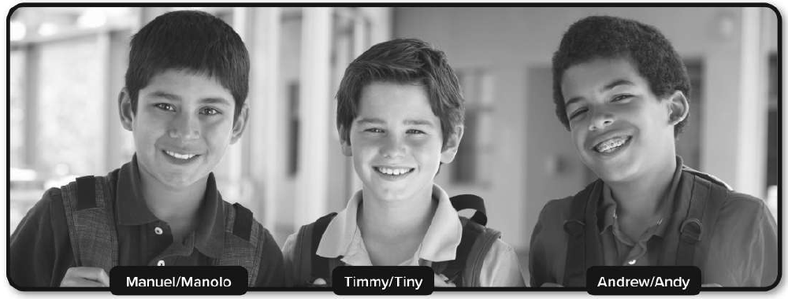
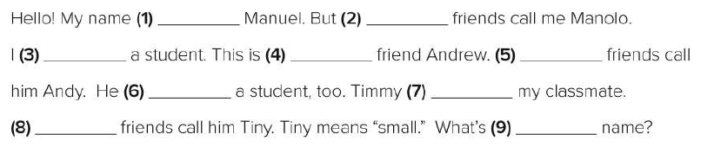
p.189
is
my
Warm up
’m
my
His
conversation
is
’s
New words
His
your
Answer Qs.
summative

