Slide 1



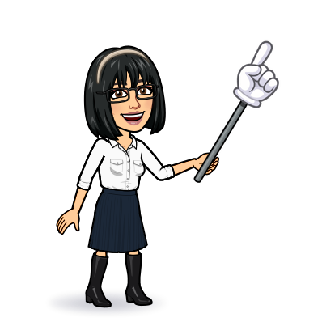


3 Grammar
Today:
Date:
- -1444
Page 4-5
By: Dalal Al-Juaid

Slide 2


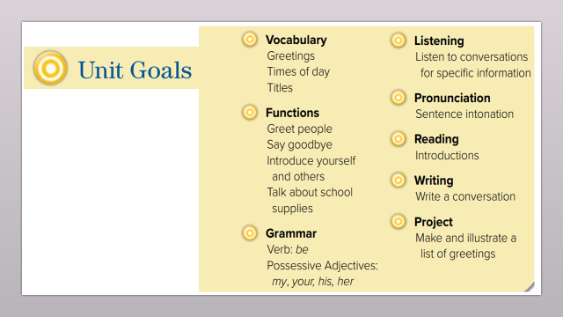
use verb Be with different subjects.
use singular possessive adjectives : my, your , his , her.
Warm up
Gram -1
Gram -2
Mind map
summative

Slide 3
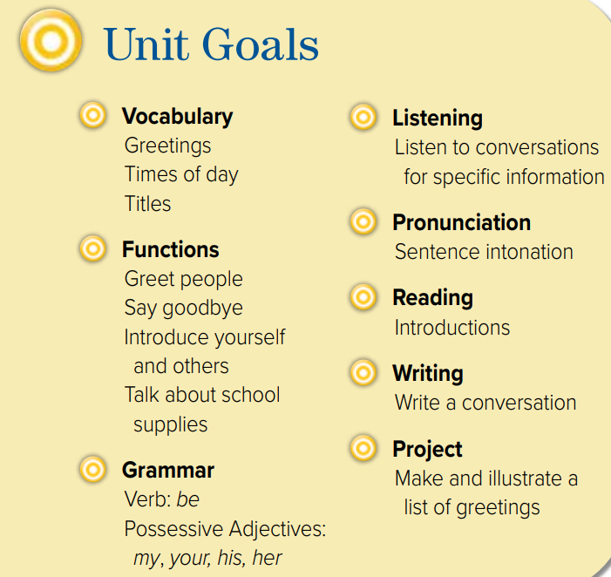

Slide 4

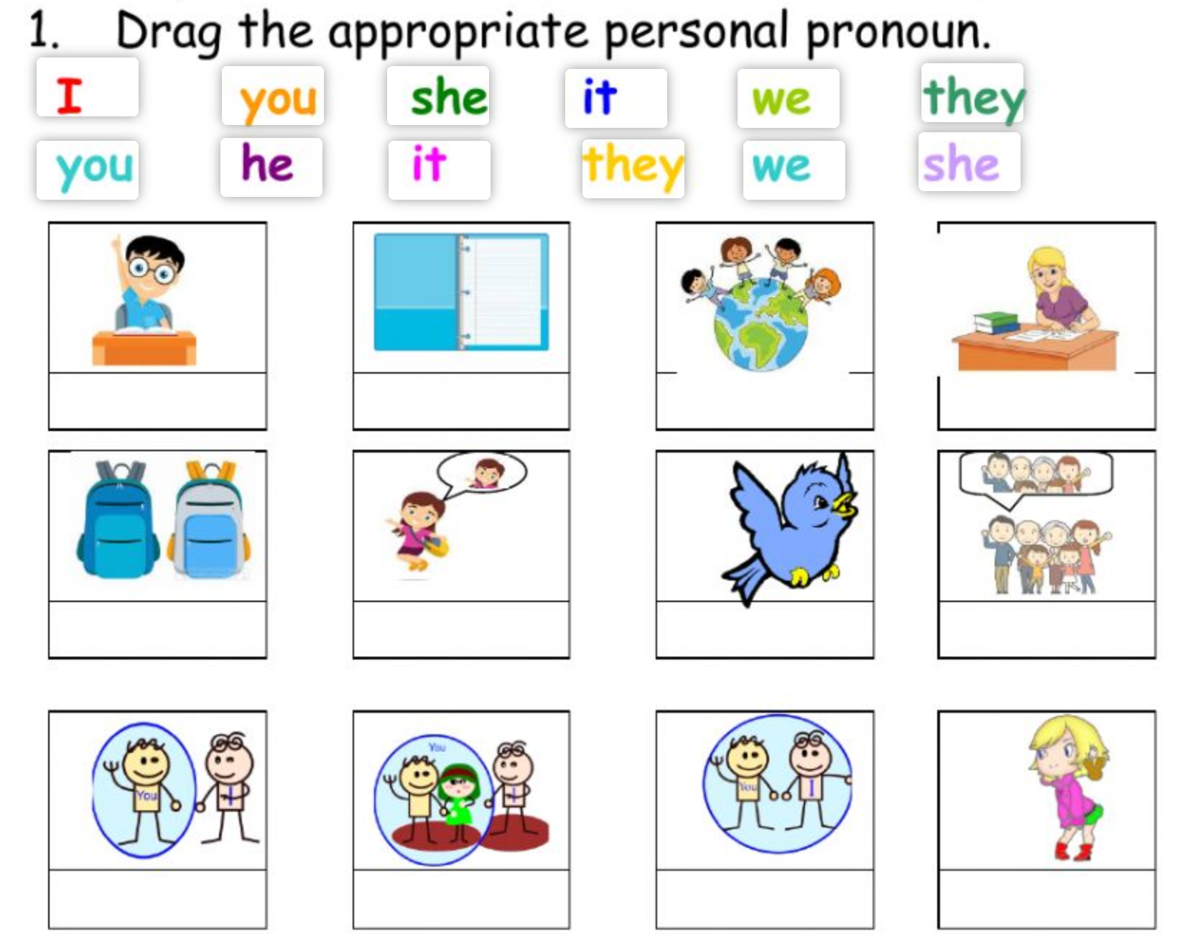


Warm up
Gram -1
Gram -2
Mind map
summative

Slide 5

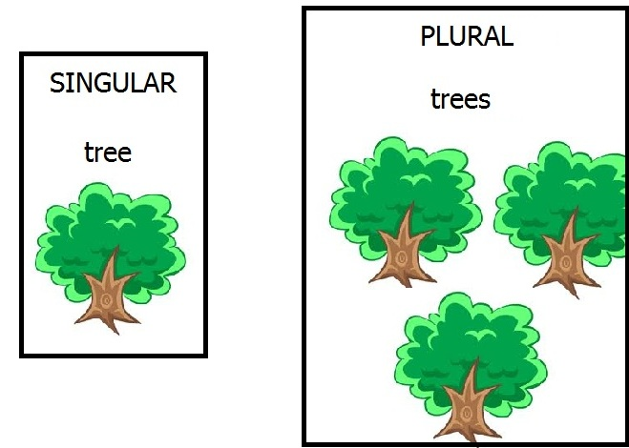
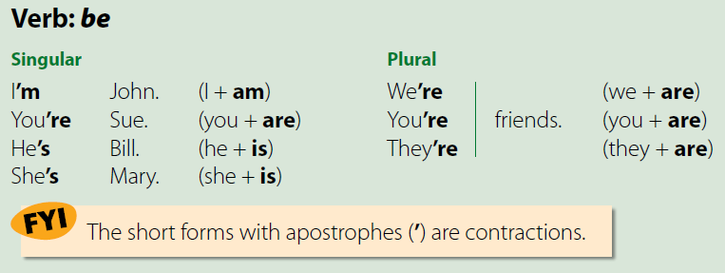

Page 4
Warm up
(short form) is normally used in conversation.
Gram -1
Gram -2
Examples ?
Mind map
summative

Slide 6
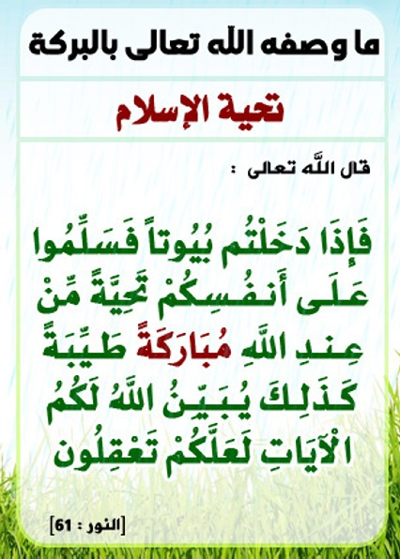
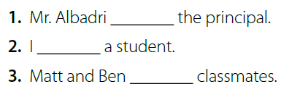
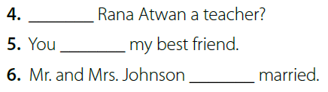
Page 4
is
‘m
are
Is
‘re
are
Warm up
Gram- 1
Gram -2
Mind map
summative

Slide 7
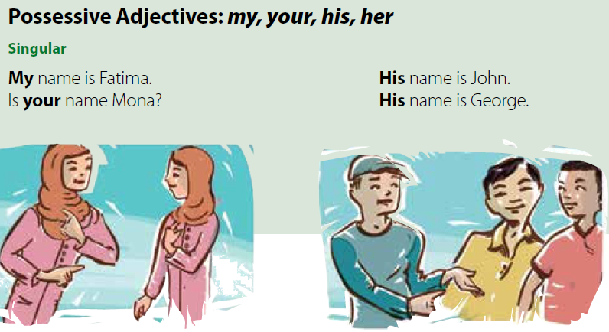
Page 4
Warm up
Gram -1
Gram -2
Correct the mistake:
Mind map
( I ) name is Dalal.
Is ( she ) name Dalal?
My name is Dalal.
Is her name Dalal?
summative

Slide 8
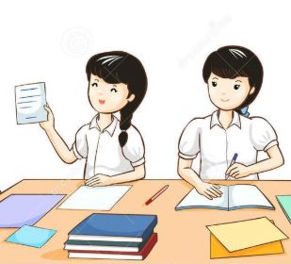




Page 4
His
My
Think pair share
His
His
Warm up
Gram - 1
Gram -2
Mind map
summative

Slide 9

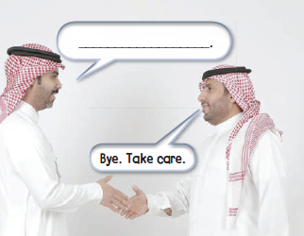

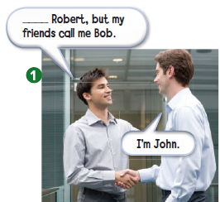
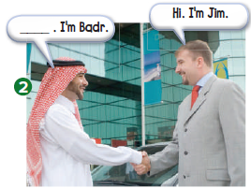
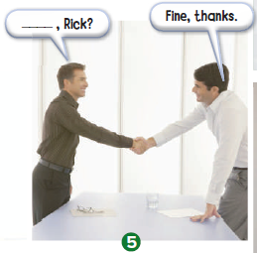
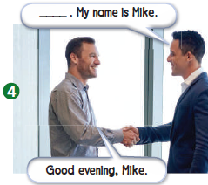
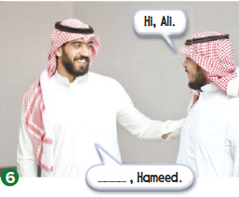
Page 5
My name is
Nice to meet you
See you later
How are you
Warm up
Good evening
Gram -1
Gram -2
Mind map
Good morning
summative

Slide 10
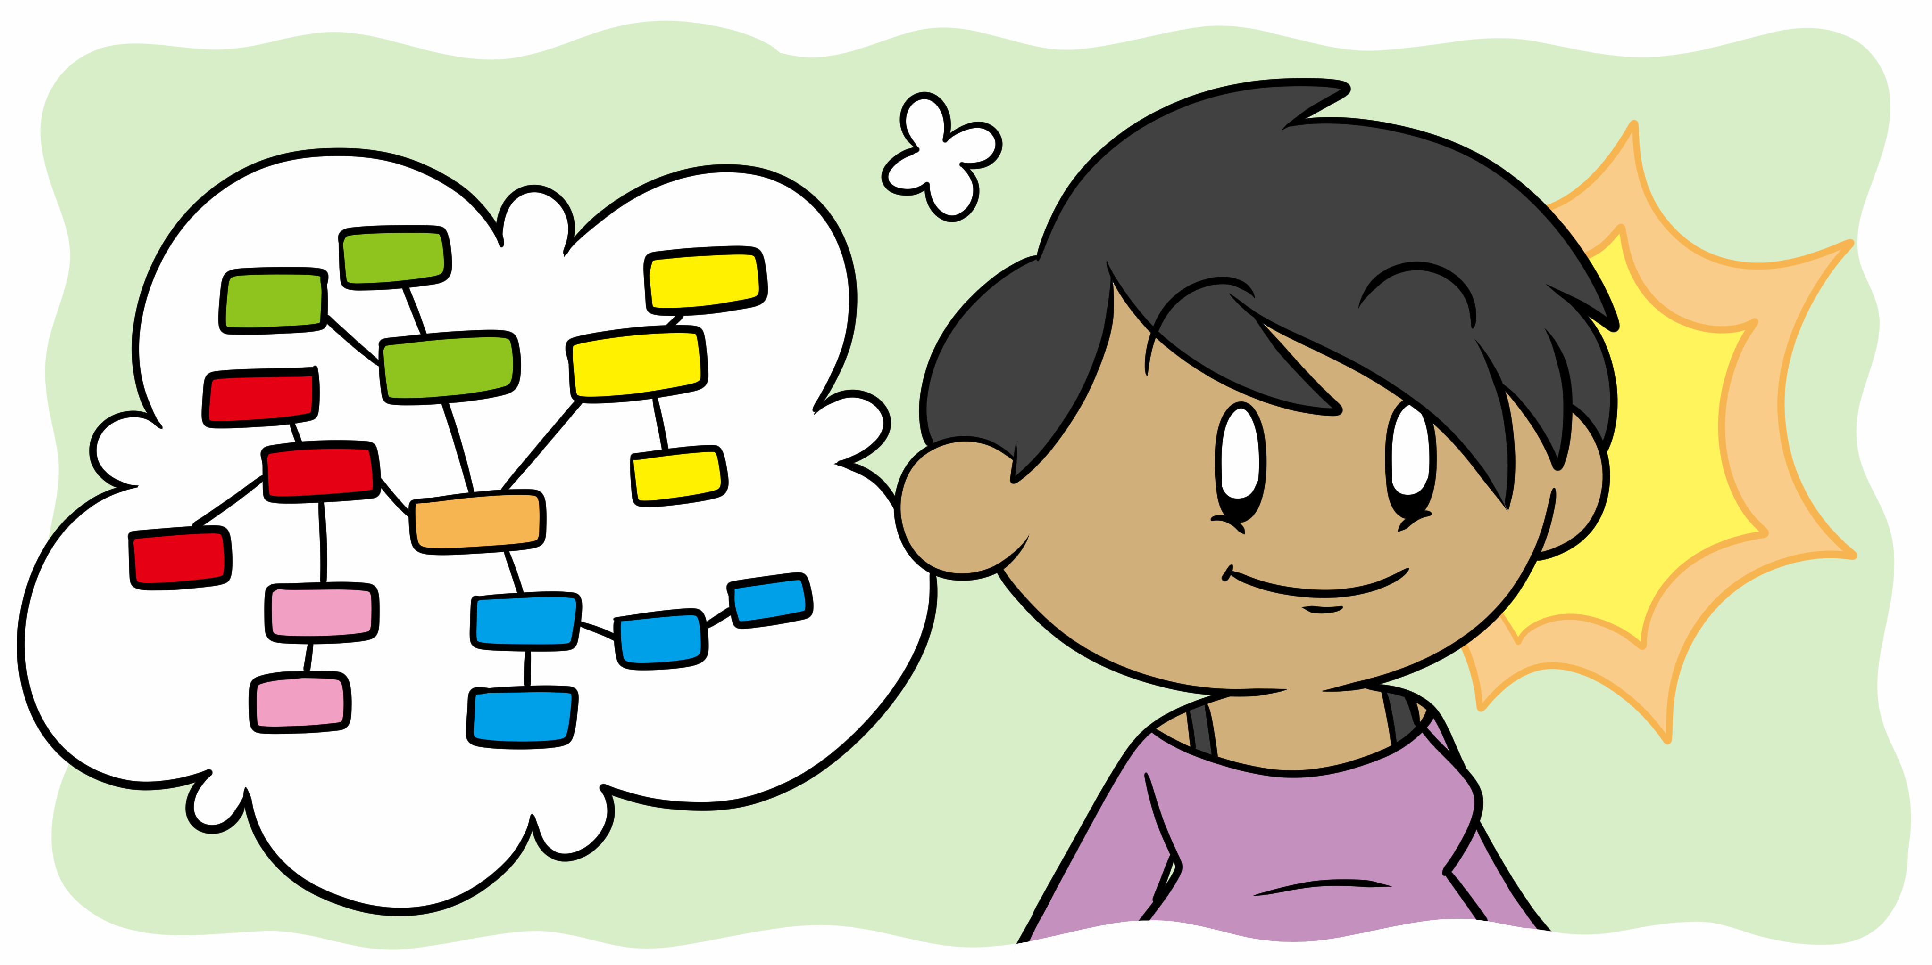
Mind map
I
my
am
Poss. Adj.
she
her
it
Verb Be
is
his
he
your
you
are
we
they

Slide 11
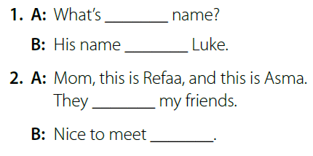
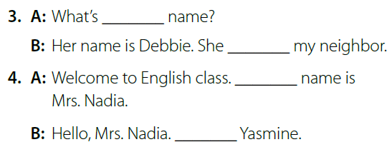
Page 4
his
‘s
pair work
‘re
you
Warm up
her
Gram -1
‘s
My
Gram -2
I’m
Mind map
summative

Slide 12





page 188 Ex (B-C)
for practice with grammar
Warm up
Gram -1
Gram -2
Mind map
summative

Slide 13
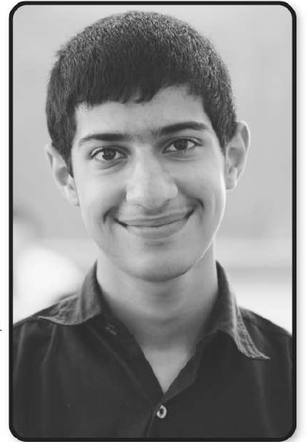
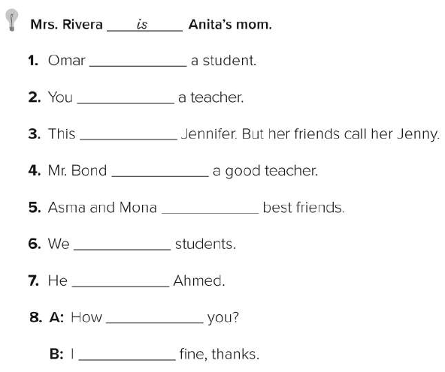
p.188
is
are
is
’s
are
Warm up
’re
Gram -1
is
Gram -2
are
Mind map
’m
summative

Slide 14

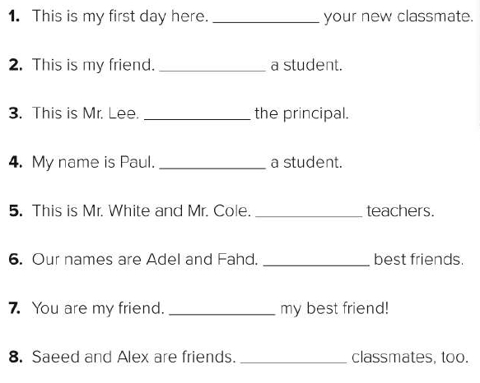
p.188
I’m
she’s
He’s
I’m
They’re
Warm up
Gram -1
We’re
Gram -2
You’re
Mind map
They’re
summative

