Slide 1
Unit 3
What Will Be , Will Be
Language in context + Conversation
Mega Goal 1.1
Done by: Entisar Al-Obaidallah

Slide 2




Lesson Objectives
Write their own personal resolutions .
Answer listening questions .
Read words that are usually not stressed .
Ask and answer questions in a conversation .

Slide 3
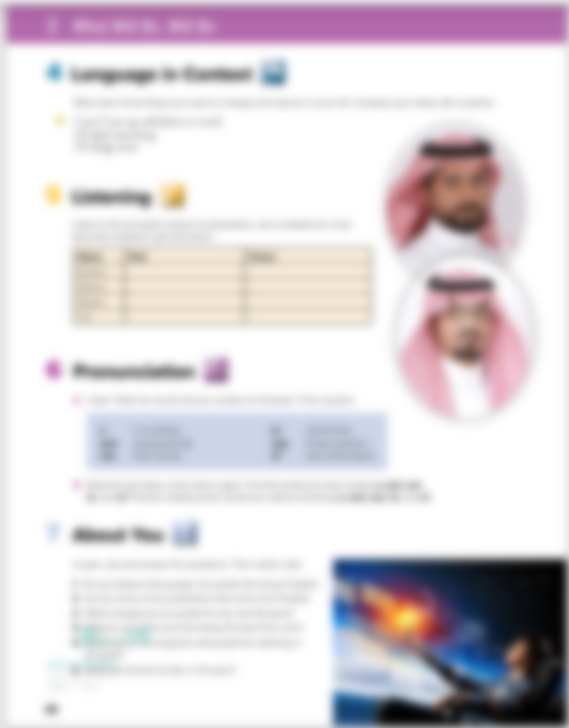
Open
Student’s book , page (34)

Slide 4
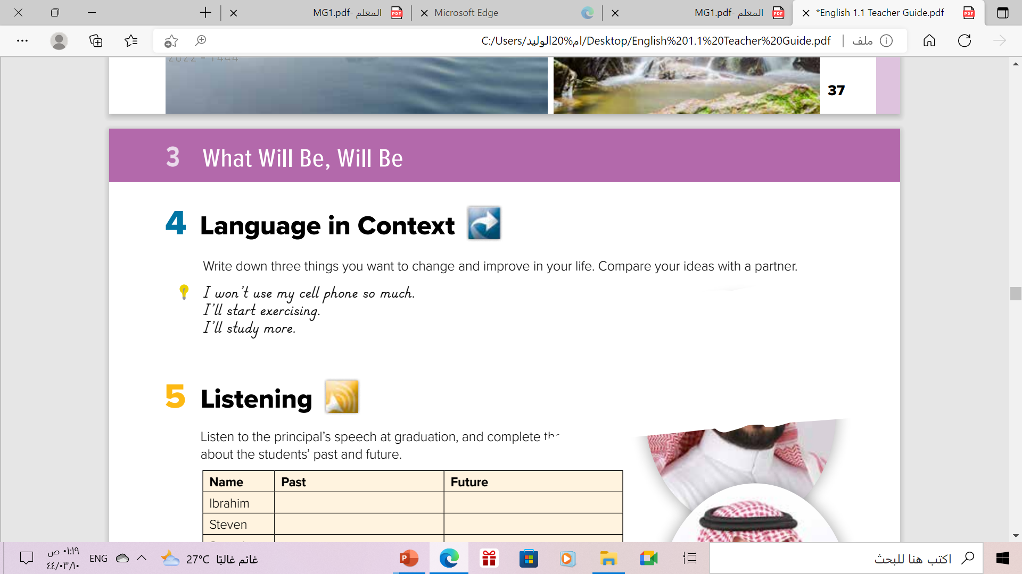
These are personal resolutions
a resolution is a promise you make to yourself.
You promise to do something that will help you

Slide 5

Write down own resolutions

Slide 6

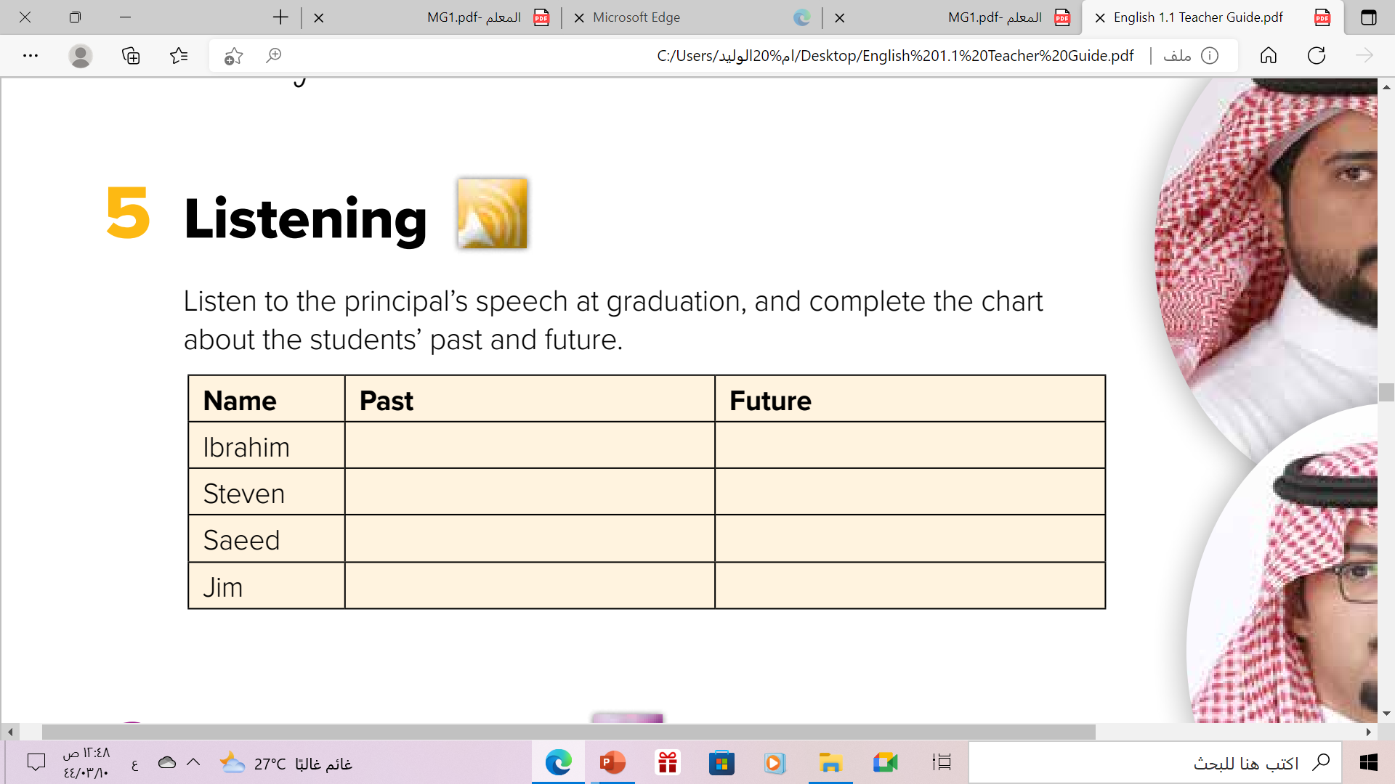
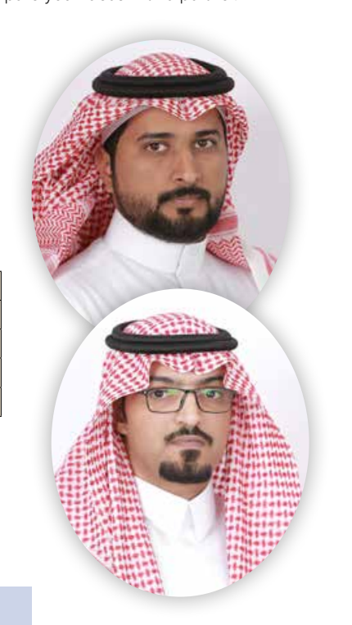
Listen & Complete:

Slide 7
He was a good runner in school race.
He will be a physical education teacher
He was captain of the debate team & good at defending her point of view .
He will be a lawyer .
He had a great scientific mind .
He will become a science researcher
He raised money and worked for
good causes .
He will be a social worker

Slide 8
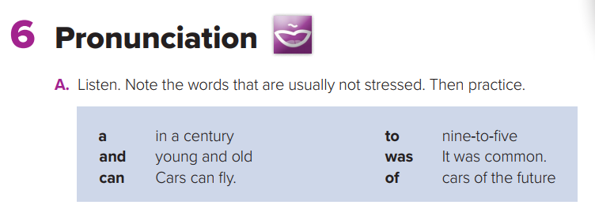

Slide 9
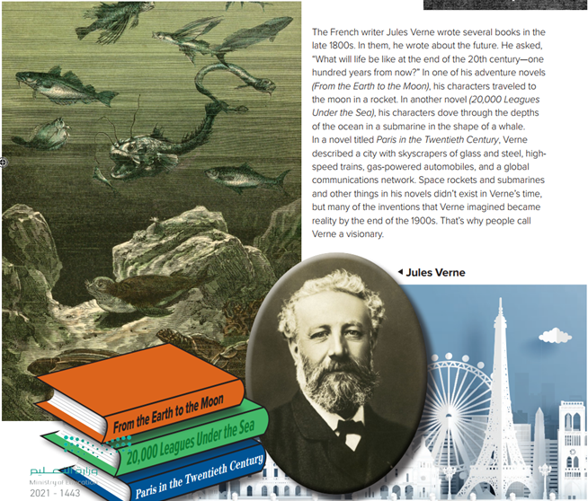
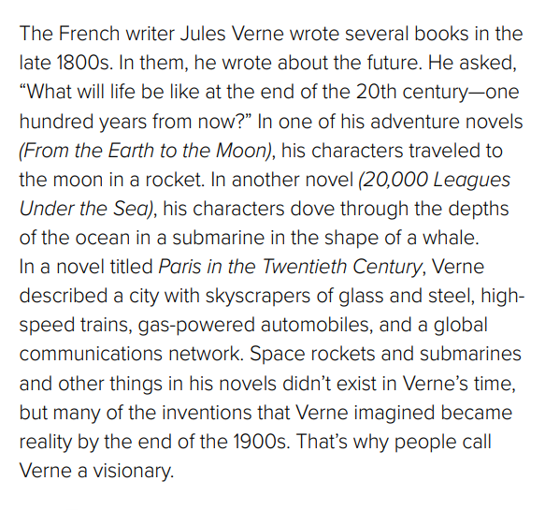

Slide 10

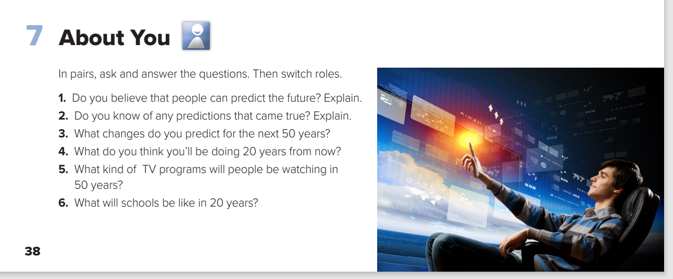

Pair Work

Slide 11
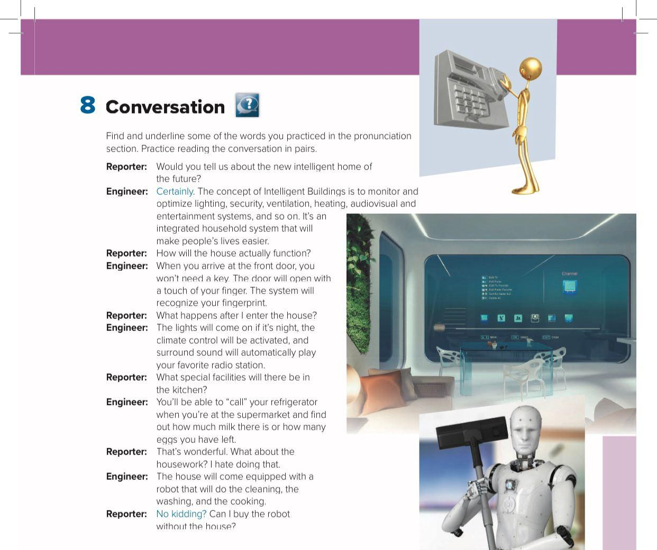

Book open p.(39)
Read along as u listen

Slide 12
What is the house like ?
an intelligent house.
What is the concept of intelligent buildings?
an integrated system that makes people’s lives easier
How do you open the front door?
The system reads your fingerprint
What makes the refrigerator “smart”?
It can tell you what you need to buy.

Slide 13
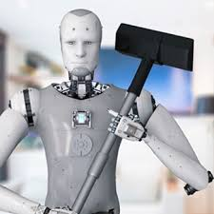
Would you like to have a robot do your housework?
What are the advantages and disadvantages?

Slide 14
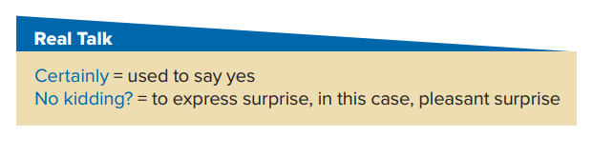

Who says
certainly…….
Who says
No kidding…….
The engineer
The reporter

Slide 15
Read the phrases and their meaning:

Slide 16
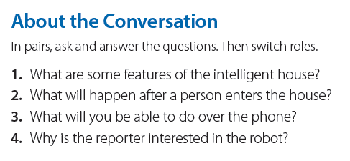
1- The intelligent house will monitor lighting, security, ventilation, heating, and
audiovisual systems.
2. When someone enters the house, the lights will come on at night, the climate
control will be activated, and surround sound will automatically play your favorite
radio station.
3. You will be able to “call” your refrigerator and find out about the things in it.
4. The reporter would like a robot to do the cleaning, washing, and cooking

Slide 17
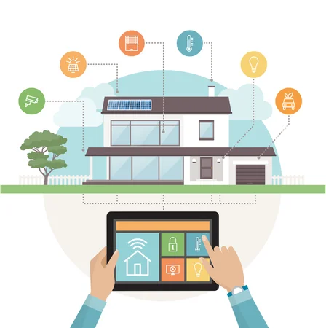
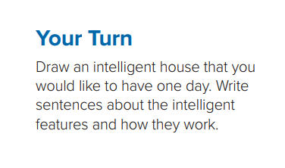

Slide 18
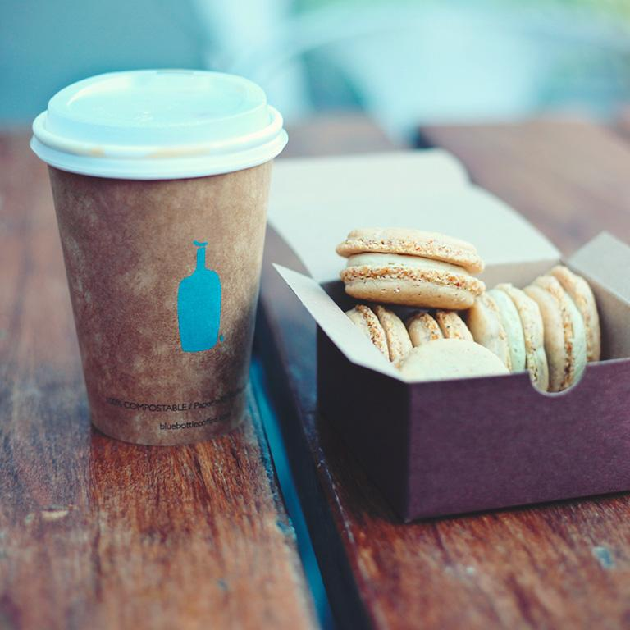
Homework
Workbook P.(102)
Exercise (F)
.

Slide 19

From the Holy QURAN

Slide 20

Thanks!

