Slide 1


Mega Goal 1.1
Unit 2
Careers
Form , Meaning & Function
Done by: Entisar Al-Obaidallah

Slide 2
Lesson Objectives
Use
Distinguish
01
02
Use
Apply
03
04
simple present tense in affirmative , negative sentences and questions
Between the relative pronouns and their uses .
Past progressive with
( while )
The rules to do the exercises

Slide 3
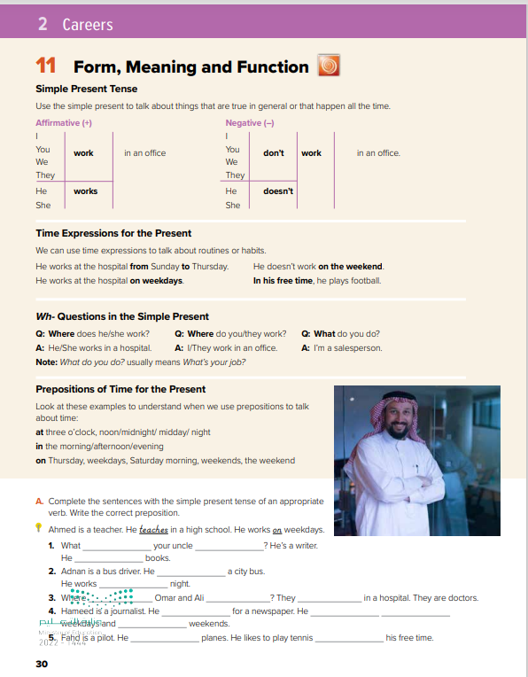
Open
Student’s book , p.( 30)

Slide 4


Choose the correct answer
Warm up
Nora ---------- in the school
work
working
works
They ………….football
play
plays
played

Slide 5
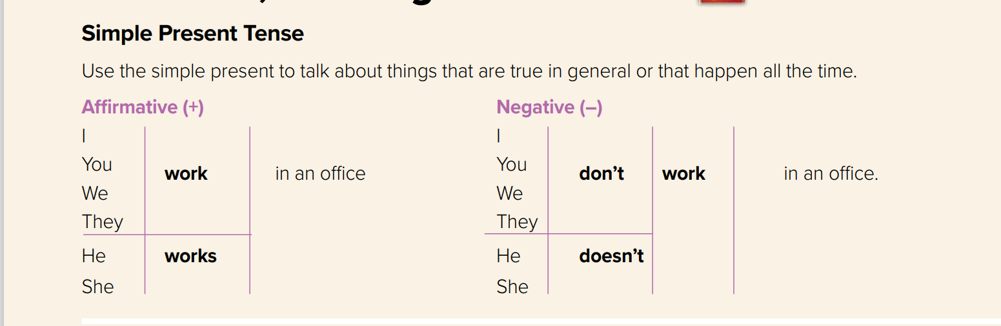


Slide 6
The structure of the Present Simple Tense
Form:
Subject (She- He –It – singular)
V ( s- es- ies)
Examples:
He cleans his room.
He goes to school by car.
He studies English
Subject (I -you - we - They - plural)
V ( infinitive)
Examples:
I clean my room.
I go to school by car.
We study English

Slide 7
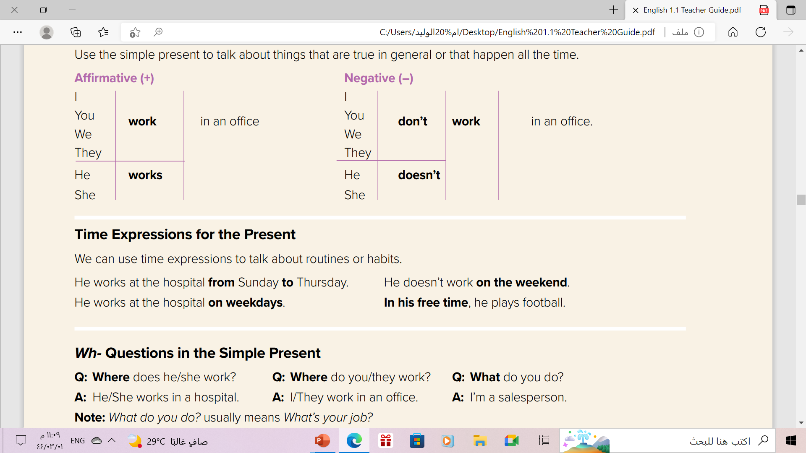

Slide 8
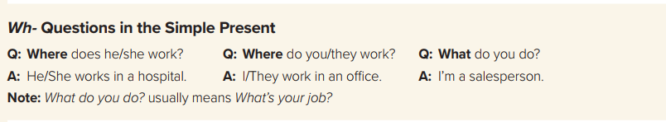


Form:
WH
does - do
subject
V( base form)
Example
Where does he travel ?
What do you study ?

Slide 9
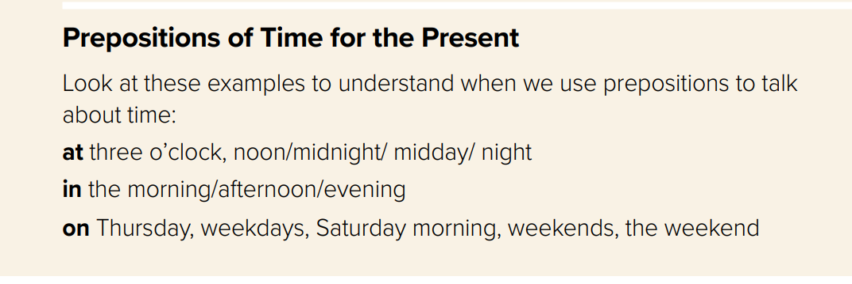

Slide 10
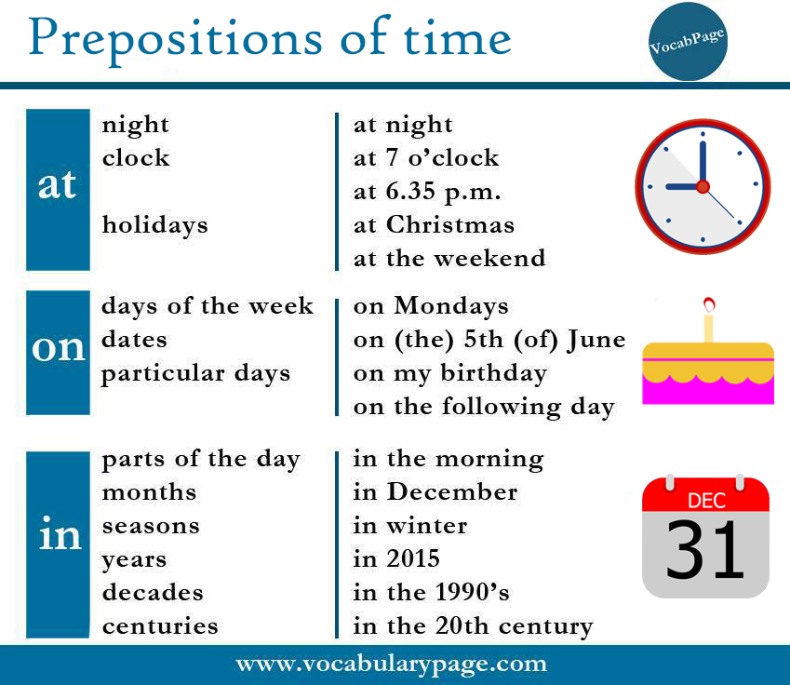

Slide 11
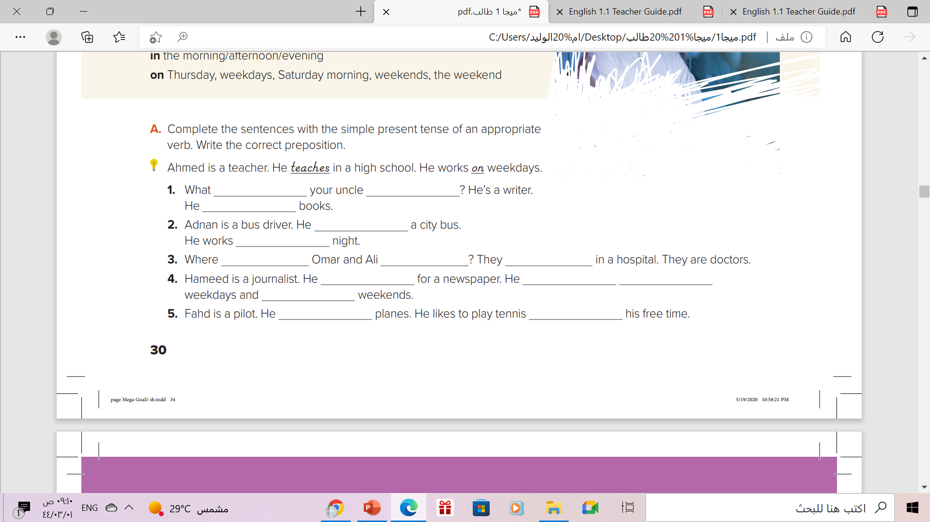
does, do, writes
does
do
writes
drives
at
do
work
work
writes
works
on
on
flies
in

Slide 12
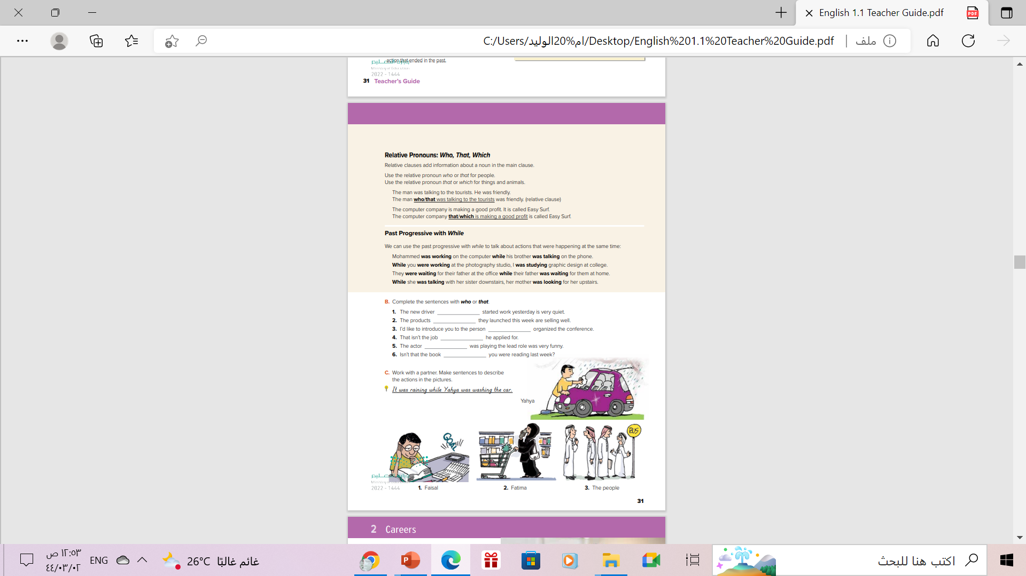
Open
Student’s book , p.( 31)

Slide 13
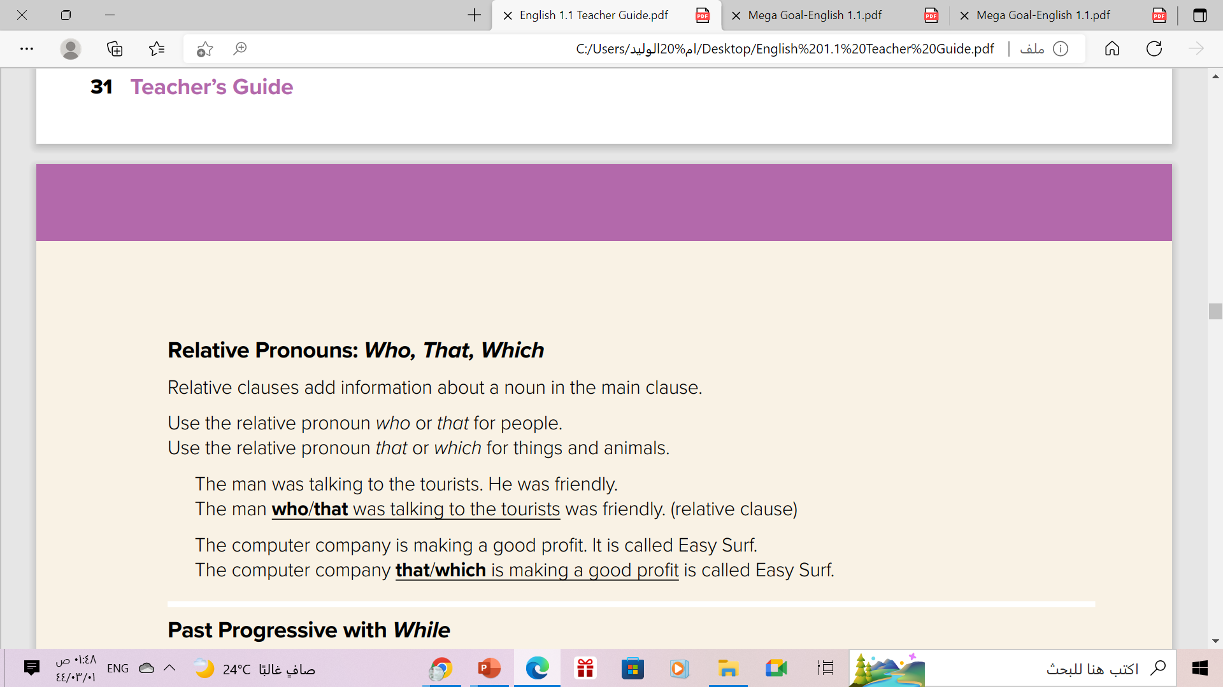


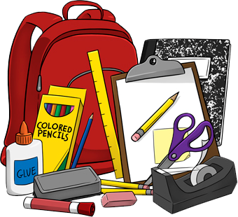
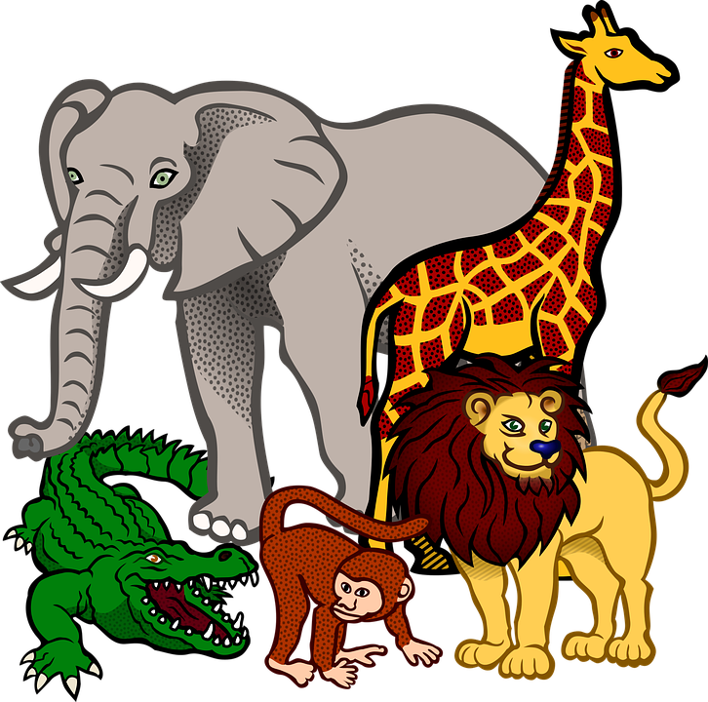
who
People ( persons)
which
Things & animals
that
Both ( people and things )

Slide 14
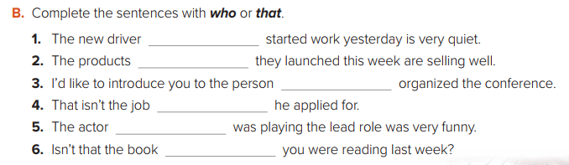
who
that
who
that
who
that

Slide 15
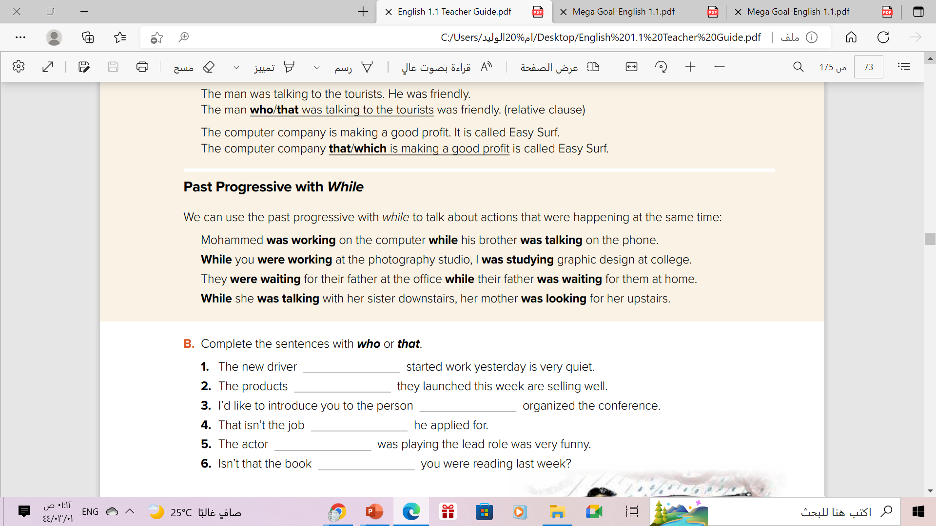
Example
While he was working at a hospital, I was sleeping.
Ali was studying while his friends were playing.

Slide 16
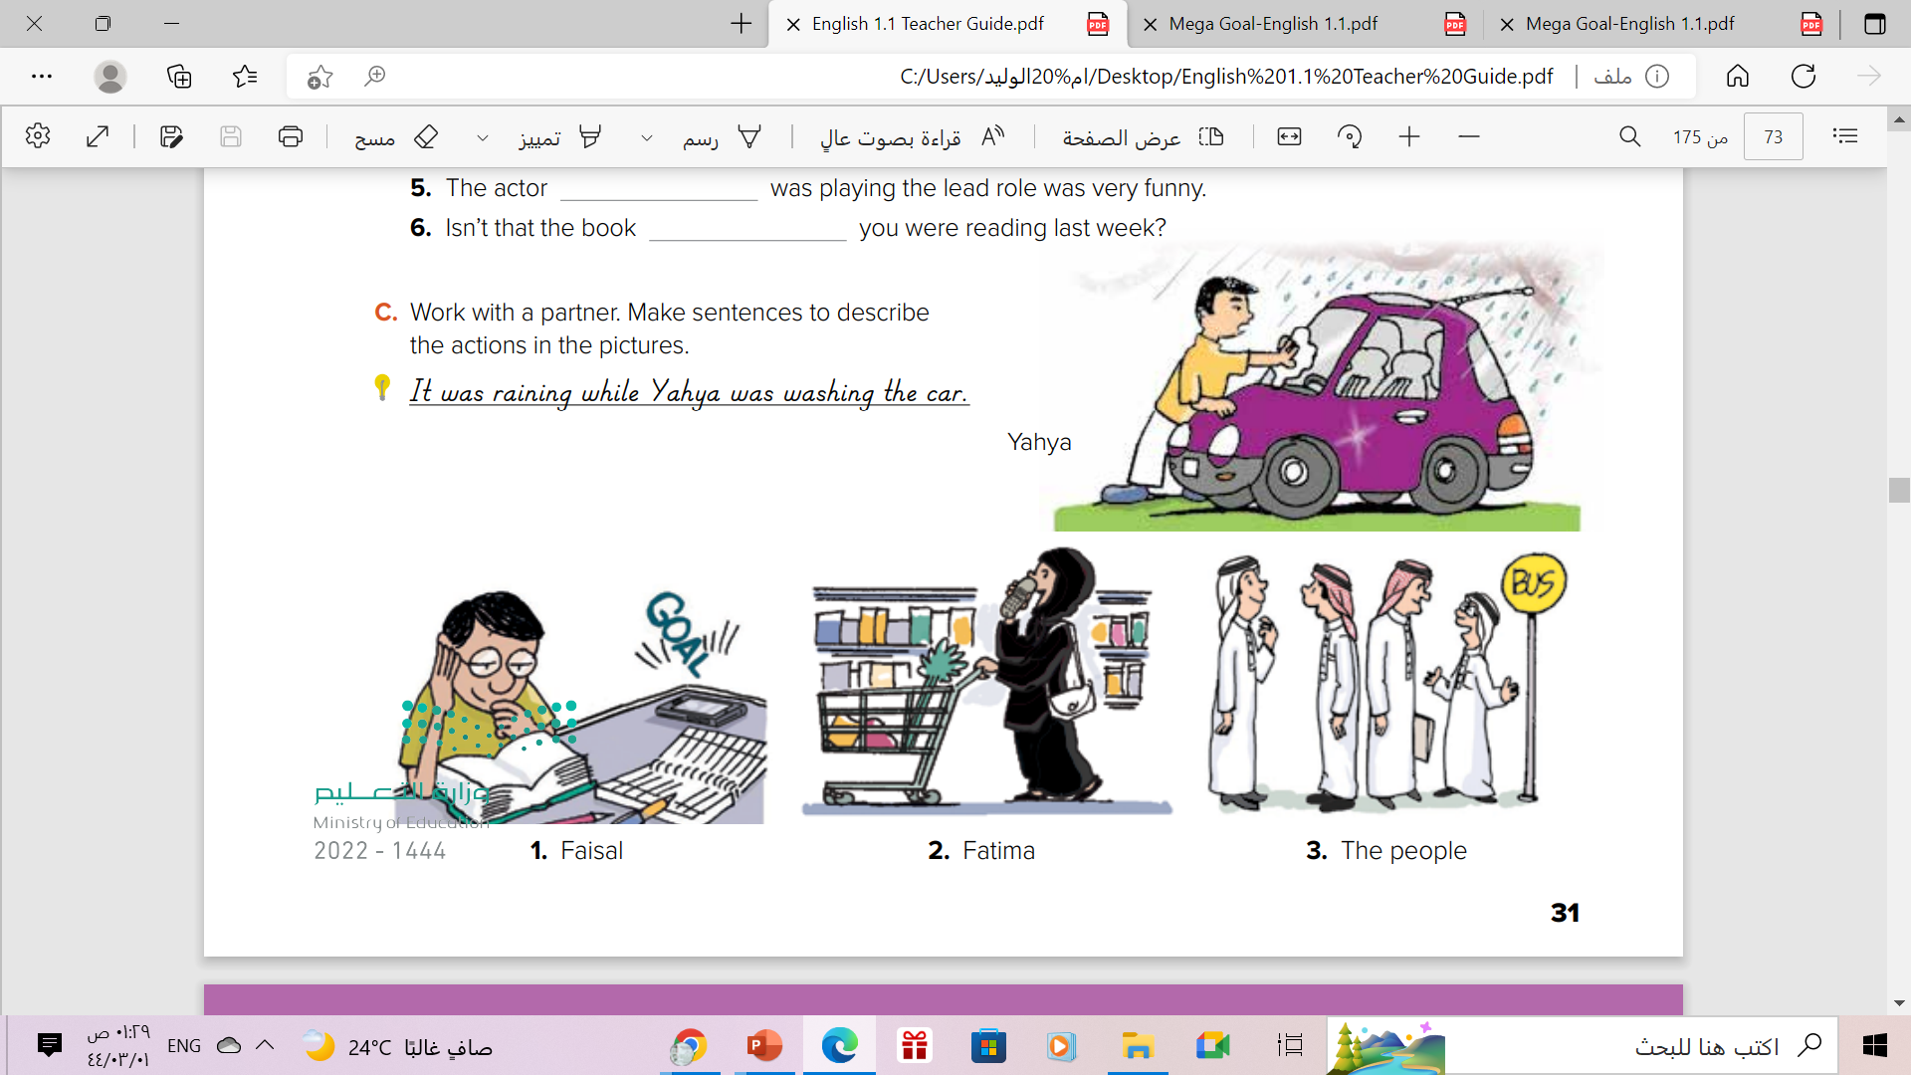

Slide 17
Faisal was listening to the football while he was studying
Fatima was talking on her cell phone while she was shopping.
The people were talking while they were waiting for a bus.

Slide 18
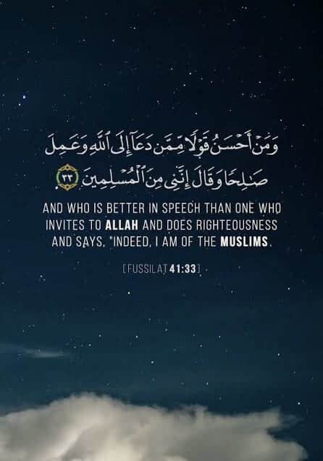
From the Holy Qur'an

Slide 19
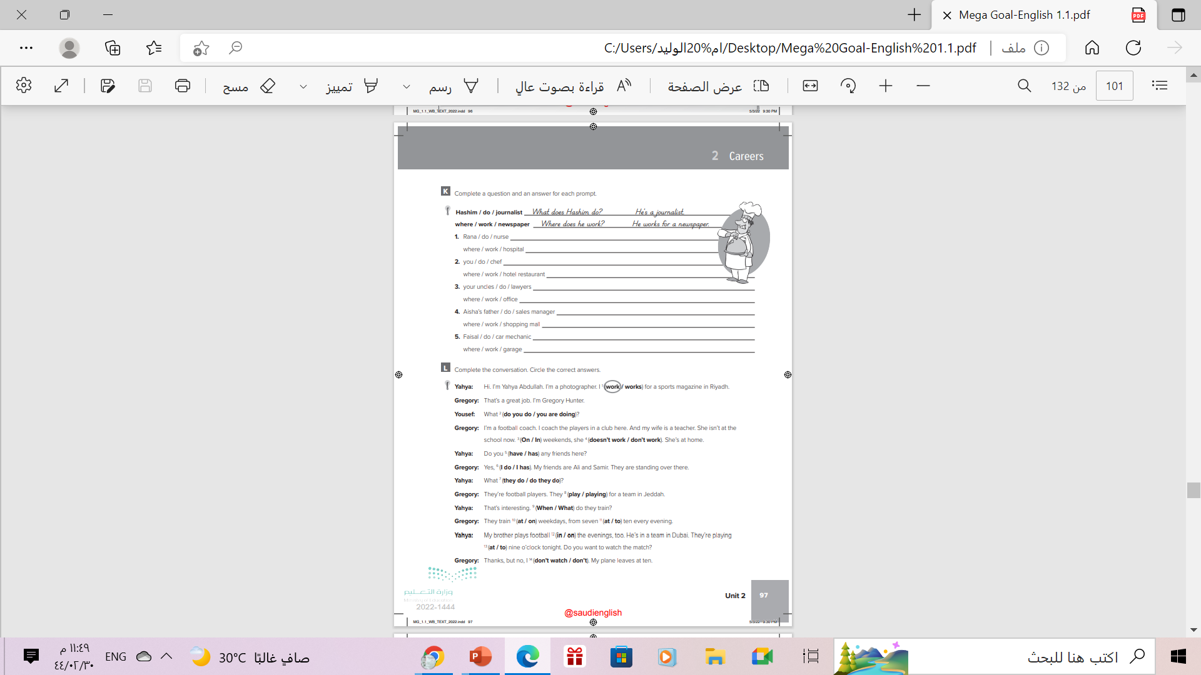
Homework
Workbook P. ( 97 ), exercise ( K )

Slide 20

THANKS!

Slide 21





ALTERNATIVE RESOURCES
Here’s an assortment of alternative resources whose style fits that of this template:
Hand painted watercolor abstract watercolor background

