Slide 1
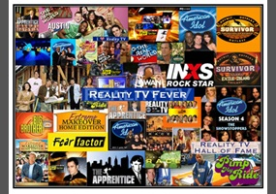
Unit 4
TV Around the World
Reading
Mega Goal 2.1
Done by: Entisar Al-Obaidallah

Slide 2
Lesson Objectives
Match the inventor to his invention
Read for specific information
Answer some questions about the text
Find out the meaning of the new words
Elicit the main idea of each paragraph

Slide 3
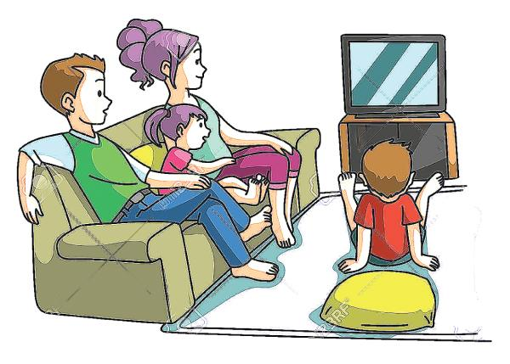

resource of information
resource of news
Why is TV so popular?
a mean of entertain
has
attractive shows

Slide 4

How much do you know about TV?
Who .. invented?
How .. invented?
When .. invented?
Where .. invented?

Slide 5

Book Open
Pages ( 54-55)

Slide 6
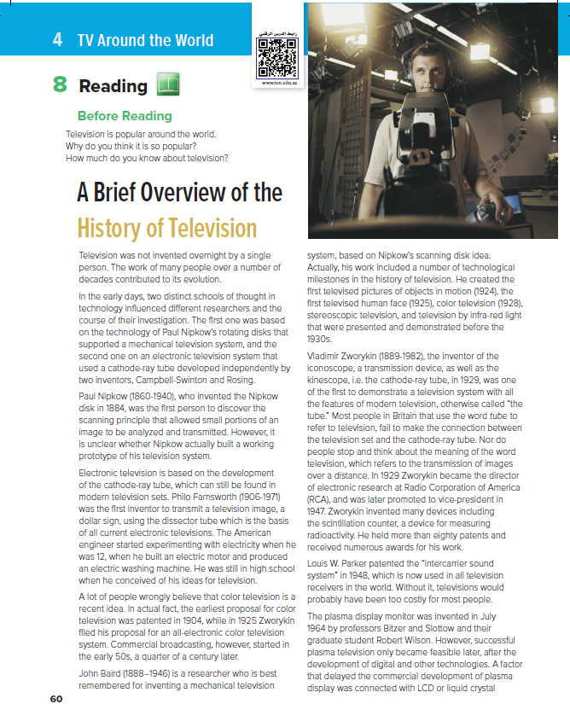

10
How many paragraphs are there ?
1
What’s the title ?
2
A brief Overview of the History of Television
7
3
What do the pictures show ?
4
Maybe a cameraman or director
8
How many paragraphs are there ?
5
9
10 paragraphs
6

Slide 7
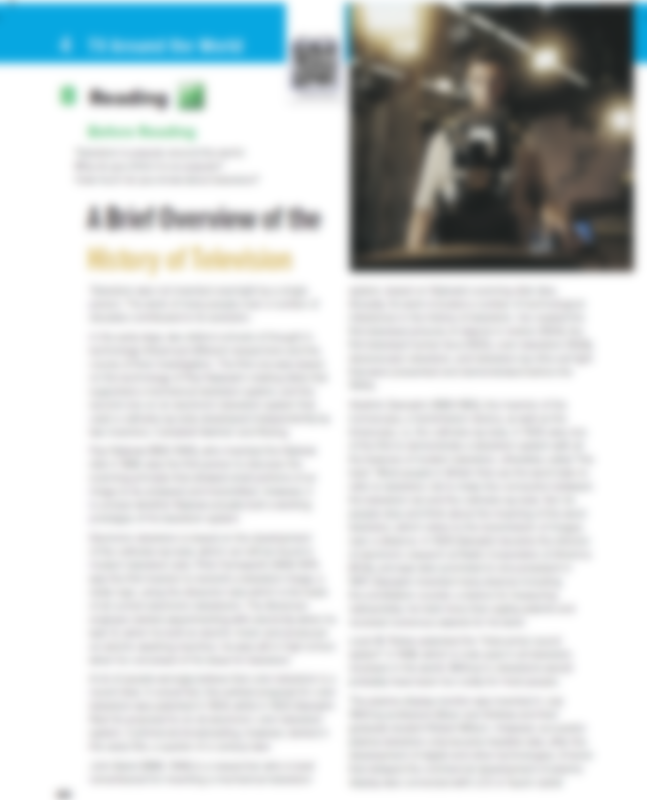



How many paragraphs are there ?
Read along as U Listen

Slide 8
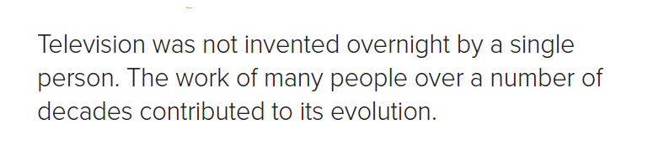

1
How many paragraphs are there ?
Was TV invented by a single person?

Slide 9
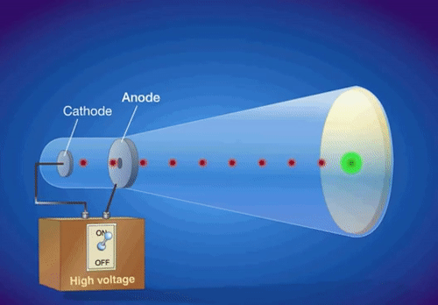
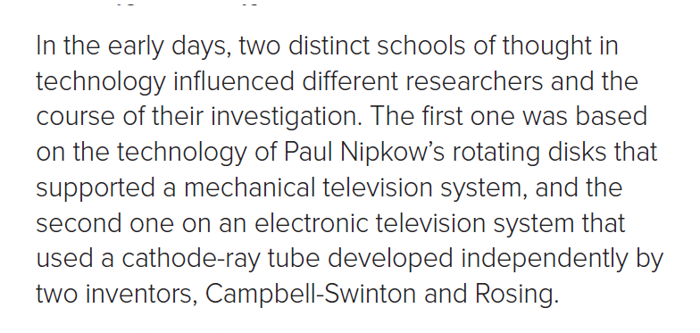
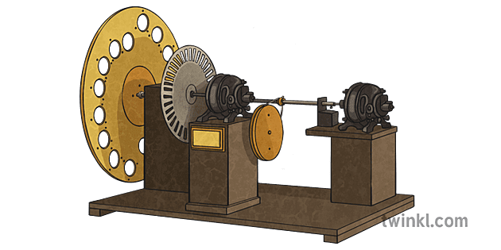
2
cathode-ray tube
Nipkow’s rotating disks
How many schools of thought in technology?
What are TV systems mentioned ?

Slide 10
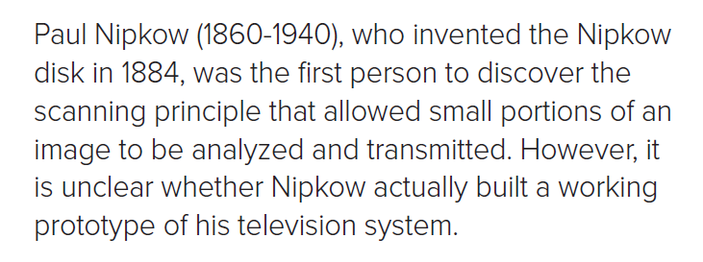
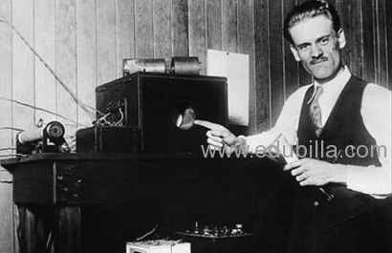
3
What did Nipkow discover?
Nipkow’s scanning principle

Slide 11
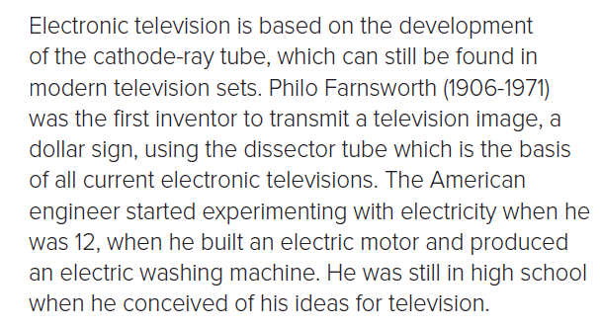
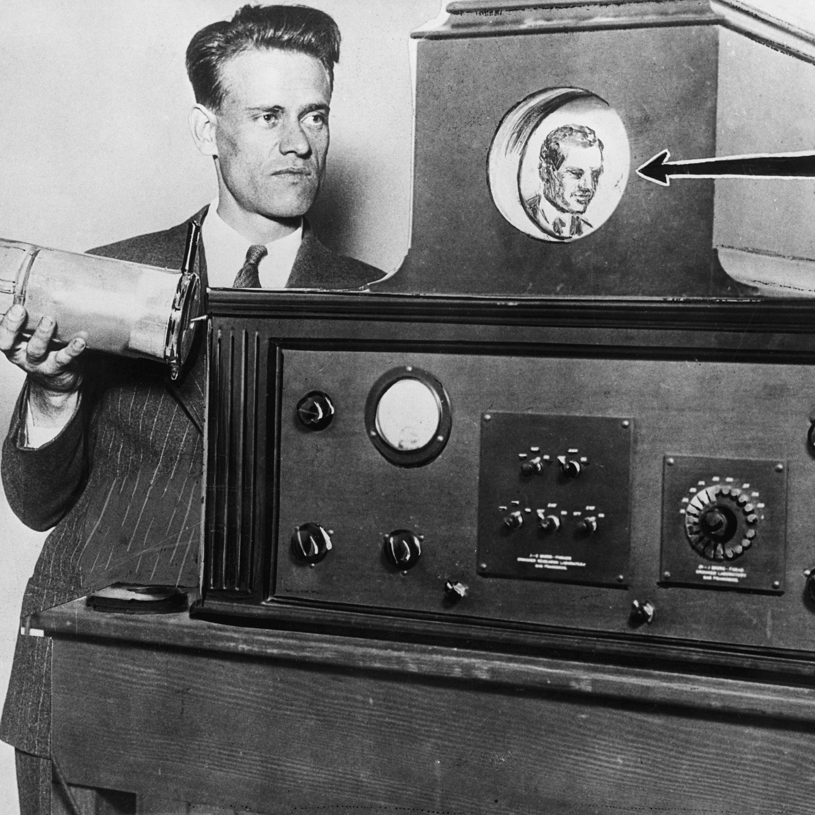
4
What is the main idea of this paragraph?
Philo’s dissector tube

Slide 12
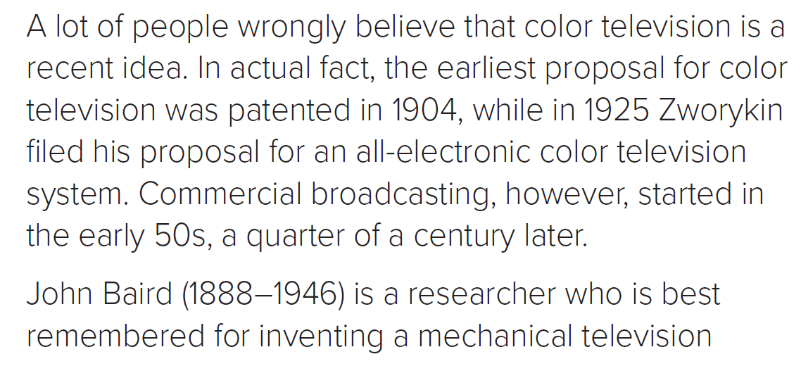
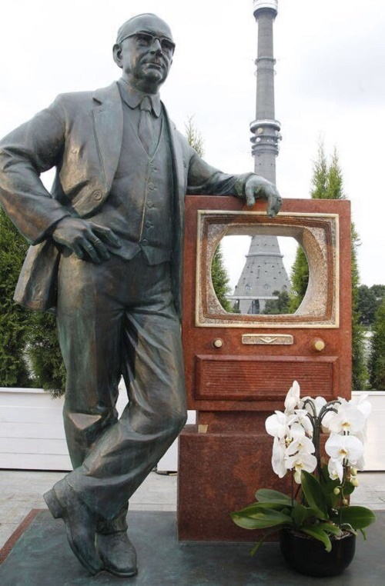
5
What is the main idea of this paragraph?
Zworykin

Slide 13
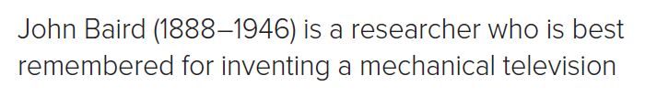
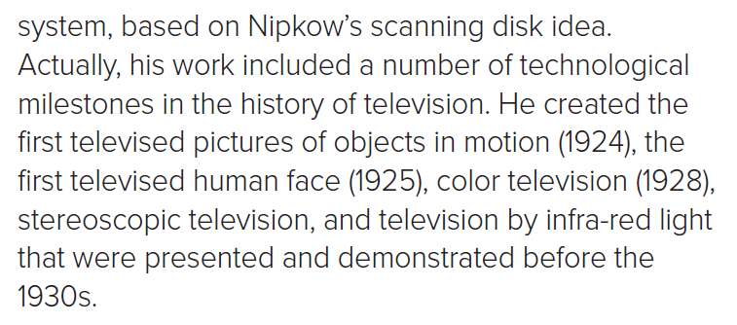
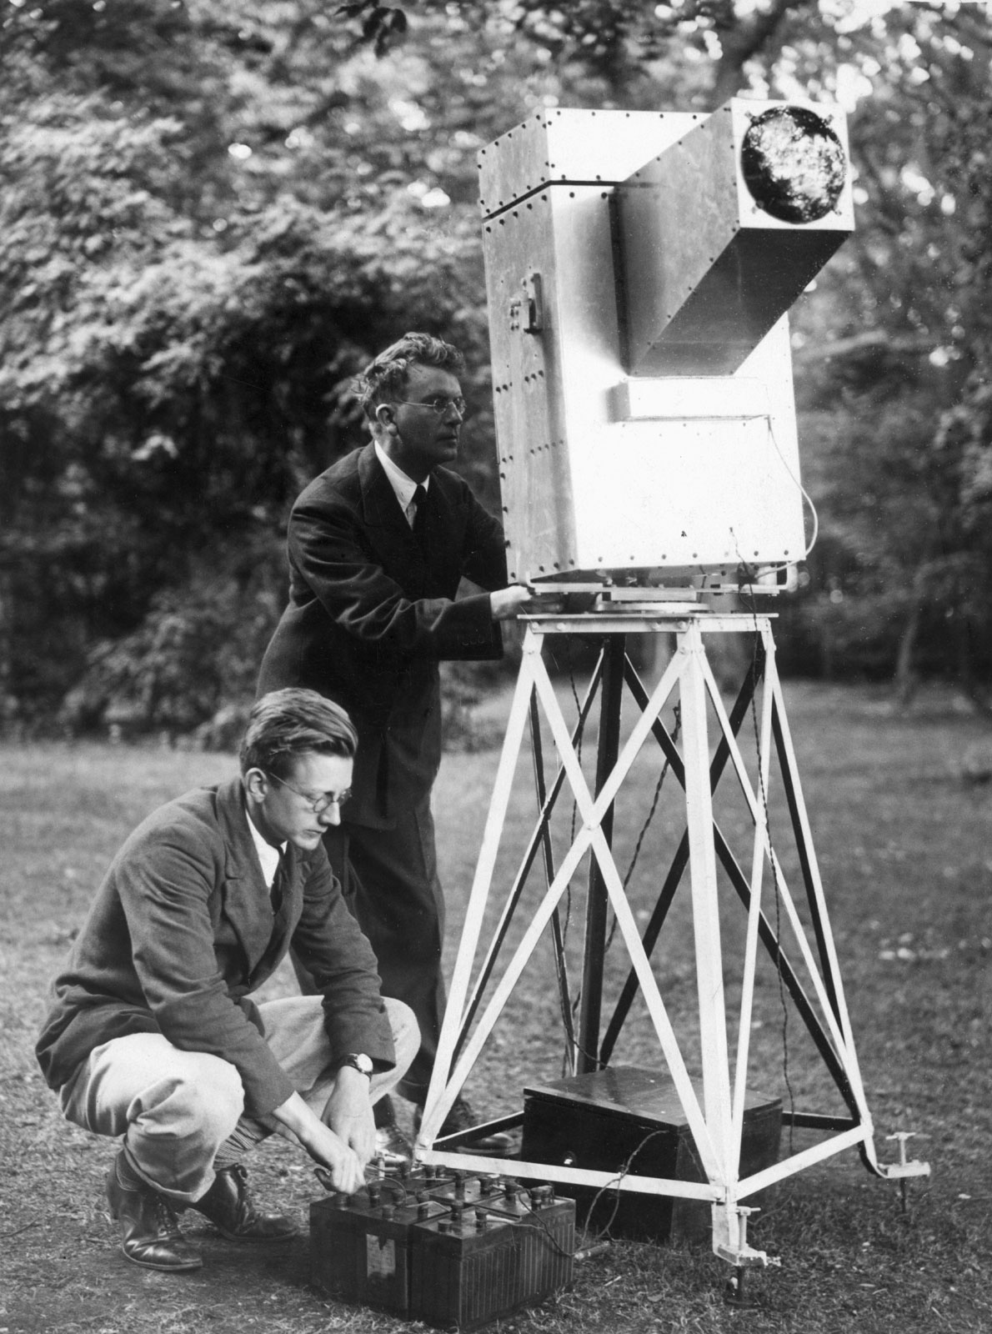
6
What is the main idea of this paragraph?
John Baird

Slide 14
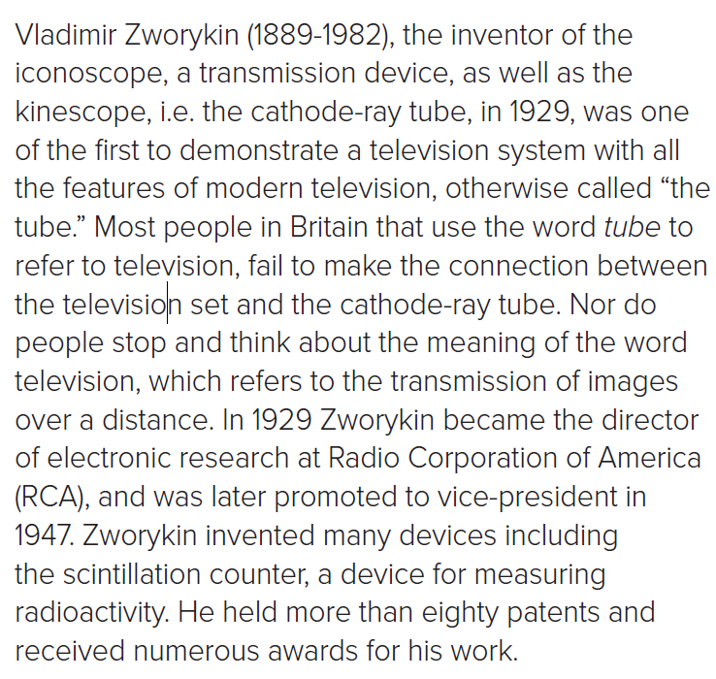
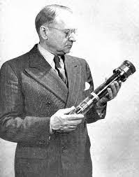
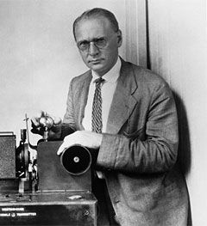
7
Vladimir Zworykin
What is the main idea of this paragraph ?

Slide 15
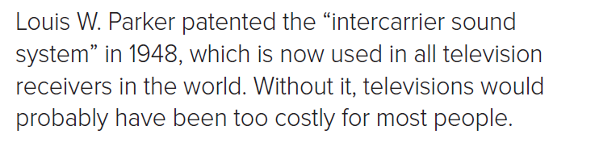
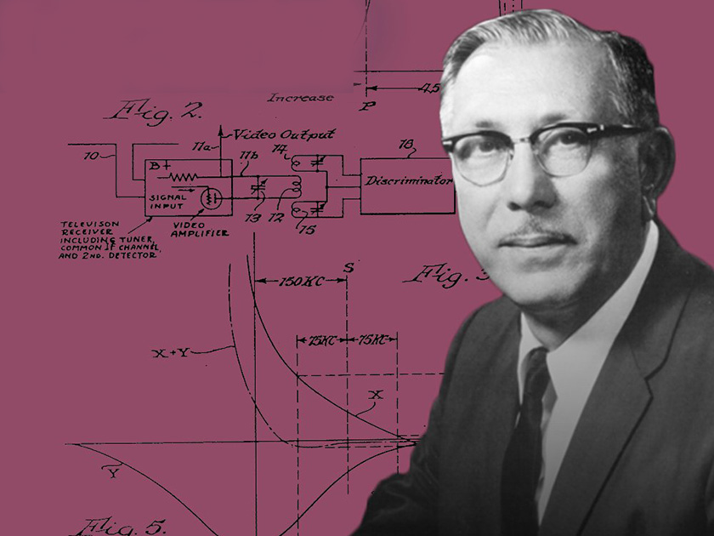
8
Louis W. Parker
Would TVs without “intercarrier sound system” be cheaper?

Slide 16
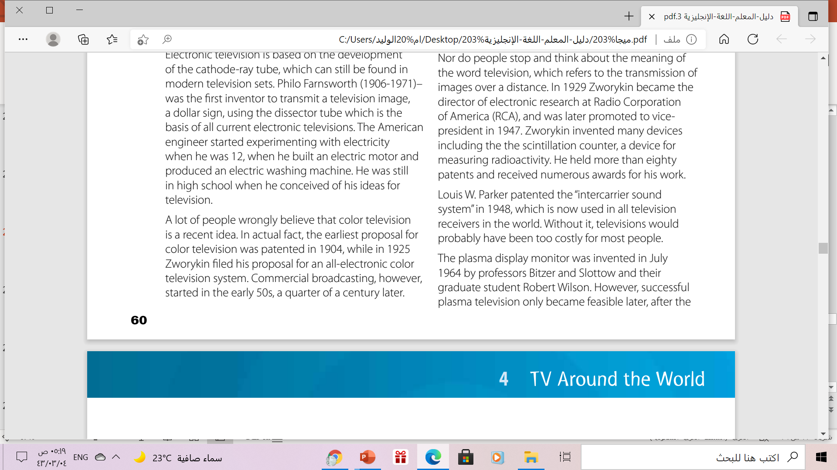
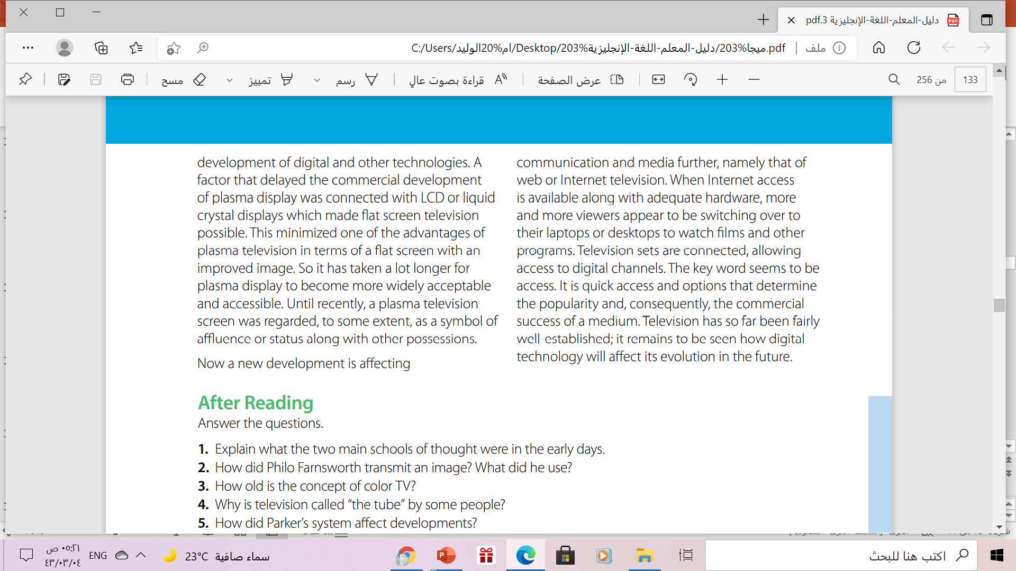
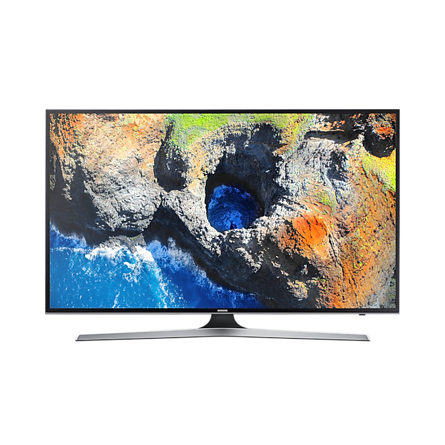
9
The Plasma TV
What is the main of this paragraph?

Slide 17
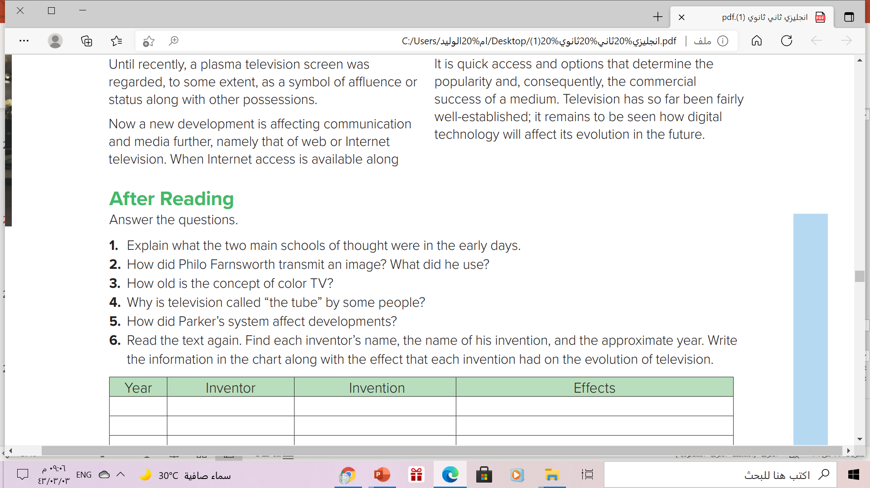
1. The two main schools of thought were: Paul Nipkow’s rotating disks and a cathode-ray tube developed independently by, Campbell-Swinton and Rosing.
2. He transmitted a dollar sign. He used a dissector tube.
3. The earliest proposal for color television was patented in 1904.
4. Because people fail to make the connection between the television set and the cathode-ray tube.
5. He made televisions cost-effective

Slide 18
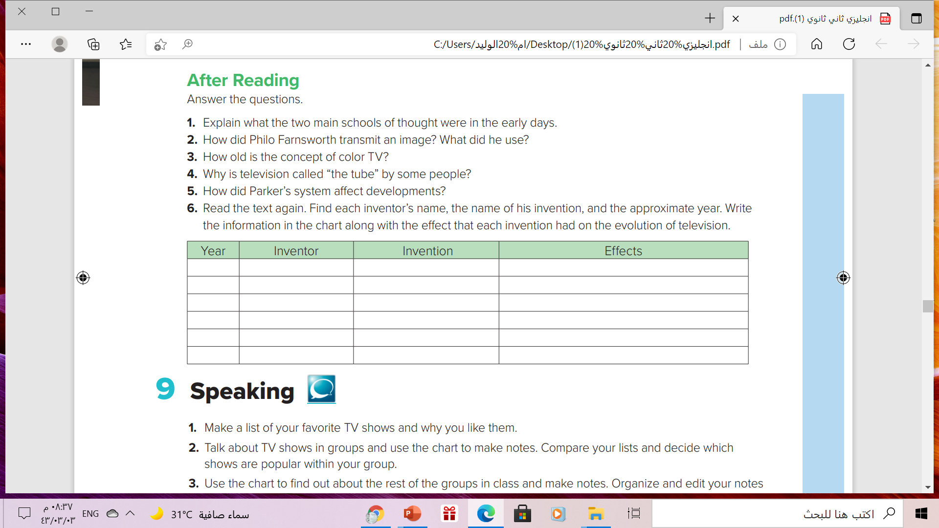
1884
1918
1924
1929
1948
Paul Nipkow
Philo Farnsworth
John Baird
Vladimir Zworykin
Louis W. Parker
The Nipkow disk
Dissector tube
mechanical television
system
iconoscope
intercarrier sound
system
allowed small portions of an image to be
analyzed and transmitted
basis of all current electronic televisions
1st televised pictures of objects in motion
1st to demonstrate a television system with all
the features of modern television
Without it, televisions would cost too much

Slide 19

Remember

Slide 20

p.(117), exercise (i)
Work Book

Slide 21

Thanks!

