Slide 1

Mega Goal 2.1
Unit 3
Far And Away
Grammar
Done by: Entisar Al-Obaidallah

Slide 2

Lesson Goals
Classify the adverbs according to their degree correctly .
Rewrite sentences using adverbs of degree ..
Use sentence adverbs correctly .
Complete a paragraph with sentence adverbs.

Slide 3

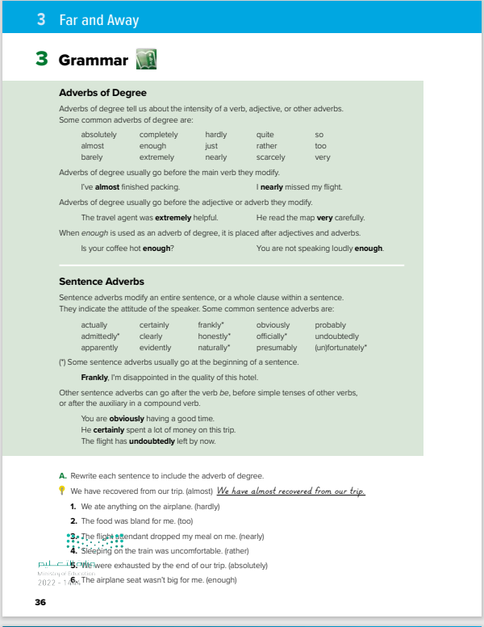
Books Open
Page: (36 )

Slide 4

What is an adverb?
A word that describes a verb, an adjective or another adverb .
Adverb Form
We make many adverbs by adding -ly to an adjective ..
Examples:
quick (adjective) quickly (adverb)
careful (adjective) carefully (adverb)
beautiful (adjective) beautifully (adverb)

Slide 5

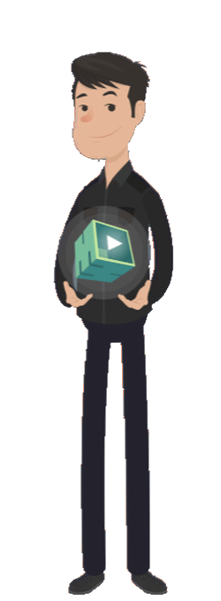
What is an adverb?
An adverb is a word that describes a verb .
Examples:
He speaks loudly
subject
verb
adverb
An adverb is a word that describes an adjective .
Examples:
He is very tall
subject
adverb
adjective

Slide 6
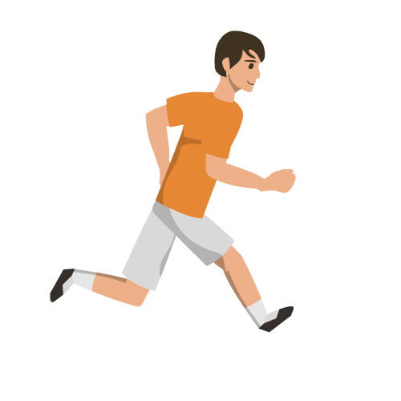

What is an adverb?
An adverb is a word that describes another adverb .
Examples:
He is running very fast.
subject
verb
adverb
adverb
Examples:
She is reading so quickly.
subject
verb
adverb
adverb

Slide 7

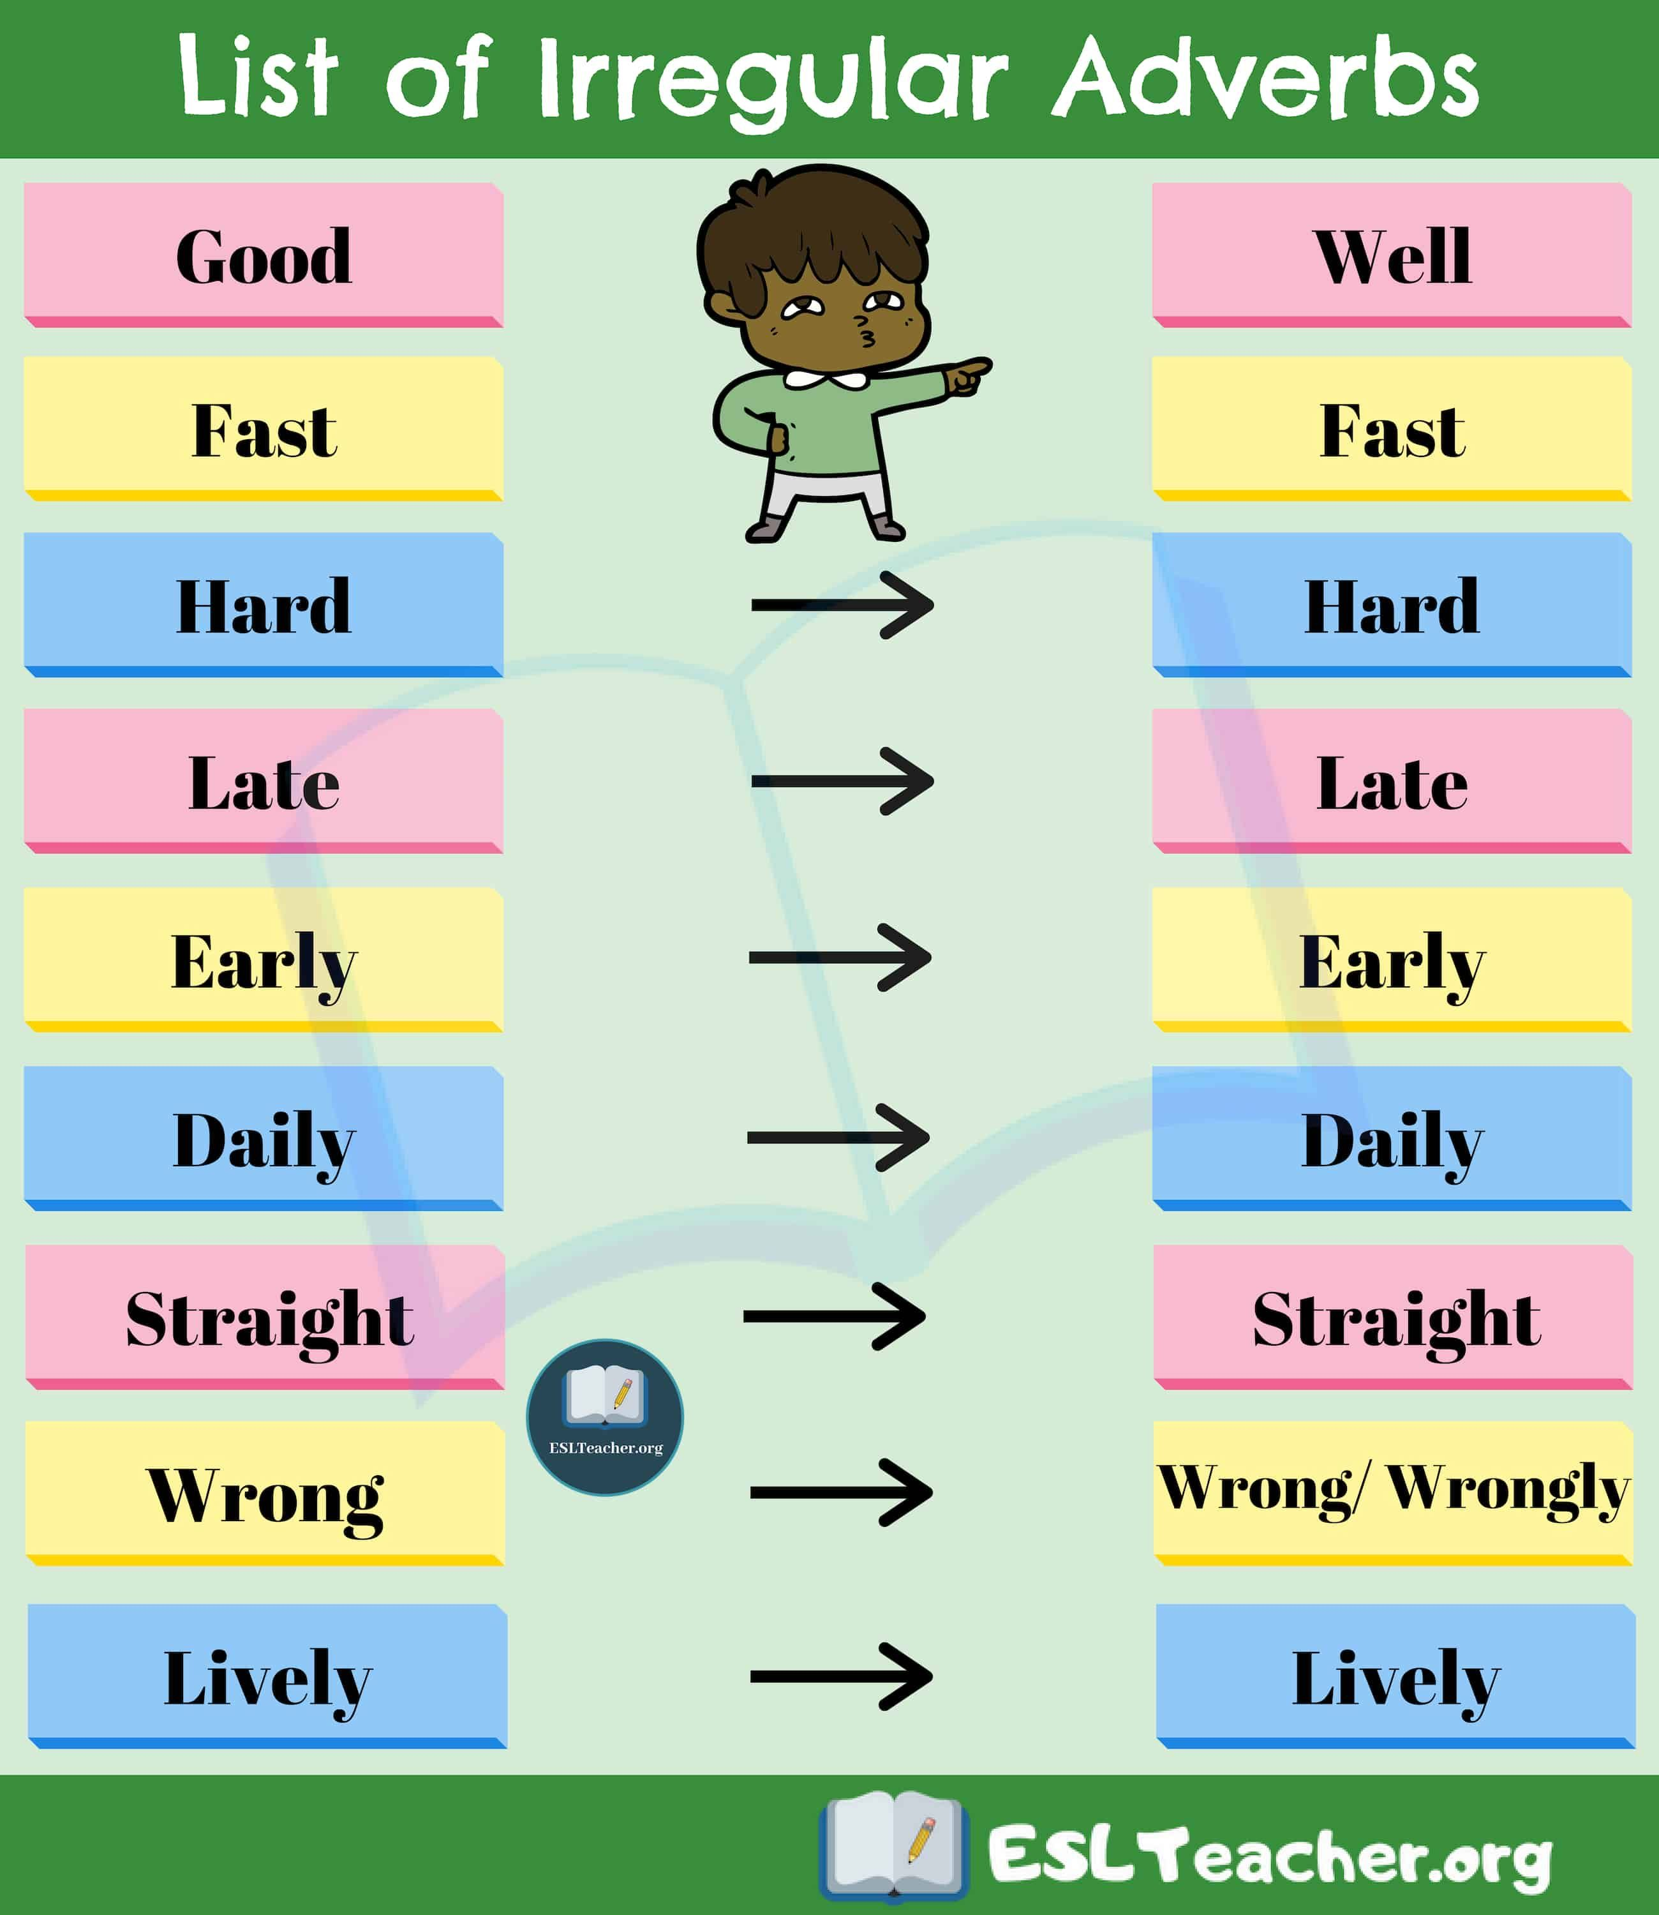
There are some irregular adverbs that are not end with –ly

Slide 8
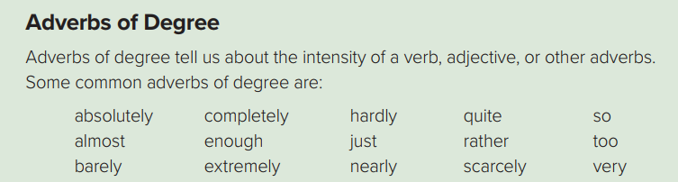
Adverbs of degree answer the question : how much or what extent .
Examples:
She entirely agrees with him. (How much does she agree with him?)
She is very beautiful. (To what degree is she beautiful? How beautiful is she?)
He drove quite dangerously. (To what degree did he drive dangerously?)
(How dangerously did he drive?)

Slide 9
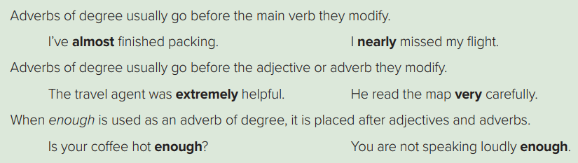
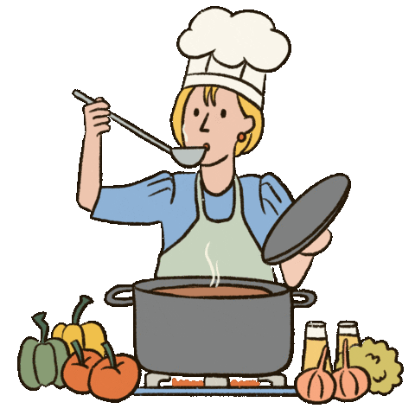
How to use adverbs of degree ?
1-Usually go before the main verb they modify.
Examples:
I’ve almost finished cooking.
adverb
Main verb

Slide 10


How to use adverbs of degree ?
2-usually go before the adjective or adverb they modify.
Examples:
The exam was extremely easy.
adverb
adjective
Examples:
He read the map very carefully.
adverb
adverb

Slide 11

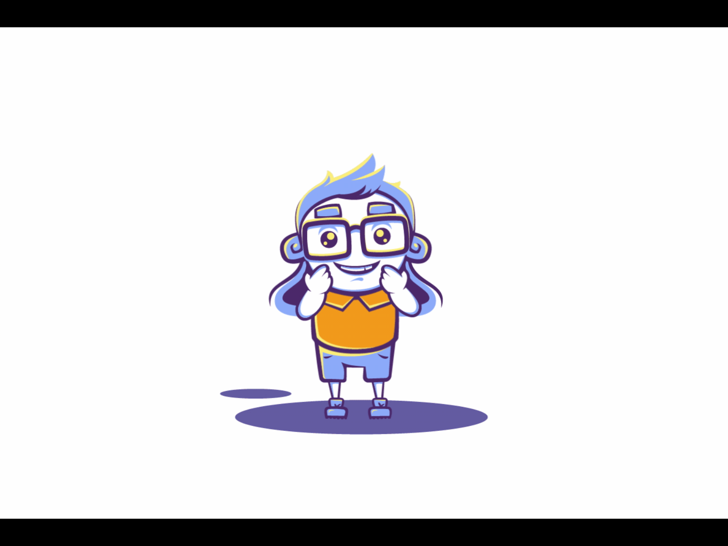
How to use adverbs of degree ?
3-When enough is used as an adverb of degree, it is placed after adjectives and adverbs.
Examples:
Is your coffee hot enough?
Examples:
adjective
adverb
You are not speaking loudly enough.
adverb
adverb

Slide 12
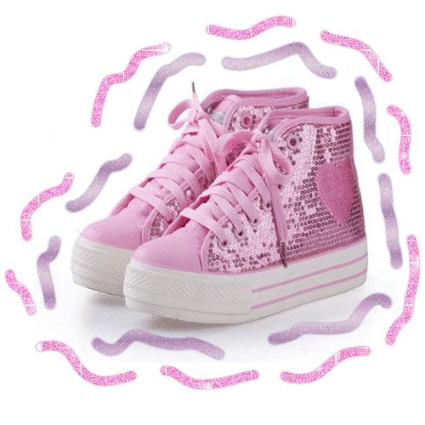
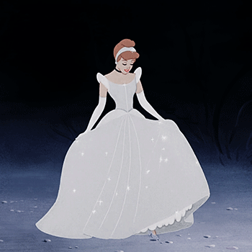
How to use adverbs of degree ?
4- “Too” meaning 'excessively: more than necessary. It goes before the adverb or adjective it modifies
Examples:
The shoes were too small
adverb
adjective
5- We use 'very' before an adverb or adjective to emphasize the meaning and make it stronger.
Examples:
Her dress was very elegant
adverb
adjective

Slide 13
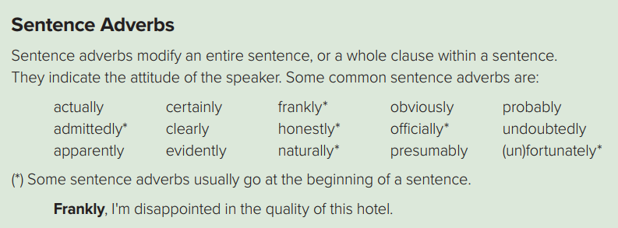

Examples:
Frankly, I'm disappointed in the quality of this hotel.
Adverb of degree
sentence

Slide 14



➔Other sentence adverbs can go after the verb be, before simple tenses of other verbs, or after the auxiliary in a compound verb.
Examples:
You are obviously having a good time.
Verb to be
adverb
Examples:
He certainly spent a lot of money on this trip.
adverb
Simple past
Examples:
The flight has undoubtedly left by now.
auxiliary
adverb

Slide 15
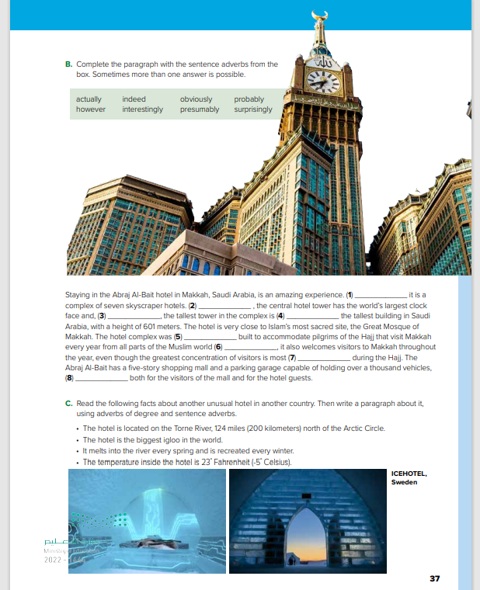
Books Open
Pages: (37)

Slide 16
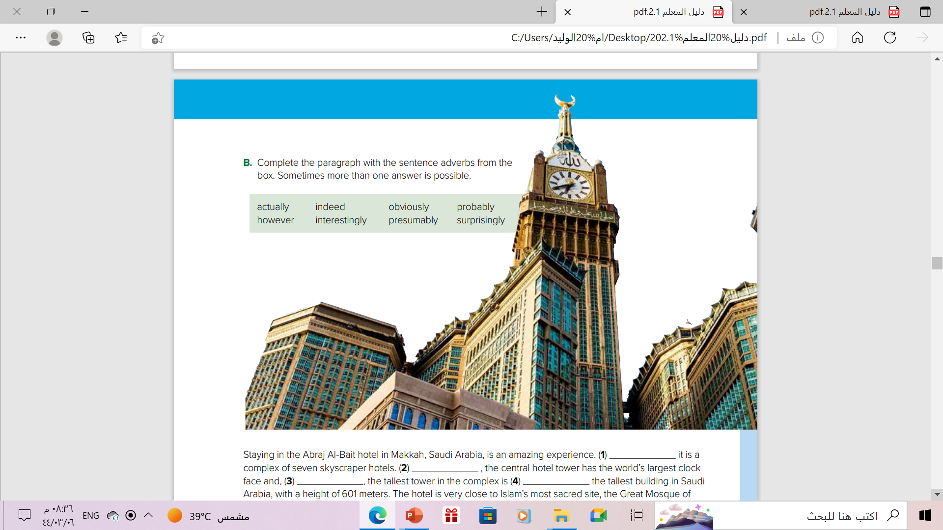
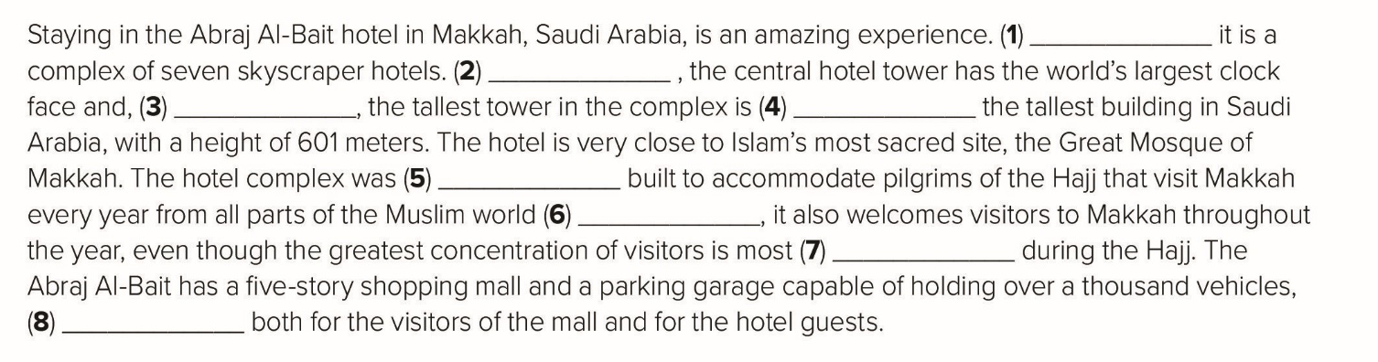
Interestingly
Surprisingly
obviously
actually
presumably
However
indeed
obviously

Slide 17
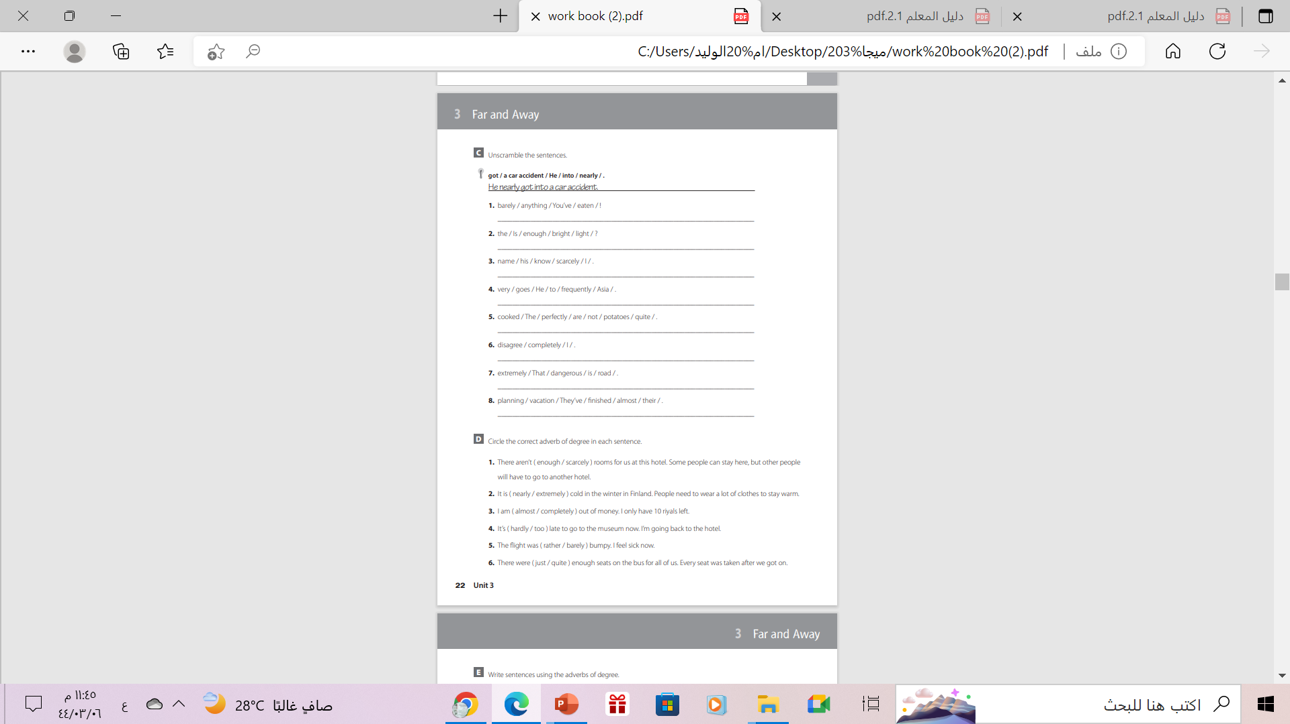
Homework
Exercise (F), P.(23)

Slide 18

From The Holy Quran

Slide 19

Thanks!

