Slide 1

Unit 3
Far and Away
Listen & Discuss
Mega Goal 2.1
Done by: Entisar Al-Obaidallah

Slide 2
Warm Up
What is the meaning of “ Far And Away” ?
→You use the expression far and away when you are comparing something or someone with others of the same kind, in order to emphasize how great the difference is between them.
Example: He's still far and away the best player we have.

Slide 3



What do you think of
“ travelling” ?
a good remedy for stress, anxiety and depression.
improves the mental and physical health.
Experience the beauty of nature, different geographies, and people.
Exploring new places, cultures and styles of living.

Slide 4

What is the advantages of
“ Travelling ” ?
discovering the world’s
educational
gaining some new friends
re-discover yourself
making memories
having fun of adventure
Refreshing
1 . Traveling abroad can be very expensive.
2. Unexpected costs & emergencies.
3. Cultural Shock
4. Language Barrier
5. Having Long Flights
Adaptation to foreign customs

Slide 5
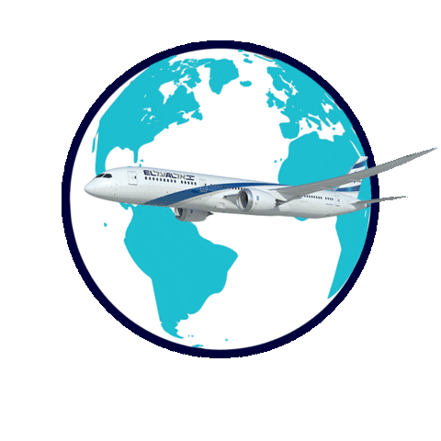
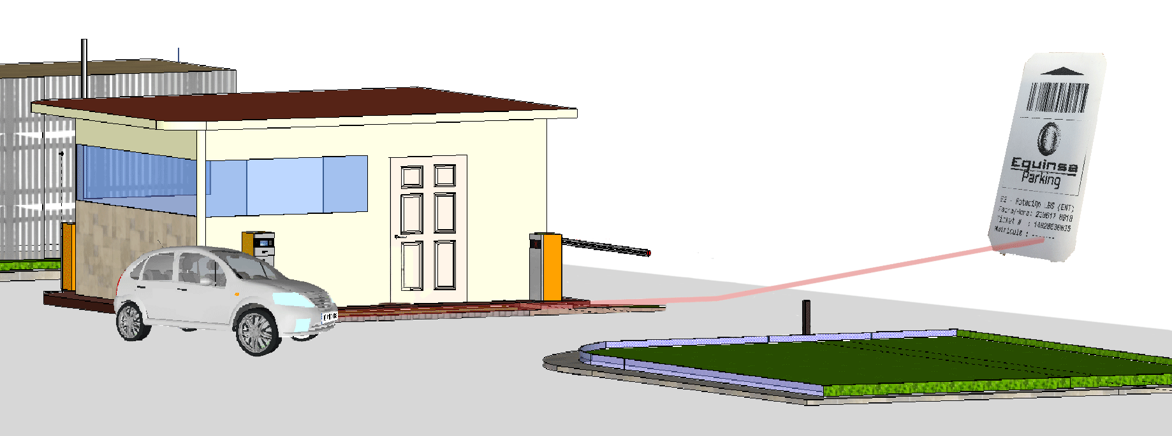
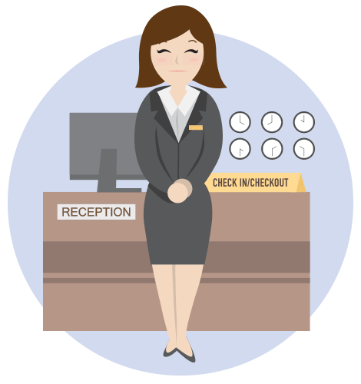



Think of the 5 things that you expect the hotel to have ?
Valet parking
Free internet
customer service
Room service (24-hors)
Tasty food

Slide 6

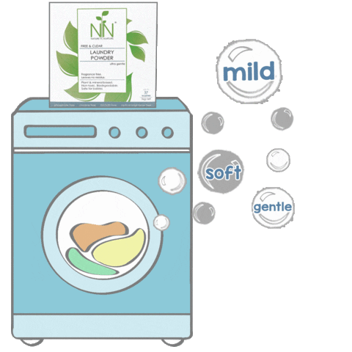
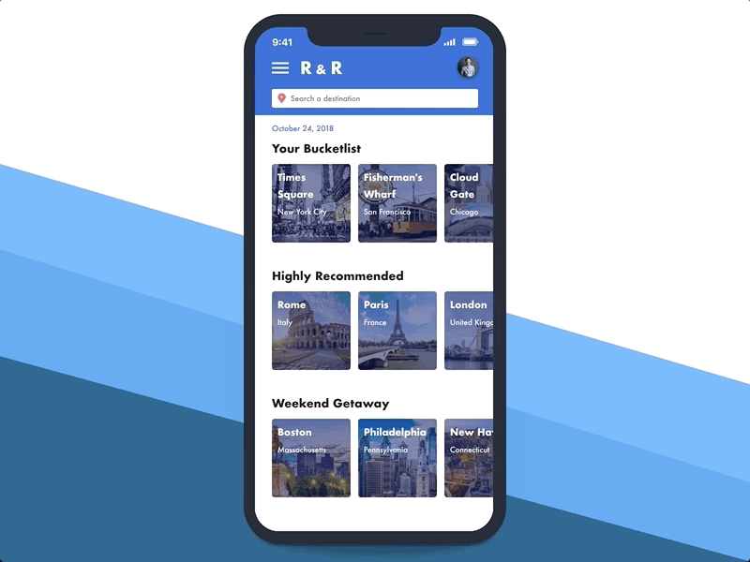
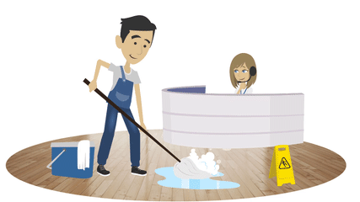

Think of the 5 things that you expect the hotel to have ?
Laundry service
Simple booking
Safety & security
Car rental service
Comfort & cleanliness

Slide 7
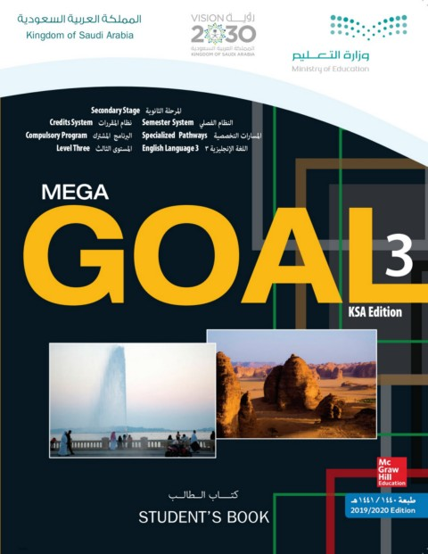
Books OPEN
Pages: 34 - 35

Slide 8


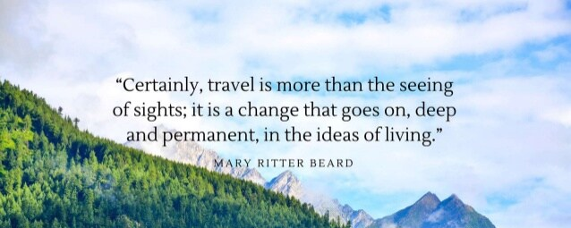
Listen as U read
Do You agree with her or not?

Slide 9
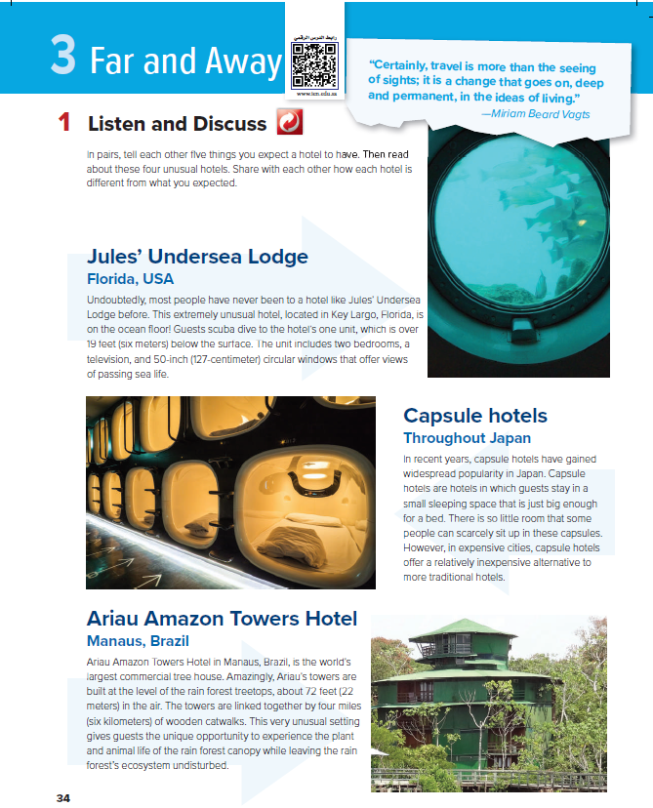
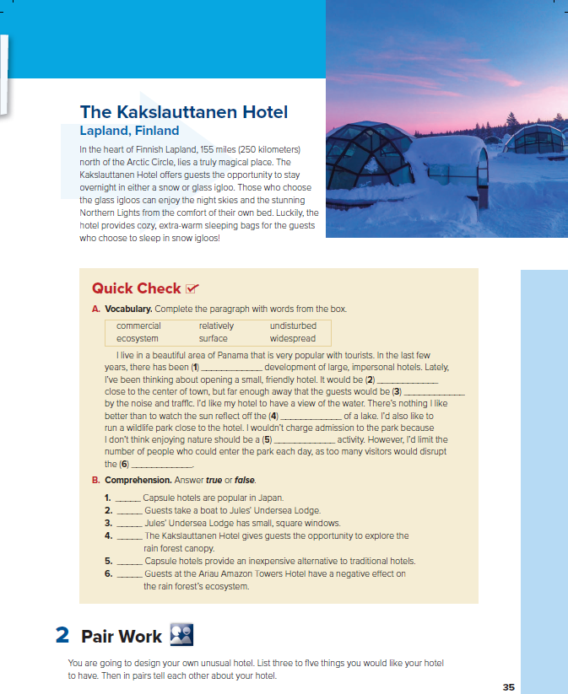
4
1
How many pictures are there?
2
4 pictures
What can you see in each one?
a hotel
3
Are they usual or unusual?
unusual

Slide 10
Which hotel…
is a tree house ?
have very small rooms ?
do you have to scuba dive to get to ?
has rooms made of snow ?
are not very expensive ?

Slide 11
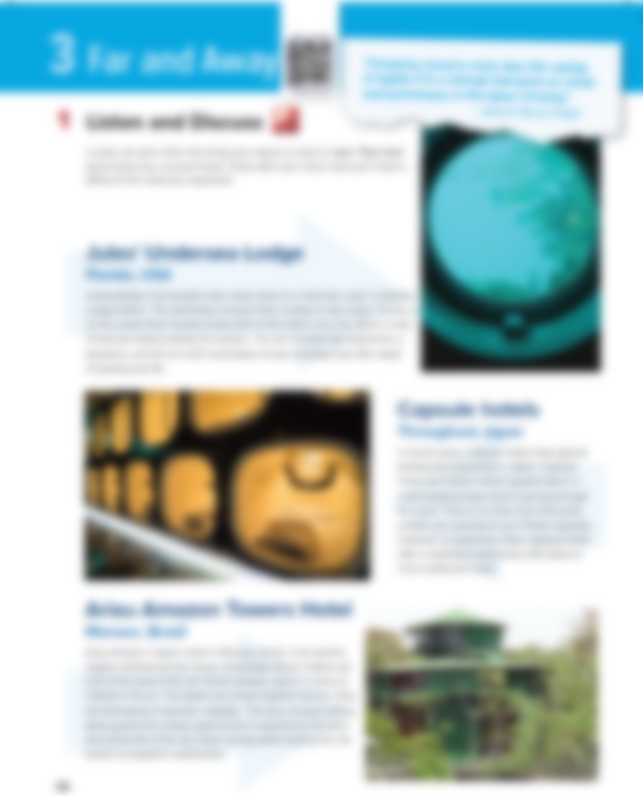


Group Work
Read along as you listen
Pages: 34 - 35

Slide 12
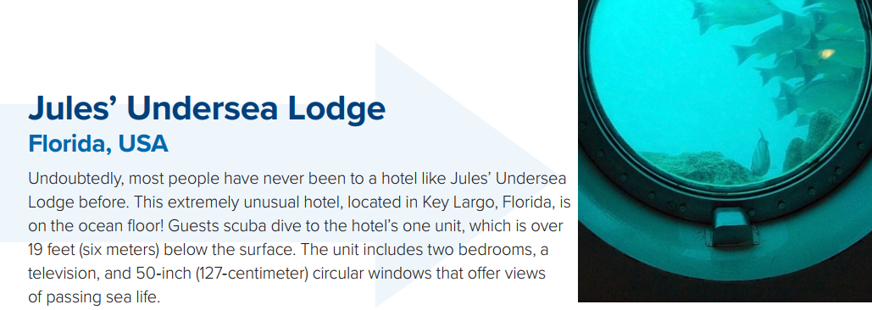
What is the name of the hotel?
What does the picture show?
What does the unit include ?
A window and a view of fish behind it
two bedrooms, a television, and 50-inch (107-centimeter) circular windows
Where does it locate ?
What is the windows shape?
located in Key Largo, Florida on the ocean floor
Circular
How do the guests reach there?
What makes it unusual ?
Guests scuba dive to the hotel’s one unit
It is undersea

Slide 13
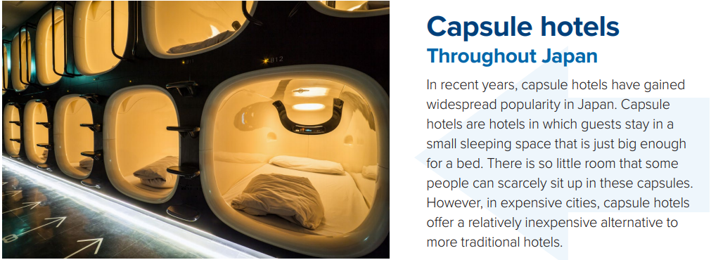
What is the name of the hotel?
Another choice or option
Where does it locate ?
Are they expensive ?
In Japan
No , they aren't
What are capsule hotel ?
What makes it unusual ?
hotels in which guests stay in a small sleeping space that is just big enough for a bed.
people can scarcely sit up in these
capsules.

Slide 14

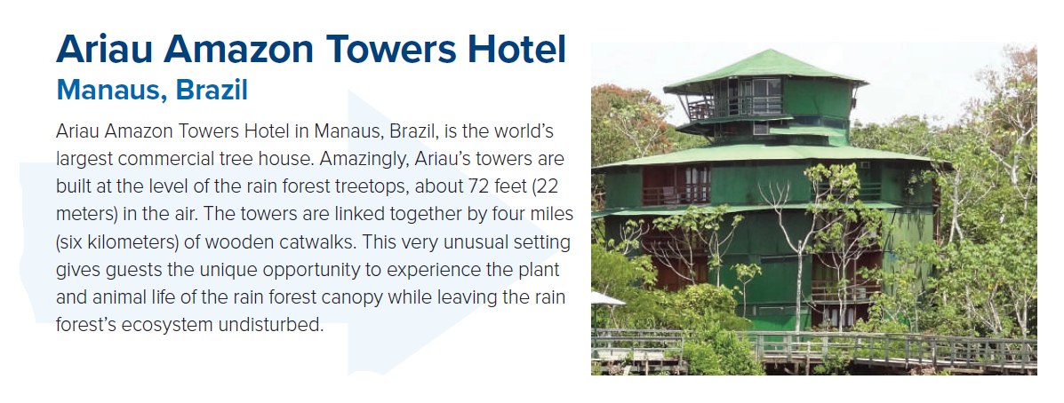
What is the name of the hotel?
the tops of the trees in a forest
Where does it locate ?
in Manaus, Brazil
What is it famous for ?
the world’s largest commercial tree house
What makes it unusual ?
Ariau’s towers are built at the level of the rain forest treetops, about 72 feet (22 meters) in the air. The towers are linked together by four miles (six kilometers) of wooden catwalks.

Slide 15
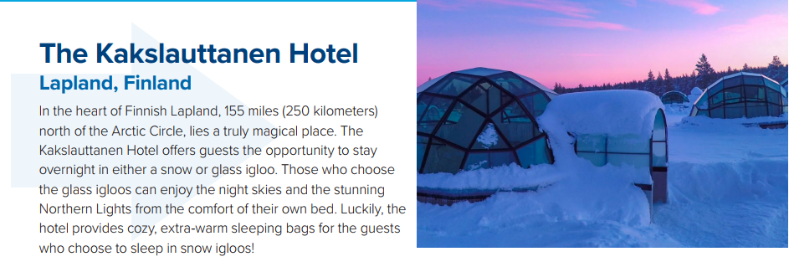
What is the name of the hotel?
comfortable and warm
Where does it locate ?
What does the Kakslauttanen Hotel offer ?
In Lapland, 155 miles (250 kilometers) north of the Arctic
offers guests the opportunity to stay
overnight in either a snow or glass igloo.
What does the hotel provide for the guests ?
the hotel provides cozy, extra-warm sleeping bags

Slide 16

Which HOTEL
you would like to stay at?

Slide 17
Books OPEN
Pages: 34 - 35

Slide 18

Find the word

Slide 19
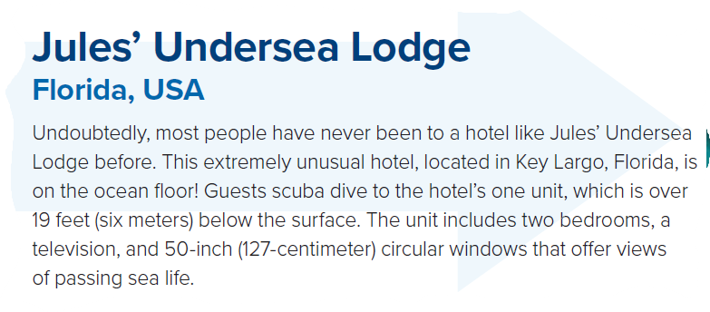

Find
Word that means …
“round”

Slide 20

Find
Word that means …
“another choice”

Slide 21

“the tops of the trees in a forest”
Find
Word that means …

Slide 22

“comfortable & warm”
Find
Word that means …

Slide 23
Books OPEN
Page: 35

Slide 24
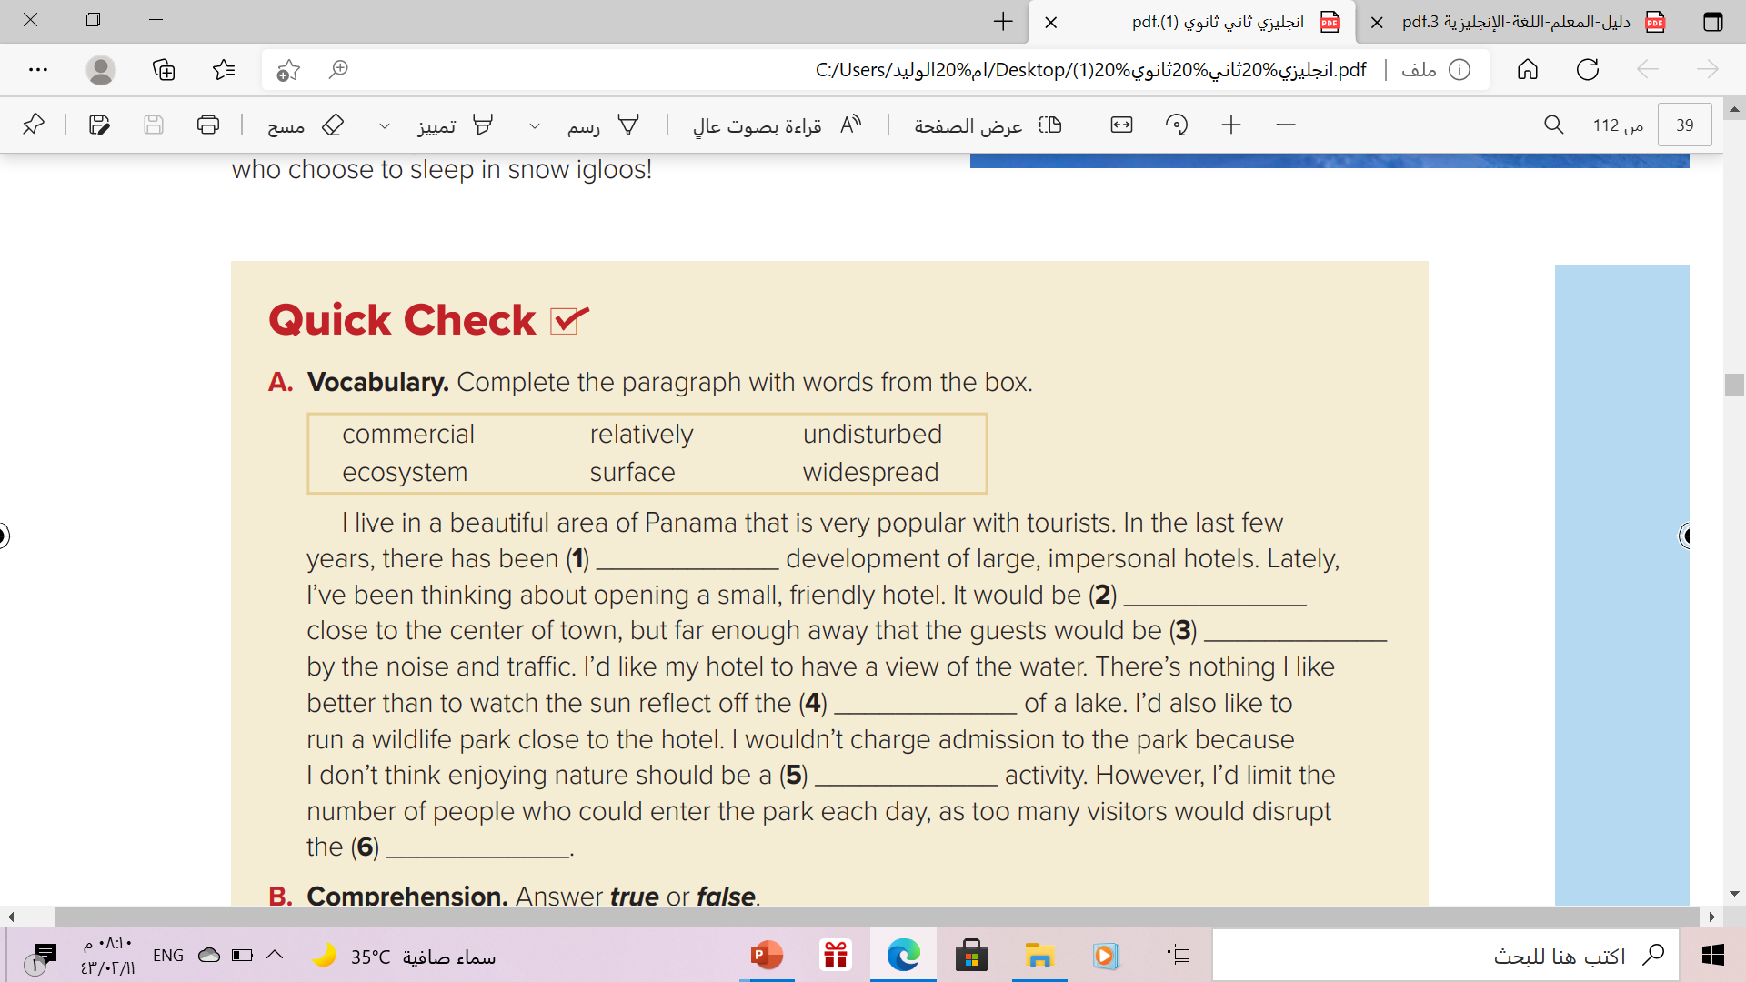
widespread
relatively
undisturbed
surface
commercial
ecosystem

Slide 25
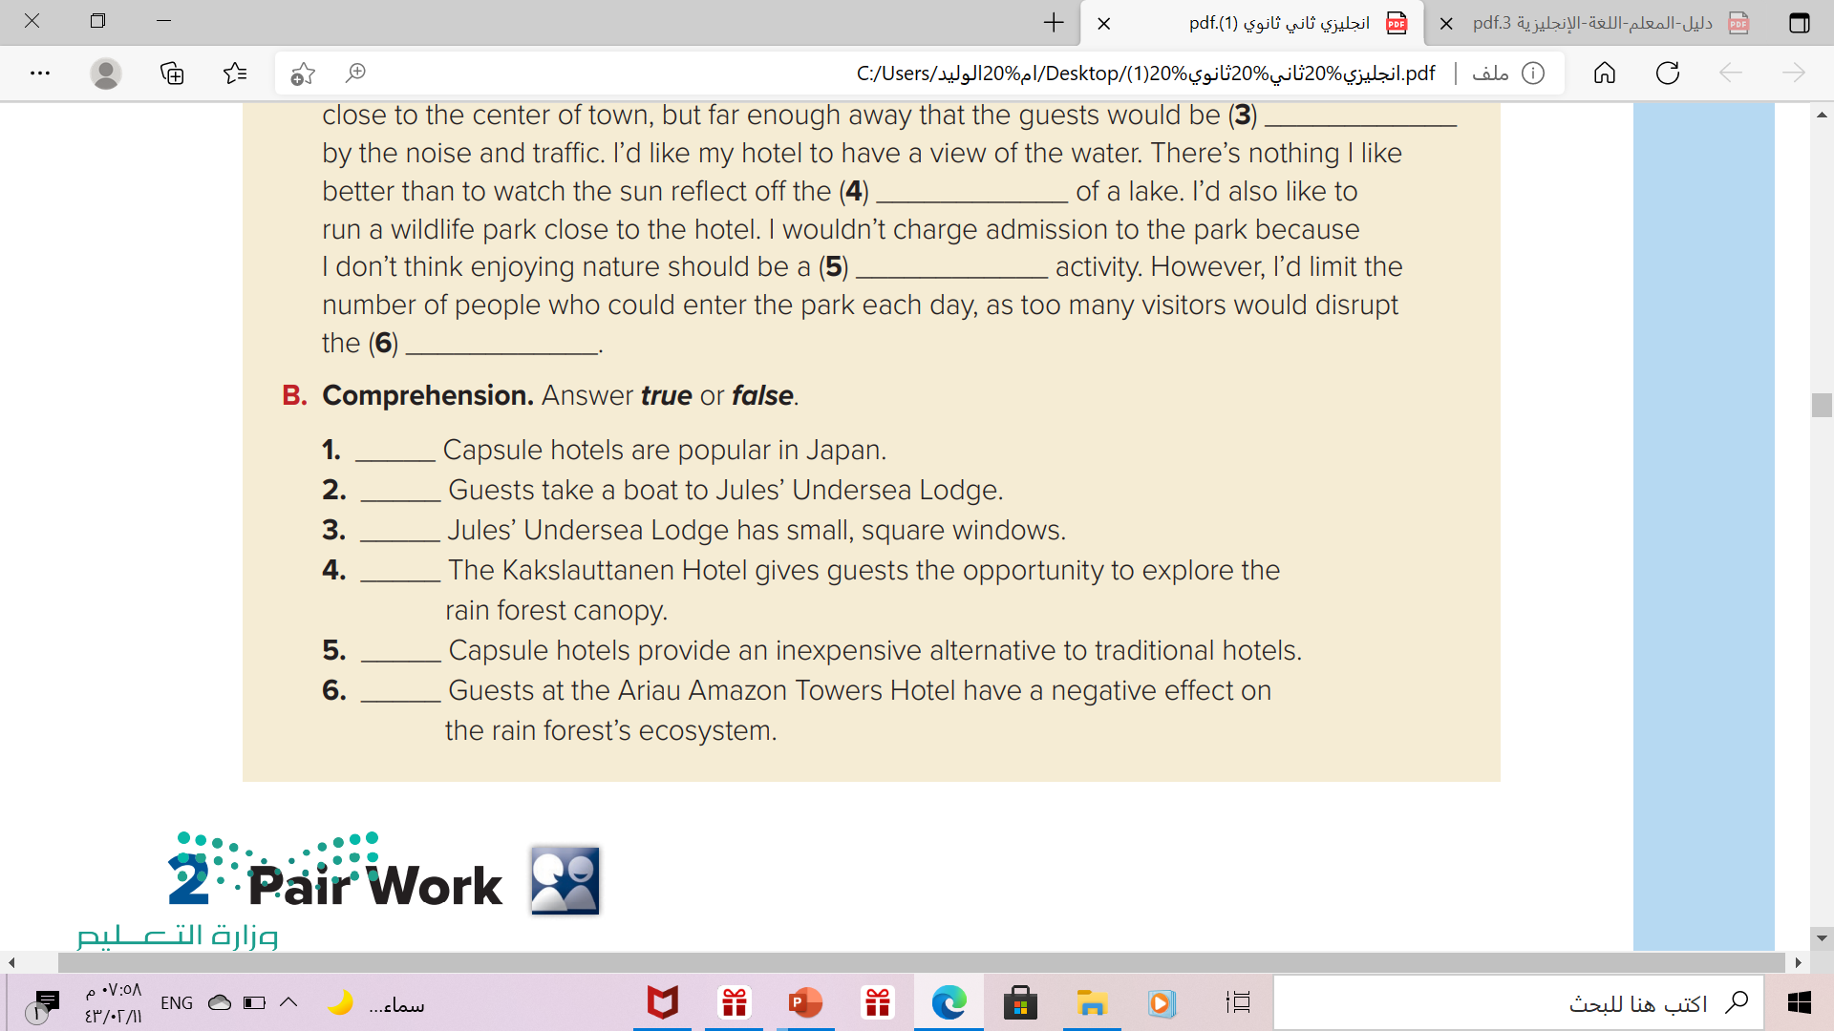
Quick Check
True
False
(Guests scuba dive to Jules’ Undersea Lodge ).
False
(It has large, circular windows.)
False
(The Ariau Amazon Towers Hotel
True
False
(Guests leave the rainforest’s ecosystem undisturbed.)

Slide 26
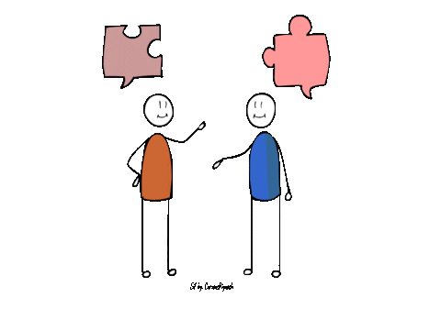
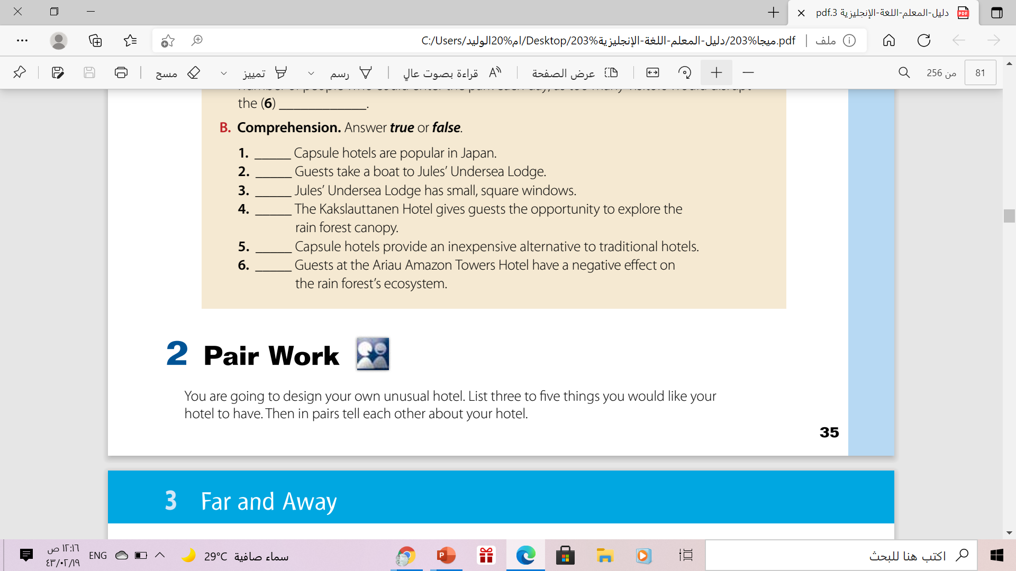
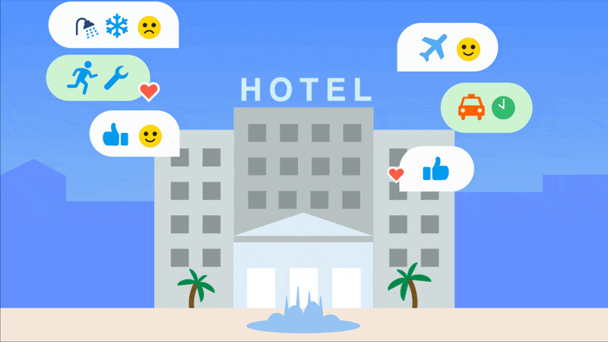

Slide 27
Workbook
Page: (103), exercises (A-B)

Slide 28

Thanks!

