Slide 1

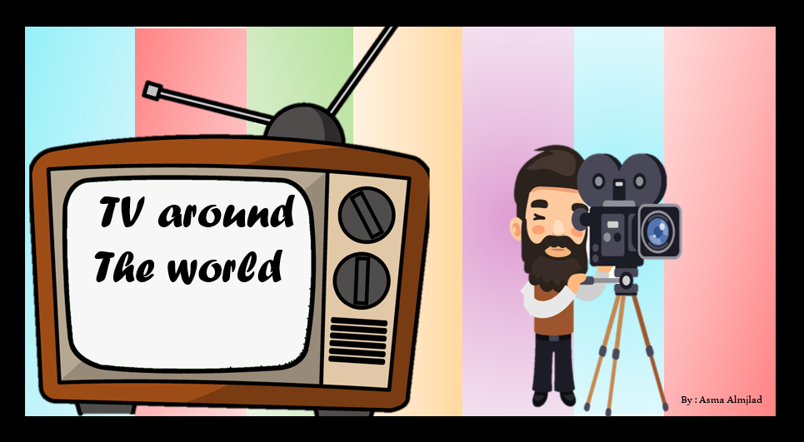

Listen and discuss

Slide 2
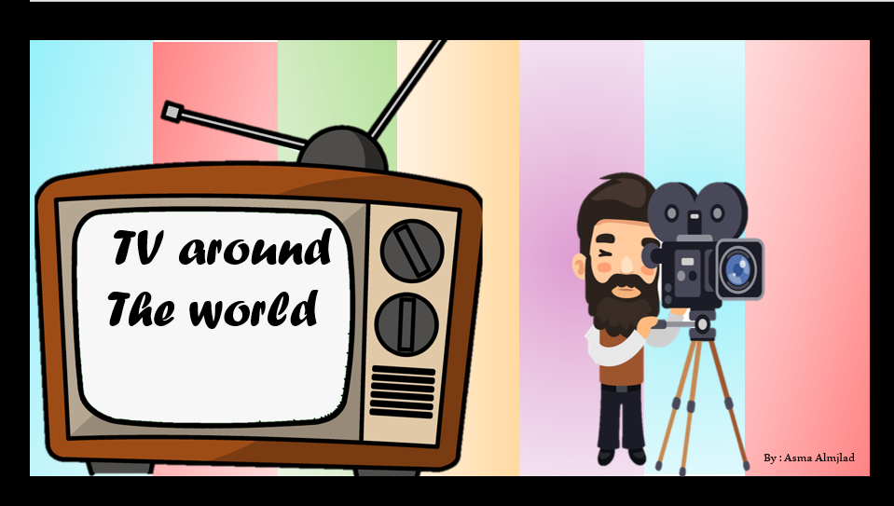


Slide 3
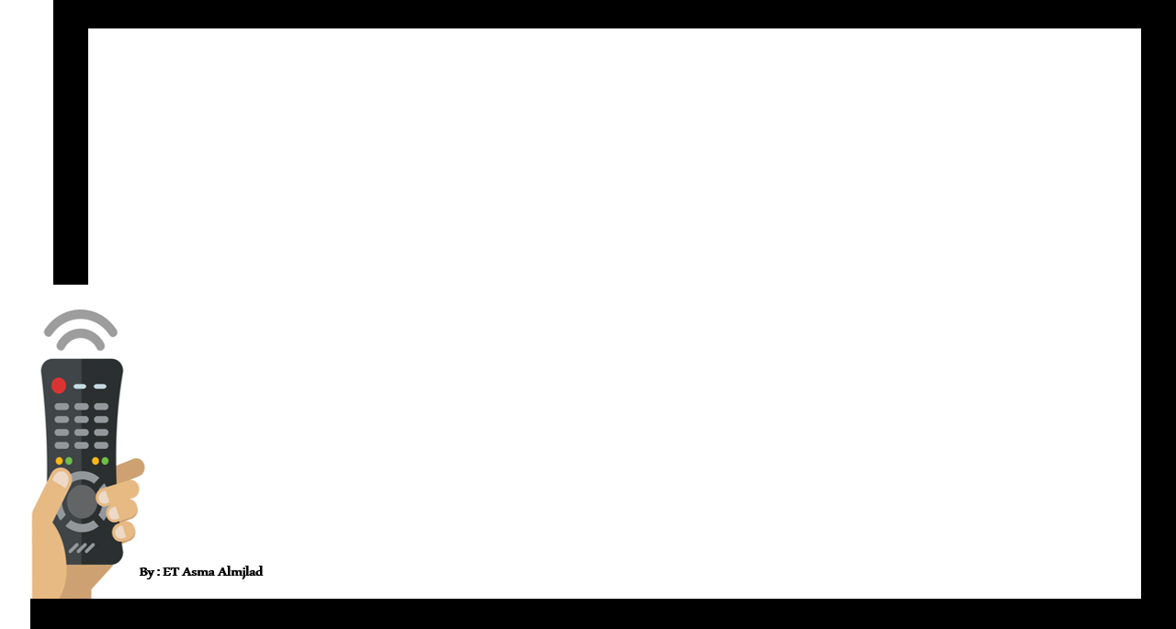

Objectives
List TV programs that they like or dislike
Determine the types of TV programs
Match the program with its description

Slide 4


Slide 5
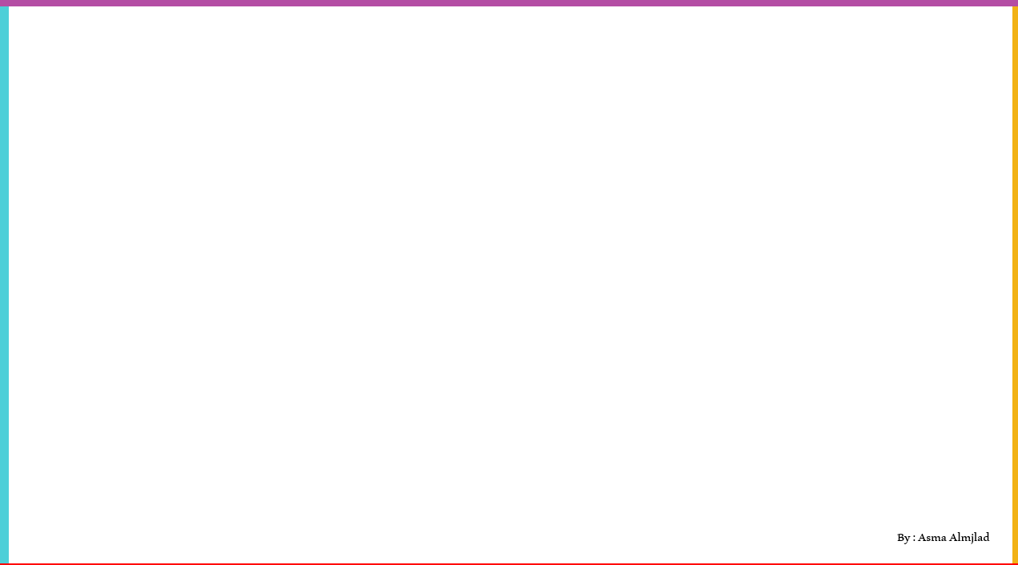
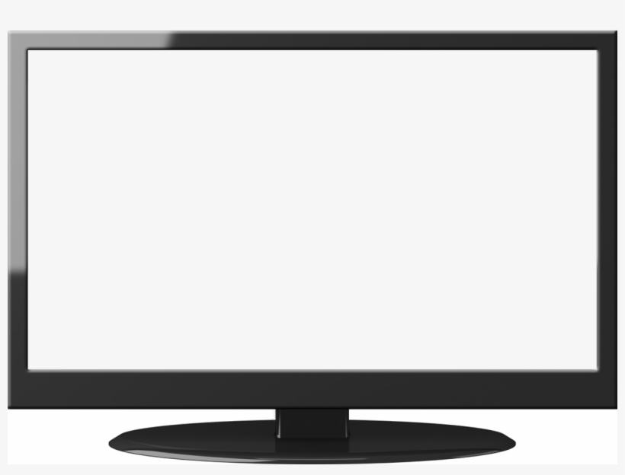

By : Asma Almjlad

Slide 6







What do we call these ?

Slide 7



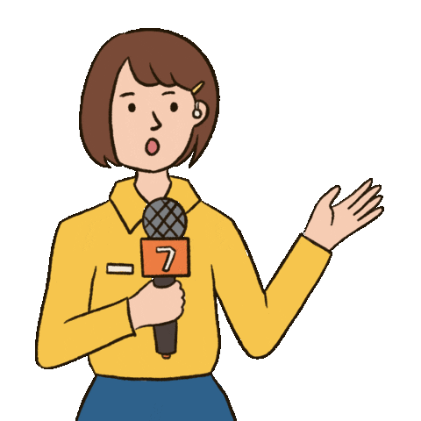
Do you like watching TV ?
What’s your favorite TV show ?

Slide 8

What are kinds of TV programs do you
like or dislike?

Slide 9

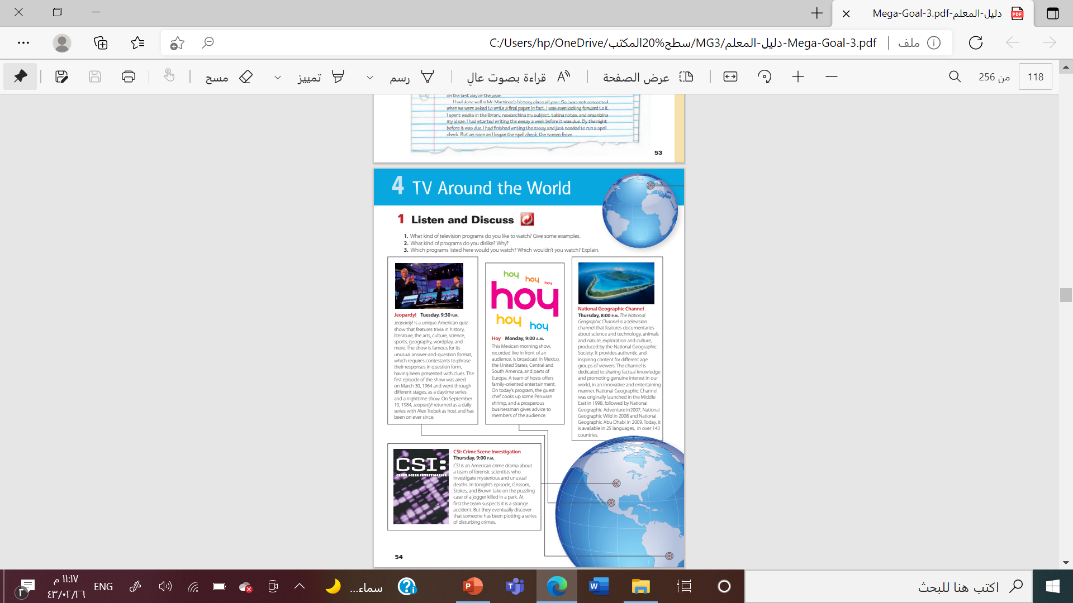
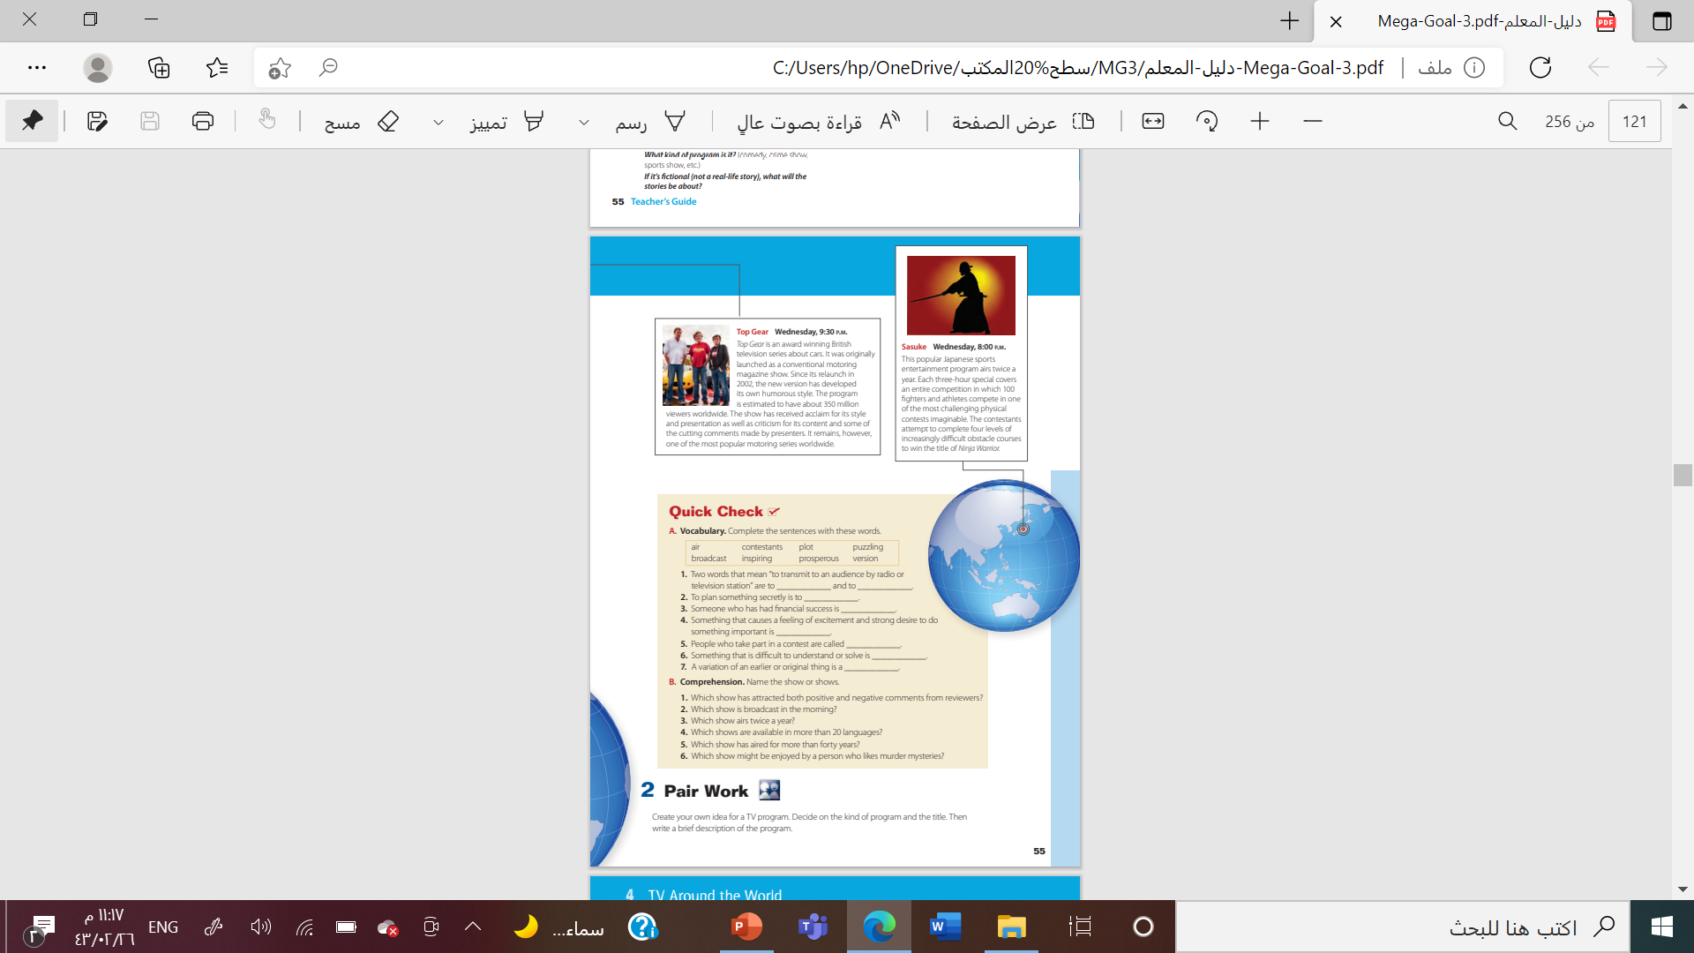
@ page 28+29

Slide 10


What are these ?
How many TV shows can you see ?
Which programs listed here would you watch?

Slide 11
Which program is about cars ?
Which program is a quiz show ?
Which is a sports program ?
Which program is good for family viewing ?

Slide 12

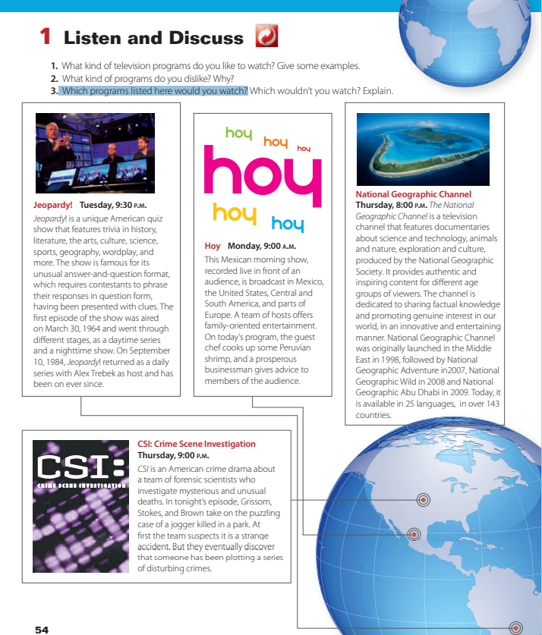
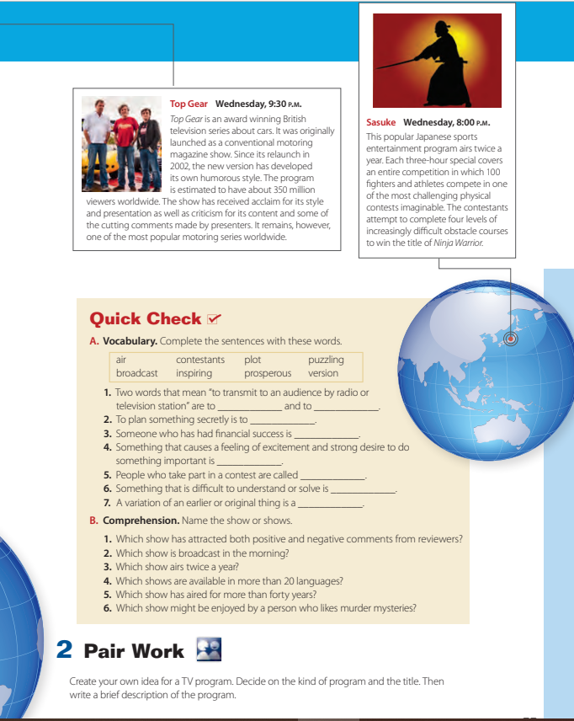


Slide 13
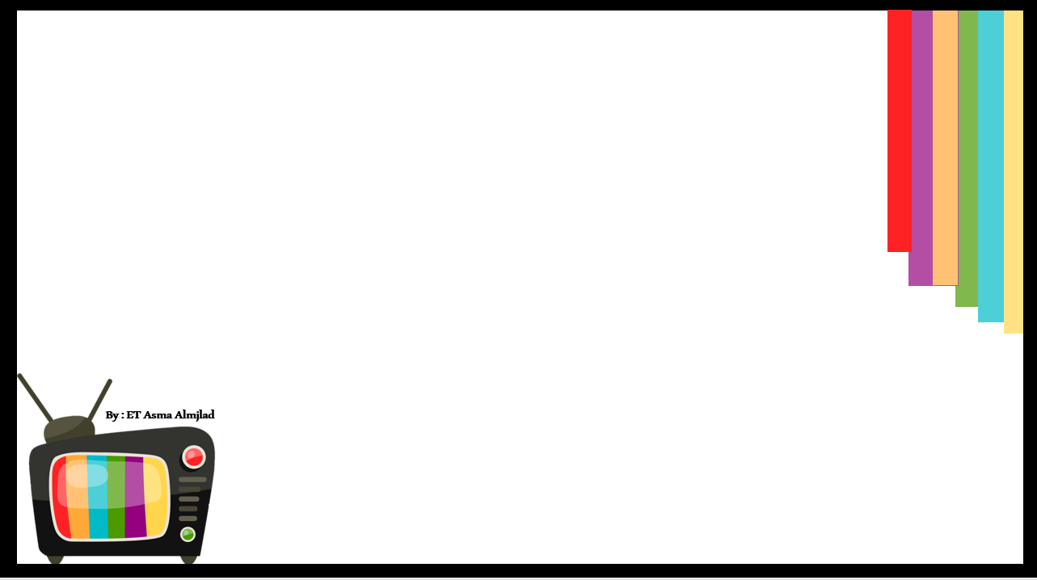
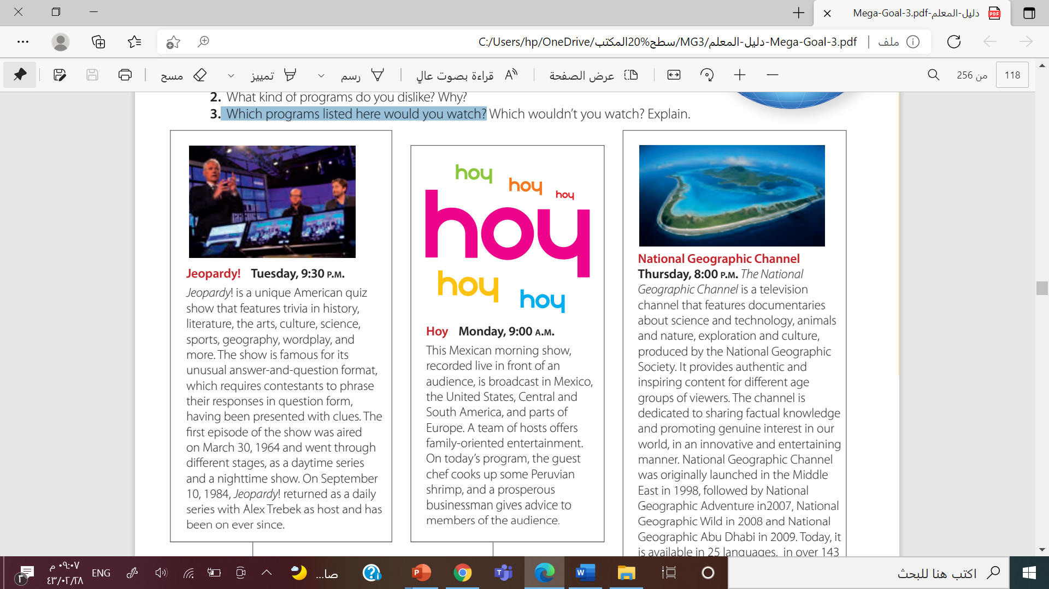
What is Jeopardy ?
What is it famous for ?
When was the 1st episode aired ?
Who was the host ?

Slide 14

When does Hoy show ?
What is the idea of the show ?
Is it MACXICAN program ?
What does THE CHEF cook up ?

Slide 15
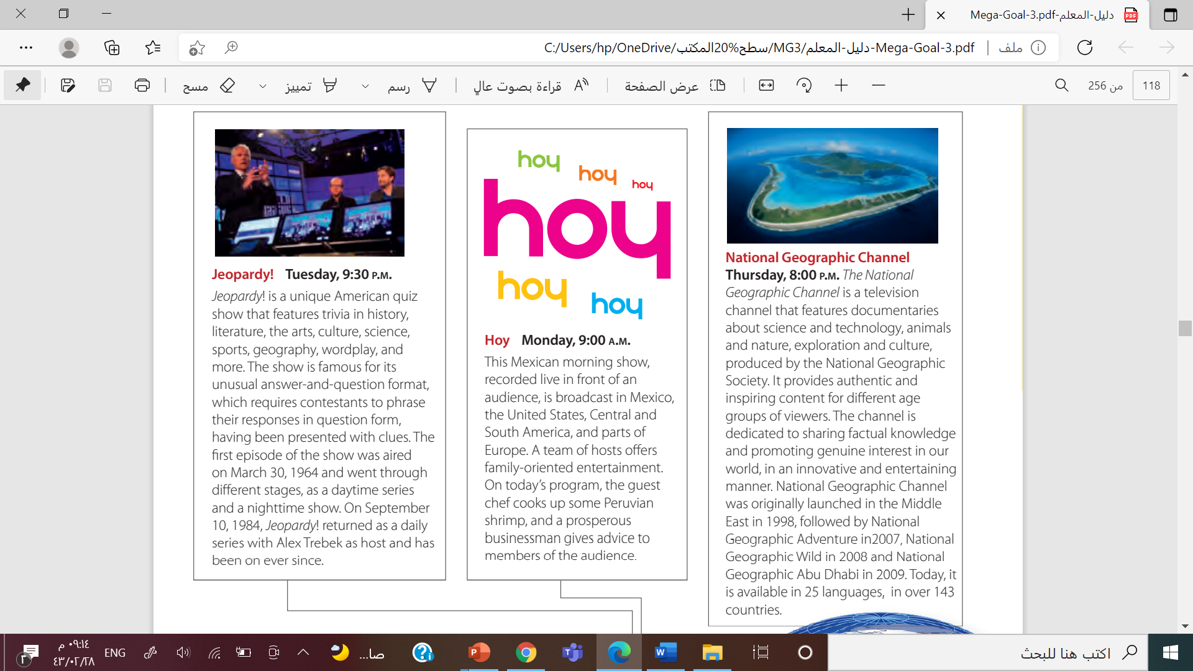
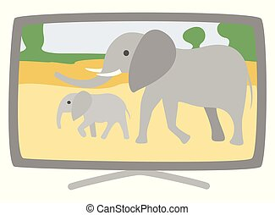
What is The National
Geographic Channel ?
How many languages are available
for National Geographic Channel ?
Do you watch it before?
Do you like watching documentaries about science and animals or nature?

Slide 16
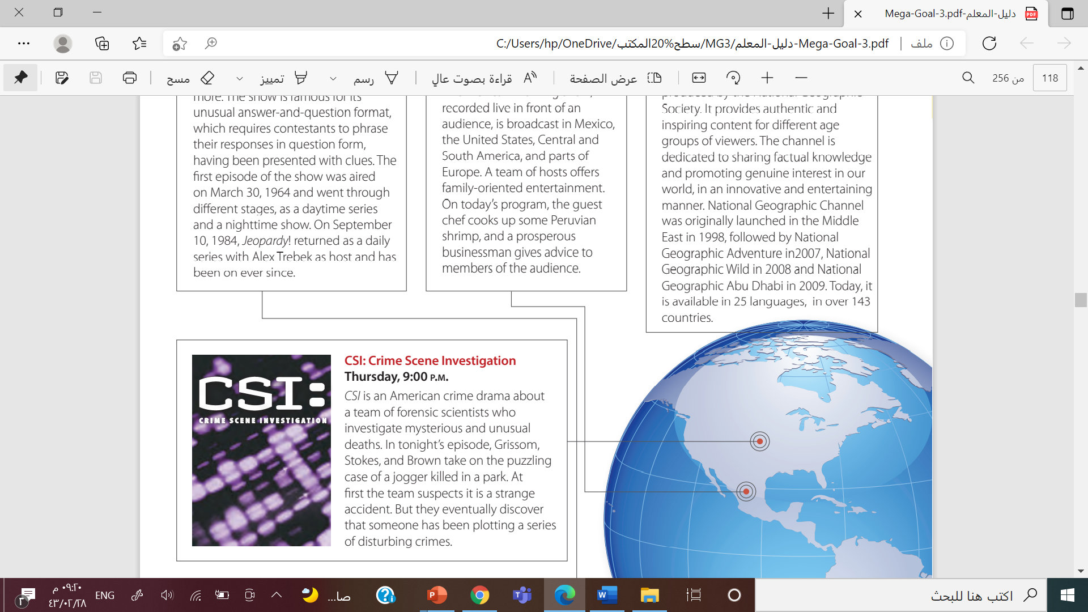

What is CSI refer to ?
What are the types of crime?
Is it Britch program ?

Slide 17
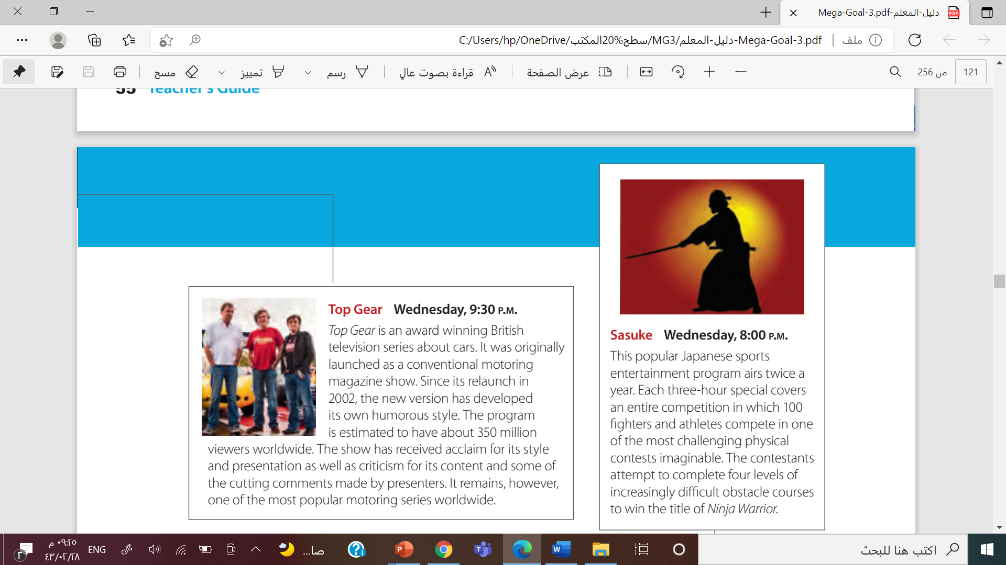

What is Top Gear show about?
How many viewers of the program ?
Is it a popular motoring show?

Slide 18
What is the kind of this program ?
This Program airs 5 times a year.
How many fighters compote in ?

Slide 19


Slide 20
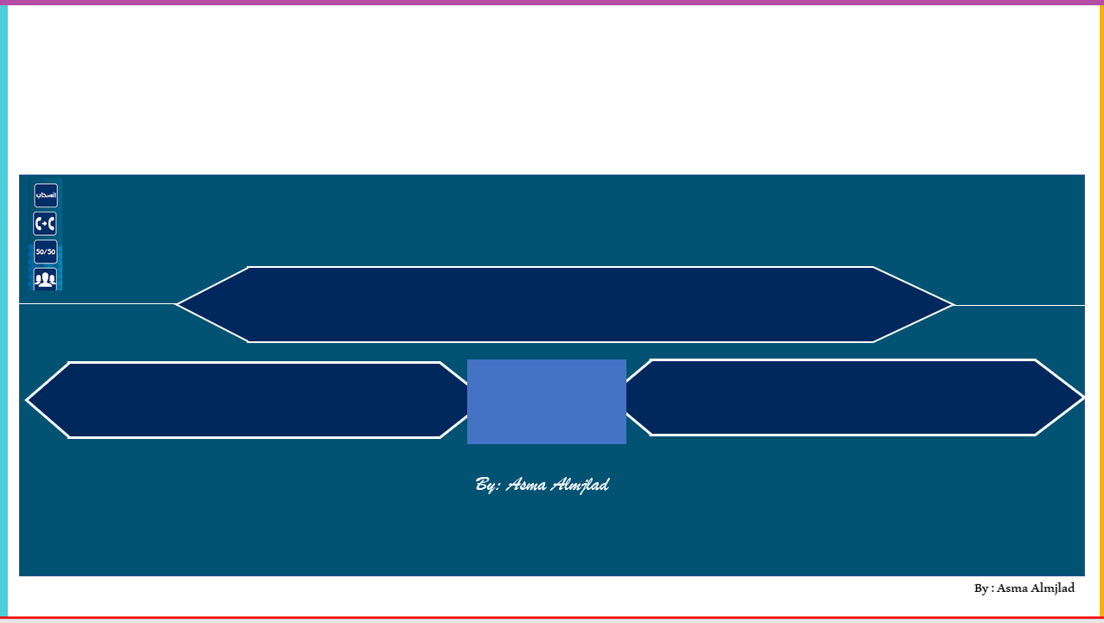


a complete change of something, such as a person’s clothing or hairstyle
makeup
Makeover

Slide 21
an unlucky accident
mishap
trivia

Slide 22
to try to do something
vicious
attempt

Slide 23

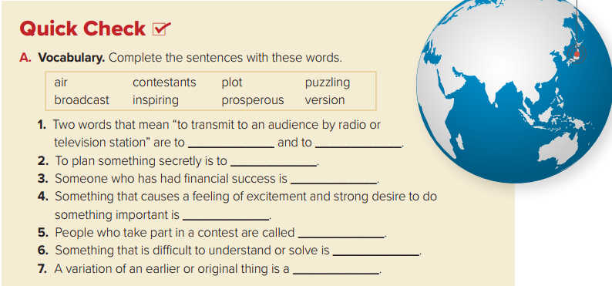
air
broadcast
plot
prosperous
inspiring
contestants
puzzling
version

Slide 24
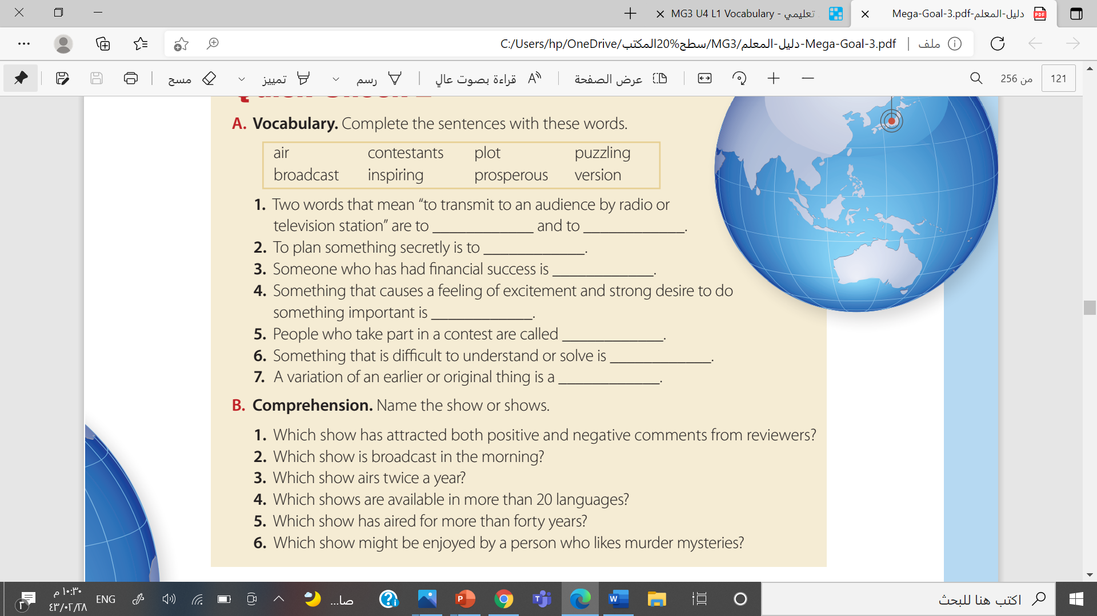

1- Top Gear
2- hoy
3- Sasuke
4- National Geographic shows and documentaries
5- Jeopardy!
6- CSI

Slide 25



By : Asma Almjlad

Slide 26






Slide 27



Slide 28
