Slide 1
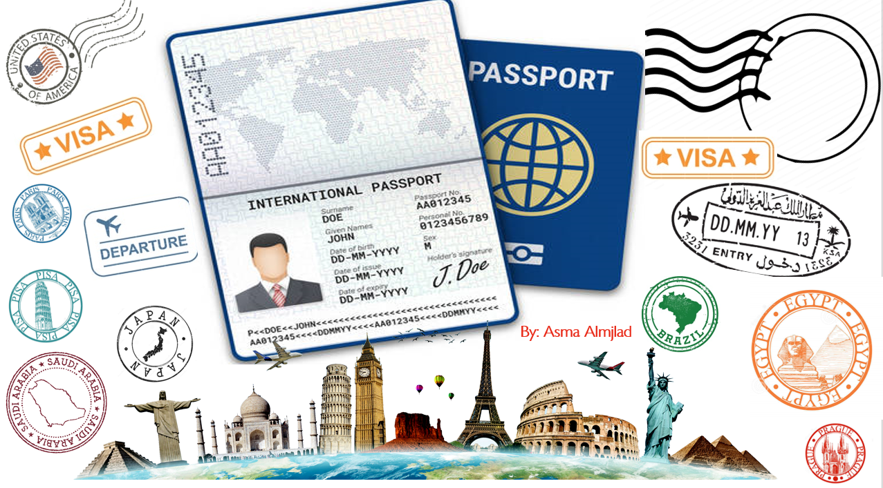

MG3
U3:Far and away
Form, meaning and function
U:3
Far and away
Oct 2021

Slide 2
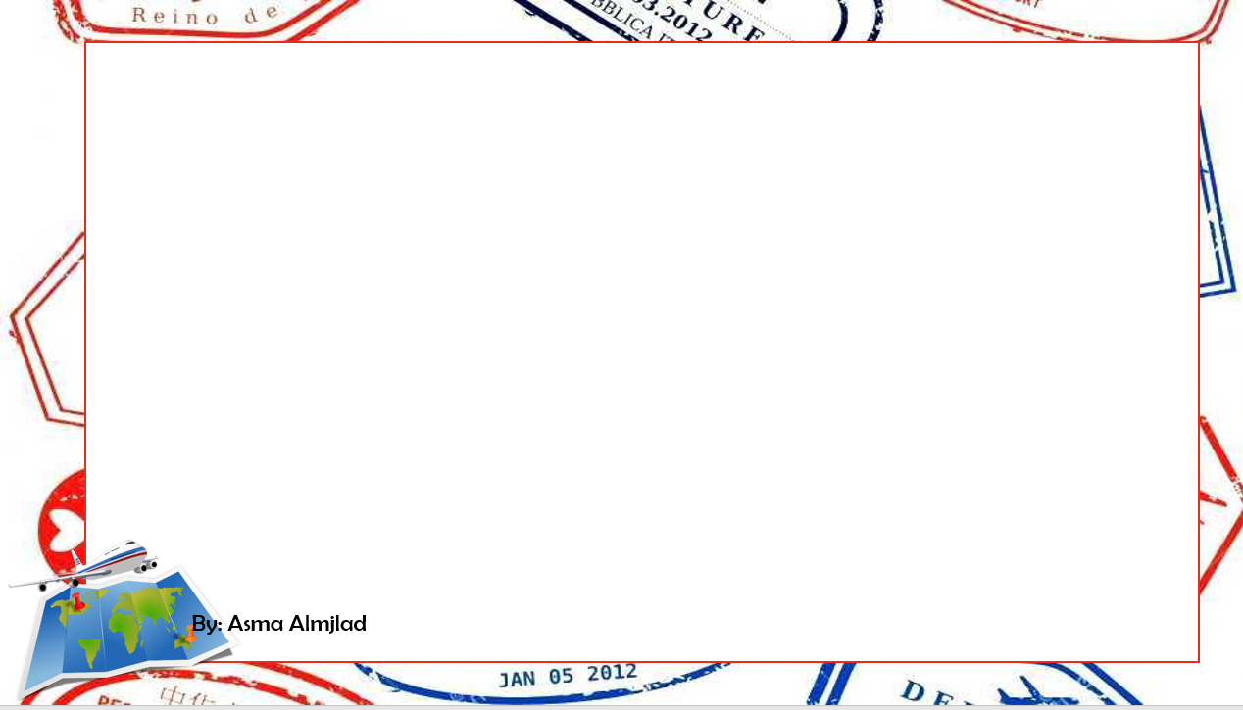


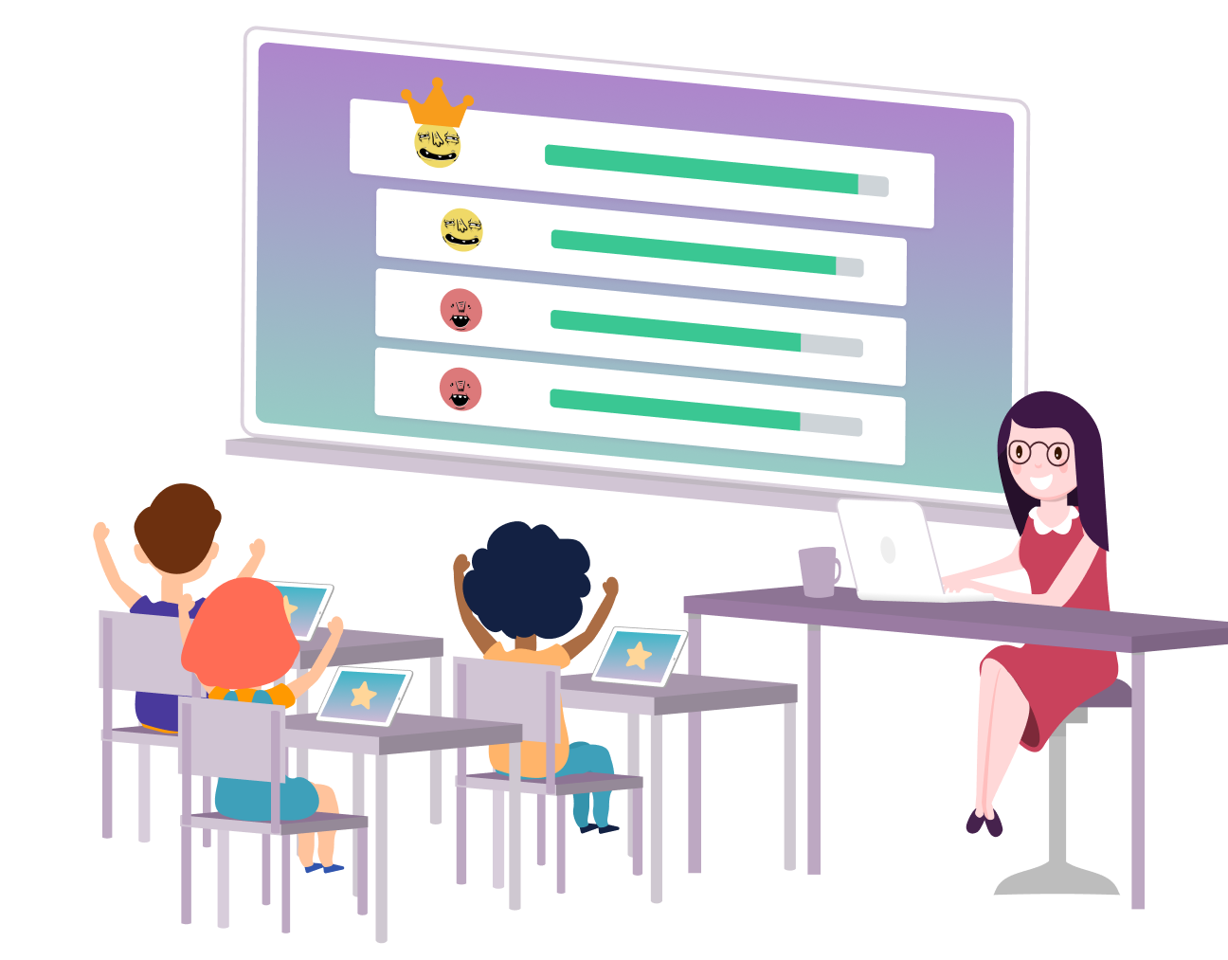


Slide 3

n
Objectives
Use "be going to" to talk about future plans
Choose the suitable question word for the information question
Use “will" to talk about future plans

Slide 4
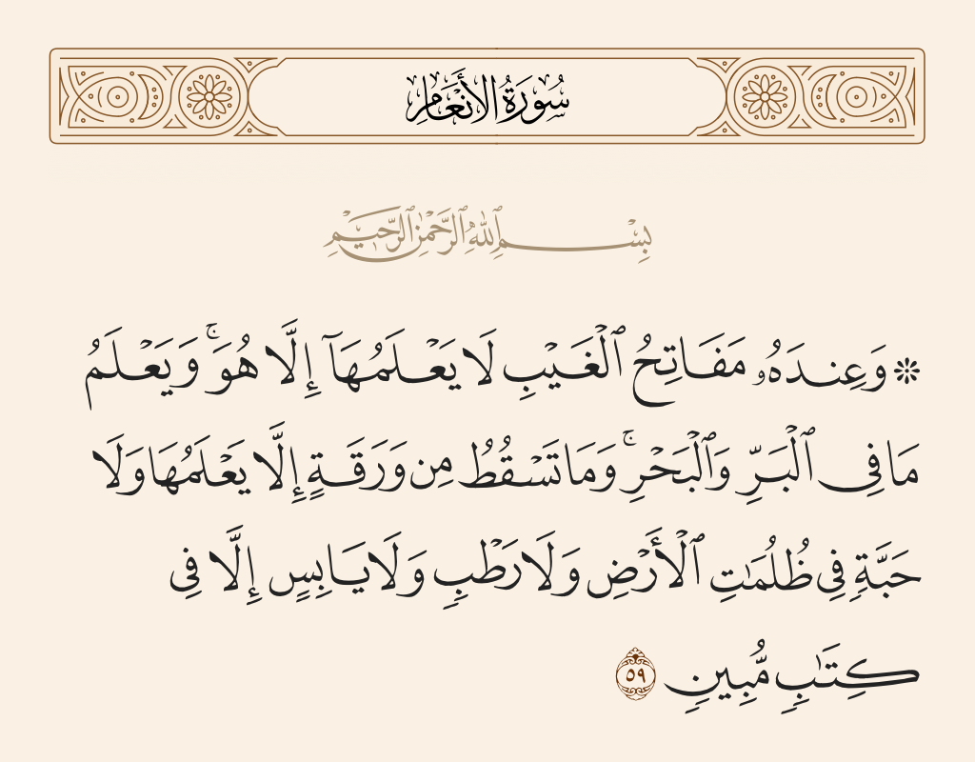

Slide 5


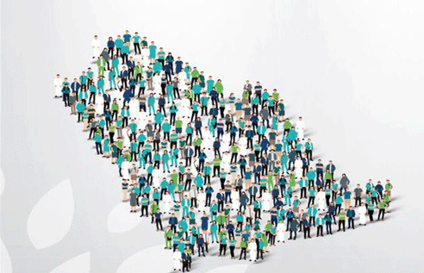

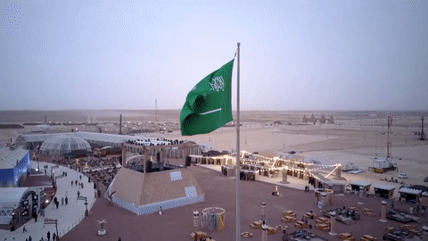


Slide 6
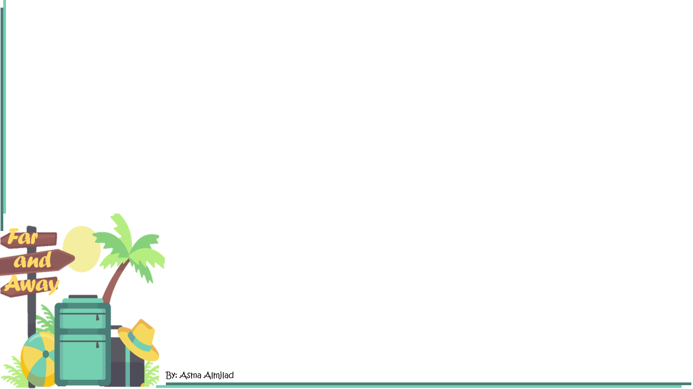


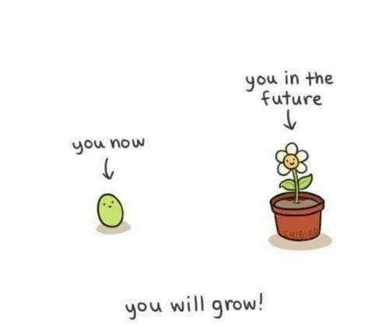


Slide 7
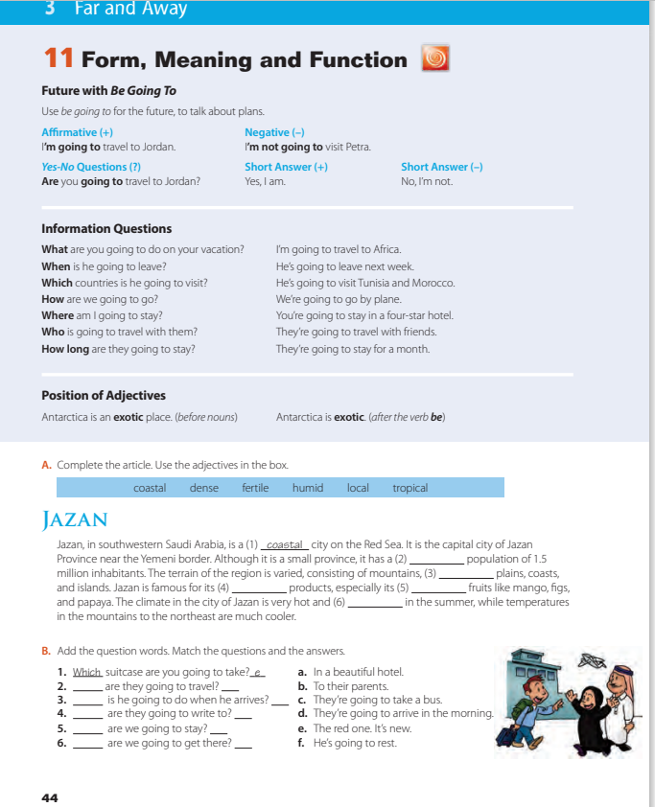
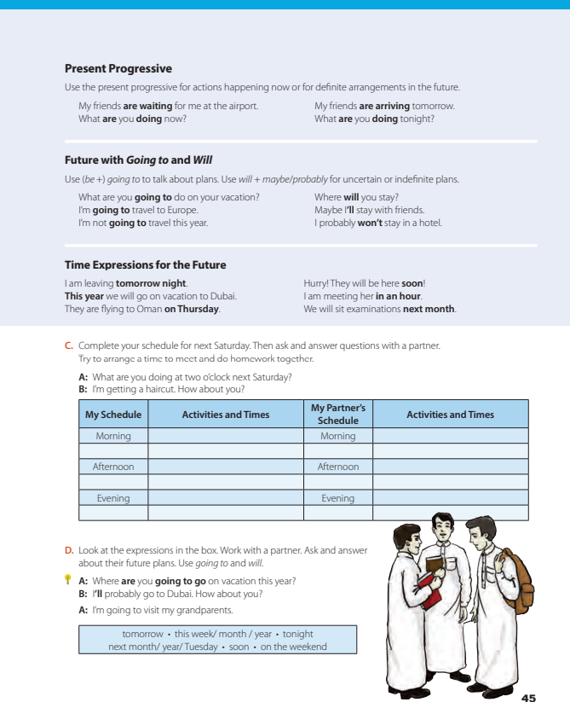

@ page 44 +45

Slide 8
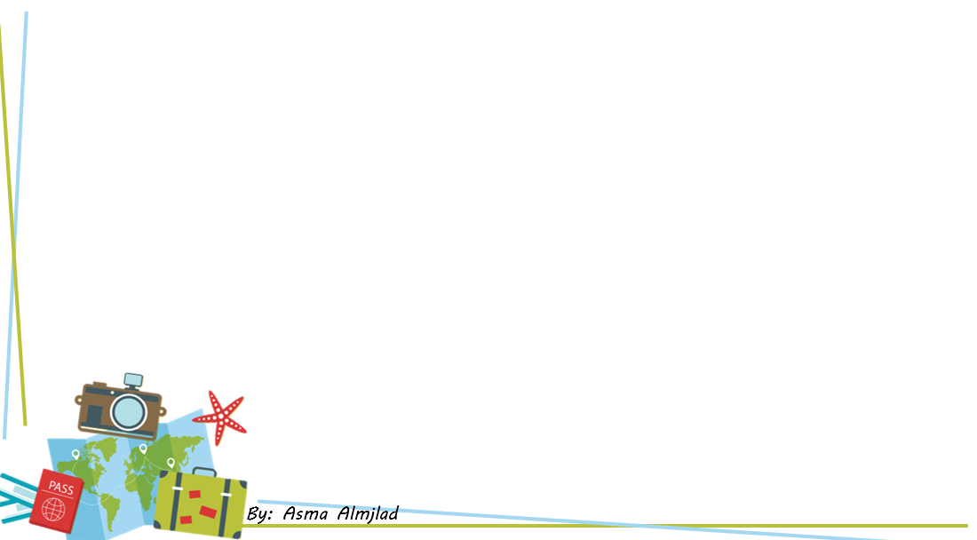

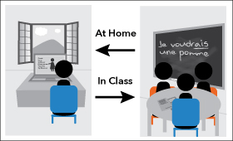
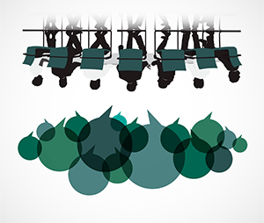

By: ET Ammar Al-Eid

Slide 9

How can you write a sentence in the future ?
Be going to
will

Slide 10
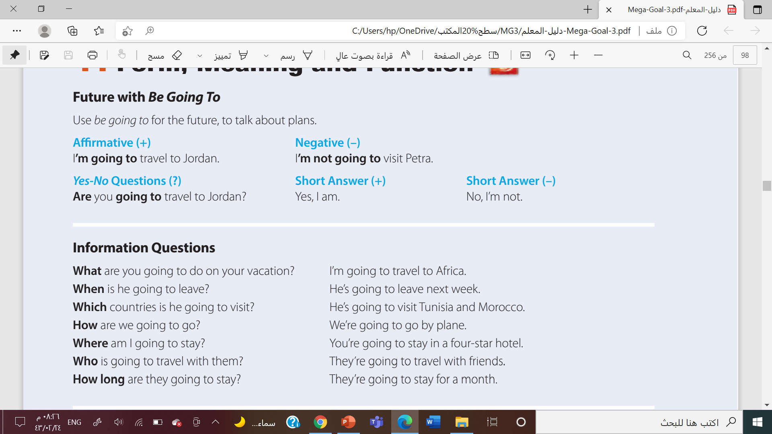
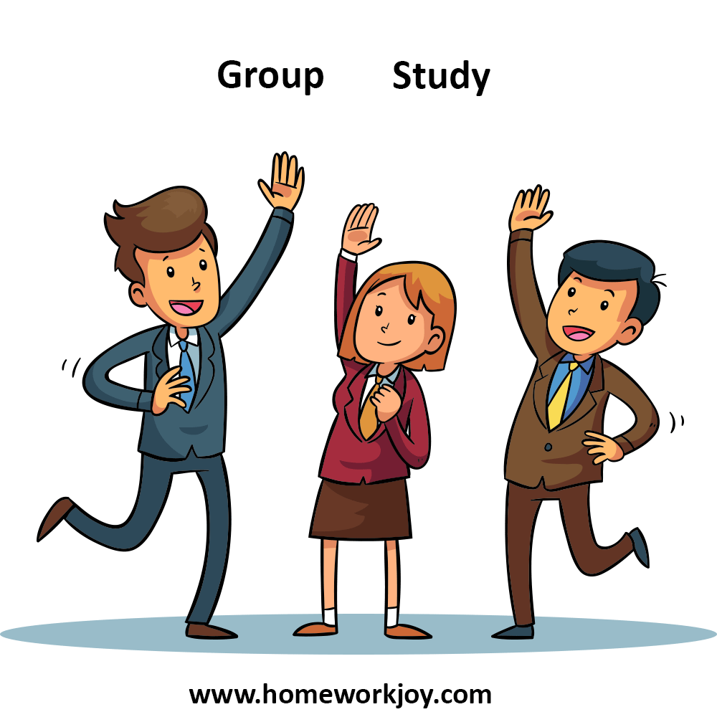

Slide 11
Form
Affirmative sentences
Be + going to + v inf
e.g.
I am going to travel to Abha
Negative sentences
Be + not + going to + v inf
e.g.
I amn’t going to travel to Abha

Slide 12
Form
Yes or No question
Are you going to travel to Abha?
form.
Be + S + going to + v inf… ?
Wh question
What are you going to do this weekend?
Form
Wh + Be + S + going to + V inf …?

Slide 13
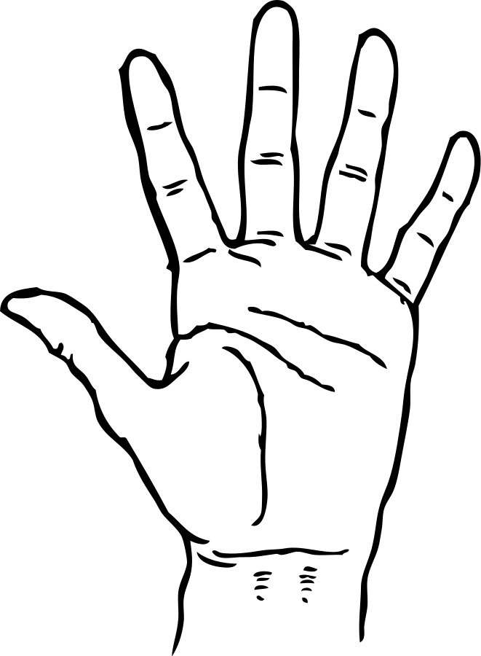
List five of question words

Slide 14

Ask about person
who
when
Ask about place
Classify
where
Ask about time
What
Which
Ask for a reason
Ask for things
Ask about choices

Slide 16


Slide 17

Ali is going to ( play – playing - plays ) football tonight.
Sara is ( go – goes – going ) to visit her friend next week .
They ( amn’t – aren’t – isn’t ) going to study
Are you going to ( study – studying – studied ) tomorrow ?

Slide 18
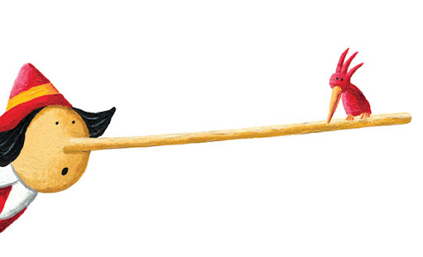


Find the fib
She is going to joins us

Slide 19
Find the fib
Is Omar goes to come?

Slide 20

Find the fib
You are going to is angry .

Slide 21
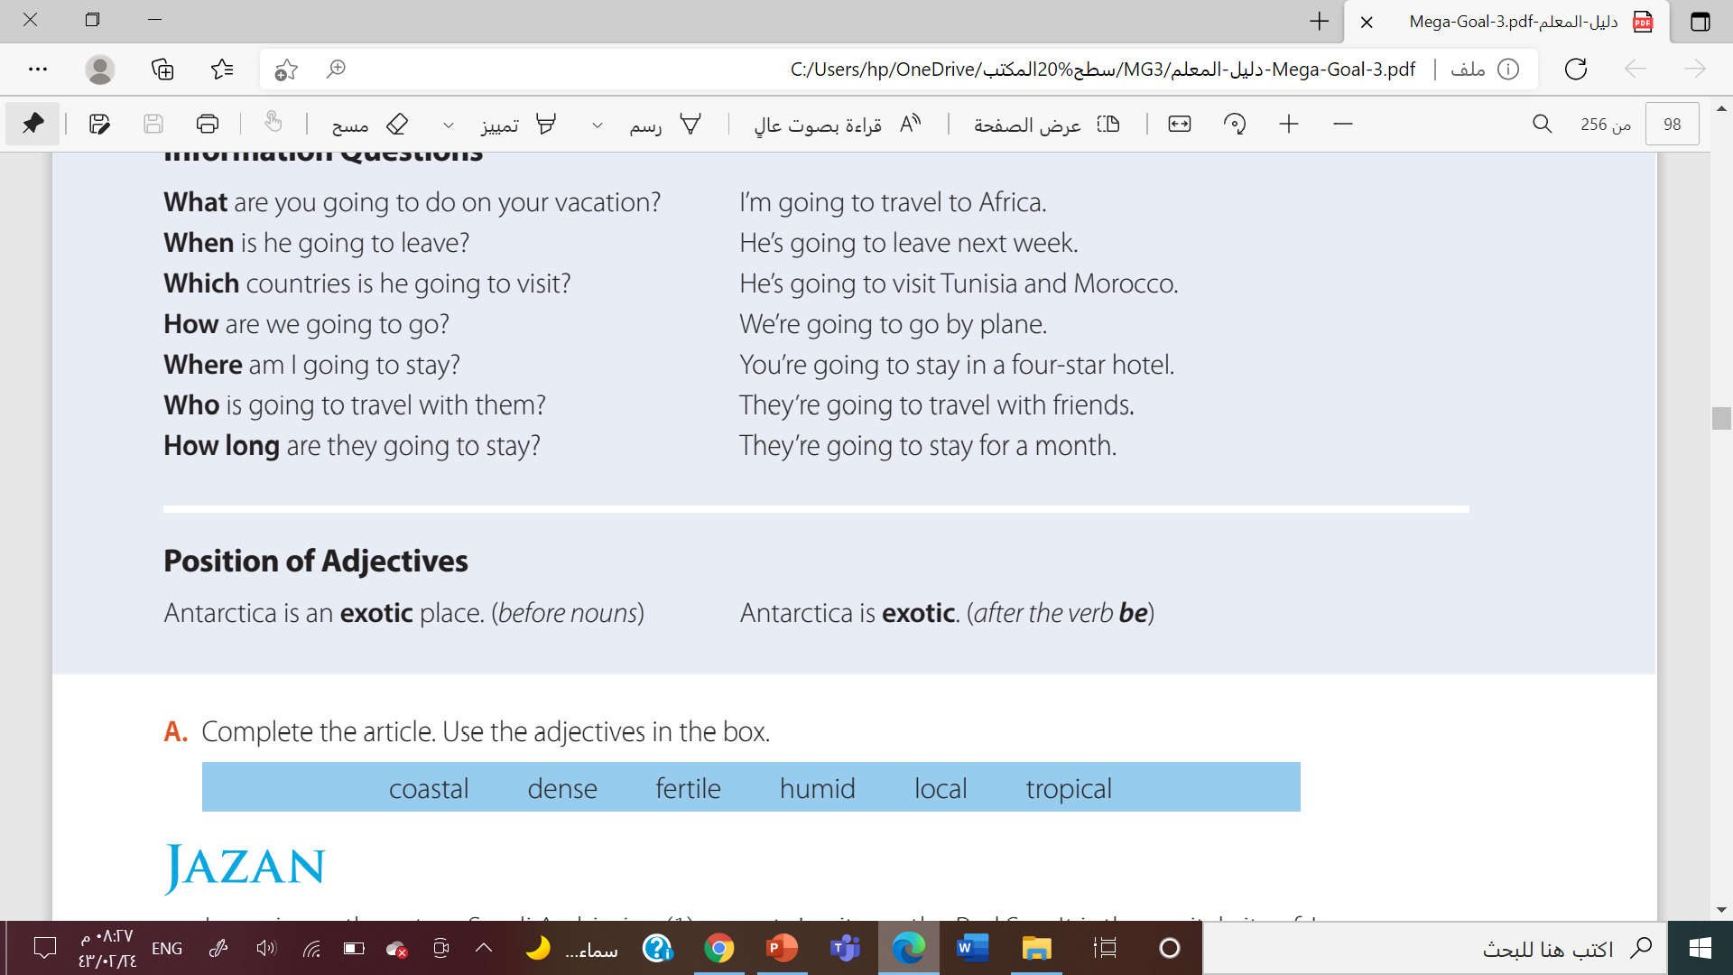


Slide 22




After verb to be
He is an intelligent boy.
She is a nice girl.
Before nouns
Noura has a very old house
I like big cars

Slide 23
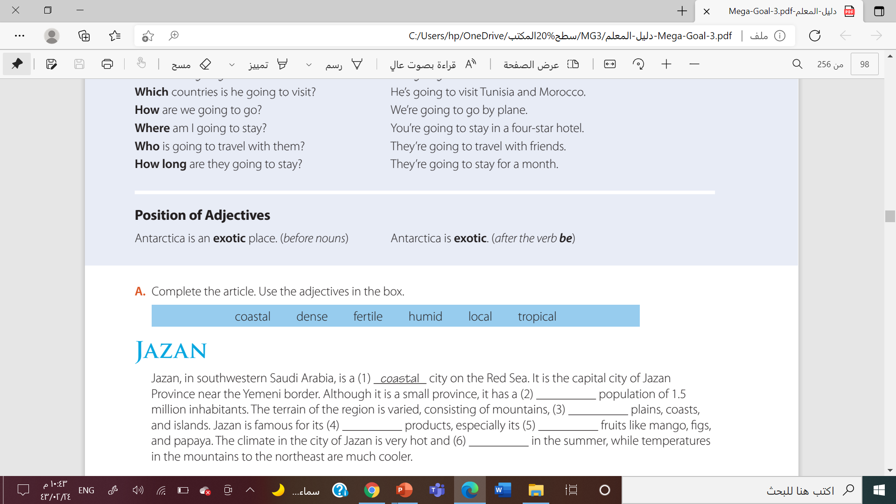
dense
fertile
local
tropical
humid

Slide 24
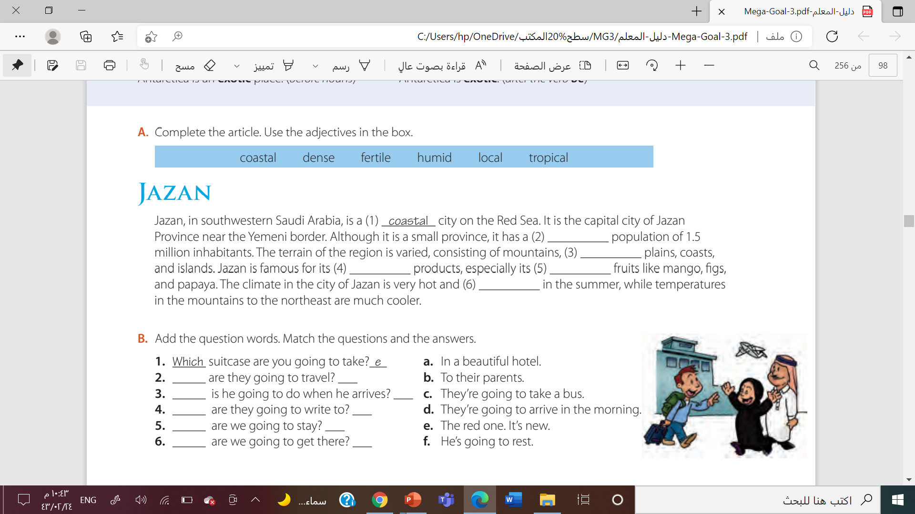
how
c
what
f
who
b
where
a
when
d

Slide 25
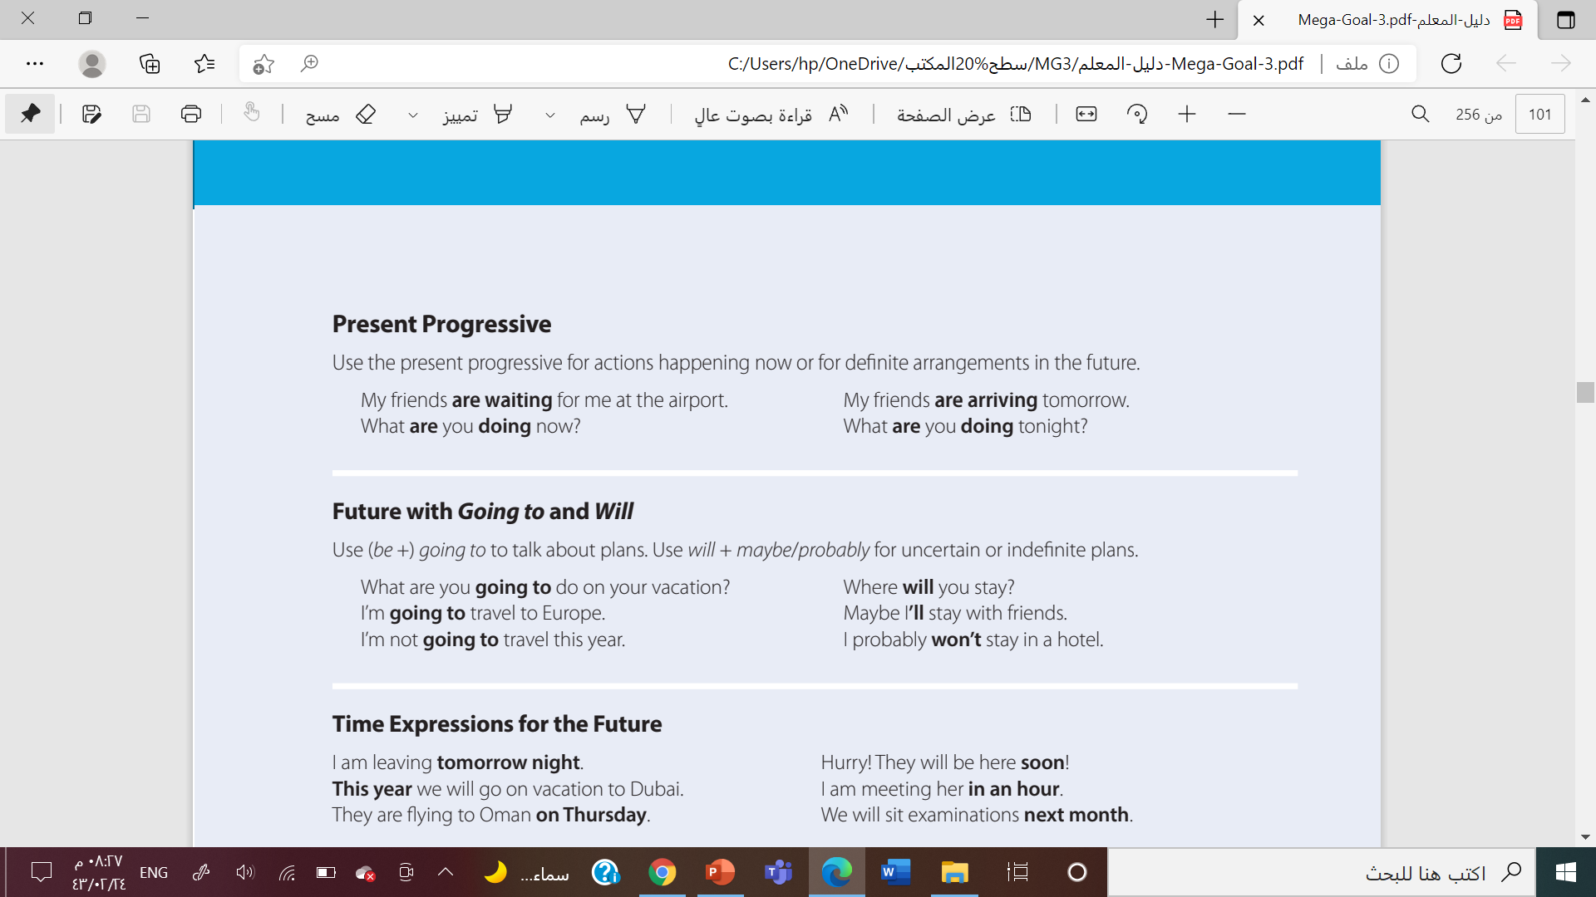

Slide 26
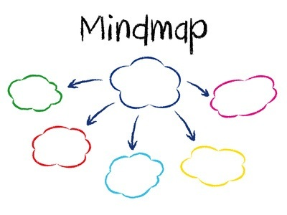

Slide 27
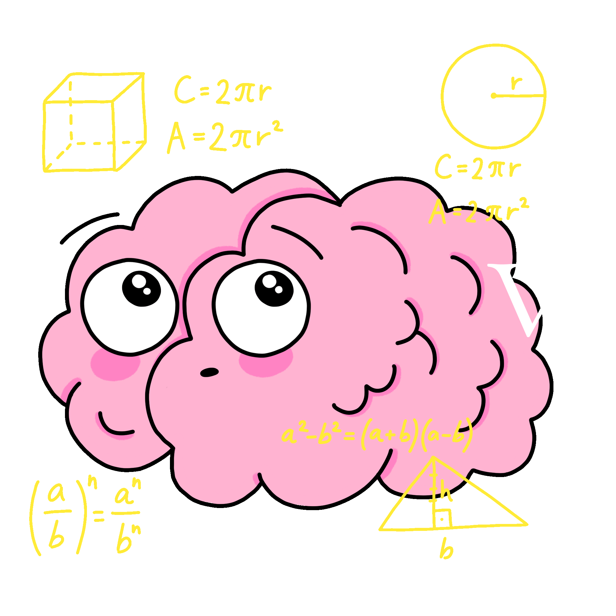




She
He
it
is
Present progressive
I
V + ing
are
You
We
they
am

Slide 28




Slide 29
It will( rains – raining – rain) tomorrow.
Hammd ( isn’t – won’t – hasn’t ) buy this car .
The meeting will ( is – are –be) at 9.30 am.

Slide 30







He will be here tomorrow
Look at the sky. I’m sure it’s going to rain soon
Find Out
My friend is going to travel to Europe next month
His father will work till 8:00 pm tonight
Noura will be in London on Monday .

Slide 32
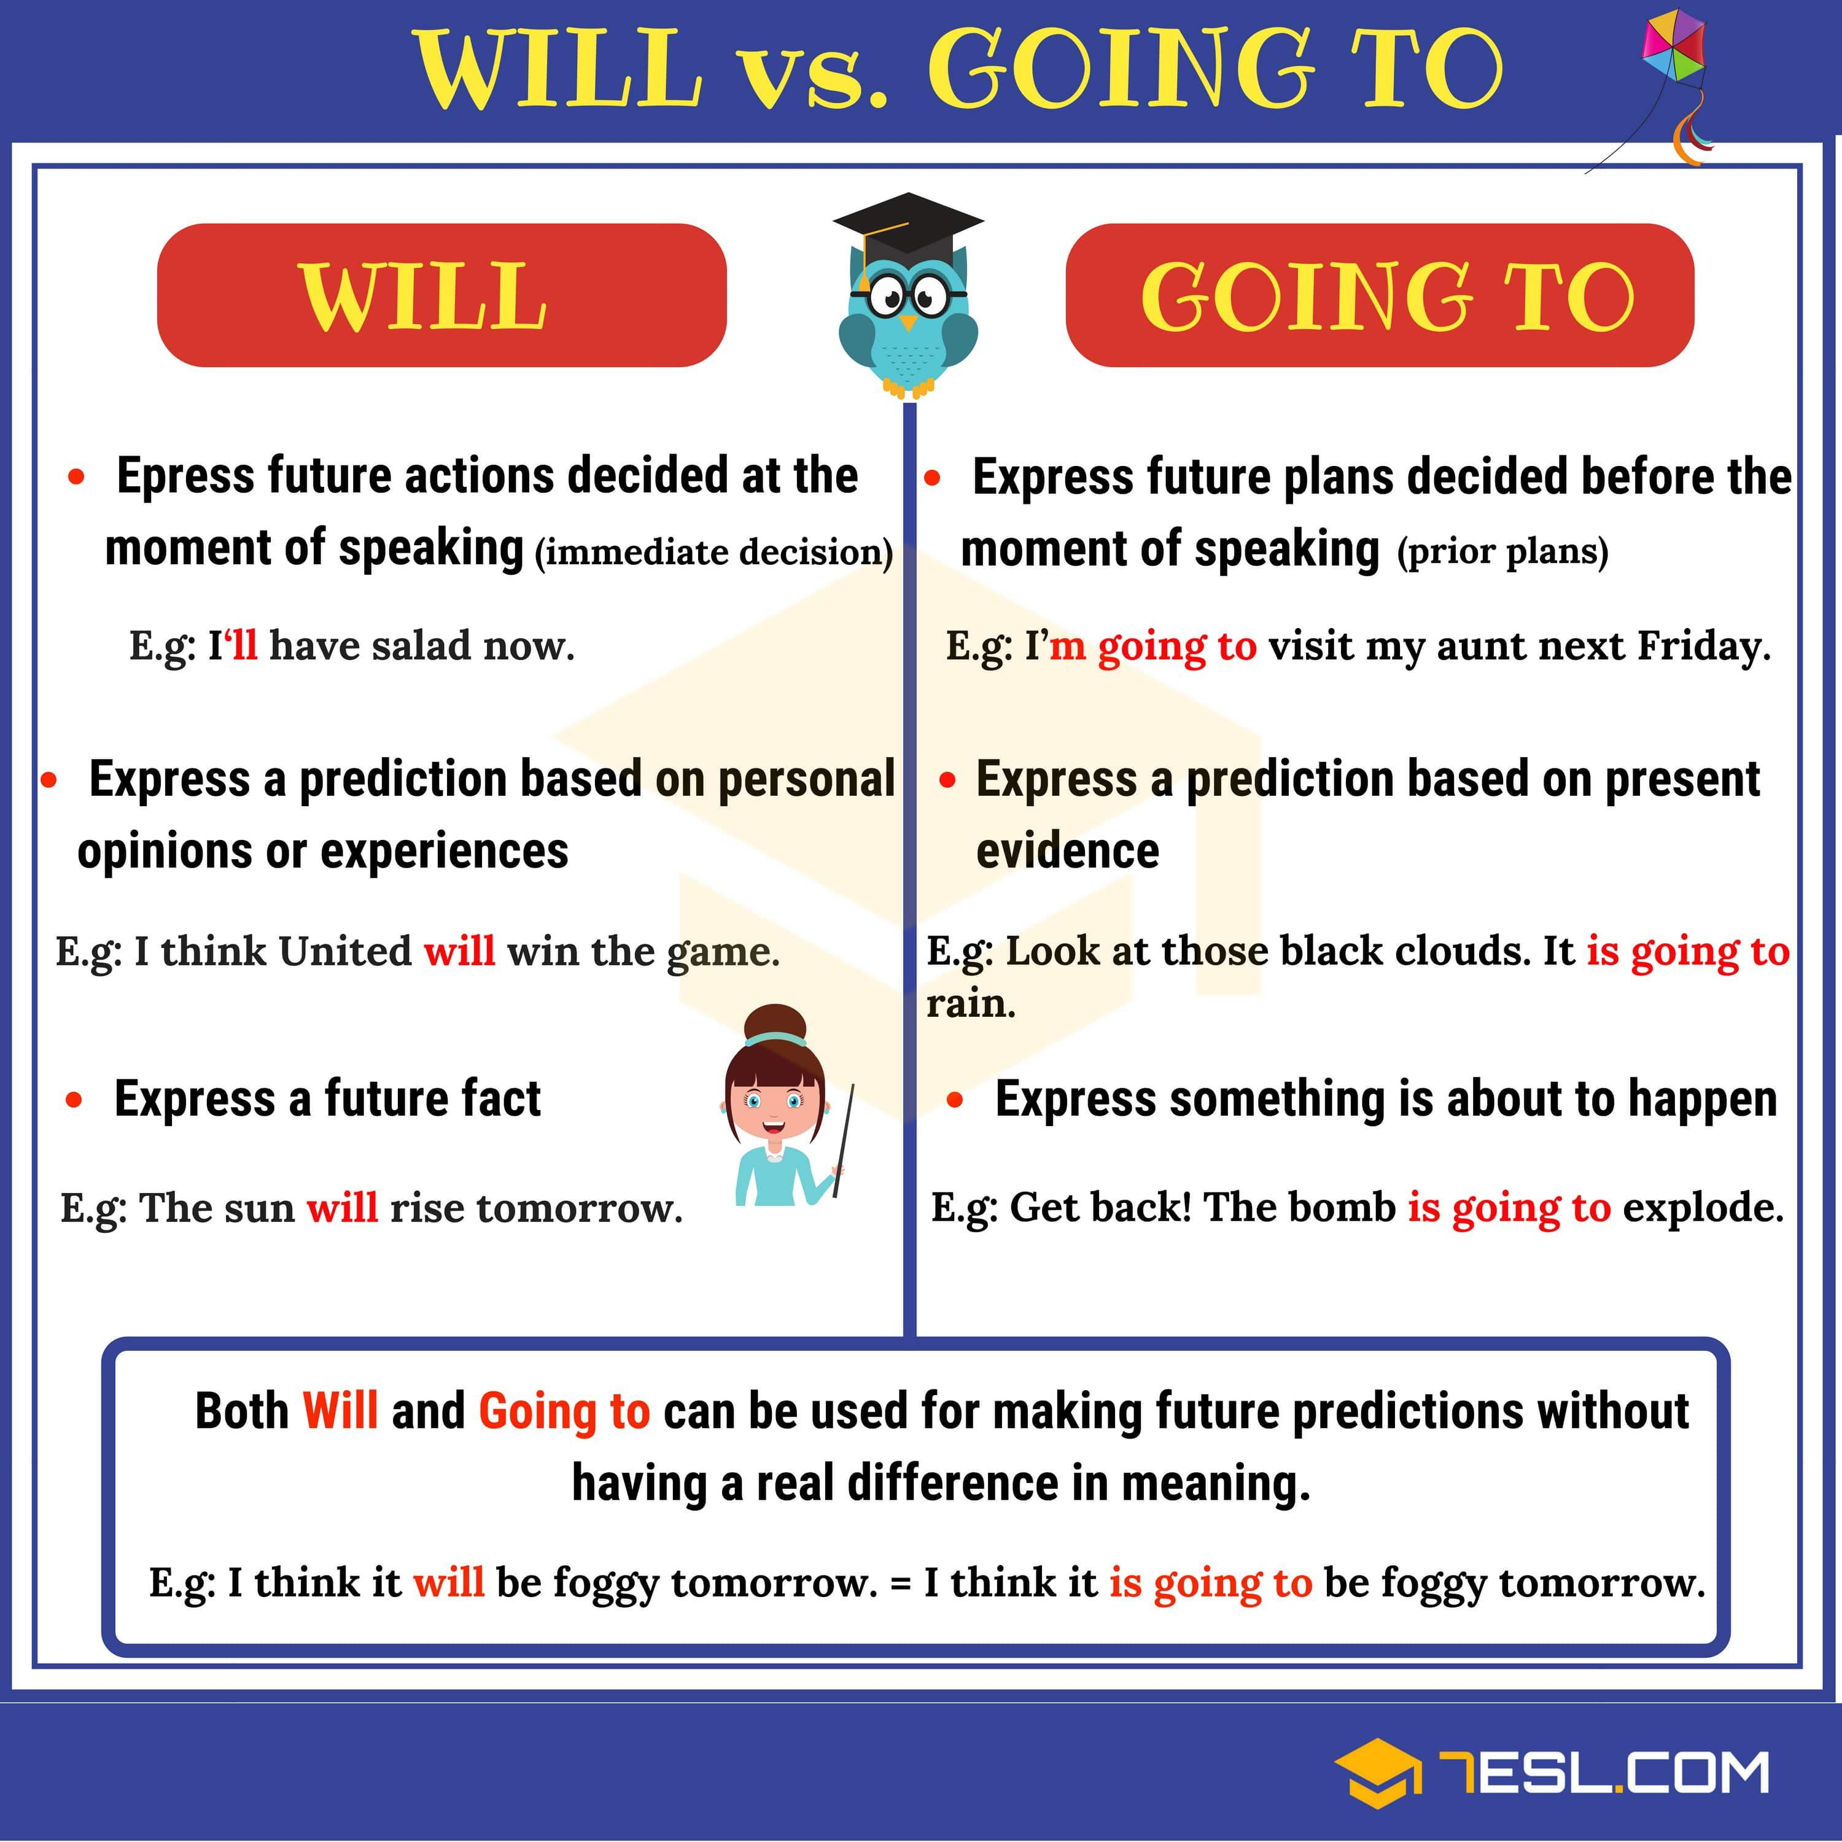

Slide 33
venn diagram
Be + Going to
will
Future
actions
Future plans
Predicting
Uncertain plans
V + inf

Slide 34


Work
book

Slide 35
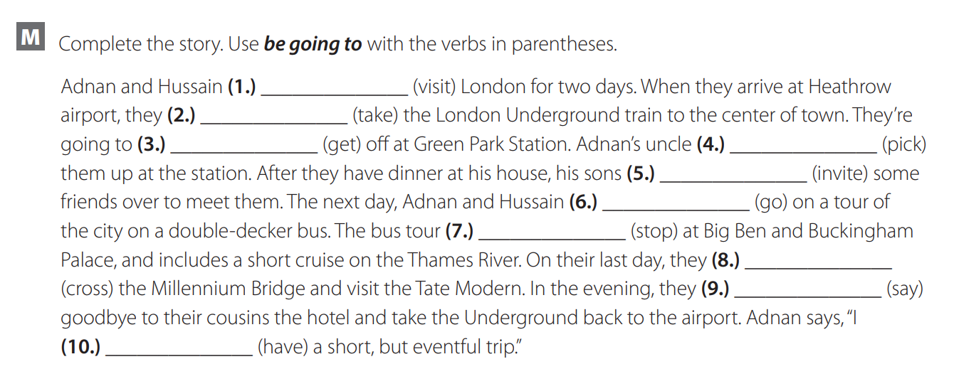
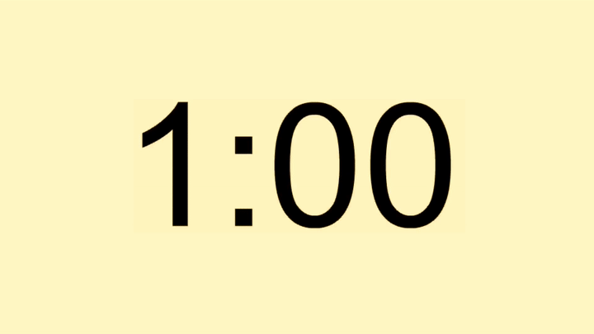
Are going to
Are going to
Is going to
Are going to
Are going to
Are going to
Is goiung to
Are going to
Are going to
Am going to

Slide 36
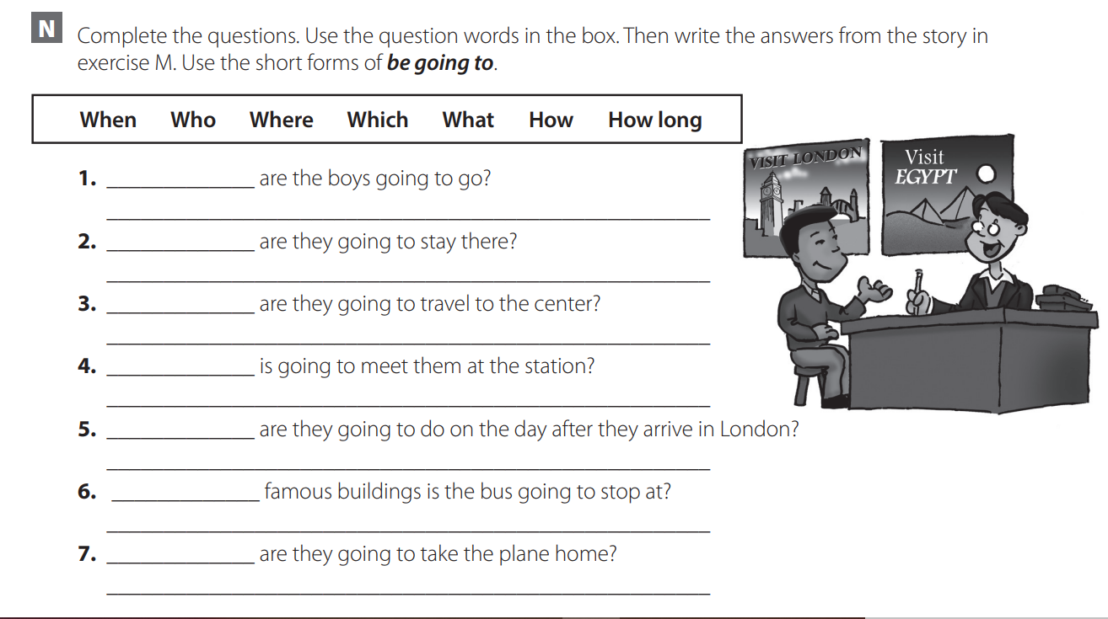

where
They’re going to go to London
How long
They’re going to stay there for two days
How
They’re going to take the Underground train.
who
Adnan’s uncle is going to meet them.

Slide 37
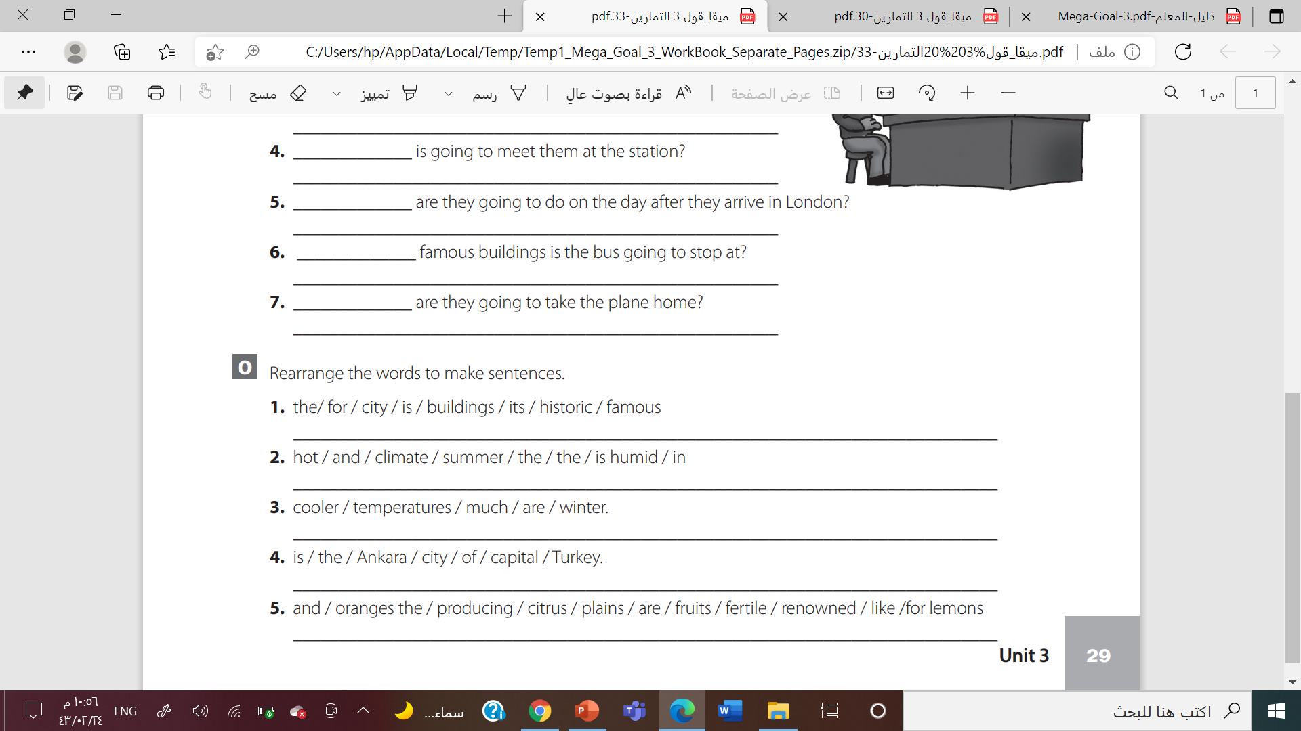
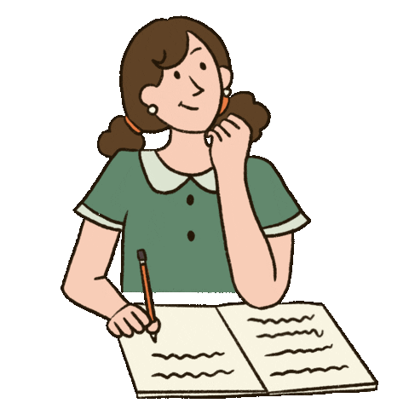
. The city is famous for its historic buildings
. The climate is hot and humid in the summer
Winter temperatures are much cooler.

Slide 38
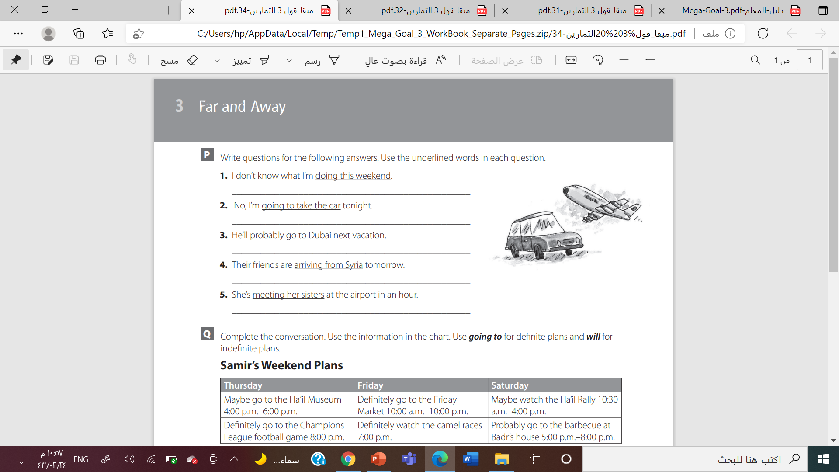

What are you doing this weekend?
. Are you going to drive home tonight?
Where will he go (on his) next vacation?

Slide 39
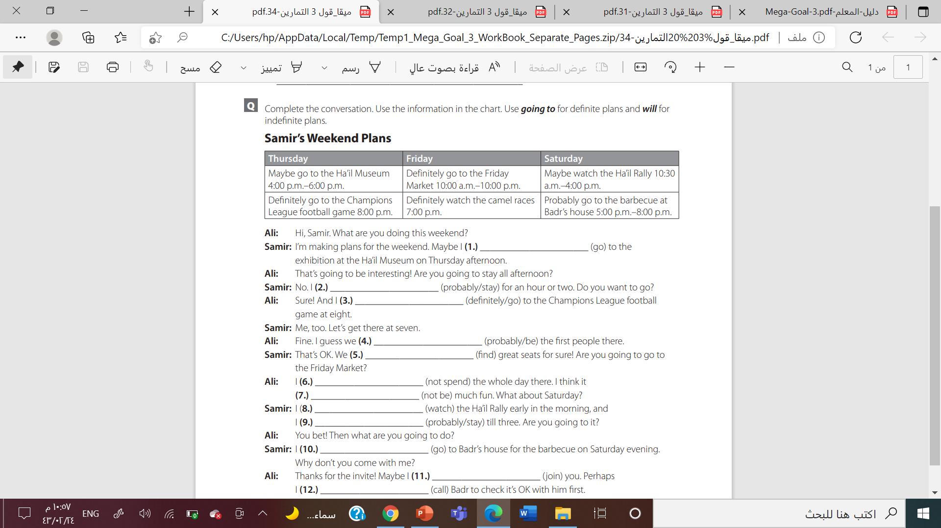

Slide 40



Slide 41

By Asma Almjlad

