Slide 1

U 2: What are they making?
11- Form, Meaning and Function
Tr. Nora Khalid

Slide 2
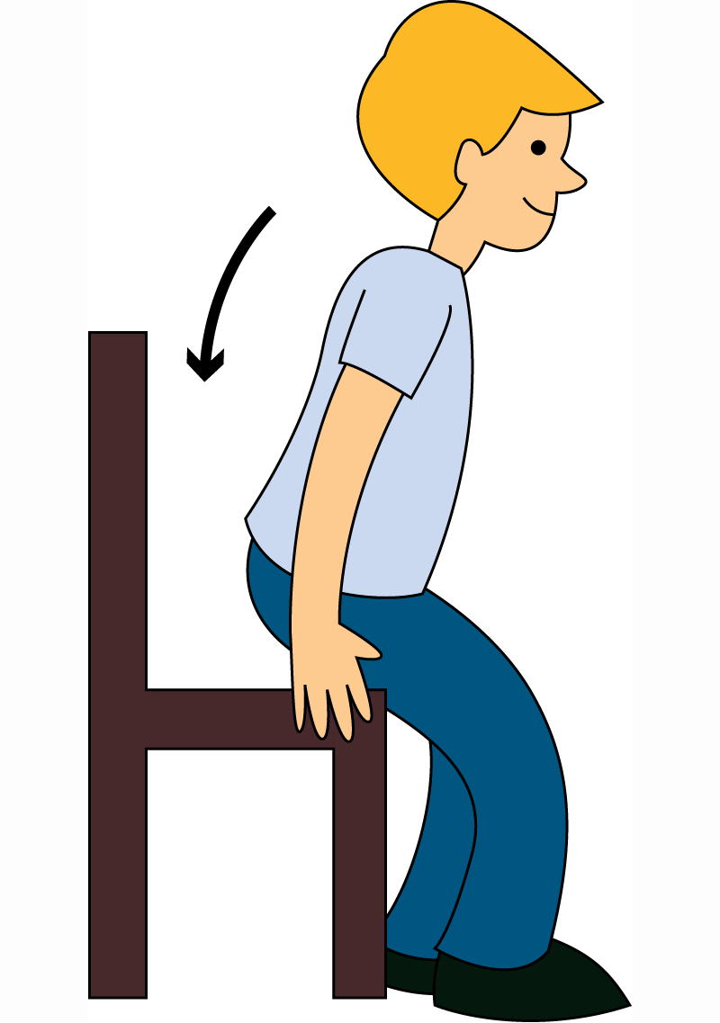

Sit down
Don’t smoke

Slide 3


Open the book
Don’t run

Slide 4
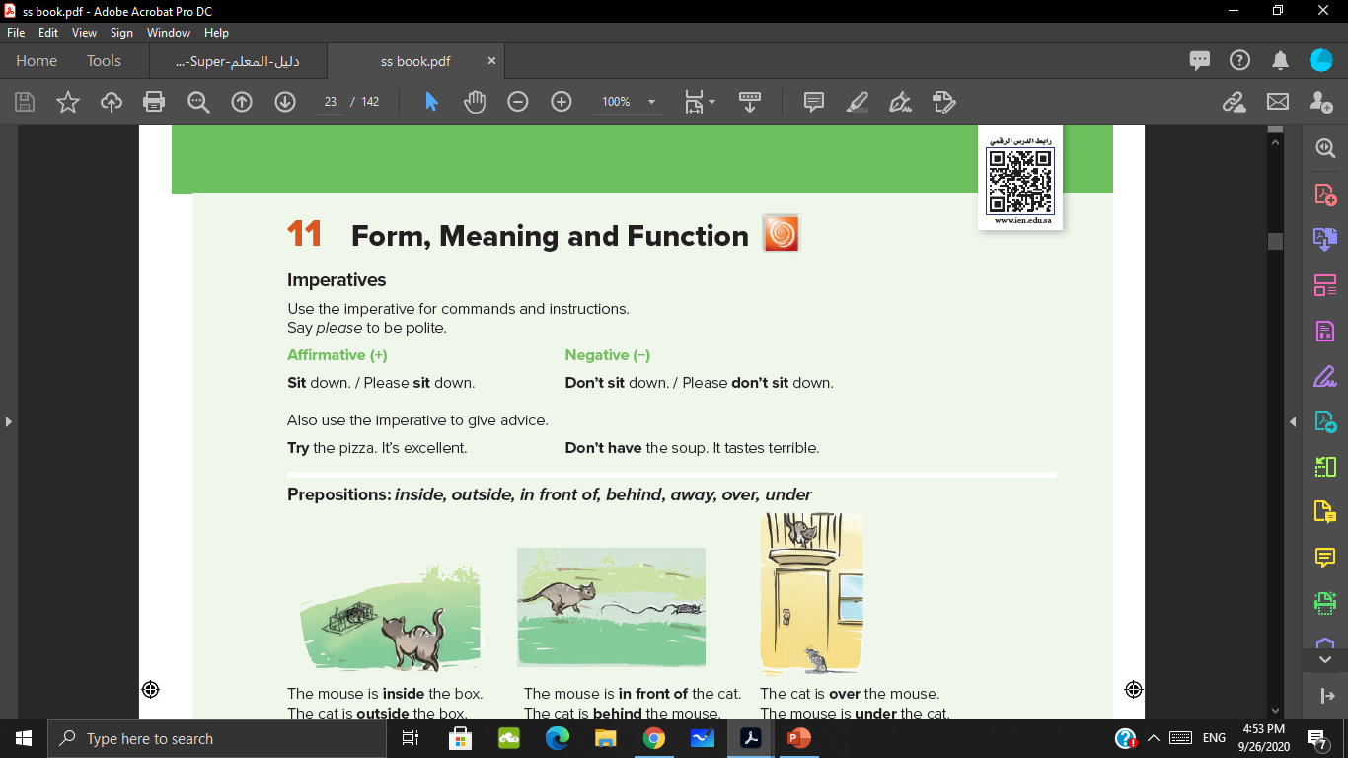


Read

Slide 5
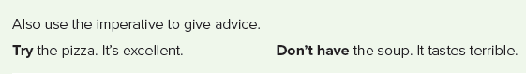
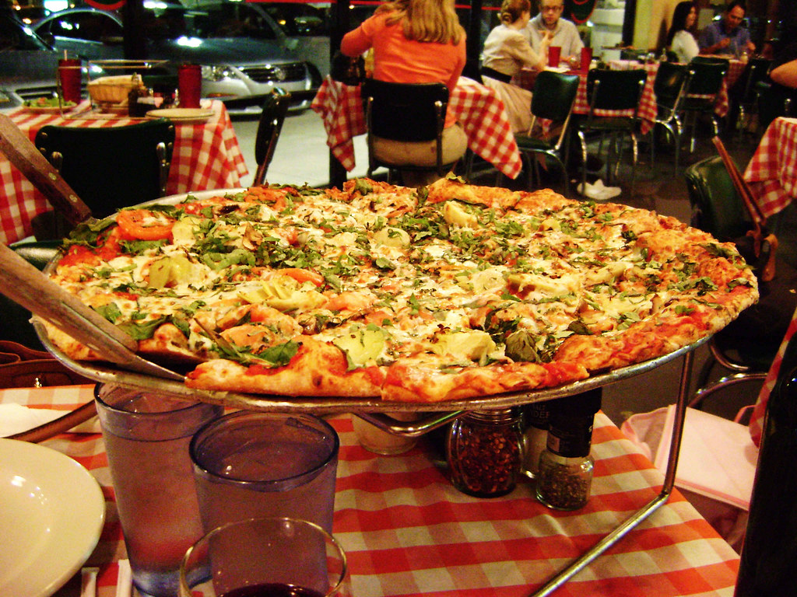
This Photo by Unknown Author is licensed under CC BY

Slide 6
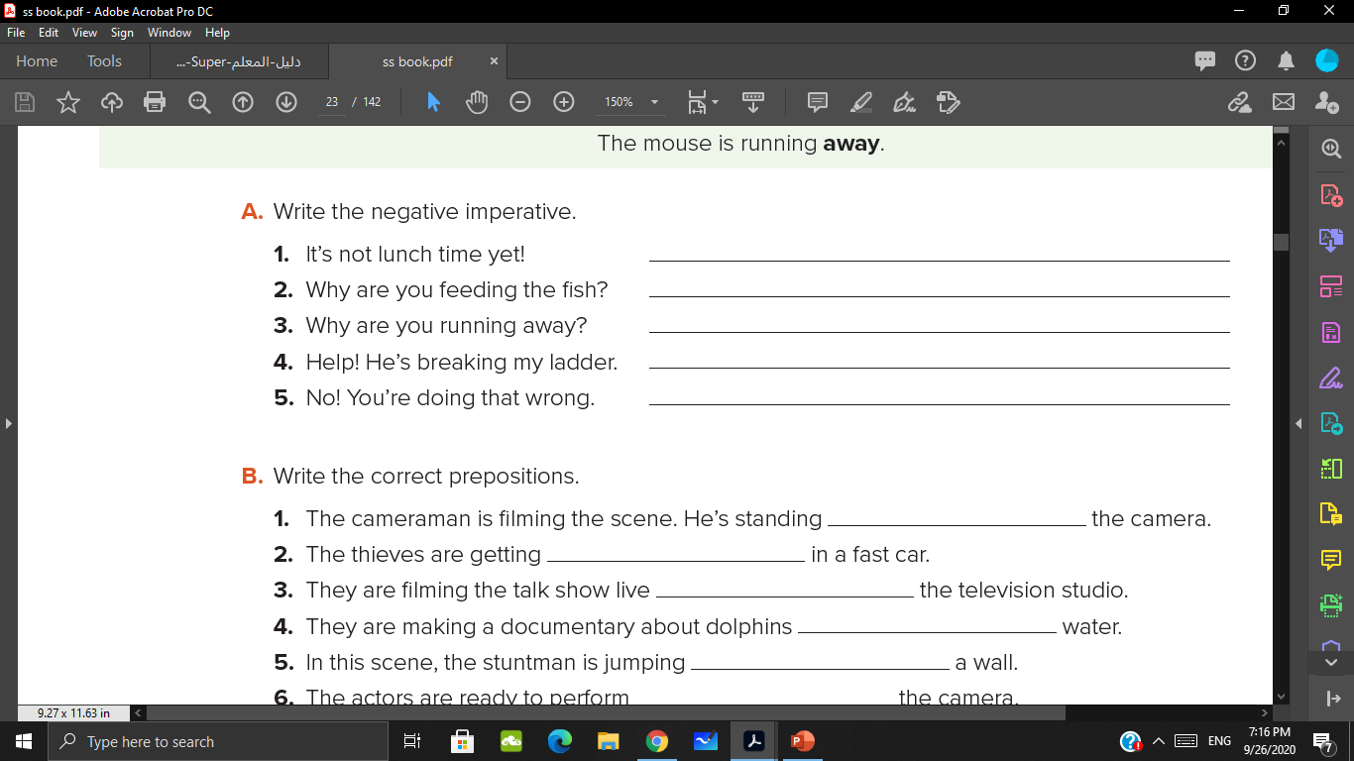
Don’t eat lunch.
Don’t eat the fish.
Don’t run away.
Don’t break my ladder.
Don’t do that.

Slide 7
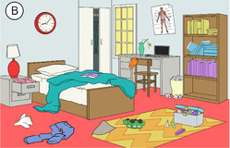



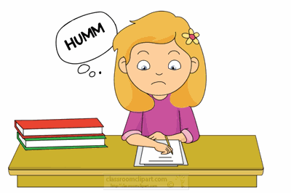
3
1
2
4
5

Slide 8
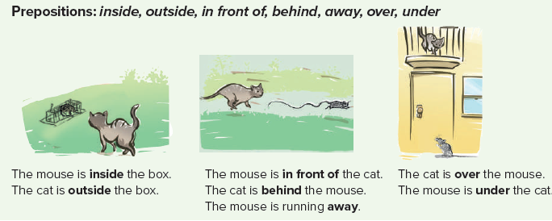
Do you remember the previous lesson about “preposition of place” ?

Slide 9
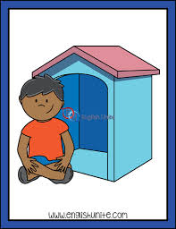
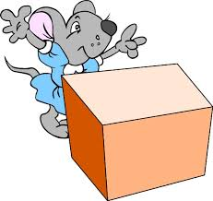

The mouse / the box
The girl / the box
The boy / the house

Slide 10
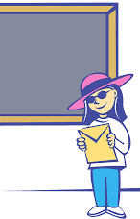

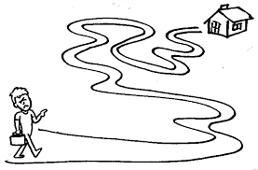
The man / walking
The man / the car
The girl / the board

Slide 11
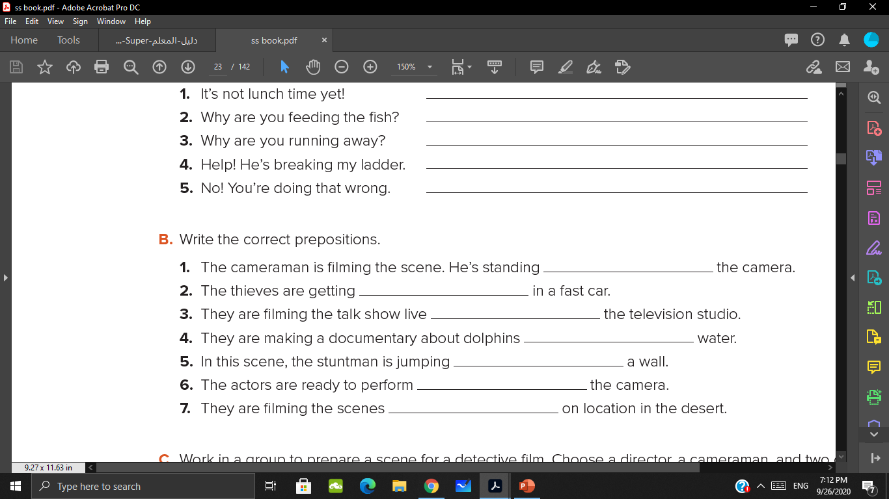
behind
away
inside
inside
over
in front of
outside

Slide 12

https://wordwall.net/play/4640/135/527

