Slide 1

Are you here on vacation?
Unit 1
MS. Nora Khalid

Slide 2



Unit: 1
1- listen and discuss
Hello, I’m Nora.
N-O-R-A
Introduce yourself!

Slide 3
Unit: 1
1- listen and discuss
My last name is Alotaibi
A-L-O-T-A-I-B-I

Slide 4
Unit: 1
1- listen and discuss
I was born in …, but I raised in ….

Slide 5
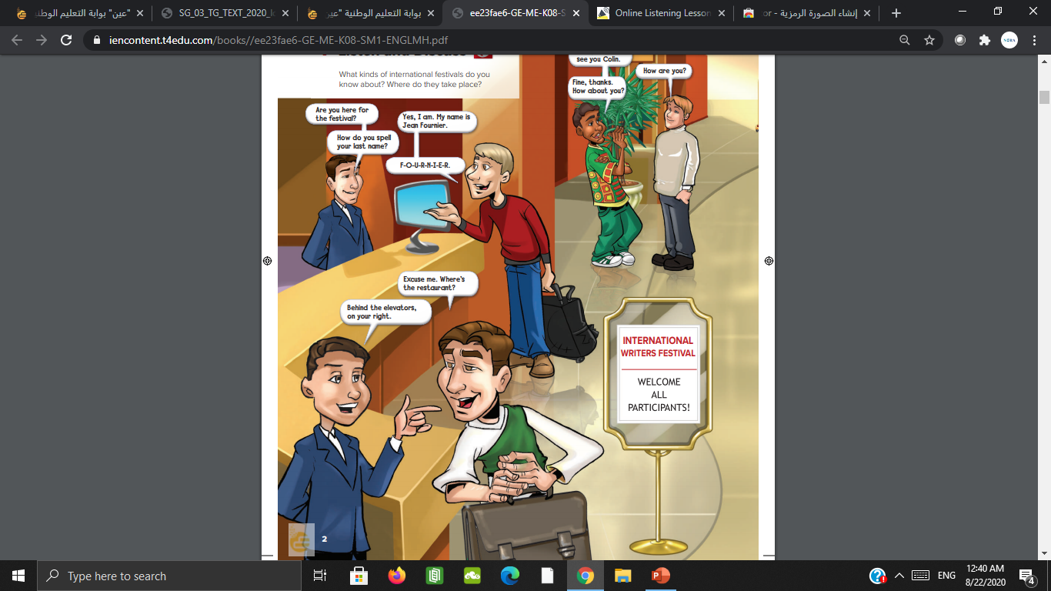
Unit: 1
1- listen and discuss
Where are the people?
They are in a hotel lobby.

Slide 6
Unit: 1
1- listen and discuss
What are the people doing?
They are talking.

Slide 7
Unit: 1
1- listen and discuss
Why are so many people there?
for an international writers festival.

Slide 8
Unit: 1
1- listen and discuss
Where are they from?
Faris is from Saudi Arabia. Keton was born in Mumbai and was raised in New
Delhi.

Slide 9
Unit: 1
1- listen and discuss
How many people are checking into the hotel?
one.

Slide 10

Unit: 1
1- listen and discuss
Listening time

Slide 11


Unit: 1
1- listen and discuss
Farewells | Greetings
Good night - Take care - - - | Good morning Hello - - -

Slide 12


2- pair work
Unit: 1
Greet someone you know.
Introduce yourself to someone.
Introduce a friend to someone.
Say goodbye to someone.

Slide 13
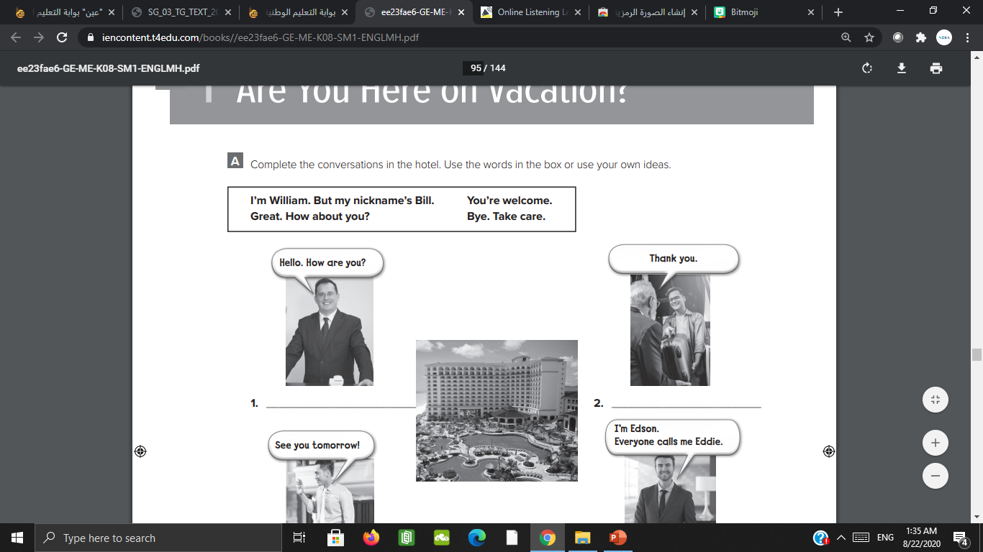
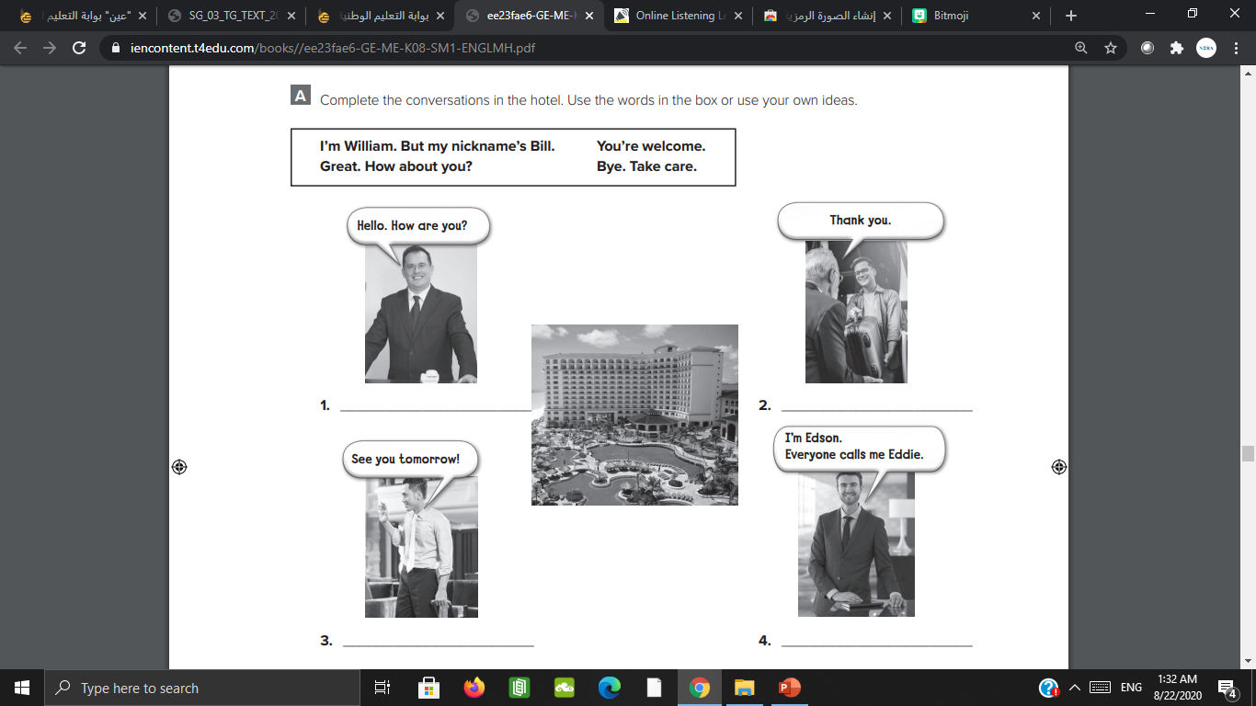
Workbook P 89
Unit: 1
Great. How about you?
You’re welcome.

Slide 14
Workbook P 89
Unit: 1
Bye. Take care.
I’m William. But my nickname’s Bill

Slide 15
Thank you
Unit 1
MS. Nora Khalid

Slide 16


Unit: 1
3- grammar
You can find the lesson on this link:
https://www.oppia.org/embed/exploration/Hqsa5KmPyCBN

Slide 17
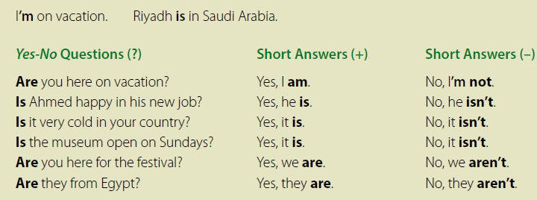
Unit: 1
3- grammar
Read:

Slide 18

Unit: 1
3- grammar
Write:
I am
He ___
She ___ on vacation.
We ___
You ___
They ___
is
is
are
are
are

Slide 19
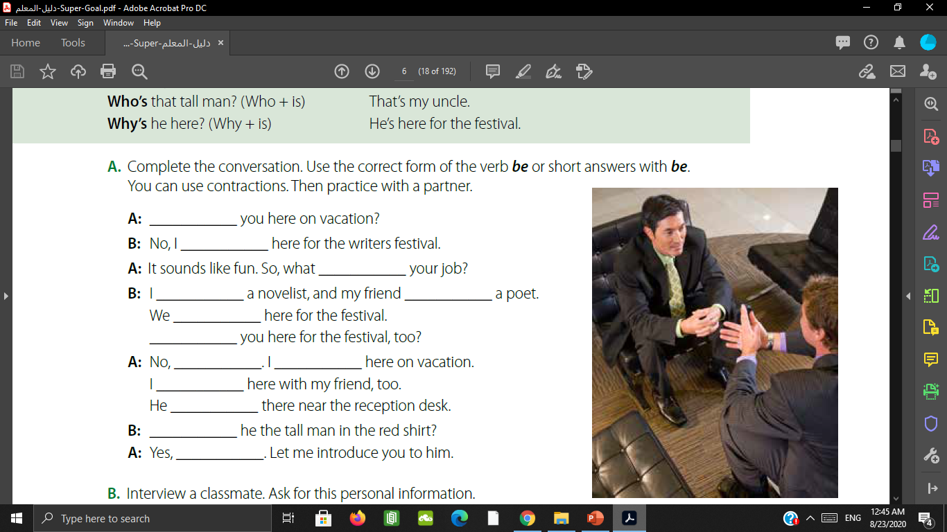
Unit: 1
3- grammar
Are
am
is
am
is
are
Are
I’m not
am
am
is
Is
He is

Slide 20
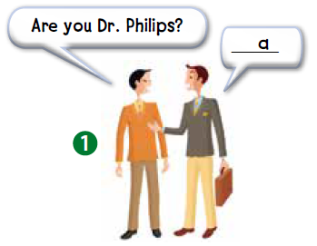


Unit: 1
3- grammar
a. No, I’m Luke Robbins.
b. That’s all right.
c
c. Nice to meet you.
d. Fine, thanks.
e. You’re welcome.
f. William. But my friends call me Bill.
d

Slide 21
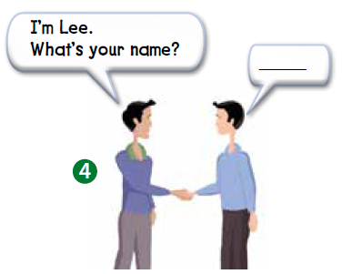
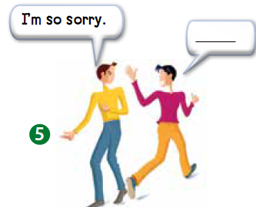

Unit: 1
3- grammar
a. No, I’m Luke Robbins.
f
b. That’s all right.
b
c. Nice to meet you.
d. Fine, thanks.
e. You’re welcome.
e
f. William. But my friends call me Bill.

Slide 22
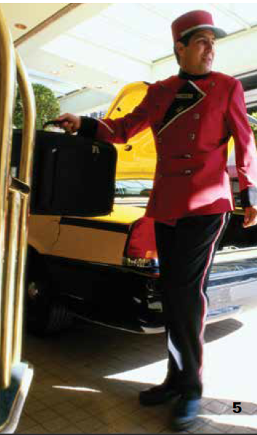
Unit: 1
4- listening
Who is talking?
Mr. Wilson
Where are they?
They’re at the hotel.

Slide 23
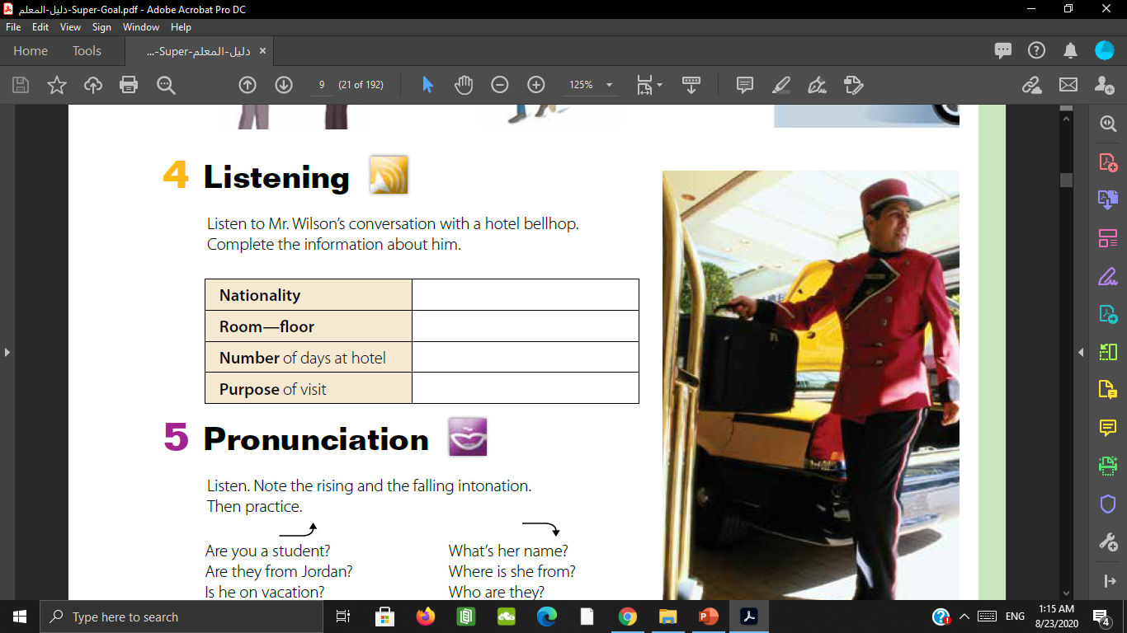
Unit: 1
4- listening
Look at the chart
What kind of questions you are going to hear in the conversation?

Slide 24
Unit: 1
4- listening
Listening time

Slide 25
Unit: 1
4- listening
UK- British
905- 9th floor
1
A meeting

Slide 26
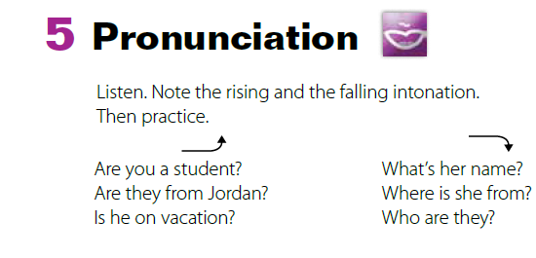
5- pronunciation
Unit: 1

Slide 27

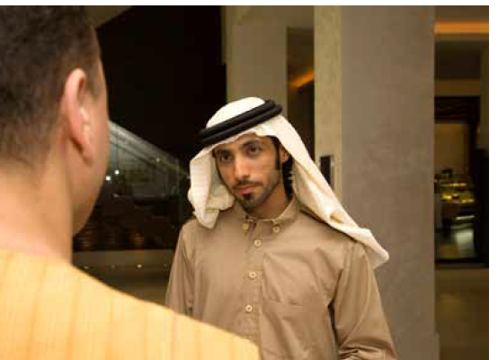
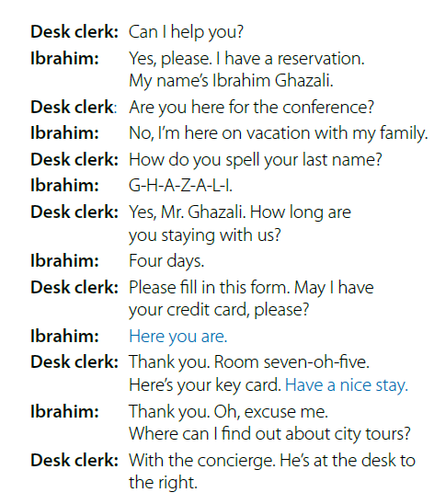

6- conversation
Unit: 1
Microsoft
Teams

Slide 28
6- conversation
Unit: 1
Who are the
people?
What are they probably talking about?

Slide 29
6- conversation
Unit: 1

Slide 30
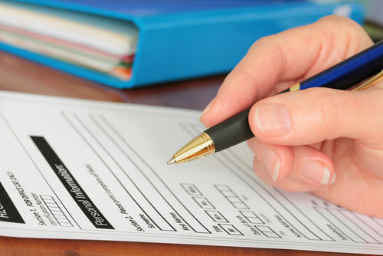

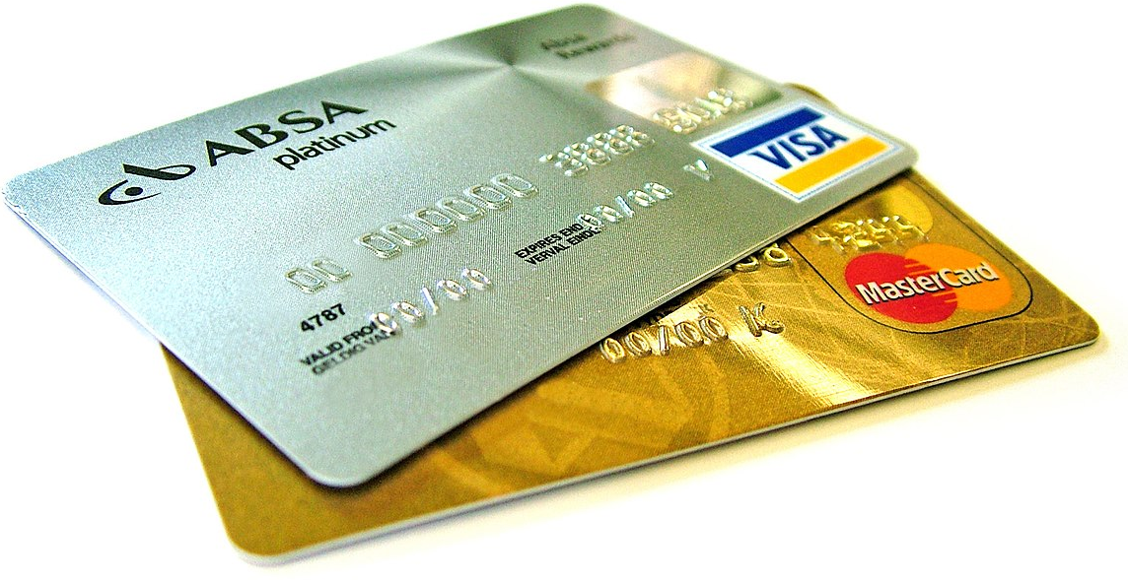
6- conversation
Unit: 1

Slide 31
6- conversation
Unit: 1
1. What’s Ibrahim’s last name?
2. Is Ibrahim at the hotel on business?
3. How is he paying for the hotel?
4. How long is he staying in the hotel?
5. What’s his room number?
His last name is Ghazali
No, he isn’t. He is on vacation.
By credit card.
For four days.
His room number is 705.

Slide 32
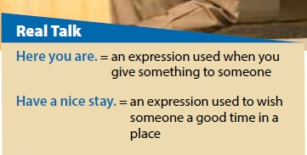
6- conversation
Unit: 1
Read

Slide 33
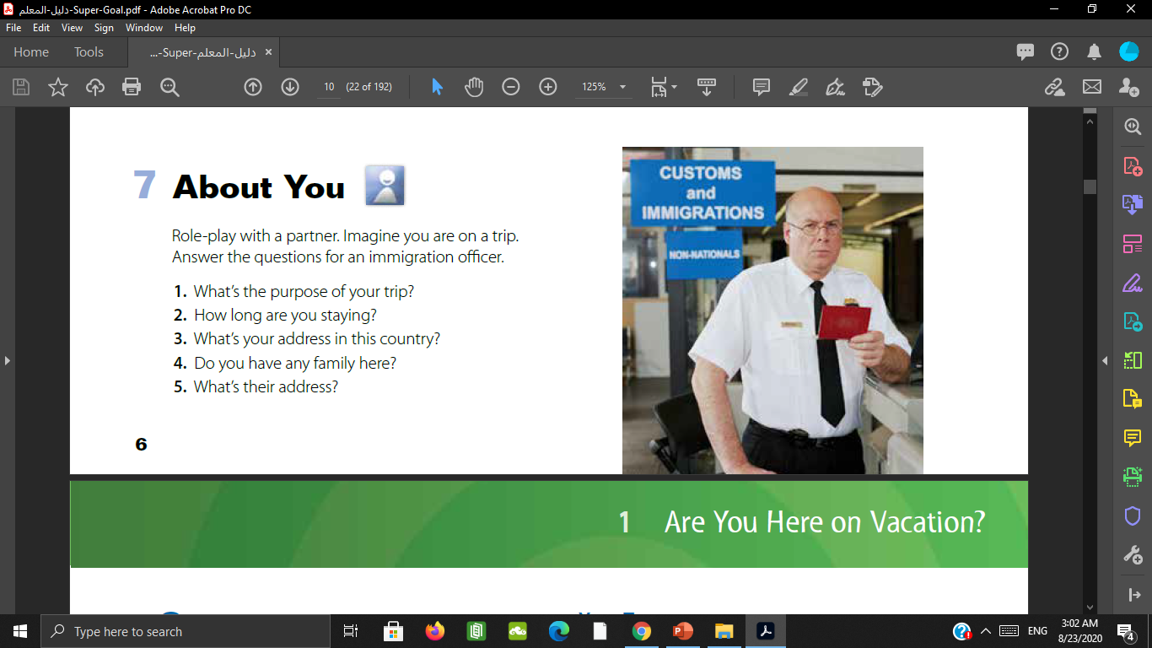
7- About you
Unit: 1

