Slide 1
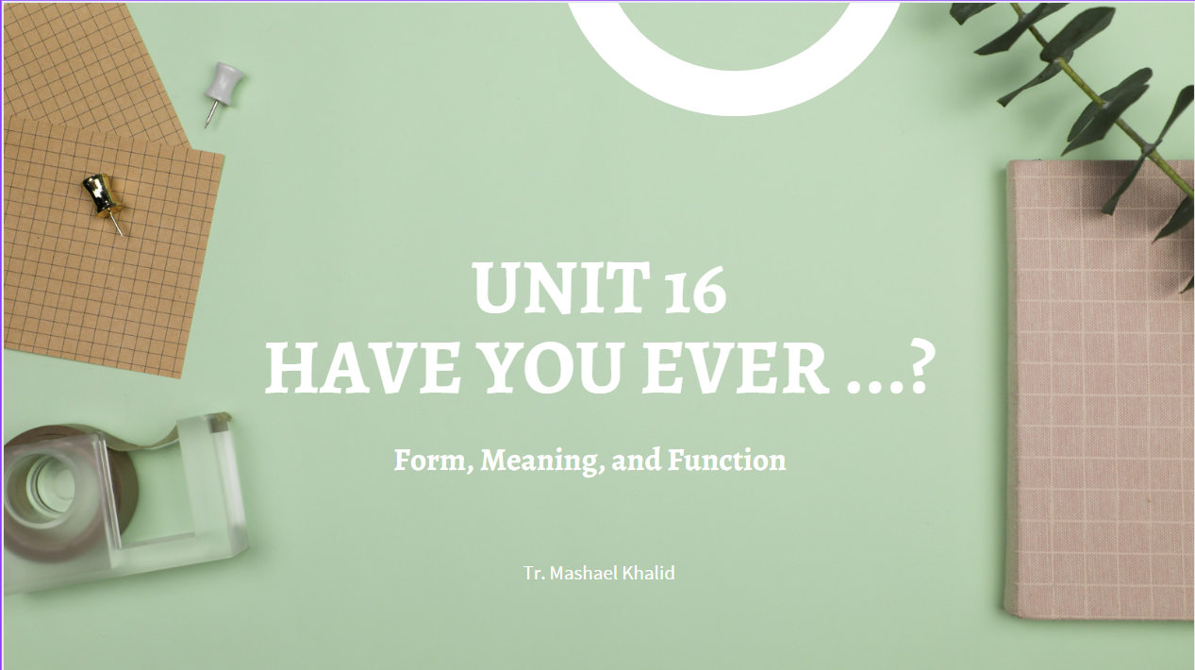

Slide 2
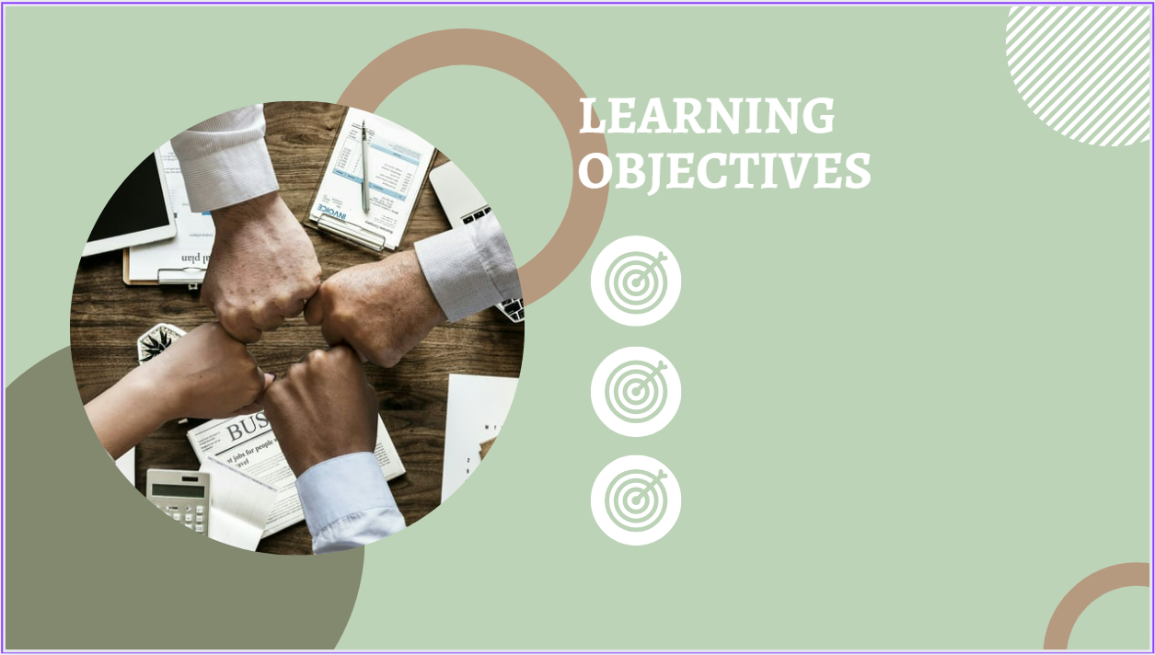
Thursday 5-11-1444H
Review simple present and present progressive.
Review present perfect vs simple past .
Pg.138

Slide 3
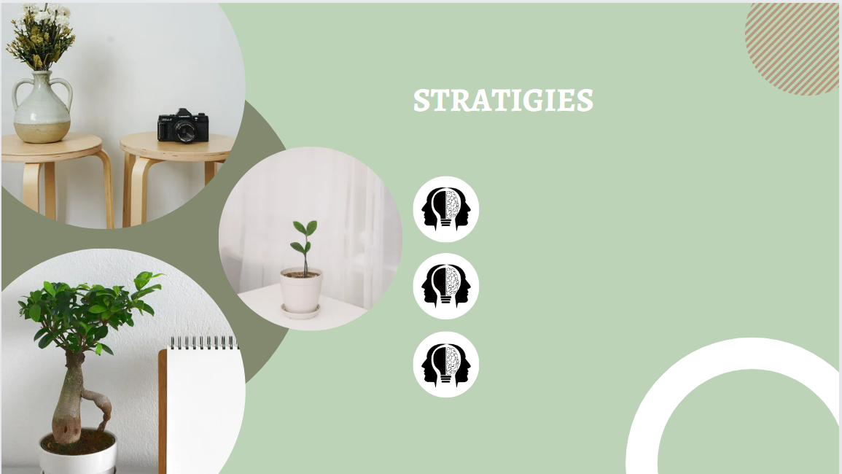
Thursday 5-11-1444H

Slide 4

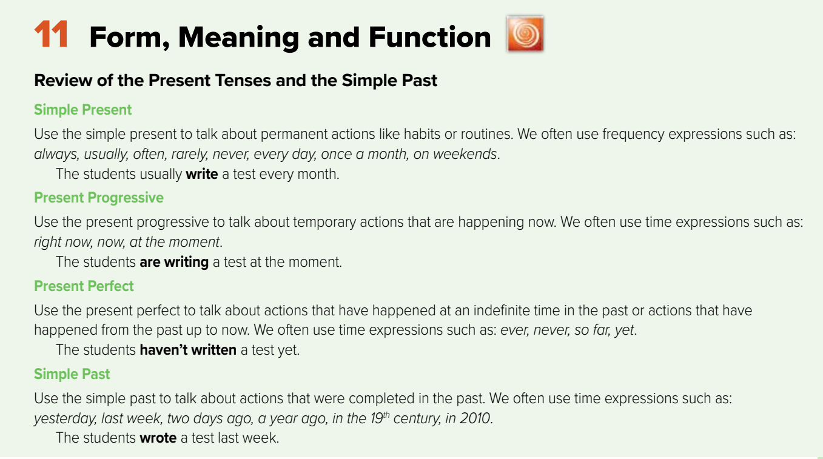
Thursday 5-11-1444H
Pg.154

Slide 5
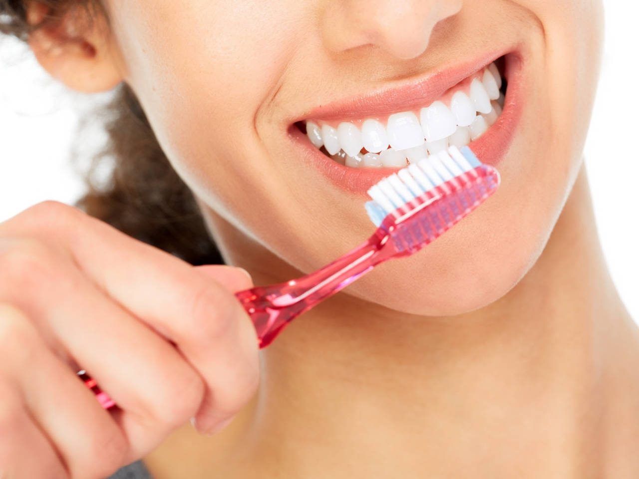
Thursday 5-11-1444H
I usually brush my teeth before I get to bed.
Present simple
Pg.154

Slide 6
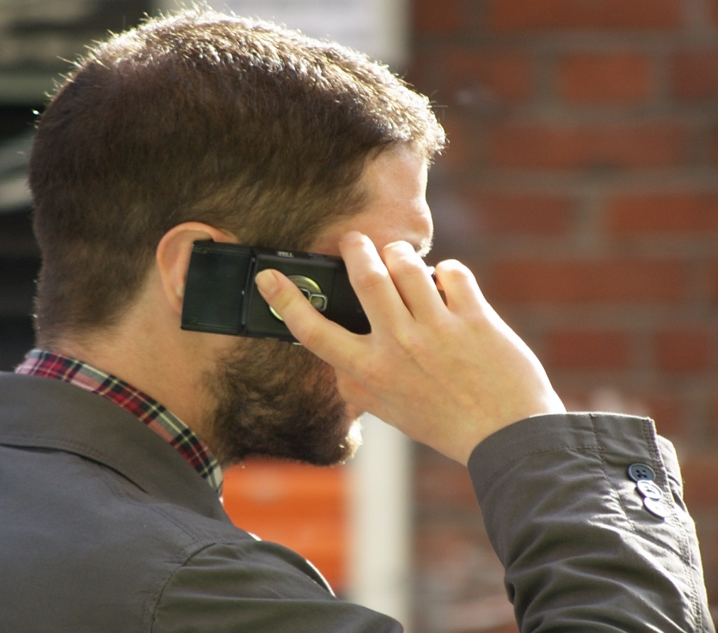
Thursday 5-11-1444H
He is speaking on the phone right now.
Present progressive
Pg.154

Slide 7
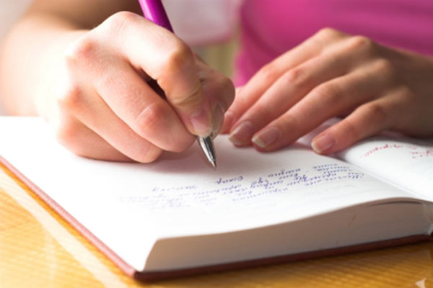
Thursday 5-11-1444H
She hasn’t written her article yet.
Present perfect
Pg.154

Slide 8
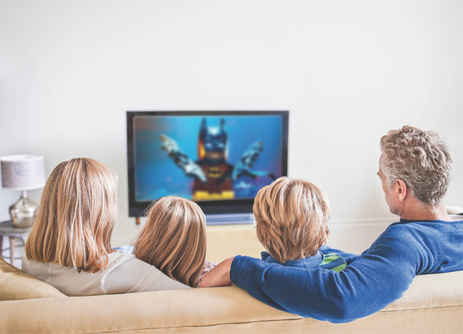
Thursday 5-11-1444H
We saw a movie yesterday.
We watched a movie yesterday.
Past simple
Pg.154

Slide 9
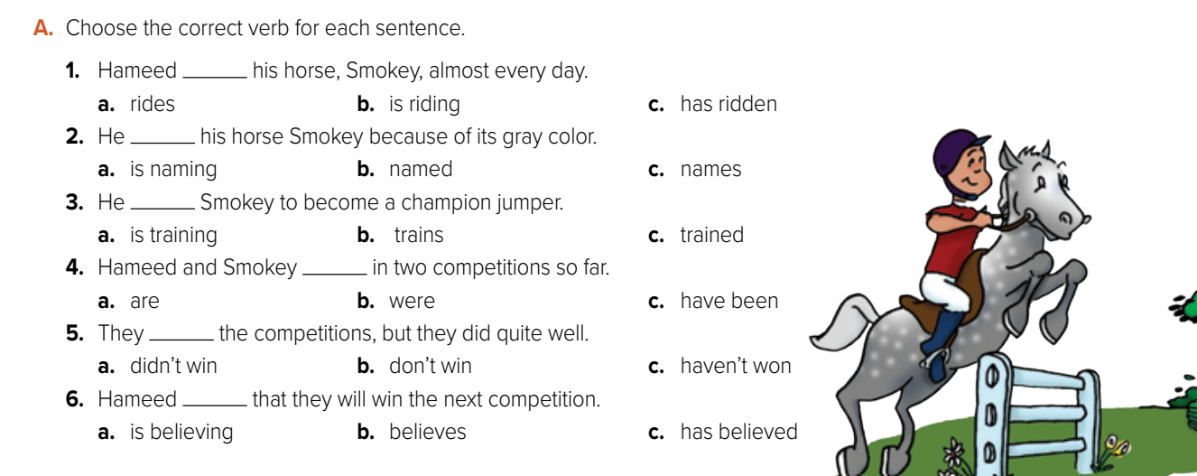
Thursday 5-11-1444H
a
b
a
c
a
b
Pg.154

Slide 10
Thursday 5-11-1444H
B. Put the verbs in parentheses into the correct forms of the present or past.
1. We____________ (not be) to Oman yet, but we_______ (go) to UAE last year.
2. Ali usually ______(walk) to work, but yesterday he _______ (take) a taxi.
3. She_____(lose) her keys, so now she ___________(search) the house to find them.
4. So far she__________ (look) in her room, but the keys ________ (not be) there.
5. We _________(not eat) anything all day because we _________ (fast) for Ramadan.
6. Oh, no! It ________(rain), and I _____ (leave) my umbrella in the car.
7. I __________ (not know) why you’re nervous. ____________________(you / not ever / fly) in a plane?
8. They ________(not use) cars in the 19th century. Today, people ______(drive) their cars everywhere.
haven’t been
went
walks
took
lost
is searching
has looked
weren’t
didn’t eat
are fasting
is raining
left
don’t know
Haven’t you ever flown
didn’t use
drive
Pg.154

Slide 11
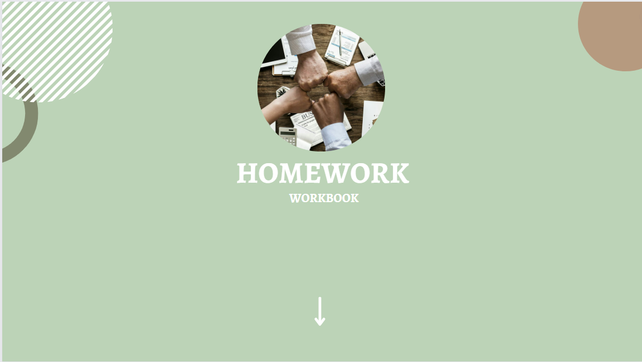

Slide 12


