Slide 1
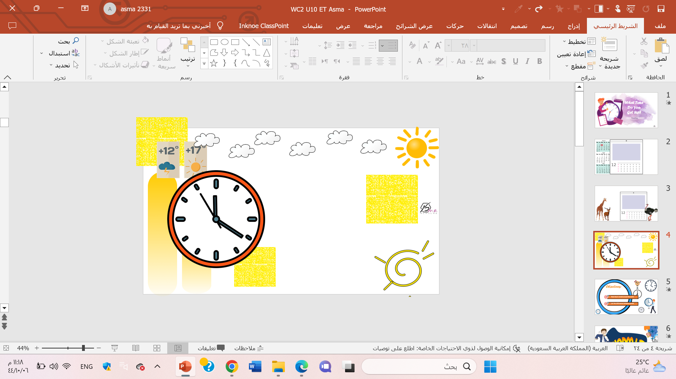

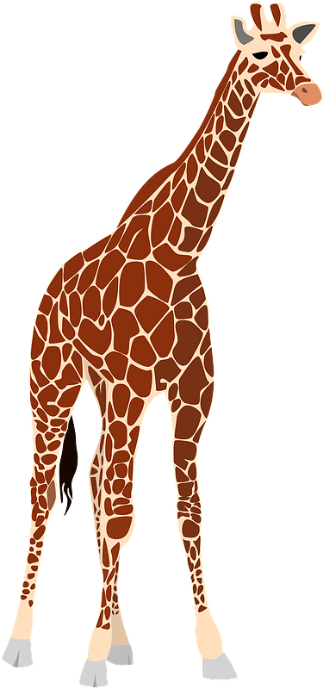
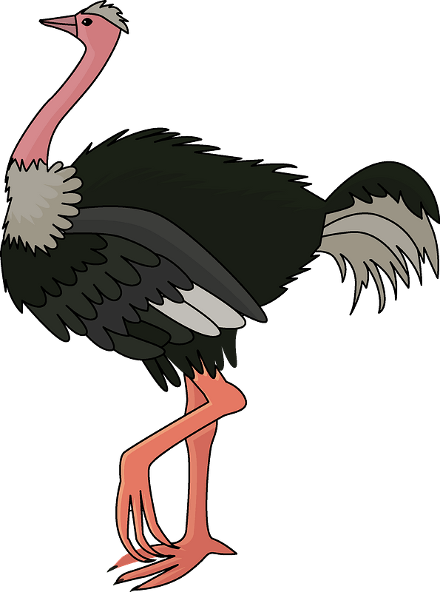
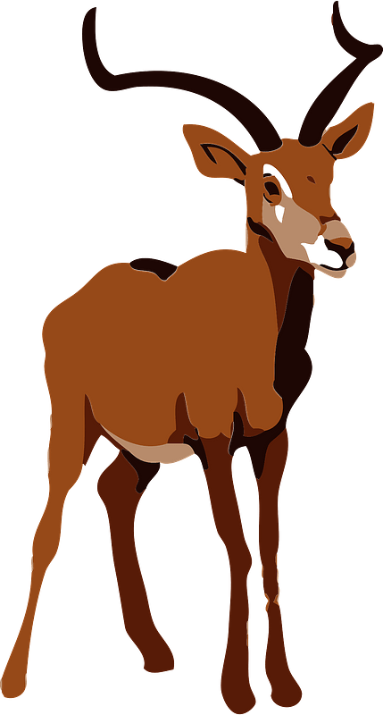
My Day, Animals, Places
Rhythms
& Listening

Slide 2
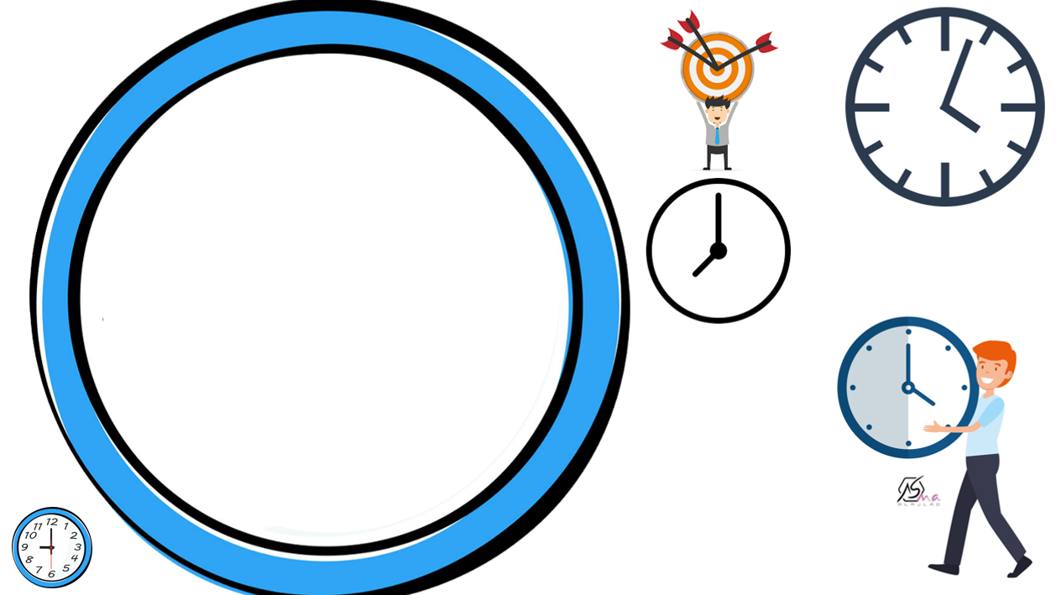

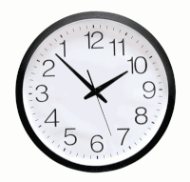
Objectives:
Use can to talk about abilities.
Talk about the weather of each season.
Read and comprehend simple sentences.

Slide 3
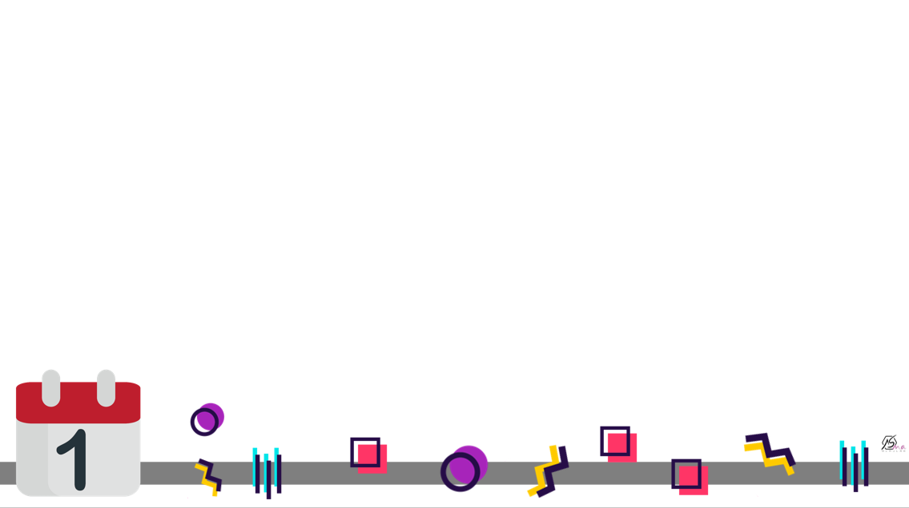


Slide 4
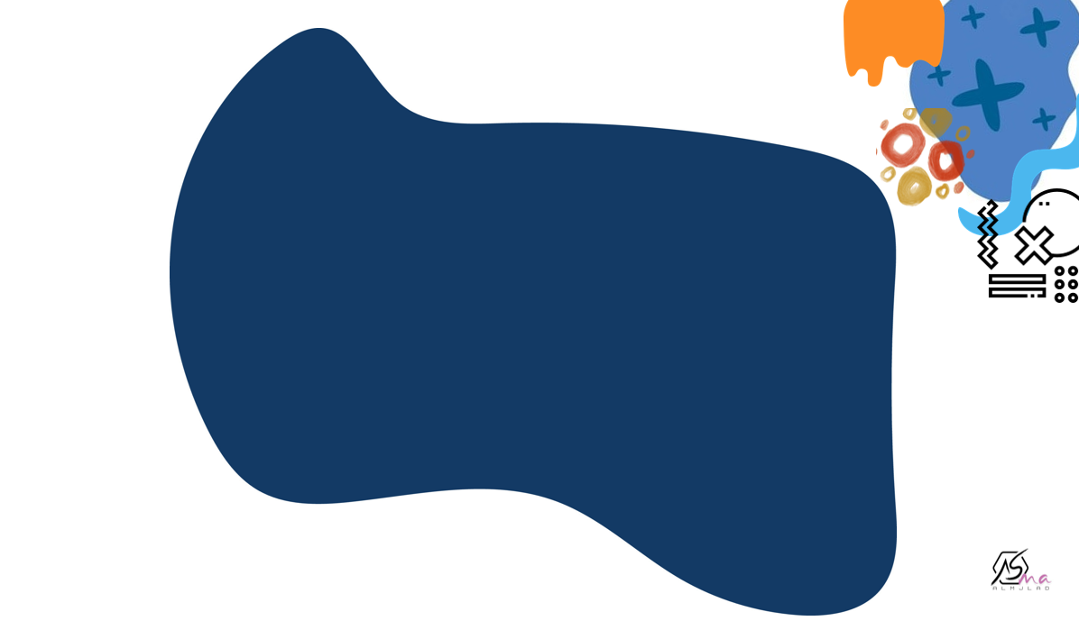
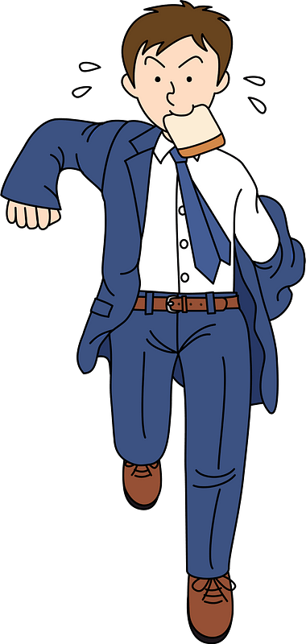


Slide 5
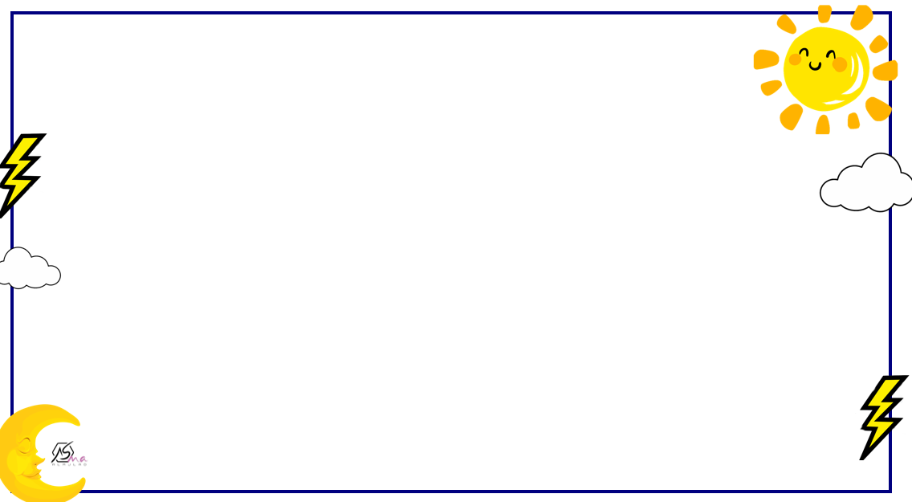



List things that you can do it ?

Slide 6
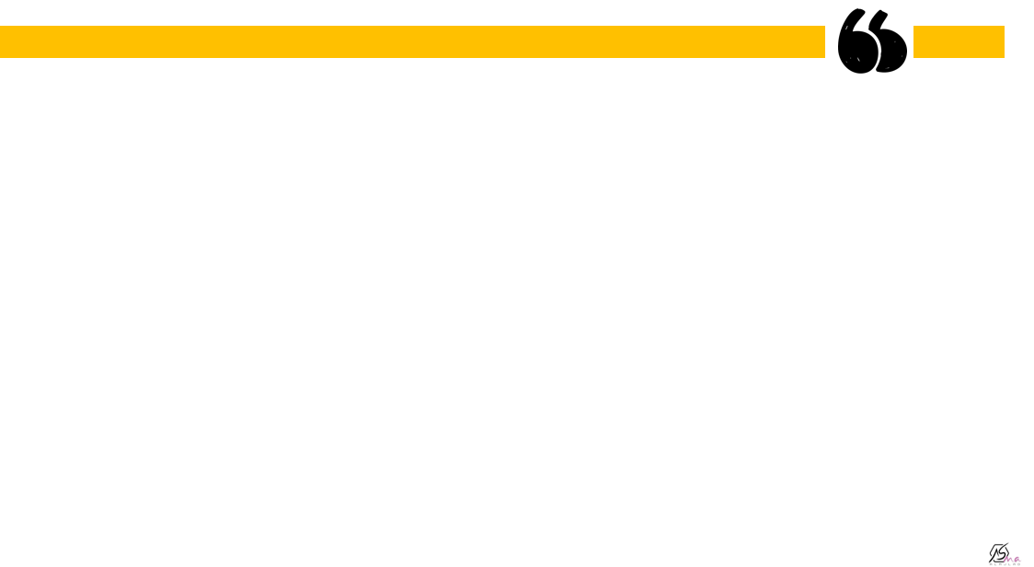

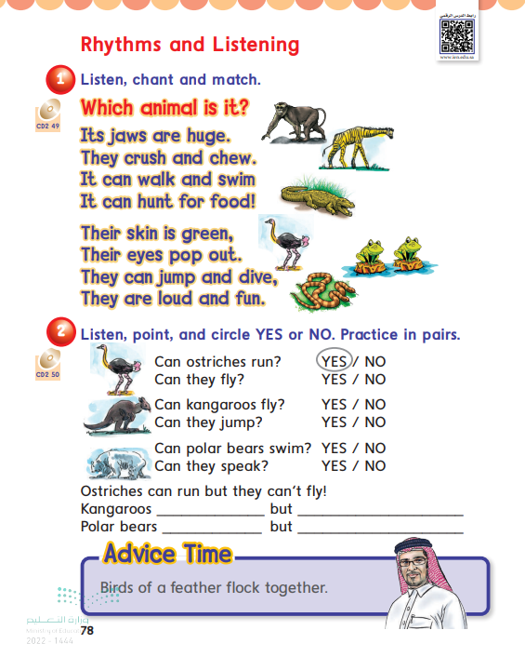
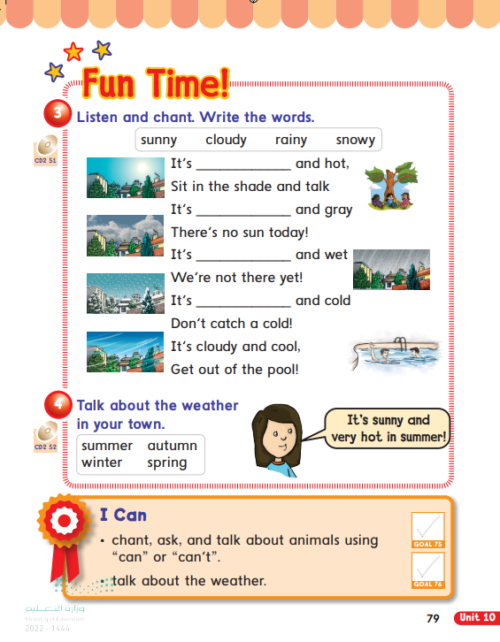

@ page 78+79

Slide 7
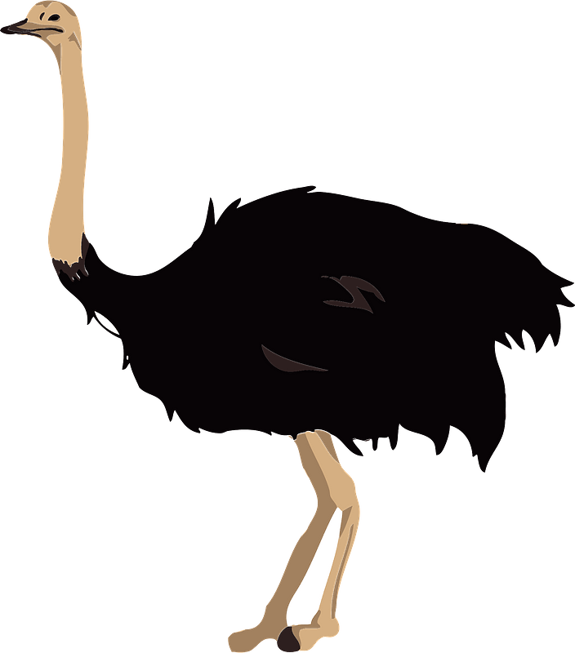
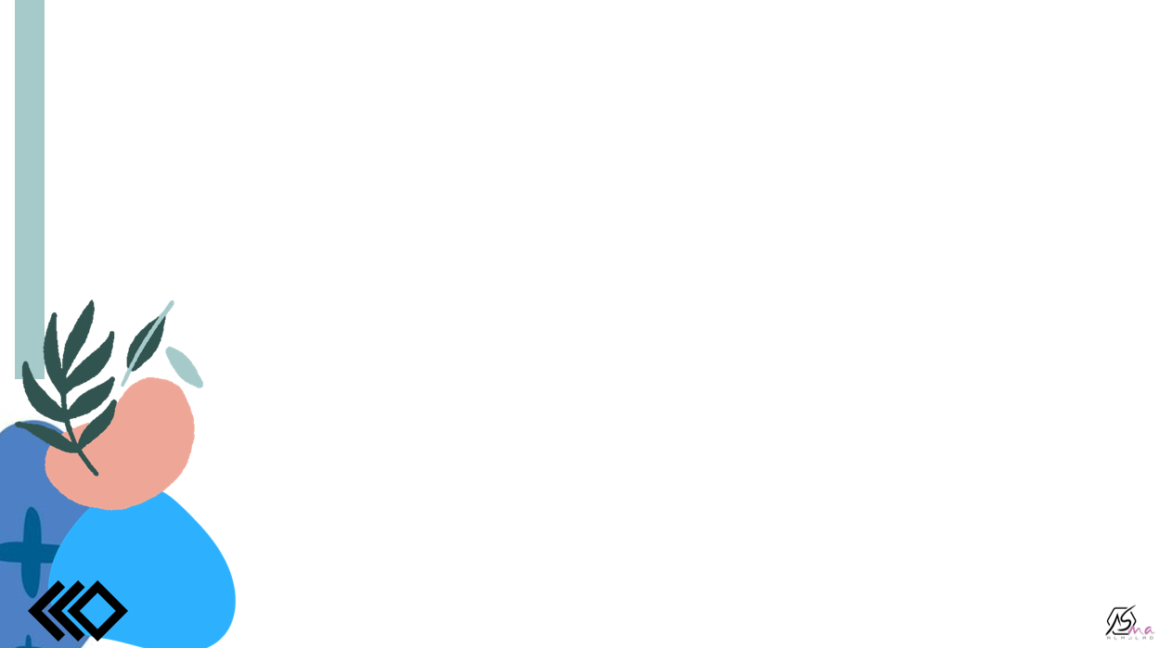
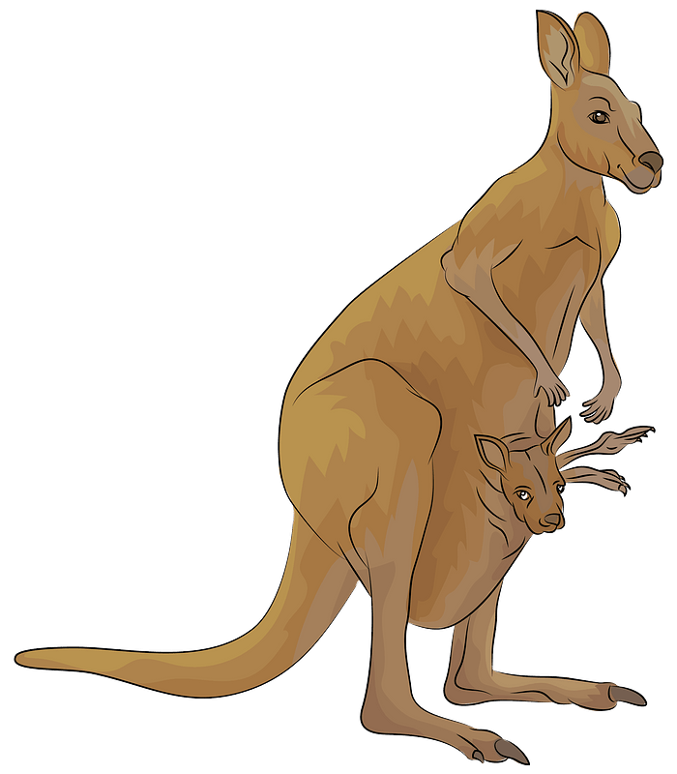

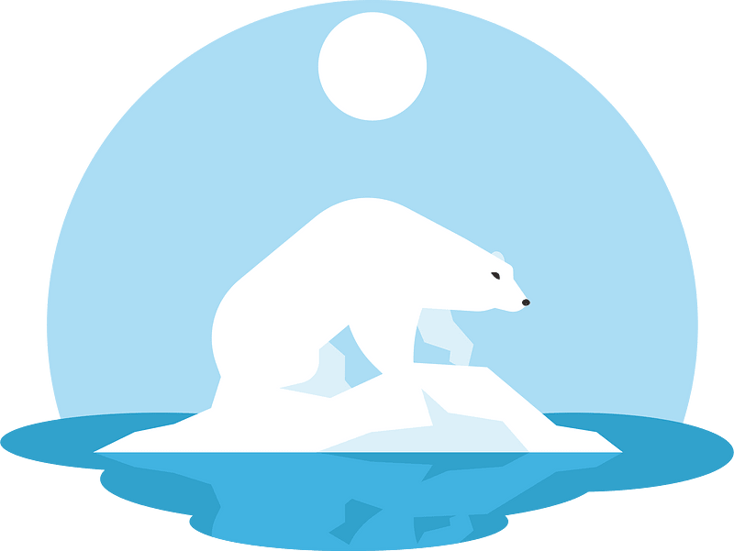
ostrich
kangaroo
polar bears
crocodile

Slide 8
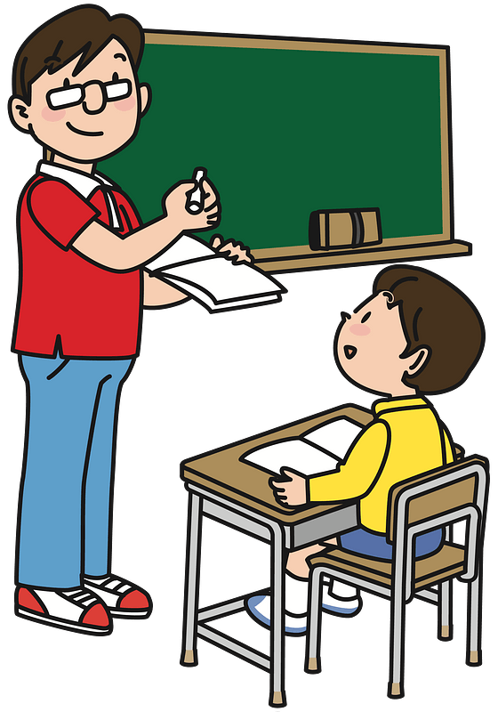
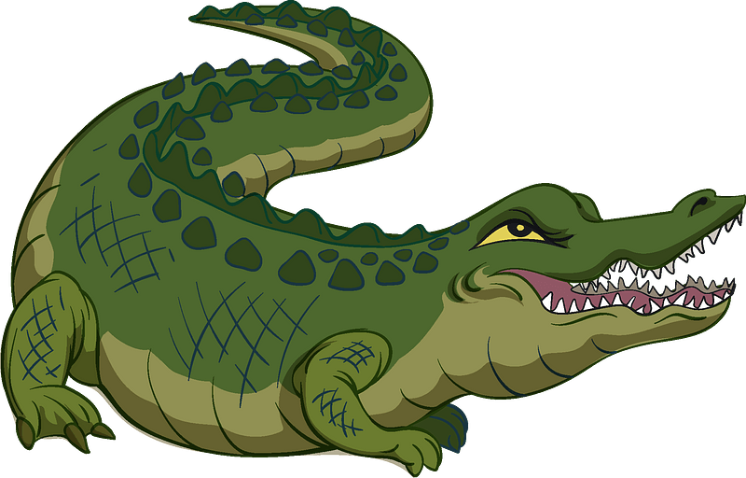
No , they can’t.
Crocodiles have big mouths BUT they can’t speak.
Can crocodiles
speak?

Slide 9
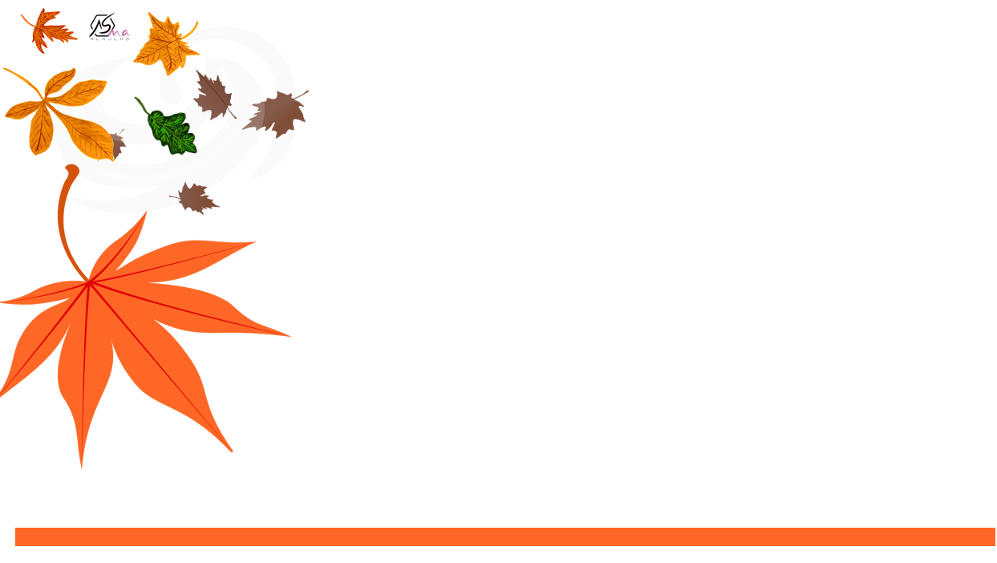

No, they can’t.
Can ostriches fly ?
Ostriches can run BUT can’t fly.

Slide 10

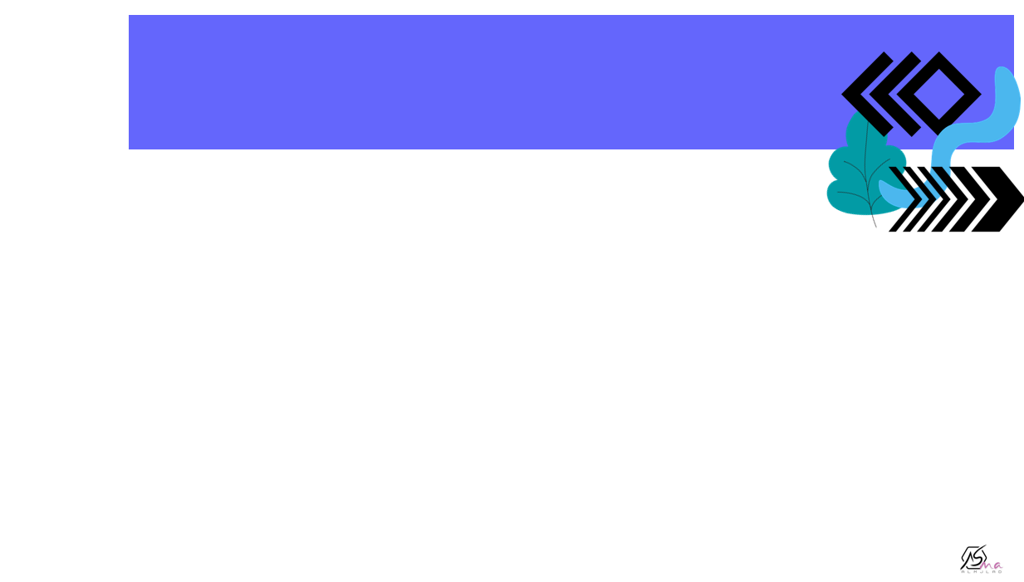
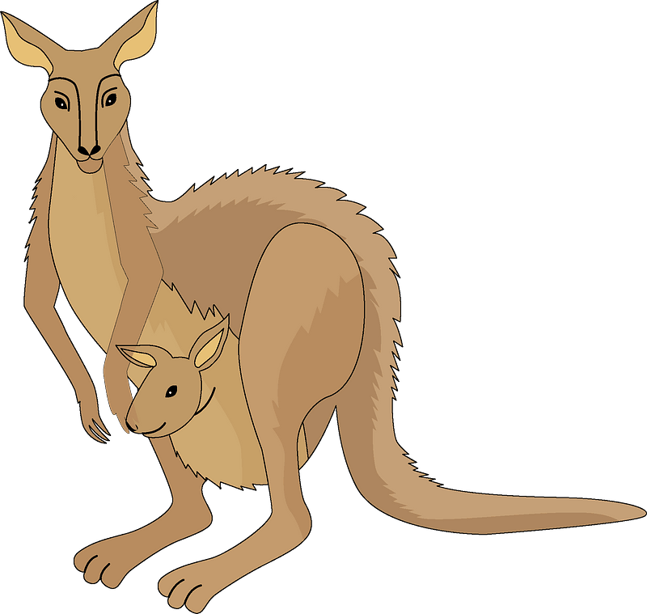

No, they can’t.
Can Kangaroos fly ?
Kangaroos can jump BUT can’t fly.

Slide 11
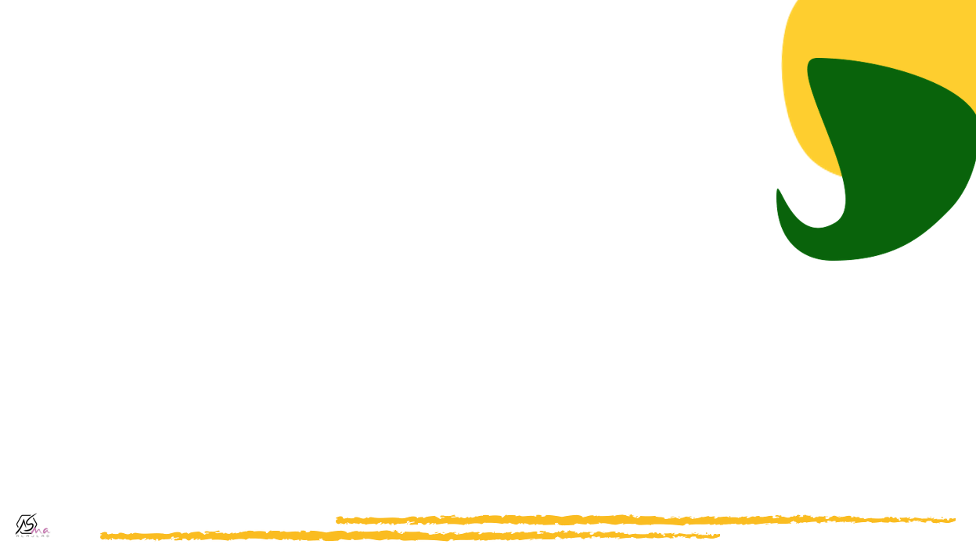
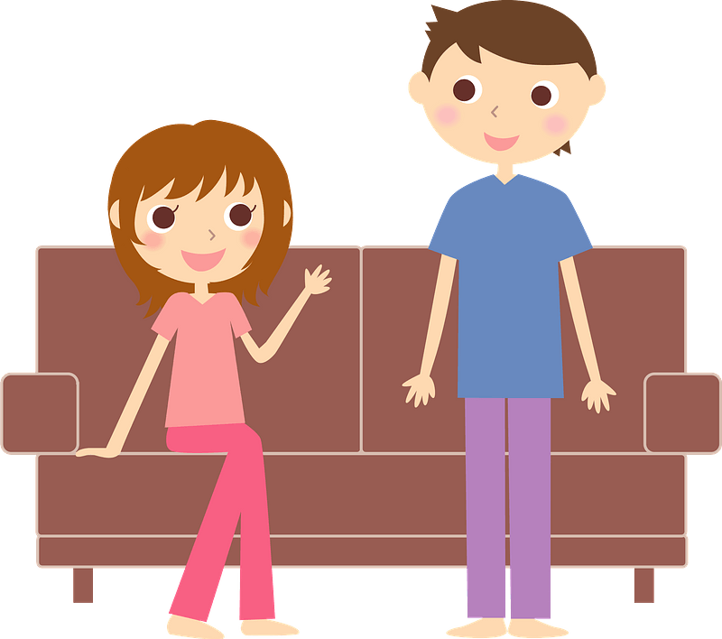
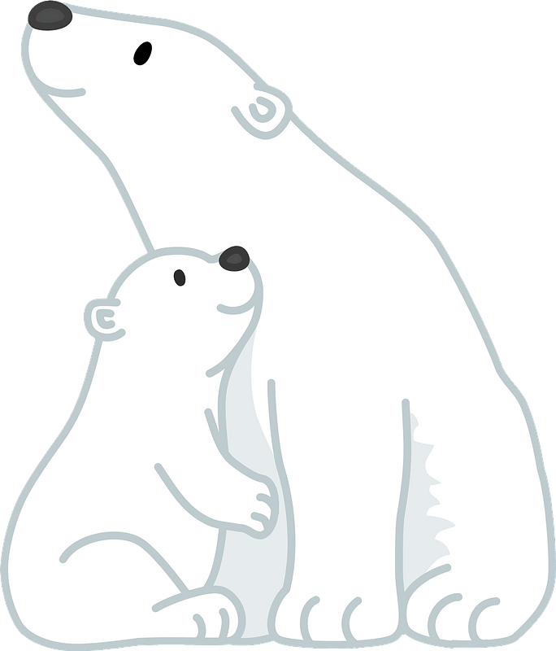
Polar bears can swim but they can’t speak.
yes, they can.
Can polar bears swim?

Slide 12
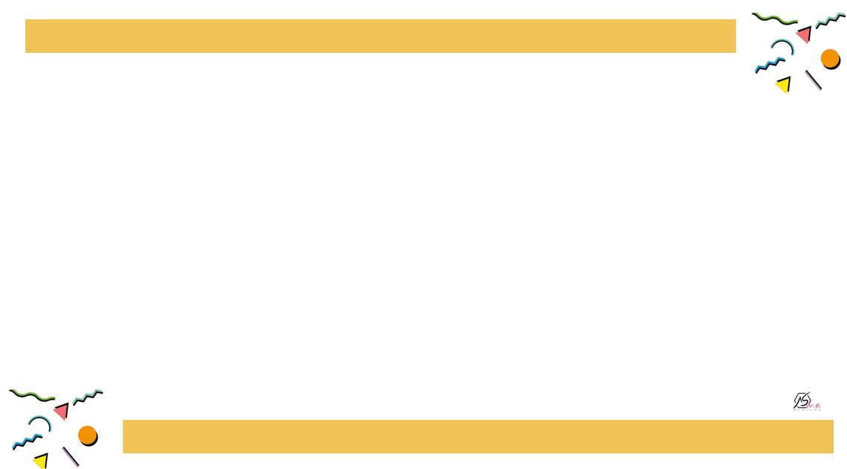


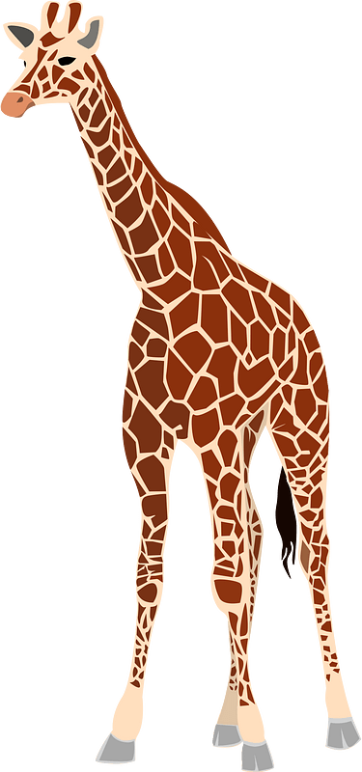



Which animal is it?
it's jaws are huge
They crush and chew
It can walk and swim
It can hunt for food!

Slide 13

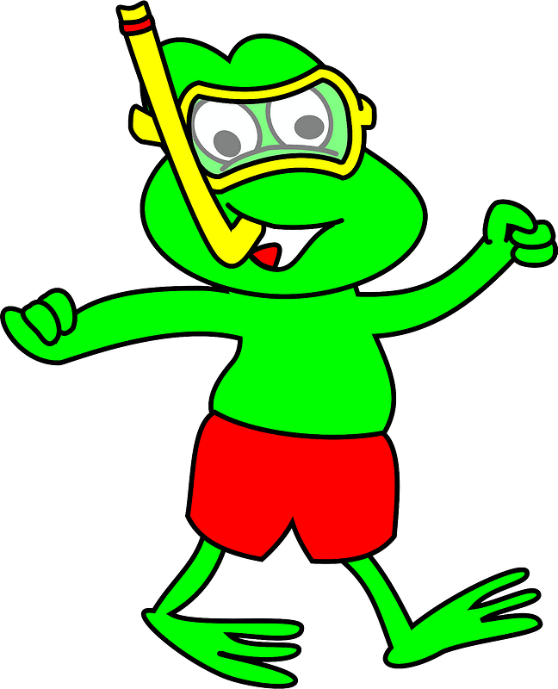
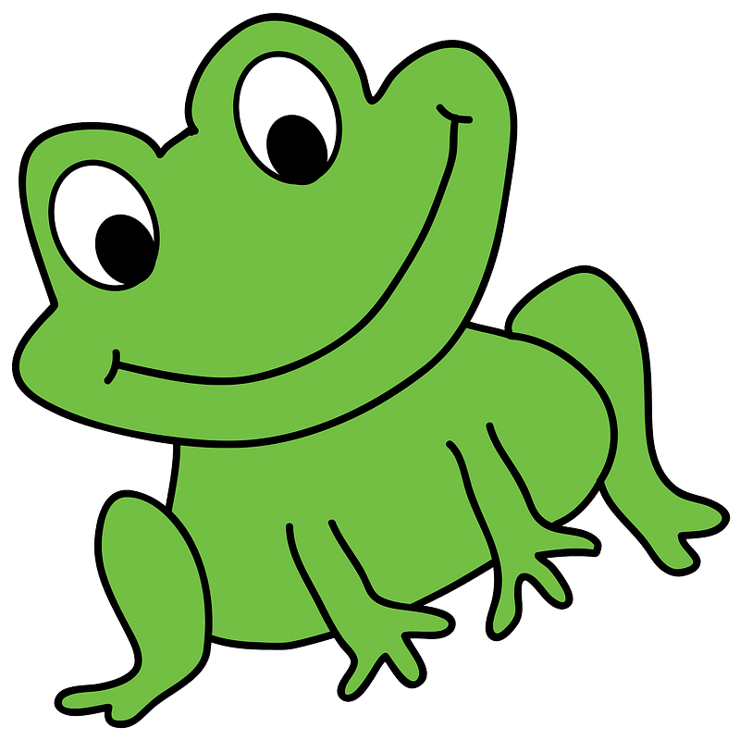
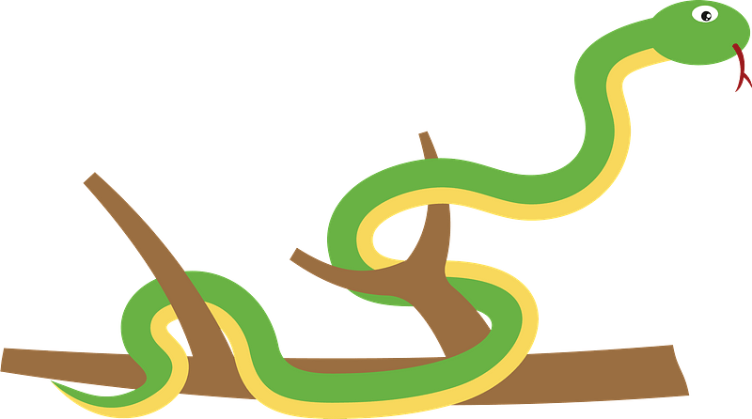
Which animal are they?
Their skin is green,
Their eyes pop out.
They can jump and dive,
They are loud and fun.

Slide 14
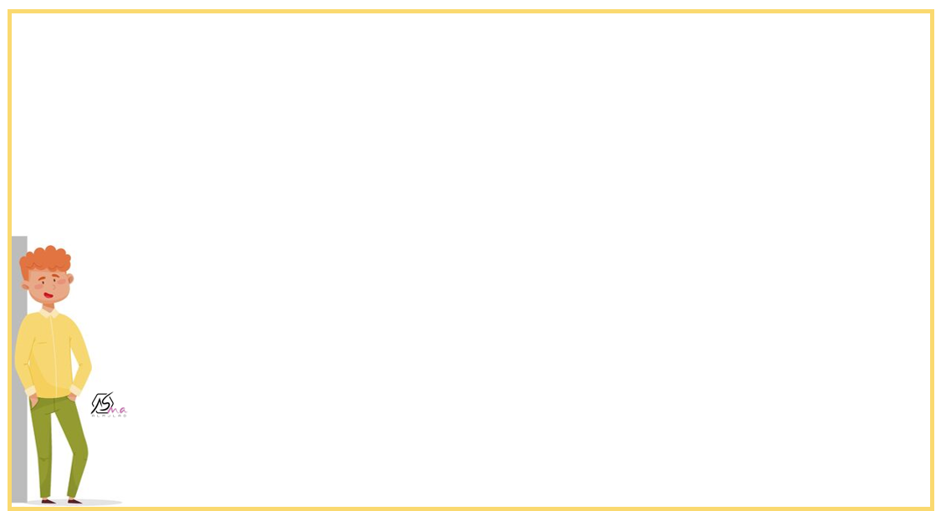
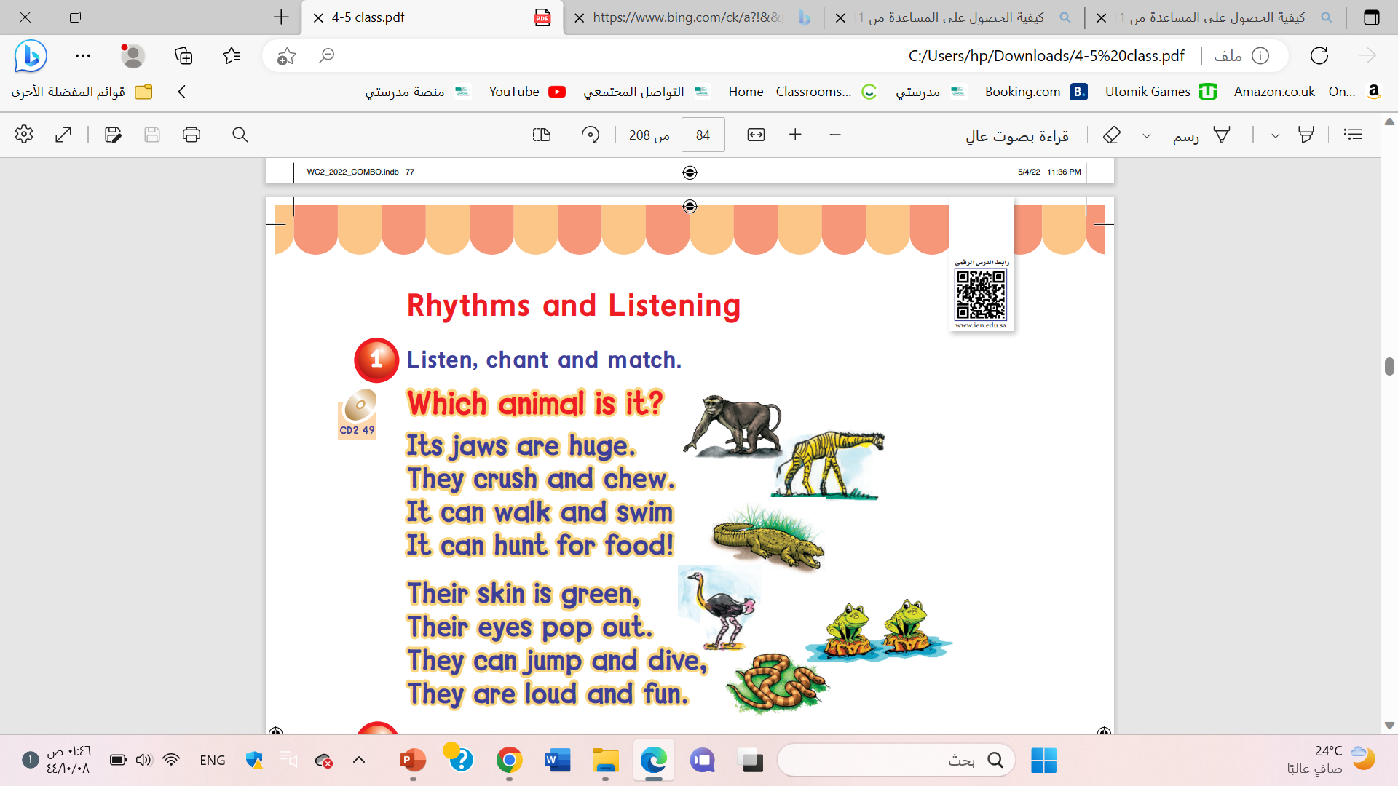


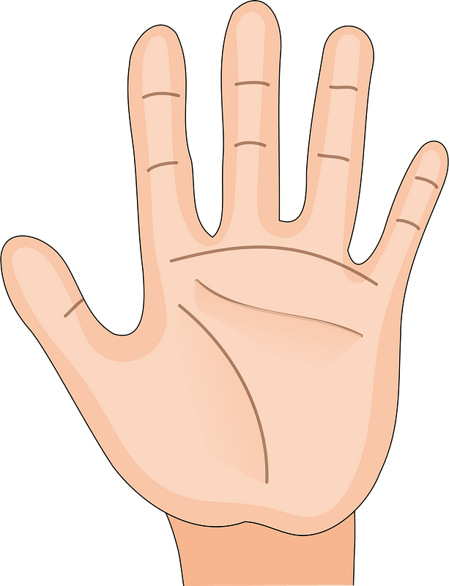
List Five animals

Slide 15
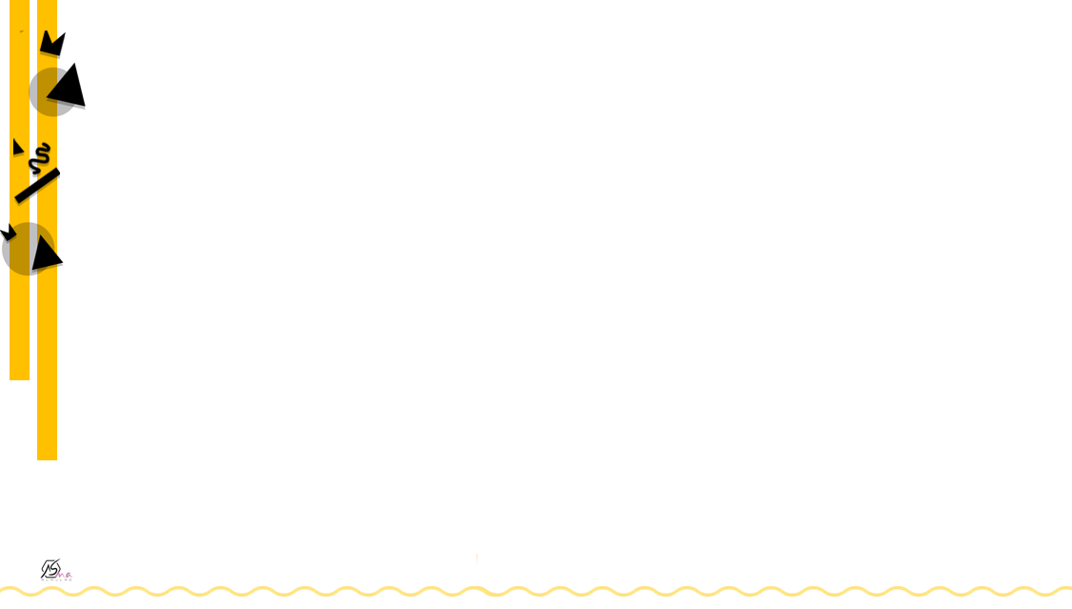

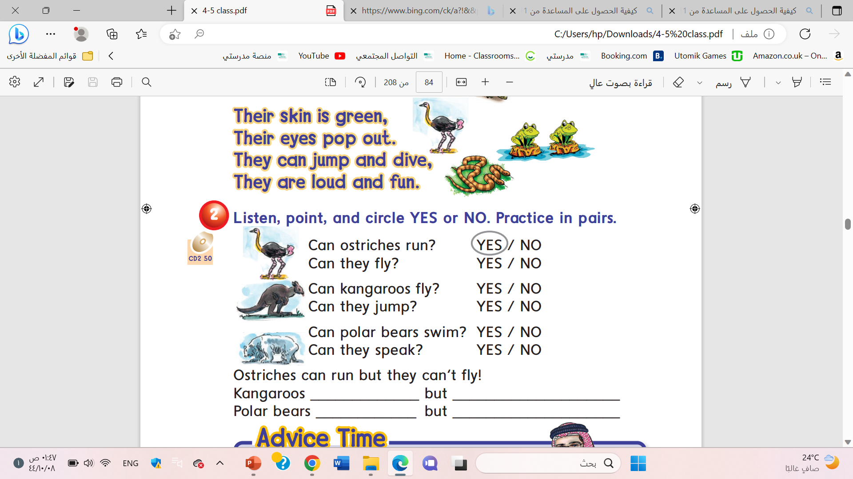

Slide 16
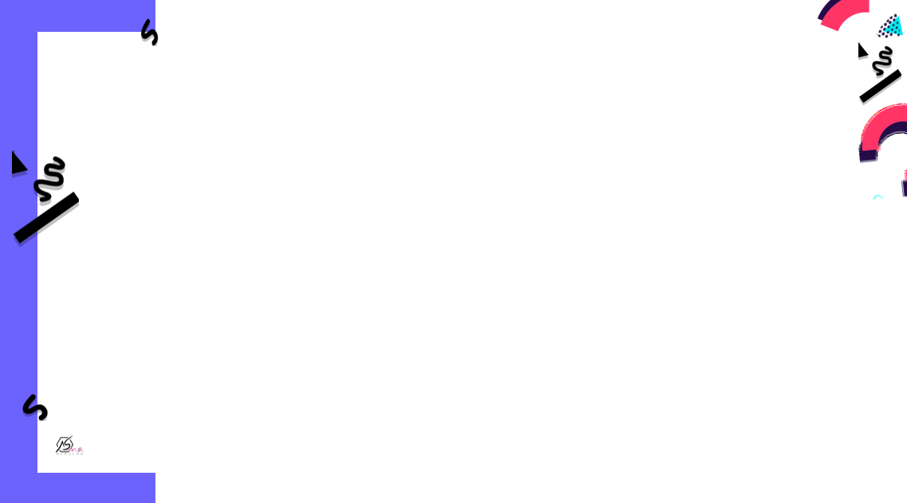

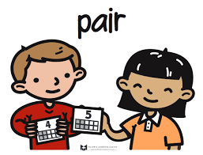

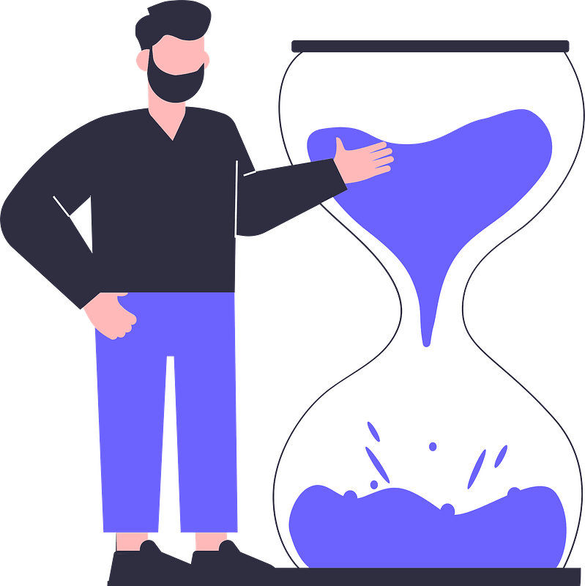
run
fly
swim
speak

Slide 17
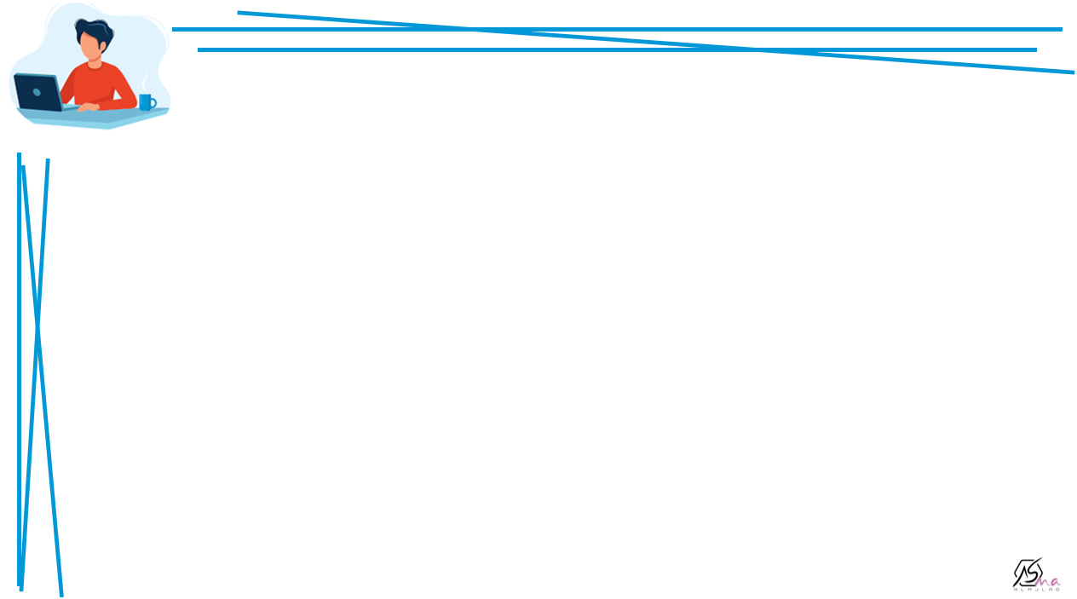



Omar can’t………..
Nora can ……….
He can ……………….

Slide 18
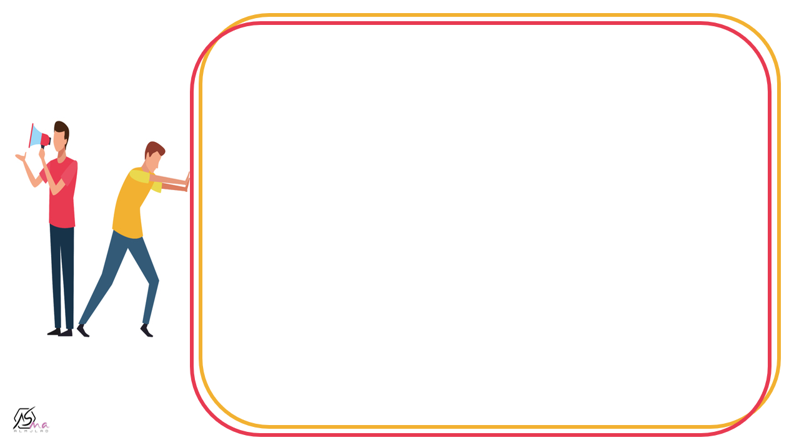
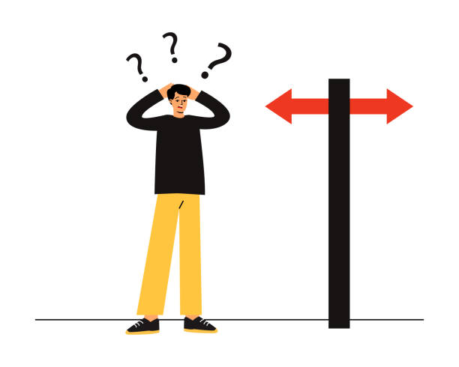

I can’t ………………..

Slide 19
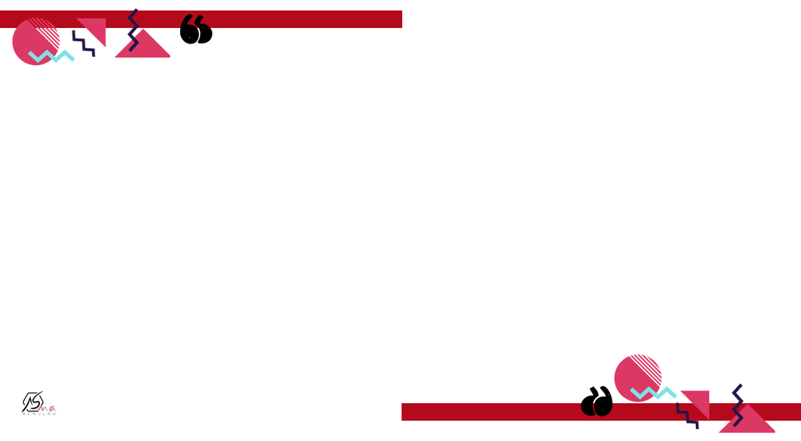
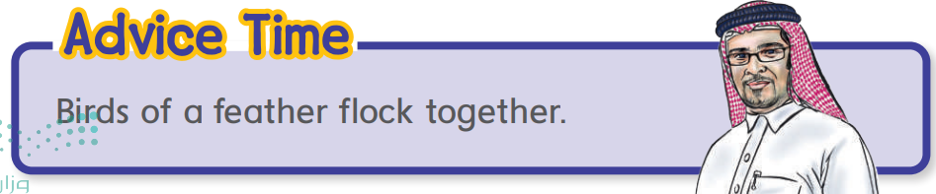

Slide 20
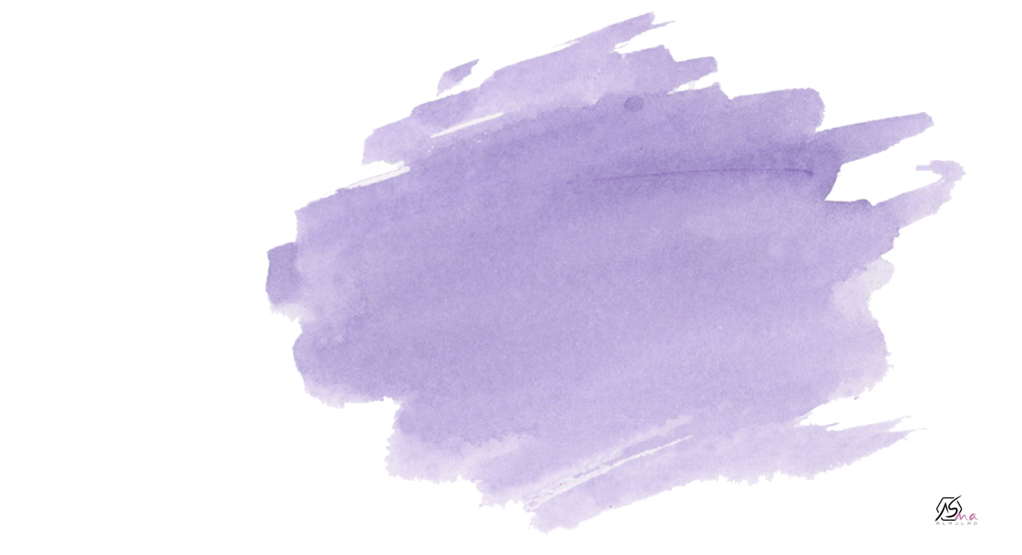



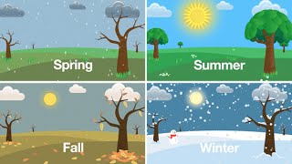

How many seasons are there in the year?
There are 4 seasons.

Slide 21
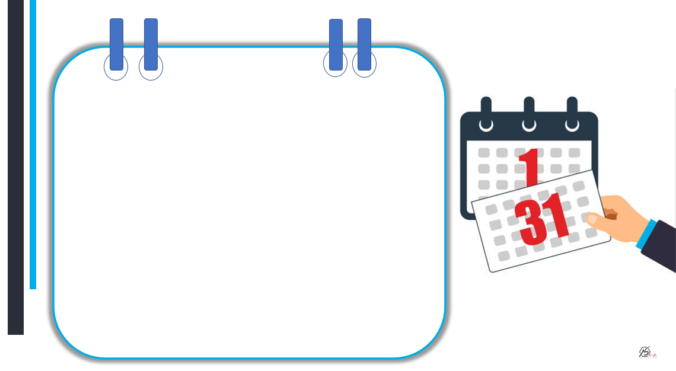



It’s sunny.
It’s cloudy
It’s rainy.

Slide 22
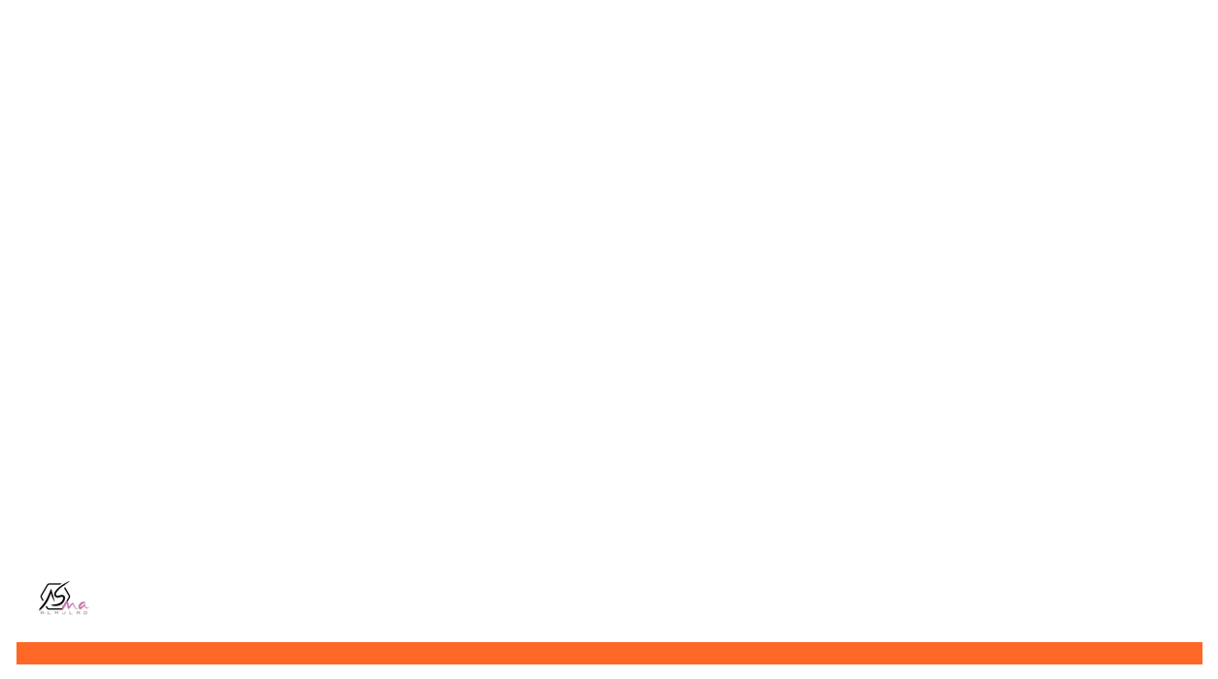
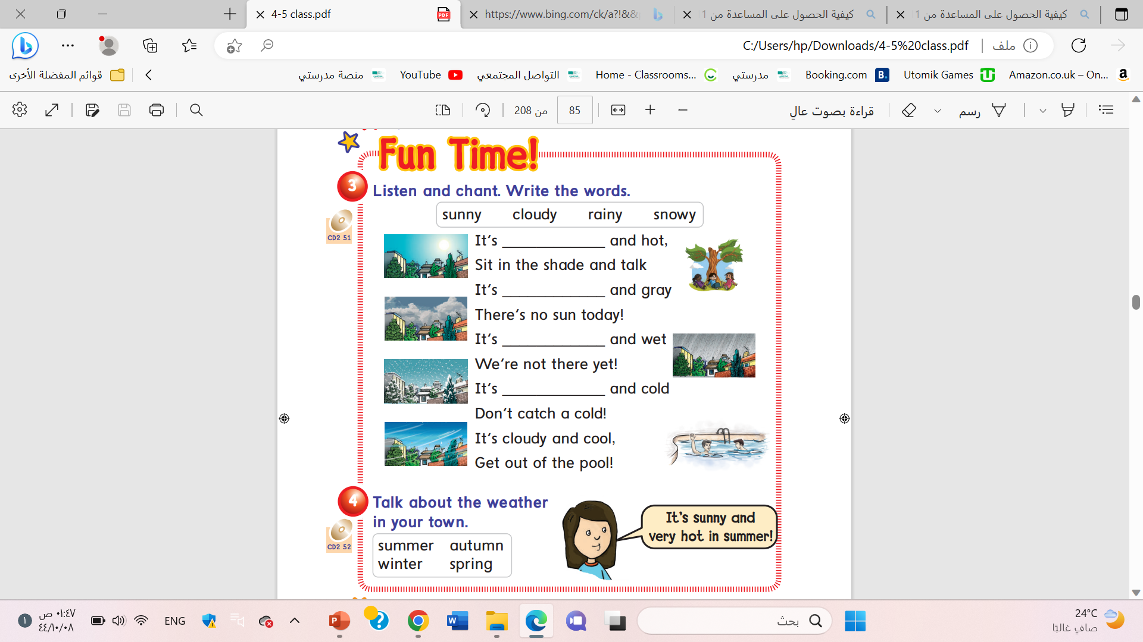
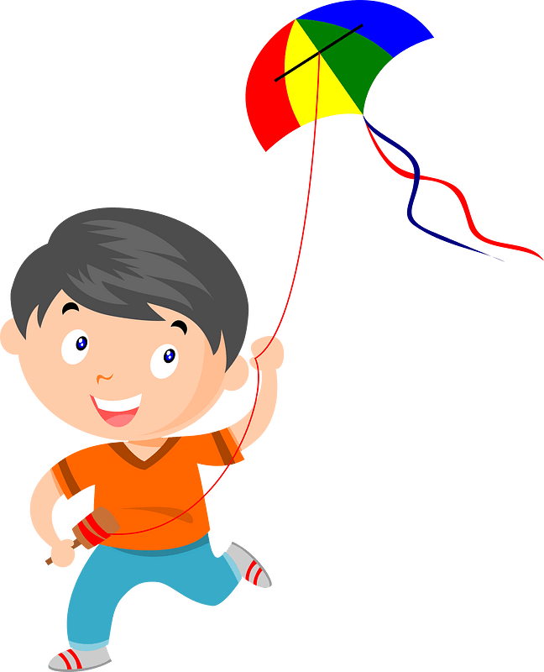
sunny
cloudy
rainy
snowy

Slide 23
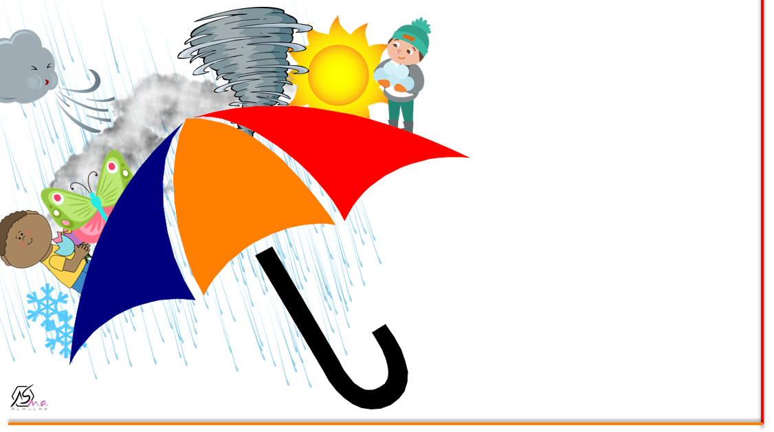









What is the weather in your city?

Slide 24
Very hot
summer
It’s a ……………………and …………………………in …………………………..!
sunny
It’s a ……………………and …………………………in …………………………..!
It’s a ……………………and …………………………in …………………………..!
It’s a ……………………and …………………………in …………………………..!

Slide 25



Let’s chick the weather

Slide 26






It’s ……….and wet .
sunny
rainy

Slide 27

It’s ……….and hot.
sunny
snowy

Slide 28
We …..meet tomorrow if you want
can
Can’t

Slide 29
I ….come to the party . I am really busy.
can
can’t

Slide 30

It is …………………and cold
snowy
cloudy

Slide 31
Ostriches can’t run but the can fly.
True
False

Slide 32



Slide 33



Slide 34

Work
book

Slide 35

huge
walk
swim
green
jump
dive

Slide 36

Yes, they can/
No, they can’t.
No, they can’t
swim
fly
bite
run

Slide 37

cloudy
rainy
snowy

Slide 38




Slide 39




Slide 40



