Slide 1
Unit 8 Grammar
P 66 – 67

Slide 2
Your mood

Slide 3
Objectives
01
02
03
04
Have you ever
Present and simple tense
listening
Pronunciation
Present perfect affirmative –negative and interrogative versus past simple
Review of simple past and present
Listen for specific
information
/v/ in have

Slide 4
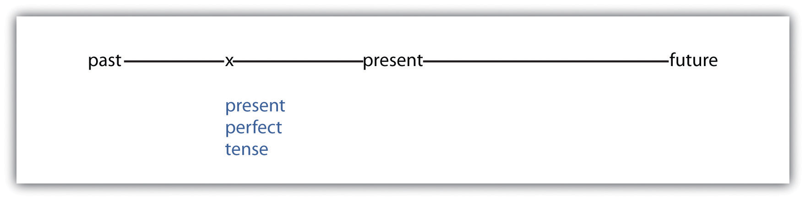
Present perfect
We use this tense to talk about something in the past, but we don’t know when the event happened or its not important when it happened
هذه الصورة بواسطة كاتب غير معروف مرخصة بالاسم CC BY-SA-NC

Slide 5
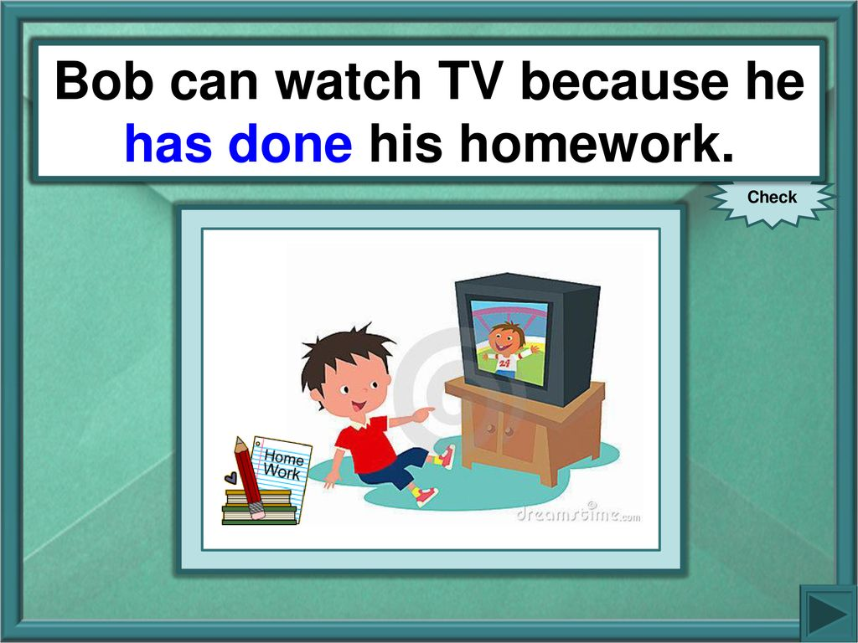
Present perfect
Done is a past participle ..
Other example:
Been-written –ridden – had -gone….

Slide 6
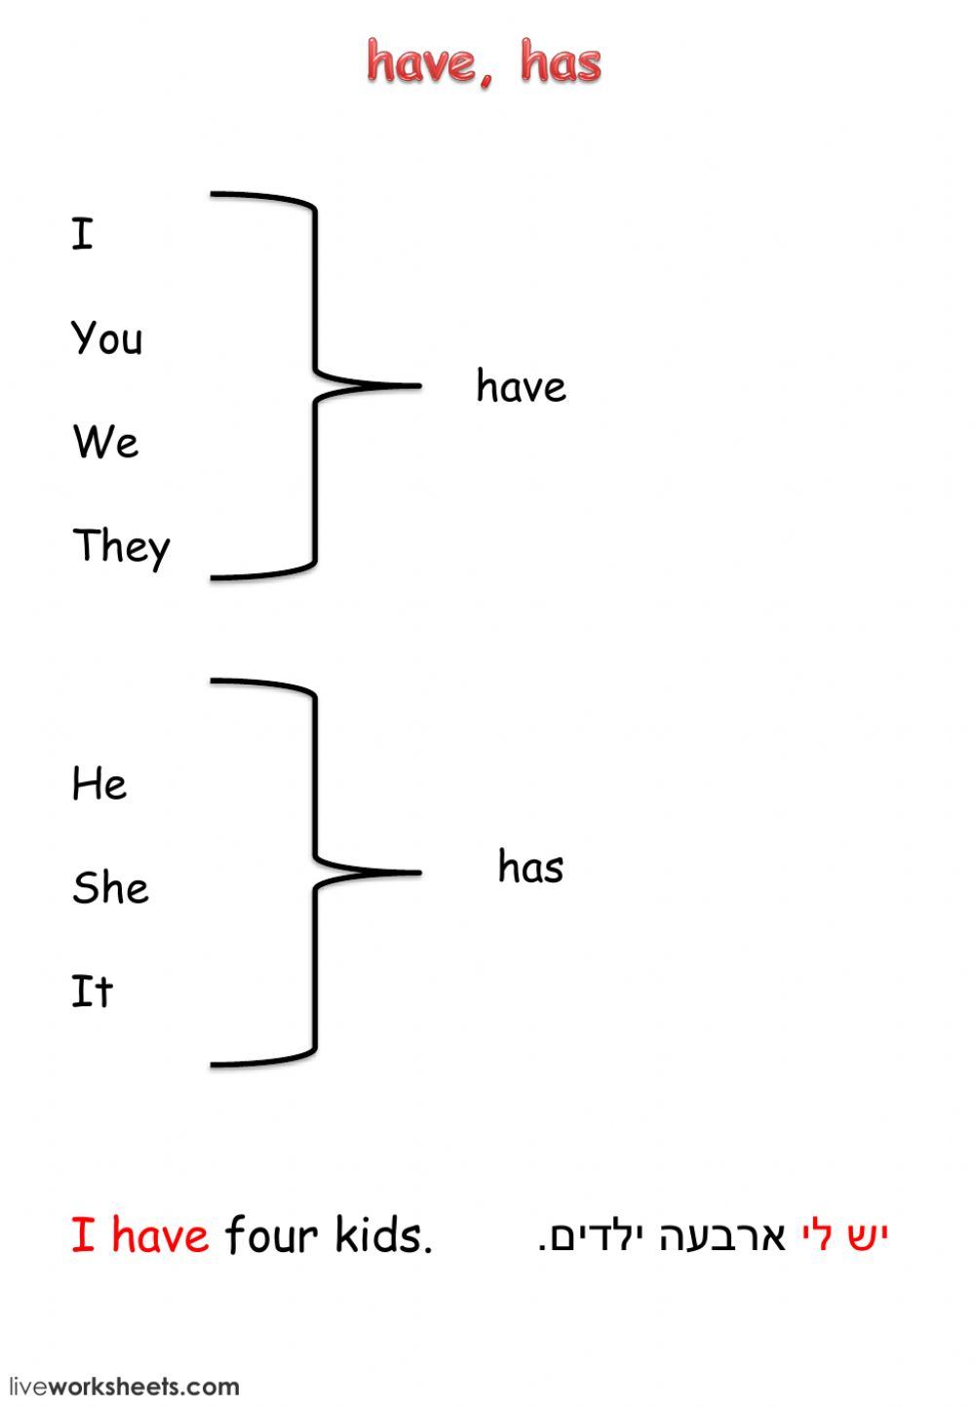

Present perfect
I have seen a bear
she has seen a bear.

Slide 7
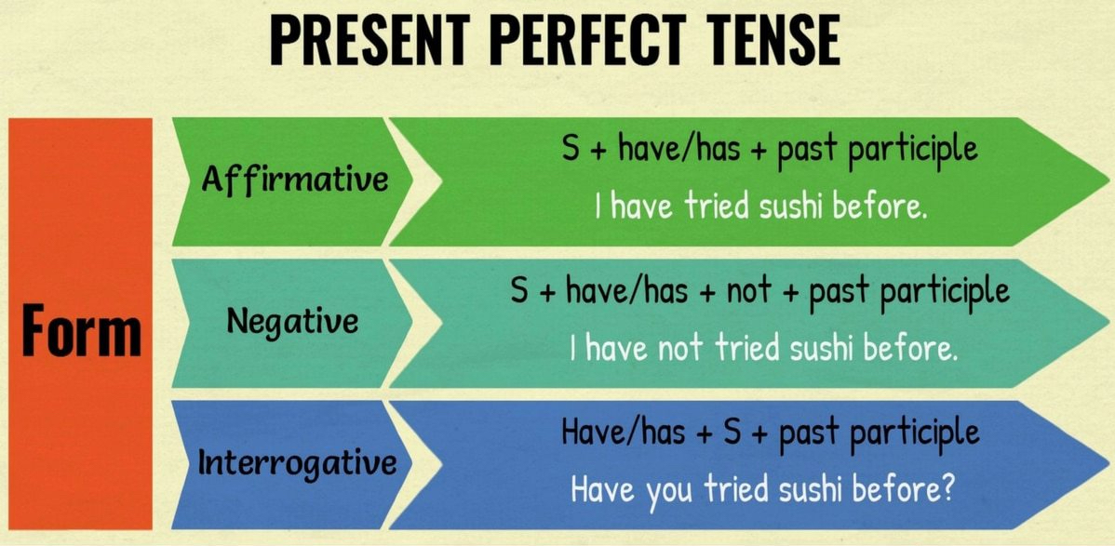

Slide 8


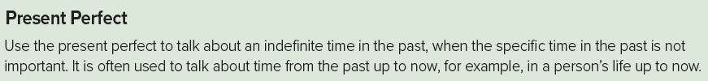
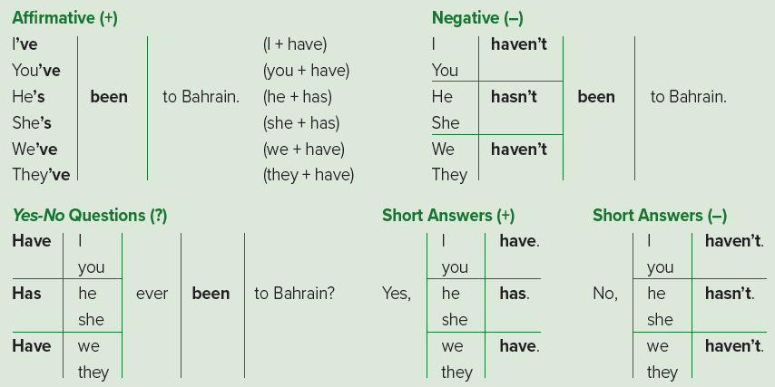
S + has + P.P(V3)
have
Page 66

Slide 9
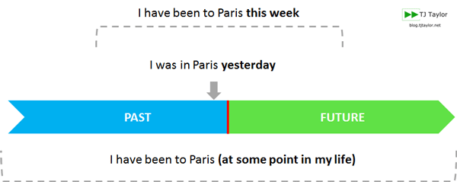

Slide 10

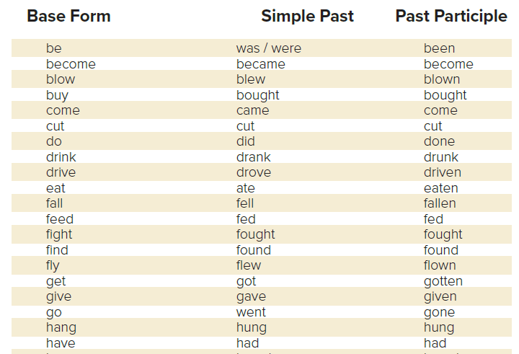
p.83

Slide 11


Slide 12
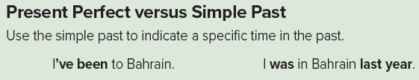

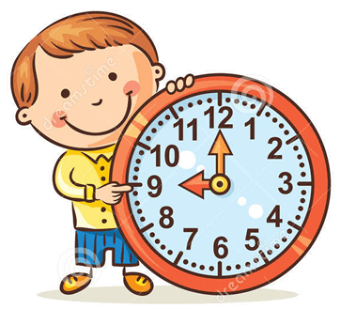
Page 66
☺☻In the first sentence,
do we know when the speaker went to Bahrain? (no)
☺☻ In the second sentence,
do we know when the speaker went to Bahrain? (yes)
☻ the time in the past; for example:
yesterday, last night/week/weekend and
(number) hours/days/weeks/months/years ago.
Time Phrases:

Slide 13
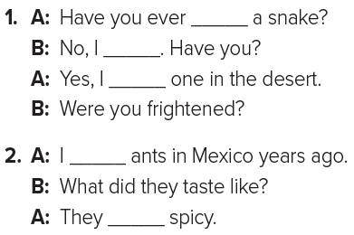
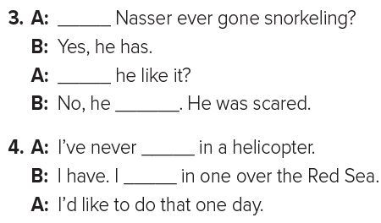
Page 66
seen
haven’t
Has
saw
Did
ate
didn’t
ridden
flown
been
were
flew
rode

Slide 14

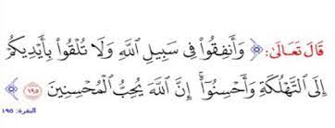
But don’t forget
to stay safe

Slide 15


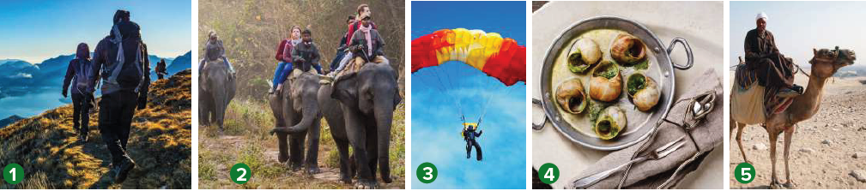
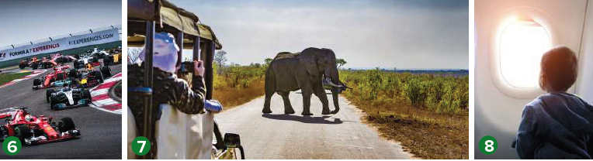
Page 67
A. Have you ever ridden a camel?
B. No, I haven’t. Have you?
A. Yes, I have.
I rode one in Abha.
A: I’ve never flown in an airplane.
B: I have. I flew in one over the Red Sea.
A: I’d like to do that one day.

Slide 16
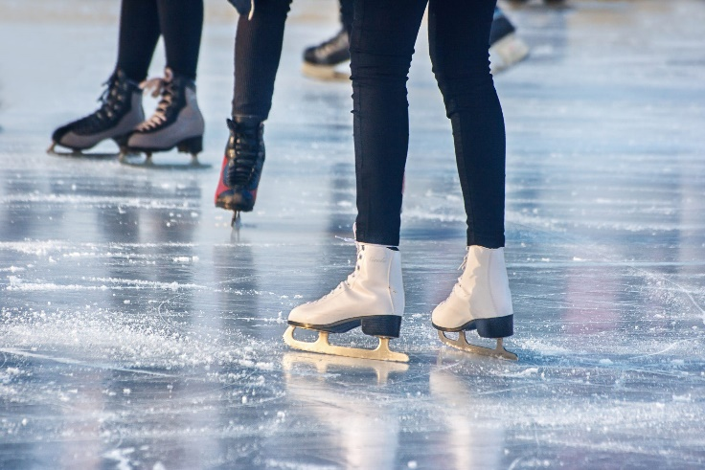
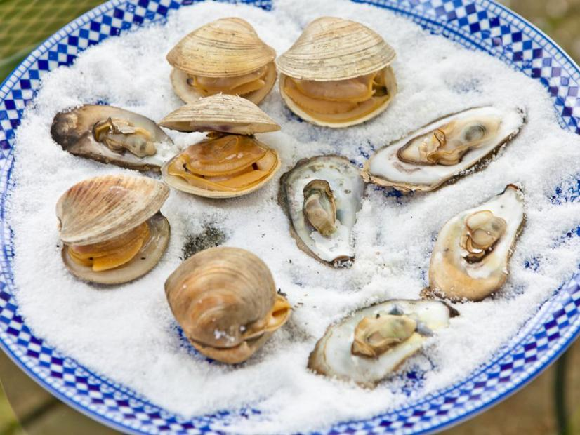
Page 67
A: I’ve never gone ice skating.
B: Yes, I have. I went ice-skating in the winter.
A: I ate oysters in China years ago.
B: What did they taste like?
A: They were sweet and salty.
oyster
محار

Slide 17



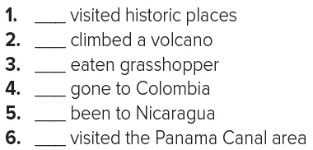



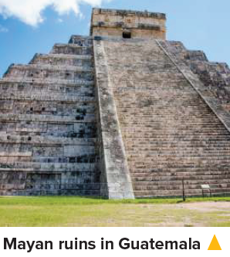
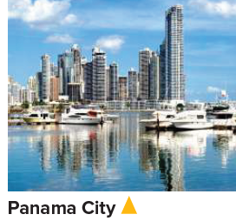

Page 67
Someone talk about traveling around Central America.
What do visitors to Central America often do there?

Slide 18

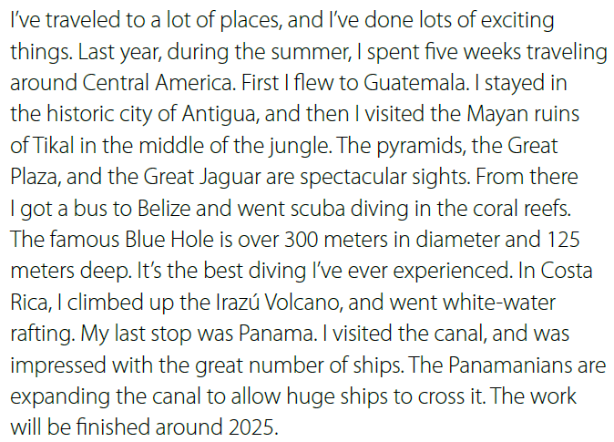
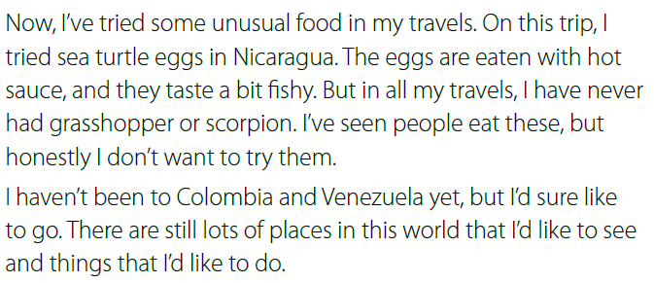
Page 67

Slide 19








Assign page 120 and 121 for practice grammar
Ex C, D, E, and F

Slide 20
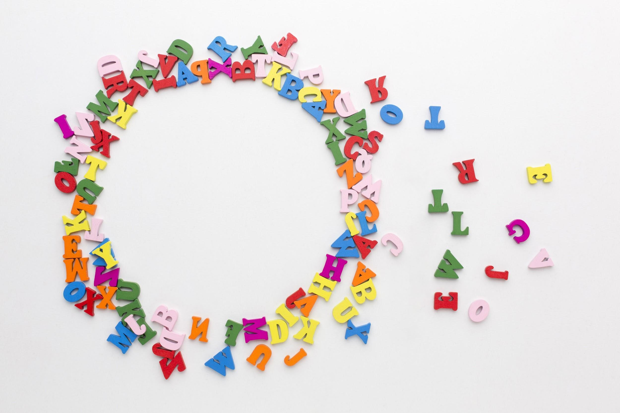
Have a nice day

