Slide 1
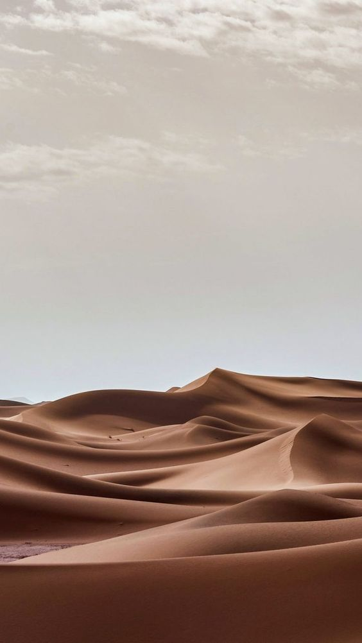
Learning Objectives:
Practice reading strategy: using context
Answer questions about a text

Slide 2

What do you know about camels?

Slide 3
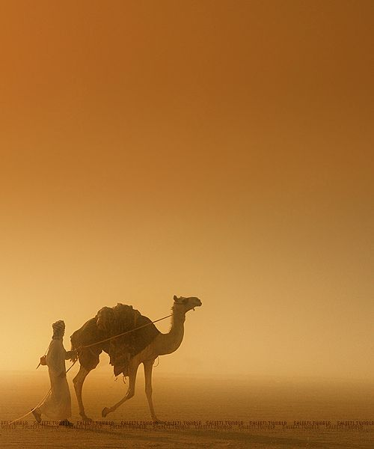
Have you ever ridden one?

Slide 4
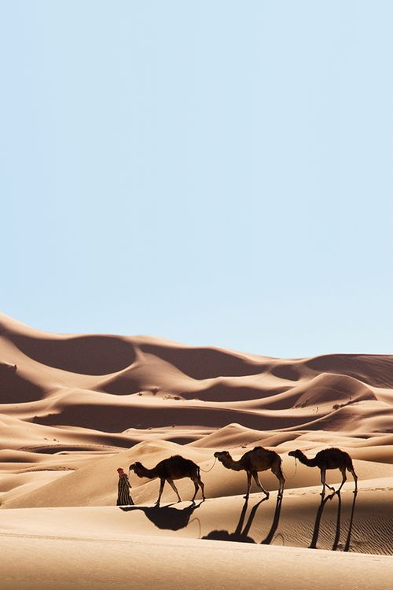
Camels
are mammals with long legs. Some camels have one hump others have two humps
Camels have other ways to adapt to their environment.
"ships of the desert."
Humans have used camels as a means of transport for thousands of years.
Camels are often the main source of meat, milk and even leather or wool products.

Slide 5
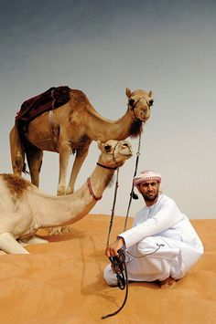

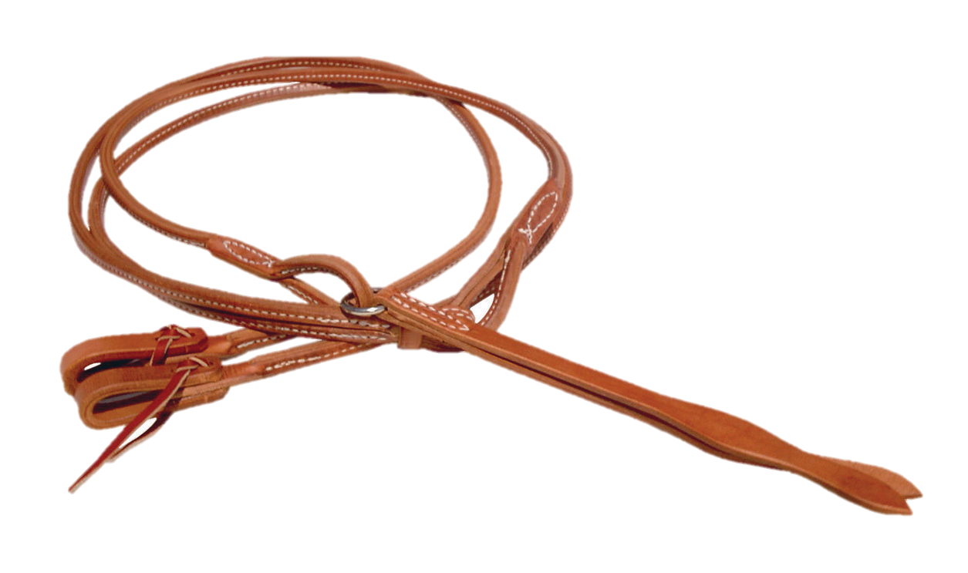
reins
reins
it is something you hold to control a camel, it must be
something that resembles a rope.

Slide 6
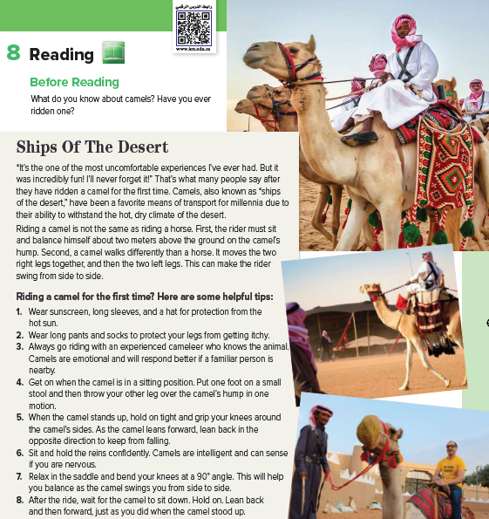

What are the men doing?
What part of the world are they in?
what do you think
ships of the desert
refers to?

Slide 7
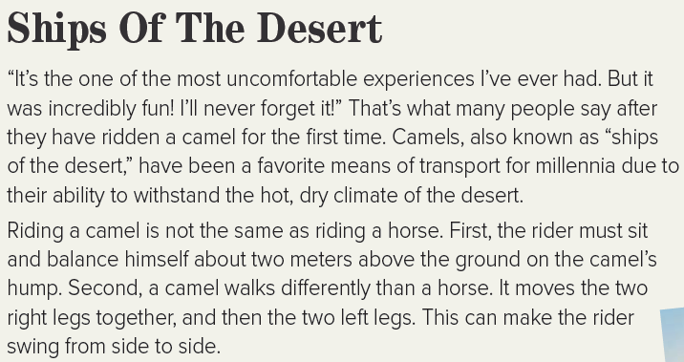

Page 69

Slide 8
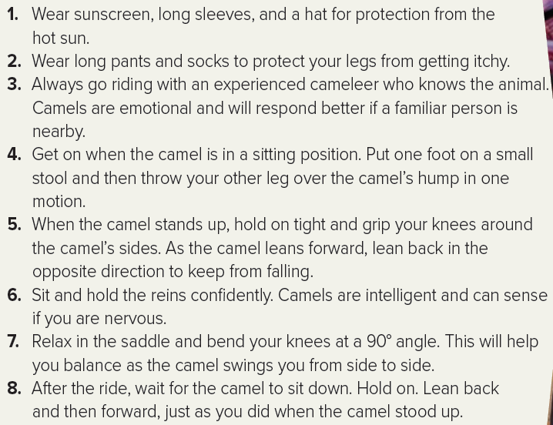

Slide 9

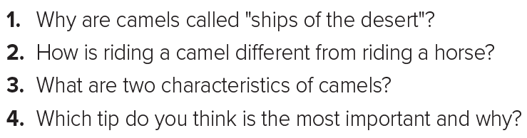
1. Because they have been used as a means of transport in the desert due to their ability to withstand the hot, dry climate.
2. The rider must sit two meters above the ground on the camel’s hump, and the movement of the camel swings the rider from side to side.
3. Camels are emotional and intelligent.
4.

Slide 10

Why are camels called "ships of the desert"?
Because they have been used as a means of transport in the desert due to their ability to withstand the hot, dry climate.

Slide 11
How is riding a camel different from riding a horse?
The rider must sit two meters above the ground on the camel’s hump, and the movement of the camel swings the rider from side to side.

Slide 12
What are two characteristics of camels?
Camels are emotional and intelligent.

Slide 13
Which tip do you think is the most important and why?
Relax in the saddle and bend your knees at a 90° angle because this will help you balance

Slide 14



Assign page 122 for practice reading
Ex G

Slide 15


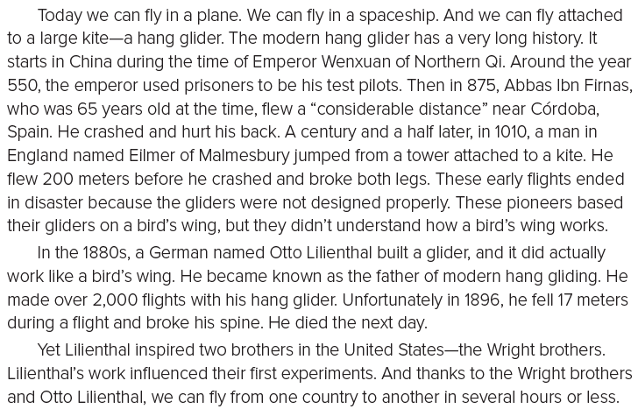
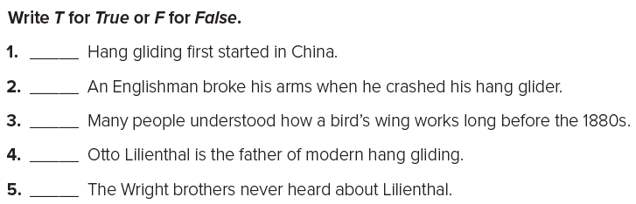
Page 122
T
F
F
T
F

