Slide 1


♥
Practice a conversation
Answer questions about a conversation
Share some experiences

Slide 2
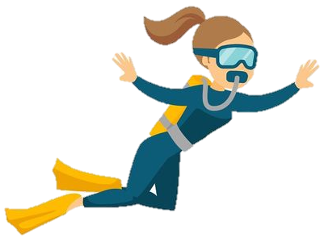
https://youtu.be/qIYCmHGBIhk

Slide 3

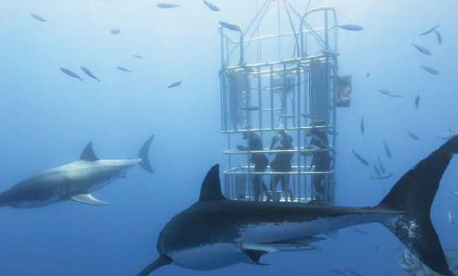
Page 68
Would you like to have this kind of experience?
Why or why not?

Slide 4
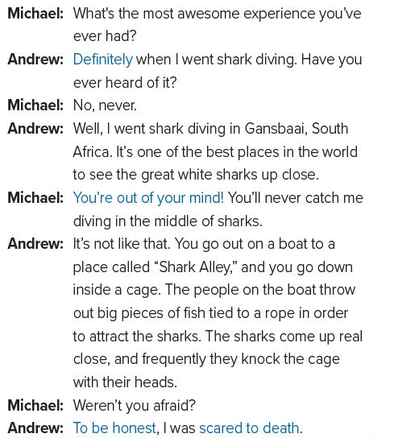
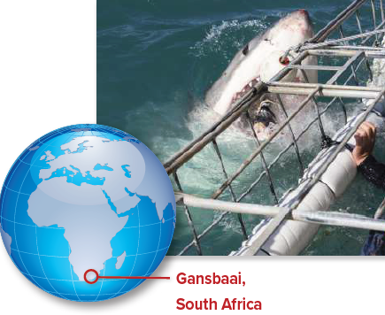

Slide 5


Slide 6
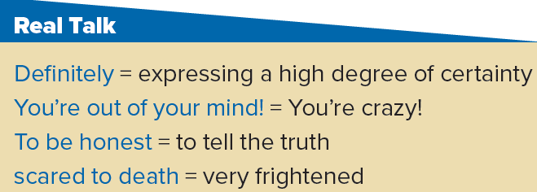

Slide 7

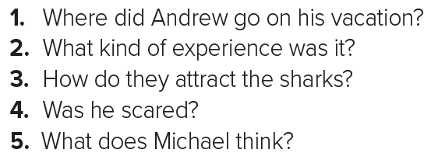
1. He went shark diving in Gansbaai, South Africa.
2. It was an awesome experience, but it was scary.
3. People throw out big pieces of fish.
4. Yes, he was. Andrew says he was scared to death.
5. Michael thinks that Andrew is crazy.

Slide 8

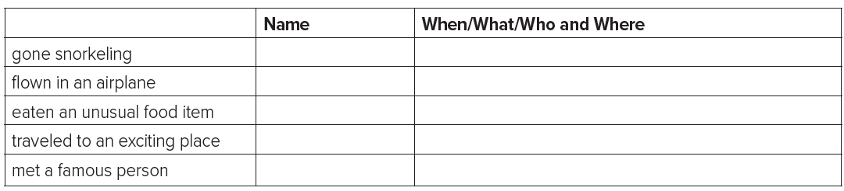
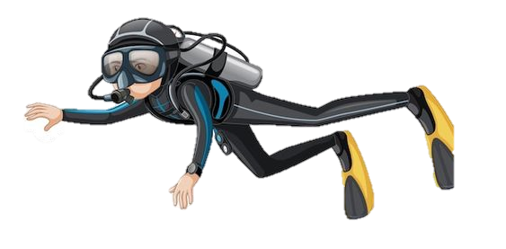
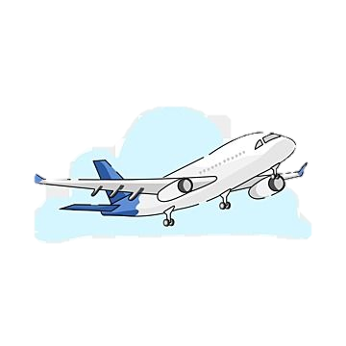

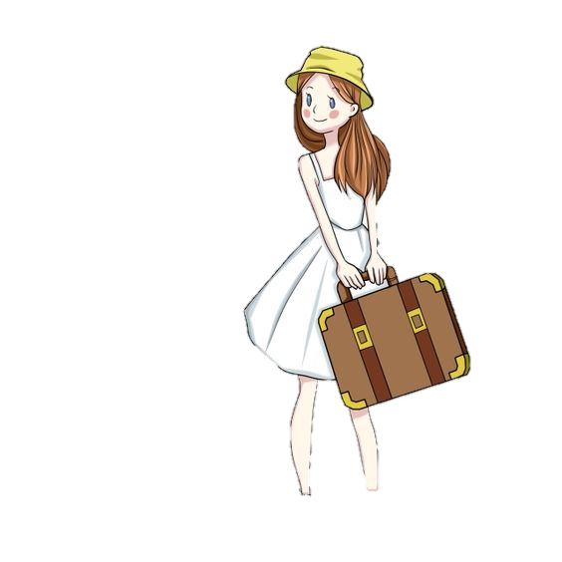
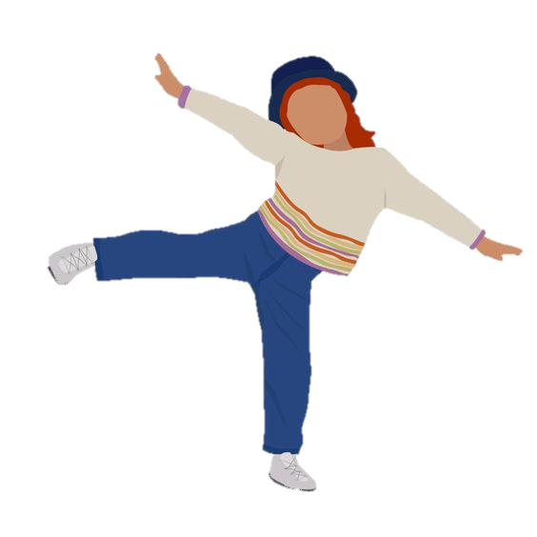

Last year. In Jeddah . With her family.
Amal

Slide 9
1.When I went horse ridding.
2. Walking the streets of Abha holding my son’s hand.
It was a beautiful day with clouds.

