Slide 1


Slide 2
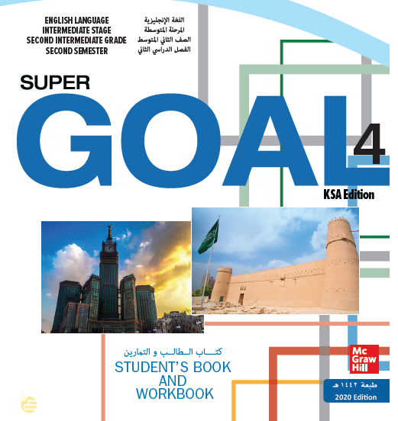

Slide 3


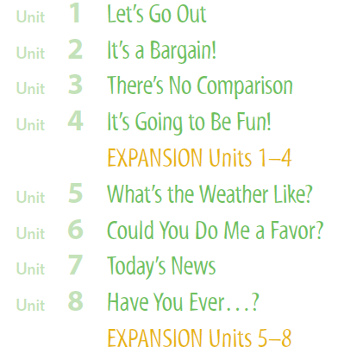

Slide 4

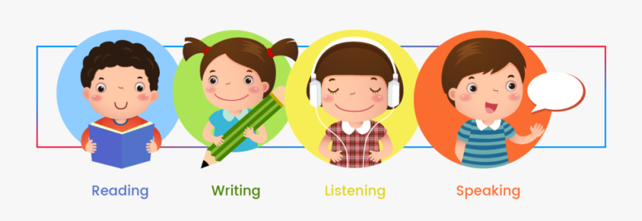

Slide 5
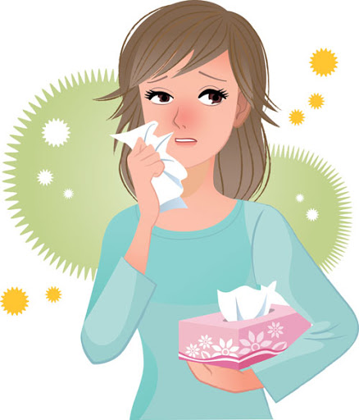
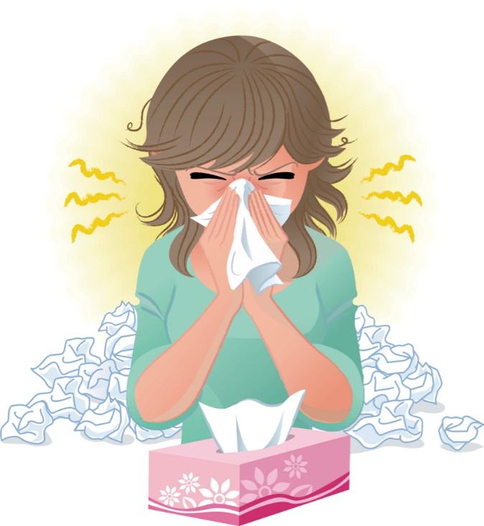
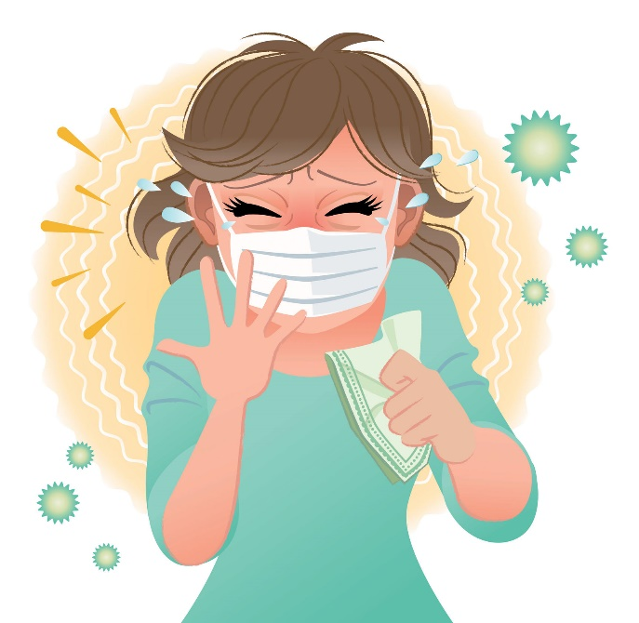
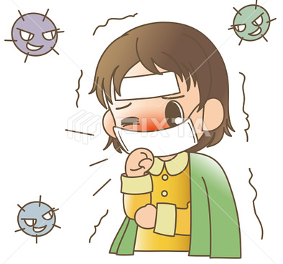
Covid 19
☺Avoid gathering !
☺We must wear a mask before
going out.
☺Social distancing is not a
choice, it is a must!
☺Keep a distance of 2 meters
to avoid accountability
☺wash hands constantly.

Slide 6
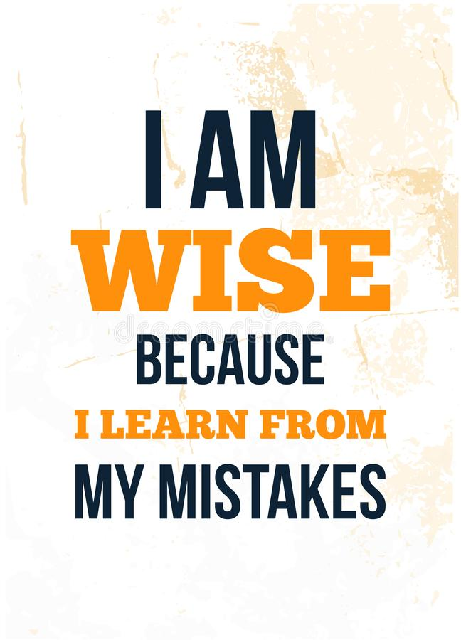

Slide 7
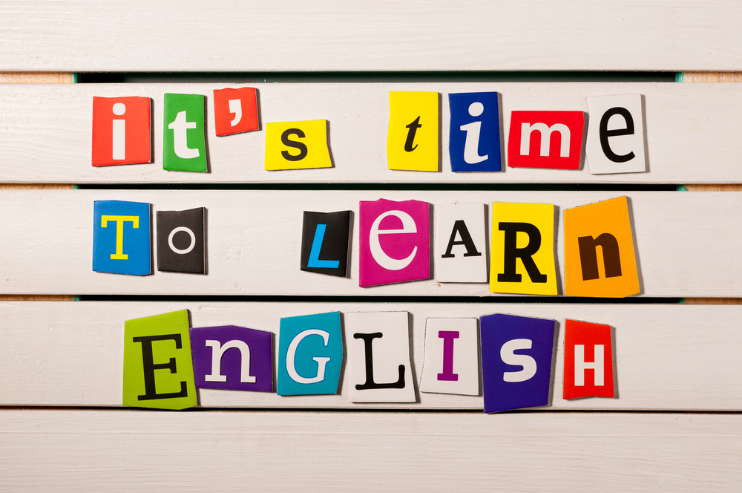

Slide 8


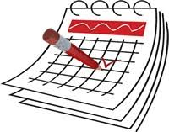


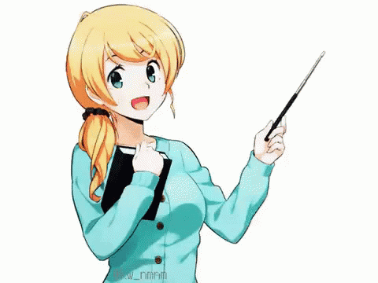
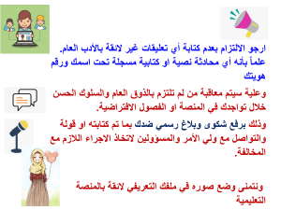

Today: Tuesday
Date:
24-8-1442 H
April 6th \ 2021
everyone,
How is everything going?

Slide 9




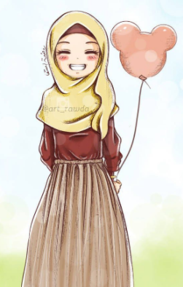
ارجو الالتزام بعدم كتابة أي تعليقات غير لائقة بالأدب العام. علماً بأنه أي محادثة نصية او كتابية مسجلة تحت اسمك ورقم هويتك
وعلية سيتم معاقبة من لم تلتزم بالذوق العام والسلوك الحسن خلال تواجدك في المنصة او الفصول الافتراضية.
وذلك برفع شكوى وبلاغ رسمي ضدك بما تم كتابته او قولة والتواصل مع ولي الأمر والمسؤولين لاتخاذ الاجراء اللازم مع المخالفة.
ونتمنى وضع صوره في ملفك التعريفي لائقة بالمنصة التعليمية

Slide 10
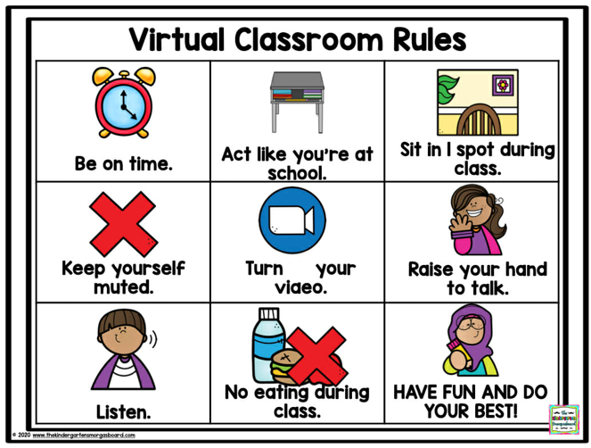
off

Slide 11



☺
♥
Practice reading strategy: using context
Answer questions about a text
..

Slide 12

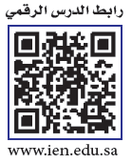

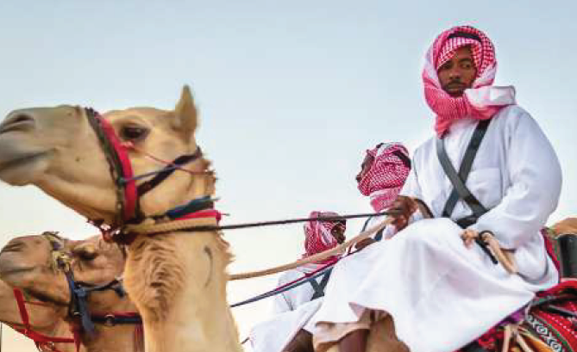


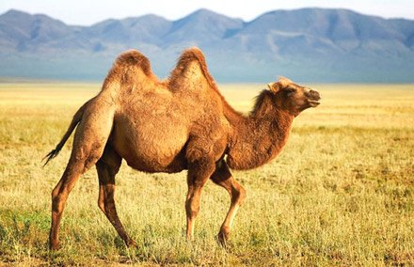
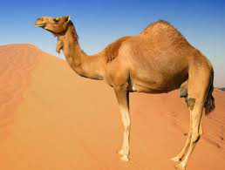
Page 69
Camels
are mammals with long legs. Some camels have one hump others have two humps
Camels have other ways to adapt to their environment.
"ships of the desert."
Humans have used camels as a means of transport for thousands of years.
Camels are often the main source of meat, milk and even leather or wool products.

Slide 13

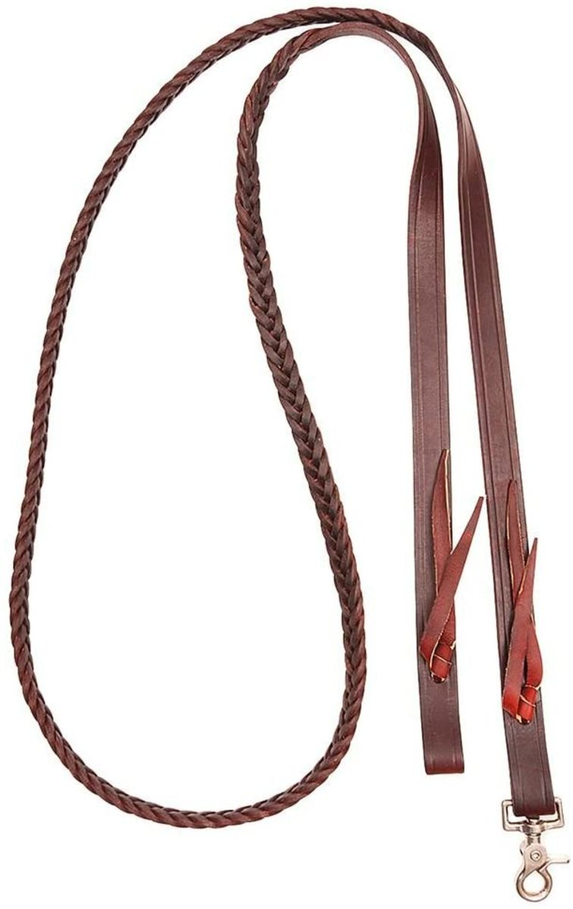
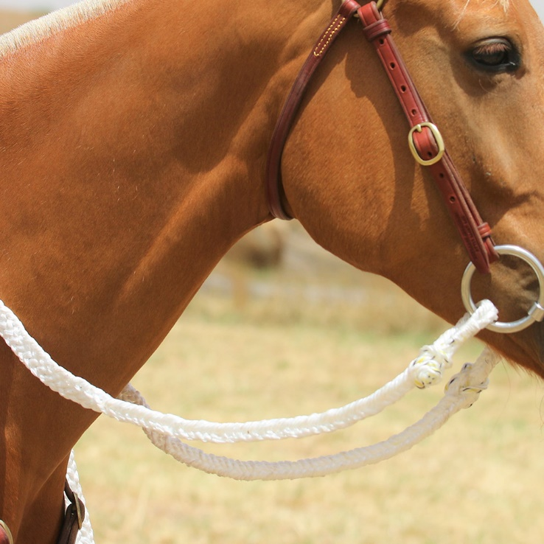
READING STRATEGY Using context
Use contextual clues for general meanings of words you do not know. For example,
reins -
it is something you hold to control a camel, it must be
something that resembles a rope.
reins

Slide 14
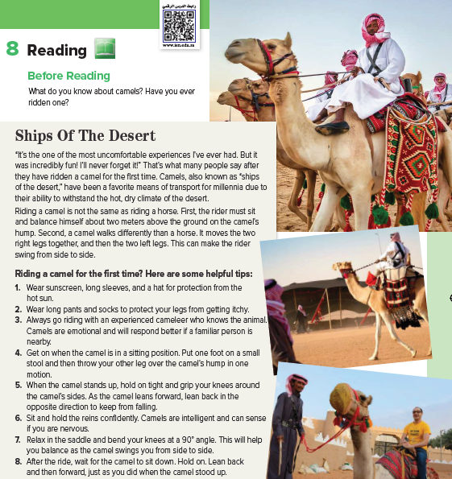

Page 69
What are the men doing?
What part of the world are they in? *riding a camel. *what do you think ships of the
desert refers to? camels.

Slide 15

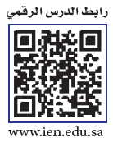

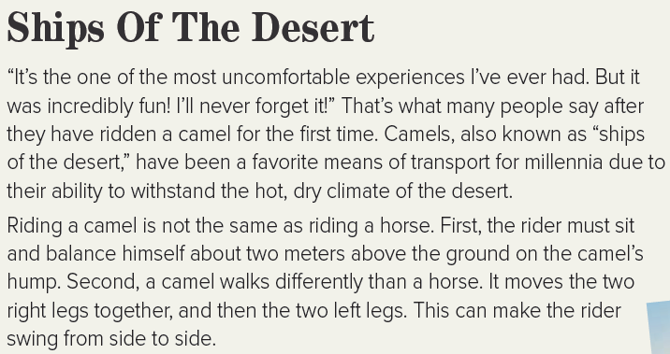
Page 69

Slide 16
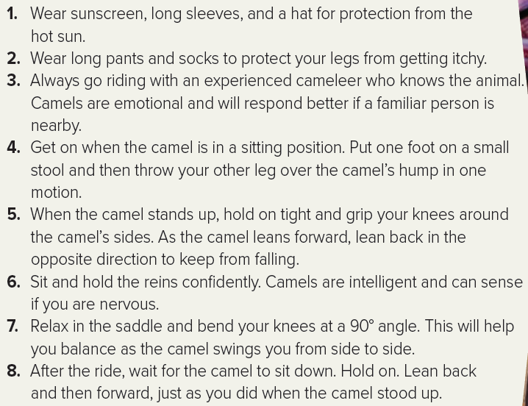
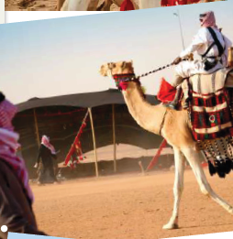
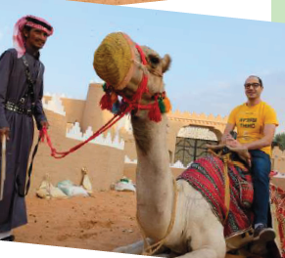
Page 69

Slide 17

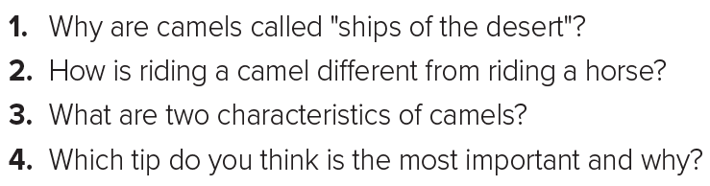
Page 69
1. Because they have been used as a means of transport in the desert due to their ability to withstand the hot, dry climate.
2. The rider must sit two meters above the ground on the camel’s hump, and the movement of the camel swings the rider from side to side.
3. Camels are emotional and intelligent.
4. Relax in the saddle and bend your knees at a 90° angle because this will help
you balance

Slide 18








Assign page 122 for practice reading
Ex G

Slide 19


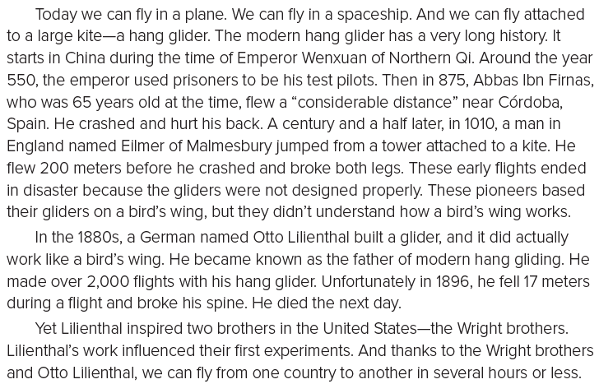
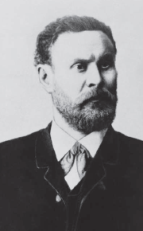
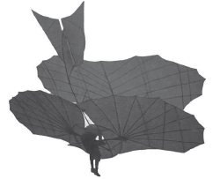
Page 122

Slide 20
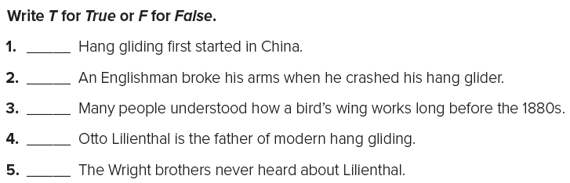
Page 122
T
F
F
T
F

Slide 21


أتمنى الاهتمام بمتابعة الدروس في قتوات عين الرسمية من وزارة التعليم
T.Noureyah Alghamdi
The end

Slide 22
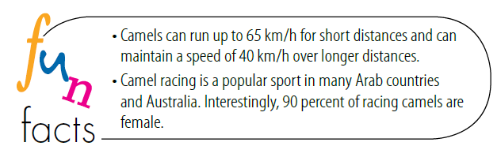

Slide 23
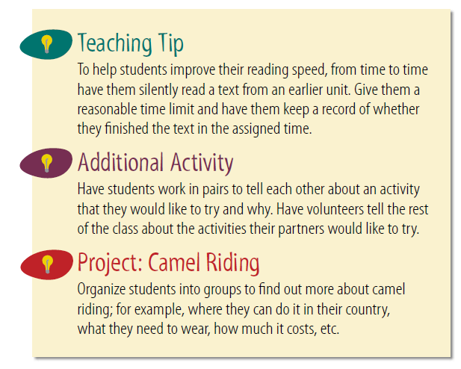

Slide 24

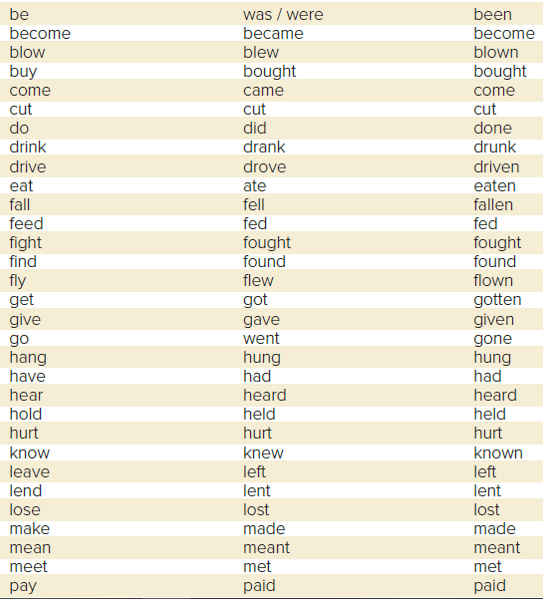
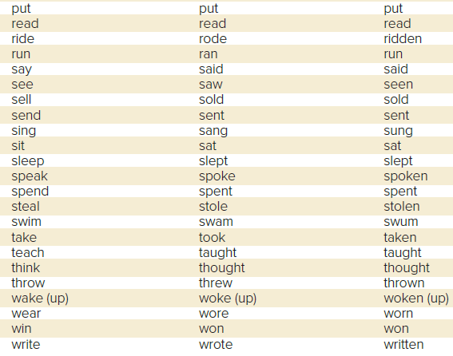

Slide 25

