Slide 1
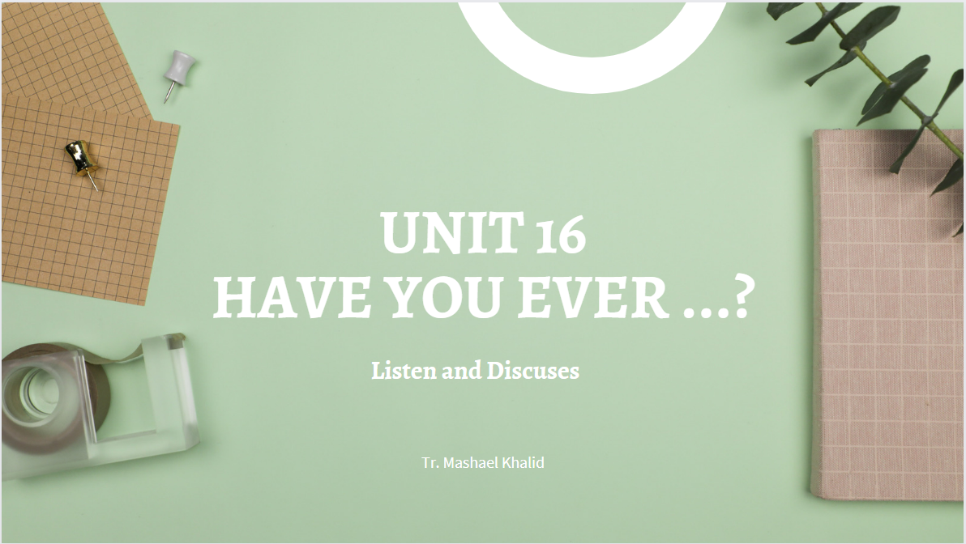

Slide 2

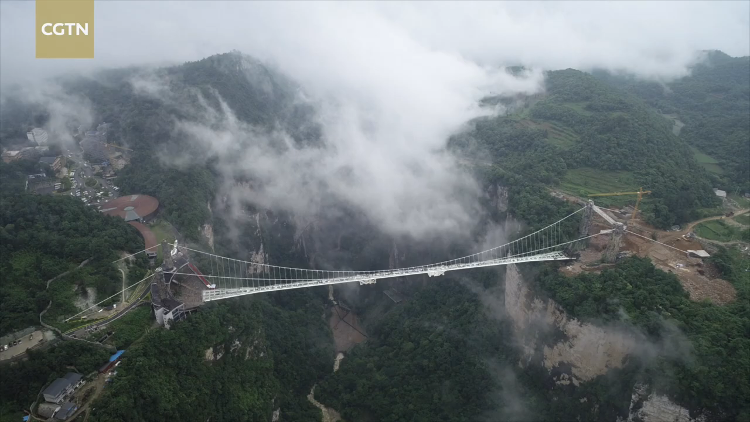
Sunday 24-10-1444H

Slide 3
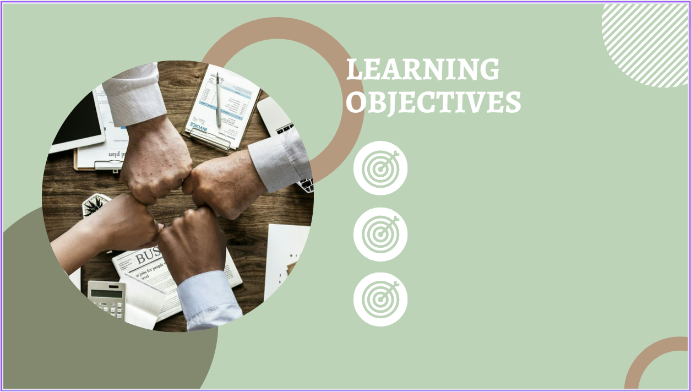
Sunday 24-10-1444H
Start a discussion about people’s experiences.
Read short information.
Answer questions about the lesson
Pg.138

Slide 4

Active discussion.
Think-pair-share
Heads together.

Slide 5


Sunday 24-10-1444H

Slide 6



Sunday 24-10-1444H
Scott: Have you ever been hang gliding?
Omar: Yes, I have. I went last year. It was awesome
Pg.138

Slide 7

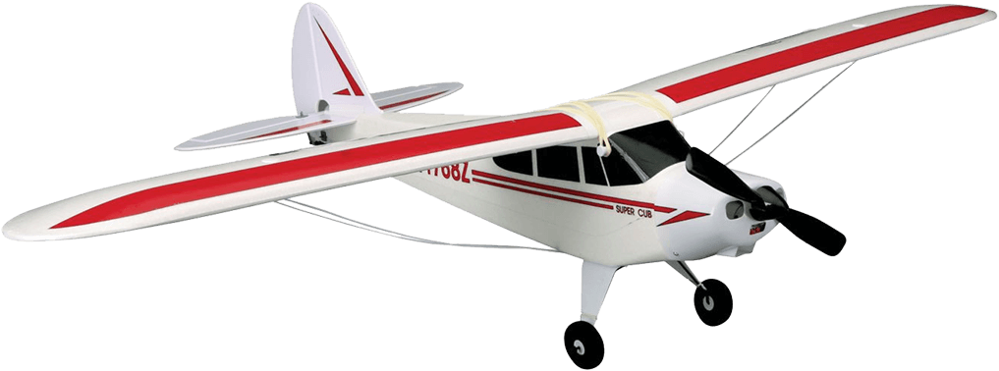
Sunday 24-10-1444H
Scott: Have you ever flown in a small plane?
John: No, never. This is my first time.
Pg.138

Slide 8
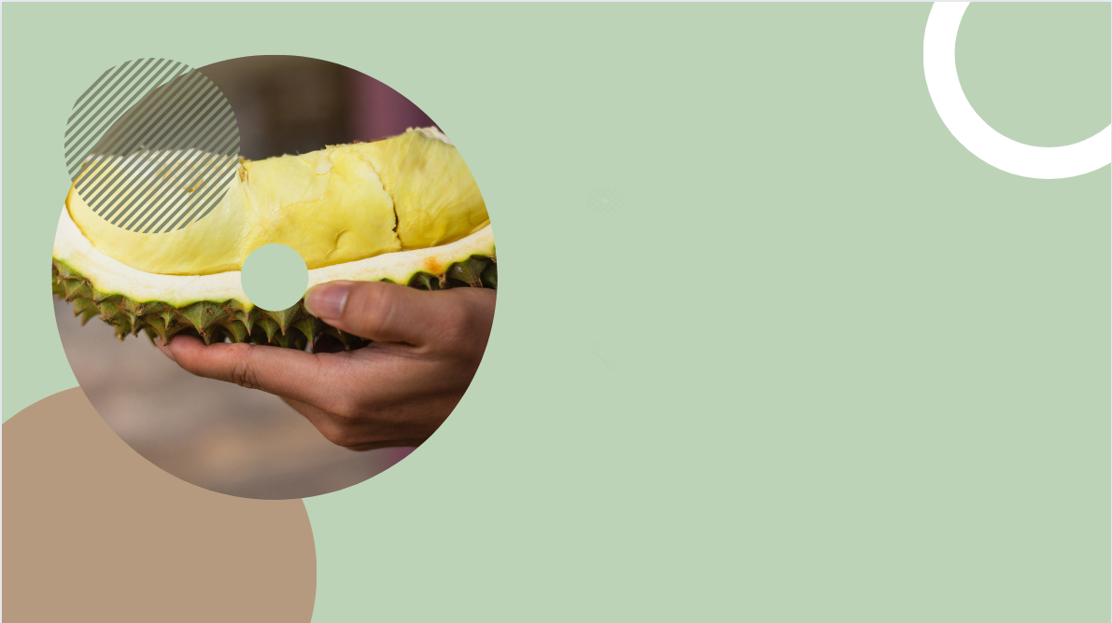
Sunday 24-10-1444H
Scott: Have you ever eaten something weird?
Qassim: Yes, we have. My family and I ate durian fruit in Malaysia.
Pg.138

Slide 9

Sunday 24-10-1444H
Scott: Have you ever ridden a camel?
Adnan: Yes, when I was in Egypt.
Pg.138

Slide 10

Sunday 24-10-1444H
Scott: Have you ever seen an unusual animal?
Mark: Yes, I’ve seen a zorse.
A zorse is half zebra, half horse.
Pg.138

Slide 11

Sunday 24-10-1444H
Scott: Faisal, have you ever gone on a desert safari?
Faisal: Yes, I have.
Scott: When did you do it?
Faisal: Two years ago near Riyadh. It was fun and exciting.
Pg.139

Slide 12
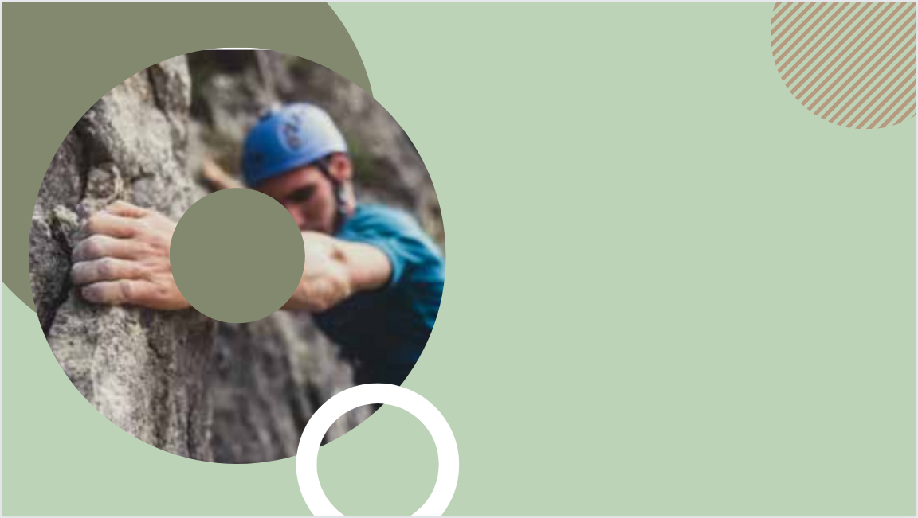
Sunday 24-10-1444H
Scott: Have you ever tried cliff hanging?
Don: No, I haven’t. No ropes, no harness. I’m not crazy.
Pg.139

Slide 13

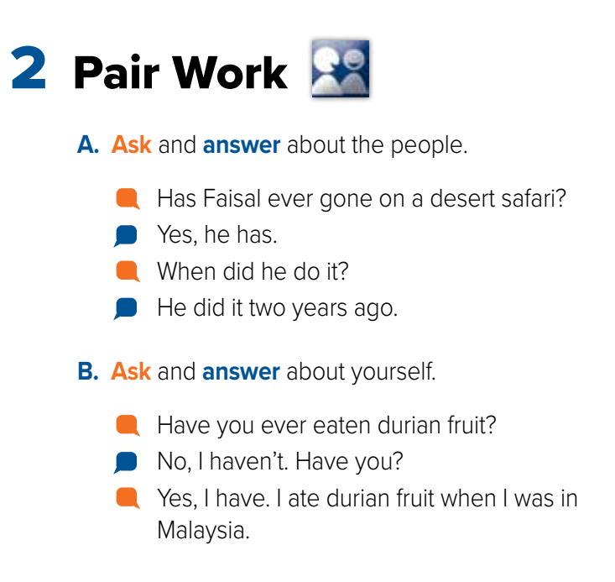

Sunday 24-10-1444H
Pg.139

Slide 14
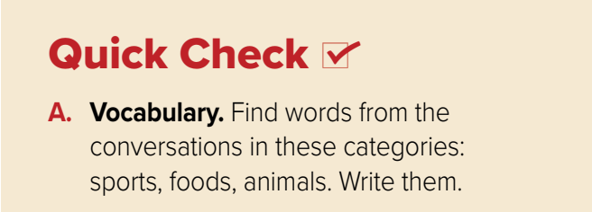



Sunday 24-10-1444H
Sports
Foods
Animals
Hang gliding
Durian fruit
Camel
Zorse
Zebra
Horse
Cliff hanging
Desert safari
Pg.139

Slide 15
Sunday 24-10-1444H
B. Comprehension. Answer yes or no.
1. ______ John has flown in a small plane.
2. ______ Omar has been hang gliding.
3. ______ Adnan rode a camel in Egypt.
4. ______ Qassim and his family have never eaten durian fruit.
5. ______ Don went cliff hanging last year.
6. ______ Mark has never seen an odd animal.
no
yes
yes
no
no
no
Pg.139

Slide 16
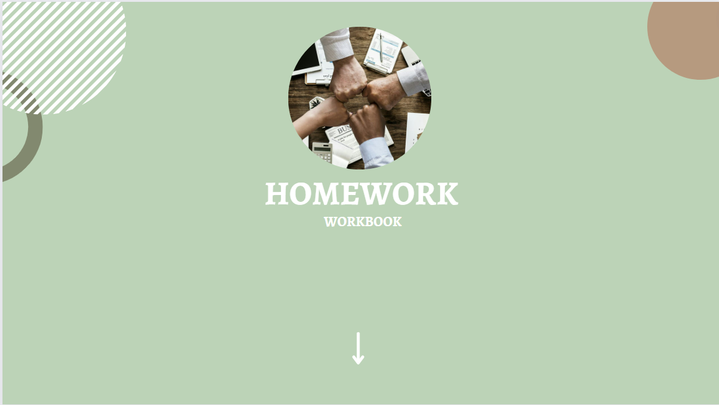
Pg.253

Slide 17
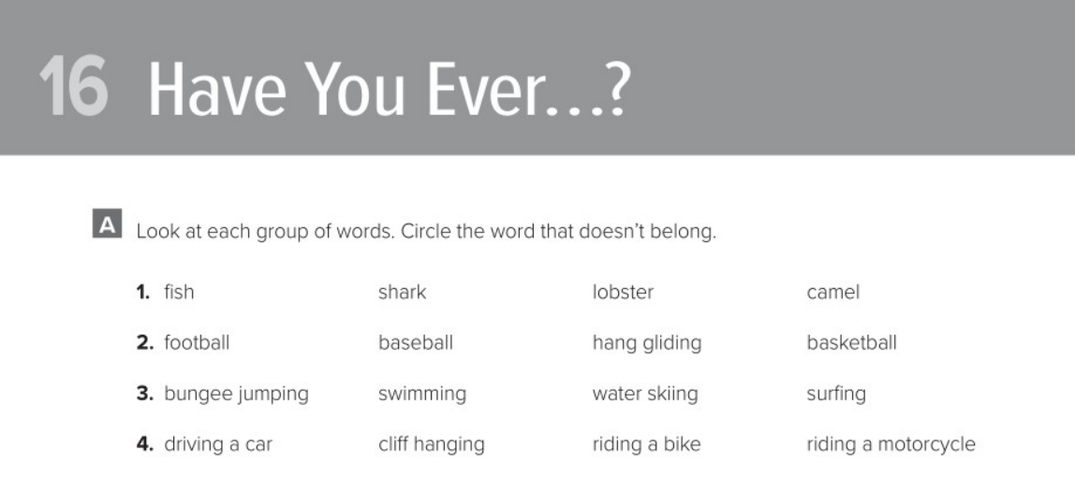
Pg. 253

Slide 18
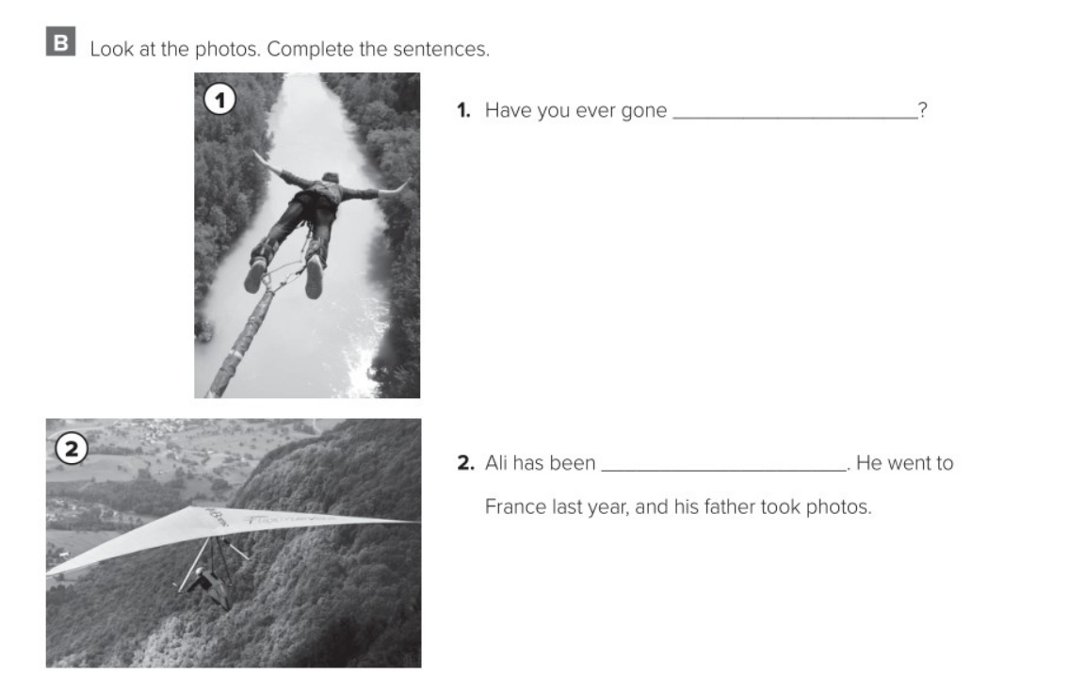
bungee jumping
hang gliding
Pg. 253

Slide 19
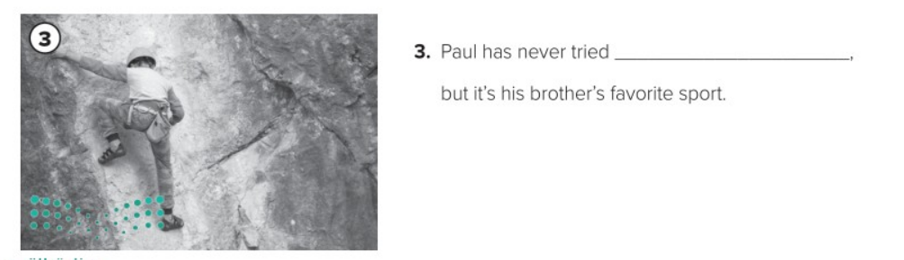
cliff hanging
Pg. 253

Slide 20


