Slide 1

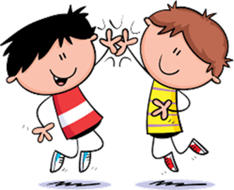

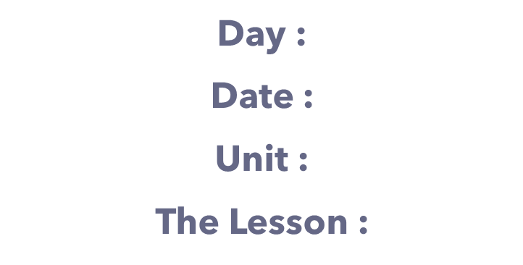



Slide 2




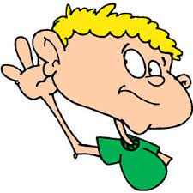

class rules
Listen to the teacher's explanation

Slide 3

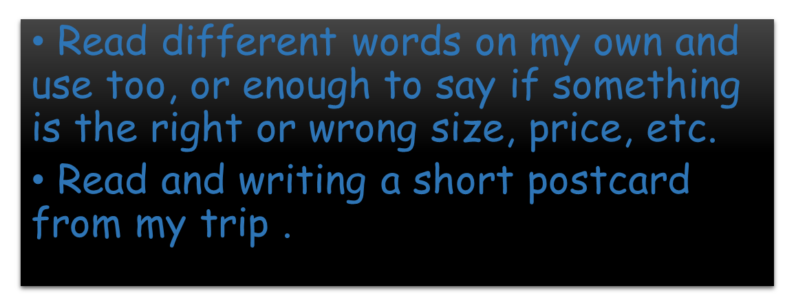

Slide 4




Slide 5
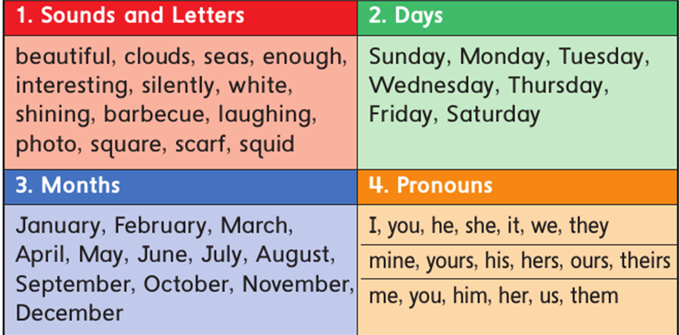

Slide 6
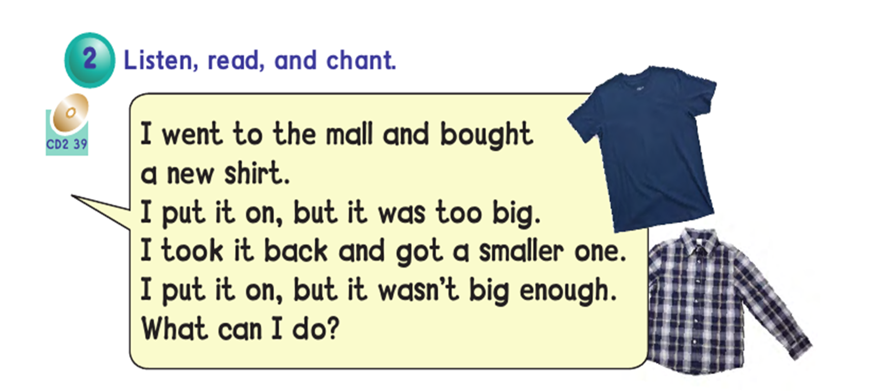

Slide 7


Watch

Slide 8
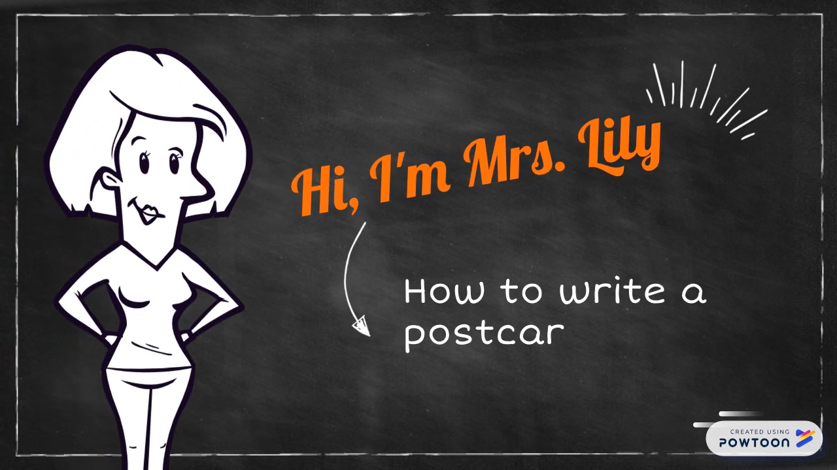

Slide 9



Slide 10

Can you read, match, and complete
the chant ?
Open your book
page:49

Slide 11
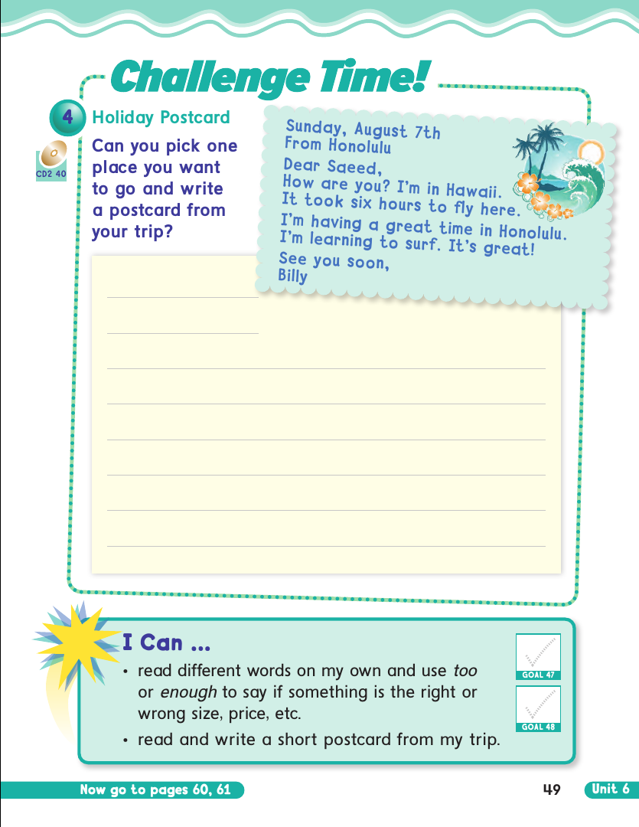

Slide 12
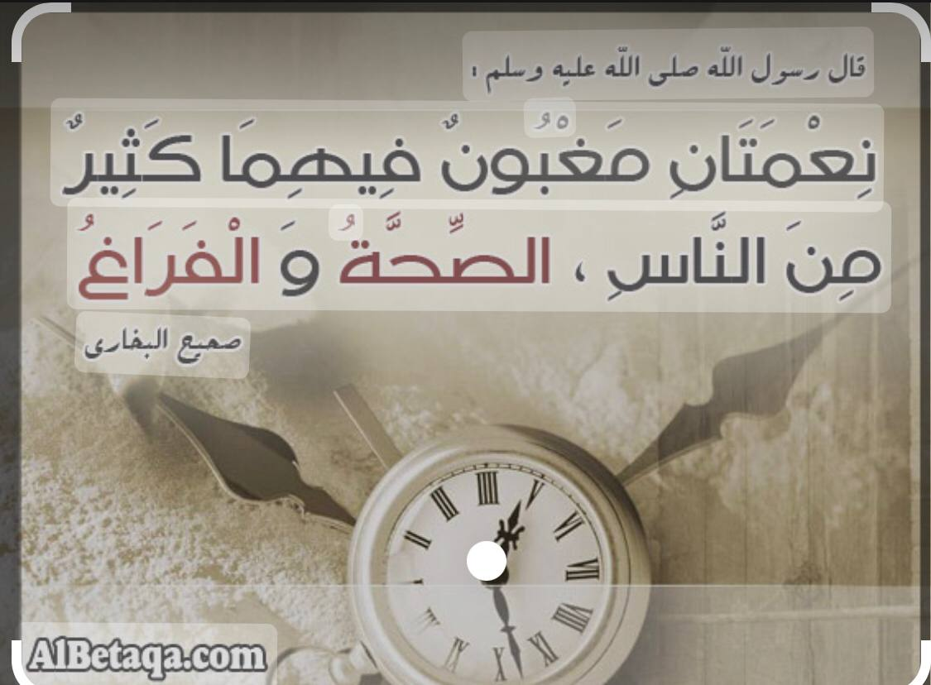

Slide 13

H.W Page : 117+118

