Slide 1
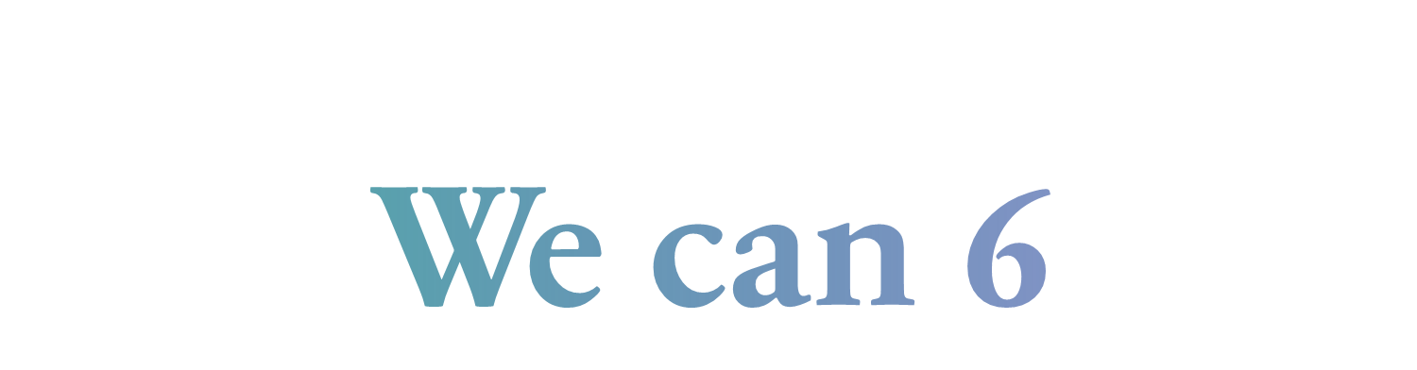
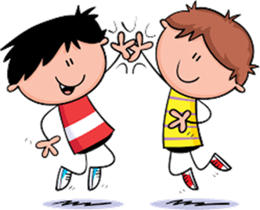

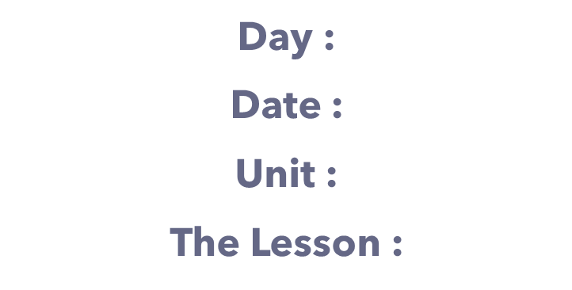



Slide 2




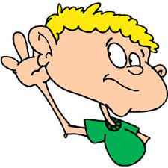
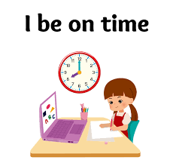

class rules
Listen to the teacher's explanation

Slide 3

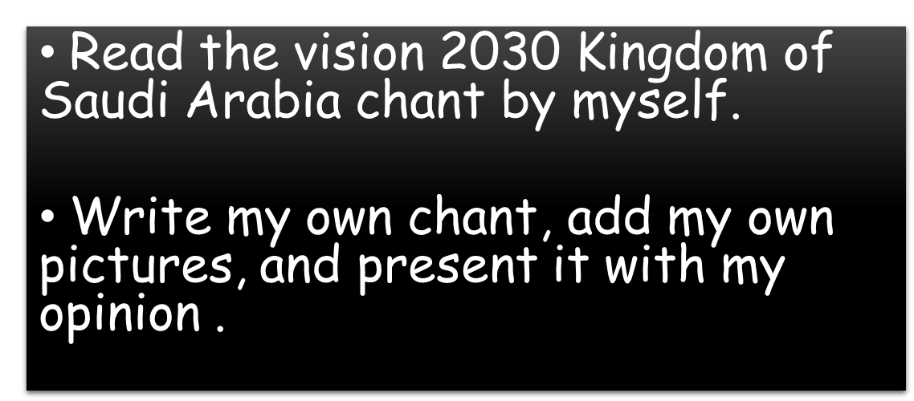


Slide 4




Slide 5




Slide 6


Small

Slide 7
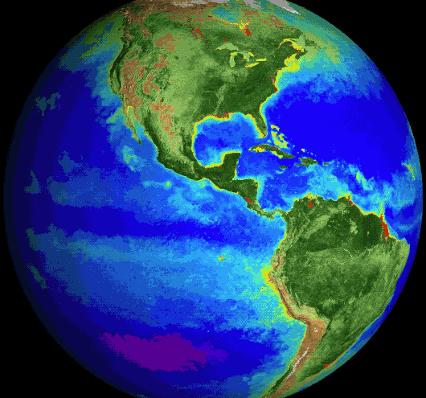
Globe

Slide 8
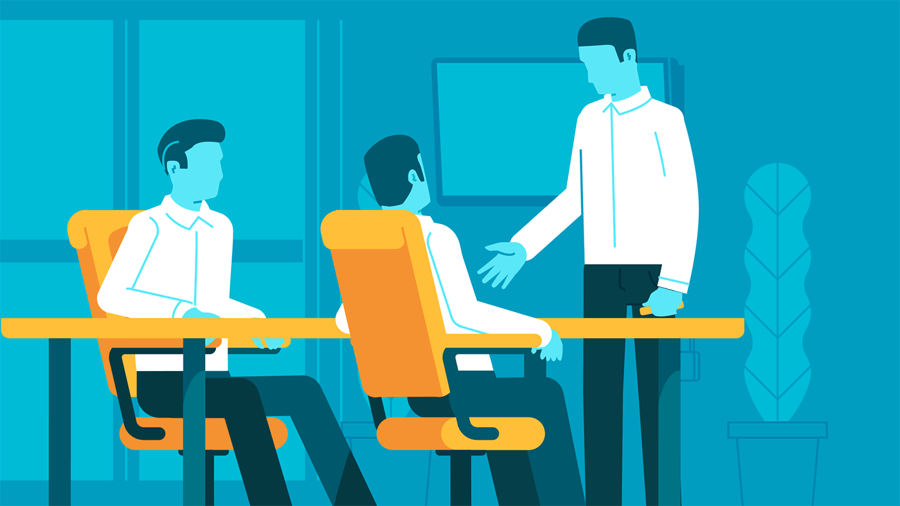
Business

Slide 9


Leader

Slide 10

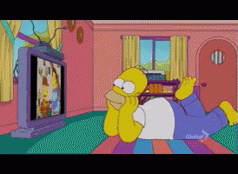
Watch

Slide 11

Vision 2030

Slide 12


Slide 13




Slide 14

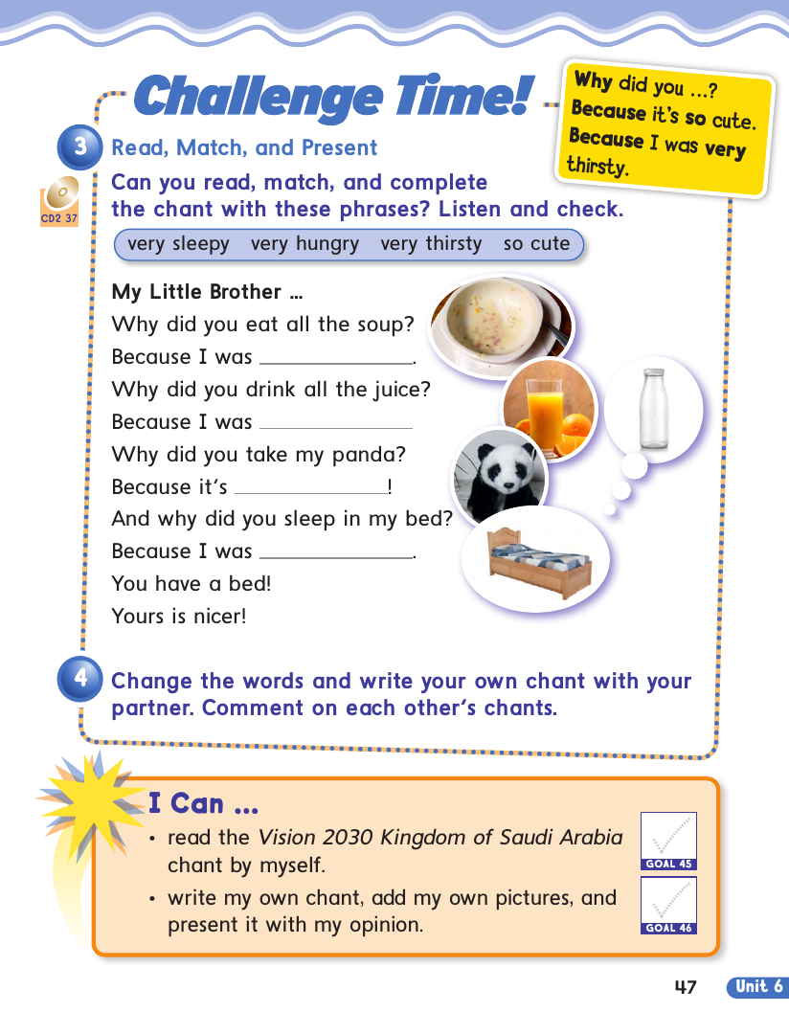
Very hungry
Very thirsty
So cute
Very sleepy

Slide 15

Why did you … ?
Because It’s …
Because I was …

Slide 16

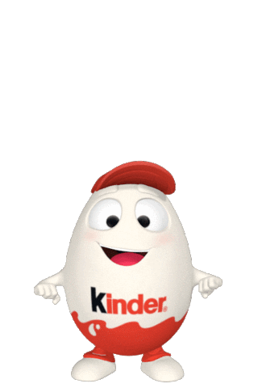
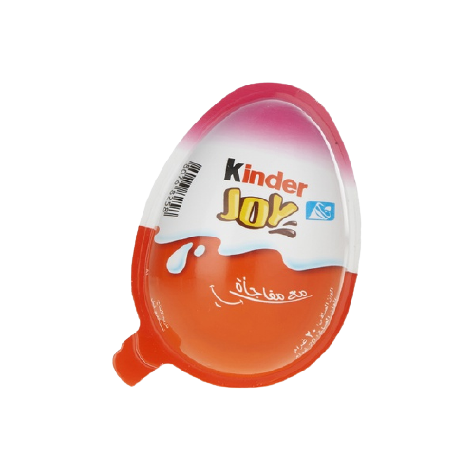
لعبة
ابدأ

Slide 17
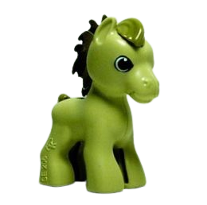
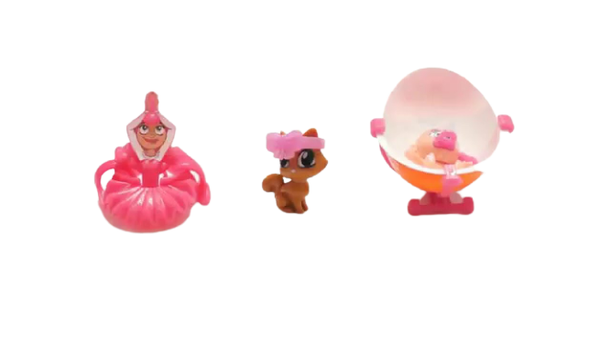
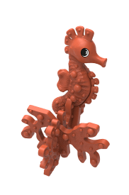


Slide 18


Why did you eat all the soup ?
Because I was ...............................
so cute
very hungry
very sleepy

Slide 19


And Why did you sleep in my bed ? Because I was ...............................
very thirsty
so cute
very sleepy

Slide 20


And Why did you sleep in my bed ? Because I was ...............................
very thirsty
very sleepy
very hungry

Slide 21

Why did you take my panda?
Because it's ...................................
so cute
very hungry
very sleepy

Slide 22
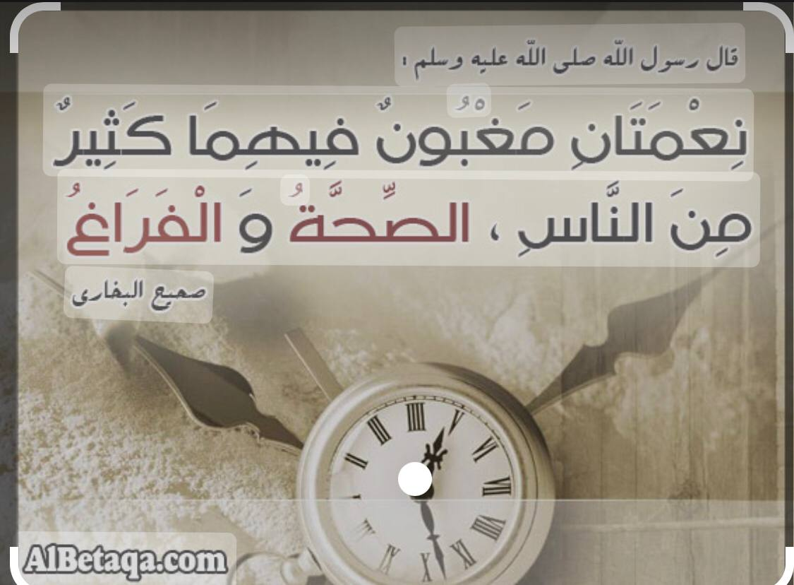

Slide 23


Slide 24

H.W Page : 115+116

