Slide 1

Unit 7 form, meaning and function
Tr. Nora Khalid

Slide 2

1
Use adverbs of degree
2
Use “could” and
“was able to”

Slide 3
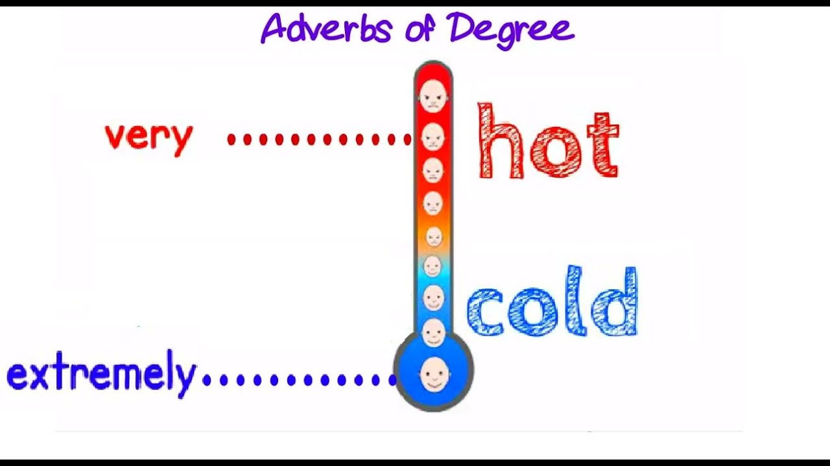

Slide 4
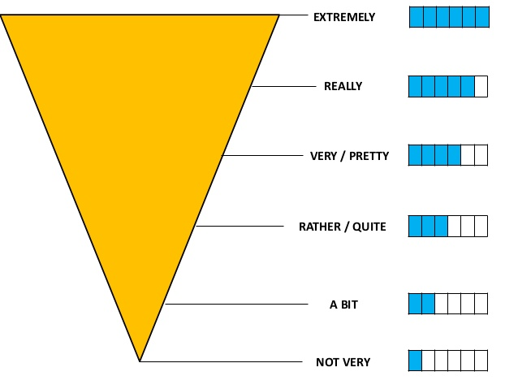

Slide 5
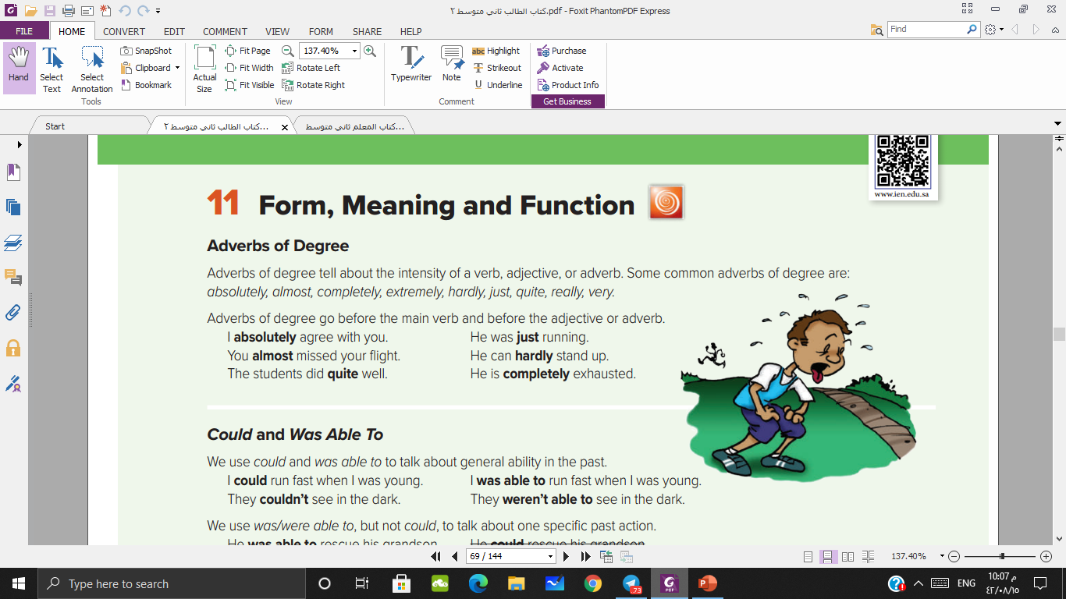

Slide 6
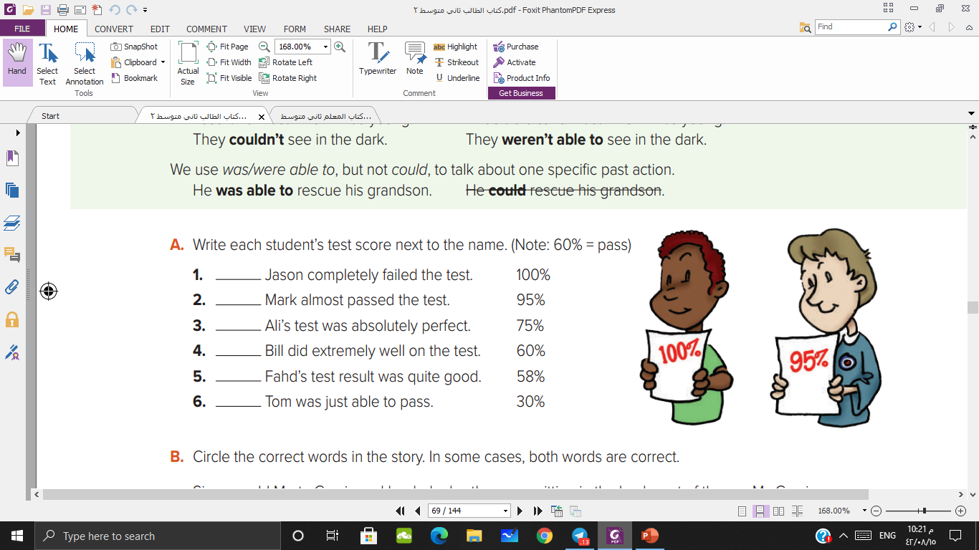
30%
58%
100%
90%
75%
60%

Slide 7

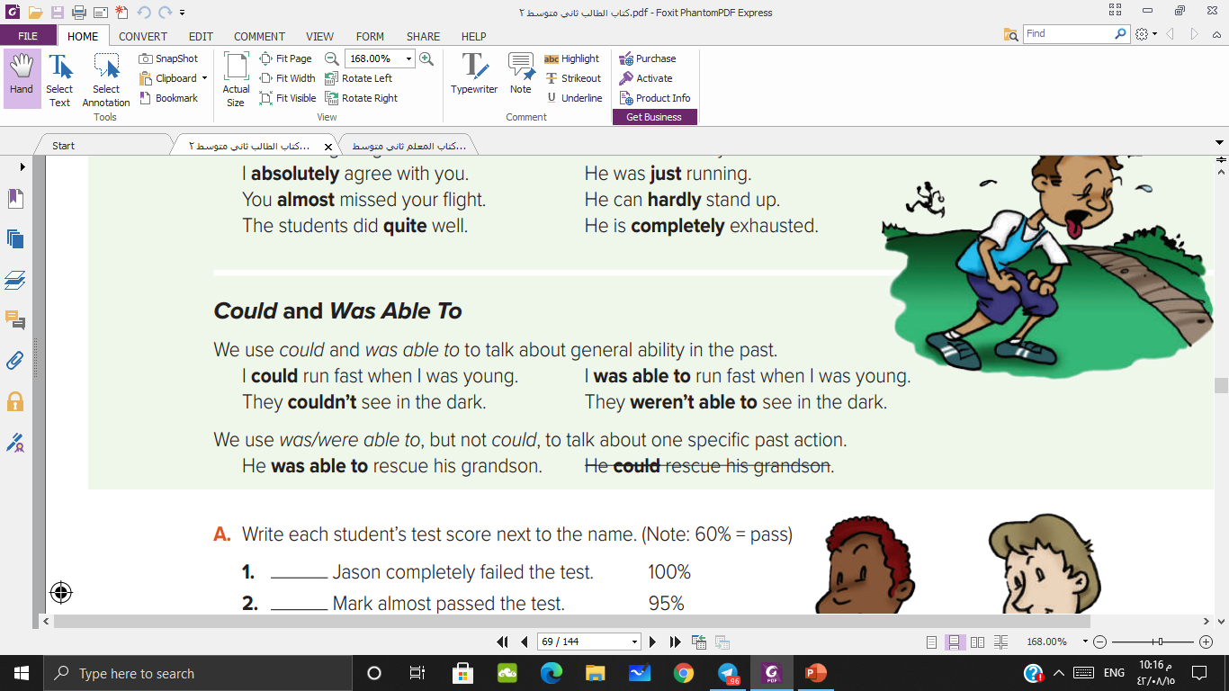

Slide 8
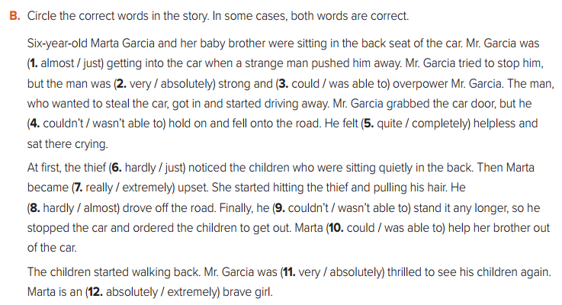

Slide 9


