Slide 1

Unit 7 form, meaning and function p 63
Tr. Nora Khalid

Slide 2

1
Use there was
2
Use there were

Slide 3
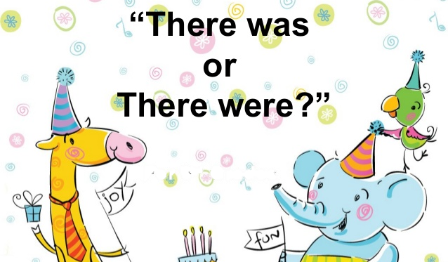

Slide 4
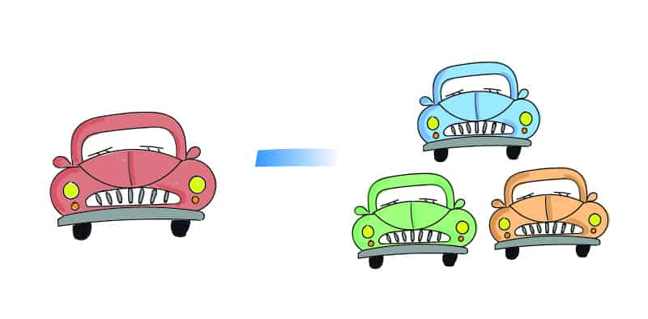
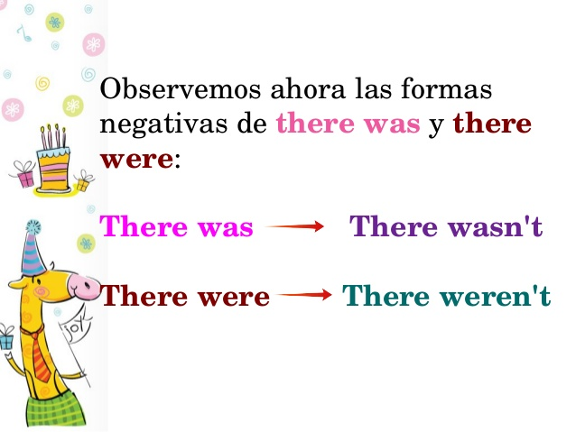

Slide 5
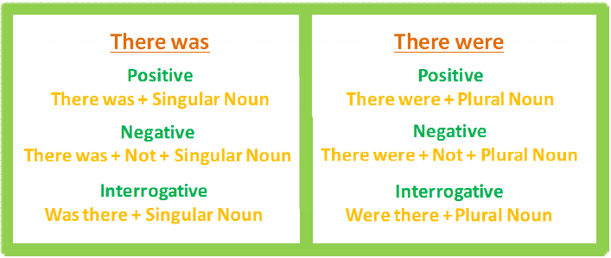

Slide 6
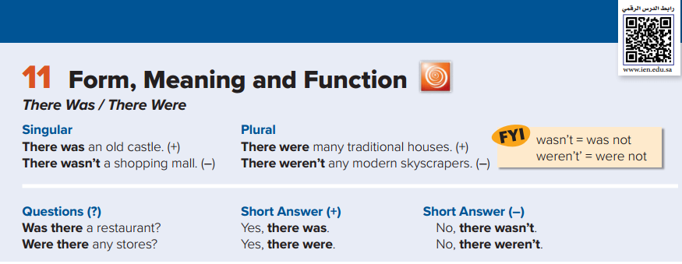




Slide 7
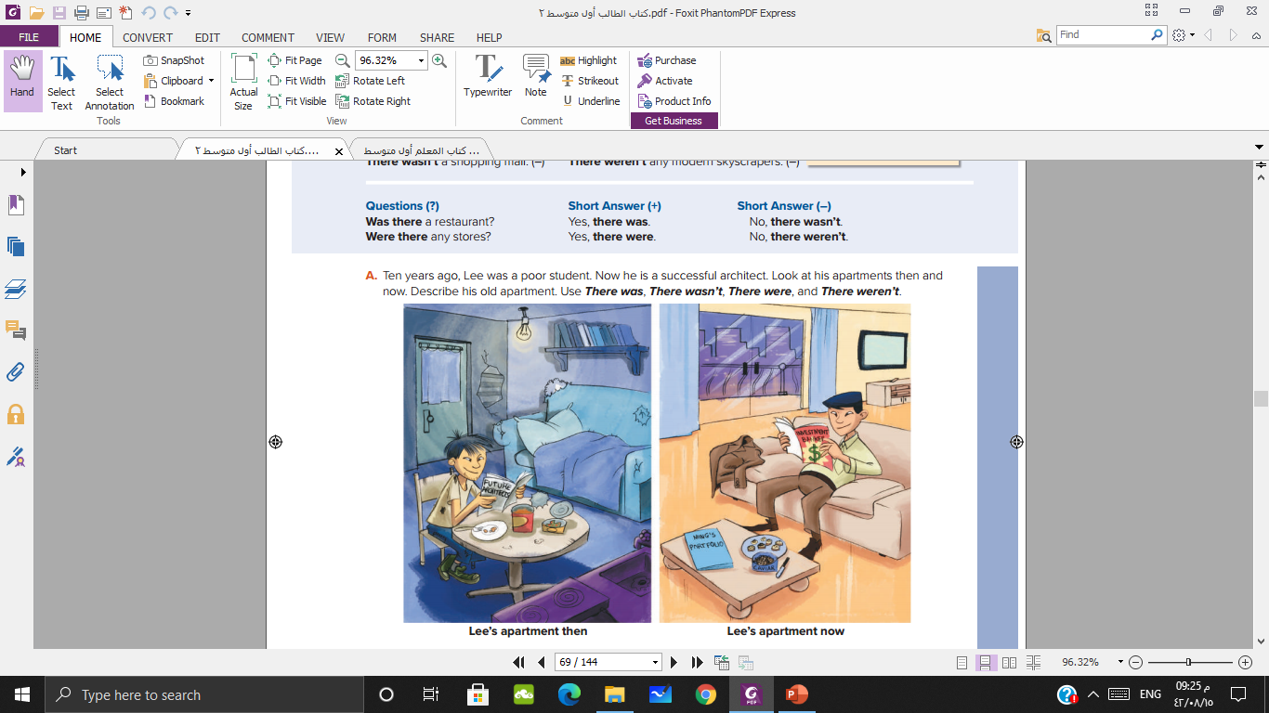



Slide 8
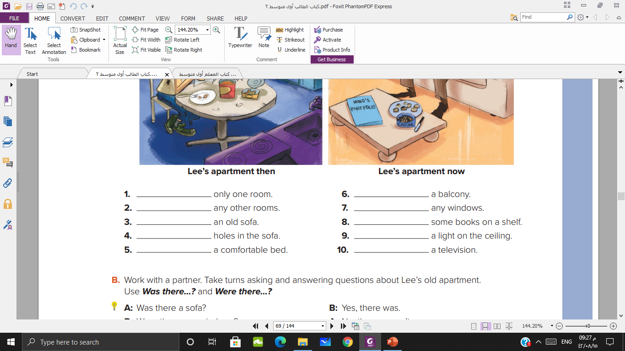
There was
There wasn’t
There weren’t
There weren’t
There was
There were
There were
There was
There wasn’t
There wasn’t

Slide 9


Slide 10
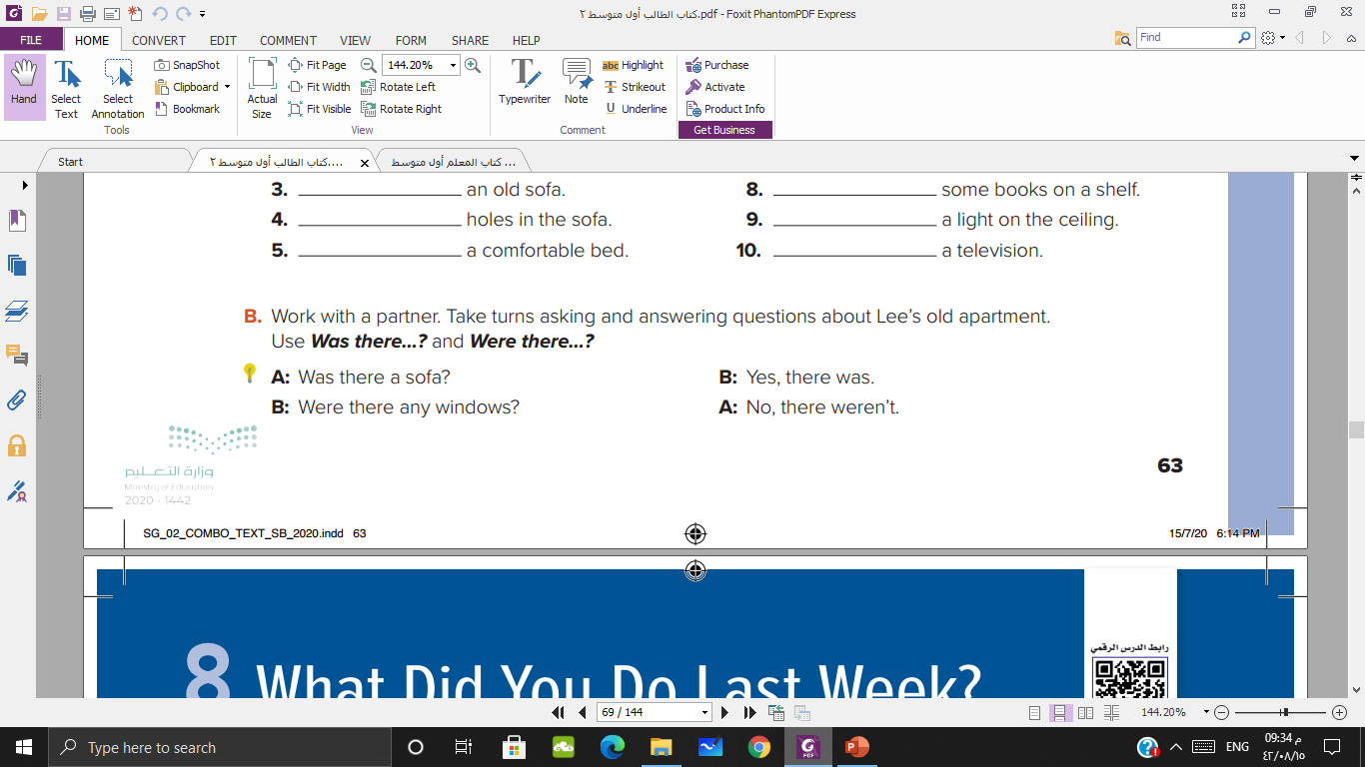

Slide 11



