Slide 1

UNIT 7 Writing
Tr. Nora Khalid

Slide 2

Attach a sequence of events to find a story
Follow steps to write a summary
Suggest a title for a summary
Create a chain diagram from a story

Slide 3
Look at the event chain diagram.
What news story is it from in this unit?
Conversation on P 60
1
Robert was delivering a pizza last Friday night
The elevator in the building broke down
3
He stayed calm, ate the pizza, and fell asleep
4
He was trapped in the elevator for 10 hours.
5
The manager came to fix the elevator.
2

Slide 4
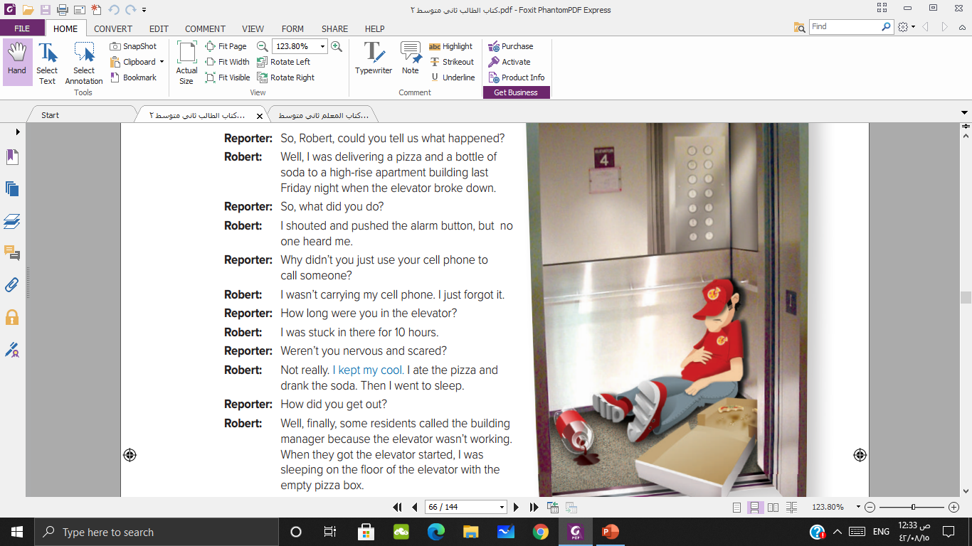

Slide 5

stuck…for 10 hours
trapped…for 10 hours
kept my cool
stayed calm
went to sleep
fell asleep
got the elevator started
came to fi the elevator

Slide 6
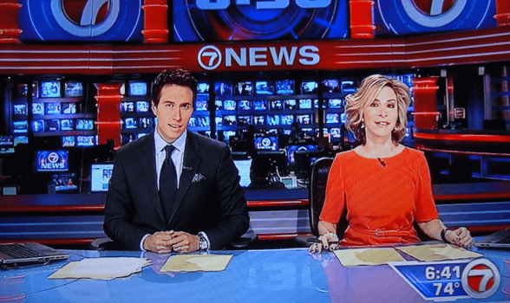



Summarizing

Slide 7
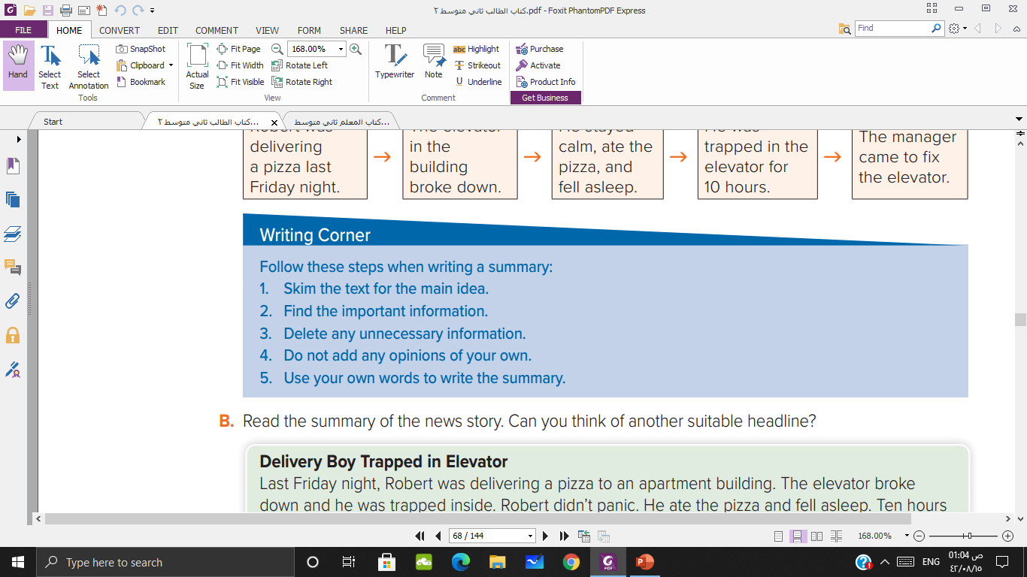
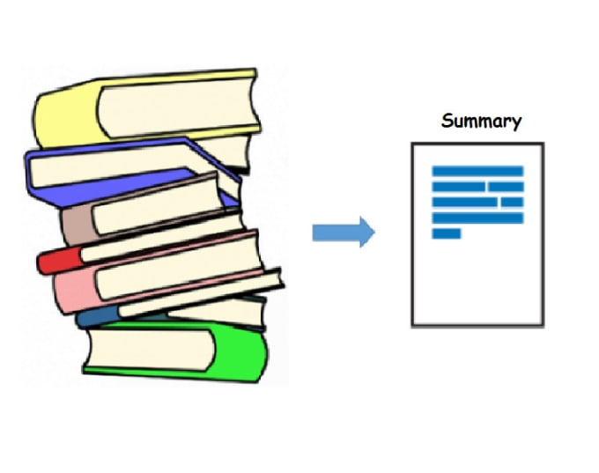


Slide 8
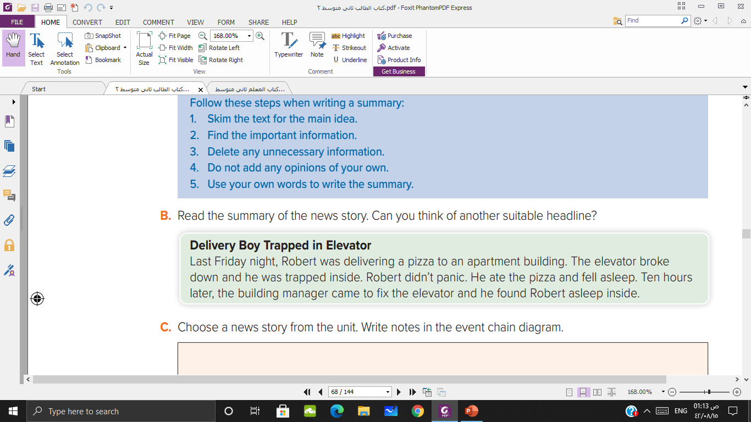
Manager Finds Delivery Boy in Elevator
10 Hours Trapped in Elevator

Slide 9
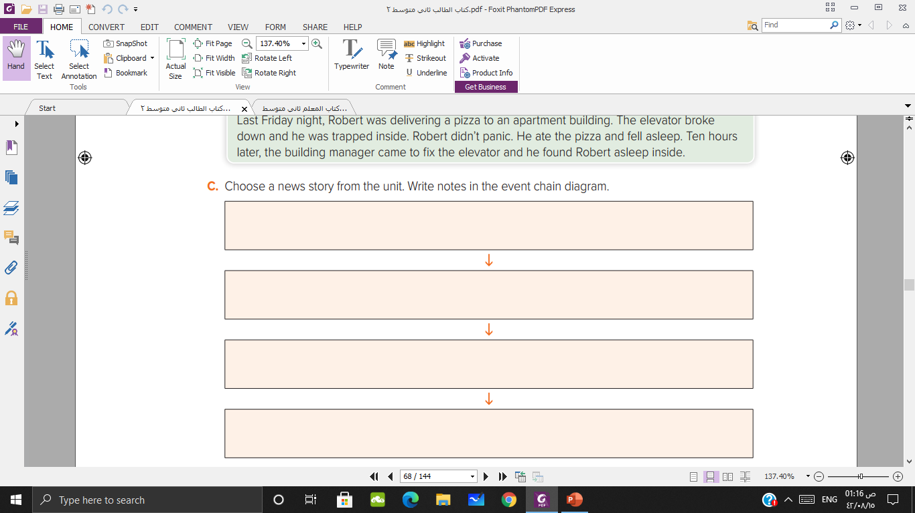
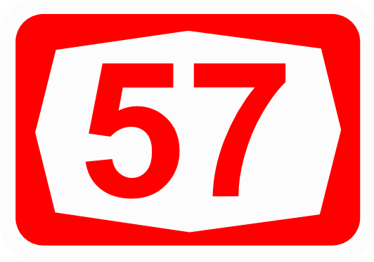
A storm was coming, and Ricardo was rushing to get home
Ricardo was listening to broadcast
The lighting hit him, and his hair and ears were burned
Ricardo is alive

Slide 10


