Slide 1


Slide 2

Wednesday 13/10/1444 H
Present progressive
Past simple
I am eating my breakfast now.
He cleaned his car yesterday.
Future
We will visit you next week.
    Present simple
She leaves early everyday.
Future
I am going to buy a new computer.
Past simple
The boy wrote an interesting story.
Past progressive
The students were studying for five ours last night.
Pg. 132

Slide 3

Wednesday 13/10/1444 H
Use past progressive in sentences.
Combine longer actions with
shorter ones using When.
Link pictures to conversations
Practice syllable stress
Pg. 132

Slide 4
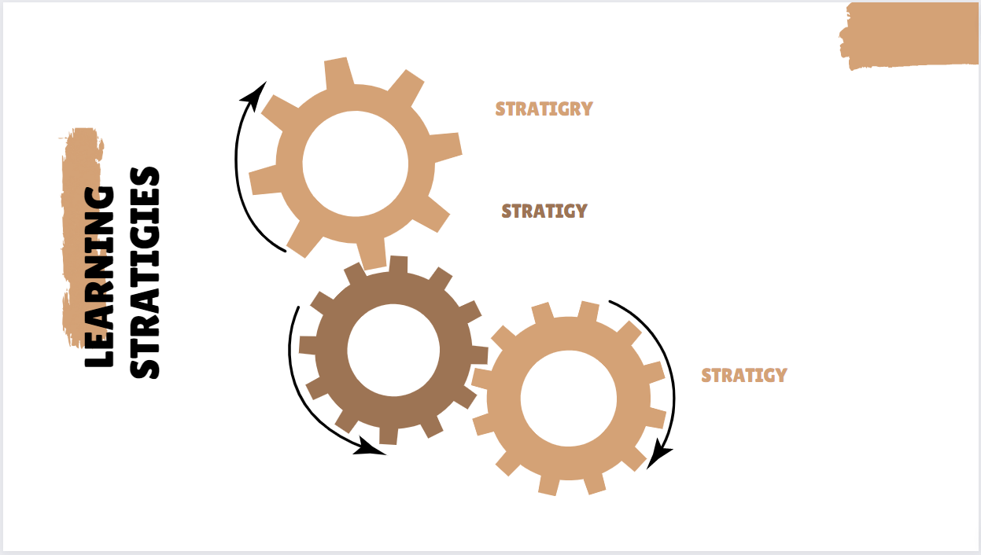
Wednesday 13/10/1444 H
Active discussion
Heads together
Frayer Model
Pg. 132

Slide 5

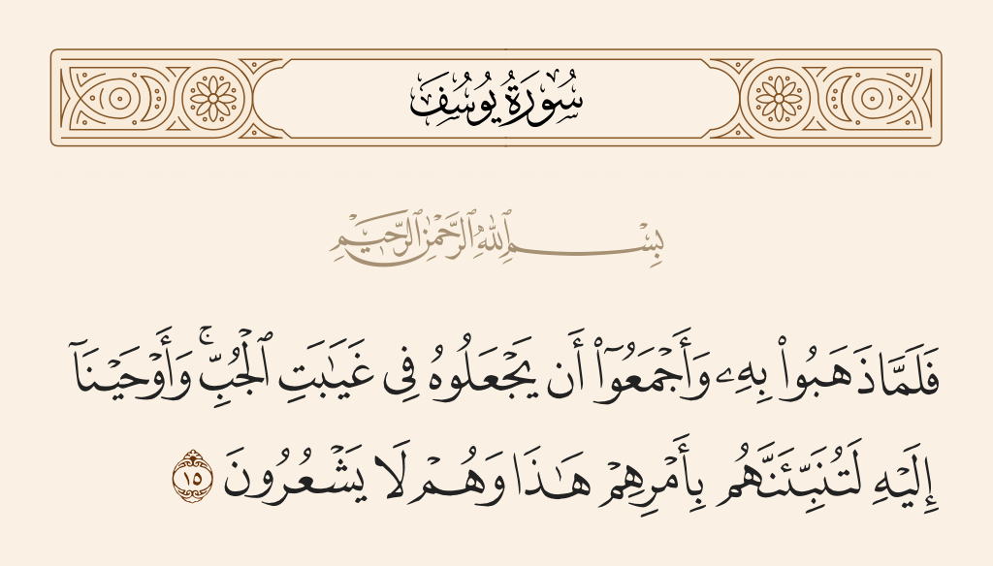
Wednesday 13/10/1444 H
Pg. 132

Slide 6

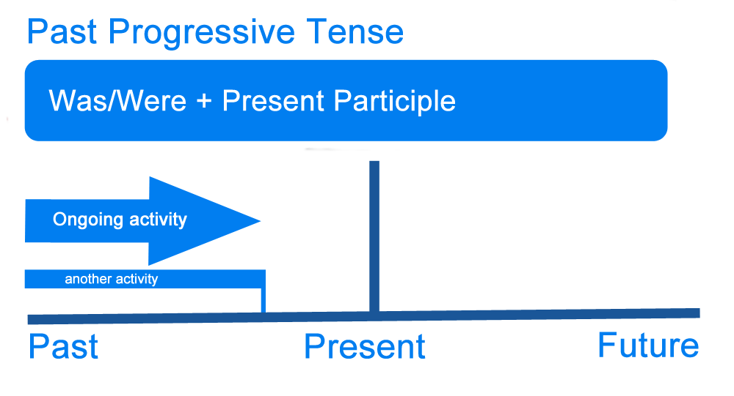
Wednesday 13/10/1444 H
Active discussion
Timeline
Pg. 132

Slide 7
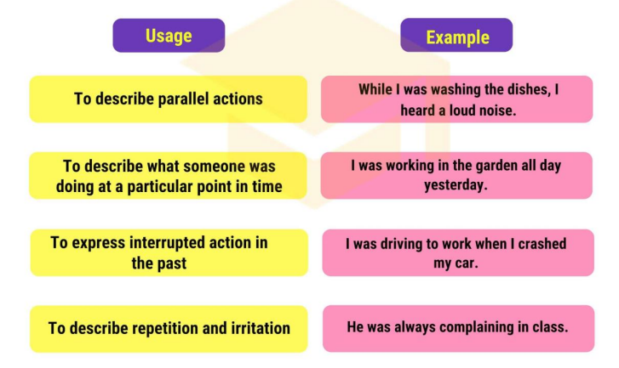
Wednesday 13/10/1444 H
I was studying.
I was studying when my sister came into the room.
Pg. 132

Slide 8
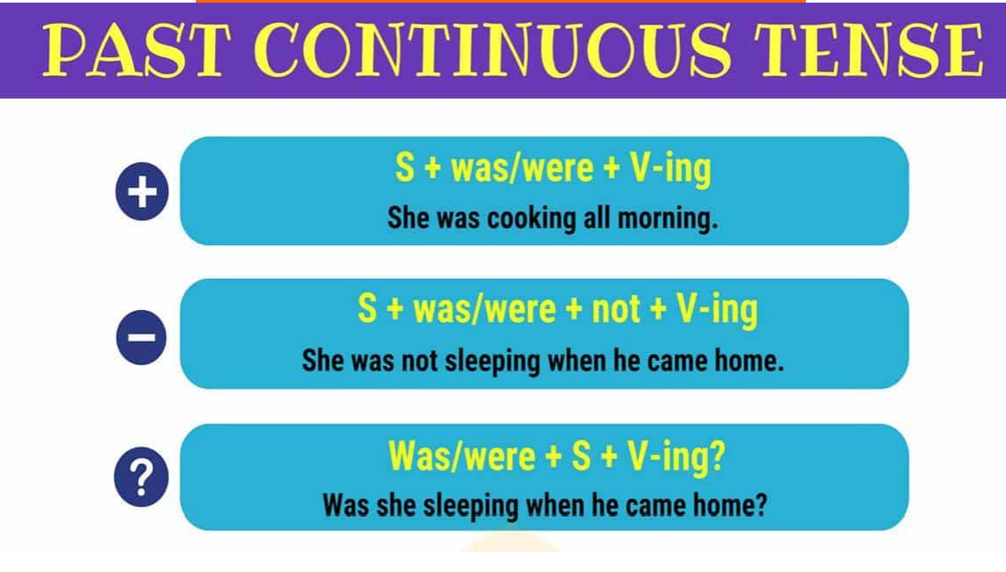
Wednesday 13/10/1444 H
Pg. 132

Slide 9
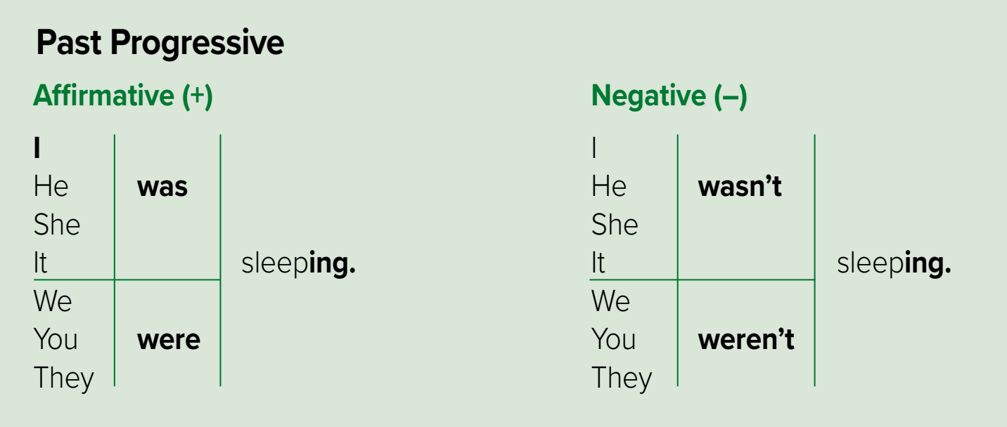
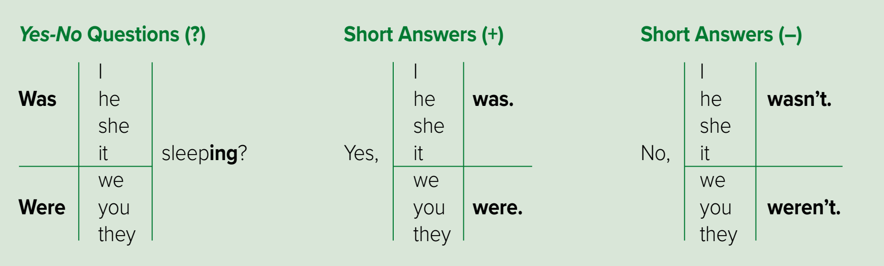
Wednesday 13/10/1444 H
Pg. 132

Slide 10
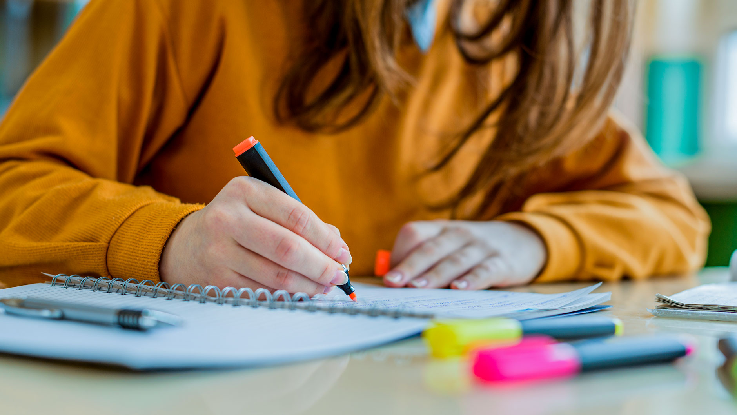
Heads together
Wednesday 13/10/1444 H
Study
She
was
studying.
Was
she
studying?
Yes, she was
Pg. 132

Slide 11
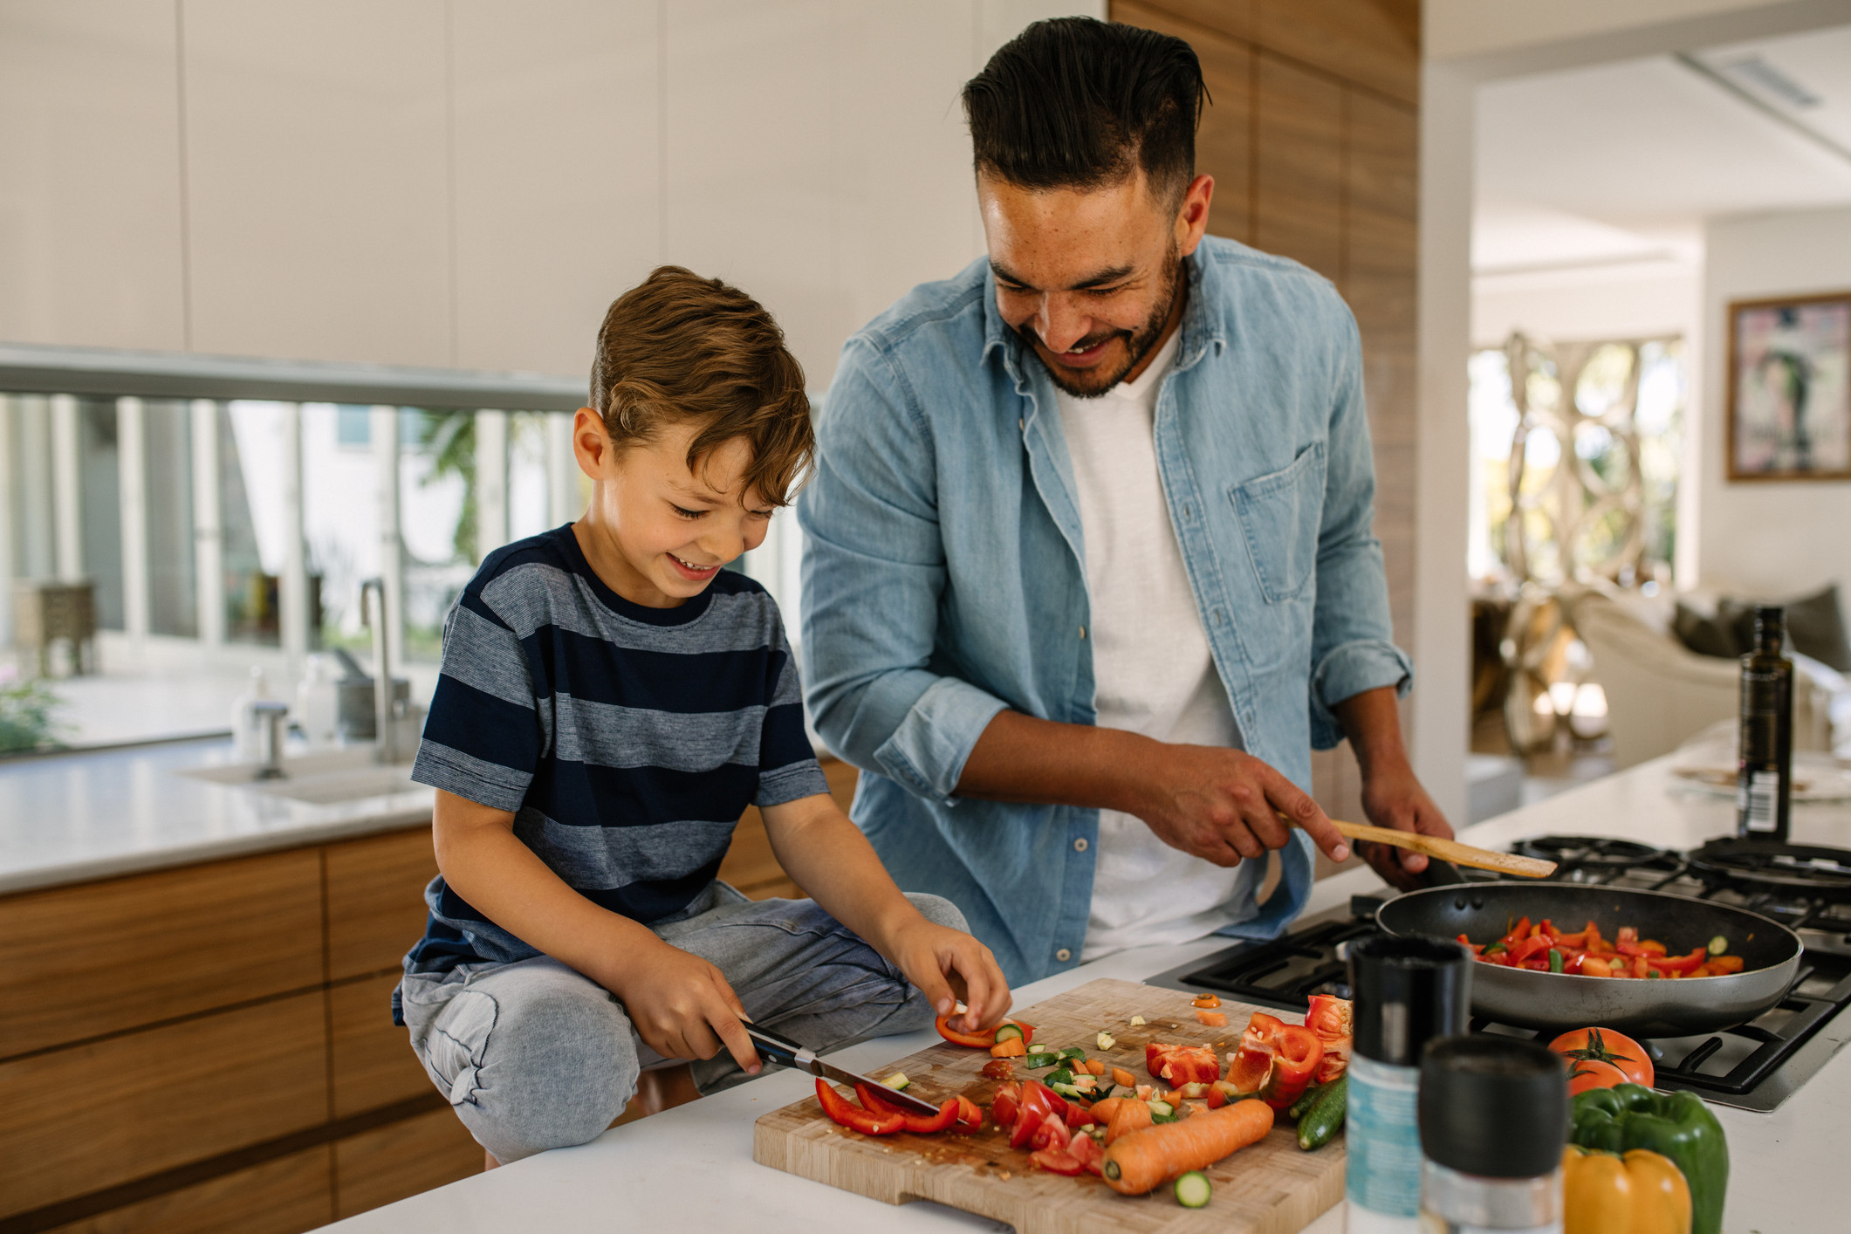
Heads together
Wednesday 13/10/1444 H
Play
They
weren’t
playing.
Were
they
playing?
No, they weren’t.
They
were
cooking.
Pg. 132

Slide 12
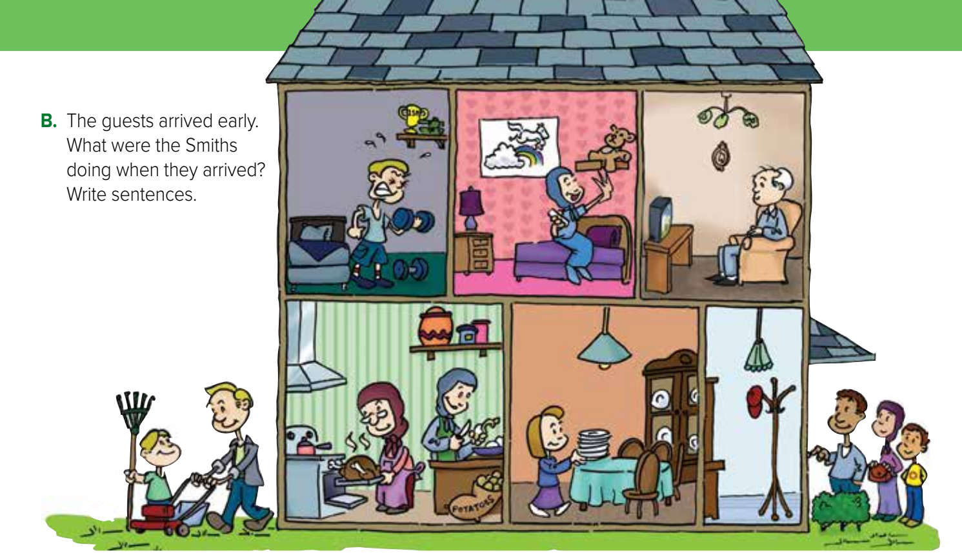
Wednesday 13/10/1444 H
Pg. 133

Slide 13
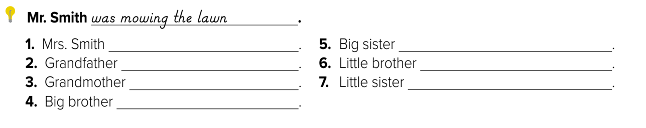

Wednesday 13/10/1444 H
was peeling potatoes.
was watching Tv.
was cooking.
was lifting weights.
was sitting in her room.
was helping his father.
was sitting the table.
Pg. 133

Slide 14

Wednesday 13/10/1444 H
Use past progressive in sentences.
Combine longer actions with
shorter ones using When.
Link pictures to conversations
Practice syllable stress
Pg. 132

Slide 15
Wednesday 13/10/1444 H
I was studying.
I was studying when my sister came.
Pg. 132

Slide 16
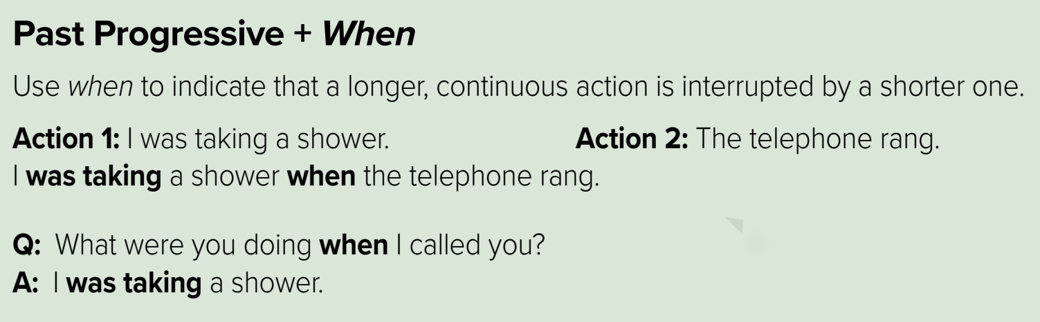
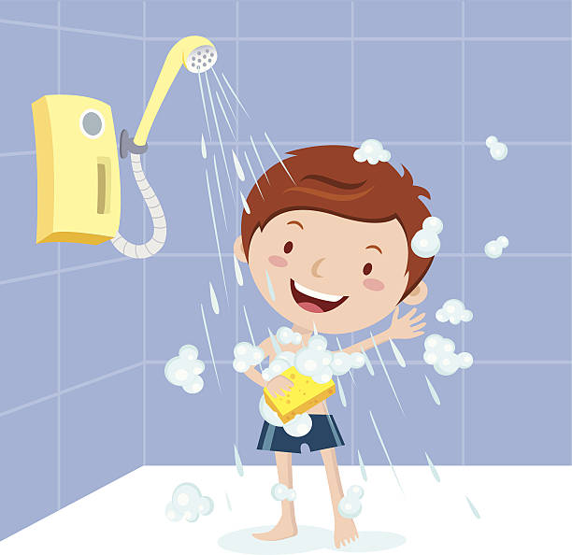

Wednesday 13/10/1444 H
Past progressive
Past simple
Pg. 132

Slide 17
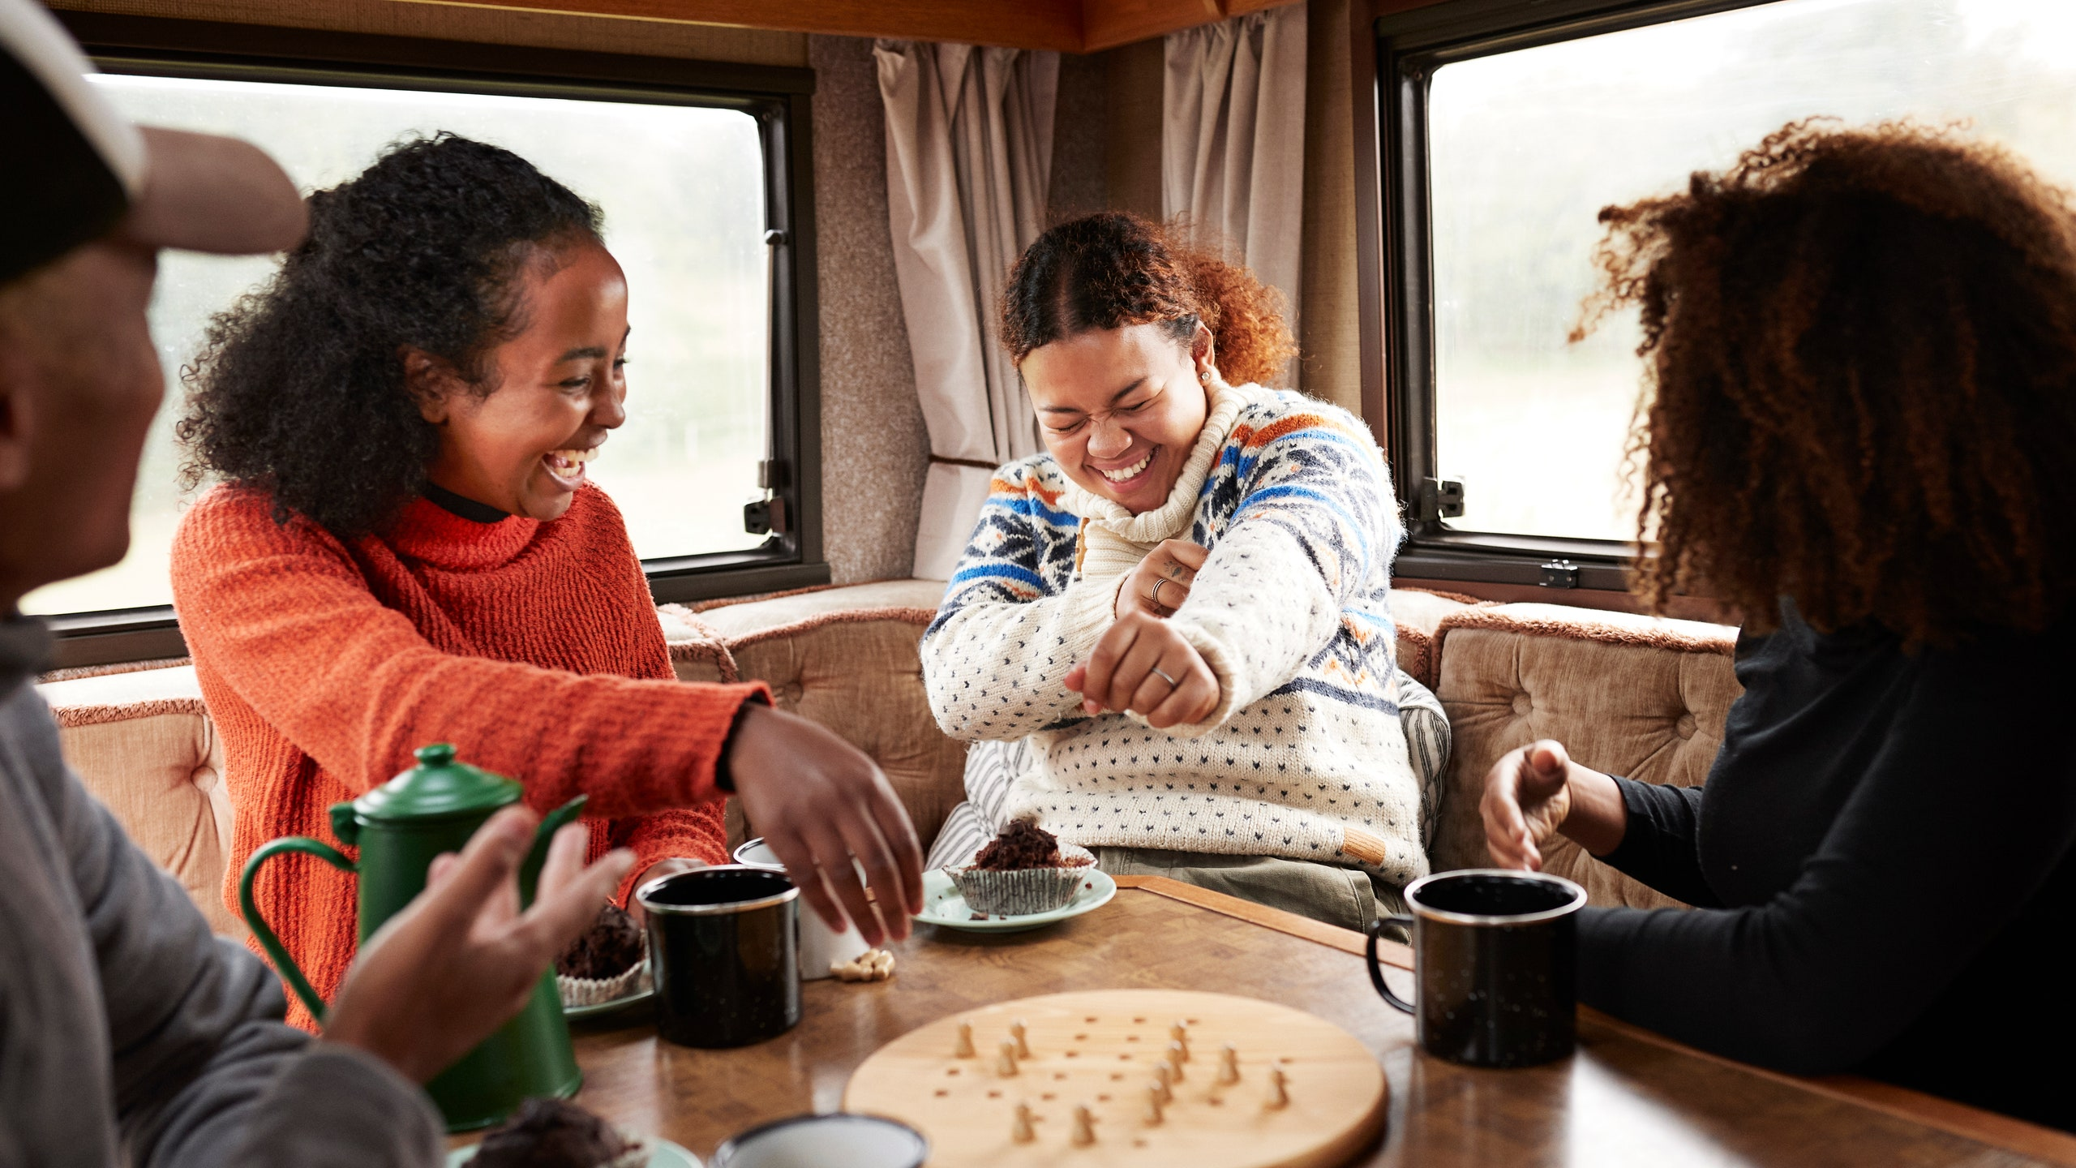
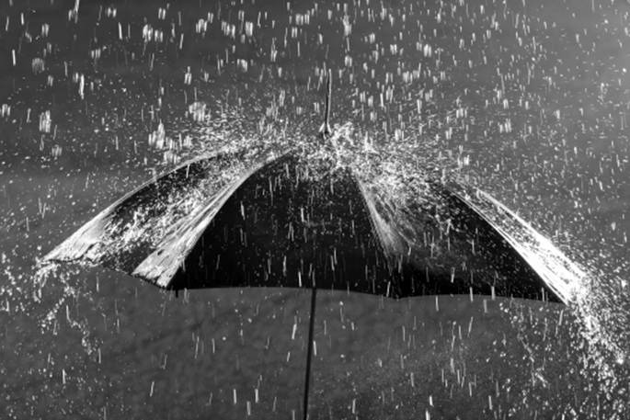
Heads together
Wednesday 13/10/1444 H
They chat
Rain start
They
were
chatting
when
the rain
started.
Pg. 132

Slide 18
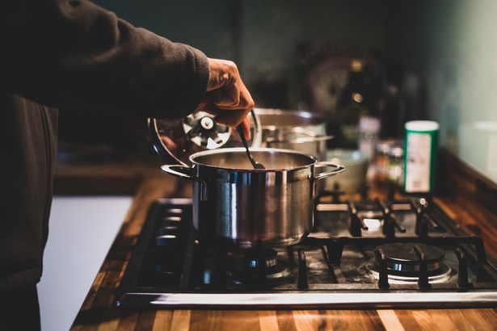
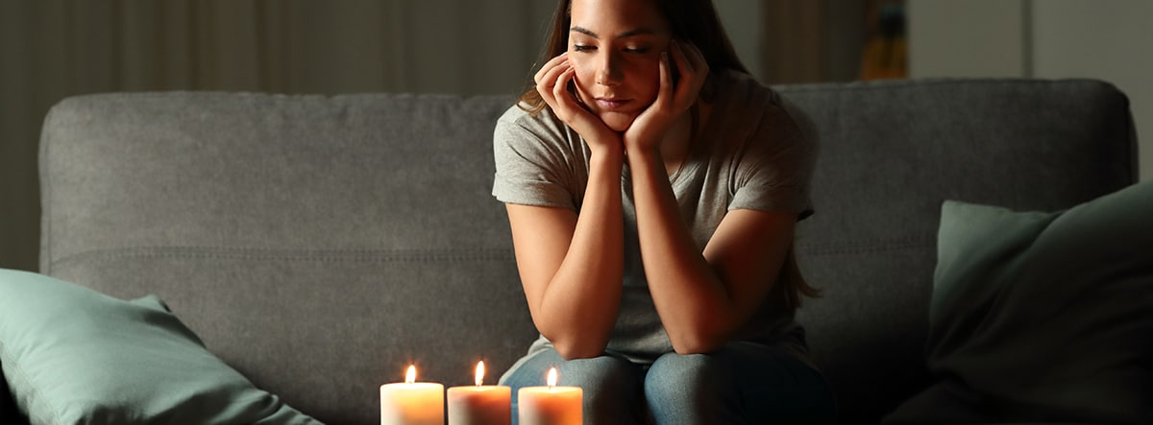
Heads together
Wednesday 13/10/1444 H
I cook dinner
Electricity go out
I
was
cooking
dinner
when
the electricity
went
out
Pg. 132

Slide 19
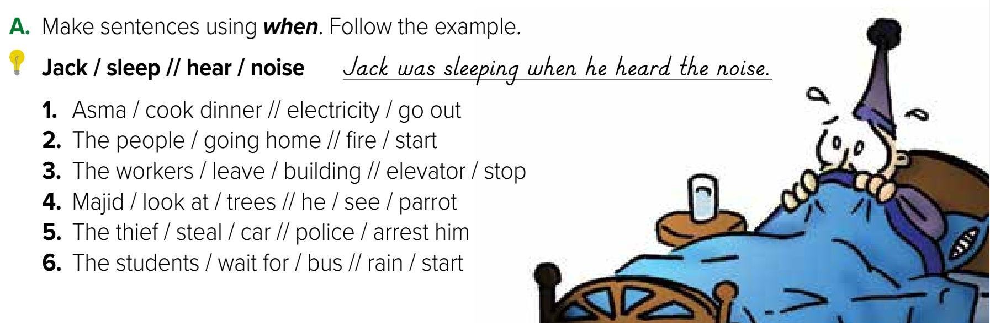
Wednesday 13/10/1444 H
Past progressive
Past simple
Pg. 132
Pg. 132

Slide 20
Wednesday 13/10/1444 H
1- Asma was cooking dinner when the electricity went out.
2-The people were going home when the fire started.
3-The workers were leaving the building when the elevator stopped.
4-Majid was looking at the trees when he saw a parrot.
5-The thief was stealing a car when the police arrested him.
6-The students were waiting for the bus when the rain started.
Pg. 132

Slide 21
The workers was leave the building when the elevator stop.
The thief stole a car when the police was arresting him.
The baby were cry when the mother come.
The students waited for the bus when the rain starting.

Slide 22
Wednesday 13/10/1444 H
Use past progressive in sentences.
Combine longer actions with
shorter ones using When.
Link pictures to conversations
Practice syllable stress
Pg. 132

Slide 23
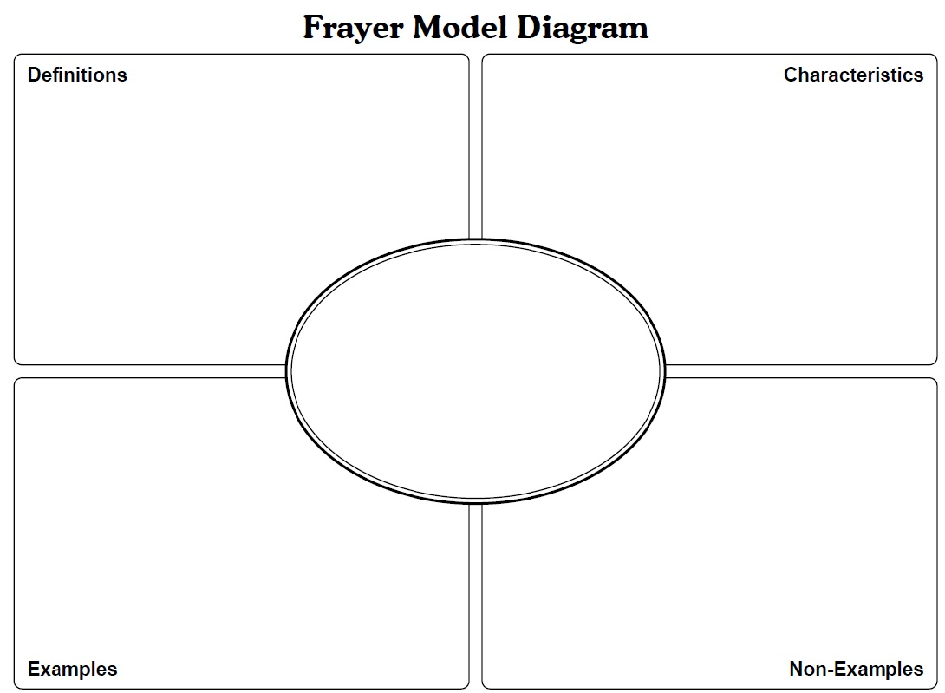
Wednesday 13/10/1444 H
Frayer Model
A tense that describes an ongoing actions in the past
S- was/were -v+ing
S- was/were + not – v+ing
Past progressive
The boys were playing video games for three hours yesterday.
The boys will play video games.
Pg. 132

Slide 24
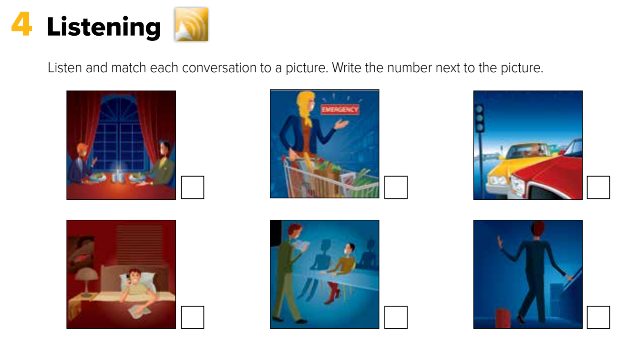

Wednesday 13/10/1444 H
2
5
4
1
6
3
Pg. 133

Slide 25
Wednesday 13/10/1444 H
Use past progressive in sentences and questions.
Combine longer action with
shorter one using When.
Link pictures to conversations
Listen and pronounce words
Pg. 132

Slide 26

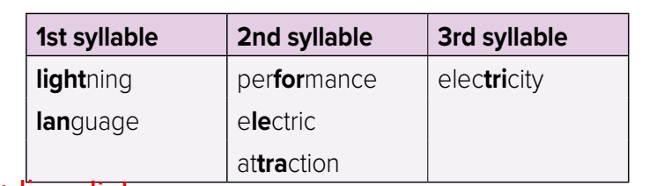
Wednesday 13/10/1444 H
Pg. 133

Slide 27
Wednesday 13/10/1444 H
Use past progressive in sentences and questions.
Combine longer action with
shorter one using When.
Link pictures to conversations
Listen and pronounce words
Pg. 132

Slide 28


Wednesday 13/10/1444 H
Homework
Workbook
Pg.250
Pg.251

Slide 29
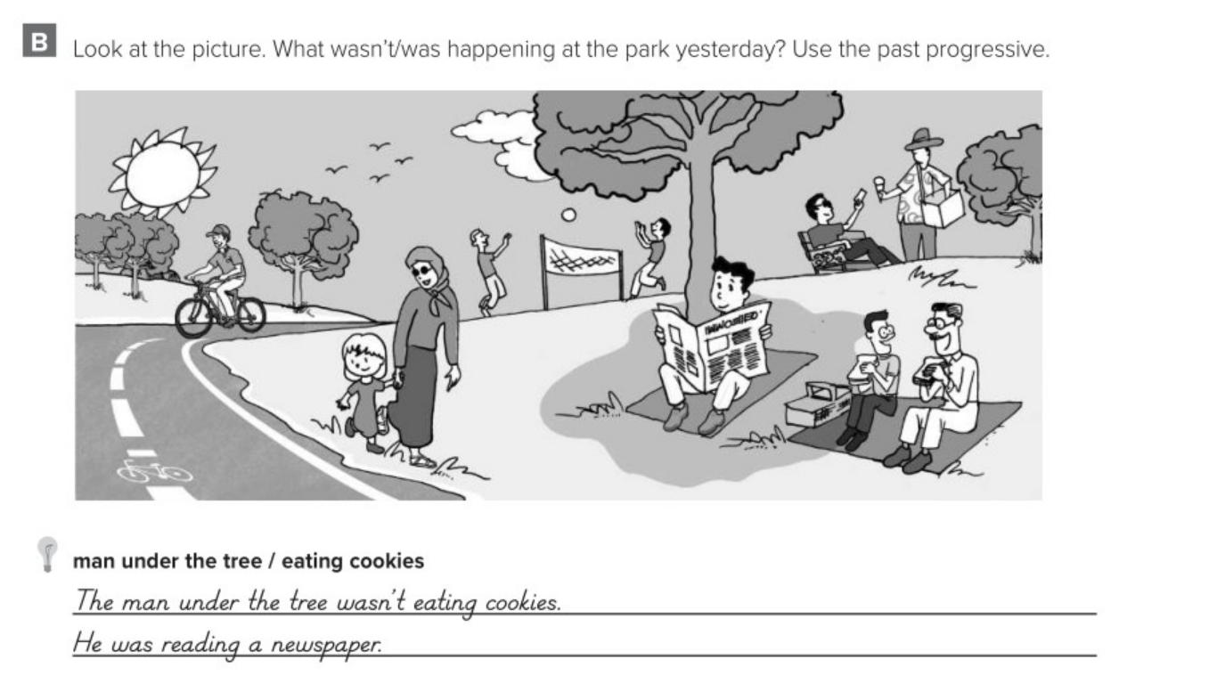
Pg.250

Slide 30
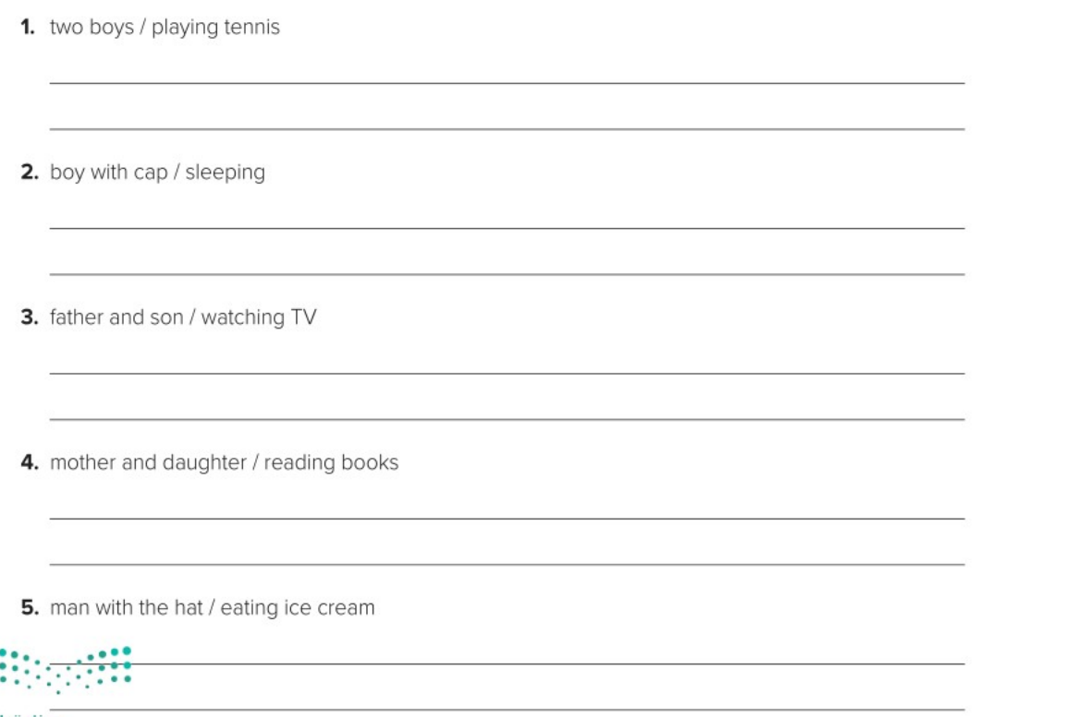
The two boys weren’t playing tennis.
They were playing volleyball.
The boy with the cap wasn’t sleeping.
He was riding his bike.
The father and son weren’t watching TV.
They were eating sandwiches.
The mother and daughter weren’t reading books. They were walking in the park.
The man with the hat wasn’t eating ice cream. He was selling ice cream to the boy.
Pg.250

Slide 31
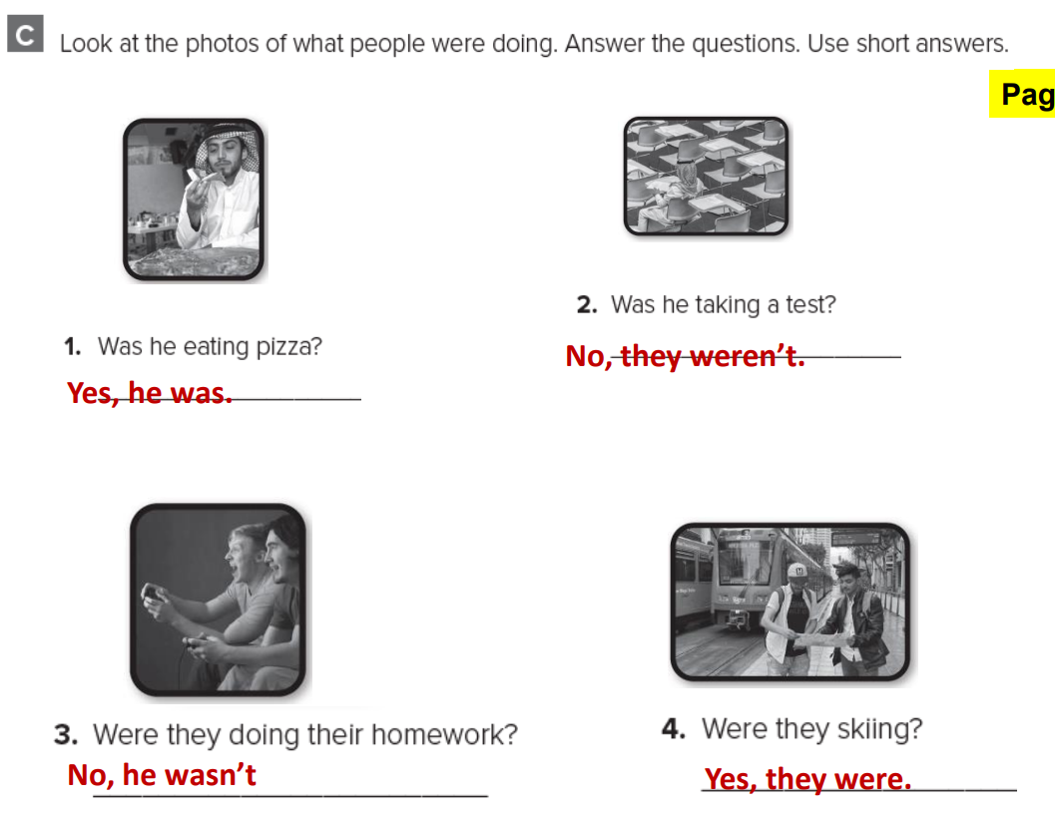
Pg.251

Slide 32
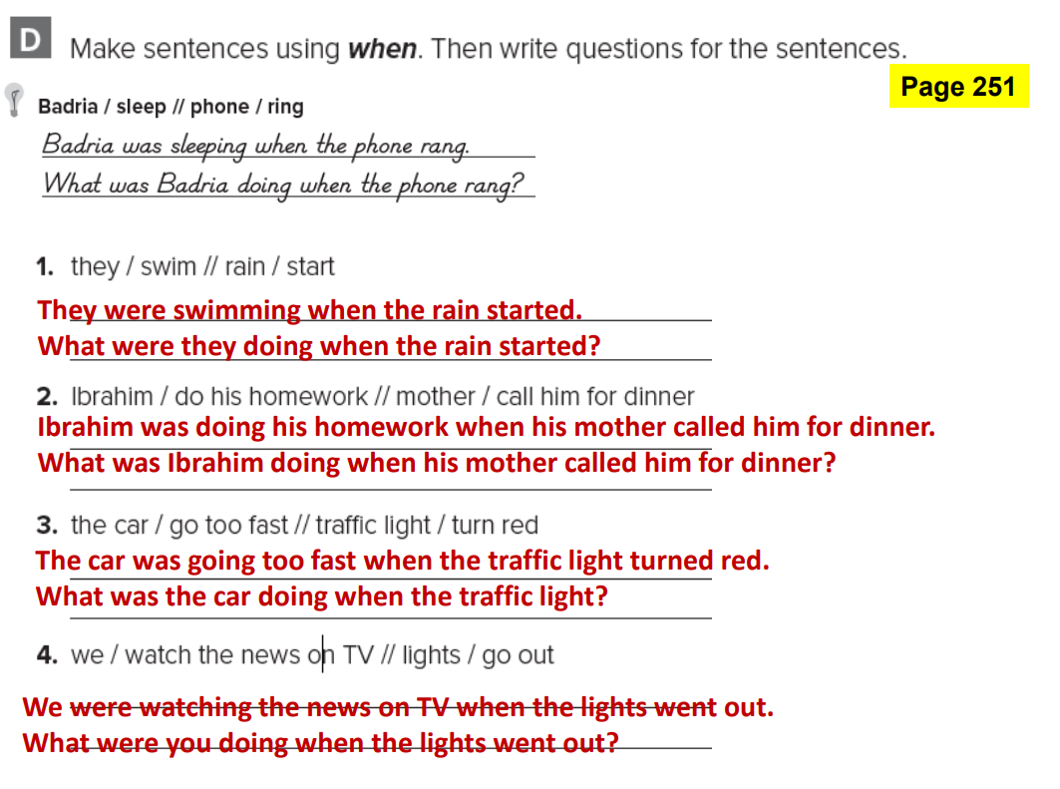
Pg.251

