Slide 1

Unit 15
Today’s news
CONVERSATION
Page 134

Slide 2
Today’s Objectives:
Answer questions about the conversation .
Practice using real talk phrases.
Answer questions about yourself.

Slide 3
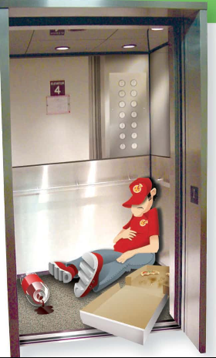
What do you see in the picture?
Where is the man?
What does he have in the elevator with him?
What’s he doing in the elevator?
Why do you think he is sleeping in the elevator?
How do you think he felt when it first happened?
What do you think he did?

Slide 4
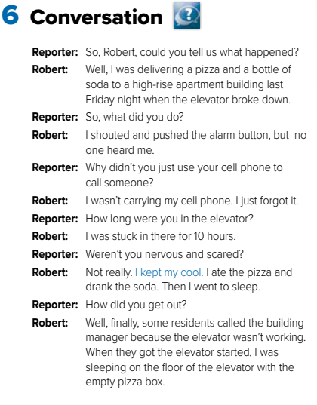
https://www.youtube.com/watch?v=zzH_xo2KF5Q&ab_channel=iEN

Slide 5
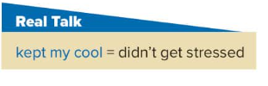
Who said “kept my cool” ?
Why did he say it ?

Slide 6
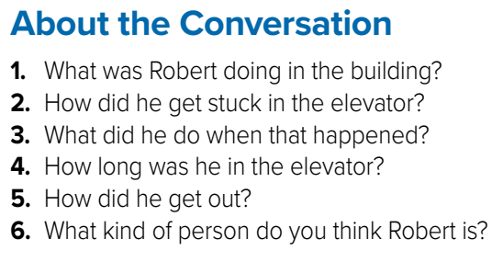
Robert was delivering a pizza.
He got stuck in the elevator because it broke down.
He shouted and pushed the alarm button. Then he ate the pizza, drank the soda, and went to sleep.
He was in the elevator for 10 hours.
He got out when some residents called the building manager because the elevator wasn’t working.
He is a calm person who doesn’t get upset easily

Slide 7
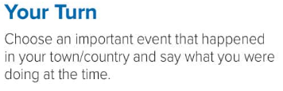

Slide 8
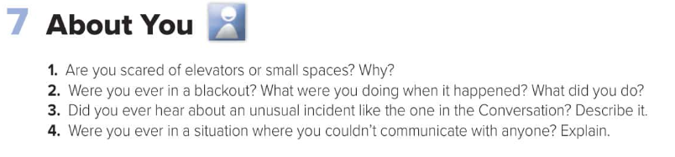

Slide 9
Homework
Page 251

Slide 10
Have
a
nice
day

