Slide 1
Unit 14
Grammar p 124

Slide 2
Objectives:
01
02
Make
Use
03
04
Use
Listen
Request and offers
Want + object + infinitive to get people to do something
05
Produce
The reduction of could you
Tell and ask to get people to do something
To get phone messages

Slide 3

Can
Could
Will
Would
How to make requests

Slide 4

Sure certainly of course
No problem
How to agree requests

Slide 5
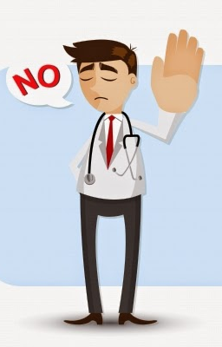
Sorry. I can’t
Not now. I’m busy
How to refuse requests

Slide 6
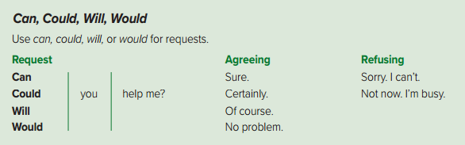

Slide 7
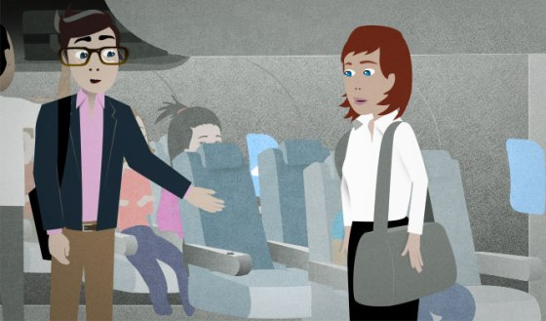
I will
Let me
How to make offers

Slide 8
Thank you
You are very kind
How to accept requests

Slide 9

That’s all right
Don’t worry
How to refuse requests

Slide 10
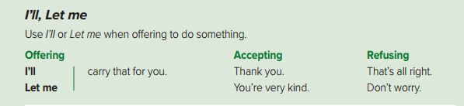

Slide 11


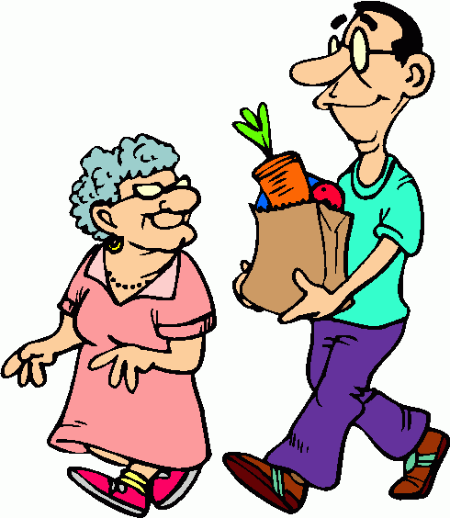
I want to help
I want him to help

Slide 12
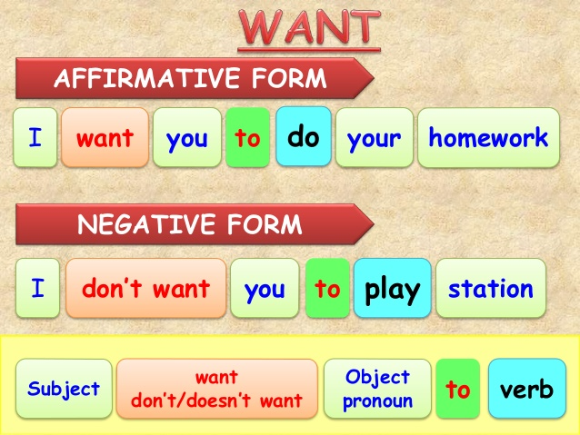

Slide 13
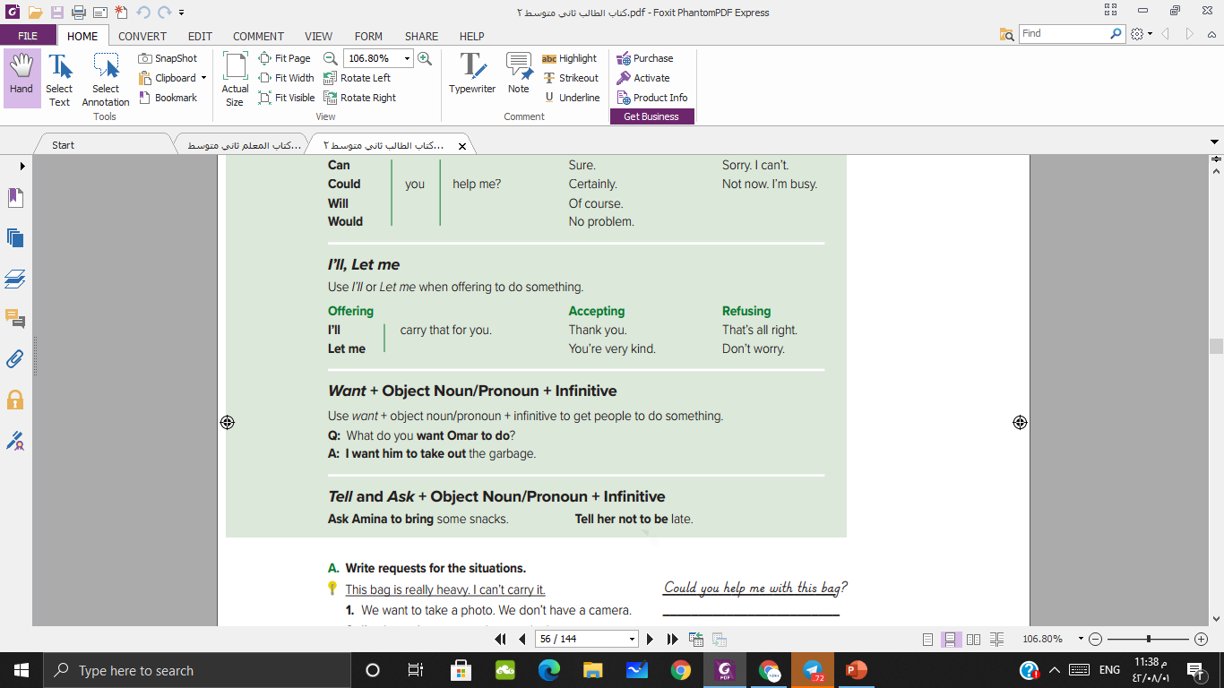

Slide 14

tell followed by a noun or pronoun and an infinitive means the same as ask followed by a pronoun or an infinitive
I told them to came at 8
I asked them to came at 8

Slide 15


Slide 16
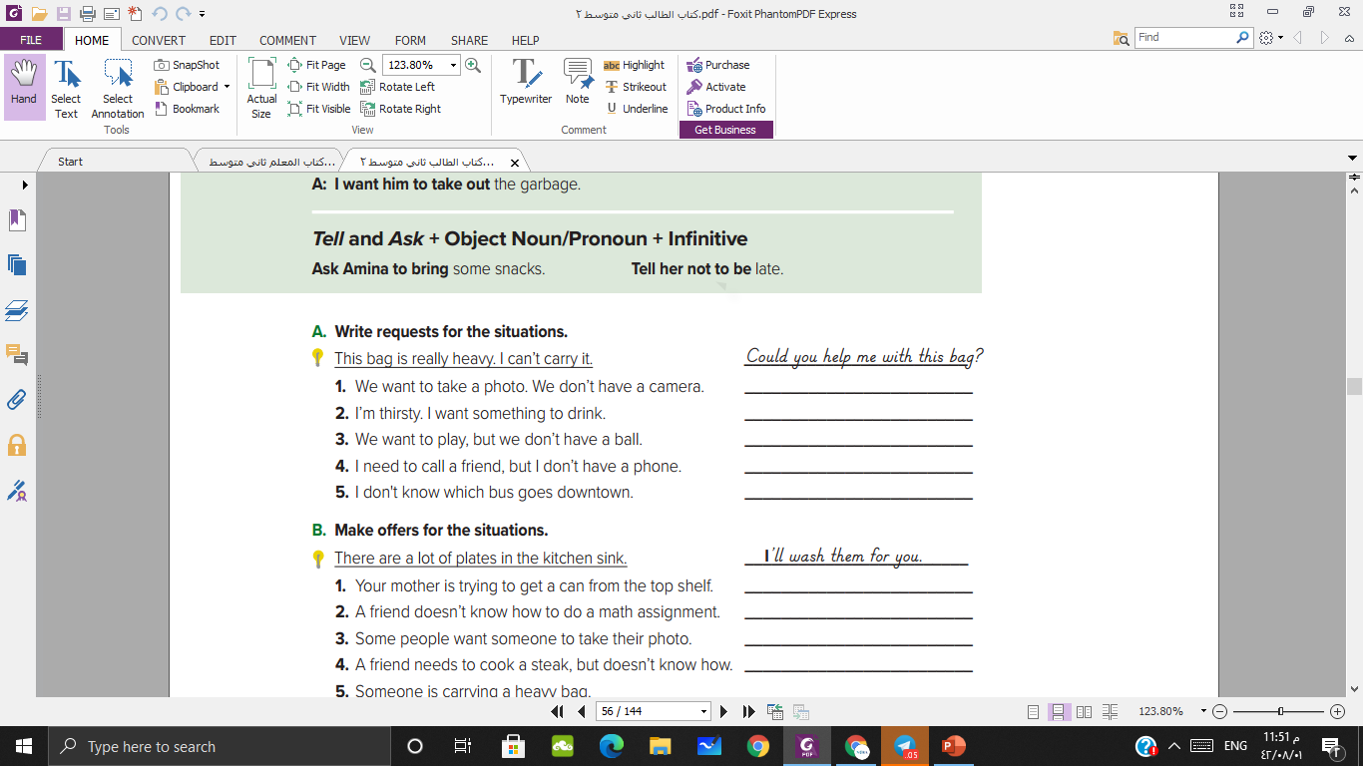
Could we borrow your camera?
Will you get me something to drink?
Would you lend us your ball?
Can I borrow your cell phone?
Could you tell me which bus goes downtown?

Slide 17
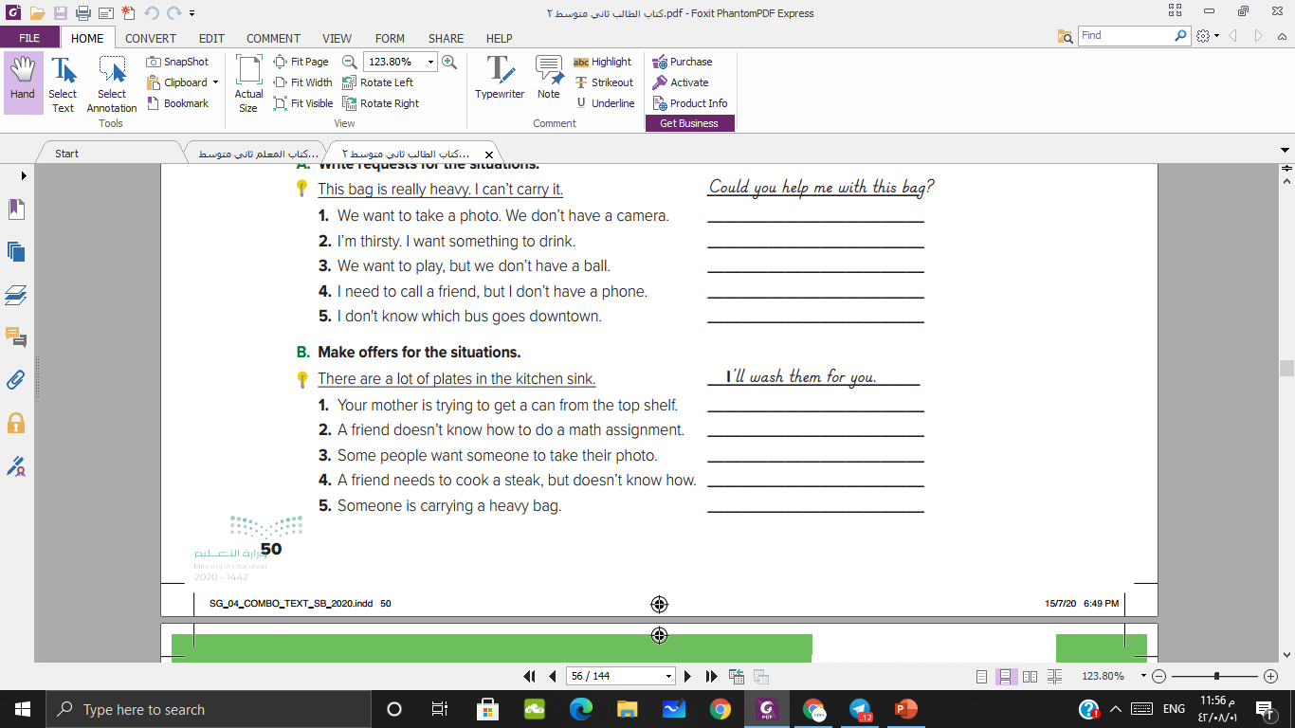
Let me get the can for you
I’ll help you do the math assignment
I’ll take the photo for you
Let me show you how to cook a steak
Let me carry your bag for you

Slide 18
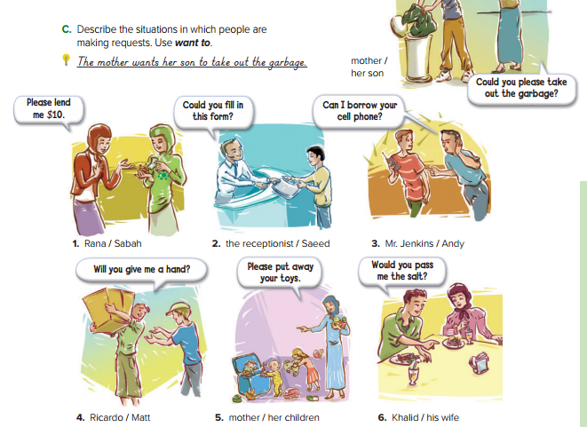
Speak

Slide 19

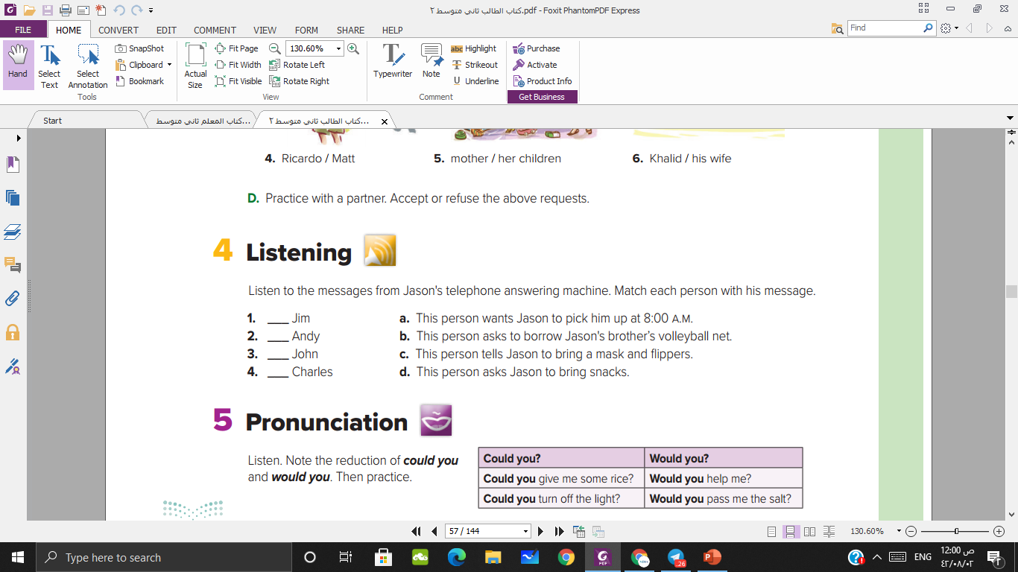
d
a
b
c

Slide 20
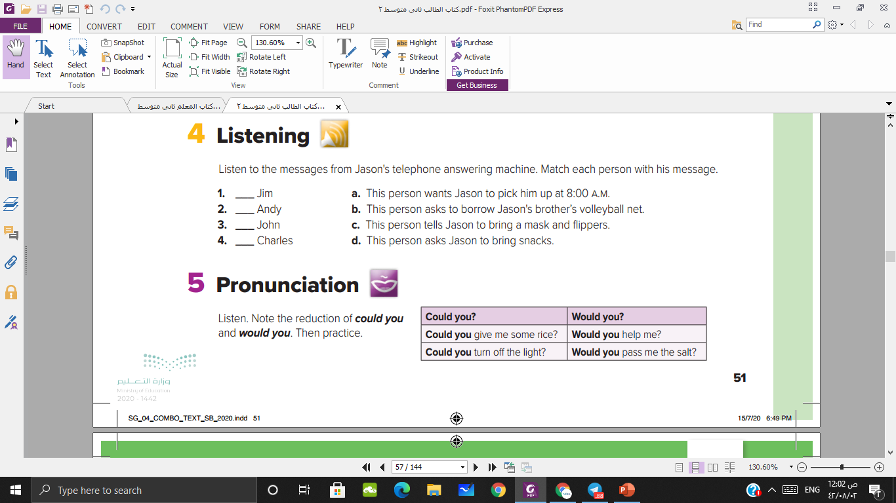

Slide 21
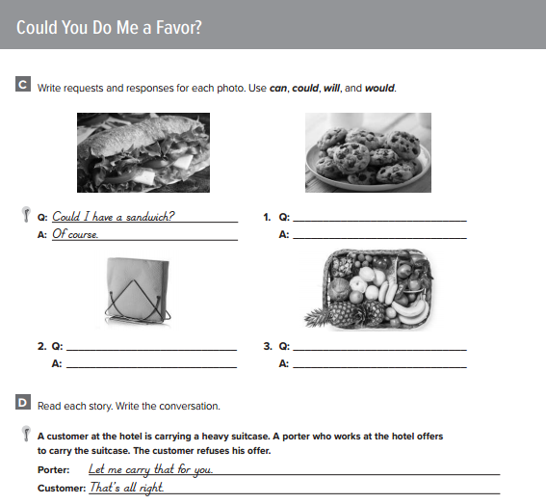
Homework
P. 246

Slide 22

Have a nice day

