Slide 1

Revision
https://wordwall.net/resource/5995620

Slide 2






Warm up
What do you do ?
I’m
going to be
a…………………..
What are you
going to be
in the future ?

Slide 3
Warm up
What do you do ?
I’m
going to be
a…………………..
I will be
a ……………….
What will you be
in the future ?
What are you
going to be
in the future ?

Slide 4

Warm up
What will you be
in the future ?
I’m
going to be
a…………………..
Are you a teacher now ?
When will you be a teacher ?
Future
Will

Slide 5

Unit 13
Grammar
Day :
Date :

Slide 6


Slide 7


Use future with will
Apply information questions
Listen for specific information

Slide 8


Slide 9
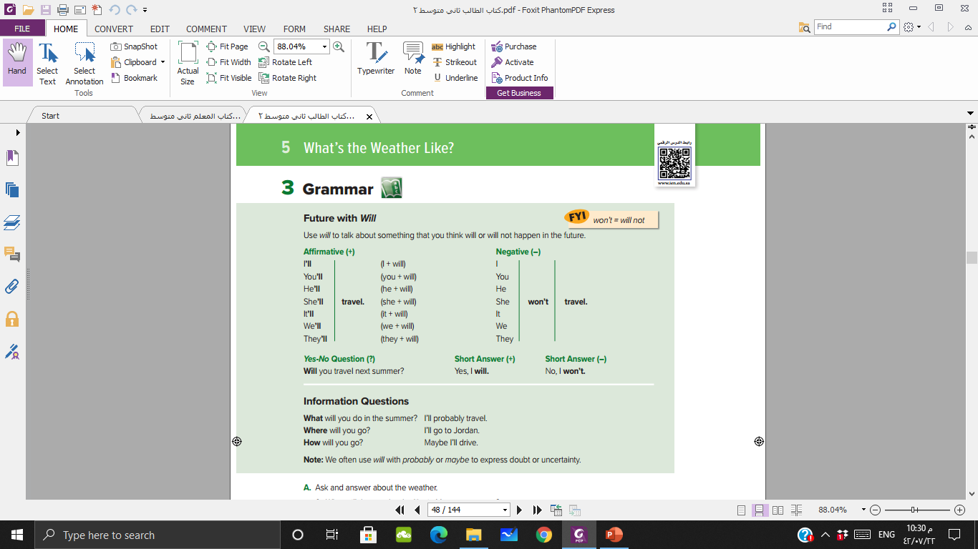




Slide 10



Sentence
S + will + v.inf + Comp.
She
will
travel
to Paris .
He
will
sleep
early
Negative
She
won’t
travel
to Paris .
He won’t sleep earl .

Slide 11

Sentence
S + will + v.inf + Comp.
They
will
fish
tomorrow .
Yes / No
Question
Will
they
fish
tomorrow ?
Yes ,
they
will .
No,
they
won’t .

Slide 12


Slide 13
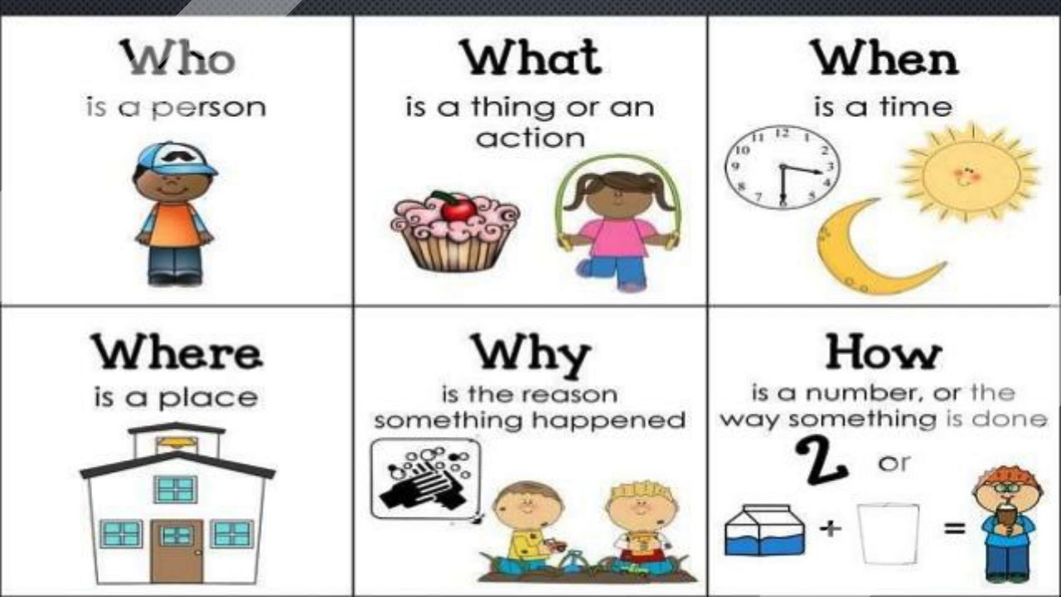

Slide 14



+
will + S + v.inf + comp.
will
She
go
?
Where
She will go to Paris
When
will
he
sleep
?
He will sleep at 11 pm.

Slide 15

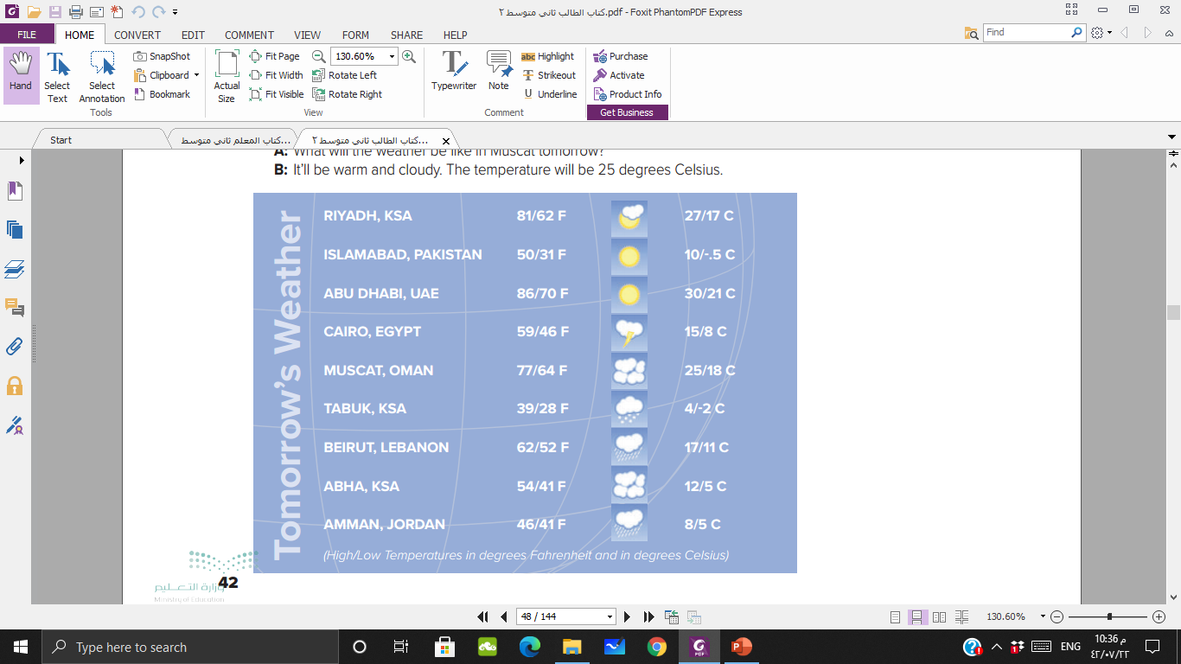
What will the weather be like in ……… tomorrow?
It will be …………..
It will be very warm and partly cloudy
It will be cool and sunny
It will be hot and sunny
It will be cool and rainy
It will be quite warm and cloudy
It will be cold and snowy
It will be a bit warm and rainy
It will be cool and rainy
It will be cool and rainy

Slide 16
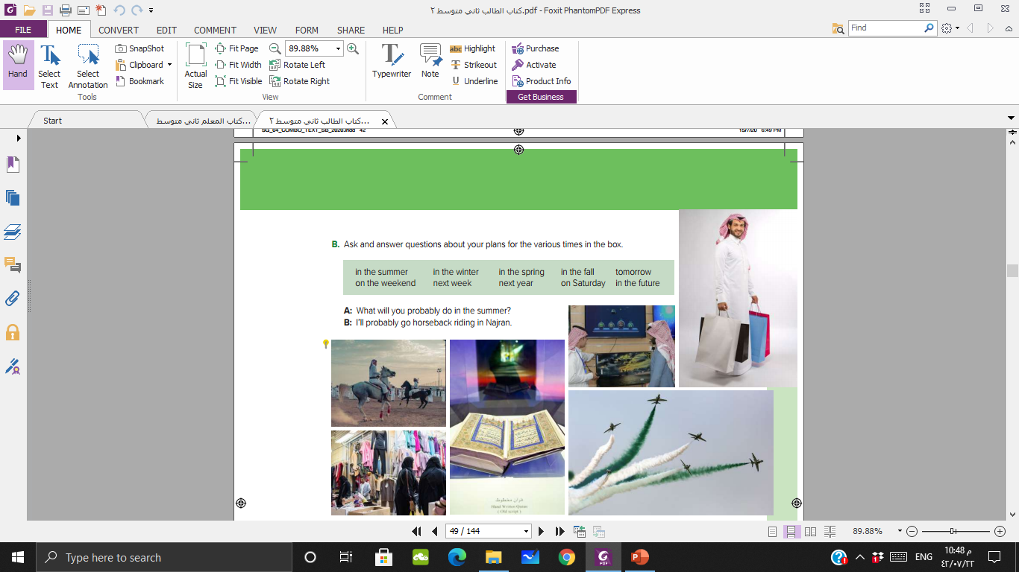

Slide 17
Final
Evaluation
https://wordwall.net/resource/11307107/will-future

Slide 18

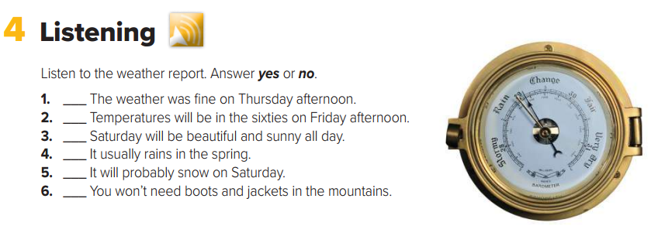
No
No
No
Yes
No
No

Slide 19
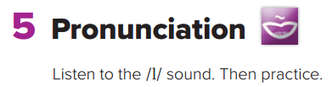


Slide 20
Home work
Page : 242

Slide 21

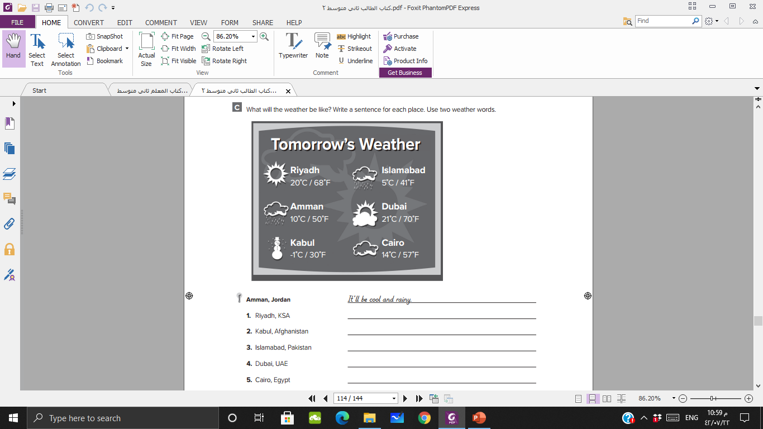
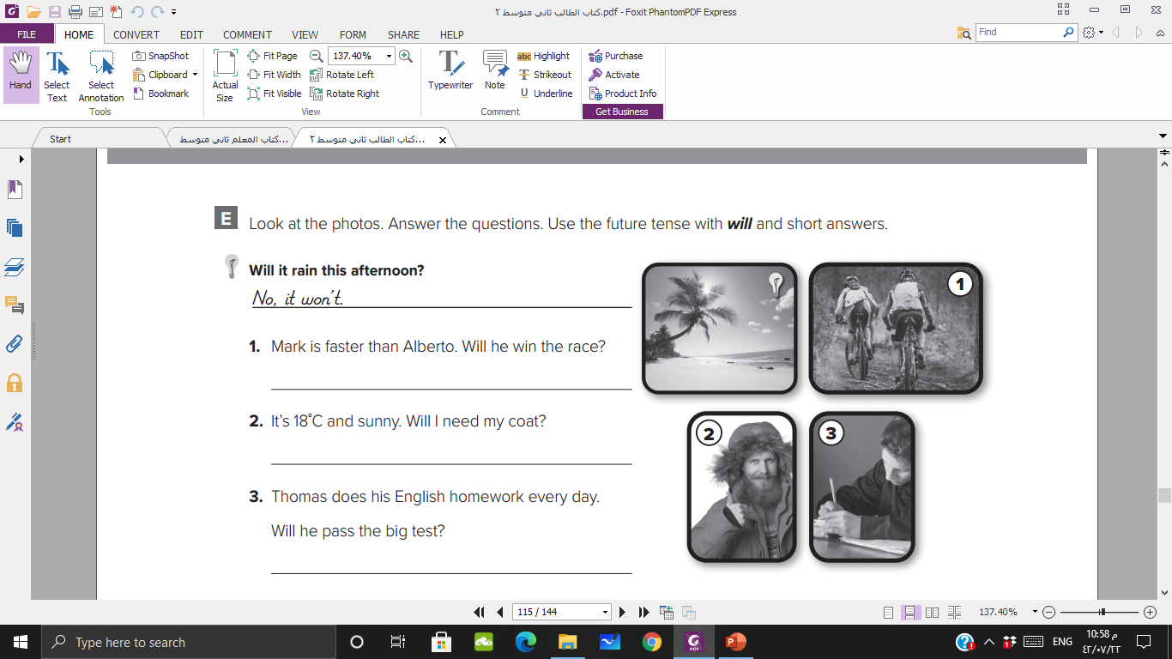

Slide 22


