Slide 1



Unit 3 Amazing Animals
Mega Goal 2.3
writing
Done by: Entisar Al-Obaidallah

Slide 2

Lesson Objectives
01
03
02
04
Find out
Research
some information about dolphins according to the text
about a type of animal
Identify
Write
the topic of each paragraph of the text
a descriptive essay about a type of animal

Slide 3

Warm up
What do you know about dolphins?
What do you want to know about dolphins?

Slide 4

Open
Pages ( 42-43 )

Slide 5



Listen & Read along

Slide 6

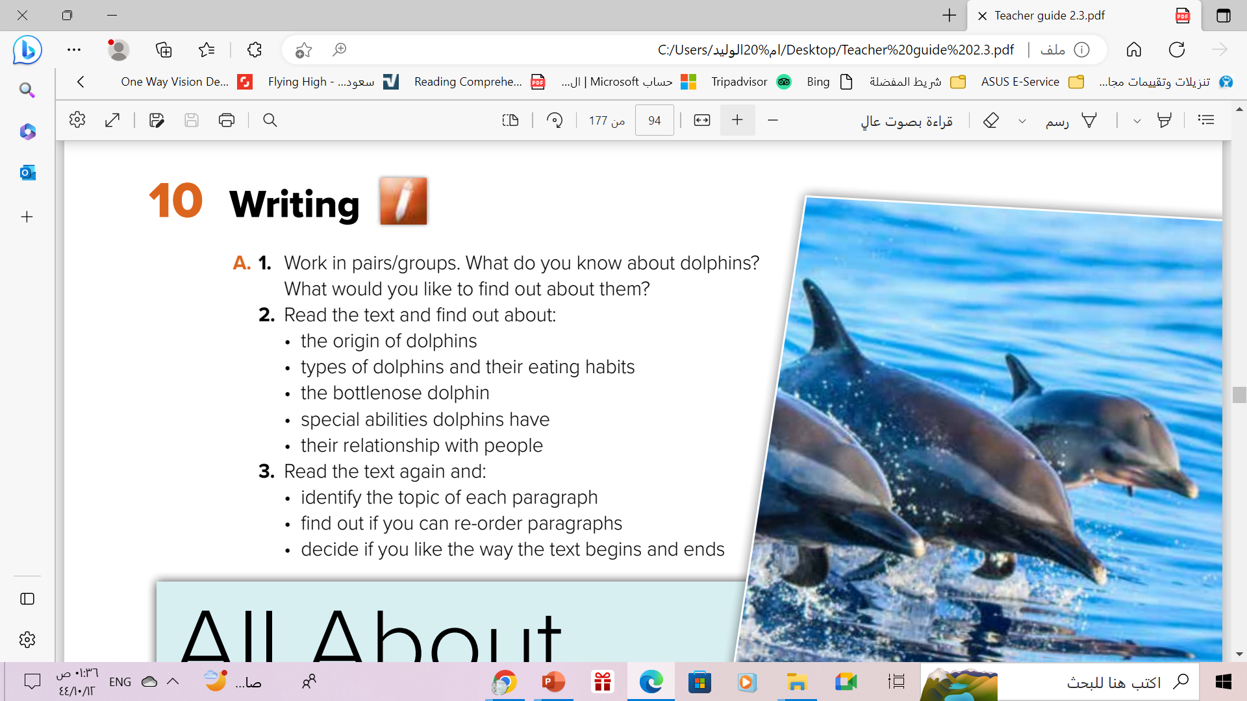
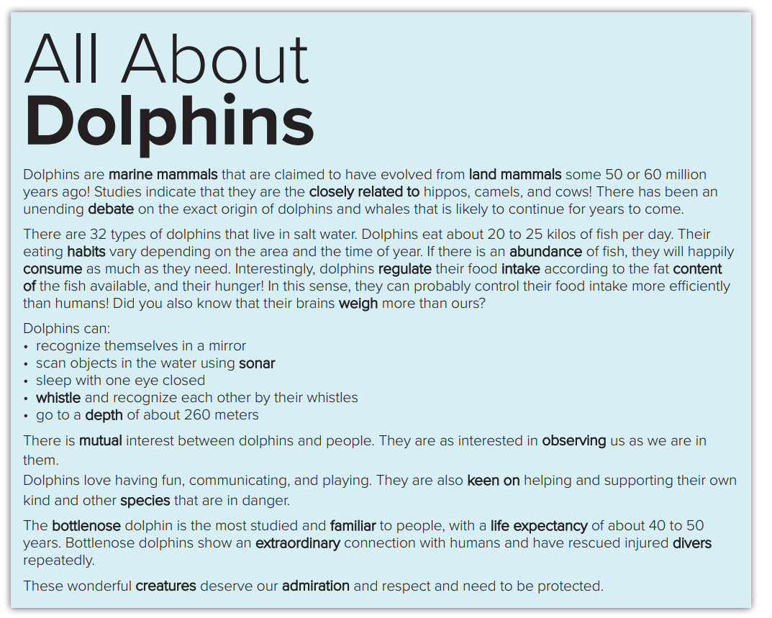

Slide 7
The origin of dolphins: marine mammals that are claimed to have evolved from land mammals some 50 or 60 million years ago.
Types of dolphins: 32 types that live in salt water
Eating habits: 20 to 25 kilos of fish per day/ they regulate their food intake according to the fat content of the fish and their needs
Special abilities
Bottlenose dolphins: more familiar to people/ life expectancy: 40 to 50 years/ connection with humans/ rescued divers
Relationship with people: connection with people, interested in people, have rescued people repeatedly.

Slide 8

Scan & identify the topic of each paragraph

Slide 9


1-What are dolphins?
2-Dolphins & their eating habits
3-The abilities of dolphins
4-Dolphins & people
5-The qualities of dolphins
6-Conclusion/The writer’s view

Slide 10
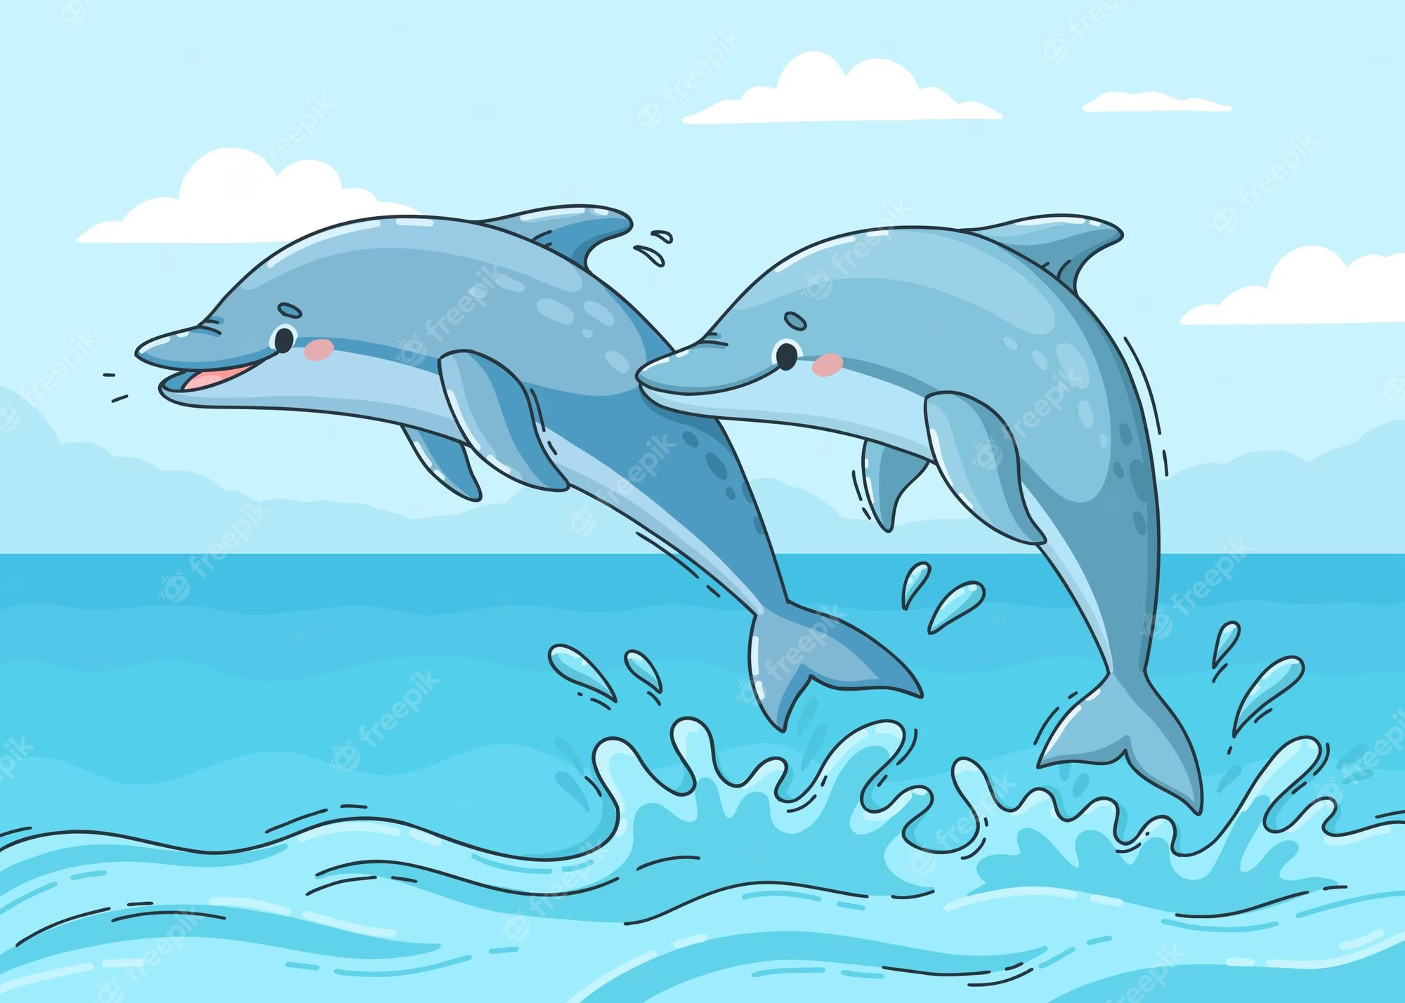
What have you learned about dolphins?

Slide 11
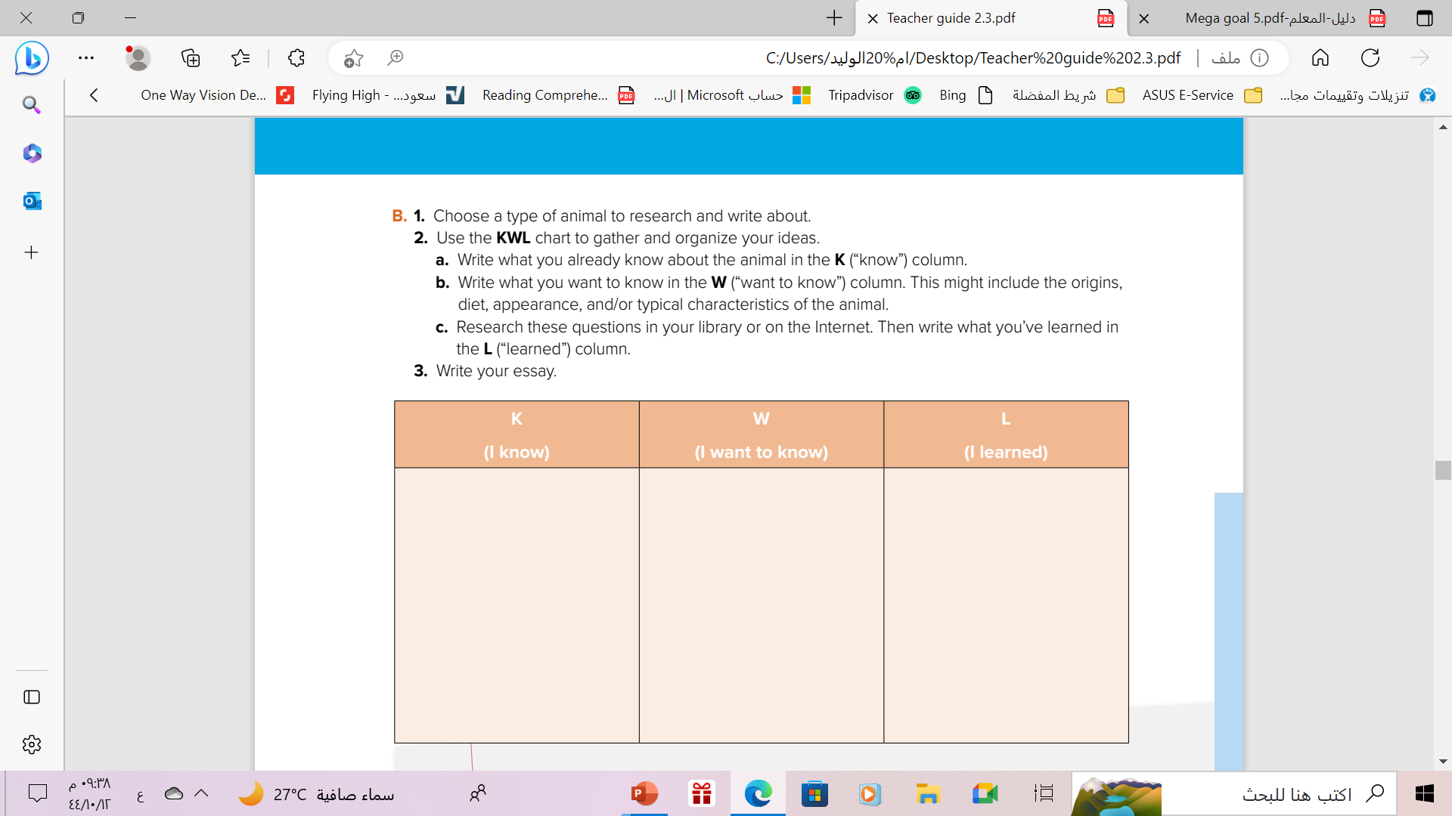


Slide 12




● Dogs are friendly with people
● Their eating habits
● Many purposes dogs
could be used for
● They are loyal to their owners
● Their characteristics
● They have a fur
● Their abilities

Slide 13
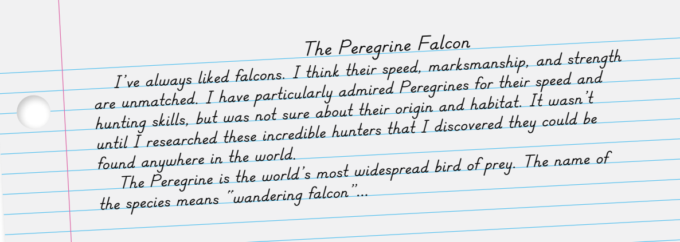
This is the model text you have to simulate when you write your essay

Slide 14
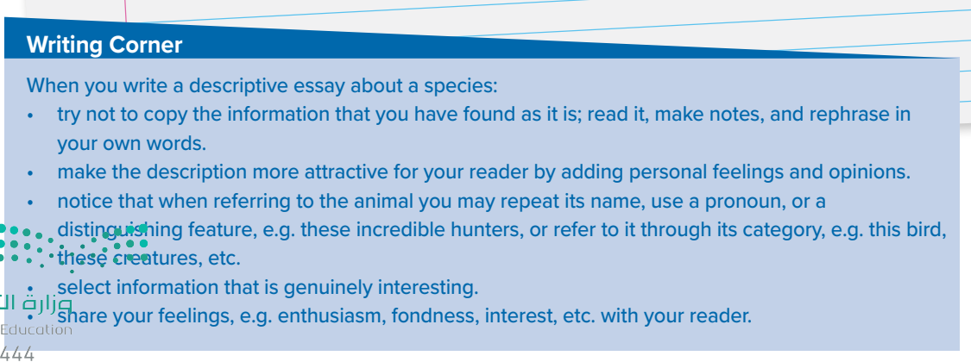
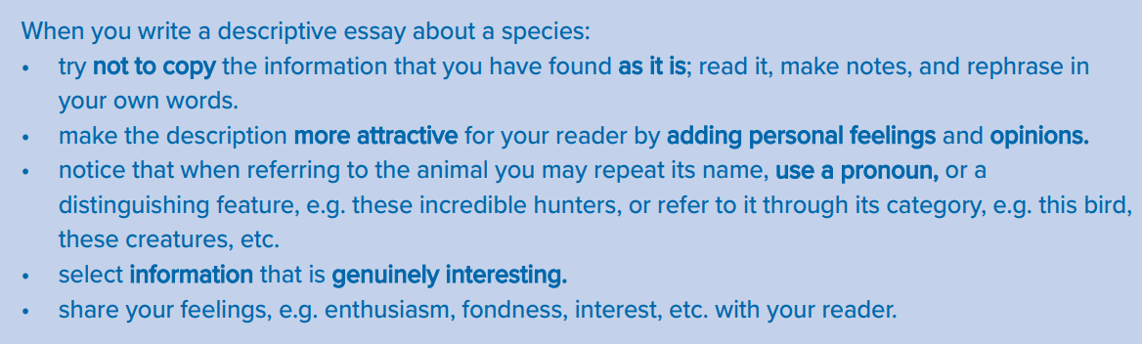
Follow these steps
when you write
a descriptive essay about
A Type of Animal

Slide 15
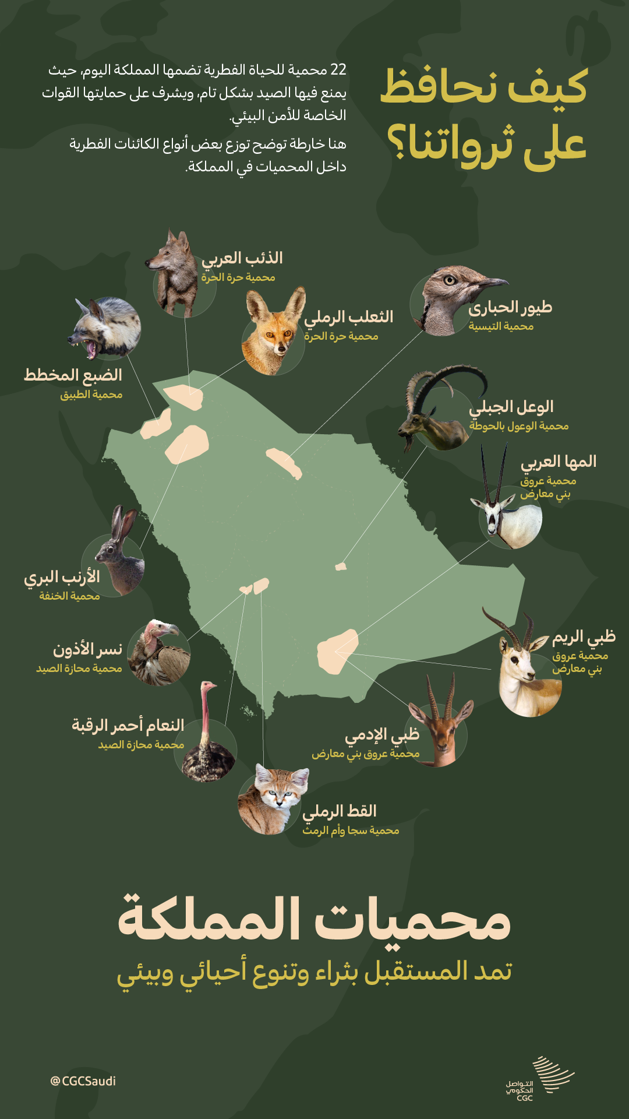


Saudi Arabia Efforts to Protect Wildlife

Slide 16

ENRICHMENT
https://youtu.be/hzPBYAI9fxA

Slide 17

From The Holy Qura’n

Slide 18
Homework
Workbook , P.( 108 )
exercise ( K)

Slide 19

Thanks!

